Slide 1

Teaching Academic Vocabulary in the Content Areas to Migrant Students
Meeting the Challenges of the CCSS

Slide 2
PURPOSE OF THIS WORKSHOP
Provide participants with strategies to support migrant students in acquiring academic vocabulary as outlined in the Common Core State Standards.

Slide 3
WORKSHOP OUTCOMES
Participants will…
…leave with a better idea on how to select and prioritize key academic vocabulary
…implement 2-3 new strategies to support migrant students in their academic vocabulary development

Slide 4
Essential Questions for Today:
Why is vocabulary instruction so important?
What is unique about migrant students and academic vocabulary learning?
What are exemplary strategies for vocabulary instruction?

Slide 5

How do you teach vocabulary?
Notes:
We’re going to have a chance to talk with each other about how we choose which words to teach and how we teach those words

Slide 6
Discuss in Table Teams
How do you know which words to focus on?
How do you choose which words to teach?
Notes:
Give teams 5 minutes to discuss this.
Share out (person with the shortest hair is reporter) to share one way that your group chooses vocabulary.

Slide 7
What Strategies Do You Use?
Individually, write the way(s) that you currently teach or focus on vocabulary. One strategy per sticky.
Each person shares their strategies with table team members. (Look for new or recurring ideas!)
Each group shares the themes or recurring ideas that they found.
Notes:
ACTIVITY #2
Individually, on sticky notes, (one idea per note) write as many ways as you can think of how you currently teach vocabulary in your classroom. (2 mintues)
Now share in table groups and hear about the various methods of teaching vocabulary. (5 min)

Slide 8
TRUTH BE TOLD…
A – I’ve seen it done
C – I confess! I have done it!
B – I’ve seen it done too often
D – Do people really do this?!?
5. Look up vocabulary words in the dictionary and copy the definitions.
4. Use vocabulary words in a sentence.
3. Have students write out vocabulary lists.
2. Have students write the words in their vocabulary lists multiple times.
1. “If I speak slower and louder, they’ll learn it.”
Notes:
David Letterman style:
Top 5 instructional strategies for teaching academic vocabulary!
In your head, think about whether A, B, C or D applies to each activity
#5 Look up vocabulary words in the dictionary and copy the definitions.
#4 Use vocabulary words in a sentence.
#3 Have students write out vocabulary lists.
#2 Have students write the words in their vocabulary lists multiple times.
#1 “If I speak slower and louder, they’ll learn it.”

Slide 9

Common Core State Standards
Let’s Take a Look at the Common Core Regarding Academic Vocabulary
Notes:
On sticky notes, note as many ways as you can think of how you currently teach vocabulary in your classroom. How do you choose which words to teach?
In table groups discuss the various methods of teaching vocabulary & where the words are generated from.

Slide 10
CCSS necessitates a shift
in the way we teach vocabulary.
A discussion between NYS Commissioner of Education John B. King Jr., David Coleman (contributing author to the Common Core) and Kate Gerson (a Sr. Fellow with the Regents
Notes:
Watch this video clip – educators discussing the shift and emphasis on deeper, more academic word knowledge in the Common Core

Slide 11
Common Core State Standards
Reading Anchor Standard #4
  Interpret words and phrases as they are used in a text, including determining technical, connotative, and figurative meanings, analyze how specific word choices shape meaning or tone.
Language Anchor Standard #4
  Determine or clarify the meaning of unknown and multiple-meaning words and phrases by using context clues, analyzing meaningful word parts, and consulting general and specialized reference materials as appropriate.
Language Anchor Standard #6:
  Acquire and use accurately a range of general academic and domain-specific words and phrases sufficient for reading, writing, speaking, and listening at the college and career readiness level; demonstrate independence in gathering vocabulary knowledge when encountering an unknown term important to comprehension or expression.
Notes:
Here are the primary standards that talk about vocabulary development.

Slide 12
Common Core State Standards
Reading Anchor Standard #4
  Interpret words and phrases as they are used in a text, including determining technical, connotative, and figurative meanings, analyze how specific word choices shape meaning or tone.
Language Anchor Standard #4
  Determine or clarify the meaning of unknown and multiple-meaning words and phrases by using context clues, analyzing meaningful word parts, and consulting general and specialized reference materials as appropriate.
Language Anchor Standard #6:
  Acquire and use accurately a range of general academic and domain-specific words and phrases sufficient for reading, writing, speaking, and listening at the college and career readiness level; demonstrate independence in gathering vocabulary knowledge when encountering an unknown term important to comprehension or expression.
Notes:
Here are the primary standards that talk about vocabulary development.

Slide 13
IS MY TEACHING ALIGNED TO CCSS?
In table teams, place current strategies (sticky notes) onto the corresponding Common Core Standard poster (found on your tables).
Are there any gaps? Are our current practices reaching the level of the CCSS?
Notes:
Take out the 11x17 blank standards pages on your tables. Arrange your sticky notes according to what you do to meet these standards currently. Are there gaps? Are the current practices reaching the level of CCSS? Discuss in table teams. Share out whole group.

Slide 14
Let’s take a deeper look into CCSS in grade bands
Get into grade band groups. Select a recorder, a reader and a presenter.
Reader reads aloud the grade band standards (5 minutes)
Group reflects--Are there any gaps? Are our current practices reaching the level of the CCSS? What questions do we have?
Recorder writes while group responds with questions and comments (5 minutes)
Presenter presents summary of comments (1 minute)
Notes:
Take out the 11x17 blank standards pages on your tables. Arrange your sticky notes according to what you do to meet these standards currently. Are there gaps? Are the current practices reaching the level of CCSS? Discuss in table teams. Share out whole group.

Slide 15
Let’s take a deeper look into CCSS in grade bands
Get into grade band groups. Select a recorder, a reader and a presenter.
Reader reads aloud the grade band standards (5 minutes)
Group reflects--Are there any gaps? Are our current practices reaching the level of the CCSS? What questions do we have?
Recorder writes while group responds with questions and comments (5 minutes)
Presenter presents summary of comments (1 minute)
Notes:
Take out the 11x17 blank standards pages on your tables. Arrange your sticky notes according to what you do to meet these standards currently. Are there gaps? Are the current practices reaching the level of CCSS? Discuss in table teams. Share out whole group.

Slide 16
QUESTIONS on CCSS?

Slide 17
Why a SPECIAL WORKSHOP Related to migrant students?
What Is Unique About Migrant Students?

Slide 18
Who Are Our Migrant Students?
The defining characteristic of a migrant student is
MOBILITY
Notes:
Review definition of who is a migrant and priority for service

Slide 19
Which Students Are a Priority for Service?
  Students whose education has been interrupted during the regular school year (mobile)
  AND
  Who are failing or most at risk of failing to meet the State’s challenging State academic achievement standards

Slide 20
Seven Areas of Concern for Migrant Students
1: Educational Continuity
  When students move from place to place they often encounter different expectations, curriculum, course requirements, assessment, etc. This is especially difficult for high school students who are trying to accrue credits and meet graduation requirements.

Slide 21
Seven Areas of Concern for Migrant Students
2: Instructional Time
  When students move they often miss instructional days between the time they leave one school and finally enroll in a new school.

Slide 22
Seven Areas of Concern for Migrant Students
3: School Engagement
  Research shows that feeling part of the school community is an important protective factor and predictor of school success. When students change schools frequently, they often feel like the new kid who doesn’t really belong

Slide 23
Seven Areas of Concern for Migrant Students
4: English Language Development
  Parents of MEP students often do not speak English. Students are often English Language Learners.

Slide 24
Seven Areas of Concern for Migrant Students
5: Education Support in the Home
  Parents often work long hours:
    living conditions are often crowded and noisy
    Often there are no books in the home
    Often parents have low levels of education

Slide 25
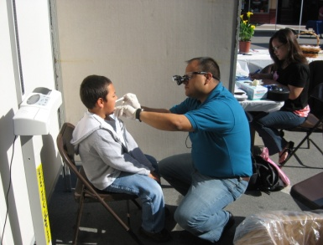
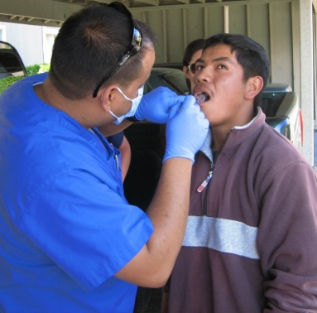
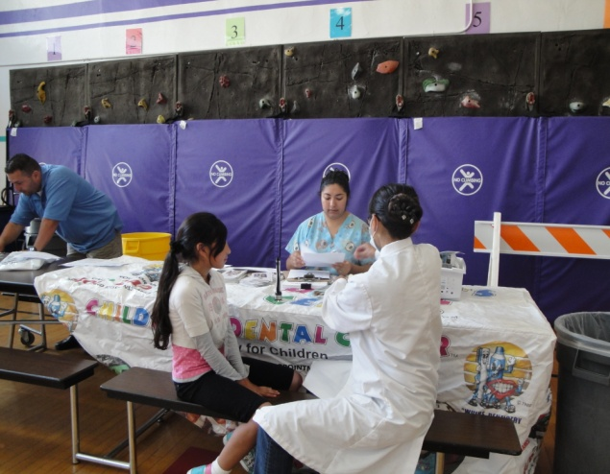
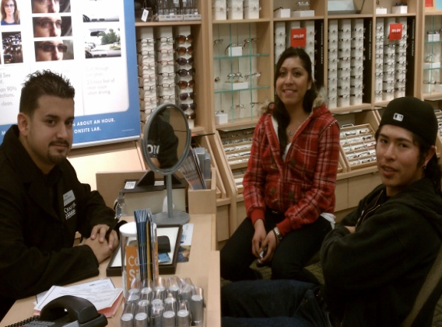
Seven Areas of Concern for Migrant Students
6: Health
MEP students frequently have unmet health needs including dental and vision issues
Notes:
English Language Development: Parents of MEP students often do not speak English. Students are often English Language Learners
Education Support in the Home: Parents often work long hours; living conditions are often crowded and noisy; often there are no books in the home; often parents have low levels of education
Health: MEP students frequently have unmet health needs including oral and vision issues; mention UW study on effects of pesticides on farmworker children;
Access to Services: Families often do not know how to access community services or participate in the American school system. They are often isolated because of lack of transportation or language barriers.

Slide 26
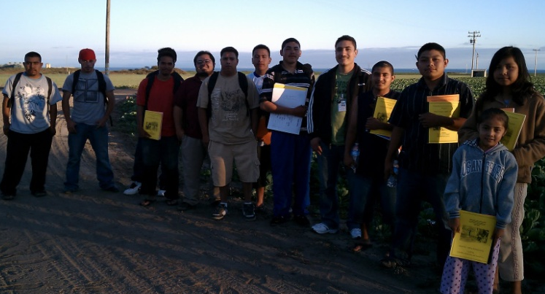
Seven Areas of Concern for Migrant Students
7. Access to Services
Families often do not know how to access community services or participate in the American school system. They are often isolated because of lack of transportation or language barriers
Notes:
English Language Development: Parents of MEP students often do not speak English. Students are often English Language Learners
Education Support in the Home: Parents often work long hours; living conditions are often crowded and noisy; often there are no books in the home; often parents have low levels of education
Health: MEP students frequently have unmet health needs including oral and vision issues
Access to Services: Families often do not know how to access community services or participate in the American school system. They are often isolated because of lack of transportation or language barriers.

Slide 27
Seven Areas of Concern for Migrant Students
Educational Continuity
Instructional Time
School Engagement
English Language Development
Educational Support in the Home
Health
Access to Services
Notes:
It is the accumulation of these risk factors that contributes to the academic needs of migrant students. They are very low on the socio-economic scale, working as unskilled laborers across Washington state and the nation. Migrant parents generally have little formal education, and little time to spend working with their children on academic tasks. Over half of the migrant students in Washington are English language learners.
Let’s take a look at what the research says about low SES, language, parent vocabulary, and these contribute to the CHALLENGES that teachers face.

Slide 28
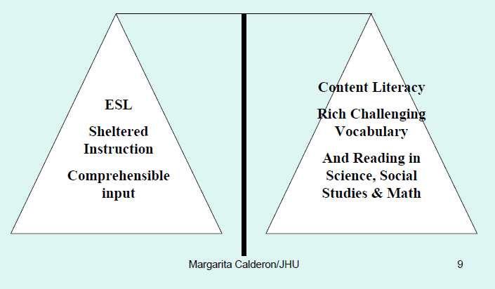
Teachers must balance comprehensible input with rich challenging vocabulary and reading in math, science and social studies in English.
Notes:
Because many migrant students are also ELLs…
ESL programs and students used to be part off on their own and that is no longer the case.

Slide 29
THE KNOWLEDGE GAP
High SES 1st graders know twice as many words as low SES classmates
By high school, they know 4 times as many words!
High SES 3rd graders have vocabularies equal to the lowest-performing 12th graders!
Beck, et al.
Notes:
Migrant families are among the lowest paid groups in the nation. Unskilled laborers making often less than the minimum wage. Because they are low SES…

Slide 30
Meaningful Differences
Study of 3-year old children and their parents:
“Parents in less economically favored circumstances had said fewer different words in their cumulative monthly vocabularies than had the children in the most economically advantaged families in the same period of time”
                Betty Hart and Todd Risley
Notes:
And the finding is heartbreaking that by the time the children were 3 years old, parents in less economically favored circumstances had said fewer different words in their cumulative monthly vocabularies than had the children in the most economically advantaged families in the same period of time.
Many Migrant parents have not had educational opportunities that high SES parents have had…
“Given the consistency we saw in the data, we might venture to extrapolate to the first 3 years of life. By age 3 the children in professional families would have heard more than 30 million words, the children in working-class families 20 million, and the children in welfare families 10 million. Hart and Risley, Meaningful Differences
Interview between Todd Risley and David Boulton regarding Learning to Read: From www.childrenofthecode.org
www.childrenofthecode.org/interviews/risley.htm
Vocabulary underlies Literacy:
Dr. Todd Risley: The relevance of this work to reading and literacy is fairly new. In other words, again, people are talking about it in terms of development of early vocabulary and growth and learning to read and breaking the code. If you already had the oral vocabulary, you knew the words you were reading, you experienced them as part of your oral vocabulary, then reading was easy.
David Boulton: Well, it's easier, right, because it’s easier for the code assembly and word recognition processes to snap into coherence rather than having to fuzz about in whether or not it's a word or not a word, because you've never experienced it before.
Dr. Todd Risley: Yes. There isn't any built-in confirmation of breaking the code.
David Boulton: Right.
Dr. Todd Risley: Well, reading is not my area, but it was the relevance of that that people have begun to pick up and point out now.
Learning to Read:
David Boulton: It’s interesting that you bring in affects. Our view is that children are experiencing an artificial and unnatural form of confusion involved in using this code to create the virtual reality experience we call reading. It’s an artificial, code-induced, instructed, and informed assembly that depends on their level of oral language proficiency, and how well it matches up to whatever it is they're attempting to read.
Dr. Todd Risley: Right.
David Boulton: And worse than this confusion, which is its own class of challenge, unprecedented in the evolutionary development of our brains is the context that they experience this confusion in causes them to feel like the confusion is a reflection of some fault in themselves.
Dr. Todd Risley: Right.
David Boulton: That precipitates the triggering of the affect shame. The more that it triggers, the easier it triggers, and then what we've got is a preconscious shame aversion to confusion. It decapitates learning.
Dr. Todd Risley: Right, right.
David Boulton: I mean, our concern with reading has less to do with the utility skill that's acquired -- for those that acquire it, that's great -- but rather to do with the negative collateral consequences to the kind of cognitive schema, the maladaptive, cognitive automations that form in children who shame-out along the way.
The relationship with what we saw the parents doing, the extra talk before the children were three, and the Peabody Picture Vocabulary Test scores at age nine in the third grade, is .77.
See www.childrenofthecode.org/interviews/risley.htm

Slide 31
THE GOOD NEWS!
We can make a difference if we begin teaching vocabulary in robust, vigorous, strong and powerful ways
Robust approach includes direct explanation, and is thought-provoking, playful and includes interactive practice
Beck, et al.
Notes:
INTRODUCE Isabel Beck’s books—class is designed around her books

Slide 32
Word knowledge is much more than word identification or definitional knowledge.
“It takes more than definitional knowledge to know a word, and we have to know words in order to identify them in multiple reading and listening contexts and use them in our speaking and writing.” (Allen, 1999)
Notes:
Word knowledge is SO MUCH MORE than definitional knowledge…
Must be ROBUST!

Slide 33
Reading comprehension and vocabulary knowledge are highly correlated with one another
http://Risley video clip on Meaningful Differences
                Stahl & Nagy, 2006
Notes:
Reading comprehension and vocabulary knowledge are highly correlated with one another,
and that knowledge of individual word meanings accounts for as much as 50-60 percent of the variance in reading comprehension.
Interview between Todd Risley and David Boulton regarding Learning to Read: From www.childrenofthecode.org
Vocabulary underlies Literacy:
Dr. Todd Risley: The relevance of this work to reading and literacy is fairly new. In other words, again, people are talking about it in terms of development of early vocabulary and growth and learning to read and breaking the code. If you already had the oral vocabulary, you knew the words you were reading, you experienced them as part of your oral vocabulary, then reading was easy.
David Boulton: Well, it's easier, right, because it’s easier for the code assembly and word recognition processes to snap into coherence rather than having to fuzz about in whether or not it's a word or not a word, because you've never experienced it before.
Dr. Todd Risley: Yes. There isn't any built-in confirmation of breaking the code.
David Boulton: Right.
Dr. Todd Risley: Well, reading is not my area, but it was the relevance of that that people have begun to pick up and point out now.
Learning to Read:
David Boulton: It’s interesting that you bring in affects. Our view is that children are experiencing an artificial and unnatural form of confusion involved in using this code to create the virtual reality experience we call reading. It’s an artificial, code-induced, instructed, and informed assembly that depends on their level of oral language proficiency, and how well it matches up to whatever it is they're attempting to read.
Dr. Todd Risley: Right.
David Boulton: And worse than this confusion, which is its own class of challenge, unprecedented in the evolutionary development of our brains is the context that they experience this confusion in causes them to feel like the confusion is a reflection of some fault in themselves.
Dr. Todd Risley: Right.
David Boulton: That precipitates the triggering of the affect shame. The more that it triggers, the easier it triggers, and then what we've got is a preconscious shame aversion to confusion. It decapitates learning.
Dr. Todd Risley: Right, right.
David Boulton: I mean, our concern with reading has less to do with the utility skill that's acquired -- for those that acquire it, that's great -- but rather to do with the negative collateral consequences to the kind of cognitive schema, the maladaptive, cognitive automations that form in children who shame-out along the way.
The relationship with what we saw the parents doing, the extra talk before the children were three, and the Peabody Picture Vocabulary Test scores at age nine in the third grade, is .77.
Vocabulary underlies Literacy:
Dr. Todd Risley: The relevance of this work to reading and literacy is fairly new. In other words, again, people are talking about it in terms of development of early vocabulary and growth and learning to read and breaking the code. If you already had the oral vocabulary, you knew the words you were reading, you experienced them as part of your oral vocabulary, then reading was easy.
David Boulton: Well, it's easier, right, because it’s easier for the code assembly and word recognition processes to snap into coherence rather than having to fuzz about in whether or not it's a word or not a word, because you've never experienced it before.
Dr. Todd Risley: Yes. There isn't any built-in confirmation of breaking the code.
David Boulton: Right.
Dr. Todd Risley: Well, reading is not my area, but it was the relevance of that that people have begun to pick up and point out now.

Slide 34
Migrant students (especially Els) need:
1. Explicit vocabulary instruction and
2. Structured verbal engagement
Arreaga-Mayer & Perdomo – Rivera, 1996
Notes:
There is evidence of need for explicit vocabulary instruction and structured verbal engagement in linguistically classrooms.
Arreaga-Mayer & Perdomo – Rivera, 1996 found that
Only 4% of EL’s school day is student talk.
Only 2% of EL’s day is discussion of lesson content, rarely speaking in complete sentences or applying relevant academic language.

Slide 35
We Must Build Background and Schema
Assumptions must not be made about the background or schema that our migrant students have
Notes:
So WE MUST BUILD BACKGROUND and schema

Slide 36
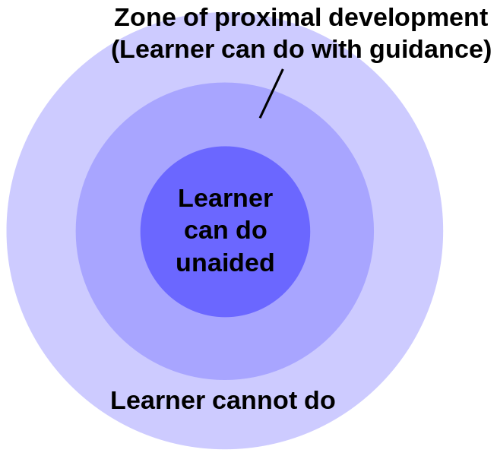
Scaffold for Support
Aim for the Zone of Proximal Development (ZPD differentiation)
Provide scaffolds that are culturally relevant and sensitive
Provide scaffolds that are intended to make the learning accessible and increases the rate of learning
Notes:
Vygotsky

Slide 37
Migrant students need:
MANY OPPORTUNITIES FOR DISCOURSE!
Notes:
Oral language development comes prior to written communication
ELL students need a strong oral language component to transfer their native language skills to English.
Use Collaborative and Individual Structures
Enables students to reach their ZPD regarding academic vocabulary
Discourse Patterns
Teacher to Student
Student to Student
T-S-S-S-T-S-T-S-S-
Cultural and Linguistic Differences

Slide 38
Why Students Need to Talk
    Using language is fundamental to learning it
    Students need to interact with peers to activate their knowledge and understanding of content
    Cooperative learning, presentations, discussions enable academic language production
    Need teacher support to gain confidence and experience
Notes:
Jim Cummins

Slide 39
How Do Your Students Talk?
What opportunities do migrant students have in your classroom to use academic language to discuss content? (Turn to your partner and share.)
Notes:
Beck and McCowan say Students must “See, Hear, Say and Use” vocabulary to learn it.

Slide 40
QUESTIONS ABOUT MIGRANT STUDENTS?

Slide 41
10 MINUTE BREAK!

Slide 42
WHICH WORDS
Should I TEACH?
So Many Words…So Little Time!

Slide 43
WHAT WE KNOW
Vocabulary knowledge is the single greatest contributor to reading comprehension and thus a strong predictor of overall academic achievement.
--Kate Kinsella, Isabel Beck, Robert Marzano, Doug Fisher, et. al.
Notes:
Duh! Like this is so obvious. We are starting with vocabulary because it is the key to access the content we know and love so dearly.

Slide 44

SOME QUESTIONS
But how do I choose the words on which to focus?
AND…
How do I prioritize among them all?
Notes:
How do I help kids learn all the vocabulary they need to learn in the short time they are with me?

Slide 45
Word Frequency Distribution
310 words make up about 50% of words in text.
We often find ourselves teaching the rare words that only occur in 10% of text!
The trick is to teach the middle of the pyramid.
Zeno et al., 1995
Notes:
Texts have you focus on the top 10% of words, the “sexy” words;
GLAD has a handout that shows there are 18 latin/greek roots that account for over 100,000 English words;

Slide 46
ISABEL BECK’s 3 TIERS
Tier 3
Tier 1
Tier 2
Isabel Beck
Notes:
Thinking of words as belonging in three tiers—Tier 1, Tier 2, and Tier 3—can help deepen and refine our understanding of academic vocabulary and help us decide which words are worth teaching.
Texts have you focus on the top 10% of words, the “sexy” words;
Show the 18 latin/greek roots that account for over 100,000 English words;

Slide 47
ISABEL BECK’s 3 TIERS
Basic Words
Zeno et al., 1995
Notes:
Thinking of words as belonging in three tiers—Tier 1, Tier 2, and Tier 3—can help deepen and refine our understanding of academic vocabulary and help us decide which words are worth teaching.
Texts have you focus on the top 10% of words, the “sexy” words;
Show the 18 latin/greek roots that account for over 100,000 English words;

Slide 48
Tier 1: The most basic words
Examples—
table
happy
baby
nose
purple
sick
hamburger
Notes:
The most basic and FREQUENTLY ENCOUNTERED words
Survival English
Isabel Beck Bringing Words to Life and others including Kate Kinsella, Robert Marsano, and Doug Fisher, Nancy Frey
It is necessary to know if your migrant students/ ell students know these words, but can be taught quickly through conversation and real objects/pictures.
Most Tier one words are learned through spoken/everyday language. Just because your students can speak in conversational English does not equal understanding of academic language.

Slide 49
Academic Vocabulary is Considered Tiers 2 and 3
Tier 3: Content (domain) specific vocabulary
Tier 2: Transportable (general academic) vocabulary
words that are used across
the curriculum in multiple
disciplines
Notes:
Language is necessary to succeed in school.
Mortar words can get very messy to identify sometimes
So Which Words do you teach?

Slide 50
ISABEL BECK’s 3 TIERS
}
Content Specific
Basic Words
General Academic; used across multiple disciplines
Academic Vocabulary
Zeno et al., 1995
Notes:
When we refer to academic vocabulary, we are referring to Tiers 2 and 3
Show the 18 latin/greek roots that account for over 100,000 English words;

Slide 51

Tier 3:
Low frequency words specific to a discipline
  Examples—
  deposition
  ecosystem
  constellations
  population
  producer
  consumer
  transformation
Notes:
These are infrequent words that are often content driven. It is best to directly teach using student friendly definitions often at the time of occurrence.
These are from the Science exemplars from Common Core
We usually teach these directly (or through experiences), we talk about what the word is and then we move on.

Slide 52
Tier 2
High frequency words found across a variety of disciplines
    Examples:
      classify
      conduct
      monitor
      investigate
      conclude
      record
      observe
Notes:
Importance and utility: Is it a word that students are likely to meet often in the world?
Instructional potential: How does the word relate to other words, to ideas that students know or have been learning?
Conceptual understanding: Does the word provide access to an important concept?
There are around 85,000 words- 7,000 of those are Tier 2 Words-So if you think about how many to teach over the course of 12 years of instruction there are simply too many words to teach- So which ones do you pick?
Words with high utility and provide help to develop concepts. Caption!

Slide 53
Taken From CCSS Appendix A:
TIER 2 WORDS…
  Are not the clear responsibility of any particular content teacher
  Are far less well defined by contextual clues in the text
  Are less likely to be defined explicitly (unlike tier 3 words)
  Frequently encountered in complex written texts
  Particularly powerful because of wide applicability
Notes:
“Tier 2 words are not unique to a particular discipline and as a result are not the clear responsibility of a particular content area teacher. What is more, many Tier 2 words are far less well defined by contextual clues in the texts in which they appear and are far less likely to be defined explicitly within a text than are Tier 3 words. Yet, Tier 2 words are frequently encountered in complex written texts and are particularly powerful because of their wide applicability to many sorts of reading. Teachers thus need to be alert to the presence of Tier Two words and determine which ones need careful attention.”
Taken from: The Common Core State Standards (English Language Arts, Appendix A)
Also, the ones that need special attention may be the words that have different meanings across different content areas or different contexts; (table vs table)

Slide 54
Criteria for Identifying Tier 2 Words
Importance and utility: Words that are characteristic of mature language users and appear frequently across a variety of domains.
Instructional potential: Words that can be worked with in a variety of ways so that students can build rich representations of them and of their connections to other words and concepts.
Conceptual understanding: Words for which students understand the general concept but provide precision and specificity in describing the concept.
Notes:
Review Criteria one more time and then have participants practice finding the Tier 2 words in the John Harrington passage. First do it individually, and have them highlight the Tier 2 words. Then have them use the EL Achieve cards to “share your thinking” with your table group. The members of the table group will “agree/disagree” using the EL achieve card sentence frames. Have table team members each take a turn “sharing” one of their Tier 2 words, while the others “agree or disagree”. Continue until time is called or all the tier 2 words have been identified.
Word families

Slide 55
Questions to help identify Tier 2 Words
Importance and utility: Is it a word that students are likely to meet often in the world?
Instructional potential: How does the word relate to other words, to ideas that students know or have been learning?
Conceptual understanding: Does the word provide access to an important concept?
Notes:
Tier 2 is not necessarily a new concept, but may be an extension of another word or relate to another word (e.g., walk vs saunter) it provides more sophistication;

Slide 56
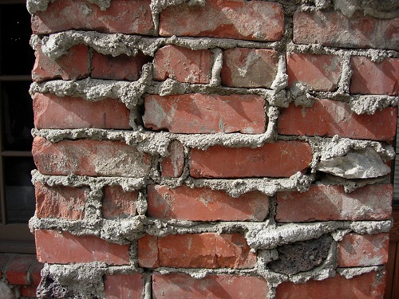
Bricks and Mortar
Notes:
Tier 1, 2 and 3 words are the bricks. Migrant students (and especially EL migrants) may also need the mortar words (connective words) to make clear sentences and create more description (using prepositional phrases for example).
EL Achieve woman who spoke at WABE…

Slide 57
Identify The Tier 2 Words From the Passage Below:
Johnny Harrington was a kind master who treated his servants fairly. He was also a successful wool merchant, and his business required that he travel often. In his absence, his servants would tend to the fields and cattle and maintain the upkeep of his mansion. They performed their duties happily, for they felt fortunate to have such a benevolent and trusting master.
Activity excerpted from Beck, McKeown, & Kucan, 2002, p. 16
Notes:
Have participants get out handout and read it. Identify which words you think are Tier 2 words. Discuss with your team. Use EL achieve cards for discussion. (see next slide)
Tier 2 words don’t differentiate between Kinder and HS. They are words that span the whole grade level gamut.

Slide 58
Using EL Achieve Discussion Cards…
Agree/ Disagree Statements
Simple: “I agree because…”
Sufficient: “I don’t think that’s right since…”
Sophisticated: “Another way to look at it is…”
Share Your Thinking
Simple: “In my opinion…”
Sufficient: “I have an idea. What if…”
Sophisticated: “It occurred to me that…”
Notes:
We want to encourage our students to use the new words orally. Remember that statistic earlier today? We don’t our students to be in that 98% that don’t talk about the content they are studying in class.
The discussion cards give non-English speakers a place to start thinking aloud with partners. -Lets give it a try.
You will notice on the discussion cards different symbols, those symbols represent simple, sufficient and sophisticated levels of language. Try with your partner with some statements with either the agree/disagree card or the share your thinking card.

Slide 59
Do your selections agree?
Johnny Harrington was a kind master who treated his servants fairly. He was also a successful wool merchant, and his business required that he travel often. In his absence, his servants would tend to the fields and cattle and maintain the upkeep of his mansion. They performed their duties happily, for they felt fortunate to have such a benevolent and trusting master.
Notes:
It’s important to note that we don’t always agree with what’s a tier 2 word and that’s OK.

Slide 60
Tier Two Words
Merchant
Required
Tend
Maintain
Performed
Fortunate
benevolent
Students’ likely expressions
Salesperson or clerk
Have to
Take care of
Keep going
Did
Lucky
kind
Notes:
These are words that a student might already have another word for like benevolent…they likely know “kind”…a simpler word. So by learning Tier II words, they gain more sophistication in their vocabulary.
One test of whether a word meets the Tier Two criterion of being a useful addition to students’ repertoires is to think about whether the students already have ways to express the concepts represented by the words. Would the students be able to explain these words using words that are already well known to them? If that is the case, it suggests that the new words offer students more precise or mature way of referring to ideas they already know about.
Adding these target words will allow students to describe with greater specificity people and situations with which they are already familiar.
NOTE these words are not simple synonyms, instead they represent more precise or more complex forms of the familiar words.

Slide 61
How do I prioritize among all the words I should teach?
So Many Words…So Little Time!

Slide 62
So Many Words…So Little Time
How do I prioritize which words need “robust instruction” when I have identified so many?
Notes:
We know we need to hit many tier 3 words, and now the research is telling us that tier 2 is “where it’s at” but there are a LOT of tier 2 words.
How do I prioritize?

Slide 63
Focus On High Mileage Words
Abstract words
Nuanced words
Words with frequently used morphemes
Notes:
See page 41 for notes

Slide 64
Lower Priority:
Cognates
Words whose meanings are direct and imageable
Words whose morphemic parts easily give context*
*(provided word study skills have been learned; (common roots, suffixes and prefixes)
Notes:
*good readers have these skills; must teach and practice for most;

Slide 65
Let’s practice in grade level (bands)
Get into grade level teams.
Review sample test questions from the old WASL tests.
Highlight tier 2 words individually. (5 minutes)
Using EL achieve cards, discuss with your team and together select those to be PRIORITIZED for direct instruction and why they were selected or others were not.

Slide 66
5 MINUTE BREAK!

Slide 67

Direct Instruction
Notes:
Take out paper (vocabulary notebook) and pen
Write these words and their definitions

Slide 68
Let’s Start With an Experience
I will introduce some new vocabulary words and their definitions. Please take out your vocabulary notebooks and write them down. You will use these words and their definitions for an upcoming activity.

Slide 69
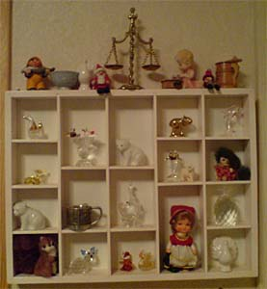
Vocabulary
finnimbrun
a trinket or knick-knack
Notes:
My grandmother had a display cabinet full of little finnimbruns that she collected from her travels across the United States.

Slide 70
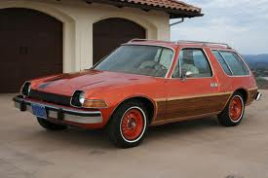
Vocabulary
fliver
A cheap car
Notes:
She was not excited that her date took her to the prom in a fliver.

Slide 71

Vocabulary
oojah
A word used for any object when the actual name for that object has slipped one’s mind.
Notes:
What is the name of that oojah that is used to connect the Mac to the projector?

Slide 72
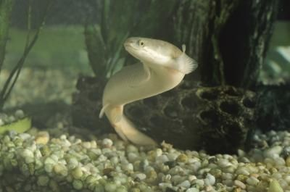

Vocabulary
sniggle
To fish for eels by lowering a baited hook into a hiding place
Notes:
My uncle caught 7 eels in one day at his favorite spot to sniggle on the river.

Slide 73

Vocabulary
hobbledehoy
An awkward gawky young fellow.
Notes:
The class hobbledehoy was the last one chosen for the dance team.

Slide 74
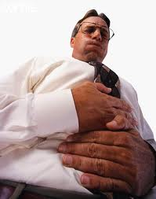
Vocabulary
borborygmus
A gurgling or rumbling sound from the stomach or intestines due to gas
Notes:
The blooming onion I ate from Outback caused a symphonic borborygmus all night long.

Slide 75
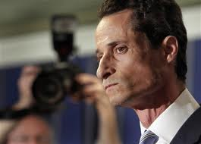
Vocabulary
snollygoster
A sleazy politician
Notes:
The snollygoster was caught trading favors for votes.

Slide 76

Vocabulary
jobberknowl
A blockhead
Notes:
Lucy’s term for that jobberknowl Charlie Brown was “Blockhead”.

Slide 77
engaging with word meanings
Short activities that help us interact with word meanings
Notes:
INSTRUCTIONS!
Have table groups use their vocabulary notebooks, the printed activity questions and blank paper on their tables to write table responses to each of the activities. (notice not all words are used – this is intentional).
Refer to the definitions in your vocabulary notebooks for this activity.
We are introducing several activities that you can do to work with word meanings. They are called
Finish the sentence…
Yes/No/Why
Would you Rather…
Word Relationships Graphic Organizer
Table Poster 1: TOP--Finish the Sentence…; Use the four vocabulary words below to complete each sentence. (Kvetch, snollygoster, fliver, hobbledehoy)
I would rather…. than ……..
I was surprised when…
Under no circumstances would I…
It was a real treat to…
Table Poster 2: TOP--WORD RELATIONSHIPS Graphic Organizer; “After reading the two words listed, put a check mark in the column that best describes the word relationship (see organizer)
Table Poster 3: TOP—WOULD YOU RATHER…; Anser each question and give your reason why…
Would you rather trust your pet to a snollygoster or a kindergarten teacher? Why?
Would you rather have your computer fixed by a hobbledehoy or a seamstress? Why?
Would you rather kvetch to a real person or someone on the phone? Why?
Would you rather be driven around in a fliver by a teenager or ride the bus? Why?
Table Poster 4: Yes/No/Why;
Would you like to ride to school with your mom in a fliver?
If you got a package of worms in the mail rather than your highly anticipated coffee pods, would you kvetch?
Would you vote for a snollygoster?
Would you feel comfortable investing your retirement savings with a hobbledehoy?
Use blank paper to write out answers. Post on corresponding wall poster for all to see.
5 minute Gallery walk to see work of all; (combine with break?)

Slide 78
Write down as many of the 8 words that you can remember along with the definition for each.
Vocabulary Test!

Slide 79
1-Hour Lunch Break!

Slide 80
Beck’s Steps to INTRODUCTION of words
Contextualize the word.
Describe how the word or concept is used in the text.
Provide a student friendly explanation.
Present an alternative context for the word-provide a sentence that shows how each word can be used in a context or situation that is not the same as the one in the text.
Invite students to interact with the word in a meaningful way.
Notes:
Step one – return to the text to see how the word is used – put into words the students can understand
Step two – create student friendly definitions
Step three – create another context for the word – students often limit the use of a new word to the context in which they first encountered it. Important to provide another context so students understand features/facets of the word.
Step four – Up to this point, the students have only listened. So we want to create an activity in which students DO something to actively engage with the words meaning. If student’s don’t DO something, it is questionable whether much learning can occur.
At early elementary they are not yet reading and the teacher is usually reading aloud. So they should encounter the words first (in context!) and then quickly process the word meaning, but don’t teach first before the encounter.
Lead participants through steps one – three above with the words they choose from the previous activity. We will look at engagement activities next.

Slide 81
Introduce New Words In A Context and Describe How Used in Text
INTRODUCTION OF NEW WORDS—Steps 1 & 2
Notes:
Did I introduce the 8 words in a context? Partially. The pictures gave some context, but a story, text, or science inquiry would have more context. I used the word in a sentence that helped to provide meaning which gave some additional context.
Isabel Beck defines contextualizing new words as providing a sentence that shows how each word can be used in a context or situation as the one in the story or text.

Slide 82
Provide Meaning through Instructional Context
Describe a situation that leads the students to understand the meaning of the word in the context presented.
Notes:
Read The TAILOR (page 99) story for K-3rd)
Examples:
In the story, the tailor was described as clever.
The tailor was also very frugal and never bought cloth to make something for himself.
The first time the tailor used the cloth he made a splendid coat
Each time a piece of clothing wore out, the tailor examined it very carefully.
The tailor worked very, very hard. Another way of saying that is that the tailor was industrious.
In the story, the cloth the tailor used was good for making different things: a coat, pants, a hat, and then a button. Another way to say this is that the cloth was versatile.
Don’t always use the exact wording of the story. Change it up in several ways.

Slide 83
Model Think-Alouds
“The rider couldn’t control the obstinate horse.
(Think aloud: “She was getting angry that this horse acted this way often.”)
Notes:
Teacher model: Obstinate must mean something that a horse could be, and it has to be something that would make a horse hard to control. Maybe scared, a horse can be scared, and because he was scared, he might act up and be hard to control. But it says the horse acted this way often and that the rider was angry about it. I don’t think a rider would be angry at a scared horse. Obstinate must be a way a horse acts that riders don’t like. It could mean stubborn, because horses can get stubborn and some horses can get stubborn often. When they do, it’s hard for a rider to get the to do what she wants.
***This type of model/scaffold should be used infrequently as it puts the students in a passive rather than active learning role.
Model a think aloud…
It’s OK to come with a wrong definition at this point;
We will work our way around to the right definition
After enough modeling of the strategy (describing the meaning from context)
Students can begin to develop their own definitions based on context.
Have students explain their thinking and explain the parts of the situation/context that helped clue them into the definition they came up with.
Teacher can model thinking aloud, but use it sparingly so that students do most of the explaining.

Slide 84
Model Questioning
“The train ride had been long, and I was tired of looking out the window. So I decided to eavesdrop on what two of the passengers sitting behind me were saying. I knew what they were saying was none of my business, but it might be interesting, so I tried to listen.”
  What is this person up to? What told you that?
  What’s this about it was none of his business?
  So, eavesdropping means what kind of listening?
Notes:
Model Questioning to help students derive meaning
Move to asking the students questions to get them to derive word meaning from instructional contexts.
What is this person up to? What told you that?
What’s this about it was none of his business?
So, eavesdropping means what kind of listening?
This is cumbersome with any regularity, but should be done often in the beginning so that students begin to use their thinking on their own to find meaning;

Slide 85
Now You Try It!
In pairs, read the text below and write three questions that will ‘lead’ the student to the contextualized understanding of the word edible.
“Please don’t eat the flowers, sir,” said the waiter. “I don’t think they are edible! They might make you sick!”
Notes:
Pairs get together and come up with questions like the previous slide that would lead the student to the meaning through context.
What is the waiter telling the man about the flowers?
If eating them might make you sick, what does that tell you?
So, if you shouldn’t eat things that are not edible, what does edible mean?

Slide 86
Student-Friendly Explanations
Introduction of New Word—Step 3

Slide 87
Who uses some variation of a “Personal Dictionary” with their students?
What kind of definitions are used?

Slide 88
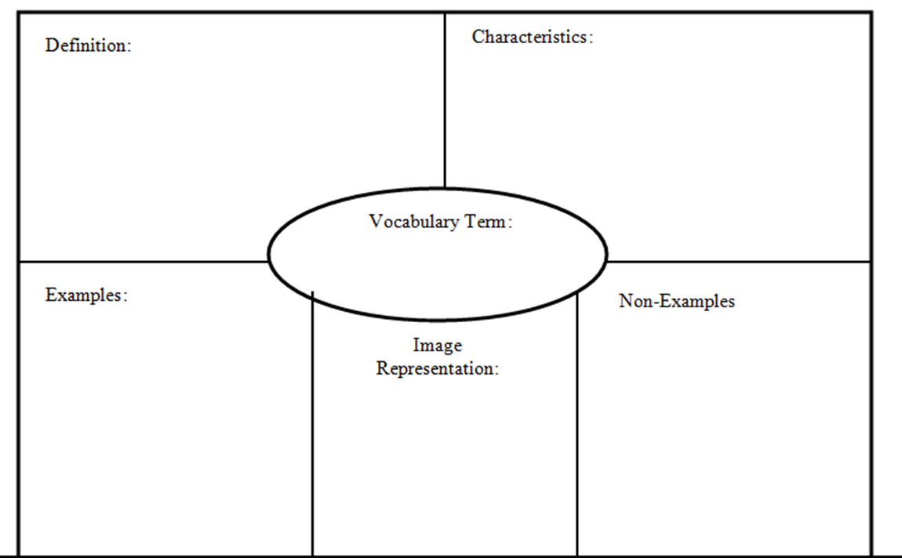
Frayer Model
Notes:
Many variations of Frayer Model – students should be encouraged to use graphics, first language to support their learning. Kate Kinsella always includes an example sentence as well.

Slide 89
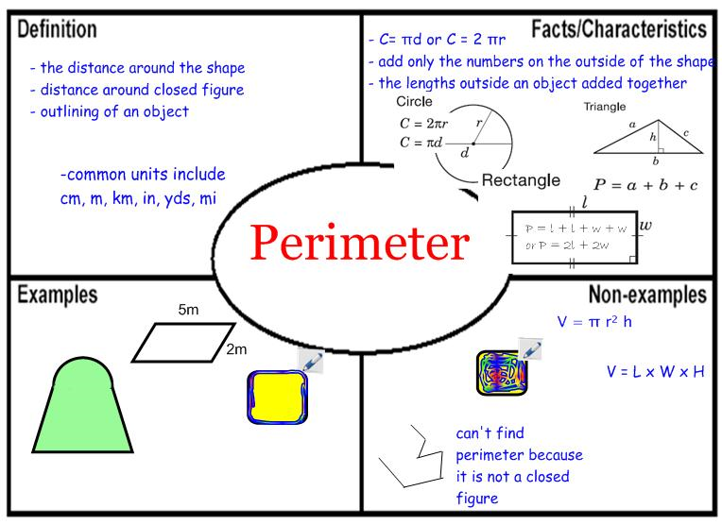
Frayer Model

Slide 90

Personal Dictionaries
Definition
Word Origin
WORD
Sketch (helps brain remember)
Sentence
Notes:
Student friendly may include the student’s own note-taking, sketching etc., but this does not necessarily make it a student friendly explanation.
Notes: discuss and compare Marzano’s personal dictionary example w other personal dictionary examples; show similarities/differences…
Have you used something like this with your students?
Talk about the importance of non-linguistic representations of words

Slide 91
Personal Dictionaries
Definition
Example
WORD
Sketch (helps brain remember)
Non-example
Notes:
Are there other variations?

Slide 92
Can be used as Vocabulary Study Cards
Front of Card
  Word
  Part of speech
  Pronunciation
  Related word forms
  First language translation/cognates
Back of Card
  Synonyms, antonyms
  Original context/source
  Definition
  Teacher example
  Student’s own sentence
  (Kinsella)
Notes:
It seems remiss not to mention a couple of other highly respected vocabulary strategies.
Look at examples of vocabulary cards – discuss cognates and why they are important to be award of – false cognates. Point to Cognate Handout

Slide 93
Problems with Dictionary Definitions
Sixty-three percent of the students’ sentences were judged to be “odd”
Sixty percent of the students’ responses were unacceptable
Students frequently interpreted one or two words from a definition as the entire meaning.
(Miller & Geldea, McKeown, and Scott & Nagy)
Notes:
Tamper A example—to interfere in an ____ way;
Tamper B exampale—to

Slide 94
Student-Friendly Definitions
Characterize the word
  How is it typically used?
  When do I use this word?
  Why do we have such a word?
Explain the meaning in everyday language
  Develop it in a way so students attend to the whole explanation, rather than just one word
  Word it in a way that reflects its part of speech
  “Somebody who…”
  “Describes something that…”
  “To do something in a ___ way”
Notes:
“It’s best to start students off with a strong focused concept of what a word means rather than draw attention to multiple senses of meaning. Rather than dealing with too much information at the outset, language used can more readily extend a concept as their use of it grows.” BWTL, p. 33
Uses complete sentences, not fragments like a dictionary
Example: tamper – Dictionary definition is “to interfere in a secret or incorrect way.” This doesn’t seem to really get at what we think of when we use the word tamper.
Student Friendly Explanation: “To change something secretly so that it does not work properly or becomes harmful.”
Good Resources for student-friendly definitions are:
Collins COBUILD Dictionary
Longman Advanced American Dictionary
Word Central; Mirriam Webster Student’s electronic dictionary
The American Heritage Dictionary of the English Language

Slide 95
Examples of Student Friendly Definitions
Beck, McKeown, Kucan, 2008;
Notes:
Page 24
Turn to your partner and share one way that these meet Beck’s definition of a “friendly” definition

Slide 96
Now You Try It!
Here are some words and their dictionary definitions. Referring to the friendly definition handout, create a student friendly definitions for each of the following.
disrupt - break up; split
illusion - appearance or feeling that misleads because it is not real
morbid - not healthy or normal
analyze -to separate into essential parts
Notes:
These are the dictionary definitions; You will write a student friendly definition;
Do individually (5 minutes?) and then have them discuss in pairs; have your group discuss at table and agree upon your final definition (that you all agree on) for each word; write the agreed upon definitions on the yellow paper;
The person who drove the shortest distance to get here today will be the one to share;

Slide 97
Let’s Practice Again!
Create student friendly definitions for the following words:
clever
frugal
industrious
versatile
Notes:
These are the dictionary definitions; You will write a student friendly definition;
Do individually (5 minutes?) and then have them discuss in pairs; have your group discuss at table and agree upon your final definition (that you all agree on) for each word; write the agreed upon definitions on the yellow paper;
The person who drove the shortest distance to get here today will be the one to share;

Slide 98
Provide Additional Contexts
INTRODUCTION OF NEW WORDS—Step 4
Notes:
Isabel Beck says that providing additional contexts means showing how each word can be used in a context or situation that is different from the one in the story or text.
Read “the Tailor” aloud. (Page 99) to get text context. Then share the following examples as different context from the text.
Examples: ”If you kept losing the key to the house, and decided to wear it on a chain around your neck—that would be a clever idea.”
“It would be frugal to only buy clothes when there is a big sale.”
“If you look out and see beautiful sunshine, you might think “What a splendid day!”
“If someone thought he or she might have found a ring with a real diamond in it, he or she would examine it very carefully.”

Slide 99
Cognitive Content Dictionary (GLAD)
If time allows, model the CCD strategy.
Notes:
Teacher model: Obstinate must mean something that a horse could be, and it has to be something that would make a horse hard to control. Maybe scared, a horse can be scared, and because he was scared, he might act up and be hard to control. But it says the horse acted this way often and that the rider was angry about it. I don’t think a rider would be angry at a scared horse. Obstinate must be a way a horse acts that riders don’t like. It could mean stubborn, because horses can get stubborn and some horses can get stubborn often. When they do, it’s hard for a rider to get the to do what she wants.
***This type of model/scaffold should be used infrequently as it puts the students in a passive rather than active learning role.
Model a think aloud…
It’s OK to come with a wrong definition at this point;
We will work our way around to the right definition
After enough modeling of the strategy (describing the meaning from context)
Students can begin to develop their own definitions based on context.
Have students explain their thinking and explain the parts of the situation/context that helped clue them into the definition they came up with.
Teacher can model thinking aloud, but use it sparingly so that students do most of the explaining.

Slide 100
Have You Ever….
  Describe a time when you might have been an accomplice to someone.
  Describe a time when you might be a novice.
Notes:
This activity helps students to associate newly learned words with contexts and activities from their own experiences. It helps students understand that they have a place for the new words in their vocabularies
“When you respond, please use the word accomplice in your sentence.” (This reminds me of GLAD when they come up with an oral sentence that tells me that you know what the word means.)
Now it’s your turn…take your three words and create 3 “Have you ever…” You will be writing the prompts for your three words (morbid, illusion and disrupt)
(I would make four handouts (one per strategy) with the strategy and example at the top, then blank space to apply the strategy to their three words (morbid, illusion and disrupt)

Slide 101
Applause, Applause!
  How much would you like …
    Being suspected of being an accomplice
    Having philanthropists as relatives
    Being described as a novice soccer player
Notes:
Ask participants to clap in order to indicate how much they would like (not at all, a little bit, a lot) to be described by the target words. After each word – be sure to ask why – Students must use the word in their answer… ex, “ I would not like to be called a novice because…”

Slide 102
Idea Completions
  The audience asked the virtuoso to play another piece of music because …
  The skiing teacher said Maria was a novice on the ski slopes because…
Notes:
Rather than asking students to write a sentence using the new word which can result in meaningless use (e.g. “I saw a virtuoso”), provide students with sentence stems that require them to integrate a word’s meaning into a context in order to explain a situation.

Slide 103
Now You Try It!
Develop your own instructional contexts using the words oojah, sniggle, borborygmus
and jobberknowl for each strategy below.
Have you ever…?
Applause, applause!
Idea completions
Word Association
Notes:
Examples in student handout should participants need to review the techniques –
Word Associations – page 2 – Word Association: Variation 1
Have you ever …? –page 4 –Generating Situations, contexts, and examples: Variation 2
Applause, applause – page 6 –Word Relationships: Variation 5
Idea completions – page 6—Writing: Variation 1
Do in pairs, then in table groups. Each table group share one technique from each type.

Slide 104
Provide Opportunities to Interact with the Word’s Meaning
INTRODUCTION OF NEW WORDS—Step 5

Slide 105
YES/NO/WHY
Say the word “clever” if I describe something or someone who is clever.
Say “No” if it is not clever.
I will ask you why you responded the way you did.
Notes:
Someone who figures out a shortcut for doing a math problem
A pet who keeps trying to get out of its cage by chewing on the bars
A baby who cries when he is hungry
A student who uses new vocabulary words in his/her writing
Someone like the troll in Three Billy Goats Gruff who is fooled into letting the first two billy goats go across the bridge
Word Associations
Have you Ever…?
Applause, Applause!
Idea Completions
Finish the sentence…
Would you Rather…
Word Relationships Graphic Organizer

Slide 106
Bringing INTRODUCTION all Together--CLEVER
Contextualize—In the story, the tailor was described as clever.
Friendly explanation—Someone who is clever is good at figuring things out and solving problems.
Additional context—If you kept losing the key to your house and decided to wear it on a chain around your neck—that would be a clever idea.
Engage with meaning—”Clever/No/Why”

Slide 107
FOLLOW UP—Provide Ample Opportunities to Interact with Word Meaning
FOLLOW UP INTERACTIONS WITH WORDS
Notes:
After the words have been introduced, students need to interact with the words and their meanings on subsequent days.
Keep new words in action for a while (rest of the week) (3-15 minutes per day for 6 words, 5-20 minutes for 8-10 words and 10-25 minutes for a 11-15 word set depending on how much writing, etc)
Provide for frequent encounters
It allows for enlarging the contexts in which students use the words and for supporting more complex thinking and writing
This is vocabulary BUILDING

Slide 108
Example/Non-Example
  Present items that ask students to distinguish between an example of a word and a non-example of a word. Both the example and non-example should be designed to present situations that have similar features and therefore require student thinking that zeros in on the meaning of the target word.
Notes:
Distribute the Example/non-example work sheet. Invite participants to look at the five variations of example/non example and create at least one activity per variation for any of their target words.

Slide 109
Word Associations
After studying explanations for accomplice, virtuoso, philanthropist, and novice:
Students answer and explain their answer:
  Which word goes with crook?
  Which word goes with “gift to build a new hospital”?
  Which word goes with piano?
  Which word goes with kindergartener?
Notes:
Activity that gives students something to respond to by relating what is presented with one of the target words.
Distribute the Word Associations work sheet. Invite participants to look at the three variations of word associations and create at least one activity per variation for any of their target words.
After they verbally shared (whole group) the answers to these questions, she prompted participants to write word associations for their three words. We want the students to GET ENGAGED with these words.
E.G., Which word goes with fire drill? (disrupt) Why? Because when the fire drill sounds I must go outside and it disrupts my learning
Which word goes with death? (morbid) Why? Because to somepeople death is creepy.
Which word goes with Halloween? (illusion) Why? Because everyone dresses up as someone else and you don’t know who they are.

Slide 110
Generating Situations, Contexts, and Examples
Students are not provided with choices as in the previous two activities. Instead, students are asked to generate appropriate contexts or situations for statements or questions about their words.
Notes:
Distribute the Situations/contexts/examples work sheet. Invite participants to look at the five variations and create at least one activity per variation for any of their target words.

Slide 111
Word Relationships
Having students think about and respond to how two words might be related is a strong activity for developing rich word knowledge. Working with two words and how their meanings and features might interact prompts students to explore novel contexts for the words and guild new connections.
Notes:
Distribute the Word Relationship work sheet. Invite participants to look at the six variations and create at least one activity per variation for any of their target words.

Slide 112
Writing
The king was miserable because…
The child was perplexed because…

Slide 113
Writing
Think of a time when you felt _______. Write a little bit about what made you feel that way.

Slide 114
Writing
Think of a time when you might need to ______. Write a paragraph to tell about it.

Slide 115
Writing
Think of someone you could describe as _______. Tell us what that person is like.

Slide 116
Did We Meet Our Outcomes?
Participants will know how to select academic vocabulary words and implement 2-3 new strategies to support migrant students in their academic vocabulary development.

Slide 117
Two Evaluations
Clock Hour evaluation will be emailed to you electronically
OSPI MEP Evaluation (paper)

Slide 118
On Behalf of the Presenters, “THANK YOU!”
Mary Kernel
Sarah Southard
mkernel@nwesd.org
ssouthard@nwesd.org

