Slide 1
Why an Academic Vocabulary Workshop for Migrant Families?
Notes:
What makes a migrant academic vocabulary workshop different from a mainstream academic vocabulary workshop?
Best practices presented in the mainstream workshops are also best practices for migrant families.
Mainstream best practices are not enough for migrant families. (August)
This workshop addresses unique needs of migrant families identified in the Seven Areas of Concern.
Educational Continuity
technology and digital literacy to increase instructional time and maintain communication regardless of family’s location (see list of resources)
timely transfer of academic records; even more meaningful with consistency of CCSS
collaborative learning where Migrant/ELLs fill in gaps by working with fluent peers on common projects
build on the geographical strengths of family
Instructional Time
provide access to preview and review resources in L1 and L2 (see VOD cast example)
facilitate migrant / Ell access to internet and computers at school in the community and wherever they may travel
coordinate and align tutoring and other supplementary activates with your curriculum
home school connection (see Project GLAD examples)
School Engagement
use migrant themes when modeling/introducing skills to the whole class. (see Irrigation and Water Issues- graphic organizers for argument writing.) This increases the Migrant/ELL student’s level of engagement because the theme is familiar and the family has expertise.
understand and address the social and cultural processes unique to migrant/ELL families (see Bicultural Ambivalence and relationship research)
English Language Development
facilitate the use of L1 in the school; know your bilingual research (see Common Underlying Proficiency and Language Transfer)
directly teach vocabulary in content areas
teach strategies for indirect vocabulary development
foster interdependency with linguistically heterogeneous groups working collaboratively (see Numbered Heads Together)
Educational Support in the Home
utilize the Literacy Tool Kit developed by the migrant program
facilitate the use of academic L1 in the home (see Lotería Academica)
use themes that related to the migrant lifestyle; tap the migrant community resources (see the Migrant Lifestyle Bibliography)
visit or phone the home – establish on-going communication with the family in ways that make them feel wanted and a part of the school. “Wow the teacher came to my house”. (see 10 Spanish Words to Call Home)
Health
Introduce/model skills to the whole class using themes that relate to migrant health issues (see University of Washington Pesticide Research Picture File Sort)
coordinate and align your literacy curriculum and key vocabulary instruction with the PE and Health teachers
Access to Services
Introduce/model skills to the whole class using themes that relate to migrant health issues (i.e. expository writing about community agencies and their services… )
Facilitate community service hours related to accessing community services; highlight the value of a migrant background and bilingual skills when providing community service or in business

Slide 2
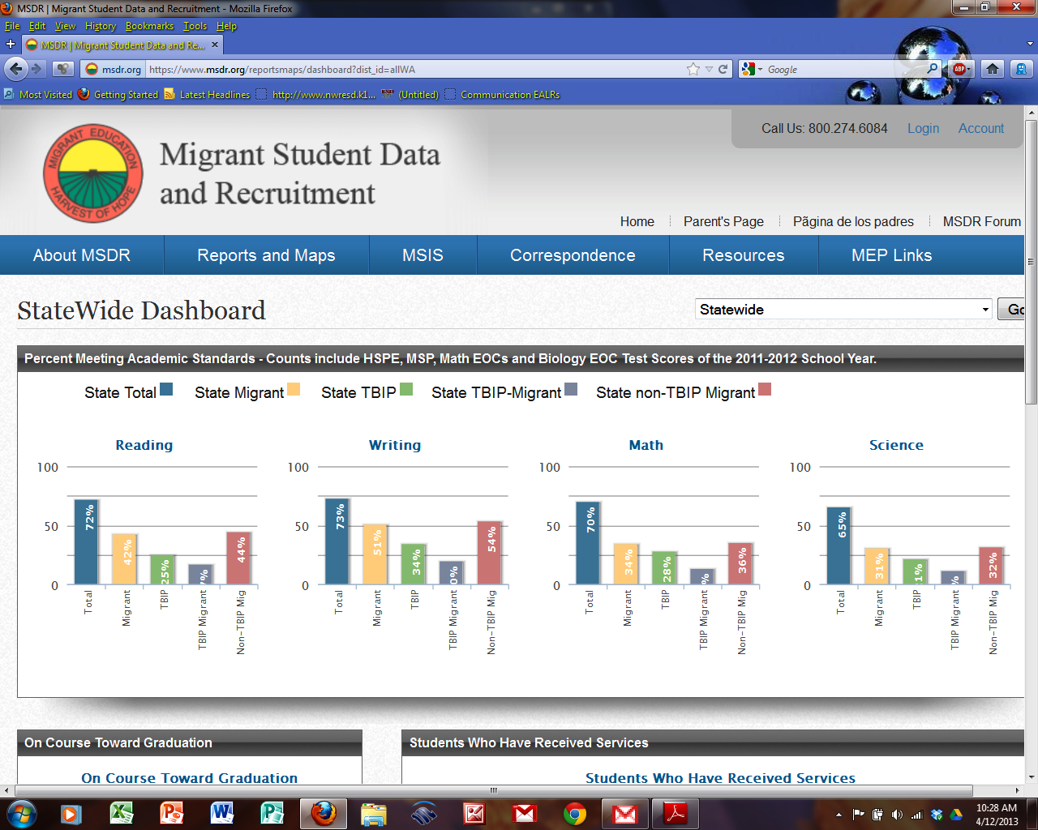
https://www.msdr.org/reportsmaps/dashboard?dist_id=allWA
Notes:
No password is required for this page
The link at the bottom of the slide is hot when viewed from the slide show.
2012 MSP and HSPE tests
Scores in every subject are greatly impacted by English vocabulary levels
Note that the lowest performing group in every subject is the Migrant/ELL group.
The biggest gap statewide is Science
What is the biggest gap for your district?

Slide 3
50,000
La brecha lingüística
29,000
50,000
17,000
3,000
Common Underlying Proficiency
Una familia típica hispanohablante, inmigrante y rica lingüísticamente
Una familia típica hablante inglesa y rica lingüísticamente
Una familia típica hispanohablante, migrante y pobre lingüísticamente
Notes:
This CUP model demonstrates the receptive vocabulary gap (Blue is Spanish, red is English)
Left: a typical immigrant child bringing a solid literacy and vocabulary foundation in Spanish; immigrates in 5th grade
Middle: a typical child from the dominant Anglo culture, 50th percentile
Right: a typical child born in the U.S. of Spanish speaking migrant farm workers with low levels of economic resources. Spanish is set aside when entering kinder
Cups are placed to illustrate the vocabulary development advantage of;
coming form a linguistically rich home, (Hart and Risley)
fluent reading starting in 4th grade where indirect vocabulary development continues
strong foundation in L1 and the Common Underlying Proficiency with nearly automatic transfer of language skills from L1 to L2,
an additive approach where L1 is maintained
Challenges for Migrant / ELLs:
The migrant child appears to be doing well in K-3 (“Kids are a sponge” myth) but after the Common Underlying Proficiency advantage is lost at 3,000 words, progress slows and the gap widens. This is a False Positive that shows up in English standardized testing (Collier and Thomas)
English vocabulary is insufficient to reach fluency and comprehension levels needed for the literacy boost to vocabulary development
A subtractive approach where migrant /ELLs are put into sheltered programs where the Spanish that they bring to school is set aside.
Research:
Beck (2002), Unfortunately, recent studies suggest that the amount of instructional time devoted to vocabulary development is simply insufficient to support the level of growth needed to close the vocabulary gap. (Implication:Migrant / ELLs need more vocabulary instructional time in addition to, not in place of, their mainstream time. Supplement not supplant.)
Graves, August, Mancilla-Martinez (2013) Once in school (average*) native English speaker's vocabulary rates increase by 3,000 to 4,000 words a year. *"From homes filled with language…“
Freeman and Freeman identify three categories of recently arrived ELL students 1) bring strong literacy skills from home country 2) bring weak literacy skills from home country 3) born in the US with weak academic vocabulary in both languages
Naagy and Herman (1984) mid-SES know 50% more words than do low-SES
Biemiller and Slonim (2001) the typical ELL student beginnins school has already learned from 5000 to 7000 words in their first langague L1
Hart and Risley (1995) Welfare children know 70 % of the vocabulary of workint-class families and 45% of the voacbulary of children from professionall families. Widening Gap starts early

