Slide 1
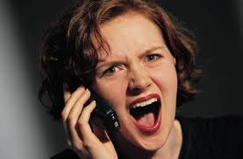
Vocabulary
kvetch
Verb: to complain
Noun: A person who complains a lot!

Slide 2
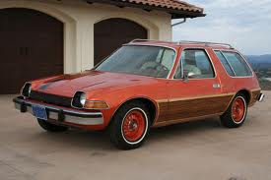
Vocabulary
fliver
A cheap car

Slide 3
Vocabulary
oojah
A word used for any object when the actual name for that object has slipped one’s mind.

Slide 4
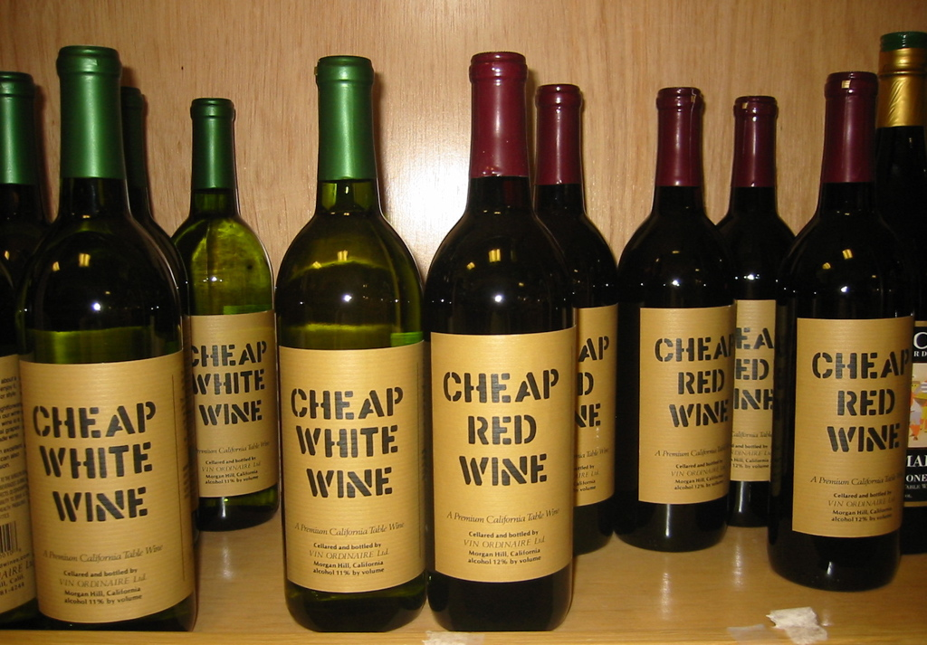
Vocabulary
inglenook
The finest wine you can get for six dollars.

Slide 5
Vocabulary
hobbledehoy
An awkward gawky young fellow.

Slide 6
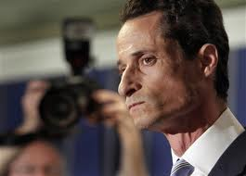
Vocabulary
snollygoster
A sleazy politician

Slide 7
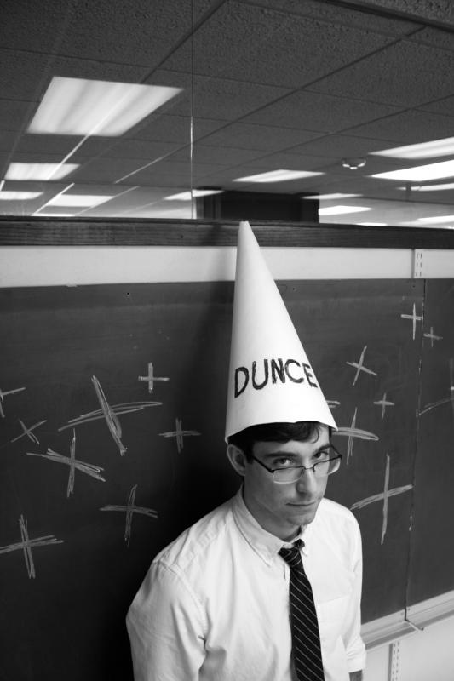
Vocabulary
jobberknowl
A blockhead

Slide 8
Yes/ No/ Why
Would you like to ride to school with your mom in a fliver?
If you got a package of worms rather than your highly anticipated coffee pods would you call and kvetch?
Would you vote for a snollygoster?
Would you feel comfortable investing your retirement savings with a hobbledehoy?

Slide 9
Graphic Organizer-Relationships
 | Same | Opposite | Go Together | No Relation
fliver-growing
hobbledehoy-geek
snollygoster-honest
kvetch-problems
Explain why you chose each box?

Slide 10
Finish the Sentence…
Use the four vocabulary words to complete each sentence-
kvetch – fliver – snollygoster - hobbledehoy
Would you rather…
How surprised were you when…
Under no circumstances would I…
It was a real treat…

Slide 11
Would you rather?
Would you rather trust your pet to a snollygoster or a kindergarten teacher?
Would you rather have your computer fixed by a hobbledehoy or a seamstress?
Would you rather kvetch to a real person or someone on the telephone?
Would you rather be driven around in a fliver by a teenage child or ride the bus?
Answer each question and give your reason why…

Slide 12
Post Test: Write the definition for each word.
Kvetch
Fliver
Oojah
Inglenook
Hobbledehoy
Snollygoster
jobberknowl

