Slide 1

So Many Words… So Little Time!
Teaching Academic Vocabulary in the Content Areas to Migrant Students

Slide 2
PURPOSE OF THIS WORKSHOP
Provide participants with strategies to support migrant students in acquiring academic vocabulary as outlined in the Common Core State Standards.

Slide 3
WORKSHOP OUTCOMES
Participants will know how to select academic vocabulary words and implement 2-3 new strategies to support migrant students in their academic vocabulary development.

Slide 4

How do you teach vocabulary?
Notes:
On sticky notes, note as many ways as you can think of how you currently teach vocabulary in your classroom. How do you choose which words to teach?
In table groups discuss the various methods of teaching vocabulary & where the words are generated from.

Slide 5
Common Core State Standards
Reading Strand: Reading Anchor Standard #4
  Interpret words and phrases as they are used in a text, including determining technical, connotative, and figurative meanings, analyze how specific word choices shape meaning or tone.
Language Strand: Language Anchor Standard #4
  Determine or clarify the meaning of unknown and multiple-meaning words and phrases by using context clues, analyzing meaningful word parts, and consulting general and specialized reference materials as appropriate.
Language Anchor Standard #6:
  Acquire and use accurately a range of general academic and domain-specific words and phrases sufficient for reading, writing, speaking, and listening at the college and career readiness level; demonstrate independence in gathering vocabulary knowledge when encountering an unknown term important to comprehension or expression.
Notes:
Here are the primary standards that talk about vocabulary development. With your sticky notes, arrange what you do to meet the standards currently.

Slide 6
Common Core State Standards
Reading Foundational Skills #2 for K and 1st grades
  Demonstrate understanding of spoken words, syllables, and sounds.
Language College and Career Readiness: Standard #5
  Demonstrate understanding of figurative language, word relationships, and nuances in word meanings.
Notes:
Here are the primary standards that talk about vocabulary development.
With your sticky notes, arrange what you do to meet the standards currently on the CCSS posters

Slide 7
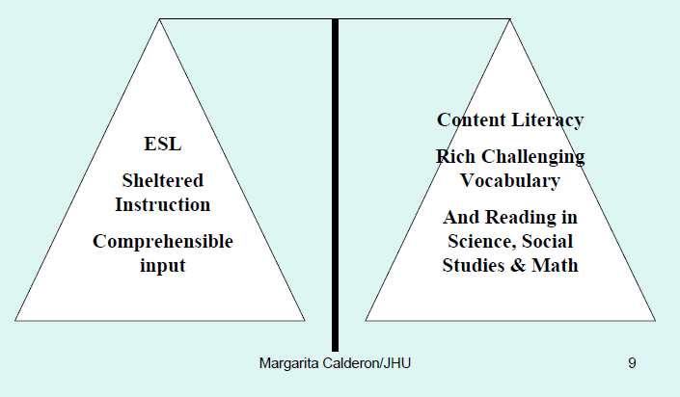
FOR ESL or ENGLISH-ONLY PROGRAMS: Teachers must balance comprehensible input with rich challenging vocabulary and reading in math, science and social studies in English.
Notes:
ESL programs and students used to be put off on their own and that is no longer the case.

Slide 8
Essential Questions:
Why is vocabulary instruction so important?
What are exemplary strategies for vocabulary instruction?

Slide 9
Word knowledge is much more than word identification or even definitional knowledge.
“It takes more than definitional knowledge to know a word, and we have to know words in order to identify them in multiple reading and listening contexts and use them in our speaking and writing.” (Allen, 1999)
Notes:
Word knowledge is SO MUCH MORE than definitional knowledge…

Slide 10
There is evidence of need for explicit vocabulary instruction and structured verbal engagement in linguistically diverse classrooms.
Only 4% of English Learners’ school day is spent engaging in student talk.
Only 2% of English Learners’ day is spent discussing focal lesson content, rarely speaking in complete sentences or applying relevant academic language.
(Arreaga-Mayer & Perdomo – Rivera, 1996)
Notes:
We need to get the students TALKING using academic vocabulary, in a structured way. Verbal engagement.

Slide 11

Vocabulary
dringle
To waste time in a lazy manner
Notes:
Now, I’m going to teach you some new vocabulary.

Slide 12
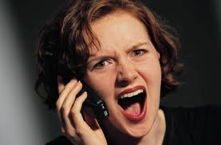
Vocabulary
kvetch
Verb: To complain;
Noun: A person who complains a lot!
Notes:
Now, I’m going to teach you some new vocabulary The word is Kvetch. It can be a noun or a verb. It means “to complain” or “A person who complains a lot”. Say the word with me. “Kvetch”

Slide 13
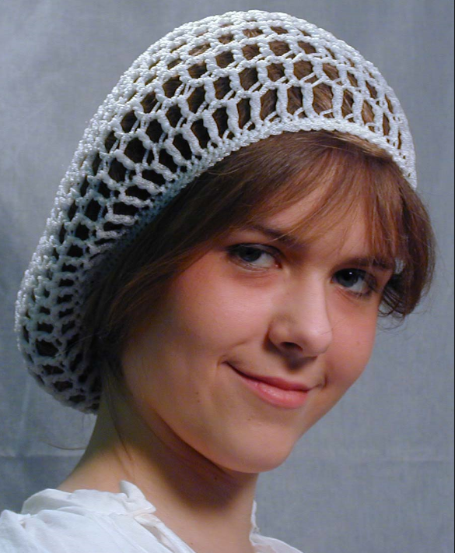
Vocabulary
snood
A small netlike cap worn by women to keep their hair in place.

Slide 14
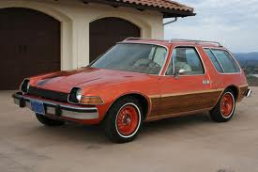
Vocabulary
fliver
A cheap car

Slide 15

Vocabulary
oojah
A word used for any object when the actual name for that object has slipped one’s mind.

Slide 16
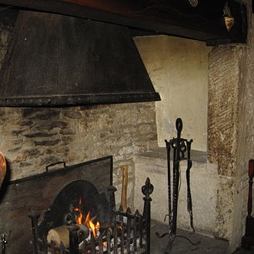
Vocabulary
inglenook
A chimney corner or small recess that adjoins a fireplace

Slide 17
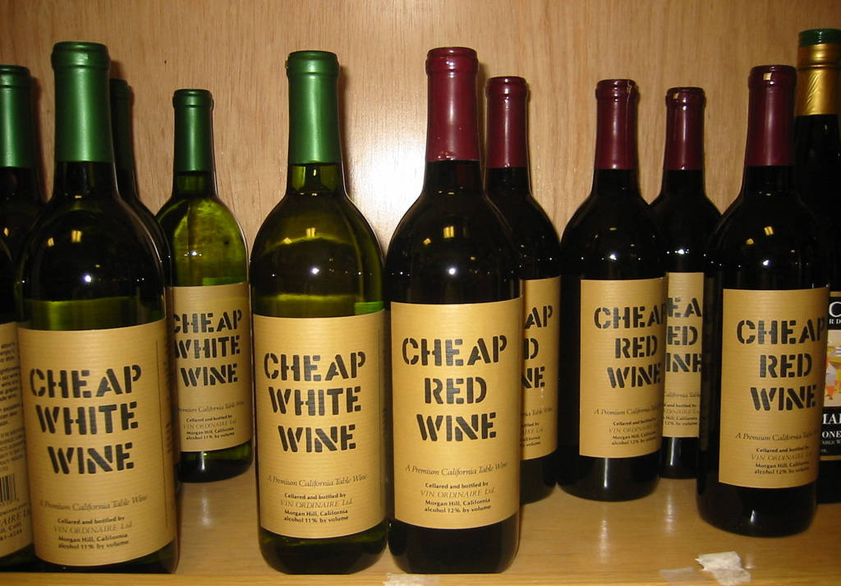
Vocabulary
inglenook
The finest wine you can get for six dollars

Slide 18

Vocabulary
hobbledehoy
An awkward, gawky young fellow

Slide 19
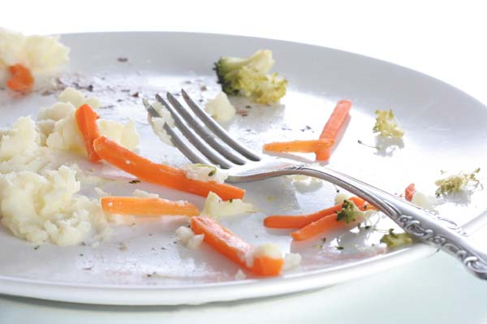
Vocabulary
tittynope
A small quantity of something left over.

Slide 20
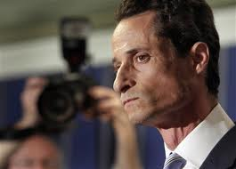
Vocabulary
snollygoster
A sleazy politician

Slide 21

Vocabulary
borborygmus
Intestinal rumbling caused by moving gas
Notes:
Bor.bo.ryg.mus

Slide 22

Vocabulary
jobberknowl
A blockhead

Slide 23
Why Vocabulary Instruction?
The bad news:
Knowledge gap in SES groups:
High SES 1st graders know twice as many words as low SES classmates
By high school, they know 4 times as many words!
High SES 3rd graders have vocabularies equal to the lowest-performing 12th graders!
The good news:
We can make a difference if we begin teaching vocabulary in robust ways . . . vigorous, strong and powerful in effect
Robust approach includes direct explanation, thought-provoking, playful and interactive follow-up.
Beck, et al.
Notes:
If we have a graph to replace words we should do this.

Slide 24

Why a SPECIAL WORKSHOP FOR MIGRANT STUDENTS?
Who is migrant?
What is PFS?
Notes:
If time, have group read “The Students of Stemville, WA” with a partner first, then read it as a group. This leads into “Why a special workshop regarding migrant students?”
“Before we discuss the migrant students in particular, I want you to read about the experience of a group of students in Stemville, WA.” Give the participants a copy of the scrambled text.
After participants read with a partner, read the last 2 paragraphs as a group. (You, the teacher, have the key to allow you to decipher the text. Do not distribute the key to the participants.) Have the group discuss some of the problems the students of Stemville faced. Migrant students encounter a lot of these obstacles.

Slide 25
What is ‘migratory lifestyle’
The defining characteristic of a migrant worker is mobility
  Move across district boundaries within or outside the state within the last 36 months;
  Seek temporary or seasonal work;
  Agriculture or fishing industry
Notes:
Find electronic copy of this information.

Slide 26
Priority for Service Migrant Students
Washington State Migrant Education Program’s definition for students identified as Priority-for-Service students:
  whose education has been interrupted during the regular school year
  who are failing or most at risk of failing to meet the State’s challenging State academic achievement standards.
  See Handout

Slide 27
Seven Areas of Concern for Migrant Students:
Educational Continuity
Instructional Time
School Engagement
English Language Development
Educational Support in the Home
Health
Access to Services
Notes:
PPT Slides for 7 Areas of Concern
Do a little review of the seven areas of concern for migrant students- just a quick review first, then a slightly more in depth- talk about each area in more personalized terms and talking about research.

Slide 28

Seven Areas of Concern for Migrant Students:
1: Educational Continuity
  When students move from place to place they often encounter different expectations, curriculum, course requirements, assessment, etc. This is especially difficult for high school students who are trying to accrue credits and meet graduation requirements.
Notes:
“It takes 30-40 days for a student to get acclimated in a new classroom- learning is limited until the student is acclimated.

Slide 29


Seven Areas of Concern for Migrant Students:
2: Instructional Time
  When students move they often miss instructional days between the time they leave one school and finally enroll in a new school.
Notes:
“It takes 30-40 days for a student to get acclimated in a new classroom- learning is limited until the student is acclimated.

Slide 30

Seven Areas of Concern for Migrant Students:
3: School Engagement
  Research shows that feeling part of the school community is an important protective factor and predictor of school success. When students change schools frequently, they often feel like the new kid who doesn’t really belong.
Notes:
“It takes 30-40 days for a student to get acclimated in a new classroom- learning is limited until the student is acclimated.

Slide 31
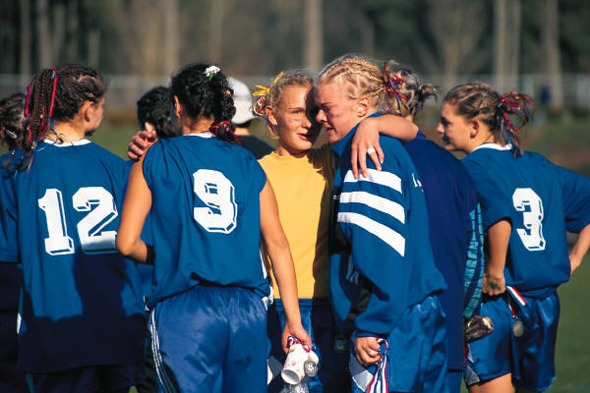
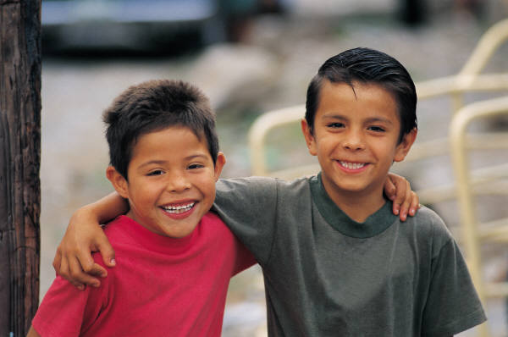

3 Types of School Engagement:
Behavioral engagement (participation)
Emotional engagement (appeal)
Cognitive engagement (investment)

Slide 32
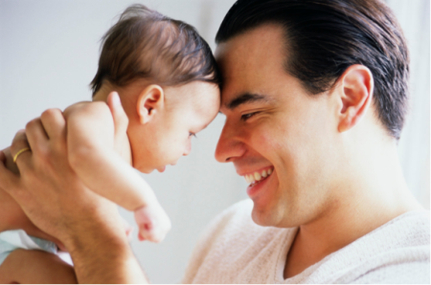
Seven Areas of Concern for Migrant Students:
4: English Language Development
  Parents of MEP students often do not speak English. Students are often English Language Learners.
Notes:
About 50% of migrant students are also LEP.
Only about 9% of all students in the state are considered LEP according to our latest data.

Slide 33
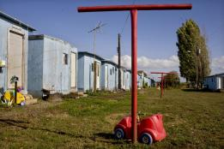
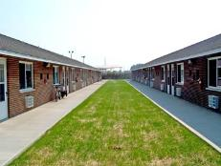
Seven Areas of Concern for Migrant Students:
5: Educational Support in the Home
  Parents often work long hours:
    Living conditions are often crowded and noisy
    Often there are no books in the home
    Often parents have low levels of education
Notes:
Parent support in the home- conditions in the home may make the educational environment difficult.

Slide 34
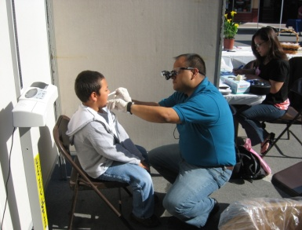
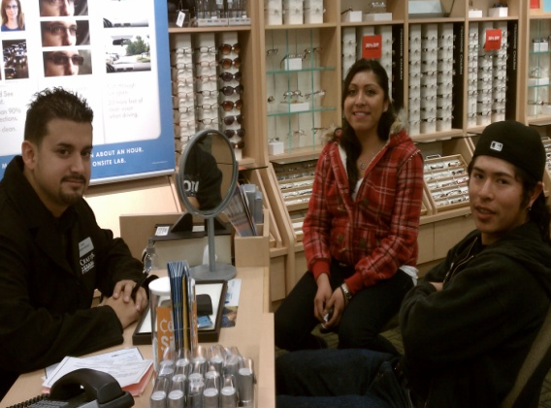
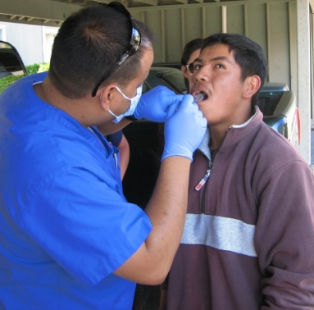
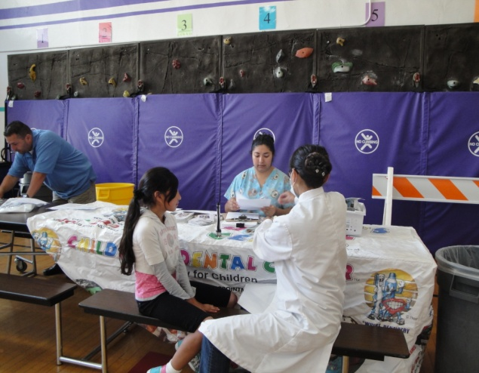
Seven Areas of Concern for Migrant Students:
6: Health
Migrant students frequently have unmet health needs including dental and vision issues
Notes:
English Language Development: Parents of MEP students often do not speak English. Students are often English Language Learners
Education Support in the Home: Parents often work long hours; living conditions are often crowded and noisy; often there are no books in the home; often parents have low levels of education
Health: MEP students frequently have unmet health needs including oral and vision issues
Access to Services: Families often do not know how to access community services or participate in the American school system. They are often isolated because of lack of transportation or language barriers.

Slide 35
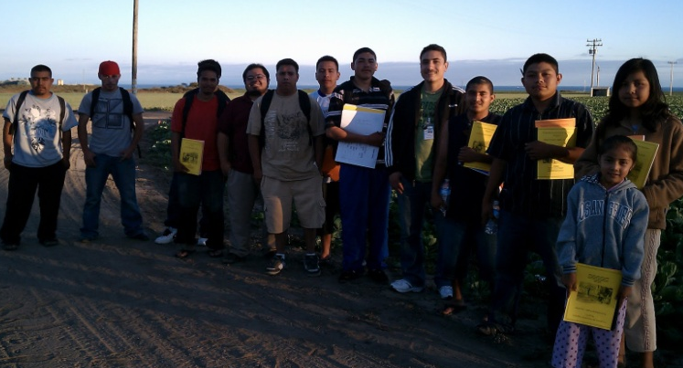
Seven Areas of Concern for Migrant Students:
7. Access to Services
Families often do not know how to access community services or participate in the American school system. They are often isolated because of lack of transportation or language barriers
Notes:
10:2: How did the 7 Areas of Concern affect in the Students of Stemville?
English Language Development: Parents of MEP students often do not speak English. Students are often English Language Learners
Education Support in the Home: Parents often work long hours; living conditions are often crowded and noisy; often there are no books in the home; often parents have low levels of education
Health: MEP students frequently have unmet health needs including oral and vision issues
Access to Services: Families often do not know how to access community services or participate in the American school system. They are often isolated because of lack of transportation or language barriers.

Slide 36
So what can teachers do to improve educational chances of migrant students affected by the 7 Areas of Concern?

Slide 37
Instructional Implications:
1. Build Background and Schema
Assumptions must not be made about the background that our migrant students have.
Teachers need to be cautious about topics being discussed…
because struggling students may not have background knowledge of that topic and can struggle with class work.
Notes:
Need a better transition here from 7 Areas to Instructional suggestions.
“So what can we teachers do to compensate for the 7 Areas of Concern?”

Slide 38
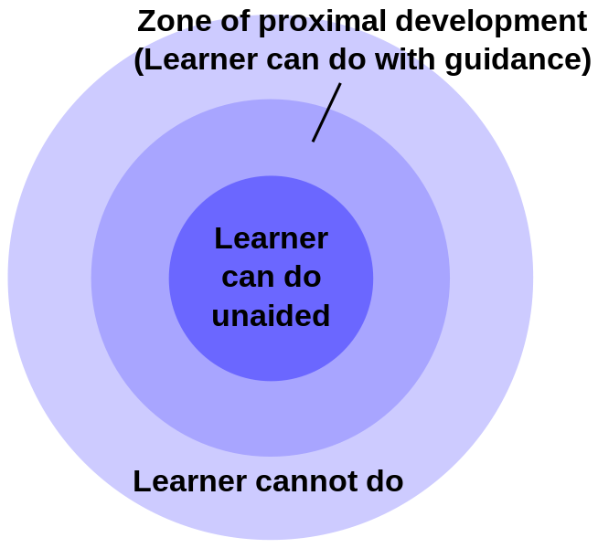
2. Scaffold for Support
Aim for the Zone of Proximal Development (ZPD differentiation)
Provide scaffolds that are culturally relevant and sensitive
Provide scaffolds that are intended to make the learning accessible and increases the rate of learning

Slide 39
3. Look for Clues
Cognates:
Take advantage of cognates
Beware of False Cognates:
Teach word parts:
  Prefixes
  Base or Root Words
  Suffixes
  Parts of Speech

Slide 40
4. Provide Many Opportunities for Discourse
Oral language development comes prior to written communication
  ELL students need a strong oral language component to transfer their native language skills to English.
Use Collaborative and Individual Structures
  Enables students to reach their ZPD regarding academic vocabulary
Provide a Variety of Discourse Patterns
    Teacher to Student
    Student to Student
    T-S-S-S-T-S-T-S-S-
    Cultural and Linguistic Differences

Slide 41
What Research Says About Why Students Need to Talk
    Using language is fundamental to learning it
    Students need to interact with peers to activate their knowledge and understanding of content
    Cooperative learning, presentations, discussions enable academic language production
    Need teacher support to gain confidence and experience
Notes:
From Jim Cummins

Slide 42
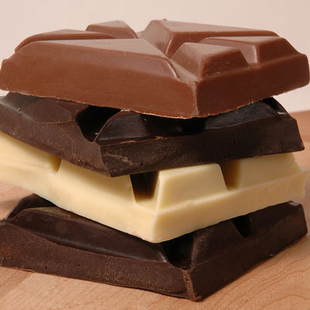
Vocabulary is like chocolate:
To experience it completely, you need to feel it in your mouth.

Slide 43
How Do Your Students Talk?
What opportunities do they have to use academic language to discuss content?
Students must
“SEE, HEAR, SAY and USE”
vocabulary to learn it.
Notes:
10:2
Beck and McCowan

Slide 44

Lets look at some of our new vocabulary words in depth.
Notes:
Have posters around the room and put together groups or pairs to go to each poster to study four of the vocabulary words shared earlier. Don’t discuss, just have groups go through the activities. (notice not all words are used – this is intentional).

Slide 45
Building Academic Vocabulary

Slide 46
Reading comprehension and vocabulary knowledge are highly correlated with one another, and that knowledge of individual word meanings accounts for as much as 50-60 percent of the variance in reading comprehension.
http://www.childrenofthecode.org/interviews/risley.htm
                Stahl & Nagy, 2006
Notes:
Interview between Todd Risley and David Boulton regarding Learning to Read: From www.childrenofthecode.org
Warning: some of the terms he uses are outdated, not politically correct. “Welfare” vs. low SES, but the information is interesting. Also, this is advertisement for the book, so we have to look past that.
10:2: What is your reaction to this video?
Vocabulary underlies Literacy:
Dr. Todd Risley: The relevance of this work to reading and literacy is fairly new. In other words, again, people are talking about it in terms of development of early vocabulary and growth and learning to read and breaking the code. If you already had the oral vocabulary, you knew the words you were reading, you experienced them as part of your oral vocabulary, then reading was easy.
David Boulton: Well, it's easier, right, because it’s easier for the code assembly and word recognition processes to snap into coherence rather than having to fuzz about in whether or not it's a word or not a word, because you've never experienced it before.
Dr. Todd Risley: Yes. There isn't any built-in confirmation of breaking the code.
David Boulton: Right.
Dr. Todd Risley: Well, reading is not my area, but it was the relevance of that that people have begun to pick up and point out now.
Learning to Read:
David Boulton: It’s interesting that you bring in affects. Our view is that children are experiencing an artificial and unnatural form of confusion involved in using this code to create the virtual reality experience we call reading. It’s an artificial, code-induced, instructed, and informed assembly that depends on their level of oral language proficiency, and how well it matches up to whatever it is they're attempting to read.
Dr. Todd Risley: Right.
David Boulton: And worse than this confusion, which is its own class of challenge, unprecedented in the evolutionary development of our brains is the context that they experience this confusion in causes them to feel like the confusion is a reflection of some fault in themselves.
Dr. Todd Risley: Right.
David Boulton: That precipitates the triggering of the affect shame. The more that it triggers, the easier it triggers, and then what we've got is a preconscious shame aversion to confusion. It decapitates learning.
Dr. Todd Risley: Right, right.
David Boulton: I mean, our concern with reading has less to do with the utility skill that's acquired -- for those that acquire it, that's great -- but rather to do with the negative collateral consequences to the kind of cognitive schema, the maladaptive, cognitive automations that form in children who shame-out along the way.
The relationship with what we saw the parents doing, the extra talk before the children were three, and the Peabody Picture Vocabulary Test scores at age nine in the third grade, is .77.
Vocabulary underlies Literacy:
Dr. Todd Risley: The relevance of this work to reading and literacy is fairly new. In other words, again, people are talking about it in terms of development of early vocabulary and growth and learning to read and breaking the code. If you already had the oral vocabulary, you knew the words you were reading, you experienced them as part of your oral vocabulary, then reading was easy.
David Boulton: Well, it's easier, right, because it’s easier for the code assembly and word recognition processes to snap into coherence rather than having to fuzz about in whether or not it's a word or not a word, because you've never experienced it before.
Dr. Todd Risley: Yes. There isn't any built-in confirmation of breaking the code.
David Boulton: Right.
Dr. Todd Risley: Well, reading is not my area, but it was the relevance of that that people have begun to pick up and point out now.

Slide 47
Meaningful Differences
And the finding is heartbreaking that by the time the children were 3 years old, parents in less economically favored circumstances had said fewer different words in their cumulative monthly vocabularies than had the children in the most economically advantaged families in the same period of time.
                Betty Hart and Todd Risley
Notes:
The task we have is daunting.
“Given the consistency we saw in the data, we might venture to extrapolate to the first 3 years of life. By age 3 the children in professional families would have heard more than 30 million words, the children in working-class families 20 million, and the children in welfare families 10 million. Hart and Risley, Meaningful Differences
Interview between Todd Risley and David Boulton regarding Learning to Read: From www.childrenofthecode.org
www.childrenofthecode.org/interviews/risley.htm
Vocabulary underlies Literacy:
Dr. Todd Risley: The relevance of this work to reading and literacy is fairly new. In other words, again, people are talking about it in terms of development of early vocabulary and growth and learning to read and breaking the code. If you already had the oral vocabulary, you knew the words you were reading, you experienced them as part of your oral vocabulary, then reading was easy.
David Boulton: Well, it's easier, right, because it’s easier for the code assembly and word recognition processes to snap into coherence rather than having to fuzz about in whether or not it's a word or not a word, because you've never experienced it before.
Dr. Todd Risley: Yes. There isn't any built-in confirmation of breaking the code.
David Boulton: Right.
Dr. Todd Risley: Well, reading is not my area, but it was the relevance of that that people have begun to pick up and point out now.
Learning to Read:
David Boulton: It’s interesting that you bring in affects. Our view is that children are experiencing an artificial and unnatural form of confusion involved in using this code to create the virtual reality experience we call reading. It’s an artificial, code-induced, instructed, and informed assembly that depends on their level of oral language proficiency, and how well it matches up to whatever it is they're attempting to read.
Dr. Todd Risley: Right.
David Boulton: And worse than this confusion, which is its own class of challenge, unprecedented in the evolutionary development of our brains is the context that they experience this confusion in causes them to feel like the confusion is a reflection of some fault in themselves.
Dr. Todd Risley: Right.
David Boulton: That precipitates the triggering of the affect shame. The more that it triggers, the easier it triggers, and then what we've got is a preconscious shame aversion to confusion. It decapitates learning.
Dr. Todd Risley: Right, right.
David Boulton: I mean, our concern with reading has less to do with the utility skill that's acquired -- for those that acquire it, that's great -- but rather to do with the negative collateral consequences to the kind of cognitive schema, the maladaptive, cognitive automations that form in children who shame-out along the way.
The relationship with what we saw the parents doing, the extra talk before the children were three, and the Peabody Picture Vocabulary Test scores at age nine in the third grade, is .77.
See www.childrenofthecode.org/interviews/risley.htm

Slide 48
Tiered Words that can help close the Achievement Gap
Supporting students with limited language for the MSP
Migrant and ELL Populations
Notes:
Dawn will design this piece. Differentiate between tier 2 & 3 words.

Slide 49
Instructional Strategies for Academic Vocabulary (?)
A – I’ve seen it done
C – I confess – I’ve done it
B – I’ve seen it done too often
D – Do people really do this?!?
5. Look up vocabulary words in the dictionary and copy the definitions.
4. Use vocabulary words in a sentence.
3. Have students write out vocabulary lists.
2. Have students write the words in their vocabulary lists multiple times.
1. “If I speak slower and louder, they’ll learn it.”
Notes:
David Letterman style:
Top 5 instructional strategies for teaching academic vocabulary:
#5 Look up vocabulary words in the dictionary and copy the definitions.
#4 Use vocabulary words in a sentence.
#3 Have students write out vocabulary lists.
#2 Have students write the words in their vocabulary lists multiple times.
#1 “If I speak slower and louder, they’ll learn it.”

Slide 50
Vocabulary knowledge is the single greatest contributor to reading comprehension and thus a strong predictor of overall academic achievement.
--Kate Kinsella, Isabel Beck, Robert Marzano,
Doug Fisher, et. al.
Notes:
Duh! Like this is so obvious. We are starting with vocabulary because it is the key to access the content we know and love so dearly.

Slide 51
What is academic vocabulary?
Thinking of words as belonging in three tiers—Tier 1, Tier 2, and Tier 3—can help deepen and refine our understanding of academic vocabulary and help us decide which words are worth teaching.
Notes:
Sandi

Slide 52
The Importance of Selecting the “Right” Words
So many words, …so little time!
310 words make up about 50% of words in text.
We often find ourselves teaching the rare words that only occur in 10% of text!
The trick is to teach the middle of the pyramid.
Zeno et al., 1995
Notes:
Texts have you focus on the top 10% of words, the “sexy” words
We need to teach like a hamburger—the middle; the patty; the sauce that connect it to bun;

Slide 53
Tier 1: The most basic words
Examples—
table
happy
baby
nose
purple
angry
hamburger
Notes:
Survival English
Isabel Beck Bringing Words to Life and others including Kate Kinsella, Robert Marzano, and Doug Fisher, Nancy Frey
It is necessary to know if your migrant students/ ELL students know these words, but can be taught quickly through conversation and real objects/pictures.
Most Tier one words are learned through spoken/everyday language. Just because your students can speak in conversational English does not equal understanding of academic language.

Slide 54

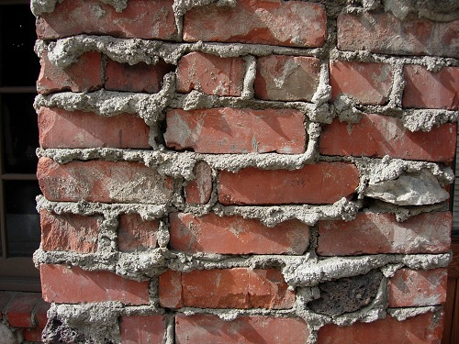
Academic Vocabulary
Content specific vocabulary
brick words = Tier 3
Transportable vocabulary
mortar words = Tier 2
(words that are used across
the curriculum in multiple
disciplines)
Notes:
Language is necessary to succeed in school.
Mortar words can get very messy to identify sometimes
So Which Words do you teach?

Slide 55

Tier 3 (brick words):
Low frequency words specific to a discipline
Examples—
deposition
ecosystem
constellations
population
producer
consumer
transformation
Notes:
These are infrequent words that are often content driven. It is best to directly teach using student friendly definitions often at the time of occurrence.
These are from the Science exemplars from Common Core
We usually teach these directly (or through experiences), we talk about what the word is and then we move on.

Slide 56
Tier 2 mortar words:
High frequency words found across a variety of disciplines
Examples—
classify
conduct
monitor
investigate
conclude
record
observe
Notes:
Importance and utility: Is it a word that students are likely to meet often in the world?
Instructional potential: How does the word relate to other words, to ideas that students know or have been learning?
Conceptual understanding: Does the word provide access to an important concept?
There are around 85,000 words- 7,000 of those are Tier 2 Words-So if you think about how many to teach over the course of 12 years of instruction there are simply too many words to teach- So which ones do you pick?
Words with high utility and provide help to develop concepts. Caption!

Slide 57
Academic Vocabulary
… is not unique to a particular discipline and as a result are not the clear responsibility of a particular content area teacher. What is more, many Tier Two words are far less well defined by contextual clues in the texts in which they appear and are far less likely to be defined explicitly within a text than are Tier Three words. Yet Tier Two words are frequently encountered in complex written texts and are particularly powerful because of their wide applicability to many sorts of reading. Teachers thus need to be alert to the presence of Tier Two words and determine which ones need careful attention.
Common Core State Standards (English Language Arts, Appendix A)
Notes:
Also, the ones that need special attention may be the words that have different meanings across different content areas or different contexts; (table vs table)

Slide 58
Criteria for identifying Tier II Words…
Importance and utility: Is it a word that students are likely to meet often in the world?
Instructional potential: How does the word relate to other words, to ideas that students know or have been learning?
Conceptual understanding: Does the word provide access to an important concept?
Notes:
Tier 2 is not necessarily a new concept, but may be an extension of another word or relate to another word (e.g., walk vs saunter) it provides more sophistication;

Slide 59
Try it….
Johnny Harrington was a kind master who treated his servants fairly. He was also a successful wool merchant, and his business required that he travel often. In his absence, his servants would tend to the fields and cattle and maintain the upkeep of his mansion. They performed their duties happily, for they felt fortunate to have such a benevolent and trusting master.
Which words are Tier 2?
Activity excerpted from Beck, McKeown, & Kucan, 2002, p. 16
Notes:
Get out handout and read it. Identify which words you think are Tier 2 words.
It’s important to note that we don’t always agree with what’s a tier 2 word and that’s OK.
Tier 2 words don’t differentiate between Kinder and HS. They are words that span the whole grade level gamut.

Slide 60
Do your selections agree?
Johnny Harrington was a kind master who treated his servants fairly. He was also a successful wool merchant, and his business required that he travel often. In his absence, his servants would tend to the fields and cattle and maintain the upkeep of his mansion. They performed their duties happily, for they felt fortunate to have such a benevolent and trusting master.
Notes:
These are words that a student might already have another word for like benevolent…they likely know “kind”…a simpler word. So by learning Tier II words, they gain more sophistication in their vocabulary.

Slide 61
Tier Two Words
Merchant
Required
Tend
Maintain
Performed
Fortunate
Benevolent
Students’ likely know it as:
Salesperson or clerk
Have to
Take care of
Keep going
Did
Lucky
Kind
Notes:
One test of whether a word meets the Tier Two criterion of being a useful addition to students’ repertoires is to think about whether the students already have ways to express the concepts represented by the words. Would the students be able to explain these words using words that are already well known to them? If that is the case, it suggests that the new words offer students more precise or mature way of referring to ideas they already know about.
Adding these target words will allow students to describe with greater specificity people and situations with which they are already familiar.
NOTE these words are not simple synonyms, instead they represent more precise or more complex forms of the familiar words.

Slide 62
Some Criteria for Identifying Tier Two Words
Importance and utility: Words that are characteristic of mature language users and appear frequently across a variety of domains.
Instructional potential: Words that can be worked with in a variety of ways so that students can build rich representations of them and of their connections to other words and concepts.
Conceptual understanding: Words for which students understand the general concept but provide precision and specificity in describing the concept.
Notes:
Review Criteria one more time and then have participants practice finding the Tier 2 words in the handout. First do it individually, then as a group. As they move to group work, introduce the EL Achieve Cards

Slide 63
Using Discussion Cards…
Agree/ Disagree Statements
Simple: “I agree because…”
Sufficient: “I don’t think that’s right since…”
Sophisticated: “Another way to look at it is…”
Share Your Thinking
Simple: “In my opinion…”
Sufficient: “I have an idea. What if…”
Sophisticated: “It occurred to me that…”
Notes:
We want to encourage our students to use the new words orally. Remember that statistic earlier today? We don’t our students to spend 98% of the time not speaking about the content they are studying in class.
The discussion cards give non-English speakers a place to start thinking and talking aloud with partners. -Lets give it a try.
You will notice on the discussion cards different symbols, those symbols represent simple, sufficient and sophisticated levels of language. Try with your partner with some statements with either the agree/disagree card or the share your thinking card.
Share your thinking about the vocabulary identified as Tier 2 in the Johnny Harrington example and state your opinions using one of the sentence starters on the Agree/Disagree cards or the Share Your Thinking cards.

Slide 64
Isabel Beck’s Steps to Vocabulary Study:
Introduce new words within a context
Provide friendly explanations
Provide an additional context for the word
Provide opportunities for students to actively process word meanings
Provide for a high frequency of encounters over time
Notes:
At early elementary, they are not yet reading themselves, the teacher is reading aloud, so they should encounter the words first and then quickly process the word meaning, but don’t teach first before the encounter.

Slide 65



1. Introducing vocabulary within a context
1. Introduce new words within a context
Notes:
At early elementary, they are not yet reading themselves, the teacher is reading aloud, so they should encounter the words first and then quickly process the word meaning, but don’t teach first before the encounter.

Slide 66
2. Provide friendly explanations:
The Problem with Dictionary Definitions:
Sixty-three percent of the students’ sentences were judged to be “odd”
Sixty percent of the students’ responses were unacceptable
Students frequently interpreted one or two words from a definition as the entire meaning.
(Miller & Geldea, McKeown, and Scott & Nagy)
Notes:
The word “tamper” is one example of a word that can be easily misunderstood by students. The dictionary definition is “Tamper: to interfere in a secret or incorrect way.;
Based on that definition, some student-generated sentences are: “My friend tampered me a surprise.” “My sister tampers when my friends come to visit.” “The band tampered bad.” These sentences are based on only one part of the definition because the students have hooked onto the words “secret” or “incorrect.”
A more student friendly definition of “tamper” is: to change something secretly so that it does not work properly or becomes harmful. This gives more information so the students can understand how the word is used more correctly.

Slide 67
Examples: Devious & Vicarious
Devious
Vicarious
Dictionary definition: straying from the right course; not straightforward
Student sentence: He was devious on his bike.
If someone is devious, he is using tricky and secretive ways to do something dishonest.
Dictionary definition: felt by sharing in others’ experiences
Student sentence: We had a vicarious time at my friend’s birthday party.
Friendly definition: If someone is getting a vicarious feeling, she is sharing an experience by watching or reading about it.
Notes:
Other examples of dictionary definitions and how they can be misinterpreted by students.

Slide 68
Developing Student-Friendly Definitions
Characterize the word
  How is it typically used?
  When do I use this word?
  Why do we have such a word?
Explain the meaning in everyday language
  Develop it in a way so students attend to the whole explanation, rather than just one word
  Word it in a way that reflects its part of speech
  “Somebody who…”
  “Describes something that…”
  “To do something in a ___ way”
Notes:
“It’s best to start students off with a strong focused concept of what a word means rather than draw attention to multiple senses of meaning. Rather than dealing with too much information at the outset, language used can more readily extend a concept as their use of it grows.” BWTL, p. 33
Example: tamper – Dictionary definition is “to interfere in a secret or incorrect way.” This doesn’t seem to really get at what we think of when we use the word tamper.
Student Friendly Explanation: “To change something secretly so that it does not work properly or becomes harmful.”

Slide 69
3. Provide an additional context for the word
Often, learners limit their use of the word to the contexts in which they were introduced.
To avoid this, present some other contexts in which the word could be used.
Notes:
For example, in the story Bremen-town Musicians (Plume, 1998) the word exhausted is used after some animals chased robbers away. “They felt so exhausted they had to rest.” Students might tie being exhausted with being chased. So examples might be being exhausted in the morning after staying up late or after baby-sitting all day for a younger cousin.
Trepidation used in “The Wisdom of Goats” (Clough, 2005.) An old goat feels trepidation as he walks to the village to tell the mayor that a storm is coming. The goat’s trepidation stems from his anticipation that no one will believe him and he will be ridiculed. T avoid the definition to be limited to being scoffed at, present other contexts such as entering a house that is supposed to be haunted or giving a speech in from of the whole school.

Slide 70
You Try It:
Create student friendly definitions for the following words.
Add an additional context for each word.
disrupt - break up; split
illusion - appearance or feeling that misleads because it is not real
morbid - not healthy or normal
(Try to include the words something, someone, or describes in your explanations.)
Notes:
These are the dictionary definitions; You will write a student friendly definition;
Do individually (5 minutes?) and then have them discuss in pairs; have your group discuss at table and agree upon your final definition (that you all agree on) for each word; write the agreed upon definitions on the yellow paper;
The person who drove the shortest distance to get here today will be the one to share;

Slide 71

4. Provide opportunities for students to actively process word meanings
One way to do that is to provide meaning through Instructional contexts.
How do you do that?

Slide 72
Provide Meaning Information through Instructional Contexts
Describe a situation that leads the students to understand the meaning of the word.
Develop a definition or explanation of the target word that is clear and explicit.
Have students explain their thinking and explain the parts of the situation that helped him or her figure out the definition.
Model thinking aloud this kind of explanation, but use it sparingly so students do most of the explaining.

Slide 73

Instructional Contexts: obstinate
“The rider couldn’t control the obstinate horse. She was getting angry that this horse acted this way often.”
  First step is teacher modeling
Notes:
Teacher model: Obstinate must mean something that a horse could be, and it has to be something that would make a horse hard to control. Maybe scared, a horse can be scared, and because he was scared, he might act up and be hard to control. But it says the horse acted this way often and that the rider was angry about it. I don’t think a rider would be angry at a scared horse. Obstinate must be a way a horse acts that riders don’t like. It could mean stubborn, because horses can get stubborn and some horses can get stubborn often. When they do, it’s hard for a rider to get the to do what she wants.
***This type of model/scaffold should be used infrequently as it puts the students in a passive rather than active learning role.
Model a think aloud…
It’s OK to come with a wrong definition at this point;
We will work our way around to the right definition

Slide 74
Instructional Context: Eavesdrop
“The train ride had been long, and I was tired of looking out the window. So I decided to eavesdrop on what two of the passengers sitting behind me were saying. I knew what they were saying was none of my business, but it might be interesting, so I tried to listen.”
  What is this person up to? What told you that?
  What’s this about it was none of his business?
  So, eavesdropping means what kind of listening?
Notes:
Move to asking the students questions to get them to derive word meaning from instructional contexts.
This is cumbersome with any regularity, but should be done often in the beginning so that students begin to use their thinking on their own to find meaning;

Slide 75
Instructional Context: Edible
“Please don’t eat the flowers, sir,” said the waiter. “I don’t think they are edible! They might make you sick!”
  What is the waiter telling the man about the flowers?
  If eating them might make you sick, what does that tell you?
  So, if you shouldn’t eat things that are not edible, what does edible mean?
Notes:
Ask participants to get out their agree/disagree or Ask a Question card. Then lead through the questions – call on participants. The second and third responders should use their cards rather than say, “He/she already said what I was going to say…”

Slide 76
4. Provide opportunities for students to actively process word meanings
4 ideas for doing this:
Word Associations
Have you Ever…?
Applause, Applause!
Idea Completions
Notes:
These are 4 suggested activities from Isabel Beck.

Slide 77
Engaging Students in Dealing with Word Meanings
Word Associations: After studying explanations for accomplice, virtuoso, philanthropist, and novice:
Students answer and explain their answer:
  Which word goes with crook?
  Which word goes with “gift to build a new hospital”?
  Which word goes with piano?
  Which word goes with kindergartener?
Notes:
After they verbally shared (whole group) the answers to these questions, she prompted participants to write word associations for their three words. We want the students to GET ENGAGED with these words.
E.G., Which word goes with fire drill? (disrupt) Why? Because when the fire drill sounds I must go outside and it disrupts my learning
Which word goes with death? (morbid) Why? Because to somepeople death is creepy.
Which word goes with Halloween? (illusion) Why? Because everyone dresses up as someone else and you don’t know who they are.

Slide 78
Engaging Students in Dealing with Word Meanings
Have you ever …?
  Describe a time when you might have been an accomplice to someone.
  Describe a situation when you might be a novice.
Notes:
This activity helps students to associate newly learned words with contexts and activities from their own experiences. It helps students understand that they have a place for the new words in their vocabularies
“When you respond, please use the word accomplice in your sentence.” (This reminds me of GLAD when they come up with an oral sentence that tells me that you know what the word means.)
Now it’s your turn…take your three words and create 3 “Have you ever…” You will be writing the prompts for your three words (morbid, illusion and disrupt)
(I would make four handouts (one per strategy) with the strategy and example at the top, then blank space to apply the strategy to their three words (morbid, illusion and disrupt)

Slide 79
Engaging Students in Dealing with Word Meanings
Applause, Applause!
  Clap to show…
  How much would you like …
  Being suspected of being an accomplice
  Having philanthropists as relatives
  Being described as a novice soccer player
Notes:
Ask participants to clap in order to indicate how much they would like (not at all, a little bit, a lot) to be described by the target words. After each word – be sure to ask why – Students must use the word in their answer… ex, “ I would not like to be called a novice because…”

Slide 80
Engaging Students in Dealing with Word Meanings
Idea Completions
  The audience asked the virtuoso to play another piece of music because …
  The skiing teacher said Maria was a novice on the ski slopes because…
Notes:
Rather than asking students to write a sentence using the new word which can result in meaningless use (e.g. “I saw a virtuoso”), provide students with sentence stems that require them to integrate a word’s meaning into a context in order to explain a situation.

Slide 81

You Try It
Using the words disrupt, illusion, and morbid develop instructional contexts.
Word Association
Have you ever…?
Applause, Applause!
Idea Completions
Notes:
Examples in student handout should participants need to review the techniques –
Word Associations – page 2 – Word Association: Variation 1
Have you ever …? –page 4 –Generating Situations, contexts, and examples: Variation 2
Applause, applause – page 6 –Word Relationships: Variation 5
Idea completions – page 6—Writing: Variation 1
Do in pairs, then in table groups. Each table group share one technique from each type.
Next, do vocabulary test of target words. (Before lunch)

Slide 82
Classic Vocabulary Test!
Write down the definition of each of these words –
dringle
kvetch
tittynope
fliver
snood
oojah
hobbledehoy
inglenook
jobberknowl
snollygoster
borborygmus

Slide 83
CCSS necessitates a shift in the way we teach vocabulary.
A discussion between NYS Commissioner of Education John B. King Jr., David Coleman (contributing author to the Common Core) and Kate Gerson (a Sr. Fellow with the Regents
Shift 6: Academic Vocabulary
  http://www.brockport.k12.ny.us/m/content.cfm?subpage=18527
Notes:
Show just after lunch as people are returning.
Also a good time to talk about results of the vocabulary test.
Show MEP Clearinghouse and especially the Math Vocabulary Cards that can be a resource for ELLs, for Anchor Charts, etc.
Can do Students of Stemville activity not done before.

Slide 84
Vocabulary Building
Example

Slide 85
Vocabulary in Practice
Read the sample test questions from the MSP or EOC.
  Create 3 lists of words:
    Tier One
    Tier Two
    Tier Three
  Choose 5-10 words you want to focus on
Notes:
In job alike groups, have groups read through the exemplars for each grade/subject (upper elementary, middle school, hs). Have groups create posters that include Tier one words ELL students may not know, Tier two words, Tier three words. Groups should work together to determine which tier two words are worthy of instruction. Choose 7-10 words.
Have groups report out which words they determined and explain why.

Slide 86
Introducing the Words
Contextual the word-describe how the word or concept is used.
Provide a student friendly explanation.
Present an alternative context for the word-provide a sentence that shows how each word can be used in a context or situation that is not the same as the one in the text.
Invite students to interact with the word in a meaningful way.
Notes:
Step one – return to the text to see how the word is used – put into words the students can understand
Step two – create student friendly definitions
Step three – create another context for the word – students often limit the use of a new word to the context in which they first encountered it. Important to provide another context so students understand features/facets of the word.
Step four – Up to this point, the students have only listened. So we want to create an activity in which students DO something to actively engage with the words meaning. If student’s don’t DO something, it is questionable whether much learning can occur.
Lead participants through steps one – three above with the words they choose from the previous activity. We will look at engagement activities next.

Slide 87
Engagement with the Words
Example/non-example
  Present items that ask students to distinguish between an example of a word and a non-example of a word. Both the example and non-example should be designed to present situations that have similar features and therefore require student thinking that zeros in on the meaning of the target word.
Notes:
Distribute the Example/non-example work sheet. Invite participants to look at the five variations of example/non example and create at least one activity per variation for any of their target words.

Slide 88
Engagement with Words
Word Associations – this is another type of activity that gives students something to respond to by relating what is presented with one of the target words.
Notes:
Distribute the Word Associations work sheet. Invite participants to look at the three variations of word associations and create at least one activity per variation for any of their target words.

Slide 89
Engagement with Words
Generating Situations, Contexts, and Examples – here students are not provided with choices as in the previous two activities. Instead, students are asked to generate appropriate contexts or situations for statements or questions about their words.
Notes:
Distribute the Situations/contexts/examples work sheet. Invite participants to look at the five variations and create at least one activity per variation for any of their target words.

Slide 90
Engagement with Words
Word Relationships – Having students think about and respond to how two words might be related is a strong activity for developing rich word knowledge. Working with two words and how their meanings and features might interact prompts students to explore novel contexts for the words and guild new connections.
Notes:
Distribute the Word Relationship work sheet. Invite participants to look at the six variations and create at least one activity per variation for any of their target words.

Slide 91
Engagement with Words
Writing-As students move beyond early elementary grades, students will surely use their vocabulary words in writing.
Notes:
Distribute the Word Relationship work sheet. Invite participants to look at the six variations and create at least one activity per variation for any of their target words.

Slide 92
Engagement with Words
Returning to the Story Context
Puzzles
Notes:
Distribute the final page of examples but do not need to spend time creating examples.

Slide 93
Additional Strategies
Vocabulary Study Cards
Back of Card
  Synonyms, antonyms
  Original context/source
  Definition
  Teacher example
  Student’s own sentence
  (Kinsella)
Front of Card
  Word
  Part of speech
  Pronunciation
  Related word forms
  First language translation/cognates
Notes:
It seems remiss not to mention a couple of other highly respected vocabulary strategies.
Look at examples of vocabulary cards – discuss cognates and why they are important to be award oe – false cognates. Point to Cognate Handout

Slide 94
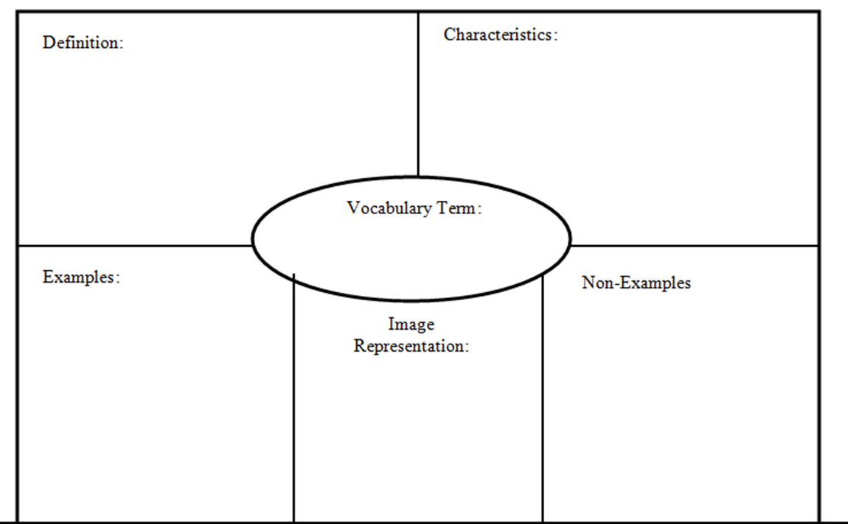
Frayer Model
Notes:
Many variations of Frayer Model – students should be encouraged to use graphics, first language to support their learning. Kate Kinsella always includes an example sentence as well.

Slide 95
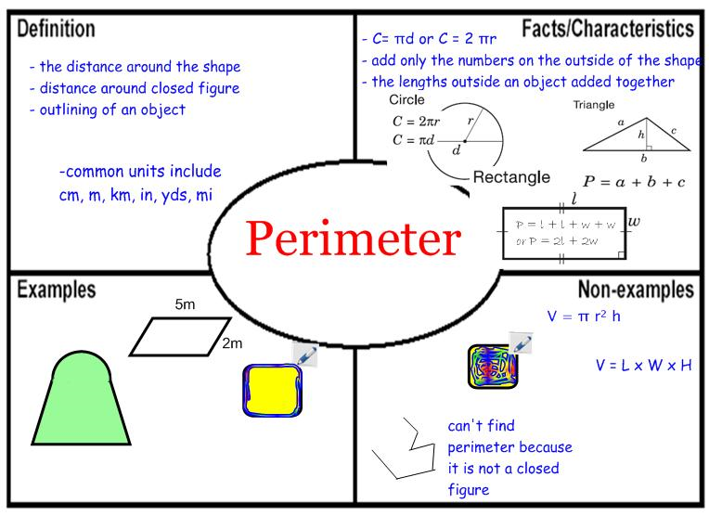
Frayer Model

Slide 96
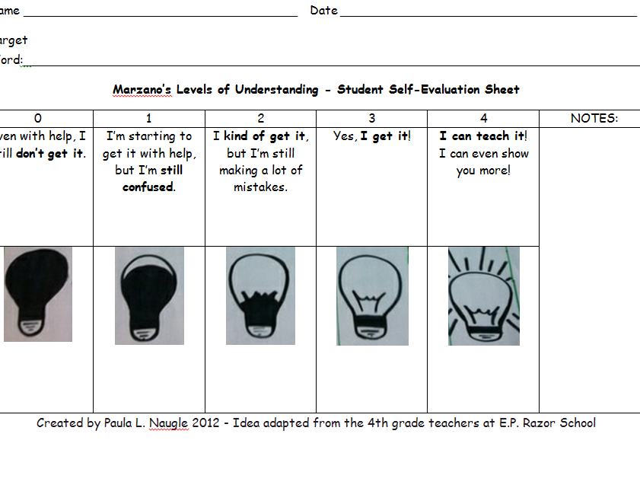
Student Self Assessment
Kinsella
Marzano
Vocabulary Knowledge Rating Sheet: Burning Out at Nine? + = I definitely know it. - = I definitely don’t know it. ? = I’m not sure
Word | Before Reading | After Instruction | After Reading
Similar, adj | +
Participant, n. | ? | +
To attend, v. | - | ? | +
Comparable, adj. | - | ? | ?
Independent, adj. | ? | +
To encourage, v. | +
Creativity, n. | +

Slide 97
OUTCOME OF THIS WORKSHOP
Did we meet our outcomes?
Participants will know how to select academic vocabulary words and implement 2-3 new strategies to support migrant students in their academic vocabulary development.

Slide 98
Thought for the day:
When was the last time you did something for the first time?

Slide 99
Evaluations
Will you commit to trying something new to teach academic vocabulary?
What will you do?
Clock Hour
OSPI MEP Evaluation
  http://www.mdsr.org/evaluations

Slide 100
THANK YOU for coming today!
Please contact us with any questions or comments you might have.

