Slide 1
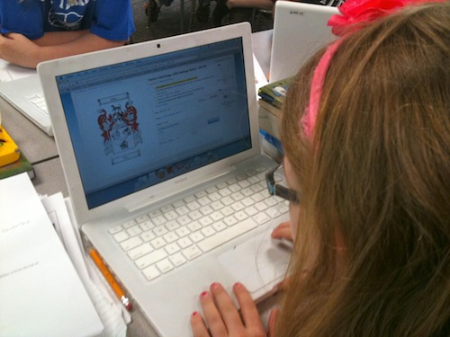
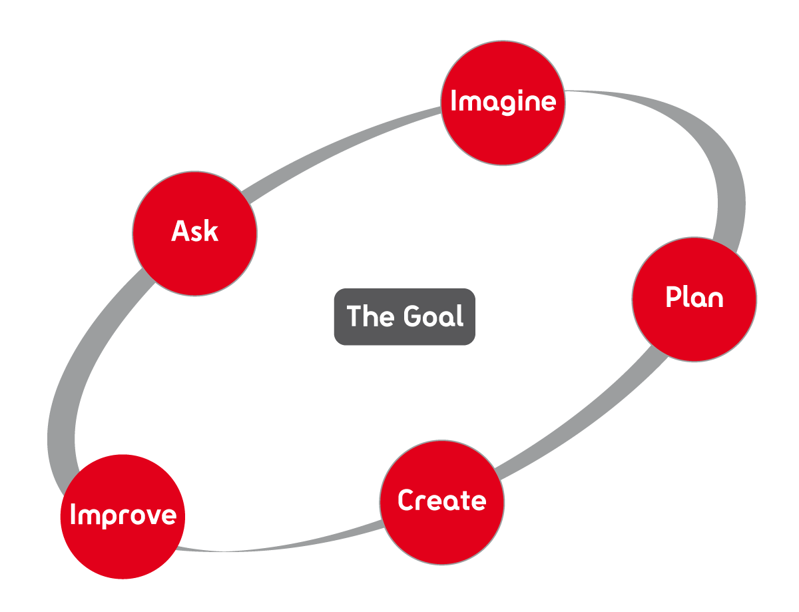
The Important Book About Materials Engineers
Research & Explore
Determine Problem
Evaluate/Redesign
Test
Written by Maria Villalovos

Slide 2
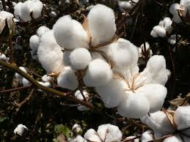
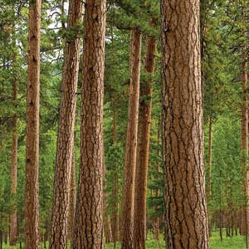
The important thing about materials engineers is that they work with the materials used to make different kinds of technologies.
A material is something you can use to create things.

Slide 3
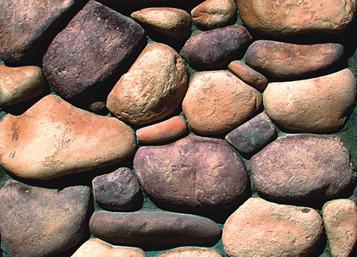
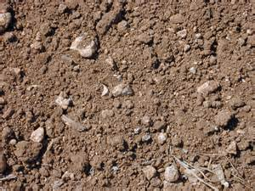
Earth materials include solid rocks, sand, soil, water and the atmosphere.
Rocks & gravel
Sand
Soil
Water
Atmosphere

Slide 4
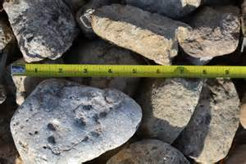
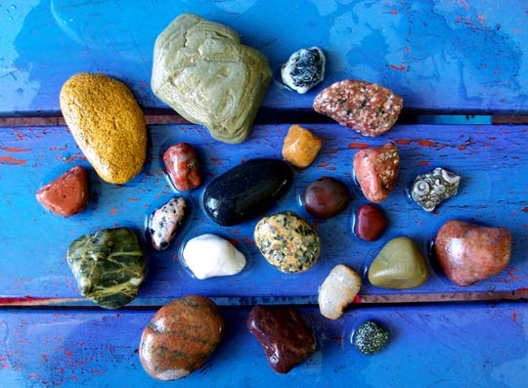
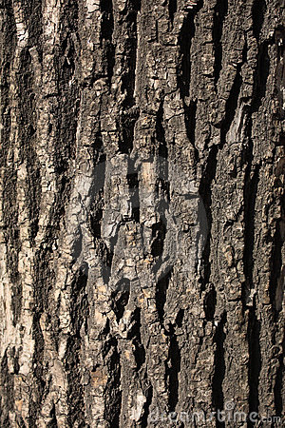
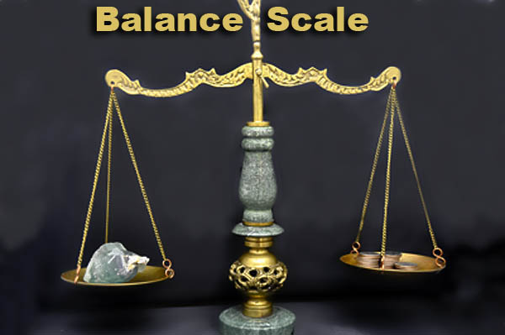
Materials have different observable physical properties such as size, weight, color, shape and texture.
Rocks come in all sizes
Different colored rocks
Light and heavy materials
Rough tree bark
But the important thing about materials engineers is that they influence almost every man-made object.

Slide 5
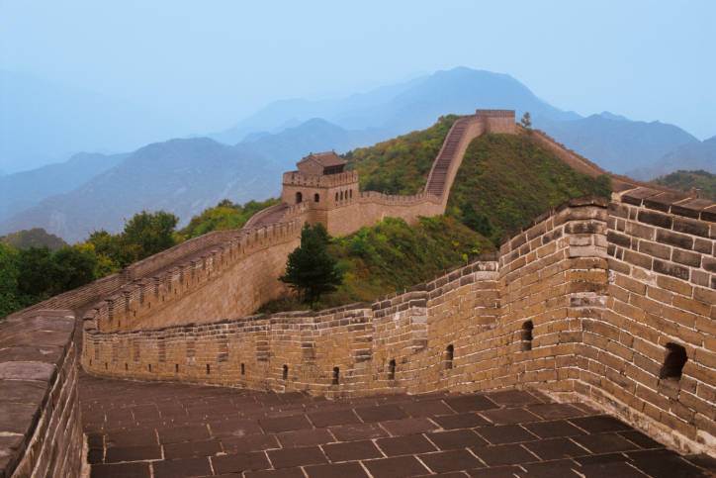
The important thing about materials engineers is that they work with the materials used to make different kinds of technologies.
Technology involves changing the natural world to meet human needs or wants.
The Great Wall of China was built to protect China from its enemies.
Cellular phones allow people to stay in communication with others. Today’s cellular phones even allow people to access the Internet.
People in different countries use different materials to build their houses.

Slide 6
The engineering design process is a set of steps that materials engineers take to solve a problem or meet a certain need.
RESEARCH/ EXPLORE
DETERMINE PROBLEM/NEED
PLAN/DESIGN
REDESIGN
CREATE/TEST

Slide 7
Materials engineers have a lot to think about and must answer certain questions throughout the engineering design process.
What is the problem?
What have others done?
What are the constraints?
Ask
What are some solutions? Brainstorm ideas.
Choose the best one.
Imagine
Plan
Draw a diagram.
Make a list of materials you’ll need.
Create
Follow your plan and create it. Test it out!
Improve
Make your design even better. Test it out!
But the important thing about materials engineers is that they influence almost every man-made object.

Slide 8
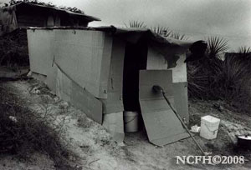
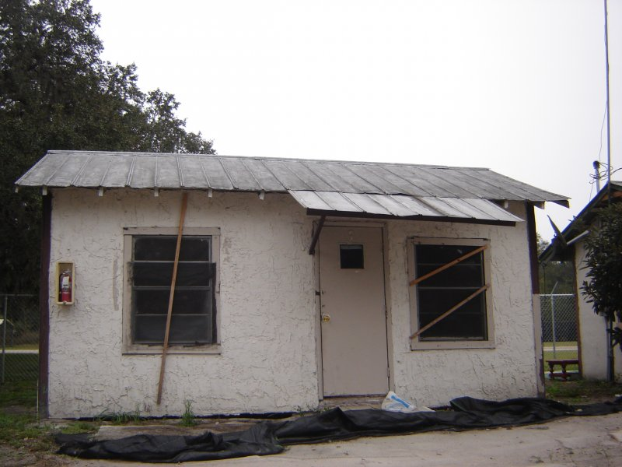
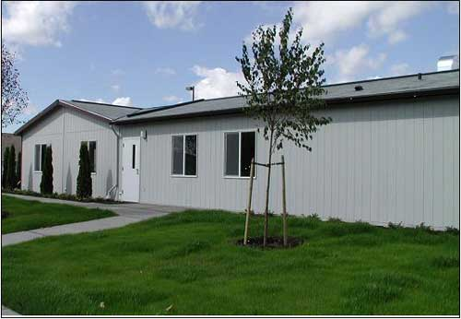
The important thing about materials engineers is that they work with the materials used to make different kinds of technologies.
Development involves the changing and improving of a solution, and it continues throughout the design process, often even after a product ships to customers.
The materials used for the homes of people who travel for work, also known as migrant workers, have improved over time so that they can live comfortably.

Slide 9
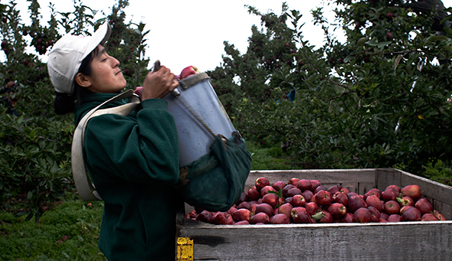
But the important thing about materials engineers is that they influence almost every man-made object.
What types of technologies do you see in these pictures?
Remember that technologies meet a human need or want.

Slide 10
The important thing about materials engineers is that they work with the materials used to make different kinds of technologies.
Materials engineers present their information by making a claim, providing evidence, and reasoning to make a valid explanation.

Slide 11
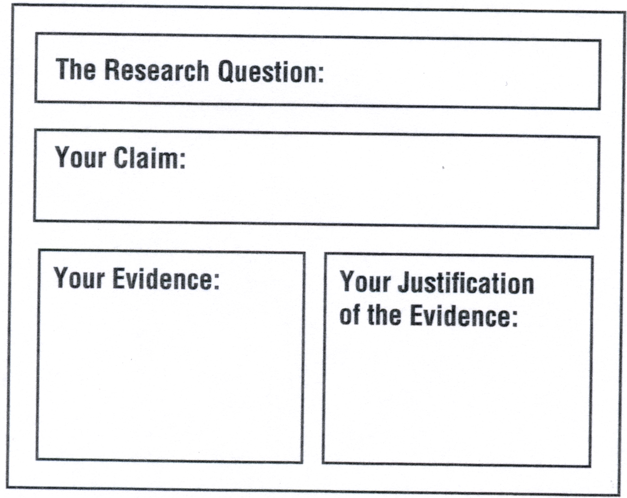
In a science class or in the workplace, materials engineers organize their work in a way that includes the parts shown below.
But the important thing about materials engineers is that they influence almost every man-made object.

