Slide 1
Migrant Graduation Specialist and Student Advocates
October 10th
8:45 – 1:00 p.m.
Title I, Part C, Migrant Education Program
Notes:
Good morning and thank you for all who are joining us today. We understand the need to work directly with students, and want to support your efforts. In doing so, today’s webinar is scheduled to take place from 10:00 a.m. to noon.
After noon, SEMY staff will be available to answer additional questions.

Slide 2
Thank you for coming!
Appreciation to OSPI, Migrant Education
Helen Malagon
Sylvia Reyna
Lupe Ledesma
Sunnyside School District
Dr. Richard Cole
MSDR
Lee Campos
Heather Garcia Mendoza

Slide 3
Segment 1: MGS/MSA Roles and Responsibilities
Large Group Activity – Fiesta Time
Migrant Students at a Glance…
Academic Press, Social Support, Relational Trust – A Research Based Model
MGS/MSA Roles and Responsibilities
MGS/MSA Time Management Activity – Slice of Life
Notes:
Today we will be reviewing the following topics:

Slide 4
Major Functions Listed in New MGS - MSA Job Descriptions
MGS/MSA Job Descriptions
Definition of a Migrant Student
Seven Areas of Concern

Slide 5
Title I, Part C, Migrant Education Program Migrant Graduation Specialist Job Description
SEE HANDOUT
General Description: The graduation specialist will act as a liaison and facilitator to school counselor for migrant students to
successfully transition to next grade level, complete high school, and transition to postsecondary education or employment.
The specialist will: (MGS)
Implement a case management model focused on providing supplemental support and intervention strategies to address the unique needs of migrant students.
Work with the district’s Migrant Education Federal Program’s director and school staff to identify and establish program and student goals in alignment with the district’s local plan and the State Service Delivery Plan.
Coordinate and ensure access to other services migrant students may be eligible and entitled to receive.
Requirements: (MGSr)
Teaching credential or bachelor’s degree in a related field.
Experience working with at-risk migrant students and families.
Knowledge of secondary school programs and state and local graduation requirements.
Written and verbal communication skills in English and primary language of target population (e.g., Spanish, Russian).
Knowledge of basic computer software programs (e.g., Microsoft Word, Excel, PowerPoint).
Experience working independently, semi-independently, and in collaborative teams.
Human relations, time management, and personal organizational skills.
Flexible work schedule.
Preferred Knowledge and Skills: (MGSks)
Knowledge of economic, social, cultural, and psychological factors influencing migrant students.
Experience working with secondary school aged migrant students in an educational setting.
Knowledge of school and community resources available to migrant students and families, including technical education, career awareness, and postsecondary education opportunities.
Major Responsibilities: (MGSmr)
Coordinate with school counselor, teachers, and other appropriate staff to develop a caseload of migrant students most at-risk of not meeting state academic and achievement standards.
Identify the barriers including educational disruption, cultural and language barriers, social isolation, various health-related problems, or other factors that inhibit the ability of selected migrant students to meet state academic and achievement standards.
Work with school counselor and selected students to develop student plans/goals that lead to a successful transition to the next grade level, graduation, and transition to postsecondary education or employment.
Develop mentor relationship with student caseload to facilitate needs of migrant students and their families.
Coordinate access to services available through school district and/or community to reduce and/or eliminate identified barriers.
Coordinate access to services available through school district and/or community that strengthen communication, self-advocacy, and leadership skills.
Facilitate access to school counselor and teaching staff regarding academic needs, including class scheduling to ensure access to required courses for graduation and transition to postsecondary education or employment.
Facilitate understanding by student and family of district requirements toward graduation, including High School and Beyond Plan.
Work with school counselor to monitor attendance, discipline, credits/grades, and other social/academic issues that may impact the student’s ability to successfully transition to next grade level, graduate, or pursue postsecondary opportunities or employment.
Maintain on-going communication with counselor, students, families, and other school staff regarding the progress of the student to achieve established goals and transition to next grade level, graduate, or pursue postsecondary opportunities or employment.
Participate in professional development opportunities to strengthen skills in working with at-risk migrant students including consolidating credits, determining high school of graduation, motivational techniques, and reporting requirements.

Slide 6
Title I, Part C, Migrant Education Program Migrant Student Advocate Job Description
SEE HANDOUT
General Description: The advocate will coordinate and facilitate the academic and support needs of migrant students with
school counselor to successfully transition migrant students to the next grade level, complete high school, and promote the
transition to postsecondary education or employment.
The advocate will: (MSA)
Work with the district’s Migrant Education Federal Program’s director and school staff to identify and establish program and student goals in alignment with the district’s local plan and the State Service Delivery Plan.
Provide supplemental support and services focused on meeting the unique needs of migrant students.
Coordinate services with other resources migrant students may be eligible and entitled to receive.
Requirements: (MGSr)
Experience in an educational or community advocacy-related field.
Experience working with at-risk migrant students and families.
Knowledge of secondary school programs and state and local graduation requirements.
Written and verbal communication skills in English and primary language of target population (e.g., Spanish).
Knowledge of basic computer software programs (e.g., Microsoft Word, Excel, PowerPoint).
Experience working semi-independently and in collaborative teams.
Human relations, time management, and personal organizational skills.
Flexible work schedule.
Preferred Knowledge and Skills: (MGSks)
Knowledge of economic, social, cultural, and psychological factors influencing migrant students.
Experience working with secondary school aged migrant students in an educational setting.
Knowledge of school and community resources available to migrant students and families, including technical education, career awareness, and postsecondary education opportunities.
Major Responsibilities: (MGSmr)
Coordinate with school counselor, teachers, and other appropriate staff to develop a roster of migrant students most at-risk of not meeting state academic and achievement standards.
Identify the barriers including educational disruption, cultural and language barriers, social isolation, various health-related problems, or other factors that inhibit the ability of selected migrant students to meet state academic and achievement standards.
Work with school counselor and selected students to develop student plans/goals that lead to a successful transition to the next grade level and postsecondary education or employment.
Coordinate access to services available through school district and/or community to reduce and/or eliminate identified barriers.
Coordinate access to services available through school district and/or community that strengthen communication, self-advocacy, and leadership skills.
Facilitate access to school counselor and teaching staff regarding academic needs, including class scheduling to ensure access to required courses for graduation and transition to postsecondary education or employment.
Facilitate understanding by student and family of district requirements toward graduation, including High School and Beyond Plan.
Work with school counselor to monitor attendance, discipline, credits/grades, and other social/academic issues that may impact the student’s ability to successfully transition to next grade level, graduate, or pursue postsecondary opportunities or employment.
Participate in professional development opportunities to strengthen skills in working with at-risk migrant students including motivational techniques and reporting requirements.

Slide 7
MGS and MSA Strand and the
Job Description Alignment

Slide 8
Always ask yourself, how does this relate to my students?
MSAmr:2,3,9, MSAr:6&7, MGSmr:2,3,11 MGSr:6&7,
Identify the barriers including educational disruption, cultural and language barriers, social isolation, various health-related problems, or other factors that inhibit the ability of selected migrant students to meet state academic and achievement standards.
Work with school counselor and selected students to develop student plans/goals that lead to a successful transition to the next grade level, graduation, and transition to postsecondary education or employment.
Support migrant student learning and engagement in the classroom by:
Relate classroom learning with real life experiences “experiential learning.”
Use Learning Pyramid to support identification of academic barriers and possible interventions and supports.
Utilize activities to promote individualized identification of barriers, development of student plans/goals, choice making, problem solving, etc.

Slide 9
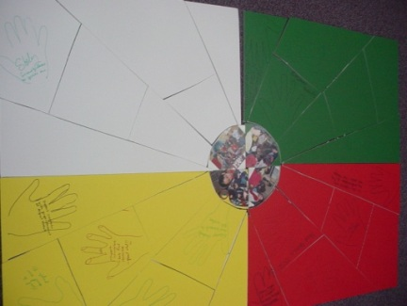
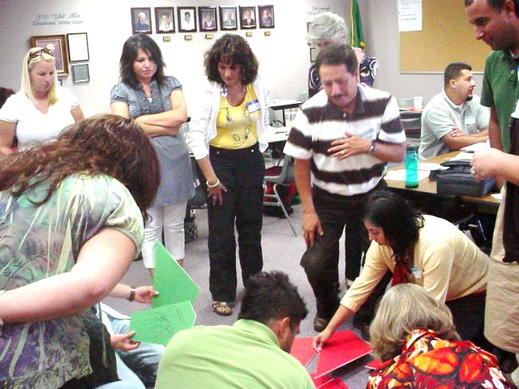
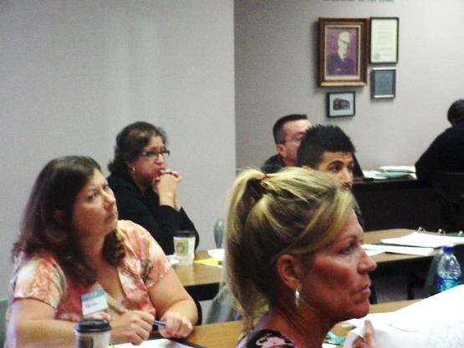
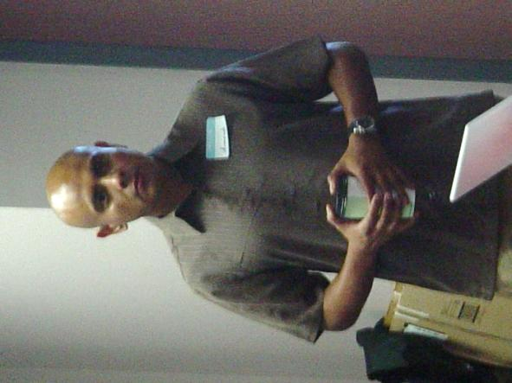
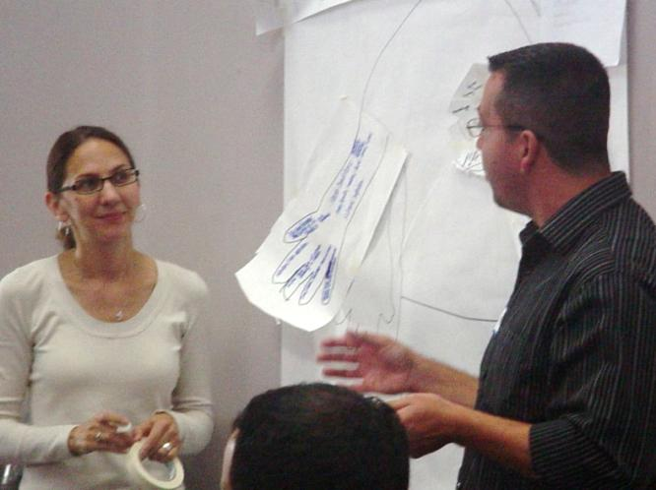
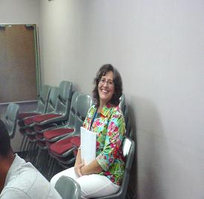
FIESTA TIME ACTIVITY
SEE HANDOUT

Slide 10
FIESTA TIME ACTIVITY
SEE HANDOUT

Slide 11
MIGRANT STUDENTS AT A GLANCE…
SEE HANDOUT
MGS/MSA Alignment: MSAks:1, MGSks:1
Knowledge of economic, social, cultural,
and psychological factors influencing
migrant students.
Notes:
Some of you were fortunate, and attended the August MEP Conference in Yakima where our State MEP Director, Helen Malagon, introduced the Washington State MEP Priorities and Service Delivery Plan.

Slide 12
WHO QUALIFIES AS A MIGRANT STUDENT?
Migratory Child means a child--
(1) Who is migratory agricultural worker or a migratory fisher; or
(2) Who, in the preceding 36 months, in order to accompany or join a parent, spouse, or guardian who is a migratory agricultural worker or a migratory fisher –
Has moved from one school district to another;
In a State that is comprised of a single school district, has moved from one administrative area to another within such district, or
As the child of a migratory fisher, resides in a school district of more than 15,000 square miles, and migrates a distance of 20 miles or more to a temporary residence.”
Public Law 107-110, Title I, Part C, Section 200.81 rev. Aug 29, 2008.
12

Slide 13
SEVEN AREAS OF CONCERN
Educational Continuity: Migrant students experience lack of educational continuity….differences in curriculum, academic standards, homework policies, and classroom routines, inconsistent course placement. Students moving more than three times are likely to fall a full academic year behind stable peers.
Instructional Time: Amount of time students spend in class and attendance patterns are impacted = lower levels of achievement.
School Engagement: Migrant students are frequently faced with adjustments to new school setting, making new friends, and social acceptance challenges, which are generally grouped as behavioral, emotional and cognitive, based on Fredricks, Blumenfeld, and Paris (2003).
Behavioral engagement: opportunities for participation(academic, social, or extracurricular activities.)
Emotional Engagement emphasizes appeal (positive and negative reactions to teachers, classmates, academic materials, and school in general) determine whether or not ties are created…a sense of belonging and feeling valued.
Cognitive engagement hinges on investment in learning and may be a response to expectations, relevance, and cultural connections.
Without engagement, students may be at risk for school failure. Migrant students need avenues that ensure they are valued and have the opportunities that more stable students have.
13

Slide 14
SEVEN AREAS OF CONCERN…continued
English Language Development: English language development (ELD) is critical for academic success. ELD focuses on the literacy skills applicable to content area learning.
Educational Support in the Home: Many migrant parents value education for their children, they may not always know how to support their children in a manner consistent with school expectations or have the means to offer an educationally rich home environment.
Health: …Compromised dental and nutritional status of migrant children…. They are at greater risk than other children due to pesticide poisoning, farm injuries, heat-related illness, and poverty…They are most likely to be uninsured and have difficulties with health care access. Families often need assistance in addressing health problems that interfere with the student’s ability to learn.
Access to Services: Newcomer status and home languages other than English often decrease access to educational and educationally-related services to which migrant children and their families are entitled. Since they are not viewed as permanent residents, services become more difficult to obtain.
14

Slide 15
Academic Press and Social Support Research Based Model Research Focuses on Cognitive and Affective Domain With Academic Achievement Outcomes This research has been acknowledged by Washington State Migrant Education as a viable and pertinent information upon which to base a student advocacy model for migrant students.
MGS/MSA Alignment: Supports All MSA Activities, All MGS Activities
Notes:
So we hope you had a chance to review the research distributed in advance of webinar.
What we can gather is to confirm what all of you already know…
I’d like to invite you to go to the arrow to the left of the chat button and share your observations about the research.
Oscar is standing by to monitor your observations and we will read some of your comments throughout the webinar.

Slide 16
The following matrix has been designed to show how research supports this triangulated notion of how to achieve migrant student success
Sergiovani
Bloom **Annenberg** Cummins/Krashen Daggett
Cognitive Domain | Academic Press | Comprehension | Rigor
Psychomotor Domain | Social Support | Production | Relevance
Affective Domain | Relational Trust | Engagement | Relationship
Migrant Services: Academic Guidance, Non-Academic Guidance, Career Education and Post Secondary Preparation, Student Leadership/Engagement, Social Work/Outreach
Developed by T. Romero 2012
Notes:
Purposely have worked to connect all these components
Based on Best Practices (Language Learners)
Brain Based Learning (Kovolik, Caine and Caine, Sylvester, Jensen, Healy)
Based on Teaching Styles and Multiple Intelligences (Gardner and others
Based on Language Learning (Cummins, Krashen, Vygosky, Asher, SIOP,
Project GLAD>
Based on Dagget, Marzano, Dufour

Slide 17
Research Based Model
Relational Trust
Feeling Safe
Having something to offer
Provide time and expertise
LEARNING
Academic Press
Provides specific direction embedded in high standards/ goals and belief of success for everyone
Social Support
Provides assistance/
help in meeting expected standards/goals
Notes:
This graphic shows the obvious link amongst Academic Press, Relational trust, and Social Support.
The research tells us that we must have all three to support learning.
As you can tell, your advocacy role is very, very important, because your job description speaks very specifically to your role as a mentor and also as a monitor of academic progress.

Slide 18
Just Academic Press and Social Support May Not Be Sustainable. What’s the Missing Piece?
100% students graduating
Social Support
Academic Press
Basing reform on these two aspects has been shown to work but may not be sustainable
Notes:
what research has told us is that basing all of our efforts on just social support and academic press, is effective but may not be sustainable.
We need to ask ourselves what is the missing piece?

Slide 19
Big Three
100% students graduating
Social Support
Relational Trust
Academic Press
Adding relational trust supports all parties within the reform effort and makes a more stable and sustainable model
Notes:
Now when you add in the missing link “relational trust” it completes this pyramid and research tells us that the three foundational supports – Social Support, Academic Press, and Relational Trust are essential to help all students graduate.
Now what does this mean to migrant students?

Slide 20
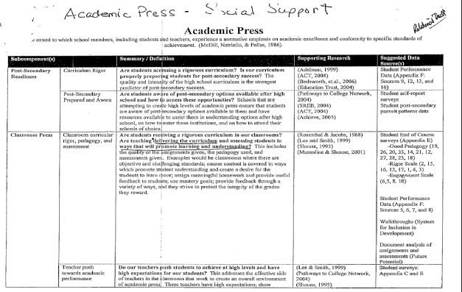
What Is Academic Press?
SEE HANDOUT
Postsecondary Readiness
Curriculum Rigor
Postsecondary Prepared and Aware
Classroom Press
Classroom curricular rigor, pedagogy and assessment
Teacher push towards academic performance
Necessary Student Characteristics
Persistence/Work Ethic/Beliefs
Goals Beyond High School
School Academic Support Structures
Student Academic Preparedness
Necessary Collective Teacher/Staff Beliefs
BE THINKING - WHAT IS THE MGS and MSA ROLE IN
FACILITATING ACADEMIC PRESS?

Slide 21
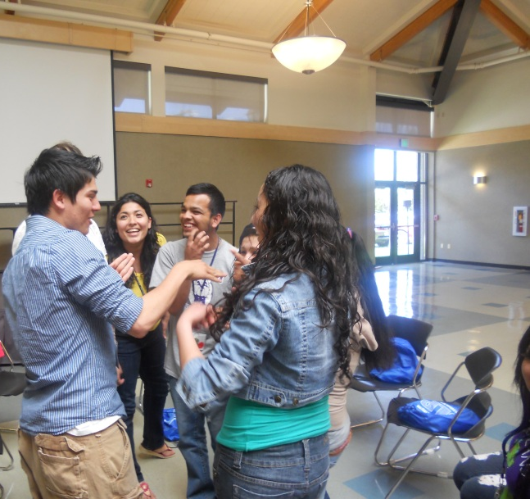
Benefit to Students - Academic Press
Academic Press affects student achievement in at least four ways:
Provides specific direction for student work and academic attainment. It points students and teachers to what they need to accomplish.
Creates incentives that motivate students and teachers to achieve at higher levels.
Enhances student self-concept – students see themselves as a learner.
Promotes relational trust

Slide 22
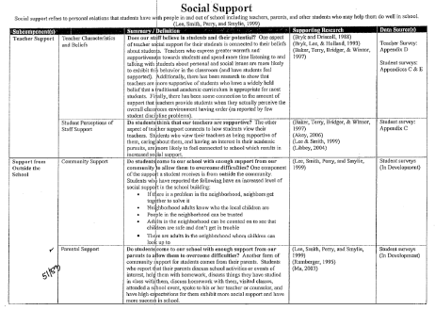
What is Social Support?
SEE HANDOUT
Teacher/Advocate Support
Teacher Characteristics and Beliefs
Student Perceptions of Staff Support
Support from Outside the School
Community Support
Parental Support
Peer Support
Peer Relations
Safety
Student Orientation
Positive Orientation Towards School
Sense of Belonging/Extracurricular Engagement
Academic Self-Efficacy (Effort/Optimism)
School Support
Student Voice
Discipline/Fairness
BE THINKING - WHAT IS THE MGS and MSA ROLE IN
FACILITATING SOCIAL SUPPORT?

Slide 23
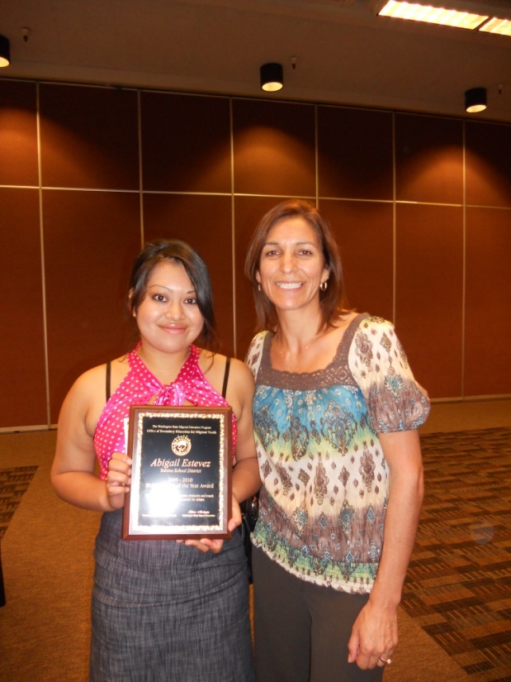
Benefit to Students - Social Support
Creates motivation for students to succeed.
Builds confidence of self.
Promotes relational trust.
Provides psychological safety.
Allows students to take risks, admit mistakes, ask for help, experience failure and bounce back (resiliency)
MGS and PASS Contact, Sylvia Sanchez, Stanton Alternative High, with award winning student

Slide 24
A Proven Model: Sunnyside High School’s – All Hands On Deck (AHOD)
Summary
Research based model implemented at Sunnyside Senior High where 18% are migrant
Proven results:
Increased graduation rate in one year from 70.9% to 78.4%
High staff: student efficacy
All hands on deck with
philosophical basis embraced by all (visionary leader)
Professional development
Staff and student roles are specific and all are held accountable
MSA, Alejandra Bobadilla, at Sunnyside High
“Coming together is a beginning, staying together is progress, and working together is success” Henry Ford
Notes:
As we continue in this webinar, it will be important to keep this research in mind as the MGS or MSA has a very specific and essential role in building relationships while supporting both academic press and social support. We welcome comments or observations about this research and will share your insights during this webinar.

Slide 25
Impact AHOD has on a school
A Proven Model: Sunnyside High School’s – All Hands On Deck (AHOD)
Builds collaboration between counseling department and school
Provides framework for school counseling program
Defines the school counseling program
Increases the power of data collection
Data used to maximize benefit to individual student growth
Increases collaboration for utilizing school and community resources.
Increases collaboration for parent partnership in their child’s education.
Notes:
Counselor

Slide 26
Counseling Department Structure of AHOD
A Proven Model: Sunnyside High School’s – All Hands On Deck (AHOD)
Senior Counselor
Grade Level Counselors
School Psychologist
Migrant Grad Specialist
Intervention Counselor
School Social Worker
Admin
Notes:
Counselor

Slide 27
A Proven Model: Sunnyside High School’s – All Hands On Deck (AHOD)
SSD Graduation Rate Trend
Graduation Year | Graduation Rate
2007 | 46.0%
2008 | 49.9%
2009 | 49.7%
2010 | 64.8%
2011 | 70.9%
2012 | 78.4%
2013 | est. 81%-83.4%

Slide 28
Together
Academic Press Social Support BUILDS RELATIONSHIPS AND CONNECTS
Migrant Students
Within the school
In classroom
With family, peers, community

Slide 29
SHOULD THE MGS/MSA CONDUCT RESEARCH BASED ADVOCACY DUTIES?
YES!
IT ALL TIES TOGETHER

Slide 30
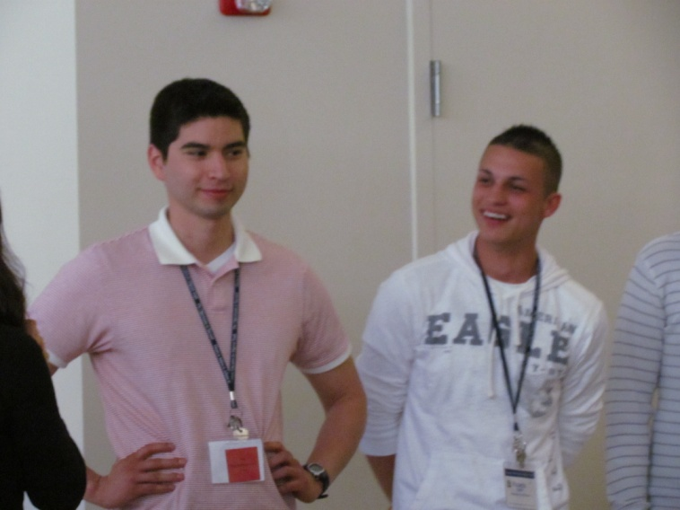
Major Functions Listed in New MGS - MSA Job Descriptions
Overview of Positions
Job Functions
Definitions of Major Functions/Sample
Strategies
MGS, Josh Barbosa, Mabton, in action with students
MGS/MSA Alignment: MSAmr:2-9, MGSmr:2-11

Slide 31
Migrant Student Advocacy
Intervention on behalf of migrant students.
The coordination or facilitation of access to academic press and social support activities to successfully:
transition migrant students to the next grade level,
support students to complete high school, and
promote student transition to postsecondary education/employment.

Slide 32
MGS and MSA CASE LOAD AND OVERVIEW
MGS = 1 FTE : 50 students - indepth one-on-one mentoring/case management service for most at risk; monitors academics
Degreed individual
Collaborates with all to develop an individualized plan of action – for academic achievement (a template will be shared)
Coordinates academic activities with teachers and counselors
Facilitates access to services
MSA = 1 FTE : 150 students - monitors academic progress
Follows lead of administrator
May work with students in small group format
Collaborates with all to develop an individualized plan of action – for academic achievement (a template will be shared)
Facilitates access to services
*Full Time Equivalent

Slide 33
MAJOR MGS and MSA FUNCTIONS -- SEE HANDOUT Advocacy Services Prioritized as Funded by the MEP
SEE HANDOUT
MGS= 1 FTE: 50 students
Self initiates; collaborates with all; indepth one-on-one mentoring and case management service for most at risk; monitors academics; coordinates academic activities with teachers and counselors; facilitates access to services
MSA= 1 FTE: 150 students
Follows lead of administrator; monitors academic progress; may work with students in small group format; facilitates access to services
Non-Academic Guidance
Priority 2* Conducted by MGSs and MSAs with .5 and above FTE
Student Engagement
Priority 2* Conducted by MGSs and MSAs with .5 and above FTE
Social Work/Outreach Priority 3 Conducted by MGSs and MSAs with full time FTE
Career Education and Postsecondary Preparation Priority 2* Conducted by MGSs and MSAs with .5 and above FTE
Academic Guidance
Priority 1 Conducted by all MGSs and MSAs
*Staff with less than a full time FTE may modify level of service as FTE and time permit.
Note: All services are intended as intervention to ensure high school graduation and are centered on ensuring ACADEMIC success and postsecondary transition. All services focus on the unique and supplemental needs of the migrant student. Staff may NOT supplant services and activities available to all students through the school.

Slide 34
MGS/MSA Responsibilities and
Research Based Model Activity

Slide 35
Research Based Model
Relational Trust
Feeling Safe
Having something to offer
Provide time and expertise
LEARNING
Academic Press
Provides specific direction embedded in high standards/ goals and belief of success for everyone
Social Support
Provides assistance/
help in meeting expected standards/goals
Notes:
This graphic shows the obvious link amongst Academic Press, Relational trust, and Social Support.
The research tells us that we must have all three to support learning.
As you can tell, your advocacy role is very, very important, because your job description speaks very specifically to your role as a mentor and also as a monitor of academic progress.

Slide 36
What Is My Job? MGS and MSA Supplemental Support Services Definitions, Priorities and Sample Strategies
SEE HANDOUT
SERVICE | DEFINITION | PRIORITY LEVEL | MAJOR RESPONSIBILITIES AS OUTLINED IN JOB DESCRIPTION | STRATEGY EXAMPLES
Academic Guidance | Support in: Development of High School and Beyond Plan unique to intended school of graduation Supplemental instruction to stay on track to complete graduation requirements in not more than 5 years of high school Transition from ESL to mainstream classes Credit accrual: Tracking of high school credit accrued across schools attended Analysis of credit accrual status; collaboration with counselors for appropriate placement Participation in alternative credit practices Receipt of credit for partial coursework | Priority 1 All staff conduct this service | Migrant Graduation Specialists and Migrant Student Advocates | Collaborate with counselor to interpret student’s current transcript and/or assist the student’s counselor in translating a provided educational record from Mexico and awarding appropriate high school transfer credit. Identify, research, and document partially completed coursework; support counselor in combining it to meet a requirement. Collaborate with the teachers and follow up on issues affecting academic achievement e.g. (is homework turned in daily and especially after excused absences and/or are teachers, parents, and students communicating, etc…) Support preparation and transfer of educational records for student’s move to another school. Utilize the High School and Beyond plan to support the student and family in understanding the district requirements towards graduation and advocating for proper placement and to monitor their individual progress. Interact with and advocate for individual student needs with instructors. Conduct in-classroom Learning Walks to assess migran student classroom engagement, and collaborate with student and teacher. Develop relationships, help students understand relevance, provide social support relative to academic achievement
 |  |  | Work with school counselor and selected students to develop student plans/goals that lead to a successful transition to the next grade level, graduation, and transition to postsecondary education or employment. Facilitate access to school counselor and teaching staff regarding academic needs, including class scheduling to ensure access to required courses for graduation and transition to postsecondary education or employment.
 |  |  | Migrant Graduation Specialists Only
 |  |  | Same as above Develop mentor relationship with student caseload to facilitate needs of migrant students and their families

Slide 37
Continued… MGS and MSA Supplemental Support Services Definitions, Priorities and Sample Strategies
SERVICE | DEFINITION | PRIORITY LEVEL | MAJOR RESPONSIBILITIES AS OUTLINED IN JOB DESCRIPTION | STRATEGY EXAMPLES
Non-Academic Guidance | Coaching on a one‐on‐one basis to expedite adjustment to and positive interaction with school, peers, and community such as: Guidance for setting personal goals and solving general problems; referral to other school resources, including counseling referrals to address crisis situations, and personal/emotional, school or family/lifestyle challenges Orientation and welcome for students who transfer midterm between schools Individual support to improve likelihood of | Priority 2* Conducted by staff with about half time and above FTE. *Staff with less than a full time FTE may modify level of service as FTE and time permit. | Migrant Graduation Specialists and Migrant Student Advocates | Collaborate with staff to identify discipline, general attendance, gang related or motivational issues and collaborate or refer to counselor or other district/community resource. Help student see applicability of classes. Support student in identifying and communicating his/her interests and goals with the counselors, parents, teachers, etc. (role playing) Develop relationships, help students understand relevance, provide social support relative to academic achievement.
 |  |  | Identify the barriers including educational disruption, cultural and language barriers, social isolation, various health‐related problems, or other factors that inhibit the ability of selected migrant students to meet state academic and achievement standards. Work with school counselor to monitor attendance, discipline, credits/grades, and other social/academic issues that may impact the student’s ability to successfully transition to next grade level, graduate, or pursue postsecondary opportunities or employment.
 |  |  | Migrant Graduation Specialists Only
 |  |  | Same as above Maintain on‐going communication with counselor, students, families, and other school staff regarding the progress of the student to achieve established goals and transition to next grade level, graduate, or pursue postsecondary opportunities or employment. Develop mentor relationship with student caseload to facilitate needs of migrant students and their families.

Slide 38
Continued… MGS and MSA Supplemental Support Services Definitions, Priorities and Sample Strategies
SERVICE | DEFINITION | PRIORITY LEVEL | MAJOR RESPONSIBILITIES AS OUTLINED IN JOB DESCRIPTION | STRATEGY EXAMPLES
Career Education and Postsecondary Preparation | Participation in: Structured career awareness options, e.g. access to career role models, professions, interest surveys, career fairs, career and technical training programs Formally structured training or individualized support on job seeking/obtaining skills College and campus visits Formally structured support for application to postsecondary educational institutions | Priority 2* Conducted by staff with about half time and above FTE. *Staff with less than a full time FTE may modify level of service as FTE and time permit. | Migrant Graduation Specialists and Migrant Student Advocates | Facilitate or coordinate access to activities/resources that will promote ongoing communication in: Providing student access to innovative opportunities for student to distinguish his/her college and scholarship applications from the competition. Student participation in education fairs, campus visits, higher education role models, etc. Identification career education programs in district and community e.g., internal and external job internships, awareness of vocational/technical classes and partnerships, etc. Promote family access to culturally relevant role models. Develop relationships, help students understand relevance, provide social support relative to academic achievement. NOTE on evaluation of events: Districts that will provide program‐funded migrant student events/activities, e.g., guest speakers, college visits, etc. should demonstrate the following: a. Documentation that the identified needs of migrant students have been addressed in accordance with state priorities and activities/events are feasible and do not reduce services to address priority needs. b. A description of how the event/activity will be evaluated for its impact on academic achievement of participating students. c. Documented plan describing how the student’s experience in event/activity will have an on‐going component that builds on school academics and post‐secondary goals.
 |  |  | Work with school counselor and selected students to develop student plans/goals that lead to a successful transition to the next grade level, graduation, and transition to postsecondary education or employment. Coordinate access to services available through school district and/or community to reduce and/or eliminate identified barriers.
 |  |  | Migrant Graduation Specialists Only
 |  |  | Same as above. Develop mentor relationship with student caseload to facilitate needs of migrant students and their families.

Slide 39
Continued… MGS and MSA Supplemental Support Services Definitions, Priorities and Sample Strategies
SERVICE | DEFINITION | PRIORITY LEVEL | MAJOR RESPONSIBILITIES AS OUTLINED IN JOB DESCRIPTION | STRATEGY EXAMPLES
Student Leadership/ Engagement | Formally structured small or large group activities to: build supportive networks, develop personal and interpersonal skills to enhance feeling of belonging in the school, and lead to school engagement and academic achievement. Project‐based locally developed student activities that will foster home and school engagement and increase academic achievement. | Priority 2* Conducted by staff with about half time and above FTE. *Staff with less than a full time FTE may modify level of service as FTE and time permit. | Migrant Graduation Specialists and Migrant Student Advocates | Facilitate or coordinate access to activities/resources that will: Model and support student development of effective communication, self‐advocacy, leadership and action planning skills using research based learning strategies Promote family access to culturally relevant role models. Identify and support migrant students in gaining access to and participating in extracurricular activities. Develop relationships, help students understand relevance, provide social support relative to academic achievement. NOTE on evaluation of events: Districts that will provide program‐funded migrant student events/activities, e.g., guest speakers, college visits, etc. should demonstrate the following: a. Documentation that the identified needs of migrant students have been addressed in accordance with state priorities and activities/events are feasible and do not reduce services to address priority needs. b. A description of how the event/activity will be evaluated for its impact on academic achievement of participating students. c. Documented plan describing how the student’s experience in event/activity will have an on‐going component that builds on school academics and post‐secondary goals.
 |  |  | Coordinate access to services available through school district and/or community that strengthen communication, self-advocacy, and leadership skills.
 |  |  | Migrant Graduation Specialists Only
 |  |  | Same as above. Develop mentor relationship with student caseload to facilitate needs of migrant students and their families.

Slide 40
Continued… MGS and MSA Supplemental Support Services Definitions, Priorities and Sample Strategies
SERVICE | DEFINITION | PRIORITY LEVEL | MAJOR RESPONSIBILITIES AS OUTLINED IN JOB DESCRIPTION | STRATEGY EXAMPLES
Social Work/Outreach | Coordination of activities with parents, other family members, teachers, service agencies, and others designed to ensure that migrant families receive full range of services available to them. (Excludes identification and recruitment process for determination of eligibility). | Priority 3 Conducted by Staff with about full time FTE . | Migrant Graduation Specialists and Migrant Student Advocates | Collaborate with teams of educators, parents, students, and community leaders to identify gaps in school and community services and leverage resources to meet those needs/ensure migrant family access. Refer students and families to school program and community service representatives in order to facilitate migrant family access.
 |  |  | Coordinate access to services available through school district and/or community to reduce and/or eliminate identified barriers.
 |  |  | Migrant Graduation Specialists Only
 |  |  | Same as above. Develop mentor relationship with student caseload to facilitate needs of migrant students and their families.

Slide 41
Continued… MGS and MSA Supplemental Support Services Definitions, Priorities and Sample Strategies
SERVICE DELIVERY APPROACH
SERVICE | DEFINITION | PRIORITY LEVEL | MAJOR RESPONSIBILITIES AS OUTLINED IN JOB DESCRIPTION | STRATEGY EXAMPLES
Case Management (MGS) | Migrant students served by a program funded graduation specialist following the duties and responsibilities as outlined in state developed job description. | Priority 1 All MGS report services with this delivery approach. | Coordinate with school counselor, teachers, and other appropriate staff to develop a caseload of migrant students most at‐risk of not meeting state academic and achievement standards. Participate in professional development opportunities to strengthen skills in working with at‐risk migrant students including consolidating credits, determining high school of graduation, motivational techniques, and reporting requirements. | No strategies. See definition.
Student Advocacy (MSA) | Migrant students served by a program funded student advocate following the duties and responsibilities as outlined in state developed job description. | Priority 1 All MGS report services with this delivery approach. | Coordinate with school counselor, teachers, and other appropriate staff to develop a roster of migrant students most at‐risk of not meeting state academic and achievement standards. Participate in professional development opportunities to strengthen skills in working with at‐risk migrant students including motivational techniques and reporting requirements. | No strategies. See definition.

Slide 42
SLICE OF LIFE ACTIVITY
SEE HANDOUT
MGS/MSA Alignment: MSAr:7, MGSr:7
Human Relations, time management, and personal organizational skills.

Slide 43
MENTOR LEAD SMALL GROUP DISCUSSIONS
SEE MENTOR HANDOUT
Discussion/Reflection Topics:
What did you notice as you completed your time allocation pie chart?
What can you learn from seeing how you spend your time?
What good choices are you making that support you in prioritizing your activities to accomplish your MGS/MSA responsibilities in the allotted time (based on your FTE)?
What activities are not supporting you in prioritizing your activities to accomplish your MGS/MSA responsibilities in the allotted time?
What did you learn about yourself in doing this exercise?
What will you the same or differently when you return to your schools this year?
As an MGS/MSA, how could you use this activity when working with your migrant students?

Slide 44
Segment 2: Migrant Student Selection and Documentation Requirements
Student Selection
Washington State PFS Definition
Framework for Student Selection/Levels of Support
Developing a Caseload and Student Roster
Conducting a SNA
Documentation of Services
MGS/MSA Log
Referred Services
Hands on Exploration of:
Online MGS/MSA Data Analysis Tools, Reports, and Resources
Notes:
Today we will be reviewing the following topics:

Slide 45
How Do I Determine Who To Serve? Student Selection
Washington State Priority for Service Definition (pursuant to federal law Elementary and Secondary Education Act, Section 1304(d)
Student Needs Assessment Report
MGS/MSA Alignment: MSAmr:1 & 2, MGSmr:1&2
Coordinate with school counselor, teachers, and other appropriate staff to develop a roster of migrant students most at-risk of not meeting state academic and achievement standards.
Identify the barriers including educational disruption, cultural and language barriers, social isolation, various health-related problems, or other factors that inhibit the ability of selected migrant students to meet state academic and achievement standards.

Slide 46
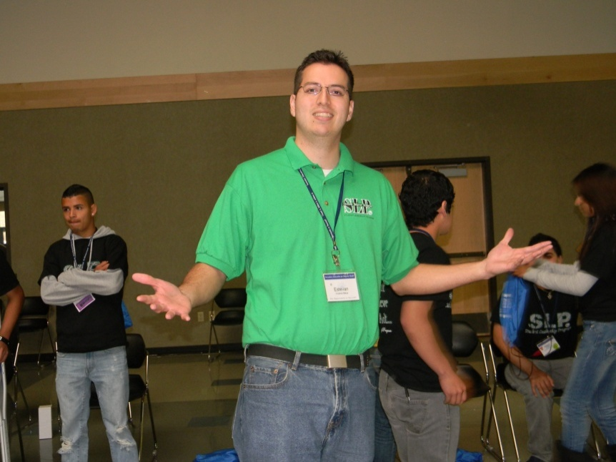
Careful Selection of Students Meets Federal Requirements
MGS/MSA staff must ensure PFS students’ needs are met first, before serving other migrant-eligible students.
MGS, Estevan Vivanco, Burlington
Why not?!

Slide 47
Washington State Priority for Service Definition
Priority for Service (PFS) students are students:
whose education has been interrupted during the regular school year
AND
who are failing, or most at risk of failing, to meet the State’s challenging State academic content standards and challenging State student academic achievement standards.

Slide 48
Washington State Priority for Service Definition
SEE HANDOUT

Slide 49
Priority for Service - Summary
Criterion #1: Interrupted school year
AND
Criterion #2: Low academic state assessment scores (see handout)
When state assessment data is unavailable, proxy risk factors may be applied.

Slide 50
PFS – Proxy Risk Factors
Language Proficiency – student’s score on Washington’s English Language Proficiency test is within the limited English proficient levels (1, 2, and 3)
Retained – enrolled in same grade from one school year to next
Grade Age / Over age - age does not match acceptable range for grade level placement with in 2 years
Credit Deficiency (for secondary age students only) – student has not earned sufficient credits per his/her school’s graduation requirements and grade level

Slide 51
FRAMEWORK FOR SELECTION/SUPPORT
SEE HANDOUT

Slide 52
Conducting a Student Needs Assessment
SEE HANDOUT
Student Needs Assessment
For WAMEP School District
As of 08/01/2013

Slide 53
FAQs for PFS (need your glossary? ☺)
Question: What if the student is new to the state or district and no data exists?
Answer: If the Student Needs Assessment (SNA) report contains no data,* determine if student is Priority for Service (PFS) by conducting local data analysis in alignment with the official state definition of PFS:
Interrupted school year (identified through SNA) AND
State assessment scores (first) or, if not available,
Proxy risk factors:
2a. Language proficiency scores
2b. Retention
2c. Grade/Age Compatibility
2d. Credit deficiency
*OSPI guidance: “The student data is compiled in the MSIS for students who have been in the Washington State Migrant Education Program or as reported through a national migrant student database, MSIX. However, for students new to the state or school, use local analysis in alignment with PFS criteria, e.g., Interrupted school year, and in the absence of assessment data, use of proxy factors.”

Slide 54
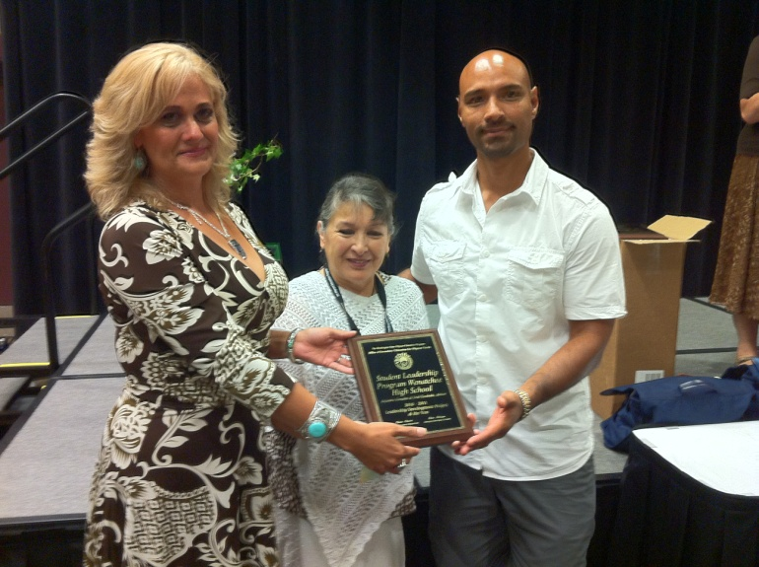
Question: Must a PFS migrant student be served by the Migrant Education Program?
A: No. Once the need for a PFS migrant student has been identified, if there are other non-migrant resources or services that can address the identified need for which a migrant student is entitled and eligible to receive, the Migrant Education Program is not required to provide that same service and could be considered supplant.
MGS, Alejandra Gonzalez, Wenatchee, State Director Helen Malagon, and Ricardo Iniquez, Wenatchee High. Project of the Year through MGS efforts.
IT IS STRONGLY RECOMMENDED: Add a column to your SNA report and document the reason a student may have not been selected for the caseload or student roster e.g. participation in GEAR UP, BRIDGES Program, etc.

Slide 55
Question: Can non-PFS migrant students be served?
A: Yes. After identifying and addressing the needs of PFS migrant students, the needs of migrant students who have not had an interrupted school year may be analyzed for appropriate services using the same academic criteria:
State assessment results (if available*) or
Proxy Risk Factors:
language proficiency scores
retention
grade age compatibility
credit deficiency
*The above student data is compiled in the MSIS for students who have been in the Washington State Migrant Education Program or as reported through MSIX. However, for students new to the state or school, use local analysis in alignment with PFS criteria, e.g., Interrupted school year, and in the absence of assessment data, use of proxy factors – language proficiency, retention, grade/age compatible, or credit deficiency.

Slide 56
FAQ About Needs Assessment and Pulling Lists of Students to Serve
How Often Do I Pull a Roster?
Informally, at least monthly (or more frequently to accommodate peak migratory times.)
Formally, on a quarterly or seasonal basis with your district administrator.
An ongoing conversation with migrant funded recruiter and records clerk would also promote timely service too late or mid-term enrolling students.

Slide 57
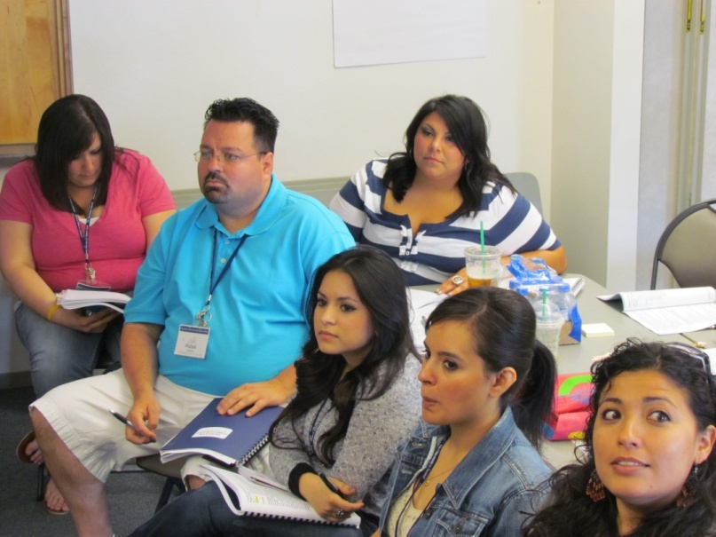
Where Do I Find the SNA?
To access SNA, request username and password to the Migrant Student Information System (MSIS) at www.msdr.org.
SNA will be available through the Quick links/Ed Staff menu.
Former migrant students, staff and MGS/MSA staff serving as role models for students – “returning to the Program to advocate and serve!”

Slide 58
Do I Print the SNA When I Pull a Roster?
Yes. Date and file a copy of the SNA each time you review and select students to be served.
How Do I Log That Services to PFS Have Been Provided By Another?
When conducting the needs assessment, it is recommended that the MGS or MSA create a column on the SNA to briefly comment and substantiate why he/she did not select a particular PFS student in the roster/caseload (e.g. ‘served in Special Ed’ ‘attending Title I after school credit recovery program’).

Slide 59
To be continued....
BREAK TIME!

Slide 60
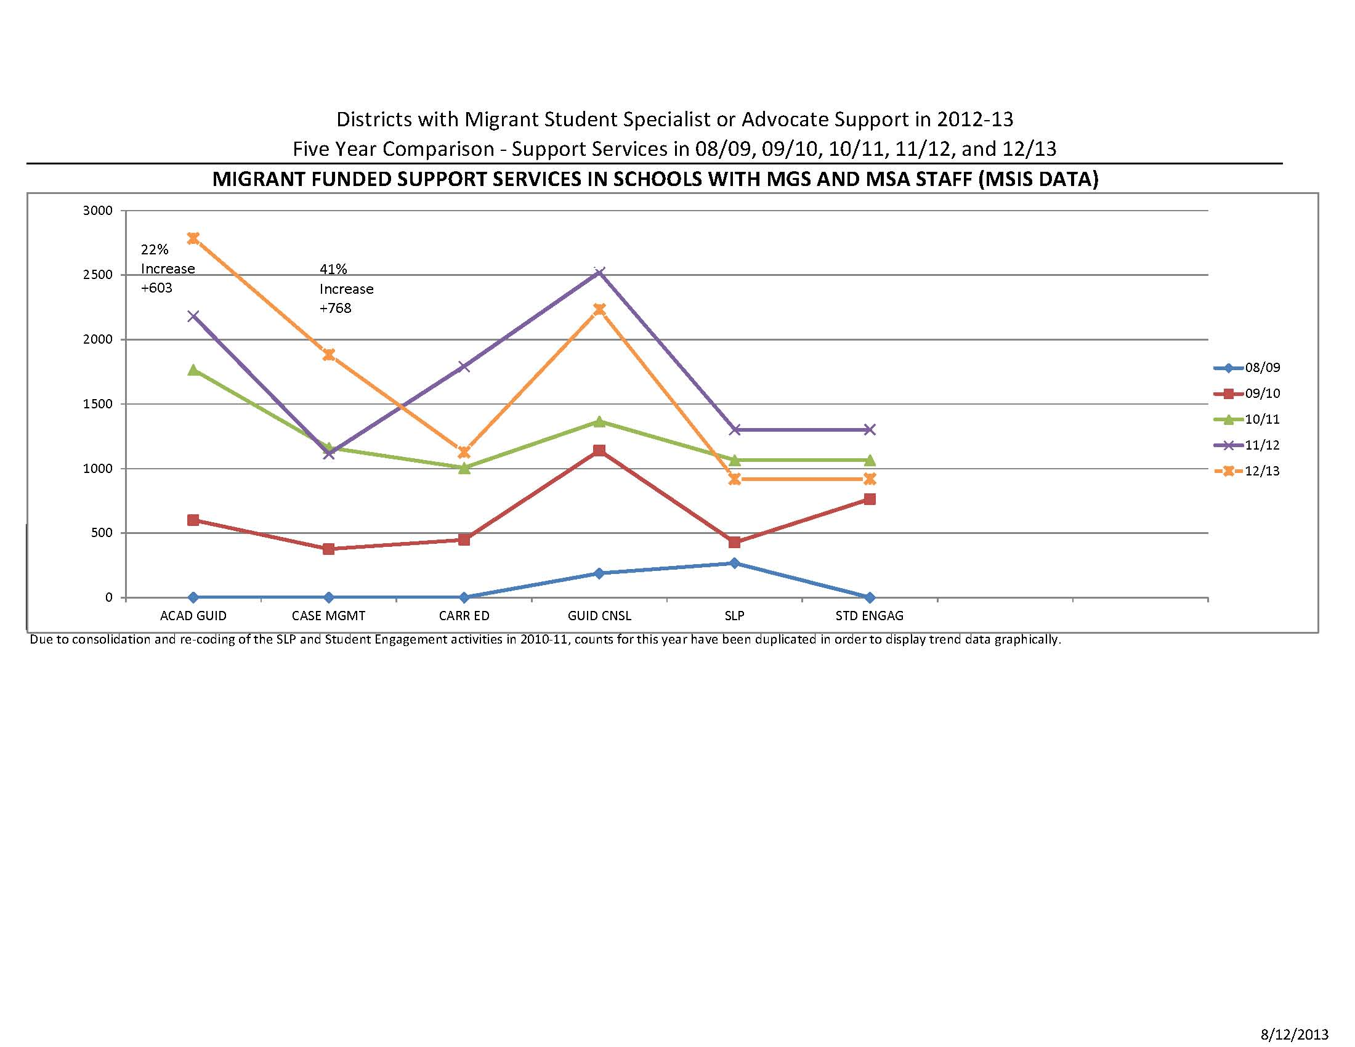
MGS/MSA Logs of Support Services as Reported into MSIS by MEP Records Clerk Administratively Useful End of Year Report Data

Slide 61
Documentation of Services – the Paperwork
MGS/MSA Log – Report your student services daily
Referred Services – Log when you refer students to educational and community services
Locally Developed Documentation of Local Student Events or Activities (academic focus and ongoing component)
Notes:
There are 3 reports you must complete as an MGS or MSA. They are:

Slide 62
Reporting Services through the MGS/MSA Log
SEE HANDOUT
NOTE:
The MGS or MSA documentation log and template are available for download at www.msdr.org. To access the pre-filled log with all enrolled migrant students and the last time they received service in the specified area , simply login to the database, select the "Quick-Link Menu"/ "Ed" Tab/"Specialist/Advocate Log". To access the "Specialist/Advocate Documentation Template" simply click on the "MEP clearinghouse"/"Secondary" Tab.
⋅ The school may replace this log and create its own documentation as long as information reported includes all major functions of the MGS/MSA and direct services are reported in MSIS. Other school records which include personally identifiably information may be kept as documentation of MGS or MSA activity in accordance with school policy.

Slide 63
Reporting Services through the MGS/MSA Log
Before you start:
Download blank or prefilled log
Save for required reporting to desktop or other file as applicable
Corroborate MGS/MSA logging procedures with school documentation system
Review definitions of major functions (summary) and report accordingly

Slide 64
Reporting Services through the MGS/MSA Log
It is strongly recommended:
To log activities on a daily basis
Print, file and share a copy of the completed log each month with migrant records clerk.
Monthly review the Student Needs Assessment (select the caseload of PFS students to be served, including new students, and re-print updated Log)
Archive these confidential files (on an annual basis for auditing purposes)

Slide 65
Referred Services - Form
SEE HANDOUT
Complete when making educational service referrals outside the school
Find form at MSIS under the
quicklinks menu/ed staff or at the MSDR.org resources tab.
Provide to records clerk.

Slide 66
Local Student Events/Activities Required Documentation
Does your school conduct student events or activities? Such as:
Guest speakers
College visits
Student conferences
College or career fairs
If yes, advocate, intervene, ensure, facilitate and coordinate migrant student access to these activities. This is a major role for an advocate, and particularly if the above support academic achievement.

Slide 67
Local Student Events/Activities Required Documentation
If utilizing Migrant Education Program funds for local student events/activities, the Program should demonstrate the following:
Documentation that the identified needs of migrant students have been addressed in accordance with state priorities and activities/events are feasible and do not reduce services to address priority needs.
A description of how the event/activity will be evaluated for its impact on academic achievement of participating students.
Documented plan describing how the student’s experience in event/activity will have an on-going component that builds on school academics and post-secondary goals.
Excerpted from OSPI MEP Webinar (September)
- http://www.k12.wa.us/MigrantBilingual/Webinar/2012Sept/MBWebinarMigrant.wmv

Slide 68
Local Student Event/Activities Documentation Considerations
Tip:
Check with your administrator and determine locally developed documentation requirements BEFORE an event or activity.

Slide 69
Consolidated Program Review
Checklists will be located on OSPI website , http://www.k12.wa.us/ConsolidatedReview/default.aspx
Local implementation of activities as noted in approved grant application.
Selection process for migrant students to be served, including Priority for Service.
Evidence of logging and reporting of services provided to migrant students.
Evidence of active Identification and Recruitment of eligible migrant students.
CPR Review Timeline 2013-14: Districts in ESDs 123 and 189 2014-15: Districts in ESDs 101 and 114 2015-16: Districts in ESDs 121 and 171 2016-17: Chosen districts in ESDs 105, 112, and 113 2017-18: Chosen districts in ESDs 105, 112, and 113

Slide 70
Consolidated Program Review
Excerpts of Program Review Checklist Relevant to MGS/MSA
MGS:
List of student caseload and Migrant-funded services provided
Documentation of selection process and log activity sheet demonstrating the intent to meet the identified needs of migrant students, including non-academic/academic activities, student advocacy, and postsecondary education, career exploration.
(In conjunction with basic education), description of process to analyze credit accrual needs of students grades 9-12
MSA:
Documentation of selection process and log activity sheet demonstrating the intent to meet the identified needs of migrant students, including non-academic/academic activities, student advocacy, and postsecondary education, career exploration.
District wide: Evidence of referrals made and professional development training attended.

Slide 71
Online MGS/MSA Data Analysis Tools, Reports, and Resources
MGS/MSA Alignment:
MSAks:3 and MGSks:3: Knowledge of school and community resources available to migrant students and families, including technical education, career awareness, and postsecondary education opportunities.
MSAmr:1 and MGSmr:1: Coordinate with school counselor, teachers, and other appropriate staff to develop a caseload of migrant students most at-risk of not meeting state academic and achievement standards.
MSAmr:2 and MGSmr:2: Identify the barriers including educational disruption, cultural and language barriers, social isolation, various health-related problems, or other factors that inhibit the ability of selected migrant students to meet state academic and achievement standards.
MSAmr:4 and MGSmr:5: Coordinate access to services available through school district and/or community to reduce and/or eliminate identified barriers.

Slide 72
Online MGS/MSA Data Analysis Tools, Reports, and Resources
MGS/MSA Alignment:
MSAmr:5 and MGSmr:6: Coordinate access to services available through school district and/or community that strengthen communication, self-advocacy, and leadership skills.
MSAmr:2 and MGSmr:9: Work with school counselor to monitor attendance, discipline, credits/grades, and other social/academic issues that may impact the student’s ability to successfully transition to next grade level, graduate, or pursue postsecondary opportunities or employment.

Slide 73
Academic Guidance in Action
SEE HANDOUT

Slide 74
A Few Academic Guidance Strategies
Placement Considerations Collaboration/Advocacy High School and Beyond and Migrant Student Plan of Action Coaching and Monitoring Academic Progress Withdrawal

Slide 75
Academic Guidance Strategies PLACEMENT CONSIDERATIONS
STRATEGIES | ACTION – HOW TO’s
Collaborate with counselor to interpret student’s transcript; and identify learning gaps | Top priority in placement: student complete partially completed requirements. If late entry resulted in placement in Alternative HS, identify how and when the student can return to the regular high school. Identify if student is likely to graduate on time. Identify if placement decisions are supporting completion of CADR requirements in English, math, science, etc.
Support counselor in combining partially completed coursework to meet a requirement. | Consult student’s record in the Migrant Student Information System database. Note partial work completed (“Unreported data, withdrawal processed”). Verify credit for education in a previous state/country was fairly awarded as transfer credit to the student. Ensure that as incoming credit is transcripted, required HEC Board codes are added as appropriate. Ensure counselor combines partial credits to satisfy graduation requirement(s).

Slide 76
Academic Guidance Strategies COLLABORATION/ADVOCACY
STRATEGIES | ACTION – HOW TO’s
Follow up on issues affecting academic achievement | Follow up with teacher/student if homework is being submitted daily especially after excused absences. Formally or informally meet with student to discuss academics. Follow up with parent(s) and teacher(s) and ask if each party is satisfied with the level of communication amongst student, parent, and teachers. Help student prepare for difficult conversations through role playing. Ensure access to teacher and or other staff (as appropriate) to discuss issues/concerns impacting academic achievements.

Slide 77
Academic Guidance Strategies COLLABORATION/ADVOCACY
STRATEGIES | ACTION – HOW TO’s
Interact with and advocate for individual student needs with instructors. | Help teachers and other appropriate staff to understand the student’s unique academic needs resulting from high mobility and the migrant lifestyle. Encourage instructors to accept make up work/missing assignments when student has excused (or unavoidable) absences. Identify if instructor offers any additional support for students e.g. one on one instruction time (before school, during lunch, afterschool, extra credit assignments, etc.

Slide 78
Academic Guidance Strategies COLLABORATION/ADVOCACY
STRATEGIES | ACTION – HOW TO’s
Conduct classroom Learning Walks to assess migrant student engagement, and collaborate with teacher and student. | Follow district etiquette or establish acceptable etiquette with instructors when conducting learning walks. Follow up with student and ask meaningful questions (during or after) to assess level of student engagement. Use real examples and observations. Follow up with instructor/student: share learning walk outcomes, provide feedback and suggestions to increase student engagement e.g. recommended interventions, differentiated instruction methods to accommodate student learning style, note taking strategies, etc.

Slide 79
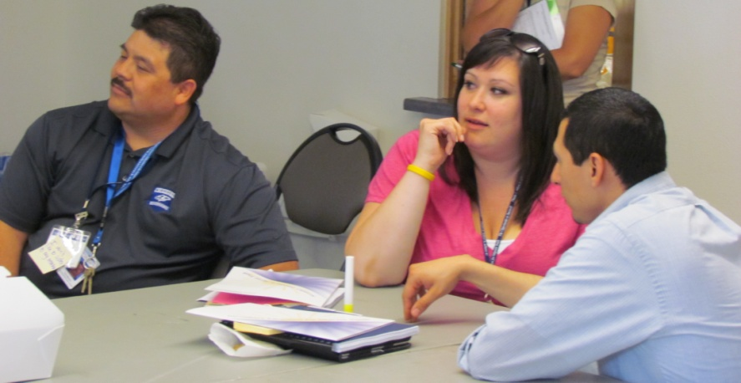
Learning Walks
Observing students in classroom helps to:
Foster positive relations
Develop shared expectations
Promote questioning
Stimulate interest
Assist students to consider and identify processes that will support achievement of the learning goals
Tino Barerra, Pasco counselor and Student Leadership Program (SLP) alumni, Samantha Ruiz, MGS, Wahluke, and Josue Quezada, WSU CAMP

Slide 80
Tip for Conducting Learning Walks
Meaningful Student Questions In the Classroom Which Promote Academic Achievement and Assess Student Engagement:
What are you learning today?
What do you understand about the learning?
How does topic or goal connect to you?
What will you do now with your new learning?
Did the learning challenge you?
Are you engaged in this class today?

Slide 81
Monitoring Academic Progress
SEE HANDOUTS
High School and Beyond Planning and the Migrant Student Plan of Action - Useful Tools
State Templates:
Migrant Student Plan of Action
Middle School Migrant Student Plan of Action
District Models
Burlington Edison Student Goal Sheet
Moses Lake Ell & Migrant Monitoring Sheet

Slide 82
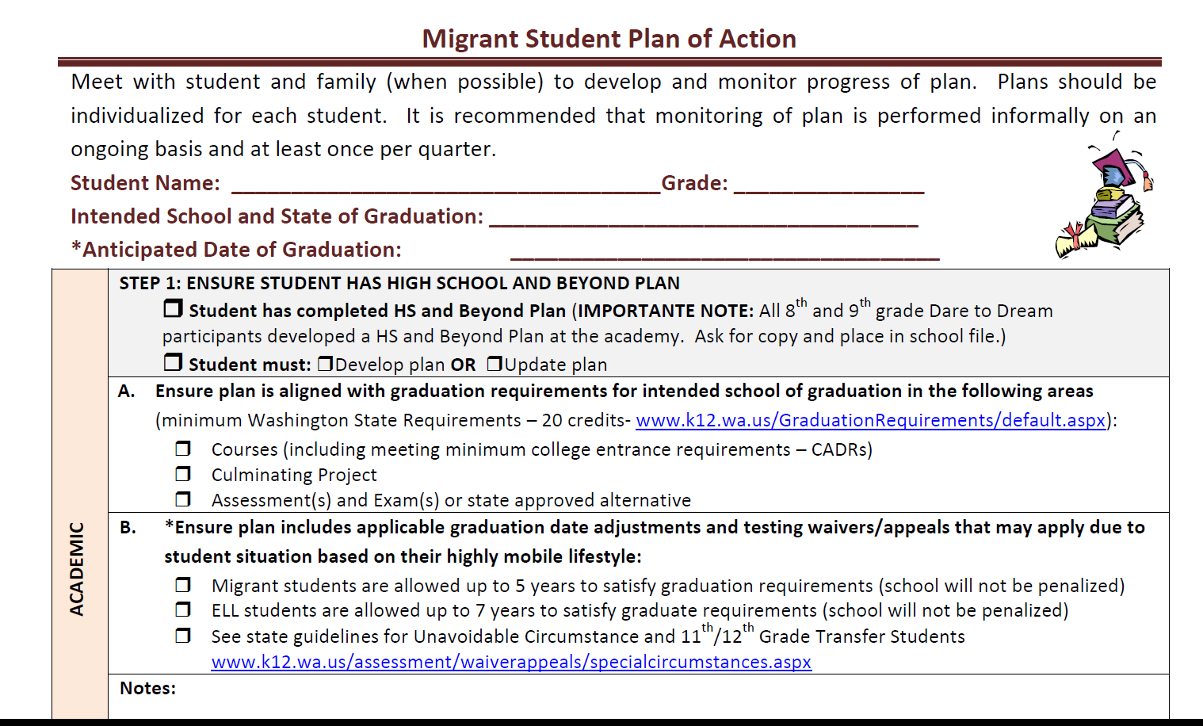
Migrant Student Plan of Action
Setting the foundation for academic planning.

Slide 83
Migrant Student Plan of Action

Slide 84
Migrant Student Plan of Action
Action Planning: Academic, Career/Postsecondary Education, Social/Student Engagement, Physical/Health

Slide 85
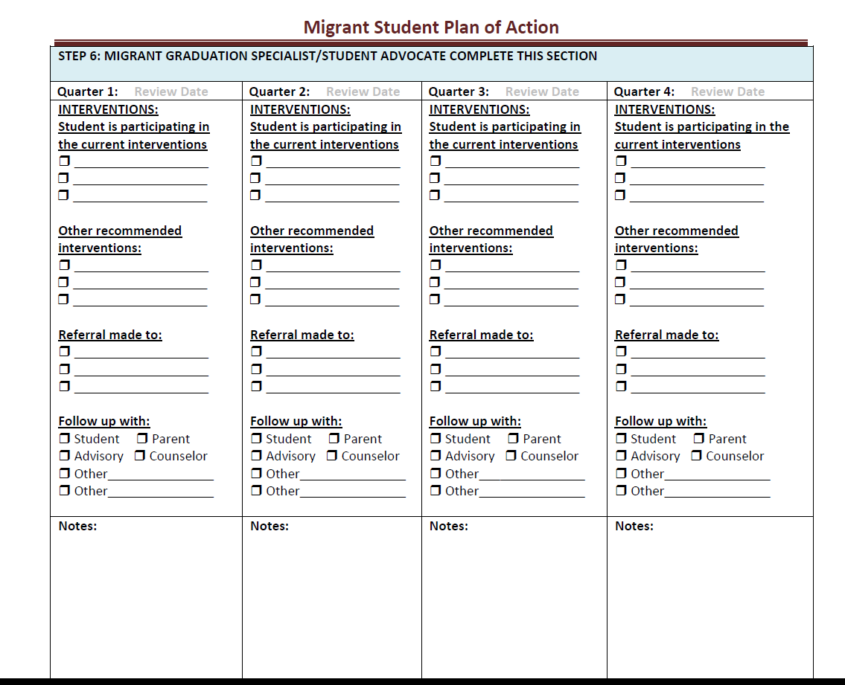
Migrant Student Plan of Action
Outcomes…

Slide 86
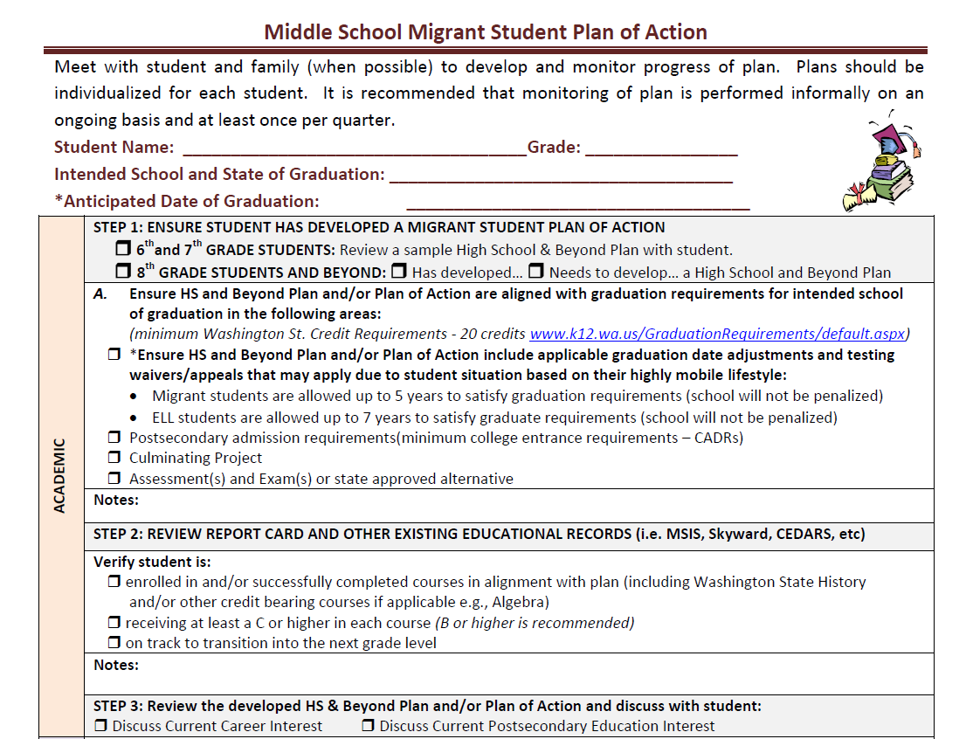
What about Middle School Student?
Setting the foundation for academic planning.

Slide 87
What about Middle School Student?

Slide 88
Segment 3: MGS/MSA Strategies in Action
MGS/MSAs in Action
Small Group Skits
“Quality Team Time Role Play” Peer to Peer Feedback/Dialogue
Notes:
Today we will be reviewing the following topics:

Slide 89
MGSs/MSAs IN ACTION – QUALITY TEAM TIME ROLE PLAY PROCESS
QUALITY TEAMS WILL:
Review the case scenario and identify the challenge.
Identify strategies, tools, and resource they could implement to address barrier in case scenario.
Plan how to role play being secondary school migrant students, MGS/MSA staff, and other educational staff.
Develop 5-8 minute skit.
GOOD LUCK!

Slide 90
GIVING AND RECEIVING FEEDBACK
SEE FACILITATOR/
ORIENTATION GUIDE PG. 23

Slide 91
MGSs/MSAs IN ACTION – QUALITY TEAM TIME ROLE PLAY PROCESS
QUALITY TEAMS WILL:
Have 5-8 minutes to perform their skit.
After: one member/observer takes the lead in the reflection.
Ask the presenting co-facilitators to describe their own experiences:
What happened in presentation?
What went well? What specifically made you feel it went well?
What did not go well? Specifically what was it that made you feel it did not go well?
What strategies, resources, or tools did your group apply?
Peers in the audience will describe what they saw and heard, including positives.
Peers who performed and audience discuss together:
What could have changed to work better – how could that change have looked?
What other ways of addressing the challenge might be effective?
Were there any behaviors or approaches that may hinder the MGS/MSA from resolving the issue?
What techniques could be applied to manage the behavior or approach, resulting in positive outcomes?

Slide 92
REFLECTION ON TRAINING COMPONENT
Segment 1: MGS/MSA Roles and Responsibilities
MGS/MSA Roles and Responsibilities
FTE/Prioritizing and Time Management
Segment 2: Student Selection and Documentation Requirements
Accessing MSIS Tools and Reports
Documenting and Reporting
Segment 3: MGS/MSA Strategies in Action
Case Scenarios (Strategies, Resources, Student Barriers)
Notes:
Today we will be reviewing the following topics:

Slide 93
Segment 4: ESD Program Implementation Planning
Review resources:
List of Districts with MGSs/MSAs
MGS/MSA Prioritization of Districts
Schedule of MGS/MSA Coaching and Support
Data Monitoring Prioritization
MGS/MSA and FPD Planning Tips
Field Office Planning Implementation/Action Planning Time
Notes:
Today we will be reviewing the following topics:

Slide 94
MGS/MSA and FPD TIPS FOR DEVELOPING COLLABORATIONS
SEE HANDOUTS
Notes:
As we continue in this webinar, it will be important to keep this research in mind as the MGS or MSA has a very specific and essential role in building relationships while supporting both academic press and social support. We welcome comments or observations about this research and will share your insights during this webinar.

Slide 95
SMALL GROUP DISCUSSIONS
Discussion/Reflection Topics:
What is the current reality at your schools?
What collaborations will you encourage your MGS/MSA at your school to strengthen to support migrant students.
What are some of the challenges they face in collaborating with others?
What seems to be the reason for the challenges?
What solution can be used to remedy problem?
What could you do as a Field Office to strengthen collaborations?
Who could support you in performing your functions and how?
Can their FPD help facilitate access to this support/collaboration?

Slide 96
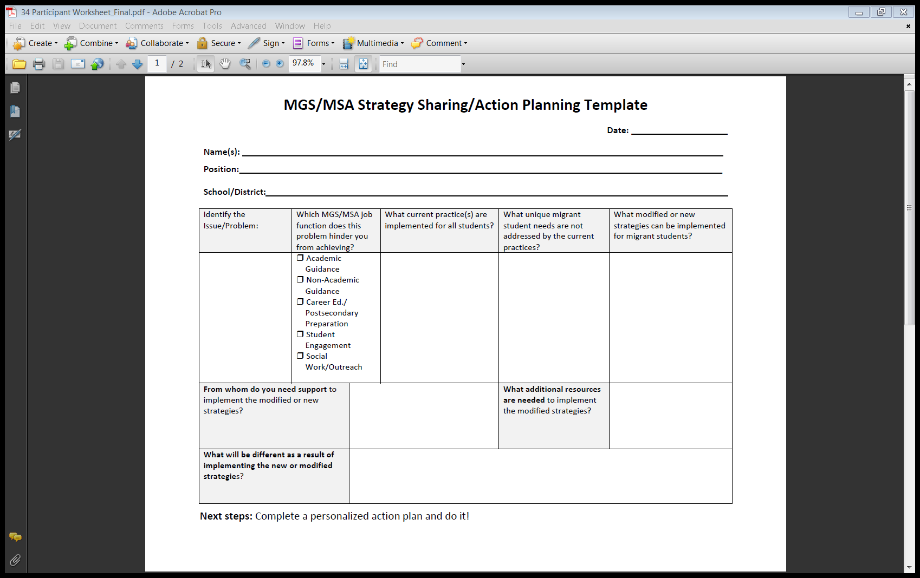
ESD PROGRAM PLAN IMPLEMENTATION SESSION
TIPS TO CONSIDER:
Consider methods for coaching district staff within your MGS/MSA implementation plan in alignment with your office contracted services.
Identify roles/responsibilities of field offices versus districts and possible partners and supports.
Identify who will be lead on action items (e.g. Field Office, MGS, MSA, or FPD.)
SEE HANDOUTS

Slide 97
TRAINING EVALUATION

