Slide 1

Evaluation Data Collection
Washington State

Slide 2

What we will cover today..
How will the district and OSPI evaluate progress toward meeting the Math MATTERS/MASTERS student and parent outcomes?
What data reporting is required for Math MATTERS/MASTERS?
What is due? When? To whom?

Slide 3

Student Outcome (K-6)
80% of Washington State migrant students enrolled in grades K-6 Math MATTERS or Math MASTERS curriculum during the summer of 2014 in grades K-6 with both a pretest and posttest will increase their scores by at least 9% from pretest to posttest on the Math MATTERS curriculum-based assessments.

Slide 4
Student Outcome Reporting
PRETEST SCORES
Teachers administer pre-assessments for their grade band, being careful to give the correct grade level test.
    If a student arrives after the pretest has been given, the test should be given to them on their first day.
Teachers score their assessments and record the pre-test scores in the item analysis spreadsheet, saving it on computer for later.
Teachers review the pretest analysis to identify areas that may require extended focus.
Notes:
This will be measured by the district record’s clerk reporting to the MSIS the pre-test score and the post-test score. It is VERY important that you enter it correctly under either Math MATTERS OR Math MASTERS depending on which curriculum you are using. It is also VERY important to enter it as a raw number NOT A PERCENT (5 correct out of 11 total would be recorded as a “5”)

Slide 5
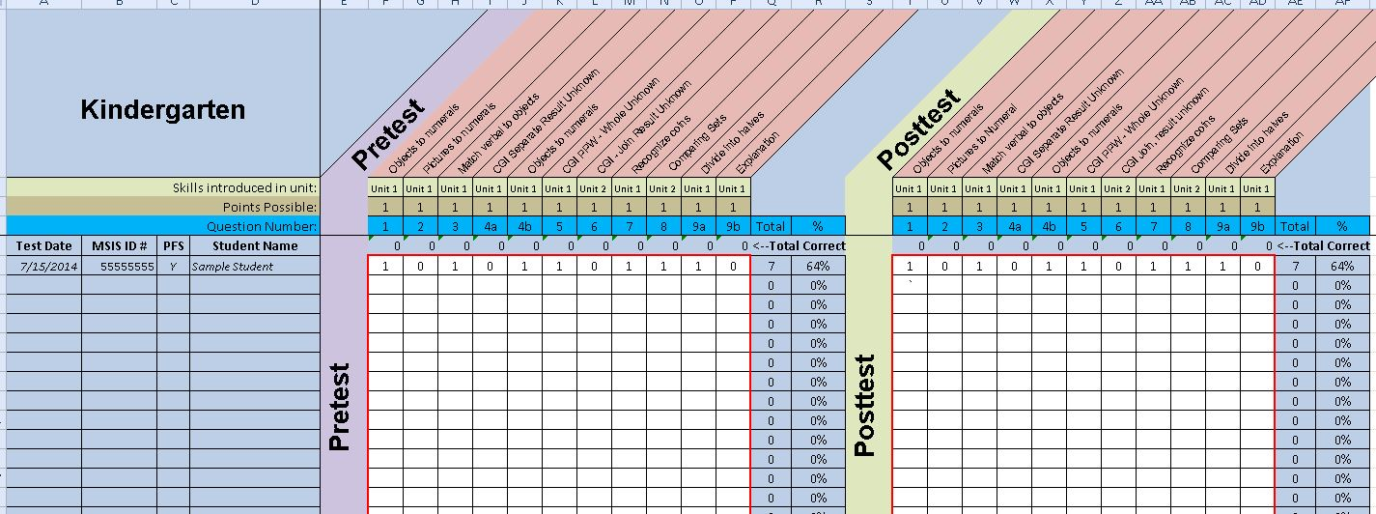
Item Analysis
This form has several purposes: 1) to help teachers target instruction, 2) to report data to the MSIS, and 3) to help the CAT design reliable assessment items.

Slide 6
Student Outcome Reporting
POSTTEST SCORES
Teachers administer the posttest at the end of the summer session making sure to use the same grade level test used for the pretest.
    Note, if a student leaves before the end of the summer, the posttest is administered on the student’s last day.
Teachers score their assessments and record the posttest scores in the item analysis spreadsheet, saving it electronically.
Teachers review the pre/post gains to see if their students met the student outcome.
Notes:
This will be measured by the district record’s clerk reporting to the MSIS the pre-test score and the post-test score. It is VERY important that you enter it correctly under either Math MATTERS OR Math MASTERS depending on which curriculum you are using. It is also VERY important to enter it as a raw number NOT A PERCENT (5 correct out of 11 total would be recorded as a “5”)

Slide 7
Teachers Report to Administrator
Teachers send the electronic item analysis with pre and posttest scores to the summer school administrator on the last work day.
Teachers give the original pre and post tests to the summer school administrator (at the same time as their item analysis).
Administrator keeps a copy of the item analyses and sends a copy to the migrant records clerk for recording on the MSIS
Notes:
This will be measured by the district record’s clerk reporting to the MSIS the pre-test score and the post-test score. It is VERY important that you enter it correctly under either Math MATTERS OR Math MASTERS depending on which curriculum you are using. It is also VERY important to enter it as a raw number NOT A PERCENT (5 correct out of 11 total would be recorded as a “5”)

Slide 8
Records Clerk Reporting
Migrant Records Clerk records in the MSIS:
  Summer school enrollment in grade level just completed in June
  Raw score and date of pre test
  Raw score and date of post test
  Supplemental services in Math for each student (also showing the total instructional minutes of summer school)
  Student attendance (days attended vs days enrolled)
Notes:
This will be measured by the district record’s clerk reporting to the MSIS the pre-test score and the post-test score. It is VERY important that you enter it correctly under either Math MATTERS OR Math MASTERS depending on which curriculum you are using. It is also VERY important to enter it as a raw number NOT A PERCENT (5 correct out of 11 total would be recorded as a “5”)

Slide 9
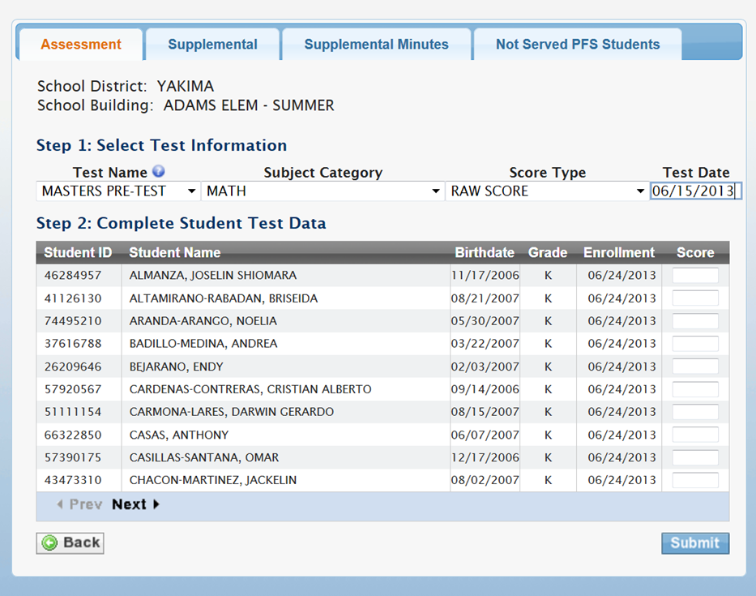
REPORTING
Pre/Post Test Scores
Teachers administer pre-assessments for their grade band (being careful to give correct grade level test)
Teachers score their assessments and record the pre-test scores in the item analysis spreadsheet
Teachers
Notes:
This will be measured by the district record’s clerk reporting to the MSIS the pre-test score and the post-test score. It is VERY important that you enter it correctly under either Math MATTERS OR Math MASTERS depending on which curriculum you are using. It is also VERY important to enter it as a raw number NOT A PERCENT (5 correct out of 11 total would be recorded as a “5”)

Slide 10
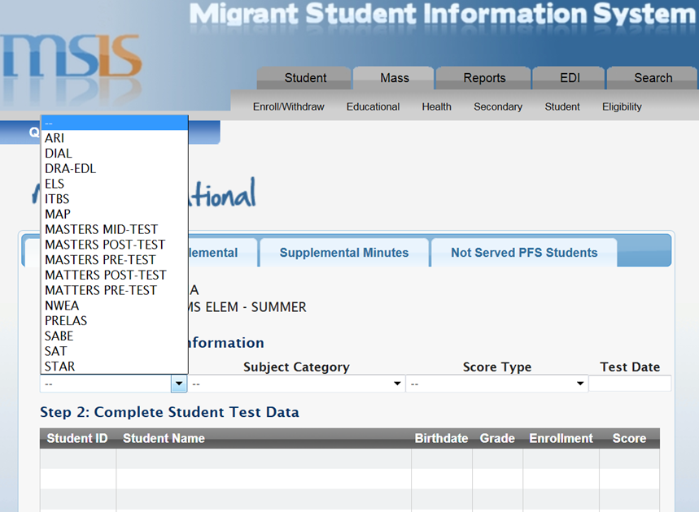
REPORTING
Pre/Post Test Scores
Notes:
This will be measured by the district record’s clerk reporting to the MSIS the pre-test score and the post-test score. It is VERY important that you enter it correctly under either Math MATTERS OR Math MASTERS depending on which curriculum you are using. It is also VERY important to enter it as a raw number NOT A PERCENT (5 correct out of 11 total would be recorded as a “5”)

Slide 11
Any
QUESTIONS?

Slide 12

Parent Outcome
80% of the returned surveys will rate 75% or more of the activities for evidence-based strategies of math learning in the home as useful* on a parent survey administered near the end of the summer program.
*Useful = level 3 or higher on the 4 point scale on the Math MATTERS Parent Involvement Survey

Slide 13
Parent Survey
Different from last year—survey will only be given once toward end of program (not twice pre and post)
We suggest it be given face to face during a parent event at the end of program.
Return sample size should be as many as migrant parents as possible but no less than 10% of the enrolled students’ parents.
Notes:
If there are 50 students enrolled in summer school, then we would expect to see a return of at least 5 parent surveys. You would give a survey to all the parents of the 50 kids, but if fewer than 5 are returned, follow up to obtain a higher return is expected.
(Note: because there may be more than one child per household, the percent of return is really greater than 10% of the parents.)

Slide 14
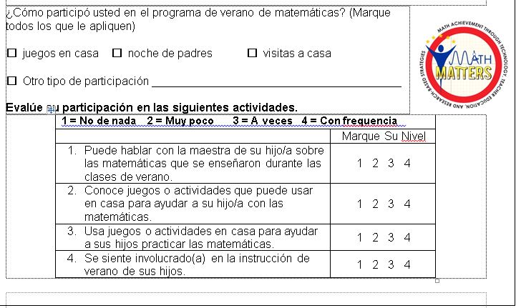
Parent Survey
There are 4 questions rated on a 4 point Likert scale.
We expect that 3 out of the 4 (25%) are scored at a level 3 or above to meet the outcome standard.
The outcome is that 80% of the surveys returned and tallied will have at least 3 out of the four questions scored at level 3 or above.

Slide 15
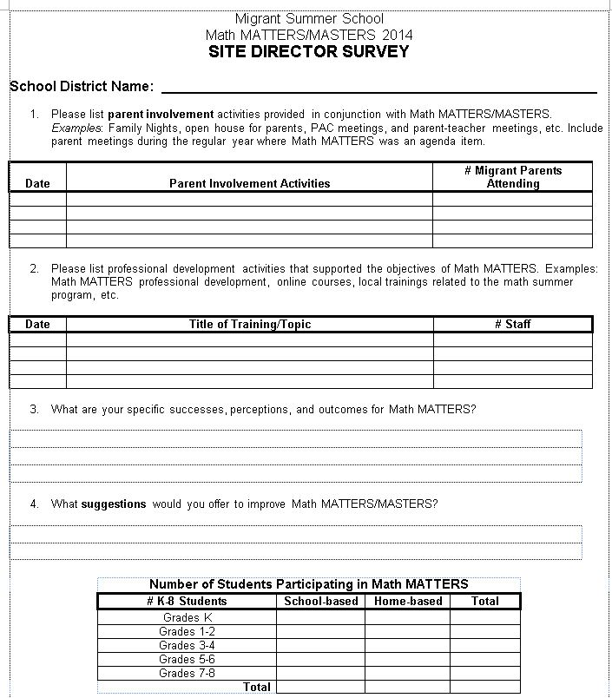
Site Director Survey
List parent involvement activities related to Math MATTERS
List professional development for instructional staff related to Math MATTERS
Enter numbers served by grade level.

Slide 16
Evaluation Summary
WHAT
DUE
All MSIS Reporting
iGrant summer EOY report (form package 249)
Send Site Director Survey to OSPI
Send Parent Surveys to OSPI
Immediately following end of program
Mid-September
August 29, 2014
August 29, 2014

Slide 17

Reflection
5 minutes
Jot down in your MM notebook anything you want to especially remember to emphasize about EVALUATION and REPORTING during your regional training…

