Slide 1
\
Training of Trainers
May 12-13, 2014
Yakima, WA

Slide 2
OUTCOME for 2-Day TOT
MEP/ESD participants will be able to conduct a successful regional or local Math MATTERS training for school district summer programs.
Notes:
After engaging in this two-day TOT, you will be able to meet the following content and language objectives:
We will start by building your background in MM through
A Review of the Math MATTERS goals and outcomes.
A Review of the evaluation results from Math MATTERS Year 1.
A Review of the components of Cognitively Guided Instruction.
Our success criteria:
You will be able to reflect and record summary information for each of these in your MMTOT notebooks

Slide 3
Content Objectives
Review Math MATTERS goals and outcomes. (BB)
Review evaluation results from Math MATTERS Year 1. (BB)
Review components of Cognitively Guided Instruction. (BB)
Notes:
After engaging in this two-day TOT, you will be able to meet the following content and language objectives:
We will start by building your background in MM through
A Review of the Math MATTERS goals and outcomes.
A Review of the evaluation results from Math MATTERS Year 1.
A Review of the components of Cognitively Guided Instruction.
Our success criteria:
You will be able to reflect and record summary information for each of these in your MMTOT notebooks

Slide 4
Content Objectives
Explore a complete Math MATTERS lesson. (CI)
Explore extension activities. (CI)
Model scoring on various (CI) assessments.
Notes:
And continuing with our content objectives for this 2-day TOT:
We will try to make the new information around a Math MATTERS lesson Comprehensible
4. Through the exploration of a complete Math MATTERS lesson.
We will Practice and Apply our new knowledge through
5. A hands-on exploration of sample extension activities.
Modeling how to score assessments.
Our success criteria:
You will be able to

Slide 5
Content Objectives
Review data collection requirements. (CI)
Explore instructional and professional development opportunities through MAS Space. (S)
Crosswalk the MM content with the CCSS math practices. (CI)
Support the planning of your local or regional MM training by facilitating planning and technical assistance on day 2. (P&A)

Slide 6
Language Objectives
Reflect and discuss Math MATTERS instructional activities. (I)
Recognize and respond orally to appropriate questioning techniques. (I & S)
Identify and discuss opportunities for using MAS Space. (I)
Write notes and summary information in your Math Matters notebooks. (R&A)

Slide 7
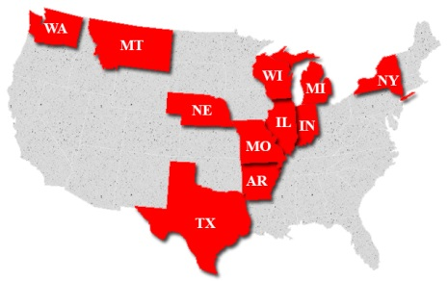
Consortium States and Partner States
Notes:
Math MATTERS is a consortium incentive grant funded by the Office of Migrant Education. The overarching goal of the project is to improve the math skills of migrant students through scientifically-based instruction, technology integration, professional development, and parent involvement.
The map indicates the 8 total consortium and 3 partner states. Washington is no longer part of the consortium but is considered a “partner” state along with Michigan and New York.

Slide 8
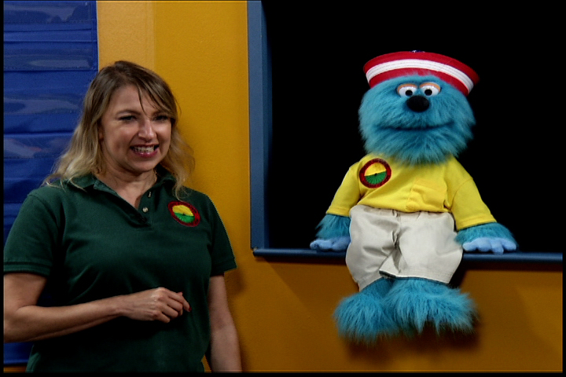
Math MATTERS Successes!
Notes:
MM has a Content Advisory Team. This team reviews the evaluation results carefully and uses the results to inform their planning for the coming year’s curriculum and training. The following slides list some of the successes from Year 1.

Slide 9
Math scores are increasing, and several teachers commented that English language ability is also increasing.
Many teachers commented that they saw growth in their students’ math abilities.
The curriculum is consistently described as “strong,” “engaging,” and “challenging.”
Teachers described gains such as “students could show that they understood the math they were doing” and “students started the summer afraid of math, but were much more confident after Math MATTERS.”

Slide 10
Suggestions
Include a Table of Contents
Provide for additional proofreading to reduce errors.
Provide more flexibility because it is difficult for some programs (of shorter duration or home-based) to conduct all of the activities or use all of the materials available.
Notes:
The Content Advisory Team made changes based on suggestions received from Year 1. There were many requests for a table of contents and have now incorporated this feature into the primary four grade bands (K, 1-2, 3-4, 5-6). They also received feedback on the number of errors, so they had two states help them edit. This had led to fewer errors.
The Content Advisory team understands from feedback that the MM curriculum and materials can be overwhelming, particularly for home-based and summer programs of shorter duration. Consequently they have tried to incorporate additional flexibility by identifying essential vs optional daily routines and providing a focused in-home lesson.
See the handout on the more focused “In-Home” instruction/lesson.

Slide 11
Math MATTERS Evaluation Results
Notes:
Let’s take a quick look at the evaluation results for Year 1. The good news is that all performance measures were met!

Slide 12
Performance Measure
Following summer programs annually, 80% of students in grades K-6 with both pre- and post-assessments in the 8 participating consortium States will increase their scores by 9% from pre-assessment to post-assessment on the Math MATTERS curriculum-based assessments.
Notes:
(Read Objective 1)
The consortium states had a few additional measures (secondary, parent and teacher related measures) but this was the main one with regard to student achievement or student gains.

Slide 13
Student Results (ALL REPORTING STATES)
 | Year 1
Grade | N | Mean Pre | Mean Post | % Gain | # (%) Gaining 9% | P value
K | 1,025 | 55% | 78% | +23% | 861 (84%) | <.001
1 | 1,047 | 52% | 77% | +25% | 844 (81%) | <.001
2 | 968 | 47% | 73% | +26% | 810 (84%) | <.001
3 | 850 | 47% | 73% | +26% | 681 (80%) | <.001
4 | 783 | 37% | 65% | +28% | 653 (83%) | <.001
5 | 719 | 38% | 65% | +27% | 588 (82%) | <.001
6 | 538 | 28% | 53% | +25% | 434 (81%) | <.001
Total | 5,930 | 45% | 71% | +26% | 4,871 (82%) | <.001
Notes:
These results do not include Washington (and probably don’t include the other two partner states because I think the only ones who had to send in their data to Meta Associates were the consortium states.
This performance measure (80%) was met with 82% of the 5,930 K-6 students with both pre- and post-assessments making the target gain. The mean gain across the grade levels and across the states was 26%. In addition, the performance measure was met at each grade level with at least 80% of students making a 9% gain.

Slide 14
Washington State Results 2013
Notes:
This performance measure (80%) was met with 82% of the 5,930 K-6 students with both pre- and post-assessments making the target gain. The mean gain across the grade levels and across the states was 26%. In addition, the performance measure was met at each grade level with at least 80% of students making a 9% gain.

Slide 15
Math MATTERS and CCSS
What is the alignment between Math MATTERS and CCSS?
Notes:
Texas told us that they can’t even “say” the word CCSS—that it’s a bad word in Texas. But they reassured us that the standards on which Math MATTERS was based we will find very similar to the Math Practices found in the CCSS.
Rather than take them at their word, it is more helpful for us as trainers to know what is and is not congruent with our CCSS. Especially because teachers will be asking and want to know this because the CCSS is their focus now.
To our knowledge, OSPI has not done a comparison of MM to CCSS, so for part of the day tomorrow, we will be working together to conduct a crosswalk between the two. Through this process we will all become more clear as to how MM aligns with CCSS and where it may deviate.

Slide 16
Math MATTERS Curriculum Approach

Slide 17
Math content and balanced literacy delivered through a sheltered instructional approach
Notes:
Math MATTERS provides a math curriculum that emphasizes the intersection between instructional practices for mathematics and reading (CGI and Balanced Literacy strategies) with instructional practices for English learners (sheltered instruction strategies aligned with the English Language Proficiency Standards). The balanced literacy that MM touts is a well scaffolded progression of guided reading and modeled writing through interactive collaborative R&W and finally independent R&W. The math content was chosen based on the content of the Texas state math test (TAKS) that migrant students were most often failing. These included multi-step problems, being able to find/show multiple ways to solve a problem, fractions, and more. You will see the Math content detail that makes up the 5 grade bands later in our training.

Slide 18
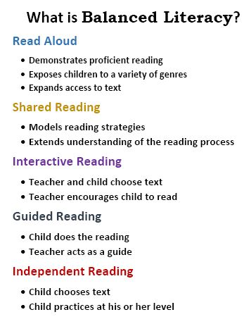
Notes:
As we walk through the lessons, we’ll be asking you to identify some of the balanced literacy and sheltered instruction strategies that are embedded. In preparation for that, let’s take a 5-minute gallery walk to look at the posters around the room and familiarize ourselves with the key pieces of this Math/Literacy intersection. These will be the Balanced Literacy poster, the Sheltered Instruction poster and the Key Math MATTERS Strategies poster. When you are finished, come back to your tables and prepare to share one thing that caught your attention from any of the three posters.

Slide 19
Curriculum Organization
Grade Band Icons:
K dog
1-2 crayon
3-4 dolphin
5-6 thunderbird
7-8 motorcycle
Each grade band contains 6 units.
(GB=6 units)
Each unit contains 3 lessons.
(Unit=3 lessons)
Notes:
The grade band breakdowns are different than the old Math MASTERS.
Math MASTERS used to be
K-1
2-3
4-5
6-8
Ask—How many grade bands are there? (5)
How many lessons in a unit? (3)
How many lessons in a grade band? (18)

Slide 20
LESSON COMPONENTS
Daily Routines
Classroom Lesson
TV Lesson
Follow Up Lesson
Routine reinforcement of skills
Literacy lesson
Transition to Math
Math lesson
Math game
Snack fractions

Slide 21
How Long Will It Take
How many instructional hours will it take to complete…
…a lesson?
…a unit?
…a grade band?

Slide 22
How Long Does a Lesson Take?
Daily Routines (30-45 min)
Classroom Lesson (60-90 min)
TV Lesson (30)
Follow Up Lesson
45
90
30
60
_________________
225 min
3.75 hours
Notes:
The time that a lesson takes is subjective. The actual time will be based on the needs of your students and how much scaffolding and differentiation you will need to do.
Daily routines take longer in the beginning while the students are learning the routines. After a while, they know exactly what is expected and they are able to move ahead at a faster pace.
Some teachers have said that they pause the TV lesson part way through and embellish or clarify what the TV teacher is saying if they have another way of explaining or want to emphasize a particular point.
There are ways to lengthen or shorten many of the activities. For example, in the follow up lesson (when the students play math games with each other) the length of “practice” during the playing of the game can be shortened or lengthened depending on the amount of time at hand.

Slide 23
Required Materials
Curriculum
DVDs
Books
Manipulatives and other supplies
Teacher’s guide and student BLMs
For the TV lesson(Math concepts)
For the Classroom (literacy) lesson
These are required to carry out the activities including food for snack fractions
Notes:
In this case, food is considered an instructional supply, not light refreshment.

Slide 24
How Do We Order Materials?
http://projectsmart.esc20.net

Slide 25
A Curriculum Order includes:
Operational Guide—Also available online
K-8 Curriculum (Paper Copy and electronic copy on CD)
Parent Guides (English/Spanish)
Curriculum Overviews
Assessments (English/Spanish)
Curriculum order does not include the DVDs of the math lessons (These are required and must be ordered separately. They will be shipped weekly beginning the last week of May as they get them taped and duplicated.)
Notes:
When you get the box of curriculum, if will include: (see above)

Slide 26
For those implementing an in-home program, a digital in-home lesson booklet will be on the CD but NOT printed.
Notes:
Do you know of anyone in your districts who might be doing an “in-home” Math MATTERS program this summer?

Slide 27
2014 Timeline for Directors
Download the Operational Guide (available now!)
Determine what grade bands will be served
Determine number of staff needed for each grade band and post positions
Determine total instructional hours dedicated to Math MATTERS (hours per day/days per week/weeks per summer)
Determine which units will be covered
Notes:
The Math MATTERS Operational Guide will be posted on the website in April. The curriculum and DVD order forms, book lists, and manipulatives lists are posted on the website. Snack fraction and supply lists will be posted this month. In your TOT binder you’ll find a copy of a suggested implementation timeline.

Slide 28
2014 Timeline (continued)
Order curriculum (and DVDs) asap (shipped in mid-May or as orders are received thereafter)
Order books (wishlists at Amazon; look up mkernel@nwesd.org )
Review manipulatives list and purchase, as necessary.
Review other supply lists (snack fractions and general supplies) and purchase, as necessary.
Plan local professional development (ESD training, PD in a Flash on MAS Space, etc.)

Slide 29
Questions?

Slide 30
5-Minute Reflection
Take 1 minute to reflect on the information just presented and what you need to remember when preparing for your training.
Create a T-chart in your Math MATTERS notebooks and label the two columns “Important TO DOs” and “Remember”
Take 4 minutes to write things you want to remember and things you need/want to do to prepare for your MM trainings.

