Slide 1
\
Lesson Walkthrough
DAILY ROUTINES
Notes:
Intro: we will walk you through all of the components of a sample lesson.
The sample we have chosen to use for this walkthrough is Grade Band 5-6, Unit 1, Lesson 1
You will have time to peruse your own grade band later in the training

Slide 2
Lesson Components
Daily Routines
Classroom Lesson (Literacy)
Transition to Math
TV (Math) Lesson (DVD)
Follow Up
Snack Fractions
Notes:
Refer to the poster on the wall throughout the day to remind you of these 6 components of a lesson and the order in which they are found in a lesson. We will be going through each piece in more detail as we do the lesson walkthrough. So let’s begin with the daily routines.

Slide 3
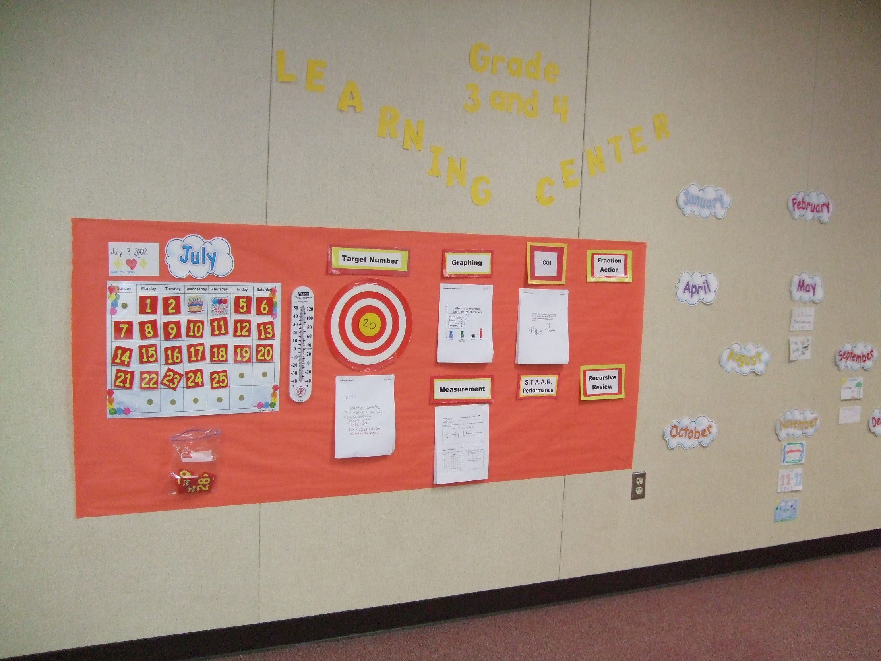
Daily Routines
Review Renew Revise Reinforce
Notes:
The Daily Routines are the first part of every day. These activities provide your students with a consistent way to sharpen the skills they are learning. The activities review previous concepts, renew and revise misconceptions previously learned, and they reinforce skills.

Slide 4
Daily Routines - Materials
Content and language objectives
BLM Measurement Lab
Centimeter ruler
BLM Polygon Shapes
BLM Fraction Action and X Marks the Spot
BLM Solve It! (Lessons 1, 2, 3)

Slide 5
Daily Routines
ESSENTIAL Activities
OPTIONAL Activities
Notes:
This year we have divided the Daily Routines into ESSENTIAL and OPTIONAL activities. The ESSENTIAL activities are specifically tied to assessment items, and will be marked as such on your 2-page overview of the unit’s routines. OPTIONAL activities are for sites with programs of longer duration, but are certainly available and appropriate for all summer sites.

Slide 6
Daily Routines Board: 5-6
Essential
Optional
Target Number
Measurement Lab
X Marks
the Spot
12
CGI
Solve It!
Fraction
Action
Money Matters
On MAS Space
Notes:
Time for you now to become learners! We are going to walk through an entire lesson cycle. Today, you will experience selected activities from the 5-6 Daily Routines board. These will be Lesson TWO activities. There are no Daily Routines written for Pre-Assessment days or for Post-Assessment Days.
Let’s begin!
Target Number – Although Target Number is an optional Daily Routine, we’d like for you to experience it today. It’s very brief, and it is ESSENTIAL in some of the lower grades. (Explain, tell them they have 30 seconds from the time the target number appears on the slide, wait 30 seconds, then share.)
We experienced a CGI problem in our PD in a Flash, so we won’t take the time to do another here. Remember, though, that many of your assessment items are CGI type problems and students do earn points for their explanations.
(Model the other Daily Routine activities for grades 5-6: Solve It, X marks the Spot, Measurement OR Fraction Action.)

Slide 7
Let’s take a peek at the lower grade bands.
Notes:
Let’s look at the ESSENTIAL and OPTIONAL activities for each of the lower grade bands. On your tables you have one copy of the Daily Routine explanations for each grade level.

Slide 8
Daily Routines Kinder
Essential
Optional
Calendar
Days of the Week
Measurement Lab
CGI
Yesterday, Today, Tomorrow
Graphing
Straws
Pennies
Money Matters
(MAS Space)
Notes:
(Name the essential routines for Kindergarten)
By the way, Kinder Teachers, your Measurement Lab and counting the days of summer school with pennies will help your students learn to differentiate the 4 coins - pennies, nickels, dimes, quarters – which is assessment item 7. This is a life skill, and very important to your students’ first grade success.

Slide 9
Daily Routines 1-2
Essential
Optional
Target Number
Solve It!
Measurement Lab
Straws
What’s
Missing?
Calendar
Graphing
Pennies
CGI
Money Matters (MAS Space)
Notes:
(Name the essential routines for grades 1-2)

Slide 10
Daily Routines 3-4
Essential
Optional
Solve It!
What’s
Missing?
Graphing
Target Number
Fraction Action
Measurement Lab
Money Matters
CGI
On MAS Space
Notes:
(Name the essential routines for grades 3-4)
You’ll see that there isn’t a Measurement Lab activity in every lesson; but where there is one, it will help students gain the understanding necessary to be successful on the assessments.

Slide 11
Daily Routines 5-6
Essential
Optional
Solve It!
X Marks the
Spot
Target Number
Graphing
Fraction Action
CGI
Measurement Lab
Money Matters on MAS Space

Slide 12
Questions on Daily Routines?
Notes:
We looked at that overview segment during our preview of the TOT Notebook. (show copy)
Now, are there any questions about the Daily Routines?

Slide 13
Reflect
Share
Write
Reflect on what you heard… (1 min)
Share w partner something you want to remember for your training… (2 min each)
Write what you want to remember in your notebook (5 min)

