Slide 1
\
Accessing MAS Space

Slide 2
What is MAS Space?
Online portals for:
Grade K-8 Curriculum
Training Videos
Professional development covering Balanced Literacy, CGI, Sheltered Instruction, Math in a Flash, and other math concepts.
Notes:
MAS Space is an online portal for students and teachers to access additional content for the Math MATTERS curriculum. There are 5 student portals, Kindergarten, grades 1-2, grades 3-4, grades 5-6, and grades 7-8. Each portal is secured by an enrollment key. Once the key is entered, you will be able to access the courses without having to type in the key again. A list of enrollment keys can be found in the Operational Guide.
MAS Space also includes portals to TOT materials and online professional development.

Slide 3
How do I access MAS Space?
http://projectsmart.esc20.net
Notes:
The easiest way to access MAS Space is by clicking on the link from the Project SMART website.

Slide 4
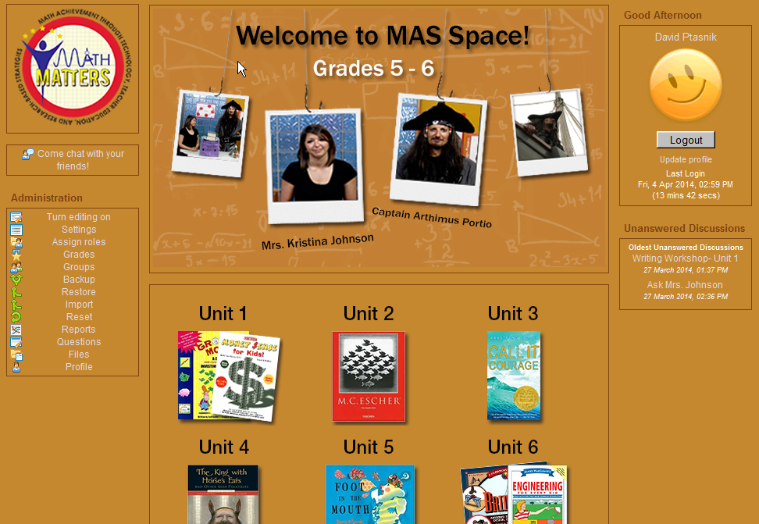
Course Home Page
Notes:
This is the grade 5-6 portal. Let’s navigate through the different activities.
In the middle of the page are the curriculum units. Clicking on one of them will take you to the unit selections.

Slide 5
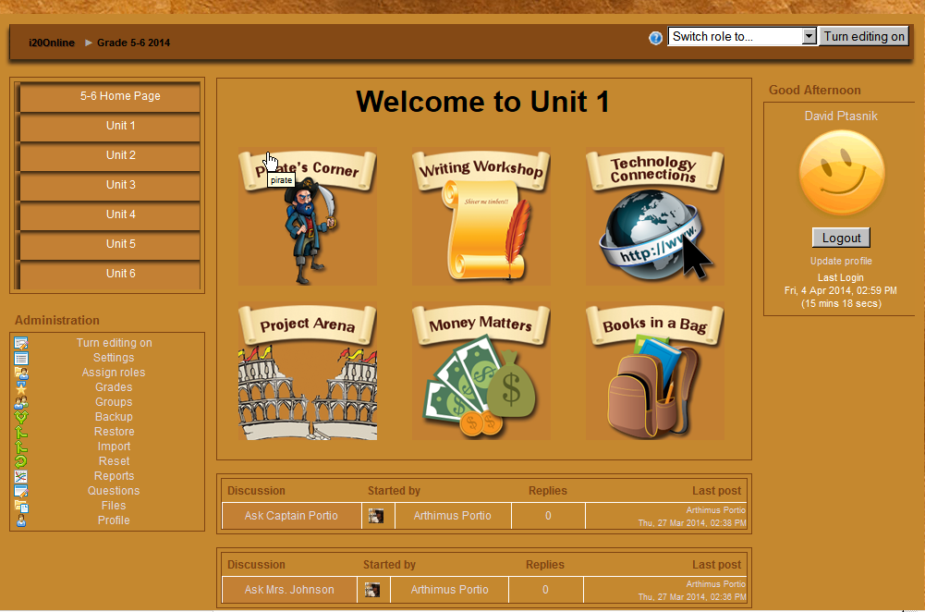
Unit 1 Selections
Notes:
This is Unit 1’s main section. To navigate, choose from a main area in the middle: Pirate’s Corner, Writing Workshop, Technology Connections, and Project Arena, You’ll notice that Money Matters and Books in a Bag have been moved to MAS Space.
To navigate to other units or back to the home page, use the navigation on the left hand side.
Two forums are found on this page, Ask Captain Portio and Ask Mrs. Johnson. Use these areas to ask questions about anything.
Every page contains a logout button. Use this to logout of course. Doing this will take you to the ESC-20 online campus home page, not the Project SMART home page.
Let’s take a look at the Pirate’s Corner.

Slide 6
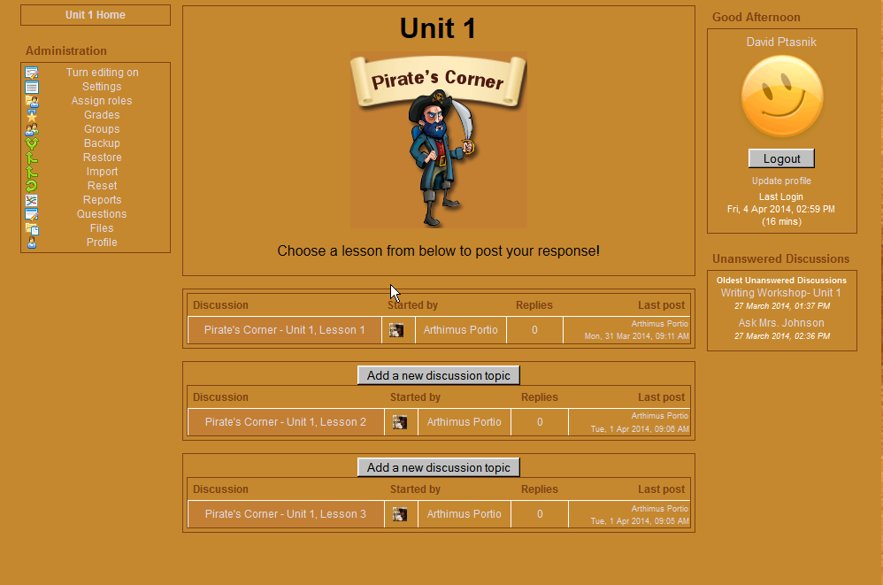
Pirates Corner Forums
Notes:
Each unit will have three forums, one for each lesson in that unit. The curriculum will refer to the question of the day called Pirate’s corner. To see the question, select the lesson by clicking the link. The next page shows the question and where to add your response.

Slide 7
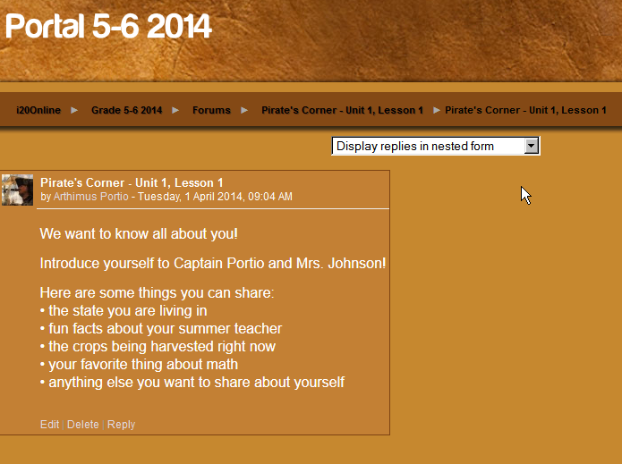
Pirate’s Corner Lesson 1 Question
Notes:
This page shows the question and where to add your response. Read the question then click on Reply to add your response.

Slide 8
Reply Box
Notes:
This page shows the question and where to add your response. Read the question then click on Reply to add your response. Once finished, click on post to forum and your answer is sent.

Slide 9
Navigating Back
Notes:
Anytime you need to navigate back to a main area and the navigation menu is not available on the left hand side, use the breadcrumbs and the top of the page and click on the course name from the trail. In this case, I will click Grades 5-6 2014 from the trail. It will take you to the last place you were viewing.

Slide 10
Navigating Back to Unit Home
Notes:
Click on Unit 1 Home to get back to the unit home page.

Slide 11
New Selections
Notes:
We have added some new areas this year. Money Matters, and Books in a Bag have both been moved out of the curriculum and added to MAS Space. All the information you need to perform the required lessons can be found in the links provided.

Slide 12
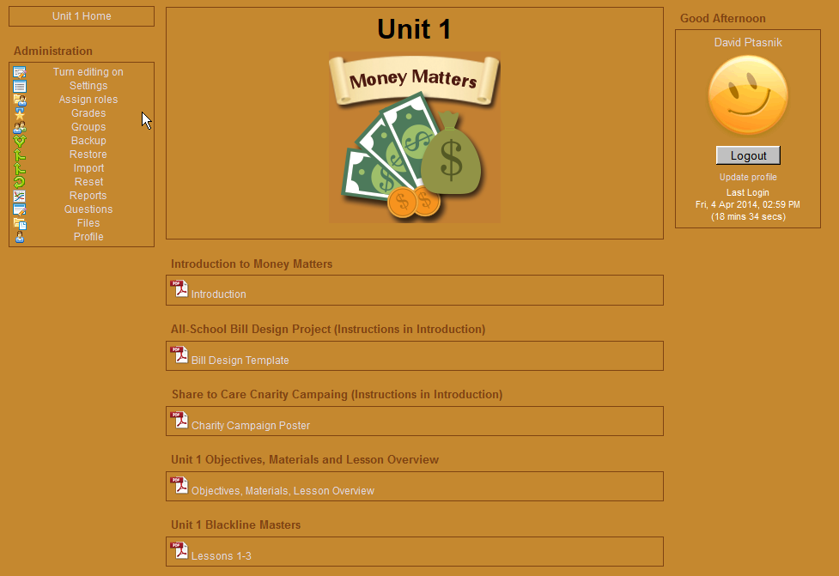
Money Matters
Notes:
Click on the documents to download the files you need.

Slide 13
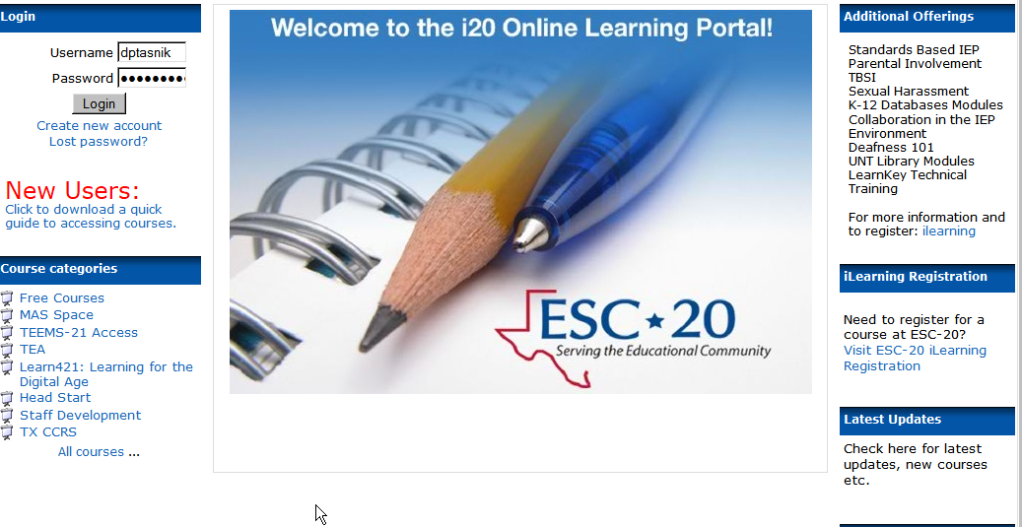
Other Courses
Notes:
Click the logout button to logout. You are brought to the system home page. The address is i20online.esc20.net if you want to get back to this page without going through the Project SMART homepage. To get back into your course or enroll in another course, click on the category name from the list to the left called MAS Space. It will take you to the main categories of MAS Space you previously viewed.

Slide 14
Professional Development
Notes:
These are the professional development courses for teachers. Each course has an enrollment key you can find in your Operational Guide. Like other courses once you enter your enrollment key, you won’t have to do it again. Texas teachers can receive CPE credit for these courses. Certificates are available upon completion of the course.

Slide 15
Virtual TOT Math MATTERS
Notes:
The virtual TOT Math MATTERS is your source for all content needed to train your users. Use this area to download content, view videos, or post questions.

Slide 16
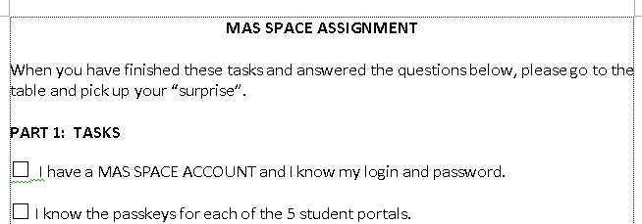
NOW IT’S YOUR TURN!
20 min
Notes:
If you didn’t bring a laptop you will need to work with a partner for this assignment. (Pass out the MAS SPACE Assignment one per person.) You will know when everyone is finished when all the surprises are gone from the table.
Dawn and I are available for on the spot support during this time if you need some. If you have MAS SPACE questions that come up during this activity…write them down. We will take Q&A at the end of this segment.
YOU WILL HAVE 20 minutes to complete the assignment and poke around in the website.

Slide 17
Wrap Up
Questions?
Notes:
What questions do you have?

