Slide 1
Maximizing Your Impact as a Para Professional
Mary Kirby, Migrant Content Specialist, ESD 123 December 5, 2013

Slide 2
Fiesta Time!
Move around the room until you hear the music stop.
Find a partner and share one word about the phrase or word.
You’ll have one minute each to share.
Notes:
Have students mull about the room. When music stops, find a partner and share one word about the following:
Something that makes you laugh -repeat music and mulling to find a new partner
Education – repeat
One thing that inspires you - repeat
Migrants and or migrant education– repeat
What’s the one thing you enjoy most about your job?

Slide 3
Objectives/outcomes
Content Objectives:
Participants will identify the needs of Migrant Students.
Participants will better understand the significance of cultural bias and poverty on students.
Language Objectives:
Participants will use effective speaking strategies.
Participants will create a language objective.
Participants will create graphic organizers for various tasks.

Slide 4
Working Together
How Proficient Collaborators Think and Act
What Social Strategy Use Looks and Sounds Like
Notes:
Look at Handout Together = (from Texts and Lessons book)
Read the Strategies aloud together – whole group
You are smart adults so we don’t need to spend time going over these in detail. But please take a second and look these over. My favorite is the fact that this gives students an example of what collaboration doesn’t look like.
On an index card – write down one of these strategies that you would like to work on yourself throughout our time together.

Slide 5
Working with diverse learners
Who are the diverse learners you work with?
What are their lives and homes like?
Notes:
On a sticky note, list the types of students you work with.
Turn and Talk – Before doing the Turn and Talk
Ideas:
learning disabled
ESL
Migrant
Struggling/behind grade level students
ALL students
Turn to your other neighbor and discuss the 2nd question.

Slide 6
Migrant 7 Areas of Concern
Educational Continuity
Instructional Time
School Engagement
English Language Development
Educational Support in the Home
Health
Access to Services
Let's take a closer look into the lives of some migrant children.
Notes:
If movie doesn’t work: http://www.youtube.com/watch?v=O0ucD1AyhcA
http://afop.org/children-in-the-fields/view-multimedia/

Slide 7
What is Culture?
On an index card, write a definition of the word ‘culture’.
In your table group, come up with a group definition of culture.
Notes:
Post definitions around room or at front of room.

Slide 8
Cultural Differences
Pre-linguistic children not spoken to
Children speak only when spoken to
Volunteering answers = showing off
Different wait times
Different story telling styles
Different personal space boundaries
Notes:
Way parents talk to kids – orders, short, less explanation –
My husband’s cousin, a teacher in NYC, visited this past summer. My boys had left their bikes outside on the driveway. She shared that in NYC that wouldn’t happen. Not because kids are bad there, but because they would look at it like you must not value your stuff if you leave it out. She said new teachers from outside of NY face this every year.
Another example was when my husband was in graduate school he had to read student papers. He kept finding that the Chinese students copied or plagiarized much of their work. When he confronted them, the response was always that they were showing respect or honor to quote an experts text.

Slide 9
Variety of School Experiences
Parents have limited school and ability to read and write and children have none
Parents can read and write in their first language but children have no school
Parents can read and write and children have been read to and written some
Parents and children can read and write in their first language

Slide 10
Students from Poverty
Could you survive in a different social class?
Notes:
Could you survive in the various classes? Take survey and discuss findings. Did anything surprise you?

Slide 11
Children raised in poverty are more likely to display:
“Acting-out” behaviors
Impatience and impulsivity
Gaps in politeness and social graces
A more limited range of behavioral responses
Less empathy for others’ misfortunes
Notes:
If is easier to condemn a child’s behavior than it is to help the student change it.

Slide 12
The federal poverty level in 2012 for a family of four is $23,681.
The average total family income for migrant farm workers ranges from $17,500 to $19,999.

Slide 13
Let’s check our knowledge!
Notes:
Do a 4 corners set up with the answers to questions on poster paper. Read the question than have participants go to the paper where they see their answer.

Slide 14
Observing an Orange
On a piece of paper, title a page: Observing an Orange
Make and record your observations about an orange
Size
Shape
Color
Patterns
Texture
Weight
Smell
Taste
……..
2 minutes

Slide 15
Model of an orange
Now take a look at the model of the orange.
Cross off words on your list that you wouldn’t have come up with by just looking at the model.
1 Minutes

Slide 16

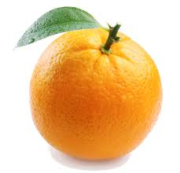

Images of Oranges
Notes:
Have students cross off anything on their list that they wouldn’t be able to know from just the images.

Slide 17
The Written Word…
orange
Notes:
Again, cross off anything that a student wouldn’t know about an orange with just the word.

Slide 18
I hear and I forget
I see and I remember
I do and I understand
-Chinese Proverb
Notes:
In table groups, come up with one activity that you could apply this to for each of the four primary content areas: LA, math, science, SS

Slide 19
The Learning Pyramid
Practice
Lecture
Reading
Teaching Others
Audio-Visual
Group Discussion
Demonstration
Notes:
On the pyramid in front of you, order the following teaching methods from most effective to least effective. Most effective being on the bottom of the pyramid – as that is where we should want our students to spend most of their time.

Slide 20
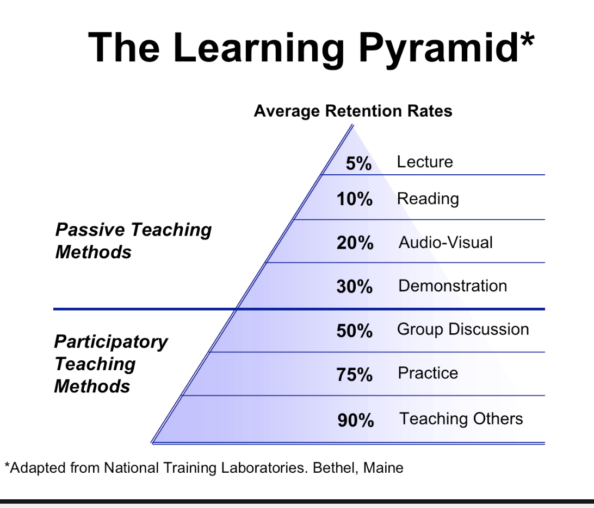

Slide 21
Language Objectives & Content Objectives
Notes:
Content Objectives – identify what students would know (parts of the plant, Lewis & Clark journey..)
Language Objectives – are the language demands of the content class (represent an aspect of academic English that students need to learn or master)

Slide 22
Think of an English learner you have worked with recently and write down all of the reasons this student is not considered English proficient in class.
The reasons you listed are your language objectives.
Notes:
Think, pair, share
Elicit responses such as: poor reading comprehension, technical difficulties in writing, problems with English pronunciation, and limited background knowledge which results in limited academic vocabulary.

Slide 23
What language will students need to know and use to accomplish this lesson’s content objectives?
How can I move my students’ English language knowledge forward in this lesson?
Notes:
Even though as Para’s we are usually not creating the lesson, it is important to understand what the objective of the lesson is.

Slide 24
Consider the following four categories as the starting point for generating language objectives
Your speech
Class discussion
Reading assignments
Writing tasks
Notes:
Your language objective needs to complement the topic and you need to explicitly address it in your lesson.

Slide 25
Language Objective Examples:
Students will be able to define the terms square, rectangle, rhombus, trapezoid, and parallelogram orally.
Students will be able to use adverbs of time in their lab report to describe their observations.
Students will be able to write comparative sentences about the two types of rocks.
Students will be able to present an oral report about one landform and its influence on economic development.
  Let’s write a language objective!
Notes:
Objectives should be narrow in focus. It is important for us to know what exactly the teacher and we expect of our students. Even more important, is that the student knows what is expected of him or her.
Look at the handout
Each table group will be given three content objectives – come up with a language objective that might work for the content objective. Share out.

Slide 26
Quick Assessment
On a post-it write down…
Green – Something you have learned.
Yellow – A question you have???
Red – What has prevented or stopped you from learning?

Slide 27

10 Minute Break!

Slide 28
Speaking to Students

Slide 29
Appropriate Orientation
Students, especially middle and high school age students, are trying to establish their own identity.
Common way to do this is to rebel against authority.
We want to choose language that steers our students away from disruptive thoughts. (We don’t want to give them opportunities to rebel against.)
Notes:
Our brains are constantly being bombarded with input from our senses. If you tried to pay attention to it all you’d go crazy. Our brains are programmed to pay conscious attention to what is important at this very moment.
In the classroom, you are the authority – therefore, students will want to rebel against you.

Slide 30
I want you to go outside.
Let’s go outside.
Notes:
I want you to go outside. – What do students hear? I want you to… This is asserting the teacher’s control – for someone who doesn’t want to be ordered around, they may instantly react negatively. How could we reword this to be viewed more favorably by a student?
Let’s go outside – here the teacher is not specifically isolated in the statement as the authority figure. Using let’s includes the teacher which may soften the command.

Slide 31
Other phrases to avoid …
You should…
I think you’d better…
You need to…

Slide 32
You try it…
I want you to find your group and sit with them.
You should leave the room now.
You have one more minute.
I’m going to give you a choice.
Notes:
In table groups, go through the examples and have each group share. Write down examples. (lots of variations)
Ex responses:
Please find your group and sit with them.
Leave the room.
One more minute.
Which choice would you like to make?

Slide 33
Any questions?
Students must make several mental adjustments to answer this question.
They have been listening to information.
They have been processing the information.
Stop. Sort through material to see if they do have a question.
Must find the words to express their idea.
Must find the courage to speak publicly.
This process takes time!
Notes:
Ask the participants if they have “any questions”.
-how many times have we heard this asked and the response is silence? How might we open up a discussion with our students and generate the maximum possible interaction?

Slide 34
Give students time to prepare their thoughts in a safe way.
Turn to one or two people near you and briefly discuss this. (WAIT – 20-30 seconds).
What thoughts or questions do you have about this topic? What comments would you like to make? What areas, if any, might I clarify? (WAIT – 20-30 seconds).
Please thank your partners for sharing. Face back toward me. Now, what questions or comments do you have?
Notes:
This whole process should not take very long – maybe one to two minutes – this is not small group work! It gives the students an opportunity to make mental adjustments and prepare to be in a discussion.

Slide 35
Ask Open Questions
What is the most important political issue facing the world today?
Two assumptions are being made by this question.
There exists only a single correct response.
The teacher’s answer is the correct answer.
Notes:
Students are being asked to first generate a list of several responses then they have to evaluate which is the believe is best. Next they need to think if their idea matches the teachers idea. Then they need to weigh the risk of being wrong in front of others.

Slide 36
Let’s practice
What’s the best way to make a cake?
What are the rules to the game of Musical Chairs?
Notes:
Do the snowball fight here to share answers (from Dawn’s vocabulary activities). Then discuss why snowball fight is a safe way for students to share out.
Examples of open questions in case participants don’t have any…”What steps would you use to bake a cake?” “Who’s played musical chairs before? What rules did you use?” –is there just a single set of rules? Nope.

Slide 37
Positive Mental Images
Images are a prime influence on behavior.
We want students to have an image in their minds that guides their behavior in the desired direction more effectively.
Don’t spill your milk.
Please be careful to keep the milk in the glass.

Slide 38
Watch these words:
can’t won’t don’t
wouldn’t shouldn’t couldn’t
avoid stop never
Now you try!
Notes:
Have posters around the room with phrases on them. Have partners write directly on the poster a positive statement.
Don’t look over there.
Try not to be late to class.
Be careful during recess. We don’t want any sprained ankles or broken bones.
Please complete this assignment without looking at your notes, the board at the front of the room, or anyone else’s paper.
Don’t make a lot of mistakes, or you’ll fail the test.

Slide 39
Compliments & Criticisms
Give Specific feedback – general feedback has been shown to have no positive affect on student behavior.
Positive Specific Praise
NOT: Well done. I liked it!
DO: Excellent presentation. I enjoyed your use of metaphor and the interaction you generated with the audience.
Provide specific criticism
NOT: That wasn’t the best you’ve done.
DO: I felt that the visual aids were hard to see, and the presentation could have covered more details of the project.
Notes:
Discuss the fact that it is good to give compliments out loud in front of whole group – encourages like actions by all. Criticisms are generally best done one on one or to the pair/group.

Slide 40
Specify the response
We need to clarify what we expect of students.
Look at the difference between these two statements:
How many of you have been to Mexico?
Raise your hands if you have been to Mexico.

Slide 41
Did you find all that? Good, let’s continue.
If you have found the second paragraph on page 27, please nod your head.
If you have not yet completed the assignment, please raise your hand.
If you have completed the assignment, please raise your hand.
  You Try!
Notes:
In the first example the teacher isn’t even looking for a response initially. The second statement indicates that the teacher really wants to know if the students are at the right spot.
Second example is phrased initially negatively. We want to emphasize the positive.
In table groups, have participants rephrase the statements on the handout to elicit a specific response. (do individually first, then share as a group – then share out).

Slide 42
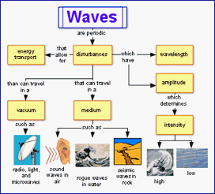
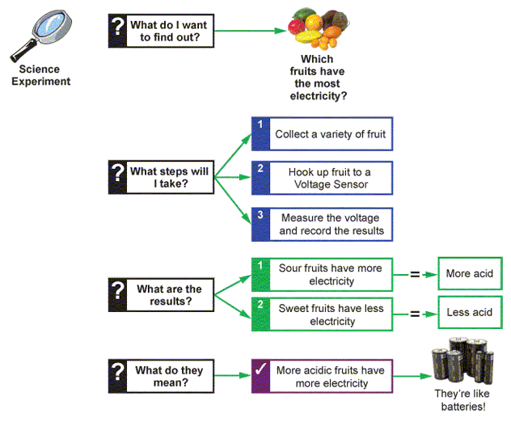
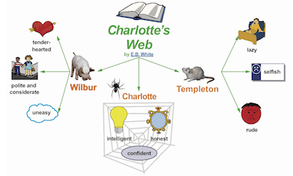
Graphic Organizers
Notes:
Graphic organizers are communication devices that show the organization or structure of concepts as well as relationships between concepts. This reduces the cognitive demands of the learner – the learner does not have to process as much semantic information to understand the information which is why they can be so great for ELLs. –www.GraphicOrganizers.com-

Slide 43
Graphic Organizers can be used to support teaching and learning in many areas.
Cause and effect
Note taking
Comparing and contrasting
Main ideas and themes
Vocabulary
Sequencing
Problem and solution
Describing and explaining

Slide 44
Why Use a Graphic Organizer?
Students are considerably more likely to understand and remember the content. They can separate what is important to know from what is non-essential.
Because semantic information processing demands are reduced, the content can be addressed at a more sophisticated or complex level.
Students are more likely to become strategic learners.
Notes:
Reading and writing skills,
communication skills, and analytical, critical, and creative thinking skills are all subject to improve
when students learn recognize these patterns of thinking, construct, and use graphic organizers

Slide 45
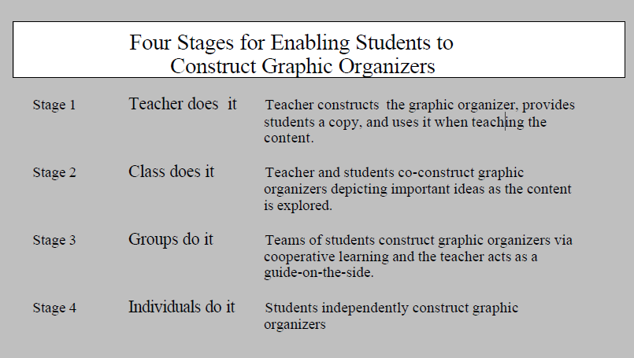

Slide 46
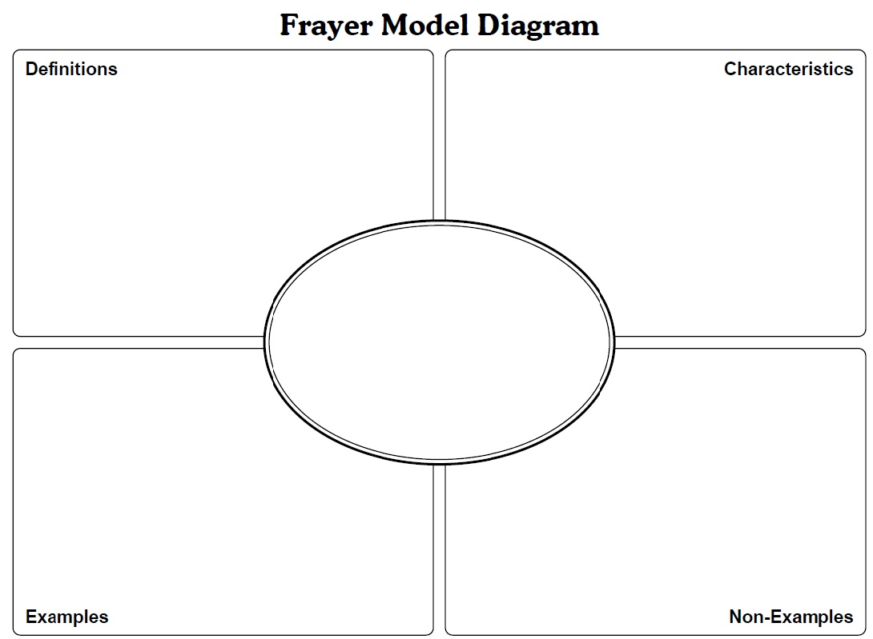
Frayer Model
Challenges
Facing Migrant Education
Notes:
Introduce Model – then have participant read the article and in groups, complete Frayer Model – for the topic of Challenges of Migrant Educution

Slide 47
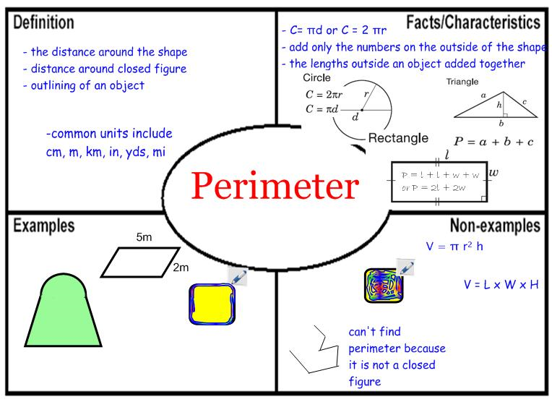
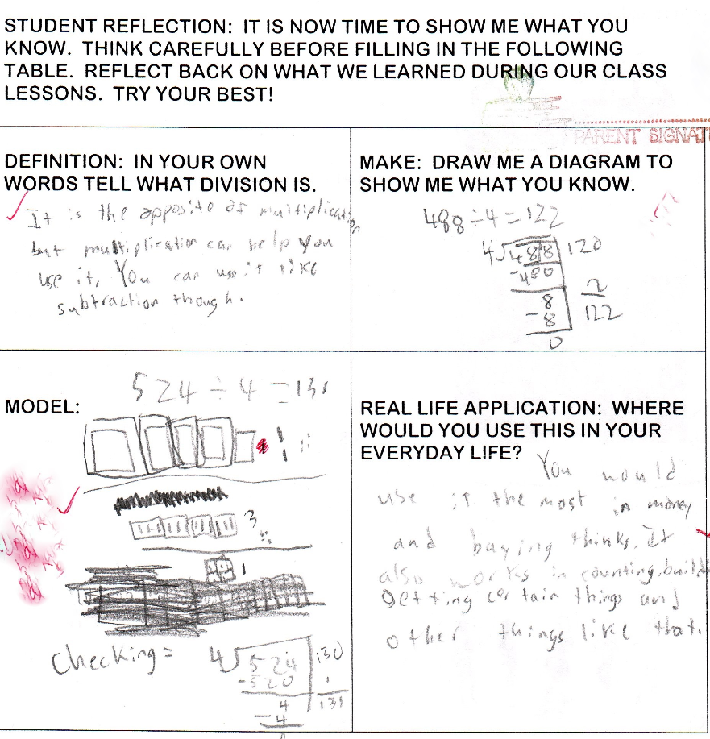
Frayer Examples…

Slide 48
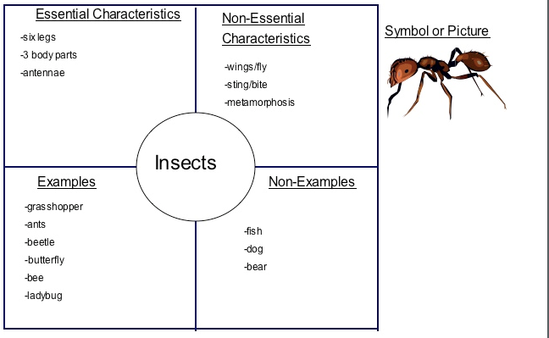
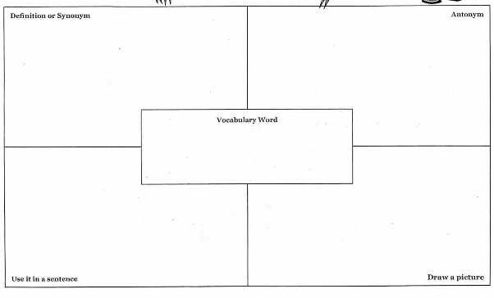

Slide 49
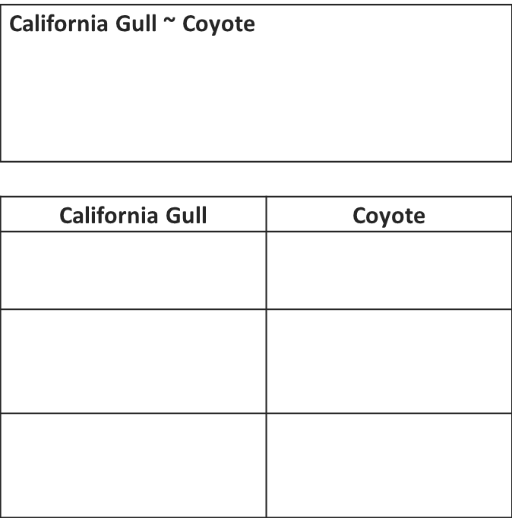
Compare - Contrast
Box and T Chart
Box:
Illustrates the similarities between two species
T-Chart:
Defines the differences using a one to one correspondence between two species

Slide 50
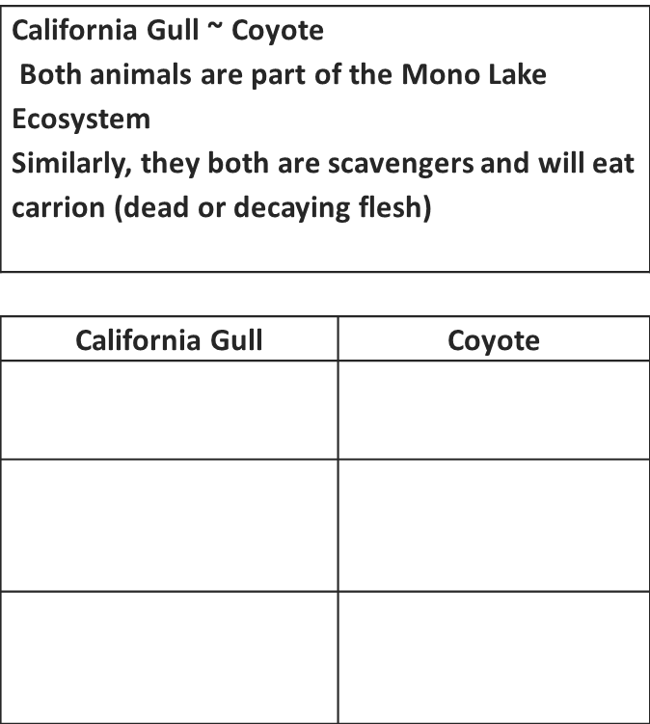

Slide 51
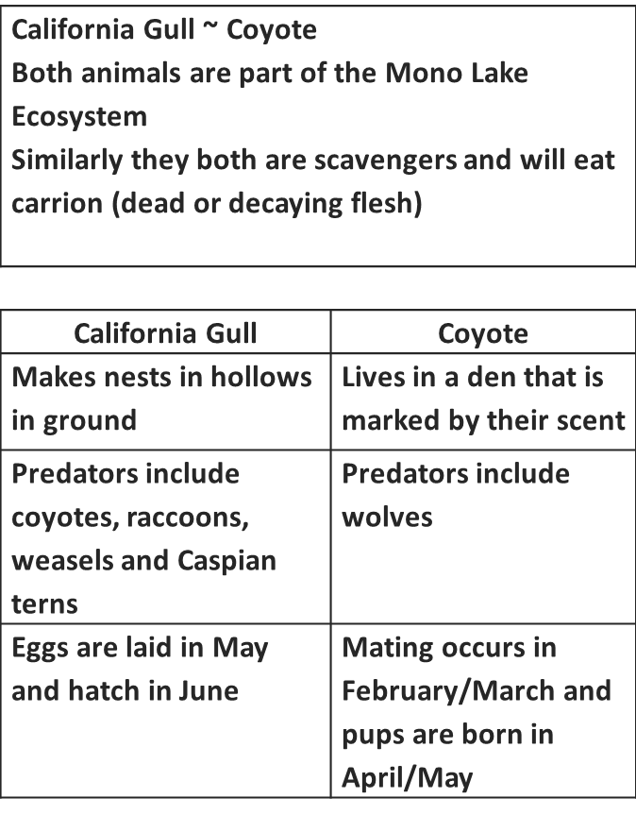
Notes:
Now that we have done one together, lets do one on our own.

Slide 52
Box and T chart
Using a Box and T chart, compare and contrast the following:
Migrant students and non migrant students

Slide 53
Review objectives
Content Objectives:
Participants will identify the needs of Migrant Students.
Participants will better understand the significance of cultural bias and poverty on students.
Language Objectives:
Participants will use effective speaking strategies.
Participants will create a language objective.
Participants will create graphic organizers for various tasks.

Slide 54
Evaluations

Slide 55
Works Cited
Allen, Richard Howell. Impact Teaching: Ideas and Strategies for Teachers to Maximize Student Learning. Boston: Allyn & Bacon, 2002. Print.
“Could You Survive: Take the Quiz.” Ahaprocess, The Grand Rapids Press, 29 April 2001. Web. 16 Sept. 2013
Echevarria, Jana, Mary Ellen Vogt and Deborah Short. Making Content Comprehensible for English Language Learners: The SIOP Model. Boston: Pearson Education, 2013. Print
EdChange: Informing Ourselves Reforming Our Schools Transforming our World. Equity & Diversity. Web. 17 Sept. 2013
Jensen, Eric. Teaching with Poverty in Mind. Alexandria: ASCD, 2009. Print.
Mendler, Allen N. Connecting with Students. Alexandria: ASCD, 2001. Print.
http://www.inspiration.com/visual-learning/graphic-organizers
Ellis, Edwin. “Q&A: What’s the Big Deal with Graphic Organizers?” 2004. Web. 18 Nov. 2013.

Slide 56
Thank You!
Mary Kirby, Migrant Content Specialist
mkirby@esd123.org

