Slide 1
The Role of Background Knowledge in Reading Instruction

Slide 2
Multiple Challenges in Close Reading
Academic language needed
Unlocking the meaning of complex texts
Notes:
One of the many hats we wear as educators of ELLs is to set up our students so they can achieve academic success. More attention is now being paid to the question of ELL rigor and finding the right balance between scaffolding and independent learning. The CCSS now call for us to be more cognizant of how we approach building ELL’s background knowledge as part of close reading.
There are multiple challenges for ELLs at all levels of English proficiency in effectively partaking in the close reading of complex texts. What is the role of background knowledge to meet these complex challenges?

Slide 3
How much background knowledge should we provide?
Continuum
None Extensive
Notes:
How much is appropriate for ELLs and migrant students?
This is an issue that we continue to struggle with…
How best to teach ELLs within a CCSS-based framework?
NONE—no background knowledge whatsoever; (exclusive attention on the text)
All the way to EXTENSIVE preparation about the subject of the text, the author, or other topics that relate to the text.
There has been some debate about whether to pre-teach elements of a text before students read it using a close reading framework
However, for ELLs, the role of background knowledge cannot be ignored.
Teachers need to find out how much background their students have about a text’s given topic and build background where necessary.

Slide 4
How much background knowledge?
“…As little preparation as required to engage with the text.”
Background knowledge should not take the place of students making meaning from the text
Notes:
--Tim Shanahan, Distinguished Professor Emeritus of Urban Education at University of Chicago; he is an expert on ELL literacy; serves as advisory to Colorin Colorado; this quote was taken from his article called “Letting the Text Take Center Stage” (fall 2013)
Teachers must help students must learn to extract the meaning from the text itself, (not pre-teach the meaning through ‘background knowledge’ in pre-reading activities) especially if working with a text over time to understand it deeply as the Common Core expects
So, although we must build ELLs’ background knowledge as necessary, we must then focus the majority of our instruction on having students working with the text itself so that they can unlock its meaning.

Slide 5
Matching Kids to Texts
Before CCSS, kids were often matched to texts at their instructional level
Now we must support and scaffold on grade level challenging texts
“Juicy Sentences”—Lily Wong Fillmore
Notes:
Some texts are harder to read than others
Before CCSS, teachers could give students books at their instructional level
With CCSS, there is a reversal of that practice
There is no firm base of research to support matching kids to texts
The levels matter, but so does the amount of support or scaffolding that a teacher does
Students will be more frustrated by challenging texts, so other instructional supports will be needed to help and encourage them
Teachers must learn to anticipate text challenges and how to support students in negotiating the texts successfully but without doing the work FOR THEM
Lily Wong Fillmore supports analyzing texts and spending time unpacking what she calls “juicy sentences”.

Slide 6
TESOL Vision of ESL Teacher Role
Expert
Consultant
Coach
Advocate
Notes:
ELL teachers have the expertise/skill set that is needed in the CCSS classroom; teachers and administrators need to partner with the ESL Teacher;
However, ESL teachers may still need support in NOT doing all the work for their students so that ELLs can gain more responsibility in negotiating texts

Slide 7
2 Areas of Background Knowledge
PROVIDING background knowledge
ACTIVATING existing prior knowledge
Notes:
We know that when a person reads, we integrate our prior knowledge with text information to form a mental representation. CCSS is all about close reading, but that doesn’t mean that we shouldn’t provide any background knowledge at all…we need to provide ‘just enough’ so students can access the text. (the Goldilocks approach)
Activating existing prior knowledge—existing prior knowledge IS background knowledge and teachers can draw upon what students already know when teaching in a CCSS framework
Example: use the title of a text as a springboard to help the students make a connection between the title and their existing knowledge of a topic without giving away the text.

Slide 8
Deciding How Much Background Knowledge
How critical is the background knowledge to the ELL’s understanding of the text?
Notes:
This is not always easy to tell. Consider how much background knowledge ELLs need within the CCSS framework. Use the following 4 elements as a check list.

Slide 9
Considerations:
Do non-ELLs have background knowledge on the topic?
Notes:
Teachers must ensure that ELLs approach the text with comparable levels of background knowledge that non-ELLs already have. If non-ELLs already approach the text with certain background knowledge, teachers should make sure ELLs have the same information. However, non-ELLs (as well as ELLs) will also need background knowledge to comprehend some texts.

Slide 10
Considerations:
Do non-ELLs have background knowledge on the topic?
Does the background provide information in place of what the author is going to provide in the text?
Notes:
The background information provided can’t give away the text. (No spoilers!) Students must gather information from the text itself instead of learning it from background knowledge the teacher provides. ELLs will still need support and scaffolding to gather information from the text itself. The next two considerations can help both groups of students.

Slide 11
Considerations:
Do non-ELLs have background knowledge on the topic?
Does the background provide information in place of what the author is going to provide in the text?
Is the background knowledge about big issues that will help students make sense of the text?
Notes:
Teachers must focus instruction only on the background knowledge that is critical to ELLs comprehending the text. ELLs don’t need to know everything possible related to the topic. For examples, ELLs don’t need to be pre-taught all the vocabulary they will encounter in a text but will need to know key vocabulary that will help them unlock the meaning of the text.

Slide 12
Considerations:
Do non-ELLs have background knowledge on the topic?
Does the background provide information in place of what the author is going to provide in the text?
Is the background knowledge about big issues that will help students make sense of the text?
Is the background knowledge you would like to provide concise?
Notes:
The more concise the background information is, the better (e.g., you may wish to reconsider taking an entire class period to build ELLs’ background knowledge). For example, you could provide some background knowledge via homework that students complete prior to class time and briefly discuss the background the next day of class.

Slide 13
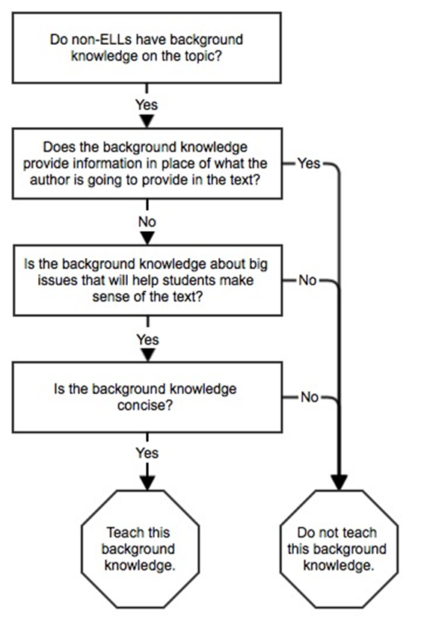
Notes:
Here is another way to work through how much background information to teach to ELLs prior to reading a text.

Slide 14
Let’s Take a Look at a Sample Text
Taken from Erinn Banting’s England the Land (2004)
(a suggested informational text for close reading in grades 4-5)
Notes:
To better illustrate how ELLs’ background knowledge comes into play during close reading, let’s take a look at a sample text. An Appendix to the CCSS provides text exemplars with sample texts of different genres suggested – but not prescribed – for each grade level. For example, Erinn Banting’s England the Land (2004) is listed as a suggested informational text for close reading in grades 4-5. Take a look at two paragraphs of this text, and think about what kinds of background knowledge students would need to fully access this text:

Slide 15
Low fences, some of which are thousands of years old, divide much of England’s countryside. These fences, called hedgerows, were fist built by the Anglo-Saxons, a group of warriors from Germany and Scandinavia who arrived in England around 410 A.D. As they gained control of sections of land, they protected their property with walls made from wooden stakes and spiny plants. Dead hedgerows, as these fences were called, were eventually replaced by fences made from live bushes and trees.
Recently, people building large farms and homes in the countryside have destroyed many live hedgerows. Other people are working to save the hedgerows, which are home to a variety of wildlife, including birds, butterflies, hedgehogs, and hares.
Notes:
Read the passage aloud for the participants
(or have them read silently to themselves, or ask for a volunteer to read aloud).

Slide 16
What do my students already know about…
…the history of the Anglo-Saxons
…what was happening during the time period described in the text (410 A.D.)
…low fences or hedgerows
…the importance of protecting one’s property in the time period described and today
… how large farms and homes in the English countryside look today
… the wildlife described in the text
Notes:
If I were using Banting’s text to teach fourth graders at varying levels of English proficiency, I would want to first find out their knowledge of…(see list)

Slide 17
So what do I do?
Recognize that ELLs will likely have little background knowledge on the topics, terms and language structures of the text
Notes:
As a teacher preparing to do a close read of this text with ELLs, I would not spend the majority of my instruction on building my ELLs’ background knowledge, like I might have done before the CCSS. However, I would recognize that my ELLs would likely have very little background knowledge on the many topics contained in this text, let alone be familiar with all the terms (countryside, warriors, stakes, spiny, fences, hedgerows, wildlife) and language structures (such as the many embedded clauses) used in the text.
I would want to carve out some (but not a majority of) my instructional time to provide my ELLs images, videos, and resources in both English and their first languages that would help position them to be better prepared to work with this text. I would also prioritize which topics from the list above would warrant my time and attention during instruction.

Slide 18
So what do I do?
Recognize that ELLs will likely have little background knowledge on the topics, terms and language structures of the text
Provide images, videos, and other resources in English and L1
Notes:
Provide the ELLs with images, videos, and resources in both English and their first languages that would help position them to be better prepared to work with this text. Some students may only need the image of a hedgerow (which also helped my comprehension of the text). It is important to provide them a comparable frame of reference that their native English speaking peers might already have developed in terms of background knowledge.

Slide 19
hedgerow

Slide 20
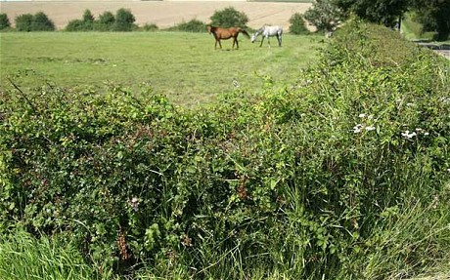
hedgerow

Slide 21
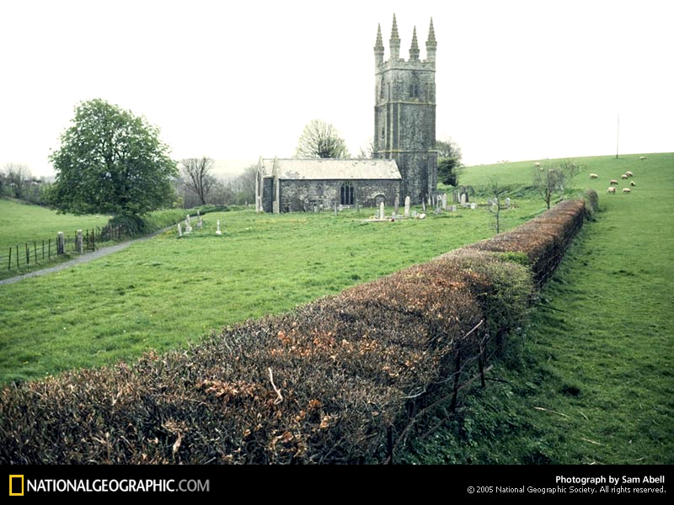
hedgerow

Slide 22
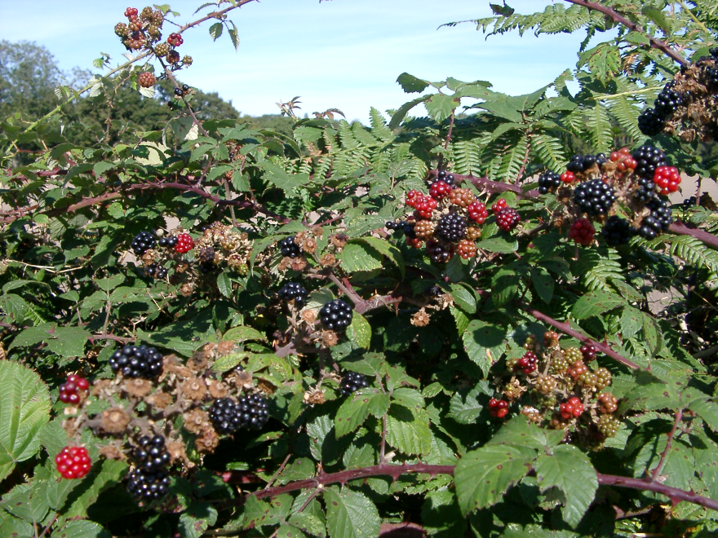
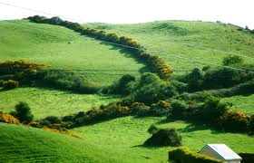
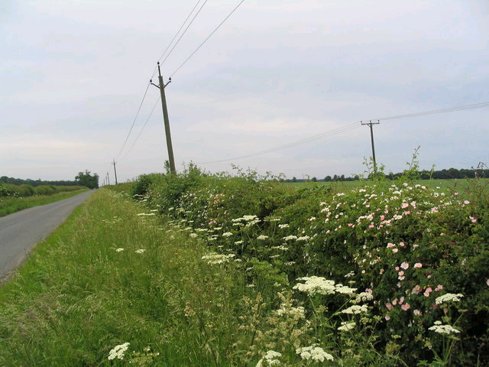
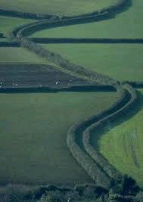
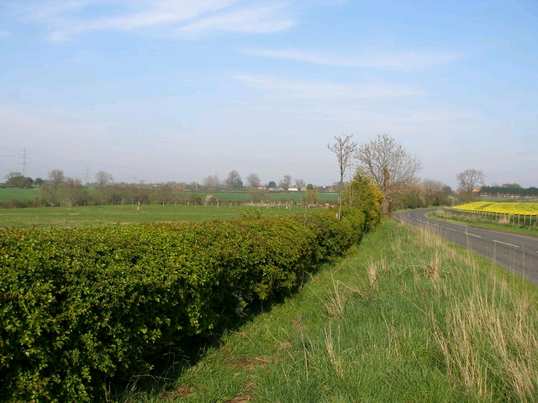
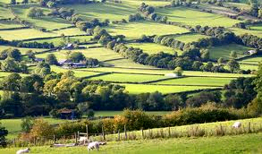
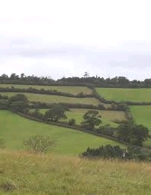
hedgerows

Slide 23
So what do I do?
Recognize that ELLs will likely have little background knowledge on the topics, terms and language structures of the text
Provide images, videos, and other resources in English and L1
Prioritize which topics would warrant more instructional time and attention
Notes:
I would also prioritize which topics warrant my time and attention during instruction. I would carve out some (but not a majority of) my instructional time to provide my ELLs the images or other resources I may have acquired.

Slide 24
Background knowledge is not necessarily the same thing as a personal connection to a text.
Notes:
For example, a student may have some knowledge about what the English countryside looks like from a documentary he or she has seen about England. On the other hand, a student’s personal connection to this text might be in the form of an event in the student’s life that took place in the countryside.
Background knowledge will most likely support the student’s understanding of the text, a personal connection might not accomplish the same goal.

Slide 25
Now Let’s Practice! (15 minutes)
Table Teams pick a reading passage and take a few minutes to read it.
Brainstorm a list of topics. “I want to find out my student’s knowledge of _________.”
Together, discuss and prioritize which topics would warrant your instructional time to build background and why.
Be prepared as a team to share out some ideas on how you would help build their background in the priority topic.

