Slide 1
Effective Vocabulary Activities & Games
Presented by Nicole Castilleja, Mary Kirby and Kathy Thornock

Slide 2
Objectives:
Participants will:
-learn Marzano's 6-step process for teaching new vocabulary terms
-discuss their current methods to teach vocabulary to students
-practice several activities and games that allow students to add to their knowledge and play with the terms
-implement 1-3 activities with students in the upcoming school year.

Slide 3
What’s the best way to teach academic vocabulary?
•Some experts you can learn from:
–Isabel Beck
–Kate Kinsella
–Robert Marzano
–Steven Stahl & William Nagy
–Michael Graves, Diane August, Jeannette Mancilla-Martinez
–Etc.
Notes:
There are many systems for teaching vocabulary. What we DO know is that handing students a list of words and having them write the dictionary definitions is not an effective method of instruction.

Slide 4
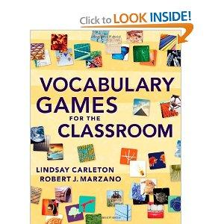
Here's What We're Using Today:
Building Academic Vocabulary by
Robert Marzano & Debra Pickering
Vocabulary Games for the
Classroom by Lindsay Carleton
& Robert Marzano

Slide 5
What do you currently do?
What methods have you used or seen used for teaching vocabulary to students?
In your experience, what works best?
Think - Pair - Share

Slide 6
Marzano’s 6 Steps to Vocabulary Instruction:
1. Provide a description, explanation, or example of the new term.
2. Ask students to restate the description, explanation, or example in their own words.
3. Ask students to construct a picture, symbol, or graphic representing the term.
Notes:
1: determine what students already know about it - or what they think they know. If you hear misconceptions, you will need to clarify when you present. If they have accurate knowledge, you can build on it.
Next, build an initial understanding by providing direct experiences:
telling a story that uses or demonstrates the term,
use video or other images to help students understand,
let students do some investigation into the term and present to the class (a skit or pantomime),
use current events to apply the term to something familiar to the students,
describe your mental pictures of the term,
find or create pictures that exemplify the term.
This step does not involve presenting a definition. It should be a more natural process. "Friendly definition." If the term is a proper noun, only give the information that's important to those specific proper nouns.
Practice making a "friendly definition" for climate: Glossary definition says "The prevailing meteorological conditions, or weather, of a place, including temperature, precipitation, and wind." Think- Pair- Share. (Book's example is "Climate is the word that describes what weather is generally like in a particular place. If someone says that a place has a warm, dry climate, it means that the winters are not really cold and there is probably not much snow, plus the summers are probably pretty hot without much rain."
Explanation about who Louis Pasteur was: "Look at your milk container and you will see the word pasteurized. That word means that the milk was heated to kill the bacteria that could make you sick. Louis Pasteur, a man from France, invented the process to make milk safe to drink in the 1800s. That process was then named after him."
STEP 2: Don't let them simply copy what you have said.
Make sure they don't have major errors. Clear up any confusions or major errors.
If they're struggling to understand, you should:
give additional descriptions, explanations, or examples,
Have students discuss with a partner or small group,
go to Step 3 and have them create a nonlinguistic representation, and then go back to the linguistic description.
Have students record their descriptions, explanations, and examples in their academic notebooks.
Step 3: Forces students to think of the term in a totally different way.
For students who think they cannot draw: Model often, provide examples of drawings that are rough but represent the ideas, allow students to work together (at first).
For students who "overdraw" model, Play "Draw me" (like Pictionary) to show how to "quick draw", discuss the difference between drawing and sketching.
It's not necessary that they draw everything freehand. They could trace a map, for instance.

Slide 7
What's different for ELLs?
1.Provide a description, explanation, or example of the new term.
2.Ask students to restate the description, explanation, or example in their own words.
3.Ask students to construct a picture, symbol, or graphic representing the term.
1. -in the student's L1
OR -pair with student of the same language or use a bilingual parapro
-give a nonlinguistic representation here
2. - in L1
- have them write related terms they know in English
3. have them create their own representations and not just copy the teacher's. It will probably reflect their own culture and experiences
Notes:
Letting students use their L1 helps them connect prior knowledge with new understanding.
Nonlinguistic representations help them understand the meaning in a way that is not dependent on understanding English. Pictures or videos from Internet can be very helpful.
Allowing them to use their native language communicates a basic respect for their language and culture.
Encourage them to record any English terms they are familiar with that are related to the term being presented.

Slide 8
One key to the process is the use of student notebooks.
Record the new terms and an initial description of each term.
Over time, the add new information as their understanding of the terms deepens and matures.

Slide 9
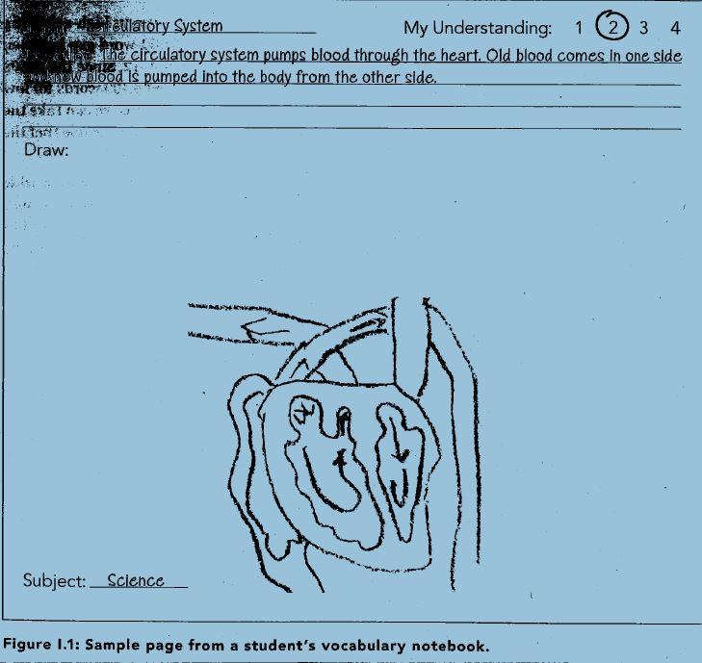
Sample Vocabulary Page

Slide 10
Marzano’s 6 Steps to Vocabulary Instruction:
4.Engage students periodically in activities that help them add to their knowledge of terms in their notebooks.
5.Periodically ask students to discuss the terms with one another.
6.Involve students periodically in games that allow them to play with terms.
•Marzano & Pickering, 2005, pp.14-15.

Slide 11
What's different for ELLs?
4.Engage students periodically in activities that help them add to their knowledge of terms in their notebooks.
5.Periodically ask students to discuss the terms with one another.
6.Involve students periodically in games that allow them to play with terms.
4. - in their L1
5 & 6. -pair with other students of same L1 or a bilingual parapro

Slide 12
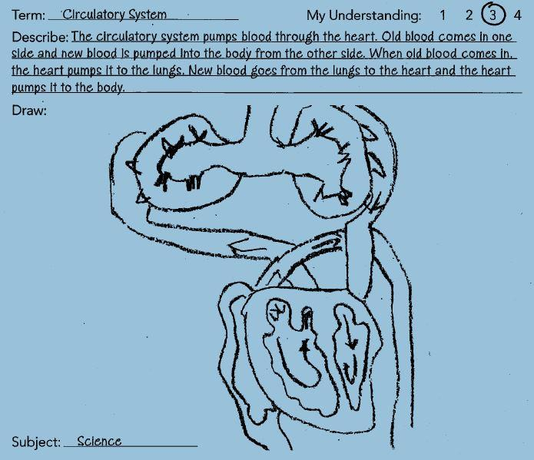
Sample Page after Steps 4, 5, and 6.

Slide 13
6. Involve students periodically in games that allow them to play with the terms.
•Vocabulary games are not just for fun (although they ARE fun and create energy and excitement).
•Vocabulary games are one part of a systematic approach to direct vocabulary instruction.
Notes:
This will be our focus today.

Slide 14
Game 1: Vocabulary Charades
Focus: Connect movement to vocabulary
Object: Act out non-linguistic representation of vocabulary, generally for elementary.
Preparation: None!
Play: 1: Students stand next to their desks and use their bodies to show meaning of terms;
2: Form teams and designate team member to act out word while others guess
3: A team works together to act out a word, the class guesses
Notes:
Energizing because it involves movement. Try acting out "radius", "diameter", and "circumference."
Two approaches can be used:
1:Students stand next to their desks and, without speaking, use their bodies to show their knowledge of each term called out by the teacher.
2: Students form teams and a designated student acts out the term while other members guess it as quickly as possible. Can be a competition among teams or teams try to beat their previous record.
Procedure 1: can be used throughout the day and only takes a few minutes or seconds. Other terms might require students to act a scene or interact with someone.
Abstract terms will take more time for students to think through. Repeated terms will take very little time.
When you're satisfied with the representation, go onto the next one. You may only use terms from one topic, or could mix topics in the same period of time
Procedure 2: Make decks of cards with 1 vocabulary word on each card. Actor takes a card and acts out the word without talking. When that team guesses the term, the actor signals it and they get a point.
Teams can play one at a time or simultaneously.

Slide 15
Game 1: Vocabulary Charades:
Act out the following vocabulary words:
radius
diameter
circumference
acute angle
obtuse angle
right angle
Notes:
Energizing because it involves movement. Try acting out "radius", "diameter", and "circumference."
Two approaches can be used:
1:Students stand next to their desks and, without speaking, use their bodies to show their knowledge of each term called out by the teacher.
2: Students form teams and a designated student acts out the term while other members guess it as quickly as possible. Can be a competition among teams or teams try to beat their previous record.
Procedure 1: can be used throughout the day and only takes a few minutes or seconds. Other terms might require students to act a scene or interact with someone.
Abstract terms will take more time for students to think through. Repeated terms will take very little time.
When you're satisfied with the representation, go onto the next one. You may only use terms from one topic, or could mix topics in the same period of time
Procedure 2: Make decks of cards with 1 vocabulary word on each card. Actor takes a card and acts out the word without talking. When that team guesses the term, the actor signals it and they get a point.
Teams can play one at a time or simultaneously.

Slide 16
Game 2: Create a Category
Focus: categorization
Object: create as many different categories as possible based on a list of terms and phrases
For upper elementary through high school, all content areas
Preparation: Create 4-8 lists of 15-20 words
Play: in teams or individually
Task: Teacher shows the word list, and students categorize 3+ terms in as many ways as possible.
Points can be given based on the number of categories generated.
Tip: nouns generally work best, but you can make lists with just verbs or adjectives.
Notes:
Object is for students to create as many different categories of words as possible based on a given list of terms and phrases. Key is a list of words that can be categorized, but which are varied enough for students to use creativity in coming up with categories. Use past vocabulary words as well as current ones. Combine words from different subjects. Participants use sticky notes to sort their words into categories.

Slide 17
Game 3: Word Harvest
Focus: Vocabulary, Categorization, Movement
Object: For lower elementary, review of content area terms
Materials: Illustration of a tree, 2 buckets or baskets, note cards of vocabulary terms
Preparation: Attach a category label to each bucket, attach terms to tree (2 categories of equal numbers)
Play: 2 teams of varying vocabulary development lineup by their basket, one at a time, kids rush to "pick" a word in their category and drop it in their basket. Next child goes until all appropriate terms are picked.

Slide 18
Game 4: Opposites Attract
Focus: Antonyms
Object: Find pair of antonyms
For lower and upper elementary
Materials: Note cards and tape
Play: Each student is given a card with a word on it, student tapes to shirt. Teacher gives the cue to find the other half of the antonym. Game can be played nonverbally, and with a time limit.

Slide 19
Game 5: Name That Category
Focus: categorization
Modeled after "$100,000 Pyramid" TV show
Helps students focus on attributes of concepts by looking for commonalities.
Preparation: Game board with identified categories of increasing difficulty in each cell. Hide the category names.
Play: Students work in pairs or small groups. Only one "clue giver" from each team can see the game board. Uncover the first cell and clue giver lists words that fit that category. When the teams correctly identify the category name, move on to the next category until one team guesses all of them. The first team done is the winner.Teams receive the points they earned up to that time.
Notes:
When the first team correctly guesses a category, they yell "Go" and the teacher uncovers the next cell. When the other teams finish one category, the clue giver looks up to see the next category. If it is still covered, he yells "go" so the teacher uncovers it. When one team has guessed all the categories, they should raise their hands and shout, "Got It!", which is the cue for all teams to stop. Award all teams the number of points they have earned up to that time. If you continue the game with another round, designate new clue givers.
After each round, take time to have several students share some of the items they included in their lists, highlighting those items that were particularly helpful to their team in identifying the category name.
You can keep track of points or just play for fun. You can have teams try to beat their previously record time.

Slide 20
200 Points
Events of the 1970s
100 Points
100 Points
types of government
villains
50 Points
50 Points
50 Points
titles of plays
battles
liquids

Slide 21
Game 6: Where Am I?
Focus: using directional coordinates and landmarks.
For lower elementary math & elementary social studies
Preparation: a map for every student or pair
Play: tell students the starting place on the map. They follow your verbal directions to find the location where you're "hiding".
Notes:
Direction examples: You're starting at the school. Go north on Vancouver Street until you get to Washington Avenue. Make a left turn and go east until you reach the Lawndale Park. I am hiding in the third house on the left. What is the address?
Example 2: We're starting in Denver where highway I-25 meets highway 225. Go north on highway 225 until it meets highway I-76. Go north on I-76 until you reach highway I-80. Head east on I-80 until you find I-90. Take I-90 east until you find US-9. This is where I am hiding. What state and city am I in?"
Version: have students take turns giving verbal-only directions to the class. Give the student a list of the terms and phrases she can use to help her classmates find her. With younger students, you might let them decide where they want to hide and write out the directions for them to read.
Vocabulary Words can be prepositions or nouns as well as geography terms.

Slide 22
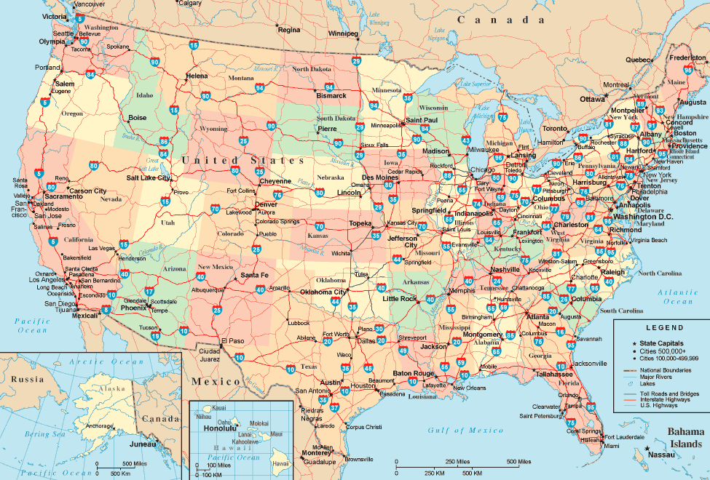
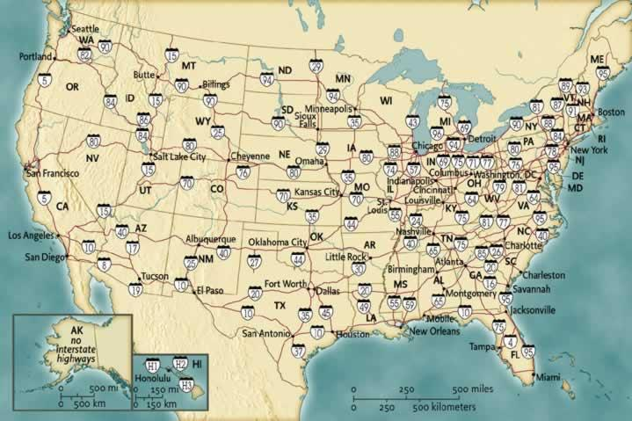
Notes:
Directions 1: Start at the intersection of Highway 29 and I-70. (Kansas City). Go west on 70 to I-25 (Denver), go south almost to the border, and then west on I-10 to the intersection with Highway 19. Where Am I? (Tuscon).
2. Start in Kansas City, go east on I-70then continue east on I-64, passing Louisville and on to Charleston, West Virginia. Turn south onto I-77 and go past Columbia, South Carolina. Turn south again on Highway 95 and go until it ends. Where Am I? (Miami, Florida)
3. Start in Kansas City, drive north on I-29 until you reach North Dakota (Fargo) and turn west on I-94 until it turns into I-90. Continue through most of Montana until you reach the intersection with I-15. Go south on I-15 until it intersects with I-80. Where Am I? (Salt Lake City, Utah)
4. Start in Kansas City. Go north on I-35 to Des Moines, Iowa. Turn east on I-80 until you arrive at Lake Michigan. Where Am I? (Chicago, Illinois)
Next, have students direct each other to locations around the map. You can use city maps, country maps, or world maps for this game.

Slide 23
Game 7: Name It!
Focus: Vocabulary & Content Terms
Object: Write the word that corresponds with a photo or illustration. For lower elementary
Preparation: Gather images that represent terms & 2 whiteboards
Play: Place the images, face down, in a container. Divide class into 2 teams. One person from each team comes up, takes a picture, looks at it, and hands it to the teacher. He then writes the word or phrase on the board. If it's correct, the teacher gives the OK sign and gives the team a point. Player 1 rushes back to tag the next teammate, etc. Team with most points wins.

Slide 24
Game 8: Two of a Kind
Focus: Homonyms
Object: Lower & upper elementary, general vocabulary
Preparation: Note cards with homonyms printed on them. One side only.
Play: Like Memory game, teams or pairs lay the cards out face down. Flip over 2 cards. If they are homonyms, keep the pair and continue. If not, partner has a turn. Kids can explain meaning before they take the cards, especially if they are homonyms that are spelled the same.

Slide 25
Game 9: Puzzle Stories
Focus: Increase vocabulary, practice writing, enhance creativity.
Object: Create a story based on the image in a puzzle. For upper elementary & middle school, working in small groups (3-5 kids).
Preparation: Make a puzzle with a simple scene for each group. Give the students a list of vocabulary 5-10 words to use in a story.
Play: Students put the puzzle together and create a story using the words.
Notes:
Teams read their story aloud. You can have kids vote on a winner or just enjoy the stories. Younger students can have less words to use. Can provide a photo rather than a puzzle. Can have kids write about what they see rather than make a story. Students could find their own photo. More advanced words require more thinking.

Slide 26
Closing & Evaluations
Revisit Objectives.... Participants will:
-learn Marzano's 6-step process for teaching new vocabulary terms
-discuss their current methods to teach vocabulary to students
-practice several activities and games that allow students to add to their knowledge and play with the terms
-implement 1-3 activities with students in the upcoming school year.

Slide 27
Evaluations
Please complete an OSPI evaluation; turn in as you exit.
Clock hours available.
THANK YOU FOR ATTENDING!

