Slide 1
Career and College Readiness
Examining the Career and College Readiness Outcomes of the Common Core and Next Generation Science Standards

Slide 2
DAVID CONLEY
Notes:
David Conley thinks THESE are the most important things students need to be CCR.
https://www.epiconline.org/Issues/college-career-readiness/the-solution/

Slide 3
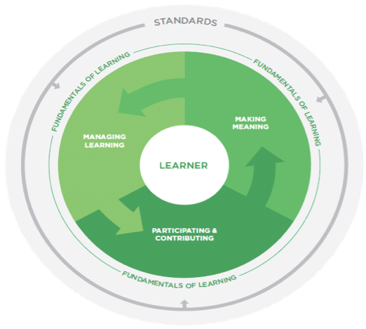
MARGARET HERITAGE
Notes:
Heritage, et al believe THESE are the most important things students need to be CCR.
https://www.cse.ucla.edu/products/misc/LearningFundamentals_FINAL.pdf
Have participants read through the article, paying close attention to describing the three fundamentals.

Slide 4
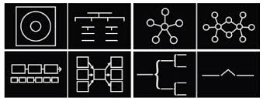
Practices and Capacities
Work with one or two other people. Each person takes a “deck” and reads through it to become re-acquainted.
Using the fundamentals of learning as a lens, work together to organize the cards to represent commonalities.
Use post-its to label your organizational design. THEN add a “title” or a caption that summarizes your understanding.
Notes:
Give teams 10-15 minutes for this process. The more familiar they are with the capacities and the practices in the standards, the faster they will be.

Slide 5
Practices and Capacities
Let’s share our titles and a brief description of how you came to that title.

Slide 6
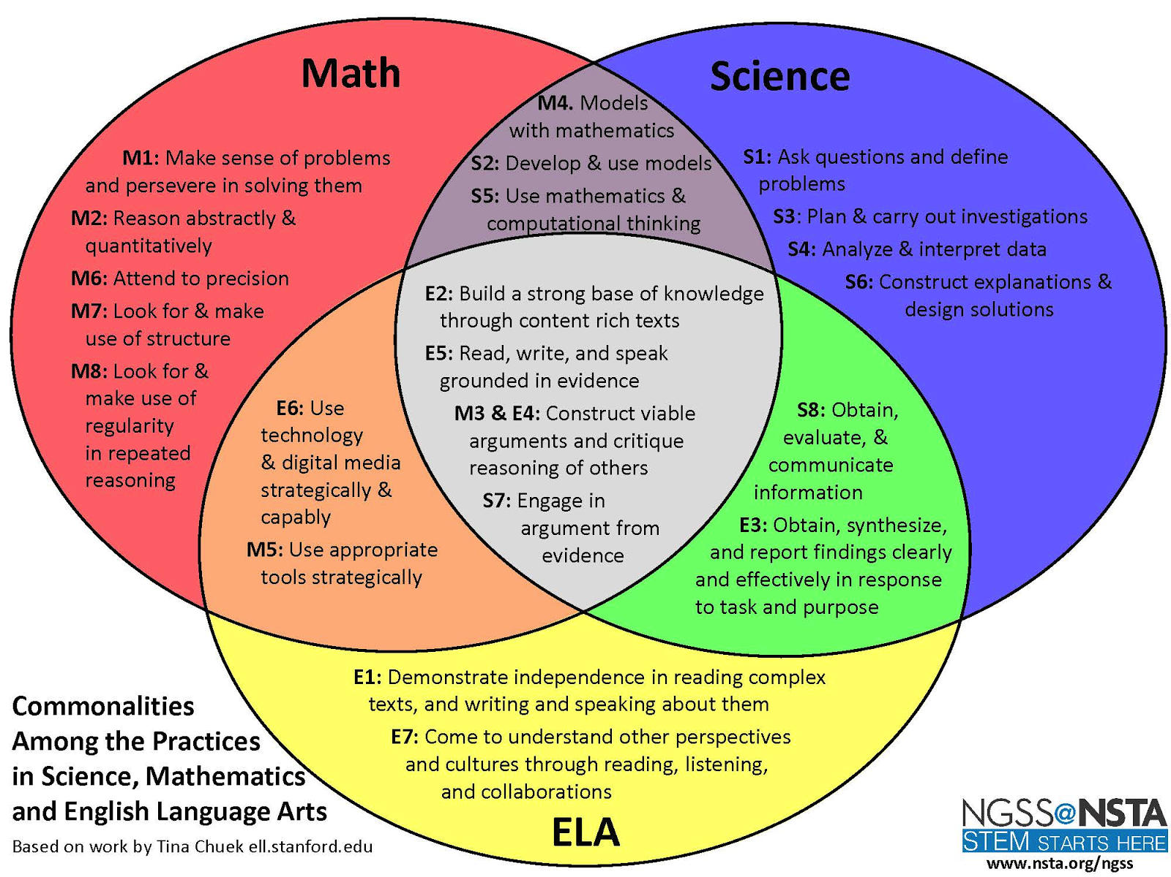
Notes:
Chueck et al. at Stanford did a similar sort of the capacities and practices and found this overlap. They were specifically looking for overlaps with regards to equity and language.

Slide 7
Your NWESD Regional Coordinators
Mary Ellen Huggins, Math mhuggins@nwesd.org
Brian MacNevin, Sciencebmacnevin@nwesd.org
Angie Schoenbeck, English Language Arts aschoenbeck@nwesd.org

