Slide 1
Transitioning to NGSS
From Conclusion writing to arguing from evidence
Your Name Here Regional Science Coordinator Your Agency Name here
Notes:
Welcome Participants
Logistics
Rest Room location
Locate the Parking Lot Poster or another similar tool.

Slide 2
Overview of the series
Session 1: Focus on an instructional strategy for Engaging in Argument from Evidence. Craft a curriculum-specific prompt. Practice with scoring items using the state 2-point rubric.
Session 2: Score and analyze student work. Deepening pedagogical content knowledge for Engaging in Argument from Evidence with emphasis on discourse and writing scaffolds. Highlight equitable teaching practices.
Session 3: Score and analyze student work. Creating CCSS ELA connections. Optimize prompts for teacher’s materials. Practice instructional shifts for continued growth.
Notes:
This 3-session series will focus on strategies for improving student performance on Conclusion Writing in science as measured on the MSP and EOC. In addition, the series will lay the foundation for moving from conclusion writing to the NGSS Science & Engineering Practice of Arguing from Evidence. Participants will develop and administer Washington State science assessment-like items and analyze their students’ performance.

Slide 3
Series Goals
I understand an instructional strategy for engaging students in arguing from evidence.
I can employ strategies that will equitably engage all students in arguing from evidence.
I understand how engaging in argument from evidence connects WA Conclusion Assessment Items with the Next Generation Science Standards.
I can craft a specific prompt that will help my students understand how to respond to an MSP/EOC assessment conclusion item.
Notes:
Display goals
Designed to support teachers K-12, this 3-session series will focus on strategies for improving student performance on Conclusion Writing in science as measured on the MSP and EOC.
In addition, this series will lay the foundation for moving from conclusion writing to the NGSS Science & Engineering Practice of Arguing from Evidence.
As a result of this series, participants will develop and administer Washington State science assessment-like items and analyze their students’ performance.

Slide 4
Agenda-Today’s journey
Morning
Brief overview of NGSS
Engaging in Argument from Evidence Instructional Model
Afternoon
Apply the argumentation instructional strategy to MSP/EOC Assessment Conclusion items.
Construct a Conclusion item to use as a Pre-assessment.

Slide 5
The three dimensions of the NGSS
Notes:
Preparation:
Navigate to a Performance Expectation on the NGSS web site. Use one of these PE’s: 2-LS-4-1, 3-LS3-2, 4-LS1-1, MS-LS4-4, HS-LS4-4. These PEs align with upcoming activity. Activate the view: “Practices and Crosscutting Concepts” to illustrate how the Dimensions are integrated into a PE.
Be prepared to toggle to this web page from the PPT presentation.
Provide background and context to for participants to understand SEP #7 by describing the dimensions and an NGSS standard.
Process:
Handout the document: “3 Dimensions/Inside the NGSS Box”.
Provide time for participants to make sense of the “3 Dimensions” side.
Emphasize diagram showing three-strands of the rope that are braided together as an analogy for the how the three dimensions are braided together in a Performance Expectation.
Ask participants to examine the “Inside the NGSS Box” side of the handout.
Toggle to the NGSS webpage to show a PE as previously described.
Check for understanding, answer questions.
Transition:
Now that you have a sense of the “big picture”, of the NGSS, let’s look deeper at the Science and Engineering Practices.

Slide 6
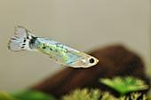
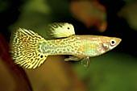
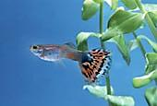
Related Performance Expectations
Notes:
3 LS3-2

Slide 7
Related Performance Expectations
Notes:
4-LS1-1

Slide 8
Related Performance Expectations
Notes:
MS LS4-4

Slide 9
Related Performance Expectations
Notes:
HS LS 4-4

Slide 10
Looking Deeper at One Science Practice
What do you think Engaging in Argument from Evidence looks like?
Notes:
Process:
Ask participants to think about a response to the prompt on the slide and share their ideas with a partner.
Popcorn some ideas from the room.
Hand out the document: Dimension 1 Science and Engineering Practices and provide time for participants to make sense of it.
Ask participants to read SEP #7 (both columns)
Ask participants to compare the Science and Engineering columns.
What are the similarities?
Ask participants to revisit the prompt on the slide. What new information needs to be added?
Transition: Argumentation from Evidence is a practice found in CCSS math, ELA and NGSS. Studies show that students have not had enough opportunity in science to engage in discourse with peers to develop, advocate for and defend a claim. Teachers feel pressure to quickly debrief after an activity or investigation and move on.
We are going to immerse you in a simulation that goes through the steps that can be used to help both teachers and students through the argumentation process.

Slide 11
Guppies
Why do guppies sometimes look different?
Notes:
Guppies are native to tropical freshwater ecosystems like those found in Venezuela.
What might be the cause of this difference in appearance?
We will investigate some data and develop an argument to answer the question.

Slide 12
Color Variation in Venezuelan Guppies
Where in the world is Venezuela?
Notes:
To bring context to our students for an activity in Engaging in Argument from Evidence build a bit of background first.
Perhaps they could think about where we are located and perhaps other places they have been to? (This is a GLAD Strategy)

Slide 13
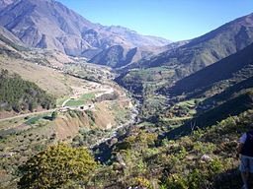
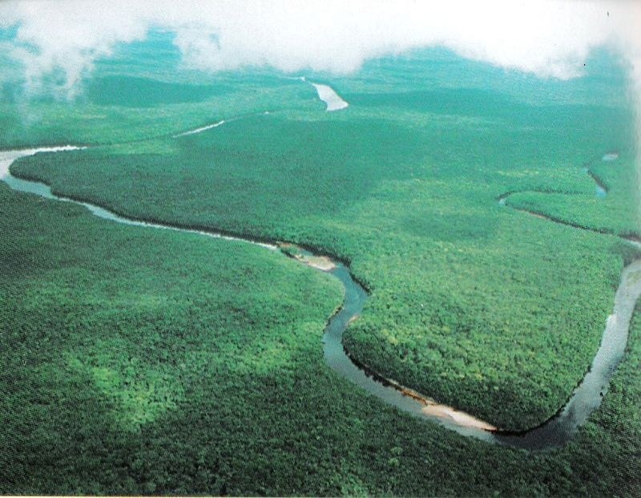
Guppy Habitat - What do you observe- What questions do you have?
Notes:
Talk with a partner and talk about what you observe or any questions you have from these photos or from the map on the previous slide. (GLAD Strategy)

Slide 14
Time for a Break!
Please be back at ________

Slide 15
Stages of the ‘Generate an Argument’ Instructional strategy
1. Teacher Identifies the Task and Question
3. Argumentation Session
2. Generate a Tentative Argument
4. The Reflective Discussion
5. Final Written Argument
Notes:
Introduce the Five Stage Scientific Argumentation Process depicted in Sampson’s book. How this process engages all learners and has several strategies that explicitly meet the needs of our migrant students.

Slide 16
Stage 1: The Teacher Identifies the Tasks and Question
Question: What caused trends in the coloration of Venezuelan Guppies?
Task: With your group, use the information in the handout to develop a claim that best answers the question.
Notes:
Process:
Show slide for Stage 1 – Identify the Tasks and Question.
Form groups of two or three.
Each group reads p19-20 – Color Variation in Venezuelan Guppies from Scientific Argumentation in Biology.
Check for understanding of the task.

Slide 17
Reading for Understanding
Remembering our Goal:
Question: What caused trends in the coloration of Venezuelan Guppies?
Task: With your group, use the information in the handout to develop a claim that best answers the question.
Pre Reading: Text Features for Color Variation in Venezuelan Guppies
With a partner skim through pages 19-23
Jot down a few text features you see in the text
Predict what you think will be in the text
Notes:
Follow the prompts on the slide.

Slide 18
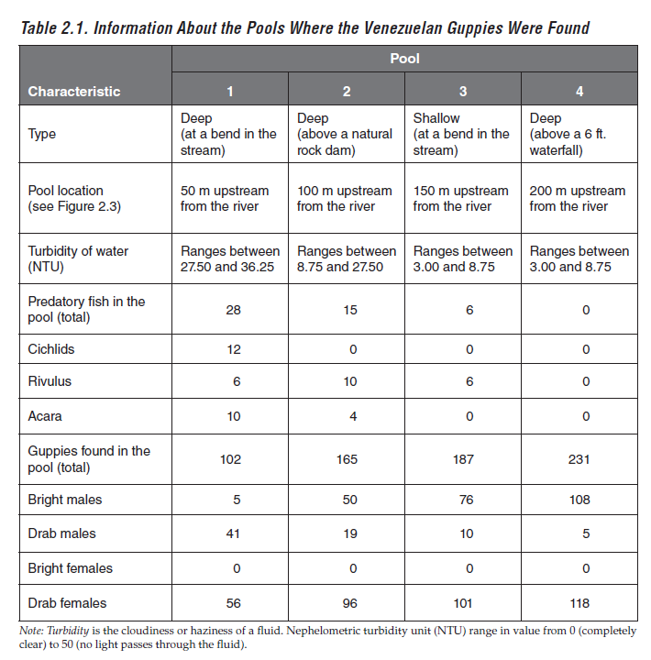
Pre Reading: Looking at Data-Page 21
Strategy to look at data…
Highlights, Comments, and Captions
What I see:
Look for changes, trends, or differences.
Draw an arrow to each of these you notice in your graph or sketch.
Write what you see. Each arrow has a different description.
Be concise.
Write only the essence, or highlights, of what you see.
Notes:
Follow the prompts on the slide.

Slide 19
Pre Reading: Looking at Data-Page 21
Strategy to look at data…
Highlights, Comments and Captions
What it means:
Interpret what you see.
Write what each observation means.
Don’t interpret the entire figure at once, just one observation at a time
Notes:
Follow the prompts on the slide.

Slide 20
Pre Reading: Looking at Data-Page 21
Strategy to look at data…
Highlights, Comments and Captions
Caption:
Think of the caption as a summary.
Begin your caption with a topic sentence describing the overview of the figure.
Join each “What I see” to its “What it means” to form a sentence.
Build a coherent description in 2 to 3 sentences.
Notes:
Follow the prompts on the slide.

Slide 21
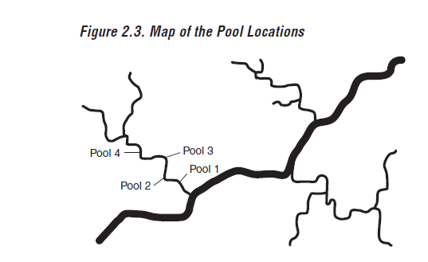
Pre Reading: Looking at Data-Page 22
Strategy to look at data…
What do I see…
What does it mean…
Caption…

Slide 22
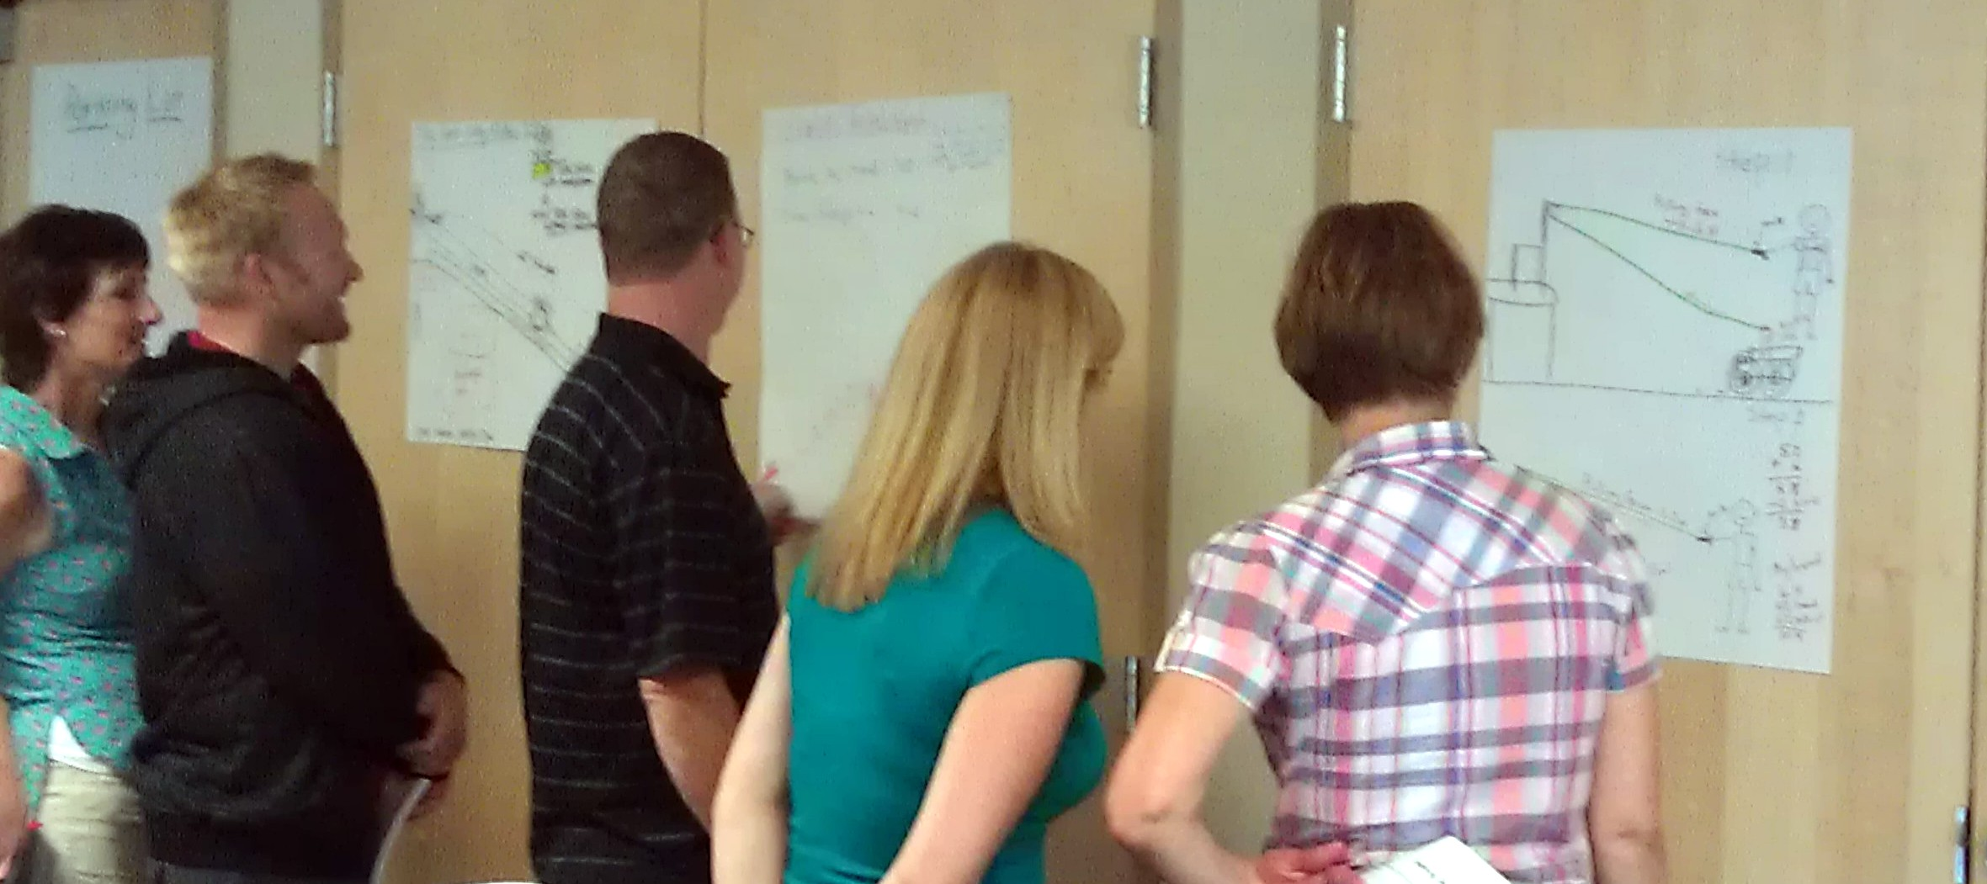
Stage 2: The Generation of a Tentative Argument
Summarize your evidence…
Analyze the evidence from pages 21-22
Look for trends or patterns
Summarize your supportive data on a chart.
Notes:
Stage 2 – Generation of a Tentative Argument: Analyze data
Groups should look for patterns, trends, differences or relationships in the data provided on p21-22
Ask groups to create a chart of their summarized, supportive data.
Prepare for Gallery Walk #1.

Slide 23
Stage 2: The Generation of a Tentative Argument
Collect data and ideas from others…
Look at data from your group and other groups
Look for trends between groups
Look for differences between groups
Notes:
Stage 2 - Generation of a Tentative Argument
Gallery Walk #1
Have groups visit other group’s data charts.
Groups should look for patterns, trends, differences or relationships.
Ask groups to revisit their own charts and add information to or revise their arguments.

Slide 24
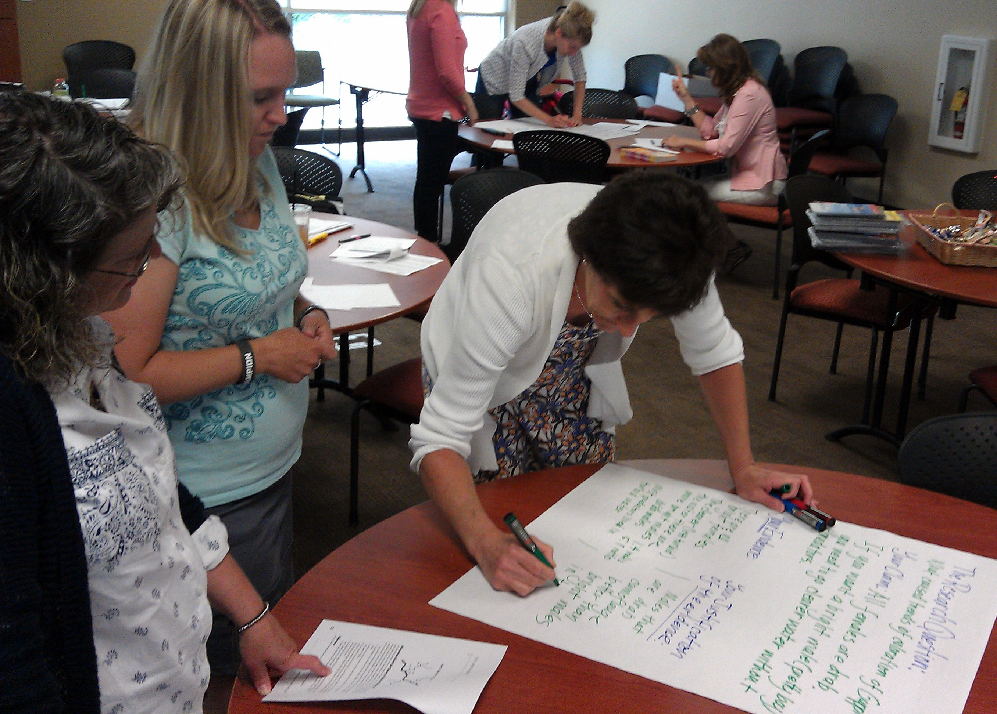
Stage 2: Generation of a Tentative Argument
The Research Question: What caused trends in the coloration of Venezuelan Guppies?
Your group’s claim:
Your evidence:
Your justification of the evidence:
Notes:
Generation of a Tentative Argument
Groups create a the graphic on chart paper.
They should identify their question, tentative claim, evidence, and justification.
NOTE: We have altered the template here slightly from the Sampson article so that the writing frame more closely resembles the MSP/EOC writing frame.

Slide 25
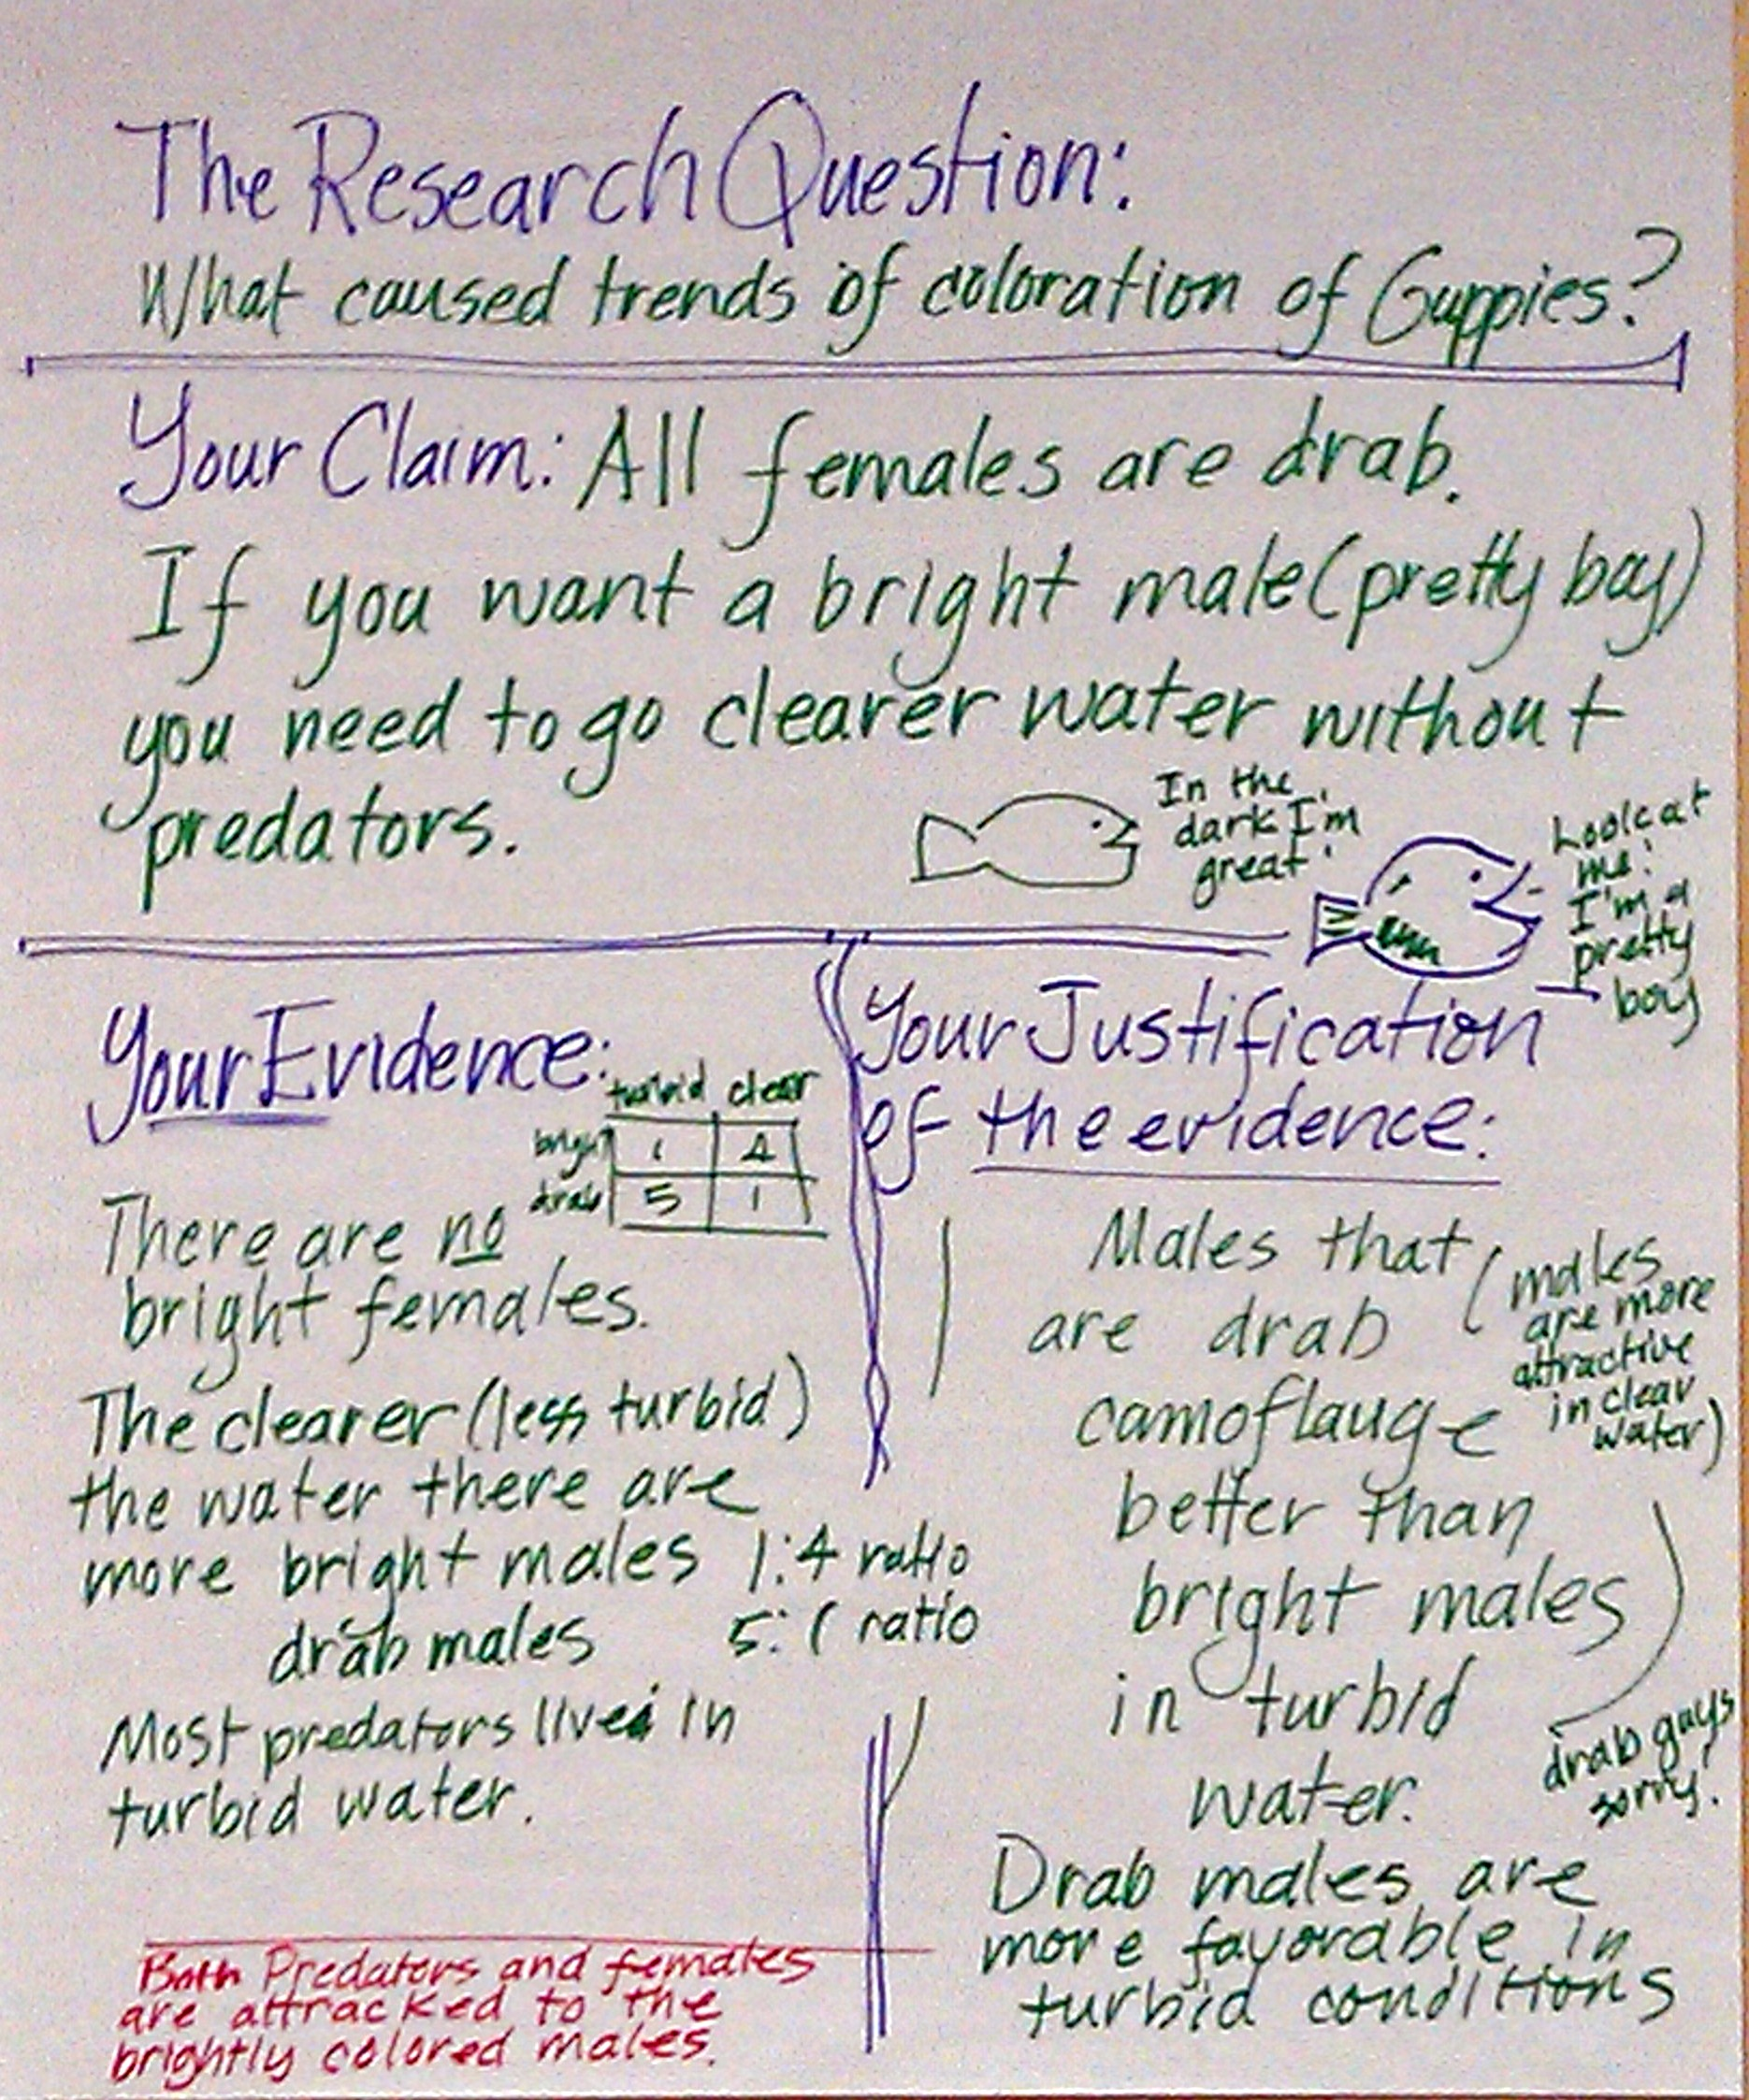
Stage 3: The Argumentation Session
Students are given an opportunity to share, evaluate and revise the products or process of their investigation with their classmates.
Notes:
Stage 3 – Gallery Walk #2
Take a “Gallery Walk” to gather more data from the charts of other groups.
Groups should keep an expert with their tentative argument while others rotate to other groups. (In the classroom teachers might want to structure this more tightly)
Ask participants to go to three different groups to gather the ideas from that group regarding their arguments.
Use the Interview Questions to guide conversations at each poster.
Add data harvested from the gallery walk to your group’s data.
Have Participants look at not only their results but the results of other groups.
Groups should bring their question, claim, and evidence together to make a justification about the answer to their question.

Slide 26
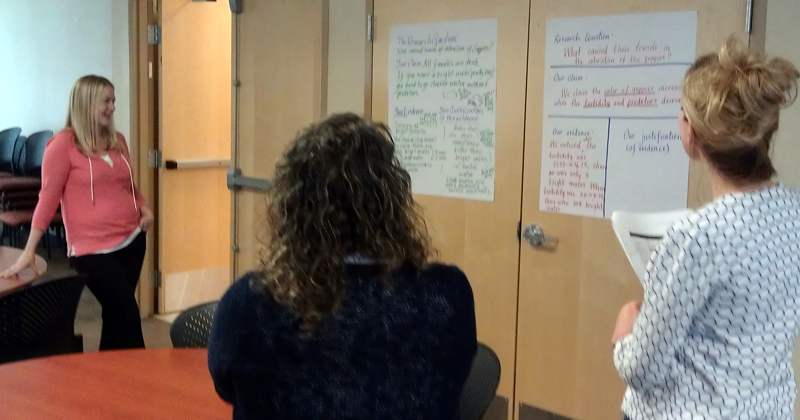
Stage 3: The Argumentation Session
Visit other groups.
Use the Gallery Walk Interview Questions to guide your discourse.
Give feedback and be ready to take back ideas to your group.
Notes:
Construction of a Viable Argument: Using Claims, Evidence, and Reasoning
You may want to use your EL Achieve Discussion Cards here, or use sticky note protocol for asking questions and providing feedback.

Slide 27
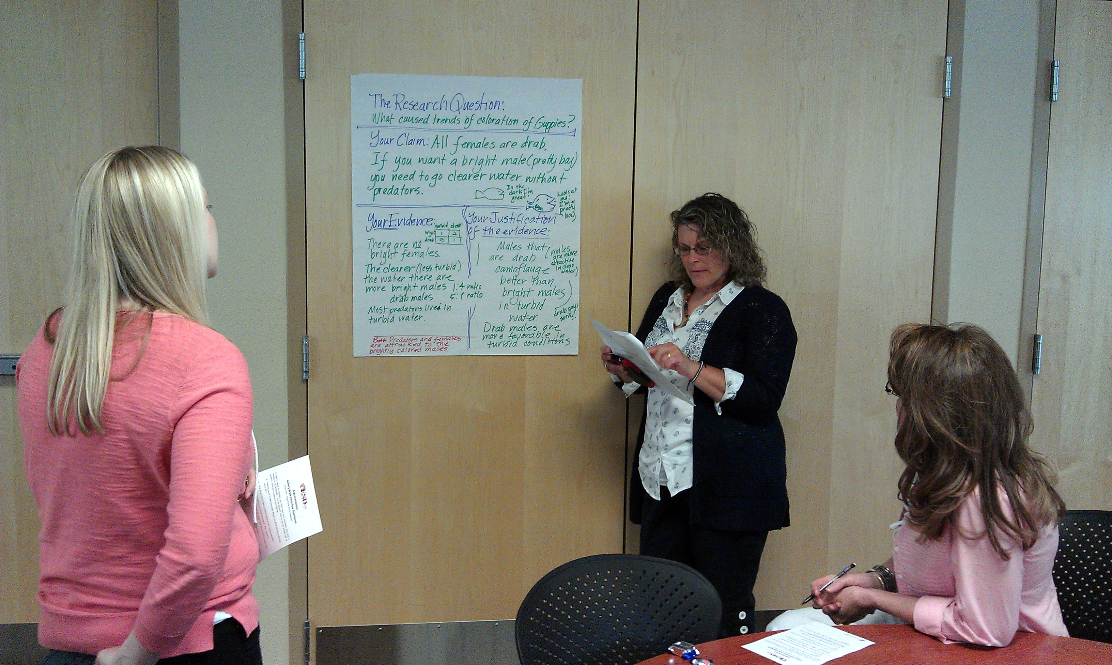
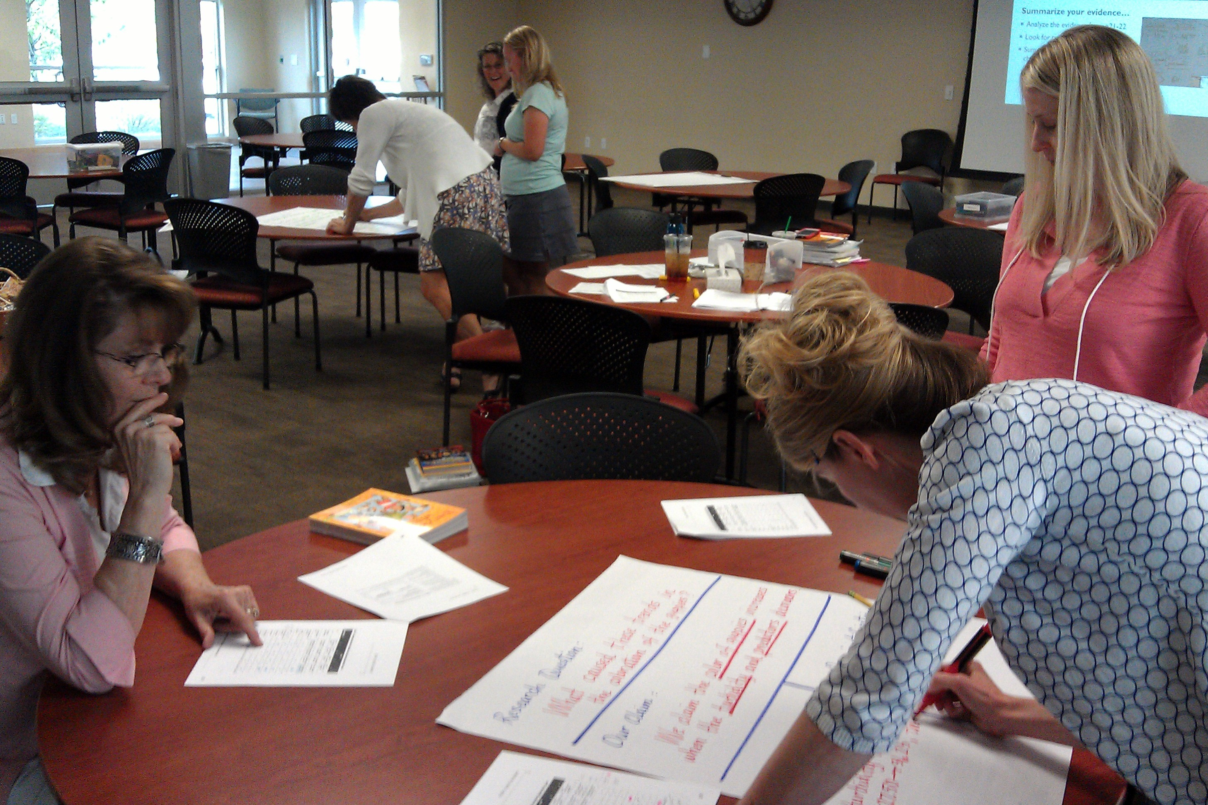
Stage 4: A Reflective Discussion
Meet with your group
Discuss anything you learned from other groups
Discuss feedback on your group’s ideas
Modify/Revise original ideas based on feedback
Teacher facilitates whole class discussion
Encouraging students to share what they learned
Common challenges faced by groups
Notes:
Construction of a Viable Argument: Using Claims, Evidence, and Reasoning
Stage 4
Original groups reconvene and discuss what they learned by interacting with individuals from other groups.
Modify original ideas based on feedback and ideas of others input
Facilitate a whole room discussion encouraging participants to share what they learned about the design challenge.
Surface common challenges faced by groups.

Slide 28
Reviewing the Stages of ‘the Generate an Argument’ Instructional Strategy
Teacher Identifies the Task and Question
Argumentation Session
Generate a Tentative Argument
The Reflective Discussion
Final Written Argument
Notes:
Construction of a Viable Argument: Using Claims, Evidence, and Reasoning

Slide 29
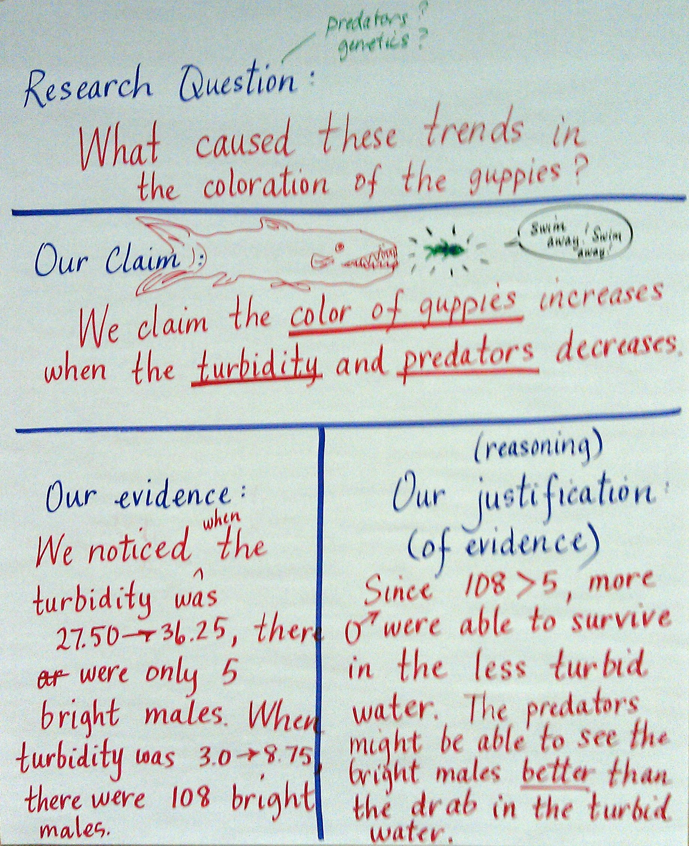
Stage 5: The Production of a Final Argument
Each student makes sense of their experiences by producing a final argument
State the question and claim you are trying to support
Include evidence (data + analysis + interpretation)
Provide a justification of your evidence
Organize your argument in a way that enhances readability
Correct grammar, punctuation, and spelling errors
Notes:
Construction of a Viable Argument: Using Claims, Evidence, and Reasoning
Stage 5 – Talk through the construction of the final argument with the whole room.

Slide 30
Reflecting on the morning
What would you need to do to support students to engage in argument from evidence?

Slide 31
Lunch!!
We will resume at _______________

Slide 32
Reviewing the Stages of the ‘Generate an Argument’ Instructional strategy
Teacher Identifies the Task and Question
Argumentation Session
Generate a Tentative Argument
The Reflective Discussion
Final Written Argument
Notes:
Construction of a Viable Argument: Using Claims, Evidence, and Reasoning

Slide 33
Goals for the afternoon
I understand how engaging in argument from evidence connects WA Conclusion Assessment Items with the Next Generation Science Standards.
I can craft a specific prompt that will help my students understand how to respond to a WA 2009 Conclusion assessment item.
Notes:
Transition: Worked through an immersion experience this morning. Now, we’ll apply that process to a typical MSP/EOC conclusion-type item and see where there are similarities.

Slide 34
Taking a look at MSP/EOC Assessment Conclusion Items
What are the requirements for a 2-point response to a Conclusion Item?
Turn and talk with an elbow partner about your thoughts.
How do the rubrics you have compare to your original thoughts?
Notes:
H/O 5th, 8th, 10th Item Specs and Rubrics after the think-pair-share. Provide some time for them to make sense of the documents. Reflect on the original thoughts and compare to what they see in the rubrics/specs.

Slide 35
Applying the rubric
Use the rubric to score your group’s work on Argument from Evidence this morning.
Examine sample student writing with the rubric…How does the conclusion item writing we did this morning compare to what kids are expected to do now on MSP/EOC?
First I thought, but now I know…
Notes:
***Be sure to specify we will be using the 2 point rubric, as it is the current MSP scoring model, across all sessions.
**(time allowing) Provide the H/O on the released item student work and allow teachers to shift from their adult learning to the student sample of work.
How does our work from the morning compare to what kids are asked to do NOW on the MSP/EOC conclusion items?
Provide time to share ah-ha’s or ‘first I thought, but now I know…’

Slide 36
Constructing item prompts
Identify an investigation in your upcoming materials that will generate data and that lends itself to constructing a conclusion item prompt.
OR
Choose an investigation that you already have taught and use that data to constructing a conclusion item prompt.
Develop a prompt that you will administer before the next session.
Sharing our work for collaborative feedback.
Notes:
Depending on who’s in attendance, this work can be by grade-level, independent…
H/O template and allow some processing time for participants to draw parallels between the template and the C-E-R framework from the morning session.
***Decide on an active sharing strategy for item prompts.
***Remind teachers before session 1 to bring in an example. Have examples from your own kits on hand in case teachers do not bring a sample.

Slide 37
Moving forward to session 2…
Use your conclusion prompt with students before any instruction (diagnostic)
Bring your unscored student responses to Session 2 (…date…)
Try out the Argumentation process with your students on other data sets or investigations.
Notes:
Discuss the idea that we do not want the teacher to provide instruction on the process of arguing from evidence with the prompt they’ve developed. Suggest however using the process with a different investigation or data set. This will provide great discourse for session 2.

Slide 38
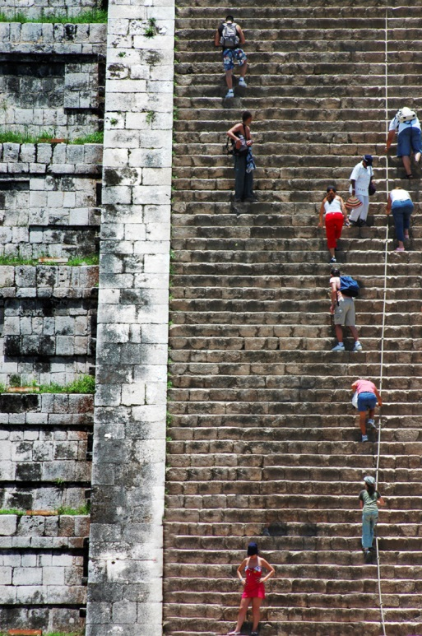
Homework
Administer the Argument from Evidence pre-assessment item to your students PRIOR to any additional instruction on Engaging in Argument from Evidence.
Bring your student pre-assessments to the next session for scoring
Bring a student roster for recording student scores
Engage students in strategies for Generating an Argument
Note successes and challenges and be prepared to debrief the experience at Session 2.
Notes:
Read through slide

Slide 39
Evaluation time
Participant survey instructions (POST your card or handout & QR)
Clock hours and evaluations
Session 2 Date Reminder

