Slide 1
Transitioning to NGSS: From Conclusion Writing to arguing from Evidence
Session 2
Brian MacNevin Regional Science Coordinator Northwest Educational Service District
Notes:
Slide 1-6 (7-10 min)
Welcome Participants
Logistics
Rest Room location
Locate the Parking Lot Poster or another similar tool.

Slide 2
Goals
I understand an instructional model for engaging students in argument from evidence to colleagues.
I can employ strategies that will equitably engage all students in argumentation from evidence.
I understand how engaging in argumentation from evidence connects WA Conclusion Assessment Items with the Next Generation Science Standards.
I can craft a specific prompt that will help my students understand how to respond to a WA 2009 Conclusion assessment item.
Notes:
Slide 1-6 (7-10 min)
Display goals
Designed to support teachers K-12, this 3-session series will focus on strategies for improving student performance on Conclusion Writing in science as measured on the MSP and EOC.
In addition, this series will lay the foundation for moving from conclusion writing to the NGSS Science & Engineering Practice of Arguing from Evidence.
As a result of this series, participants will develop and administer Washington State science assessment-like items and analyze their students’ performance.

Slide 3
Overview of the series
Session 1: Focus on an instructional strategy for Engaging in Argument from Evidence. Craft a curriculum-specific prompt. Practice with scoring items using the state 2-point rubric.
Session 2: Score and analyze student work. Deepening pedagogical content knowledge for Engaging in Argument from Evidence with emphasis on discourse and writing scaffolds.
Session 3: Score and analyze student work. Creating CCSS ELA connections. Highlight equitable teaching practices. Optimize prompts for teacher’s materials.
Notes:
Slide 1-6 (7-10 min)
This 3-session series will focus on strategies for improving student performance on Conclusion Writing in science as measured on the MSP and EOC. In addition, the series will lay the foundation for moving from conclusion writing to the NGSS Science & Engineering Practice of Arguing from Evidence. Participants will develop and administer Washington State science assessment-like items and analyze their students’ performance.

Slide 4
Agenda-Today’s journey
Morning
Scoring Student Work
Learning from our Students
Thinking About Rubrics
Afternoon
Writing a New Item
Strategies
Equity
Notes:
Slide 1-6 (7-10 min)

Slide 5
Why Norms? Why argument from evidence?
www.youtube.com/watch?v=3sKdDyyanGk
Photo by Stefan Lins
Notes:
Slide 1-6 (7-10 min)
www.youtube.com/watch?v=3sKdDyyanGk
Photo is hyperlinked to you tube video

Slide 6
The three dimensions of the NGSS
Notes:
Slide 1-6 (7-10 min)
Provide background and context to for participants to understand SEP #7 by briefly reviewing the dimensions and an NGSS standard.
Remember that Argument from Evidence is one of the essential Science and Engineering practices that works in tandem with Crosscutting concepts to deepen our understanding of the Disciplinary Core Ideas.
Transition:
Now that you have a sense of the “big picture”, of the NGSS, let’s look deeper at the Science and Engineering Practices.

Slide 7
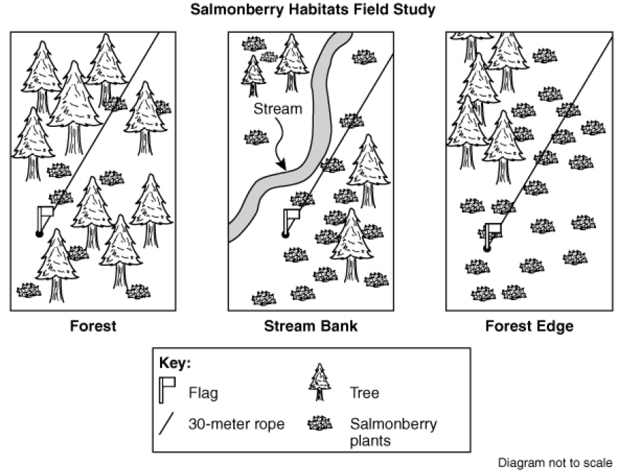
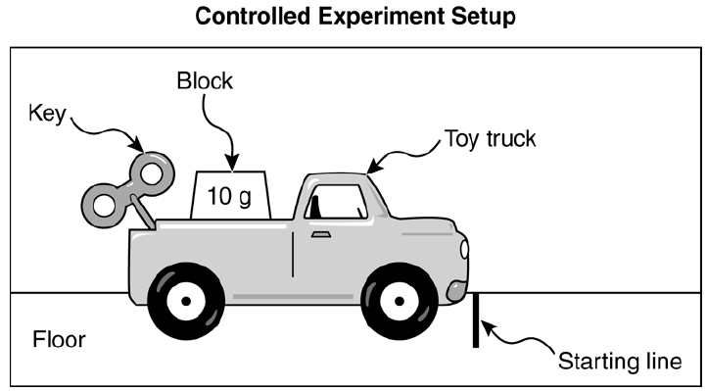
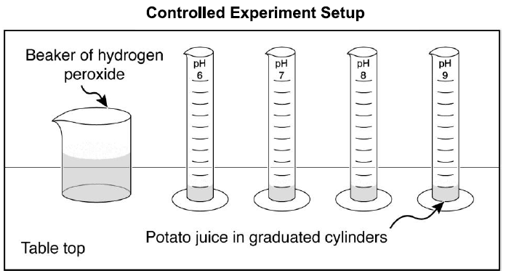
Scoring: How would you respond?
Notes:
Slides 7-10 (70 min.)
Participants select the grade level item that is closest to their teaching assignment (5, 8, EOC)
Grade 5 Conclusion Item pdf
Grade 8 Conclusion Item pdf
EOC Conclusion Item pdf
Participants respond to the conclusion item prompt

Slide 8
Scoring: How did you Score?
Notes:
Slides 7-10 (70 min.)
Participants collect the rubric and determine their attribute points
Grade 5 Conclusion Teacher pdf
Grade 8 Conclusion Teacher pdf
EOC Conclusion Teacher pdf

Slide 9
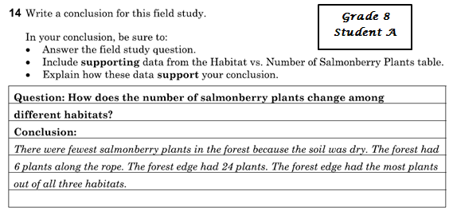
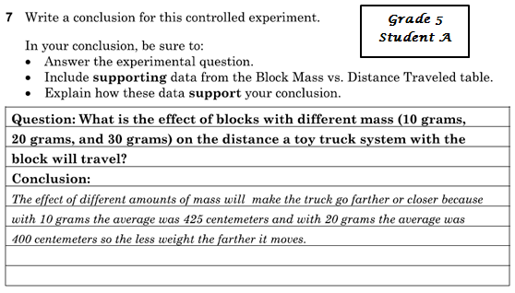
Scoring: Do you agree?
Notes:
Slides 7-10 (70 min.)
Participants are given student responses. They are asked independently to assign each student attribute points. Next they share with a partner to see if they agree and why. If needed they can get a third opinion.
Grade 5 Conclusion Student Answers (A=1; B=0; C=2; http://www.k12.wa.us/science/pubdocs/Grade5Update2014.pdf)
Grade 8 Conclusion Student Answers (A=2; B=0; C=1; http://www.k12.wa.us/science/pubdocs/Scienceg8Update2013.pdf)
EOC Conclusion Student Answers (A=2; B=0; C=1; D=2; http://www.k12.wa.us/science/pubdocs/ScienceBioEOCUpdate2012.pdf)

Slide 10
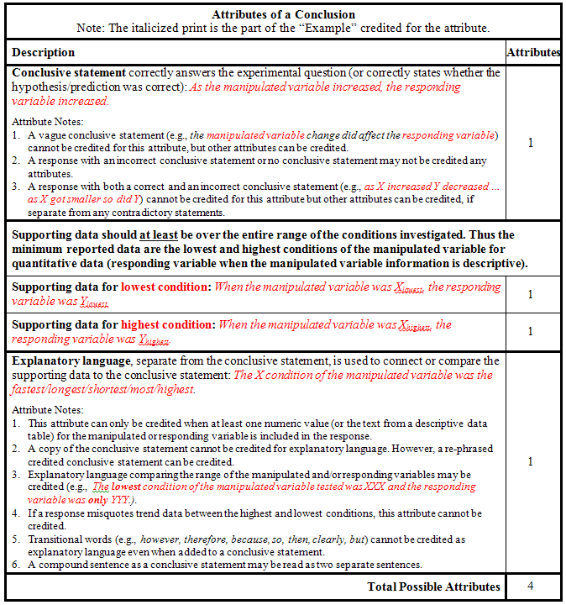
Scoring: How did your students do?
Notes:
Slides 7-10 (70 min.)
Participants score their students’ papers and record the attribute point. HS has up to 5 attribute points whereas 5th and 8th have 4.
***We must collect and/or make copies of “Class record sheet Conclusion Item”
Participants should have brought their own completed rubric created from the short answer template. If not, you can share the blank template to help guide them.
g5Conclucion
g8Conlusion
EOC-ConclusionUpdate

Slide 11
Take a Break
Notes:
Slide 11 (10 minute Break)

Slide 12
Rubric Thinking
What would you look for in a functional rubric that goes beyond the state’s expectations
Some rubric examples
How do these examples fit with and the needs of the state’s expectations
Choose/develop a rubric that works for you
We know that you will want to score students harder in the next session, however remember that your instructional expectations can be a higher bar than the state rubric but we must score with the state rubric
Notes:
Slide 12 ( 15 -20 min).
CER for rubric you would use
Now that you have looked at the state’s rubric, you may be thinking that you would like something more. Here are some examples of CER rubrics.
Give participants time to go through and choose which one they like. Have them share why they chose the one they did.
The last rubric is a rubric to help guide them as they develop their own. Share it with the participants and ask how they can include students in the process.
Developing-Scientific-Explanations pp. 7 & 12 downloaded from http://lizastark.com/portfolio/wp-content/uploads/2011/08/Developing-Scientific-Explanations.pdf
201104Claims EvidenceRubric downloaded from http://www.nsta.org/elementaryschool/connections.aspx
WritingRubric downloaded from http://morganparkcps.org/ourpages/auto/2013/2/6/52428363/WritingRubric.doc
Rubrics_for_rubrics_bie_2011 downloaded from http://bie.org/object/document/rubric_for_rubrics

Slide 13
Writing a new item
Get in grade level groups
Find an activity in your materials where students will be generating data
Think about the Claims, Evidence Reasoning Statements students could make for the data
Use the conclusion writing template and construct a question that asks for students to generate a conclusion about the data
Determine what your expectations are for earning attribute points from an MSP like rubric
Notes:
Slide 13 (50 min.)
Follow Notes on Slides. Remind people that along with our learning about what makes good claims, evidence and reasoning writing we need to remember the attributes that are credited on the MSP Conclusion rubric and be sure to design our conclusion items accordingly.

Slide 14
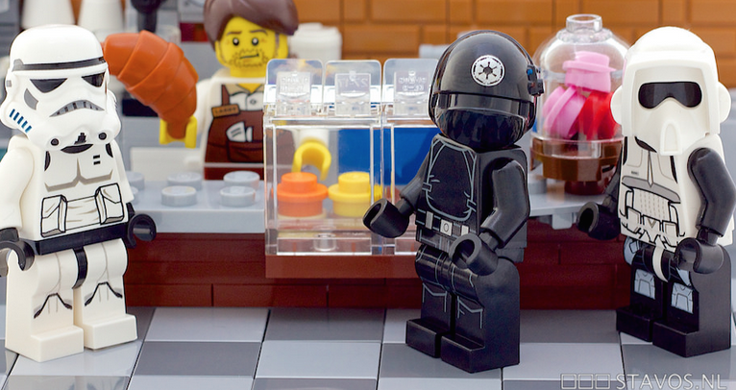
Lunch!
stavos

Slide 15
Getting FeedBack
Share your item and rubric with another grade alike “feedback partner”
Give/get feedback on the following:
Language concerns
Vocabulary concerns
Ethnic Bias concerns
Gender Bias concerns
Scaffolding needs
Notes:
Slide 15 (20 minutes)
Now ask participants to find a feedback partner that might be from a same or near grade level.
Explain to the partner the context of your lesson where the conclusion item will be used
Partners can provide feedback on post-its for each of the following areas
Partners should give feedback on following points…read through the points under give/get feedback on the following
The partner providing feedback should explain their noticings and wonderings for the written conclusion item

Slide 16
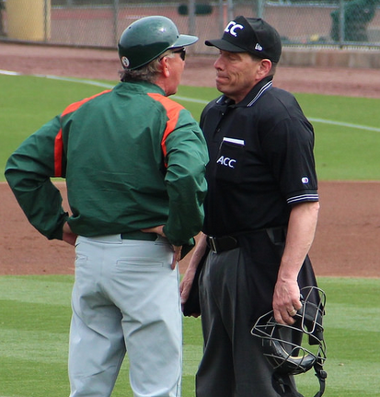
Developing Arguments supported by evidence
Thomson20192
Some rights reserved
Notes:
Slides 16-18 (5 min)
In our first session we went through a process of Thinking through claims evidence reasoning that came from Victor Sampson. Today we are going to deepen our thinking about CER using the work of Kathryn McNeill and Joe Krajcick, Carla Zembal-saul and Kimber Hershberger. You will see the components of an argument that we worked with last time in a slightly varied format but the ideas are the same.

Slide 17
Developing Arguments Based on evidence
In science, reasoning and argument are essential for clarifying strengths and weaknesses of a line of evidence and for identifying the best explanation for a natural science, reasoning phenomenon
Scientists must defend their explanations, formulate evidence based on a solid foundation of data
Examine their understanding in light of the evidence and comments by others
Collaborate with peers
Search for the best explanation for the phenomena being investigated
Notes:
Slides 16-18 (5 min)
Here is just a reminder from the Science and Engineering Practices about the importance of argument based on evidence for science and engineering.
Talk through Slide 18 and 19

Slide 18
Developing Arguments Based on evidence
In engineering, reasoning and argument are essential for finding the best solution to a problem
Collaborate with their peers
selection of the most promising solution among a field of competing ideas
Use systematic methods to compare alternatives
formulate evidence based on test data
Make arguments to defend their conclusions
Critically evaluate the ideas of others
Revise their designs in order to identify the best solution
Notes:
Slides 16-18 (5 min)

Slide 19
How to Write a Scientific argument
Components
Make a claim about the problem.
Provide evidence for the claim.
Provide reasoning that links the evidence to the claim.
Notes:
Slides 19-21 (15 min)
There are 3 components to a well formulated scientific argument: read through the components to participants

Slide 20
What are Claims Evidence and Reasoning
Claim: An assertion or conclusion that answers the original question
Evidence: Scientific data that supports the student’s claim that must be
appropriate and sufficient. Can come from an investigation or other source
such as observations, reading material, archived data, or other
Reasoning: Justification that links the claim and evidence. Shows why the
data counts as evidence to support the claim, using appropriate scientific
principles.
Notes:
Slides 19-21 (15 min)
Your CLAIM is your answer to the question or solution to the problem based on your examination and interpretation of the data
The EVIDENCE is that data that you have analyzed and interpreted
And REASONING is that justification of the evidence and how it is linked to or supports the claim you made

Slide 21
Try your own
Examine the data in the Writing an Explanation document
Use the Claims-Evidence-Reasoning Template to construct an ORAL answer to the question
Now write your argument below the data table using evidence and reasoning
Think about how you would assess your response using the Writing a Conclusion rubric….then using the rubric you preferred
Notes:
Slides 19-21 (15 min)
You can ask elementary people to work with data set 1 and secondary to work with data set 2, let them choose the data they want to write an argument for.
Use the CER template to organize your thinking
Work with a partner to construct a CER below your data set

Slide 22
K-5
The two spoons are different materials. My evidence is that one spoon is white and the other spoon is silver. The white spoon is also softer because I can scratch it with my fingernail while the silver spoon is harder because I cannot scratch it. Also, the two spoons are the same size but they weigh different amounts. The White spoon was 3.0 grams and the silver spoon was 16.4 grams. Color, hardness, and mass for the same size of objects are properties of materials . If two objects have different properties, they are different materials. Since the two spoons have different properties, I know they are different materials.
Notes:
Slides 22-27 (10 min)
Now lets examine a couple of student samples and try to pick them apart a bit to see how the components are present….or not.
Let’s look at this argument from evidence.
Use Three colored pencils/highlighters and highlight the CLAIM in one color, the EVIDENCE in a second color and the REASONING in a third color.

Slide 23
K-5
The two spoons are different materials. My evidence is that one spoon is white and the other spoon is silver. The white spoon is also softer because I can scratch it with my fingernail while the silver spoon is harder because I cannot scratch it. Also, the two spoons are the same size but they weigh different amounts. The White spoon was 3.0 grams and the silver spoon was 16.4 grams. Color, hardness, and mass for the same size of objects are properties of materials . If two objects have different properties, they are different materials. Since the two spoons have different properties, I know they are different materials.
Notes:
Slides 22-27 (10 min)
This elementary CER variation states a claim that answers the questioning, evidence that is scientific data that supports the claim and it also provide multiple piecces of data, and Reasoning-a justifiction fo why the evidence supports the claim using scientific principles. Let’s look at this argument from evidence. Use what you know from the conclusions rubric and as a partner team or table quickly score this statement as a writing a conclusion item.
What may not be in place in this statement to receive full points and how would you advise this student to modify the statement to accommodate explanatory languageRemember that in order for a claims, evidence, reasoning statement to achieve maximum points on the MSP it must very specifically contain 1) conclusive statement, 2) high low data points, 3) explanatory language that ties the claim to the evidence and highlights the relationship of the evidence to each other.

Slide 24
Analyzing Levels of complexity for CER
5th-8th
The plant that received more light grew taller. The plant with 24 hours of light grew 20 cm. The plant with 12 hours of light only grew 8 cm. Plants require light to grow and develop. This is why the plant that received 24 hours of light grew taller.
Notes:
Slides 22-27 (10 min)
Let’s look at this argument from evidence. Use Three colored pencils/highlighters and highlight the CLAIM in one color, the EVIDENCE in a second color and the REASONING in a third color.

Slide 25
Analyzing Levels of complexity for CER
5th-8th
The plant that received more light grew taller. The plant with 24 hours of light grew 20 cm. The plant with 12 hours of light only grew 8 cm. Plants require light to grow and develop. This is why the plant that received 24 hours of light grew taller.
Notes:
Slides 22-27 (10 min)
Let’s look at this argument from evidence. Use what you know from the conclusions rubric and as a partner team or table quickly score this statement as a writing a conclusion item. This is the simplest type of claims evidence reasoning argument. What may not be in place in this statement to receive full points and how would you advise this student to modify the statement to accommodate explanatory language. There is a statement that answers the question. There is evidence-scientific data that supports the claim, and there is reasoning which is justification for why the evidence supports the claim.

Slide 26
Analyzing Levels of complexity for CER
5th-8th
A chemical reaction did occur in this experiment. If a chemical reaction takes place something new is made, when something new is made properties change. If just 1 property changes then a chemical reaction occurred and a new substance was made. In the experiment properties changed. The melting points went from -7.9º C and -89.5º C to -91.5º C and 0.0º C. Both of the densities also changed from 0.96g/cm³ and 0.81g/cm³ to 0.87 g/cm³ and 1.00 g/cm³. Also 1 of the new substances is now not soluble in water when before both were. Therefore, a chemical reaction did occur because new substances were made and properties changed.
Notes:
Slides 22-27 (10 min)
Use Three colored pencils/highlighters and highlight the CLAIM in one color, the EVIDENCE in a second color and the REASONING in a third color.

Slide 27
Analyzing Levels of complexity for CER
5th-8th
A chemical reaction did occur in this experiment. If a chemical reaction takes place something new is made, when something new is made properties change. If just 1 property changes then a chemical reaction occurred and a new substance was made. In the experiment properties changed. The melting points went from -7.9º C and -89.5º C to -91.5º C and 0.0º C. Both of the densities also changed from 0.96g/cm³ and 0.81g/cm³ to 0.87 g/cm³ and 1.00 g/cm³. Also 1 of the new substances is now not soluble in water when before both were. Therefore, a chemical reaction did occur because new substances were made and properties changed.
Notes:
Slides 22-27 (10 min)
What may not be in place in this statement to receive full points and how would you advise this student to modify the statement to accommodate explanatory language.There is a statement that answers the question. There is evidence-scientific data that supports the claim, and there is reasoning which is justification for why the evidence supports the claim.

Slide 28
Speaking and Listening as a Strategy
Academic conversation involves:
exchanges between people who are trying to learn from one another and build meanings they didn’t have before
Photo by Stefan Lins
Notes:
Slides 28-29 (5-7 min.)
Remember little kids at the beginning of the session. One could argue that increased skill at speaking and listening….discourse would have led to a different type of argument with more positive, less “heart poking” results.
As we review earlier scientists and engineers need to be able to utilize discourse skills in their jobs. This is not just about Writing arguments from evidence but also about verbalizing arguments in a clear and cohesive manner.
(next is a reminder for you to talk through very briefly if you feel the need to remind)
In science, reasoning and argument are essential for clarifying strengths and weaknesses of a line of evidence and for identifying the best explanation for a natural science, reasoning phenomenon
Scientists must defend their explanations, formulate evidence based on a solid foundation of data
Examine their understanding in light of the evidence and comments by others
Collaborate with peers
Search for the best explanation for the phenomena being investigated
In engineering, reasoning and argument are essential for finding the best solution to a problem
Collaborate with their peers
selection of the most promising solution among a field of competing ideas
Use systematic methods to compare alternatives
formulate evidence based on test data
Make arguments to defend their conclusions
Critically evaluate the ideas of others
Revise their designs in order to identify the best solution

Slide 29
What do you do now?
How do you support students to access speaking and listening and writing in science in your classroom?
Stop and jot/turn and talk
Share out to group
Notes:
Slides 28-29 (5-7 min.)
Ask particpants to read the question and follow slide directions

Slide 30
The Big Question
How do we encourage and scaffold academically oriented conversation…argument from evidence between teacher and students and among students themselves?
Notes:
Slides 30-32 (16 min)
Additionally talking through your argument, evidence and reasoning to critical, supportive listeners, and receiving their feedback is the most valuable precursor to writing effective claims, evidence, reasoning statements or conclusions.
Particularly for ELL and SPEd non dominant groups talk can help students formulate their thinking. Hear about what is missing and do the preplanning necessary for a good piece of writing.

Slide 31
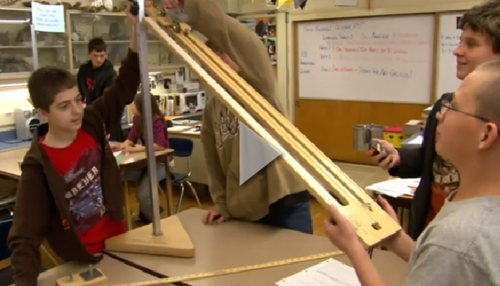
Discourse is for everyone
As you watch the video jot down 2 or three strategies that the teacher uses to foster student discourse
Notes:
Slides 30-32 (16 min)
https://www.teachingchannel.org/videos/how-discussion-enhances-learning
Or https://www.teachingchannel.org/videos/encourage-student-debate-getty
13 min.

Slide 32
As you watch the video jot down 2 or three strategies that the teacher uses to foster student discourse
Notes:
Slides 30-32 (16 min)
https://www.teachingchannel.org/videos/how-discussion-enhances-learning
Or https://www.teachingchannel.org/videos/encourage-student-debate-getty
13 min.
shor

Slide 33
A few talk Moves to get the ball rolling
Review the Talk Moves document and the Transitions and Norms document
Stand up and find a partner you haven’t worked with today by making eye contact
Discuss how these document and strategies in the video might be used in your context to intentionally foster Speaking and Listening skills.
Notes:
Slide 33 (15 min.)

Slide 34
Thinking about Equity
Take a Bio Break
Notes:
Slides 34-35 (15 min)
Let’s take a bit of a step away from Claims Evidence and Reasoning
Take a brief break and then we will dive into a bit of thinking about equity

Slide 35
Equity: Overview
“…when provided with equitable learning opportunities, students from diverse backgrounds are capable of engaging in scientific practices and constructing meaning in both science classrooms and informal settings.”
Next Generation Science Standards, Appendix D “All Standards, All Students”
Notes:
Slides 34-35 (15 min)
Equity Piece about 1 hour
10 min.
Stop and jot, Given this quote from the NGSS Appendix D “all Standards, All Students” what implications can you see for how we have traditionally have approached science instruction?

Slide 36
Equity: Overview
Non-Dominant Groups
Economically Disadvantaged (NCLB and ESEA)
Students from major racial and ethnic groups (NCLB and ESEA)
Students with disabilities (NCLB and ESEA)
Students with limited English proficiency (NCLB and ESEA)
Girls (NGSS additions)
Students in alternative education programs (NGSS additions)
Gifted and talented students (NGSS additions)
End goal all students can access/engage in science
Notes:
Slide 36 (2 min)
Quick talk through reminding people of the seven groups of non-dominant groups. The first 5 are from NCLB authorization language and the NGSS added the last three groups. While girls are not necessarily underrepresented in science classes they are definitely underrepresented in science and STEM careers. Student in alternative education programs represent unique challenges as issues of attendance, poverty, ethnicity and behavioral concerns have marginalized their successful participation in science classes and gifted and talented students are often “left to fend for themselves” but have unique strengths and needs that we need to consider.

Slide 37
Equity: Strategies for Non-Dominant Groups
Equity Card Sort
Match the non-dominant group to some research based classroom strategies
What strategies would you add for these non-dominant groups?
Notes:
Slide 37 (10-15 min)

Slide 38
Equity: Focus on a Typically challenging group
Divide articles among table partners
Each partner read their article for special needs students
In the margins note strategies or concerns that might pertain to other non-dominant groups as well
According to the article what are 3 useful strategies for special needs students in science classrooms
Notes:
Slides 38-39 (30 min.) 15 to read and 15 for the next slide discussion
http://www.nsta.org/disabilities/
Methods and Strategies: Science Success for Students With Special Needs-Oct. 2007 Science and Children
Three Keys to Success in Science for Students with Learning Disabilities-Nov 2011-Science Scope
Teaching Science to Students with Learning Disabilities-Mar. 2006 Science Teacher
Case Study 3 students with Disabilities nextgenscience.org: in this reading just read pages 1-7, skimming page 1

Slide 39
Equity: Focus on a Typically challenging group
Each person shares one of the important strategies/ideas from their article
When everyone has shared one idea continue around the table in a second/third round
As a group arrive at 3 strategies for special need students that seem particularly useful for the group
Be ready to share to the whole group
Notes:
Slides 38-39 (30 min.) 15 to read and 15 for the next slide discussion
http://www.nsta.org/disabilities/

Slide 40
Your success criteria
Teachers can construct conclusion items to engage students in relevant conclusion item writing
Students can respond more successfully to Conclusion Items on statewide assessments
Understanding and ability to use scaffolds for supporting ALL students
Notes:
Slides 40-42 (15-20 min.)

Slide 41
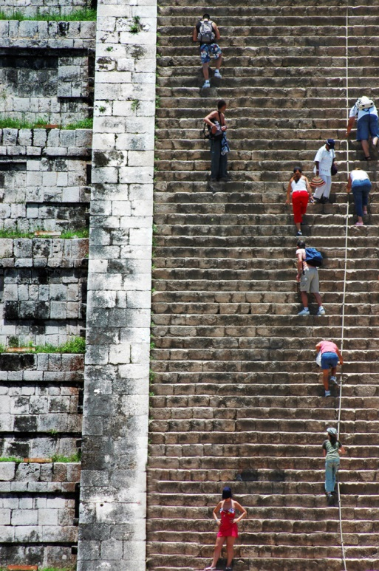
Homework
Engage students in strategies for Generating an Argument
Administer the Argument from Evidence post-assessment item to your students AFTER instruction on Engaging in Argument from Evidence.
Bring your student post-assessments to the next session for scoring
Bring your student roster for recording student scores
Note successes and challenges and be prepared to debrief the experience at Session 3.
Notes:
Slides 40-42 (15-20 min.)
Read through slide

Slide 42
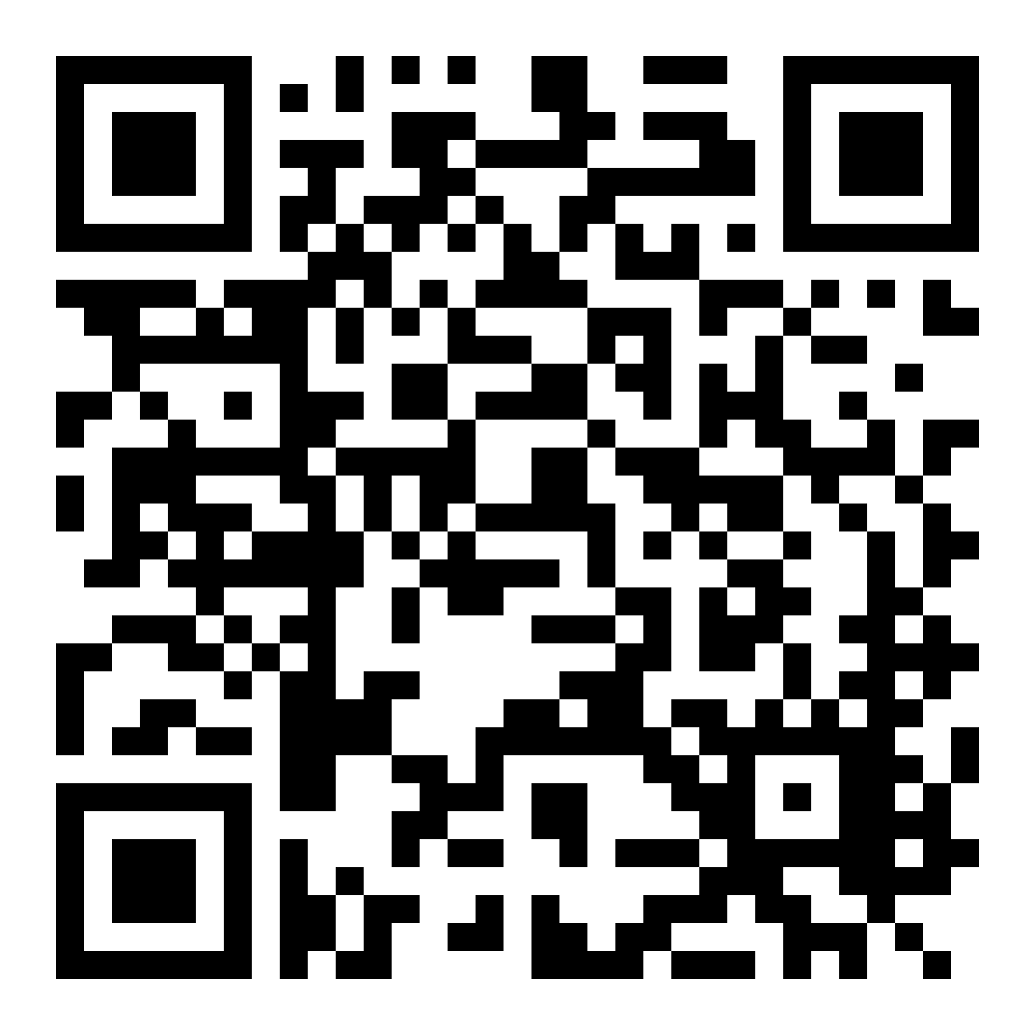
AESD Science reflection survey
Workshop Date: | 02-03-2015
Intended Goal: | Goal 1
Title of Workshop: | (from dropdown menu) Transitioning to NGSS Day 2
Number of PD Hours: | 6
ESD of this PD: | Northwest ESD 189
bit.ly/aesd_survey

Slide 43
Evaluation
Participant survey instructions (POST your card or handout & QR)
Clock hours and evaluations
Session 2 Date Reminder
Notes:
Slides 40-42 (15-20 min.)

Slide 44
RE: permission for article use for not for profit workshop
Emily Brady ebrady@nsta.org
Sent: 11/18/2014 9:22 am
To: Georgia Boatman
Hi Georgia, thanks for your email – you have our permission.
RE: permission for article use for not for profit workshop
From: Georgia Boatman [mailto:gboatman@esd123.org] Sent: Wednesday, November 12, 2014 4:18 PM To: permissions Subject: permission for article use for not for profit workshop
I am one of 9 Regional Science Coordinators in Washington state and the we all will be doing a workshop session on claims, evidence, reasoning and equity for non-dominant student populations. We are interested in using some articles from Science for Children, Science Scope and Science Teacher to have teachers read, reflect and jigsaw their learning regarding special needs populations’ strategies. Since we are teaching K-12 groups we thought to have a couple of articles at each grade level for teachers to choose from. Teachers would only get the article they are reading for the jigsaw so that would be about 10 copies of each for each our 9 groups, or about 100 copies of each. All 9 Regional Coordinators are NSTA members and this workshop session would be a not for profit endeavor.
The articles are:
Methods and Strategies: Science Success for Students With Special Needs-Oct. 2007 Science and Children
Teaching Science to Students with Learning Disabilities-Mar. 2006 Science Teacher
Prepared Practitioner –Mar. 2010 Science Teacher
Cooperative Learning in an Inclusive Science Classroom-Nov. 2011 Science Scope
Teaching Science to Students with Learning Differences-Mar. 2007 Science Teacher
Three Keys to Success in Science for Students with Learning Disabilities-Nov 2011-Science Scope
One Mode is Not for All-Jan. 2006 Science and Children
Please advise me as to whether we can have permission to use these articles at no cost. We have no budget for extensive copyright permission fees. Thanks.

