Slide 1
DEEP
DIVE
Into NGSS

Slide 2
Your Guide…
Brian MacNevin
Regional Science Coordinator
Northwest Educational Service District
E: bmacnevin@nwesd.org
T: 360.820.8505

Slide 3
Agenda
Welcome
CCR: Fundamentals of Learning
NGSS Appendix A: The Shifts
NGSS Appendix F: The Practices
NGSS Appendix G: Crosscutting Concepts
NGSS Appendix H: Engineering
NGSS
OSPI Transition Timelines
Survey and Finishing Up

Slide 4
Logistics
Restrooms
Refreshments

Slide 5
But first… a word from
HISTORY!

Slide 7
TIMMS?
PISA?
NAEP?
WHAT DO YOU MEAN WE’RE NOT #1 ?

Slide 8
Career and College Readiness
TIMMS?
PISA?
NAEP?
WHAT DO YOU MEAN WE’RE NOT #1 ?

Slide 9
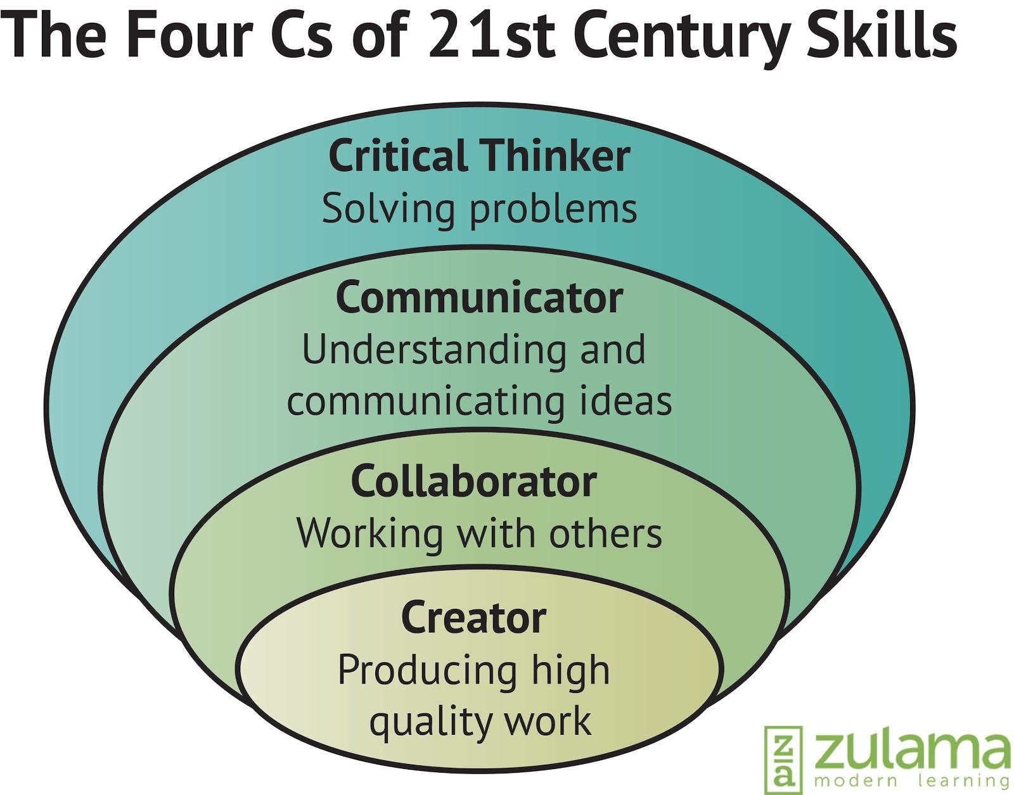
Notes:
Bernie Trilling and Charles Fadel think THESE are the most important thing students need to be CCR (or 21st century ready).

Slide 10
Notes:
David Conley thinks THESE are the most important things students need to be CCR

Slide 11
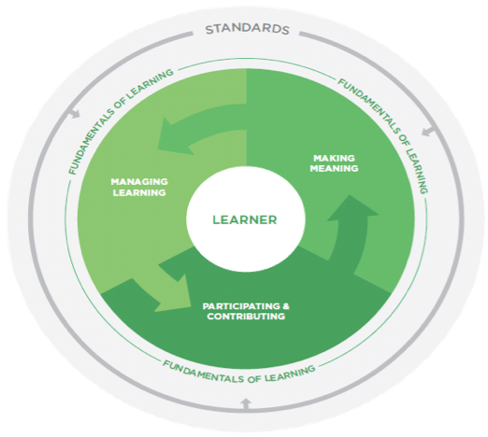
Notes:
Heritage, et al believe THESE are the most important things students need to be CCR

Slide 12
Notes:
Heritage, et al believe THESE are the most important things students need to be CCR

Slide 13
Notes:
Heritage, et al believe THESE are the most important things students need to be CCR

Slide 14
Notes:
Heritage, et al believe THESE are the most important things students need to be CCR

Slide 15
Fundamentals of Learning
Making Meaning
Participating and Contributing
Managing Learning
Notes:
FOLs (as well as Conley’s Keys and 21st Century Skills) transcend subject areas - students should have the opportunity to make meaning, participate and contribute, and manage their own learning throughout their day, year, & across years.

Slide 16
Making
Meaning
Participating and Contributing
Managing Learning
Thinking critically, creatively, and metacognitively
Connecting prior knowledge to new learning
Using language, symbols, and texts
Engaging with others in learning
Communicating ideas, feelings, perspectives, and understanding
relating to other people’s ideas, feelings, and experiences
Taking personal responsibility for learning
Adapting learning tactics
Persevering with challenges

Slide 17
Take some time to read!
Read Fundamentals of Learning:
Beginning to pg. 13
Your purpose for reading:
Return to the diagram on page 4, process with a partner.
Notes:
3 groups! 1. Plan your own stopping points, discuss with a partner or group at each. 2. Read independently and discuss thoughts when finished. 3. Workshop - read, respond authentically, discuss at points that aren’t pre determined.

Slide 18
The New Context
CAREER AND COLLEGE READINESS
COMMON CORE
ELA
COMMON CORE
MATH
NEXT GENERATION
SCIENCE STANDARDS

Slide 19
The Framework

Slide 20
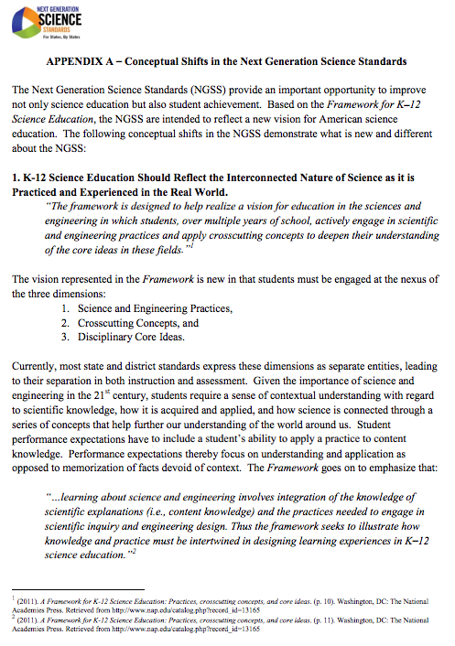
Appendix A: The Shifts

Slide 21
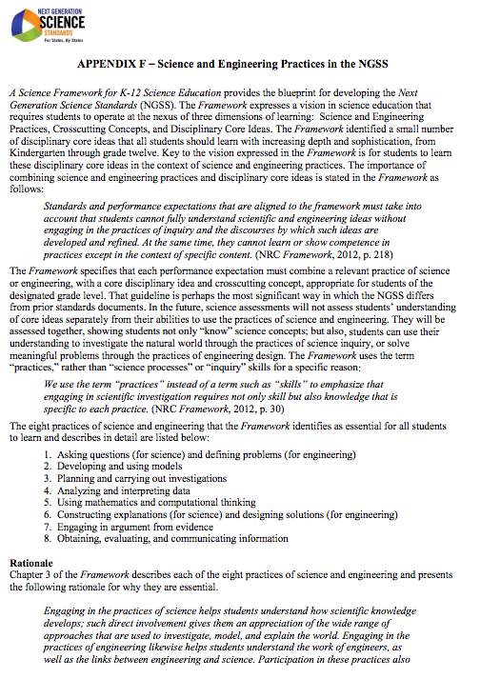
Appendix F: Science and Engineering Practices

Slide 22
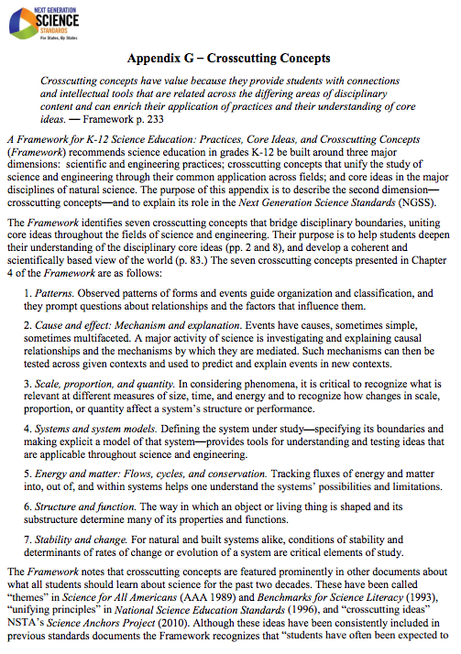
Appendix G: Crosscutting Concepts
Patterns
Cause and Effect
Scale, Proportion, and Quantity
Systems and System Models
Energy and Matter: Flows, cycles and conservation
Structure and Function
Stability and Change

Slide 23
Engineering Design Challenge!
Notes:
(75 min.)
Immersion in an Engineering Design Challenge
Zip line challenge
Purpose:
to experience a design challenge from a student perspective
To provide a common experience for discussion
To model a challenge you can carry out with your students

Slide 24
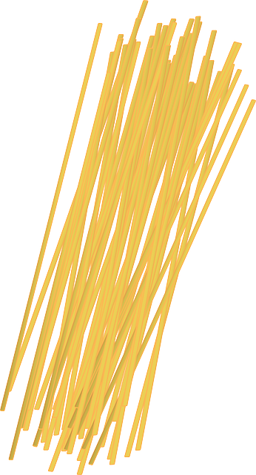
Engineering Design Challenge!
1
1 m
20
18 min
1 m
Notes:
(75 min.)
Immersion in an Engineering Design Challenge
Zip line challenge
Purpose:
to experience a design challenge from a student perspective
To provide a common experience for discussion
To model a challenge you can carry out with your students

Slide 25
Engineering Design Challenge!
Sharing
Spokesperson
Please take a moment to share briefly about your design.
Significant challenges?
Exciting innovations?
Notes:
(75 min.)
Immersion in an Engineering Design Challenge
Zip line challenge
Purpose:
to experience a design challenge from a student perspective
To provide a common experience for discussion
To model a challenge you can carry out with your students

Slide 26
Engineering in the NGSS
Notes:
Slide 9-13 12 minutes to organize and then quickly review the architecture
Can hand out the Engineering Design Standards here for a visual or wait and hand it out after the Architecture tutorial
Organize the group into tables of all 5th or all 8th grade teachers (if possible)
Give each group a copy of the Engineering Design “placemat”.
CRAIG GAVE ONE OUT TO EACH PERSON SO THAT THEY COULD TAKE NOTES ON IT.

Slide 27
What NGSS Says About What Student Engineers Should Know and Be Able to Do…
Examine the description of Engineering Design at your grade level in the following documents:
Appendix I from the NGSS
Engineering, Technology and Application of Science (ETS) standards from the NGSS
Notes:
Slide 14-19 60 min.
Engineering Design:
Hand out Appendix I, Allow them a few minutes to read the introduction
and their grade level description.
Hand out the ETS standards for 5th and 8th and allow them to skim these as well.
You can also include readings from the framework if you feel your group is ready/needs additional information

Slide 28
What NGSS Says About What Student Engineers Should Know and Be Able to Do…
Define
Add ideas from your readings and student expectations onto the Engineering Design poster
Optimize
Develop Solutions
Notes:
Slide 14-19 60 min.
Engineering Design:
At their table have them discuss what the two documents say about what students should know and be able to do.
Have them add notes inside the circles on their placemat documents.
What does this mean for their grade level?
Make notes on the Design Process placemat to capture things that students should know and be able to do in groups or partners

Slide 29
Define
Notes:
Slide 14-19 60 min.
Engineering Design:
Share out as a whole group for each circle to be sure there are no misconceptions and they have captured the essence of each element of the cycle

Slide 30
Develop Solutions
Notes:
Slide 14-19 60 min.
Engineering Design:
Share out as a whole group for each circle to be sure there are no misconceptions and they have captured the essence of each element of the cycle

Slide 31
Optimize
Notes:
Slide 14-19 60 min.
Engineering Design:
Share out as a whole group for each circle to be sure there are no misconceptions and they have captured the essence of each element of the cycle

Slide 32
Debrief
Define
Where in this challenge did you have the opportunity to practice the different elements of the engineering design process?
What implications are there for classroom engineering tasks?
Optimize
Develop Solutions
Notes:
Slide 24-25 30 min
Go back to the design graphic poster, reflect- where in this challenge did they have the opportunity to practice the different elements of the engineering design process?
Stop and jot, turn and talk

Slide 33
NGSS Architecture

Slide 34
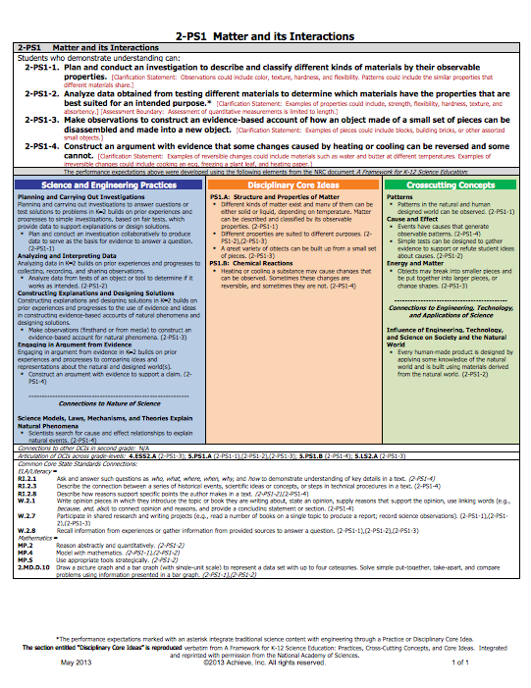
THE STANDARD
IS THE
WHOLE PAGE

Slide 35
FOUNDATION
BOXES

Slide 36
PERFORMANCE
EXPECTATIONS

Slide 37
CONNECTION
BOXES

Slide 39
NGSS Architecture
DISCIPLINARY CORE
IDEAS (DCI’s)
SCIENCE AND ENGINEERING PRACTICES (SEP’s)
CROSSCUTTING
CONCEPTS (CC’s)

Slide 40
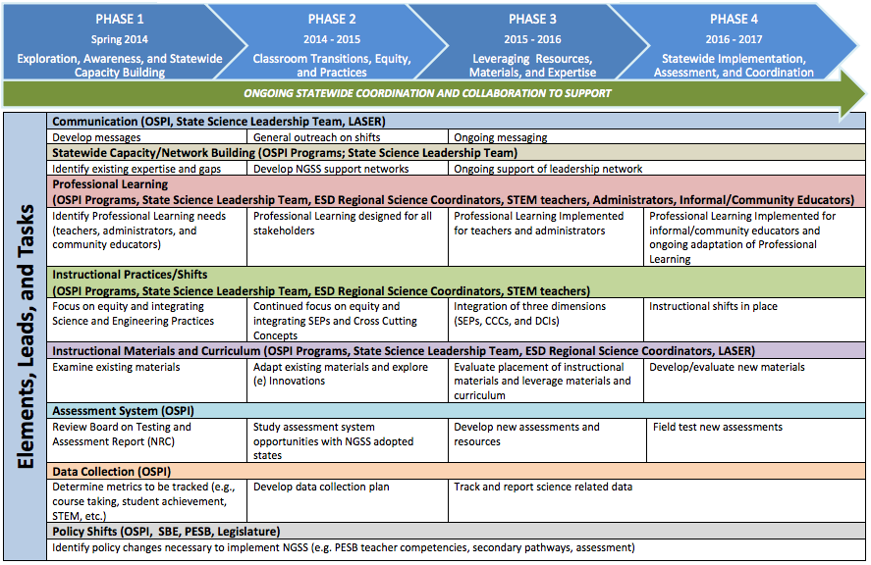
Elements of Transition

Slide 41
Assessment Timeline

Slide 42
AESD Science reflection survey
Workshop Date: | 01-24-2015
Intended Goal: | Goal 2
Title of Workshop: | DDNGSS
Number of PD Hours: | 6
ESD of this PD: | Northwest ESD 189
bit.ly/aesd_survey

