Slide 1
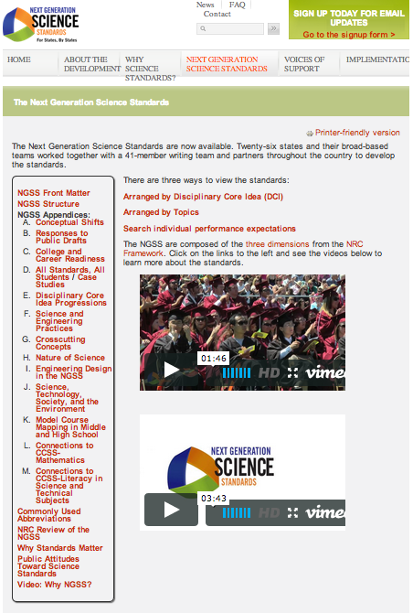
APPENDIX A:
CONCEPTUAL SHIFTS
Notes:
The NGSS website has a rich collection of resources in the appendices. The term is unfortunate as it seems to make the unimportant, but there are lots of good things to be found and read here.
This protocol will help a group of 6 or more teachers read more about the CONCEPTUAL SHIFTS found in the NGSS.

Slide 2
Looking Deeper: Appendix A
Let’s regroup and move around!
Notes:
We’ll count you off into groups 1-6.
If there’s a number you really can’t stand, you can switch with a neighbor. ☺

Slide 3
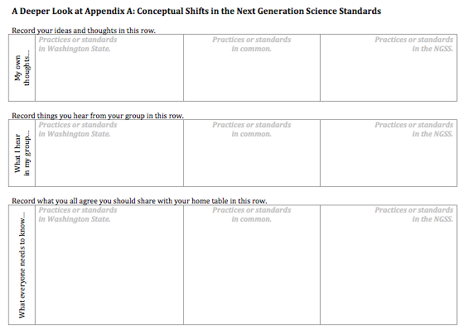
Looking Deeper: Appendix A
A Jigsaw Protocol
STEP 1: READ FOR YOURSELF | STEP 2: SHARE AND RECORD | STEP 3: FOCUS AND PREPARE | STEP 4: REPORT BACK AND SHARE OUT
STEP 1
STEP 2
STEP 3
Notes:
Learn how to navigate the NGSS Performance Expectations in order to make instructional decisions
Learn how to help educators in my district navigate the NGSS Performance Expectations
Learn how to use a protocol to help ALL students (including Migrant, Bilingual, and ELL students) engage in the Science and Engineering Practices
http://zour.deviantart.com/art/The-goal-3D-Anaglyph-169055907
For 3D image of goal

Slide 4
Looking Deeper: Appendix A
STEP 1: READ FOR YOURSELF | STEP 2: SHARE AND RECORD | STEP 3: FOCUS AND PREPARE | STEP 4: REPORT BACK AND SHARE OUT
Silently read your numbered section.
Make notes for yourself.
(People numbered 6 will read parts 6 and 7)
Notes:
Learn how to navigate the NGSS Performance Expectations in order to make instructional decisions
Learn how to help educators in my district navigate the NGSS Performance Expectations
Learn how to use a protocol to help ALL students (including Migrant, Bilingual, and ELL students) engage in the Science and Engineering Practices
http://zour.deviantart.com/art/The-goal-3D-Anaglyph-169055907
For 3D image of goal

Slide 5
Looking Deeper: Appendix A
STEP 1: READ FOR YOURSELF | STEP 2: SHARE AND RECORD | STEP 3: FOCUS AND PREPARE | STEP 4: REPORT BACK AND SHARE OUT
Share your observations with like-numbered people.
Record things that you hear and that you think are important.
Notes:
Learn how to navigate the NGSS Performance Expectations in order to make instructional decisions
Learn how to help educators in my district navigate the NGSS Performance Expectations
Learn how to use a protocol to help ALL students (including Migrant, Bilingual, and ELL students) engage in the Science and Engineering Practices
http://zour.deviantart.com/art/The-goal-3D-Anaglyph-169055907
For 3D image of goal

Slide 6
Looking Deeper: Appendix A
STEP 1: READ FOR YOURSELF | STEP 2: SHARE AND RECORD | STEP 3: FOCUS AND PREPARE | STEP 4: REPORT BACK AND SHARE OUT
As a like-numbered group, agree on what important things you need to share with your original group.
Record those agreements.
Return to your original group.
Notes:
Learn how to navigate the NGSS Performance Expectations in order to make instructional decisions
Learn how to help educators in my district navigate the NGSS Performance Expectations
Learn how to use a protocol to help ALL students (including Migrant, Bilingual, and ELL students) engage in the Science and Engineering Practices
http://zour.deviantart.com/art/The-goal-3D-Anaglyph-169055907
For 3D image of goal

Slide 7
Looking Deeper: Appendix A
STEP 1: READ FOR YOURSELF | STEP 2: SHARE AND RECORD | STEP 3: FOCUS AND PREPARE | STEP 4: REPORT BACK AND SHARE OUT
Beginning with the person numbered 1, each person shares the agreed important things.
Record the important points.
Prepare to share out what was especially important to you or surprising.
Notes:
Learn how to navigate the NGSS Performance Expectations in order to make instructional decisions
Learn how to help educators in my district navigate the NGSS Performance Expectations
Learn how to use a protocol to help ALL students (including Migrant, Bilingual, and ELL students) engage in the Science and Engineering Practices
http://zour.deviantart.com/art/The-goal-3D-Anaglyph-169055907
For 3D image of goal

Slide 8
Sharing Out
What was surprising?
What stood out?

Slide 9
Application
How could this protocol help your colleagues?
How could this protocol help your district?

