Slide 1
Northwest Regional Science Leadership Team Fall 2013-14
Beginning the
Journey to NGSS
Joanne Johnson
Brian MacNevin
Notes:
http://www.youtube.com/watch?v=6RUjt5eJAQ0
To add video of 3D moon if you have 3D glasses

Slide 2
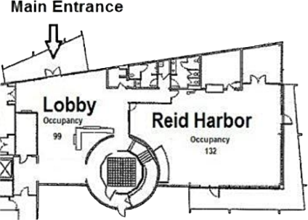
Welcome!
REST
ROOMS
Notes:
Thank you for attending
Logistics
Rest room
Parking Lot

Slide 3
Parking Lot
Post-it Notes on the window
or
tweet #nwesd

Slide 4
Agenda
09:00 Welcome
Concerns Based Adoption Model
A Deeper Look into NGSS Appendix
10:10 Break
10:20 Analyzing NGSS Performance Expectations
11:20 Lunch
12:30 NGSS Narrative
NGSS Resources Website
01:30 Break
01:40 Question Formulation Technique (QFT)
Closing and Survey
03:00 To infinity and beyond!

Slide 5
Regional Science Learning Team
These science advocates will build their own understanding of the Next Generation Science Standards in order to inform planning, professional development and implementation in their districts. They will also provide district perspectives to inform state NGSS transition plans and will have opportunities to provide input and insight on regional implementation, professional development planning and instructional materials transitions.

Slide 6
WA’s Timeline to NGSS
2013/14 | 2014/15 | 2015/16 | 2016/17 | 2017/18
READ WONDER DIGEST LEARN |  |  | NGSS FULLY IMPLEMENTED | NEW ASSESSMENT

Slide 7
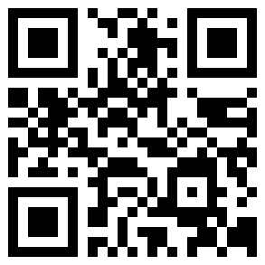
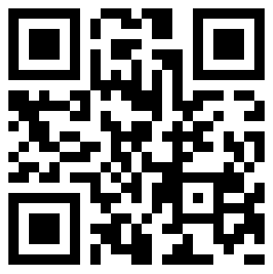
Free PDF NGSS Resources
1
The Next Generation Science Standards
http://tinyurl.com/ngss-dci
2
Framework for
Science Education
http://tinyurl.com/sci-framework

Slide 8
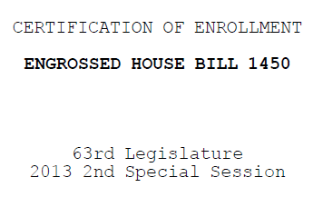
Framing the Day

Slide 9
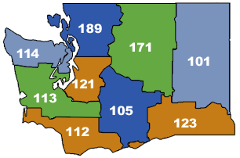
Who is in the room?
189

Slide 10
Today’s Goals
1
Learn to navigate NGSS Performance Expectations
2
Learn to help colleagues navigate the NGSS Performance Expectations
3
Learn a protocol to help students engage in questioning.
Notes:
Learn how to navigate the NGSS Performance Expectations in order to make instructional decisions
Learn how to help educators in my district navigate the NGSS Performance Expectations
Learn how to use a protocol to help ALL students (including Migrant, Bilingual, and ELL students) engage in the Science and Engineering Practices
http://zour.deviantart.com/art/The-goal-3D-Anaglyph-169055907
For 3D image of goal

Slide 11
Implementing Initiatives
At your table group, list some of the initiatives that your school, building, and/or district is trying to implement.

Slide 12
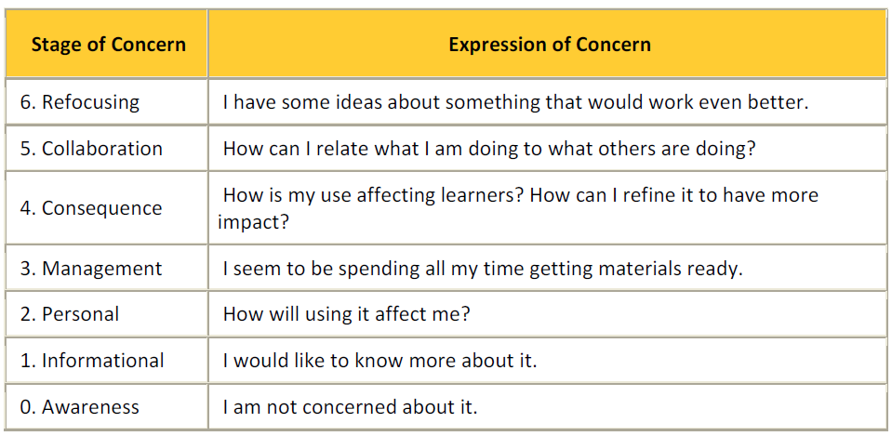
Concerns Based Adoption Model

Slide 13
Stage of Concern | Expression of Concern
6. Refocusing | I have some ideas about something that would work even better to help teachers and students learn and demonstrating their understanding of the Next Generation Science Standards.
5. Collaboration | How can I relate what I am doing to what others are doing related to the teaching and learning of the Next Generation Science Standards?
4. Consequence | How is my teaching and use of the Next Generation Science Standards affecting learners? How can I refine my teaching to have more impact helping students to demonstrate their understanding of the Next Generation Science Standards?
3. Management | I seem to be spending all my time referring back to the Next Generation Science Standards while trying to teach to them. I am trying to implement them, but am worried that it is not going well.
2. Personal | How will adopting the Next Generation Science Standards affect me and my teaching? What will it look like? What do I need to know?
1. Informational | I would like to know more about the Next Generation Science Standards, but am not ready to implement them fully.
0. Awareness | I am not concerned about the Next Generation Science Standards. I have heard of them, but I am not worried about implementing them or learning them. What I am currently teaching is just fine.

Slide 16
Application?
How might you use this tool with your colleagues?
How might you use this tool with your principal or district administrators?

Slide 17
Today’s Goals
1
Learn to navigate NGSS Performance Expectations
2
Learn to help colleagues navigate the NGSS Performance Expectations
3
Learn a protocol to help students engage in questioning.
Notes:
Learn how to navigate the NGSS Performance Expectations in order to make instructional decisions
Learn how to help educators in my district navigate the NGSS Performance Expectations
Learn how to use a protocol to help ALL students (including Migrant, Bilingual, and ELL students) engage in the Science and Engineering Practices
http://zour.deviantart.com/art/The-goal-3D-Anaglyph-169055907
For 3D image of goal

Slide 18
APPENDIX A:
CONCEPTUAL SHIFTS

Slide 19
Looking Deeper: Appendix A
Let’s regroup and move around!
Notes:
We’ll count you off into groups 1-6.
If there’s a number you really can’t stand, you can switch with a neighbor. ☺

Slide 20
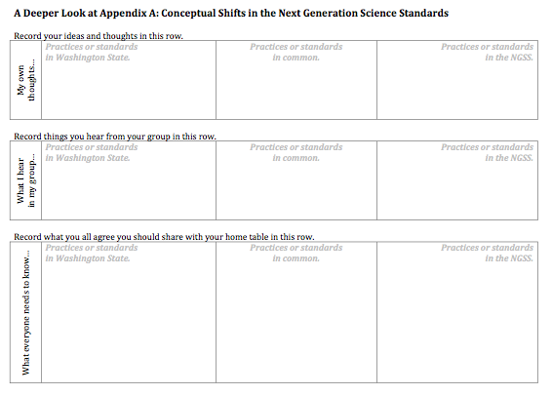
Looking Deeper: Appendix A
A Jigsaw Protocol
STEP 1: READ FOR YOURSELF | STEP 2: SHARE AND RECORD | STEP 3: FOCUS AND PREPARE | STEP 4: REPORT BACK AND SHARE OUT
STEP 1
STEP 2
STEP 3
Notes:
Learn how to navigate the NGSS Performance Expectations in order to make instructional decisions
Learn how to help educators in my district navigate the NGSS Performance Expectations
Learn how to use a protocol to help ALL students (including Migrant, Bilingual, and ELL students) engage in the Science and Engineering Practices
http://zour.deviantart.com/art/The-goal-3D-Anaglyph-169055907
For 3D image of goal

Slide 21
Looking Deeper: Appendix A
STEP 1: READ FOR YOURSELF | STEP 2: SHARE AND RECORD | STEP 3: FOCUS AND PREPARE | STEP 4: REPORT BACK AND SHARE OUT
Silently read your numbered section.
Make notes for yourself.
(People numbered 6 will read parts 6 and 7)
Notes:
Learn how to navigate the NGSS Performance Expectations in order to make instructional decisions
Learn how to help educators in my district navigate the NGSS Performance Expectations
Learn how to use a protocol to help ALL students (including Migrant, Bilingual, and ELL students) engage in the Science and Engineering Practices
http://zour.deviantart.com/art/The-goal-3D-Anaglyph-169055907
For 3D image of goal

Slide 22
Looking Deeper: Appendix A
STEP 1: READ FOR YOURSELF | STEP 2: SHARE AND RECORD | STEP 3: FOCUS AND PREPARE | STEP 4: REPORT BACK AND SHARE OUT
Share your observations with like-numbered people.
Record things that you hear and that you think are important.
Notes:
Learn how to navigate the NGSS Performance Expectations in order to make instructional decisions
Learn how to help educators in my district navigate the NGSS Performance Expectations
Learn how to use a protocol to help ALL students (including Migrant, Bilingual, and ELL students) engage in the Science and Engineering Practices
http://zour.deviantart.com/art/The-goal-3D-Anaglyph-169055907
For 3D image of goal

Slide 23
Looking Deeper: Appendix A
STEP 1: READ FOR YOURSELF | STEP 2: SHARE AND RECORD | STEP 3: FOCUS AND PREPARE | STEP 4: REPORT BACK AND SHARE OUT
As a like-numbered group, agree on what important things you need to share with your original group.
Record those agreements.
Return to your original group.
Notes:
Learn how to navigate the NGSS Performance Expectations in order to make instructional decisions
Learn how to help educators in my district navigate the NGSS Performance Expectations
Learn how to use a protocol to help ALL students (including Migrant, Bilingual, and ELL students) engage in the Science and Engineering Practices
http://zour.deviantart.com/art/The-goal-3D-Anaglyph-169055907
For 3D image of goal

Slide 24
Looking Deeper: Appendix A
STEP 1: READ FOR YOURSELF | STEP 2: SHARE AND RECORD | STEP 3: FOCUS AND PREPARE | STEP 4: REPORT BACK AND SHARE OUT
Beginning with the person numbered 1, each person shares the agreed important things.
Record the important points.
Prepare to share out what was especially important to you or surprising.
Notes:
Learn how to navigate the NGSS Performance Expectations in order to make instructional decisions
Learn how to help educators in my district navigate the NGSS Performance Expectations
Learn how to use a protocol to help ALL students (including Migrant, Bilingual, and ELL students) engage in the Science and Engineering Practices
http://zour.deviantart.com/art/The-goal-3D-Anaglyph-169055907
For 3D image of goal

Slide 25
Sharing Out
What was surprising?
What stood out?

Slide 26
Application
How could this protocol help your colleagues?
How could this protocol help your district?

Slide 27
BREAK
10 Minute Break
When you come back, please
bring your stuff and find a new seat
Elementary at tables up front
High School at tables in the middle
Middle School at tables in the back

Slide 28
Welcome Back!
Find your table and your group.
Elementary at tables up front
High School at tables in the middle
Middle School at tables in the back

Slide 29
Today’s Goals
Learn to navigate NGSS Performance Expectations
Learn to help colleagues navigate the NGSS Performance Expectations
Learn a protocol to help ALL students engage questioning.
Notes:
Learn how to navigate the NGSS Performance Expectations in order to make instructional decisions
Learn how to help educators in my district navigate the NGSS Performance Expectations
Learn how to use a protocol to help ALL students (including Migrant, Bilingual, and ELL students) engage in the Science and Engineering Practices
http://zour.deviantart.com/art/The-goal-3D-Anaglyph-169055907
For 3D image of goal

Slide 30
Analyzing a Performance Expectation
Dissecting and Examining a Standard
Notes:
BSCS Protocol “Highlight Comments and Captions” used to analyze data

Slide 31
Highlights, Comments, and Captions
Three Parts to this Protocol
- Adapted from BSCS -
Part 1: Observing - independent
Part 2: Recording - mixed
Part 3: Reflecting - mixed

Slide 32
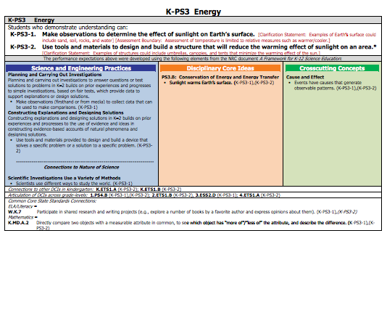
Anatomy of a Standard
STANDARD

Slide 33
Anatomy of a Standard
PERFORMANCE
EXPECTATION

Slide 34
Anatomy of a Standard
FOUNDATION
BOXES

Slide 35
Anatomy of a Standard
SCIENCE AND
ENGINEERING
PRACTICES

Slide 36
Anatomy of a Standard
DISCIPLINARY
CORE
IDEAS

Slide 37
Anatomy of a Standard
CROSS-
CUTTING
CONCEPTS

Slide 38
Anatomy of a Standard
CONNECTIONS

Slide 39
Anatomy of a Standard
CONNECTIONS TO
OTHER DCI’s

Slide 40
Anatomy of a Standard
ARTICULATION OF
DCI’s ACROSS
GRADE-LEVELS

Slide 41
Anatomy of a Standard
COMMON CORE
STATE STANDARDS
CONNECTIONS

Slide 42
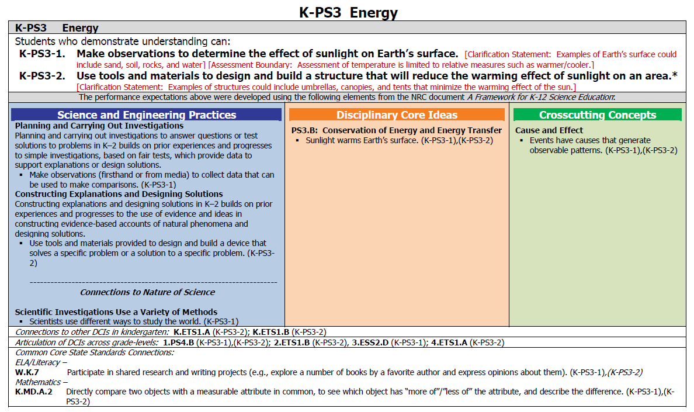
Focus on a Performance Expectation
Notes:
Choose any performance expectation you would like.

Slide 43
Choose a Standard to Investigate
Your group will decide on a standard to investigate.
Try to find one with many performance expectations.
Each person will choose a performance expectation to investigate.

Slide 44
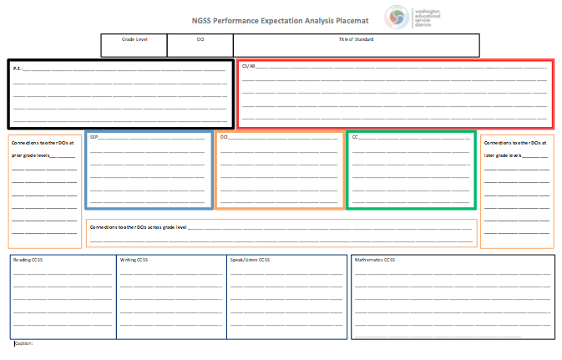

Slide 45
What Standard Did You Choose?
Grade Level | DCI | Title of Standard
K | PS3 | Energy
Notes:
Fill in the Grade Level, DCI, and Title of the standard

Slide 46
Pick a Performance Expectation
PE
AB / CS
Notes:
Choose any performance expectation you would like.

Slide 47
Text of a Performance Expectation
Notes:
Write the text of the PE and associated assessment boundaries and clarification statement(s)

Slide 48
3-Dimensional Foundation Boxes

Slide 49
3 Dimension-Foundation Boxes

Slide 50
Connection Boxes-To Other DCIs
Just record the codes for now

Slide 51
DCIs Before and After
Notes:
Only add the ones associated with the Performance Expectation you chose.

Slide 52
Connection to the Common Core

Slide 53
Highlights, Comments, and Captions
Three Parts to this Protocol
Part 1: Observing - independent
Part 2: Recording - mixed
Part 3: Reflecting - mixed

Slide 54
What Does It Mean? Implications and Inferences…
I notice that students will have to make observation and comparisons. I will have to teach these skills in multiple settings

Slide 55
Highlights, Comments, and Captions
Three Parts to this Protocol
Part 1: Observing - independent
Part 2: Recording - mixed
Part 3: Reflecting - mixed

Slide 56
Caption
If this place mat was a picture in a book, what caption would you give it?
Write a one to three sentence caption describing what you have created.

Slide 57
LUNCH!
You’ve got an hour in beautiful Anacortes!
When we are back from lunch, we’ll use these captions and placemats to further examine the NGSS.

Slide 58
Fitting it in
Read the conceptual narrative for grade level or band and see how what you’ve uncovered fits into the story line.
Look for the conceptual shifts within that story line that we saw in Appendix A.
Did anything surprise you, or were there any Ah-ha’s?

Slide 59
So What?
How could I use this with my colleagues?
How could I use this within my district?

Slide 60
www.nextgenscience.org
Notes:
New

Slide 61
Inquiring Minds Want to Know…
Do you have questions about the Next Generation Science Standards?????
Notes:
We will be going through a protocol to bring out your burning questions…
This is a protocol that can be used with your students as well as bringing out questions that you have around today’s topic.

Slide 62
COMPONENTS OF THE QUESTION FORMULATION TECHNIQUE™
1. The Question Focus (QFocus)
2. The Rules for Producing Questions
3. Producing Questions
4. Categorizing Questions
5. Prioritizing Questions
6. Next Steps
7. Reflection

Slide 63
1
THE QUESTION FOCUS (QFOCUS)

Slide 64
For States by States

Slide 65
2
RULES FOR PRODUCING QUESTIONS

Slide 66
RULES FOR PRODUCING QUESTIONS
Introduce the Rules for Producing Questions:
Ask as many questions as you can
Do not stop to answer, judge or to discuss the questions
Write down every question exactly as it is stated
Change any statement into a question
Notes:
TIP: Distribute or post the Rules for Producing Questions

Slide 67
RULES FOR PRODUCING QUESTIONS
Review the rules.
Reflect about one of these questions:
What do you think would be difficult about following these rules?
Which one of these rules might be difficult to follow? Why?

Slide 68
3
PRODUCING QUESTIONS

Slide 69
PRODUCING QUESTIONS
Divide into small groups of 3 - 5.
Decide on a note taker.
As a group call out questions one at a time
Note taker records questions from group on QFT Protocol Worksheet word for word
Notes:
Once students have discussed the Rules for Producing
Questions:

Slide 70
PRODUCING QUESTIONS
Produce as many questions as you can in allotted time
Follow the Rules for Producing Questions
Number the questions
Notes:
Introduce the QFocus and ask students to:
TIP: The note-taker should also contribute questions.

Slide 71
4
CATEGORIZING QUESTIONS

Slide 72
CATEGORIZING QUESTIONS
Define closed and open-ended questions:
Closed-ended Questions can be answered with a “yes’ or “no” or with a one-word answer.
Open-ended Questions require more explanation.

Slide 73
CATEGORIZING QUESTIONS
Step 1
Look over the list and:
mark the questions that are closed-ended with a “C”
mark the questions that are open-ended with an “O”

Slide 74
CATEGORIZING QUESTIONS
Step 2
Name the…
advantages of closed-ended questions
Then,
disadvantages of closed-ended questions

Slide 75
CATEGORIZING QUESTIONS
Name the…
Advantages of open-ended questions
Then,
Disadvantages of open-ended questions

Slide 76
4
PRIORITIZING QUESTIONS

Slide 77
PRIORITIZING QUESTIONS
For example:
Choose three questions…
that most interest you.
that are most important.
that will best help you design your research project.
you want/need to answer first.
Notes:
Criteria for prioritizing is usually set by the teacher. Criteria will depend on what you have planned as next steps with the questions.

Slide 78
PRIORITIZING QUESTIONS
Review your list of questions and choose three questions (most important; to develop a project, etc.). Mark them with an “X”
Keep the QFocus in mind while prioritizing.

Slide 79
PRIORITIZING QUESTIONS
Ask students to think about their rationale for choosing the priority questions.
For example:
“Why did you choose these three as the most important?”

Slide 80
5
SHARE

Slide 81
REPORTS
On a poster
Three priority questions
Reasons for choosing the priority questions.
Notes:
TIP: Students can assign a group member to report or collaborate in reporting.

Slide 82
7
NEXT STEPS

Slide 83
NEXT STEPS
How can we use our questions moving forward…
Professional Development | Transitioning to NGSS
For you | Your Classroom
For your district | Your District

Slide 84
8
REFLECTION

Slide 85
REFLECTION
What is the value of learning to ask your own questions?
How can you use what you learned?
Notes:
TIP: Use one or more reflection questions.
Ask one question at a time.
Regarding transition to Next Generation Science Standards thinking about the science and engineering practices

Slide 86
Additional materials to help you teach the QFT are available at www.rightquestion.org.
For a comprehensive description of how to use the Question Formulation Technique™ in the classroom please see Make Just One Change: Teach Students to Ask Their Own Questions, 2011 Harvard Education Press. http://www.hepg.org/hep/book/144/MakeJustOneChange
We would appreciate any insights, suggestions or feedback about this presentation.

Slide 87
ABOUT THIS PRESENTATION
This power point presentation will walk you through all the steps needed and tips for teaching the Question Formulation Technique™ to your students.
The Right Question Institute offers many of our materials through a Creative Commons License and we encourage you to make use of and/or share this resource. Please reference the Right Question Institute as the source on any materials you use.
Source: www.rightquestion.org
Notes:
Why would we want students to learn to ask questions?

Slide 88
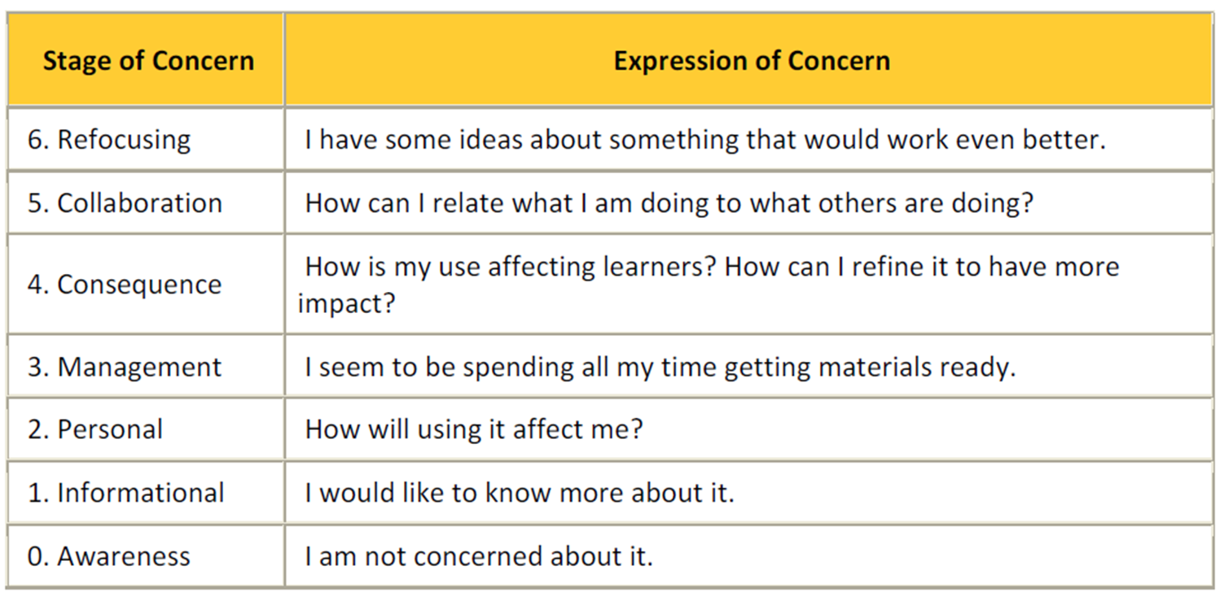
Moving Along the Stages of Concern

Slide 89
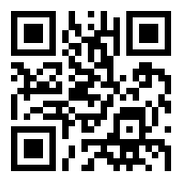
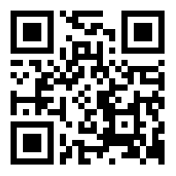
Survey and Resources
1
2
Today’s
Survey:
tinyurl.com/slnfall2013
Today’s
Presentation
Resources:
www.washingtonesds.org

