Slide 1
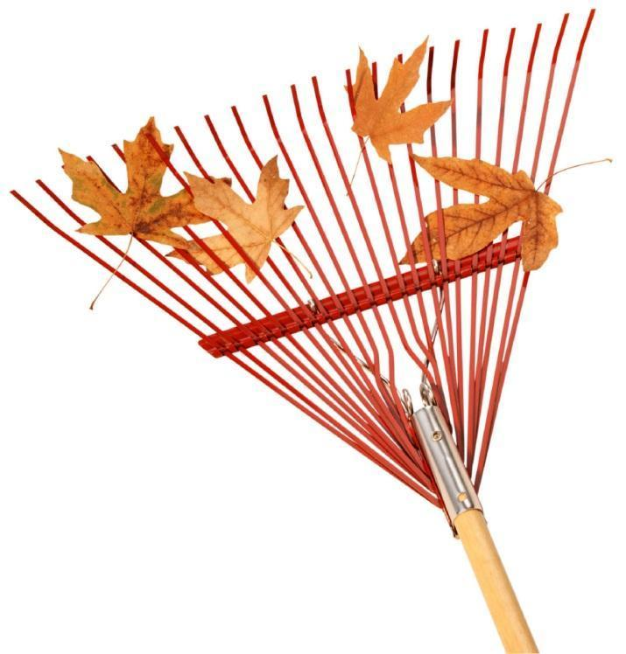
Northwest Science Leadership Network
Welcome!
Please have a seat where you like.
Complete the probe “Science and Engineering Practices Implementation”
Review the “Norms of Collaboration”
We’ll start today’s workshop at 9:00 AM

Slide 2
Northwest Science Leadership Network
October 2014
Brian MacNevin – Regional Science Coordinator
Joanne Johnson – Northwest LASER
Alliance Director

Slide 3
Logistics
Network: UID– visitor
PWD– Huskies
Hydration Station
Restrooms
Parking Lot
Notes:
Don’t get comfortable you will be working in grade level teams today.

Slide 4
Agenda
0900am Welcome
SEP’s: Models
1130am Lunch
1230pm SEP’s: Explanations
District Common Messaging
Feedback
0300pm Until next time!
Notes:
Don’t get comfortable you will be working in grade level teams today.

Slide 5
Science Leadership Network
Mission:
To strengthen regional capacity to support Washington’s transition to the Next Generation Science Standards so all students will benefit from a rich science and engineering education.

Slide 6
NW Science Leadership Network
Goal 1:
Science Leaders deepen their own understanding.
Goal 2:
Science Leaders support transition with tools.
Goal 3:
Science Leaders provide feedback to region and state.
Notes:
Goals 1:
Science Leaders will deepen their own understanding of the Next Generation Science Standards (NGSS) and the state and national education initiatives (science as well as relevant language arts and math initiatives).
Goal 2:
Science Leaders will learn tools and processes to use with colleagues in their own districts to facilitate a local transition to the NGSS. They will be a local resource to strengthen science education in their district.
Goal 3:
Science Leaders will provide feedback and district perspectives to inform state and regional NGSS implementation and support plans.

Slide 7
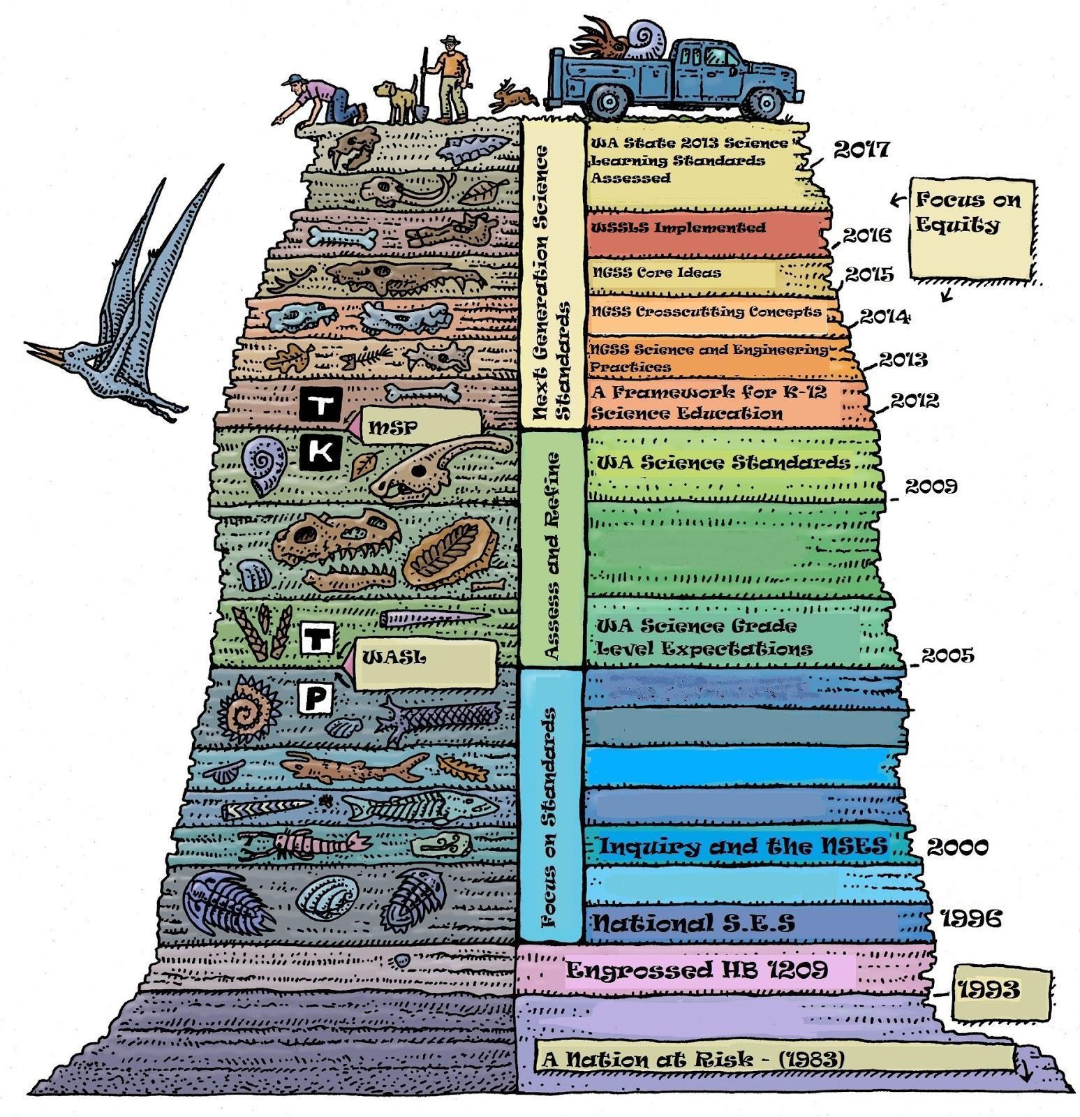
The Geologic History of Science Education in the State of Washington
Notes:
History of standards in WA State.

Slide 8
Assessment Timeline
Notes:
https://www.k12.wa.us/Science/NGSS/NGSS-AssessmentDescriptionTimeline.pdf

Slide 9
Washington State Transition Plan
Notes:
Explain the WA transition timeline.
Transition Plans available from OSPI at
http://www.k12.wa.us/Science/NGSS.aspx
Go to box on bottom of page and select third tab from left.

Slide 10
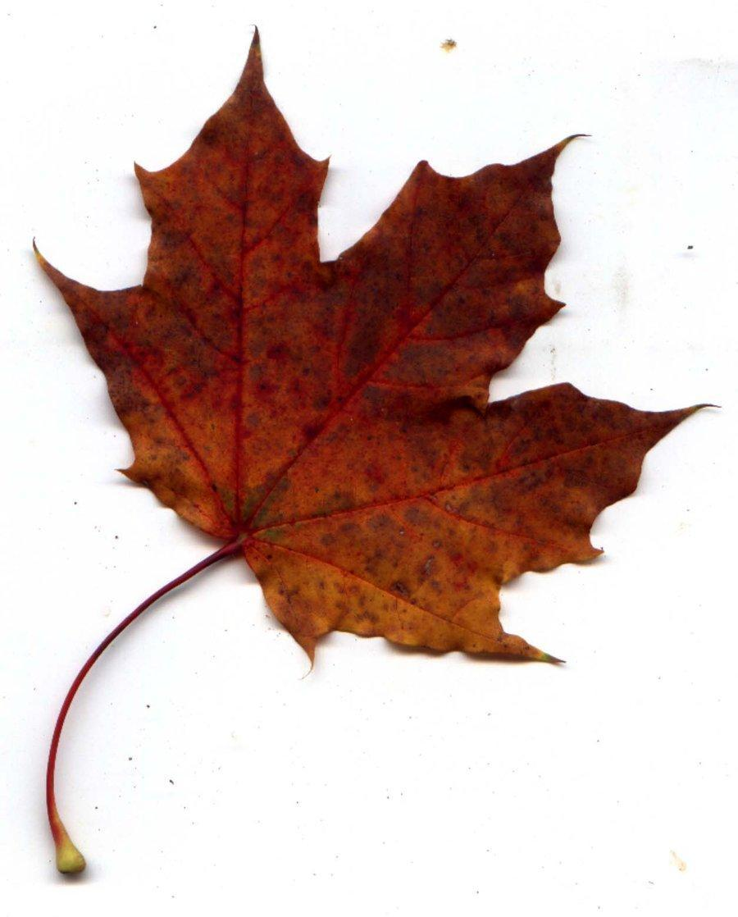
Workshop Goals
What might infusing “Practices” and “Crosscutting Concepts” look like in practice?
Apply the practice of Developing and Using Models to instructional design.
Connect the practices called Constructing Explanations & Designing Solutions, Engaging in Argument from Evidence to Developing and Using Models and WA State Learning Standards (ELA).
Develop the capacity to engage all learners in classroom discourse and the public representation of their ideas.
Craft common messages back to district.
Notes:
Goals were developed based on participant feedback from Spring.

Slide 11
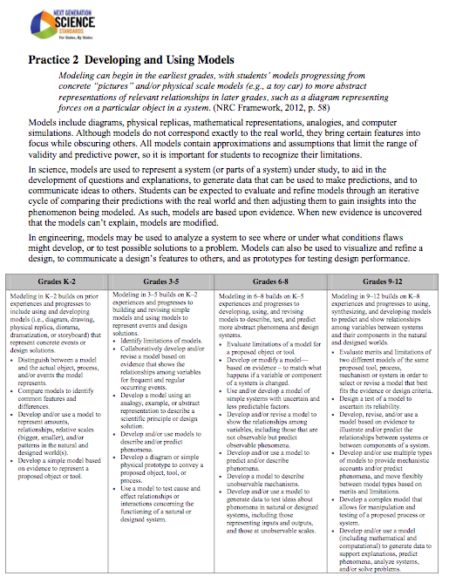
Developing and Using Models
Notes:
Take some time to read about models from NGSS Appendix F.
Pay close attention to the column at the bottom of the page that closest matches your grade level.
We won’t discuss this, but it’s background information for the next activity.

Slide 12
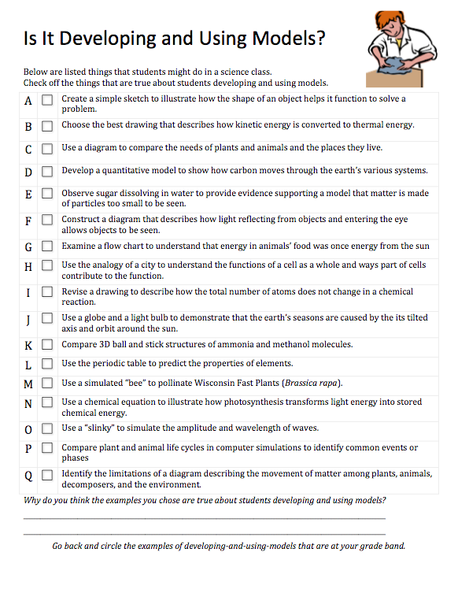
Is It Developing and Using Models?
Complete the probe.
When you are done, share with an elbow partner.
Notes:
Administer the probe.
Share that they will be revisiting the probe later in the day.
Transition: What does implementing the SEPs look like in a classroom? Today we will engage in some adult experiences around SEP #2, #6, and #7

Slide 13
The milk chocolate melts in your mouth, not in your hands.
Notes:
https://www.youtube.com/watch?v=RRESIYTRZzU
Or
http://viewpure.com/RRESIYTRZzU
m&m’s claim is that “the milk chocolate melts in your mouth and not in your hands.”
Today we are going to be evaluating that claim.
Do you think the advertisers have their science right?

Slide 14
Do you think M&M’s has the science right?
Do you agree that “the milk chocolate melts in your mouth,
not in your hands?”
C: NO! B: Sort of. A: YES!
Notes:
Do you agree with the claim that “the milk chocolate melts in your mouth, not in your hands?”
• Label one side of the room with the choices (A. B. C, etc.). This is the X axis of the graph.
(A) Yes
(B) Sort of
(C) No
• Label the adjacent wall with a range of low confidence to high confidence. This is the Y axis of the graph.
• Read the question and have students position themselves according to their answer choice and level of confidence in that answer.
The “claim” today is about the milk chocolate meling in your mouth and not in your hands. Participants may have different initial beliefs and that is what we will use for sorting them on the next slide.

Slide 15
Grade Level Groups
K-2
3-5
6-8
9-12
Notes:
Have participants group together in teams of three by gradeband. Then they can return to a table together.

Slide 16
Take a 15 minute Break!

Slide 17
Initial Thinking - Model
Draw a labeled diagram that describes what you think happens to an M&M in your mouth and in your hand that supports your claim (A, B or C).
Use your best scientific explanation based on your current understanding.
What is happening before, during, and after the candy goes from your hand to your mouth?
Prepare to share your ideas if the opportunity arises.
Notes:
On chart paper draw the model- these will be small group models based on their current thinking.

Slide 18
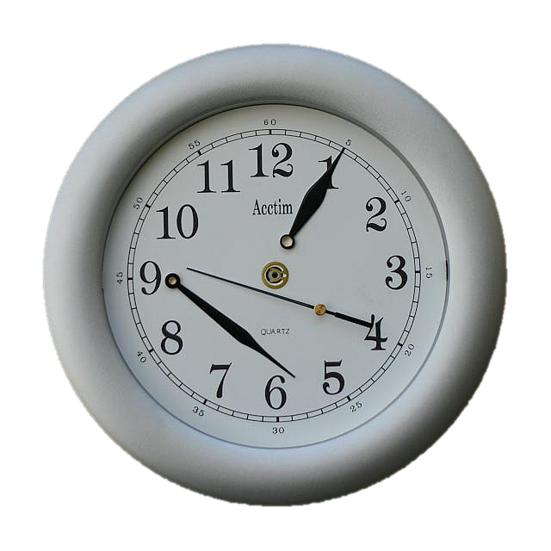
Gallery Walk and Break
How does your explanation differ from others’ in the room? Or is it similar?
What should your model include?
Notes:
Take a 15 minute break.
During this time, please visit all of the models in the room and think about these two ideas in in the slide.

Slide 19
Our Class’ Model Checklist
Gotta’ Haves
An evolving list of
Ideas and
Relationships that are
Important to a
Final explanation
Notes:
This is just an initial ideas list! Don’t bother “processing” this list right now.
Just collect ideas from the group.
Create an Explanation Checklist
The "Gotta-have" explanation checklist is not a list of vocabulary words that have to be
included in drawn or written explanation. As the checklist is developed, lesson by lesson,
it needs to be composed of IDEAS, or RELATIONSHIPS that the students now believe
are important to a final explanation. These items on the checklist are not "giving away
answers." They remind students of what is important to talk about or draw out, and these
are ideas that they have come up with themselves during the unit.

Slide 20
Gathering Evidence
Notes:
The experiment presented here is to add some common experiences, vocabulary, and observations to the class. In a workshop setting, this is just presented as a fast quick-and-dirty observing experience. But in a classroom setting, you might choose to draw this out of the students as something to explore to add more detail to our models.
The results and observations that your students pull out of this will correlate to their ages and your standards. Process the experiment with the group to help them identify that there is more in this system than m&m’s. m&m’s are a milk chocolate core surrounded by another layer of candy. Participants will notice that they behaved differently in the different water treatments. Pull that out and ask them to write themselves some notes about dissolving and melting. But we’re not yet revising our model… we’re just exploring.

Slide 21
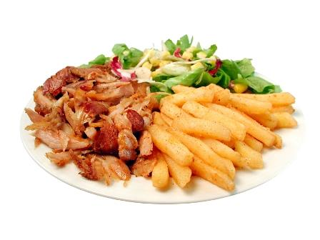
LUNCH!

Slide 22
Welcome Back! Have Room on Your Plate?
CCSS-ela
CCSS-math
NGSS

Slide 23
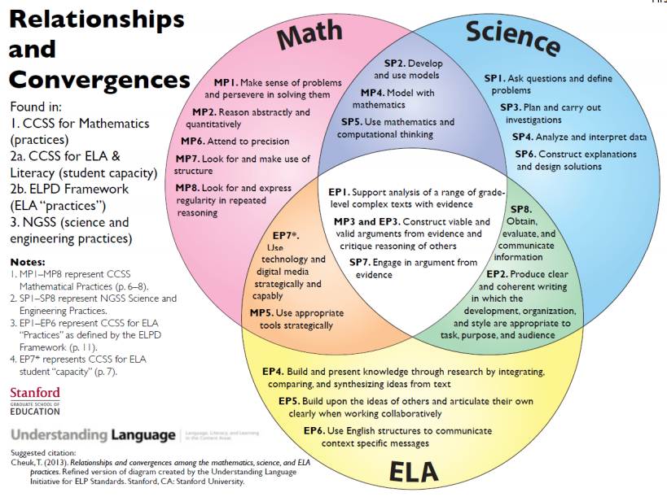
Notes:
In the NW SLN north session, we just talked briefly about this. In the NW SLN South session, we pre-empted this slide with a card-sort activity in which participants took the practices and capacities from ELA, Math, and Science and sorted them to look for commonalities and overlap. They then gallery-walked that and discussed trends or highlights they noticed. Then this slide was shared as this Stanford workgroup’s way of sorting them around equity and language needs. The card sort activity is available online at NWESD’s website.
This sets the stage for the rest of our conversations that overlap with ELA through reading and writing.

Slide 24
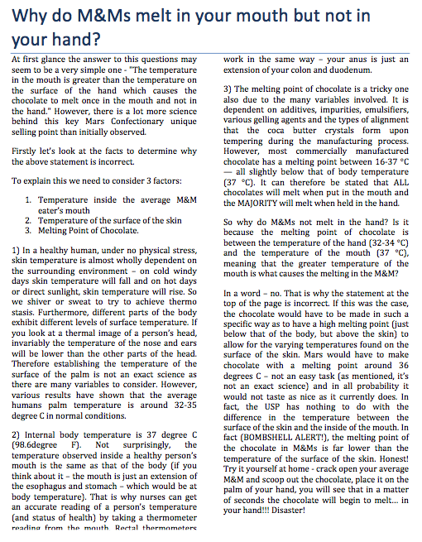
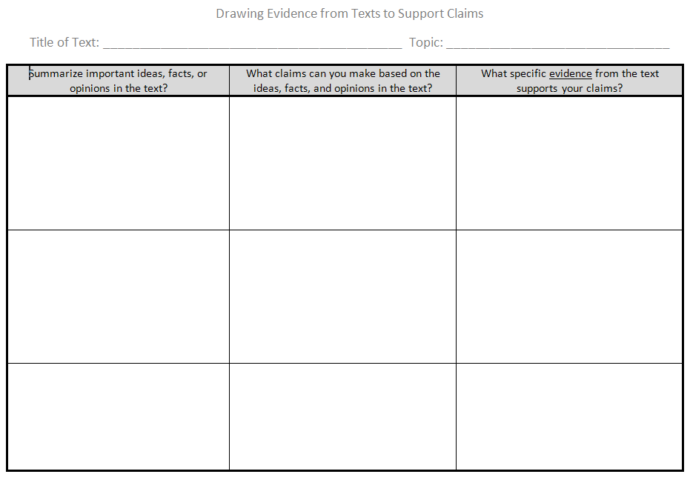
Seeking More Evidence
Notes:
Handout:
Why do M&Ms Melt in Your Mouth, but not in Your Hand? | Ask Science Gimp at JimmerUK.com. (2006, July 12). Retrieved September 22, 2014, from http://www.jimmeruk.com/Ask-Science-Gimp/why-do-mams-melt-in-your-mouth-but-not-in-your-hand.html
Participants will read the article and use the graphic organizer to support their reading.

Slide 25
Revising Our Class’ Model Checklist
Gotta’ Haves
An evolving list of
Ideas and
Relationships that are
Important to a
Final explanation
Notes:
Time to revise our class expectations of ourselves and our models!
As the instructor or teacher, at this point you can push on things that you think should now be common and included if participants don’t suggest including them in their models.
Things like solubility, melting point, body temperature, insulating qualities, state of matter… these things can be pushed for inclusion in the models now. They are part of the common class experience.

Slide 26
Adding to Our Model
What new information can you include in your model?
or
Is there anything you want to change in your model?
Consider…
What happened to the different parts of the candy?
What is happening at the particle level?
What is happening to the matter and energy?
Notes:
Go back to the Gotta-Have checklist.
This slide is a chance to prompt people to think about revising their model.
As a facilitator: choose your adventure:
IF you want participants to collaboratively revise their models:
Participants will make changes to their models right now before using the process on the next slide.
IF you want participants to revise their models on their own:
Participants will just think individually about these prompts right now before using the process on the next slide.

Slide 27
Adding to Our Model: Sticky-Notes and Language Scaffolds
We added….
Added to our model -
Revised our model -
Questions we still have -
Use the Sentence Frames!
We used to think….
We are wondering….
Notes:
Use the half-sheet handout with the sentence frames on it for participants.
You will need pink, yellow, and blue sticky notes for each group.
IF participants are revising their own model right now:
They will make stickies for themselves and place them on their model poster.
IF participants are suggesting revisions to others:
Provide them time to move around the room and use stickies to suggest revisions to others’ models.
THEN you will need to give them time to respond to those recommendations in their model.
ELA and ELL Tips:
Students are often reluctant to comment on others' drawings, so we have them practice by placing notes on their own models.
They learn how to write notes in full sentences that provide reasons for requesting possible changes.
We always provide students with sentence frames.
One sentence frame should be about a puzzle or a question that a group has. This opens the door to really new ideas or to gaps in the potential explanation that could not be expressed in any other way.
Allow time after the commentary for the creators of the model to read the notes and decide if they should act upon the suggestions.

Slide 28
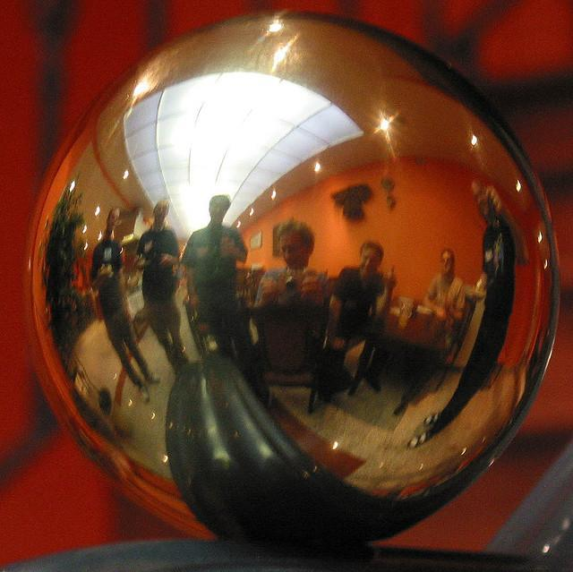
Reflecting on Developing and Using Models
How have your ideas changed?
Revisit the probe. Any new insights?
What should students at your grade band know and be able to do with the practice of developing and using models? (Appendix F p.6)
Notes:
Share the probe answers in the “teacher page”
Share Appendix F p.6.
Ask participants to reflect on their own learning and on implications for classroom practice.

Slide 29
Notes:
Should they get page 6 as a handout?
Share answers to probe.

Slide 30
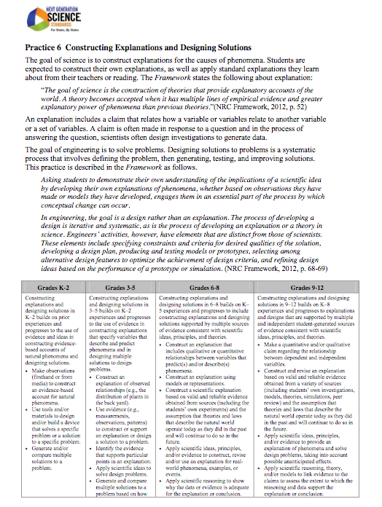
Constructing Explanations and Designing Solutions
Notes:
Participants read SEP 6 and the appropriate grade-band in the table on the bottom.

Slide 31
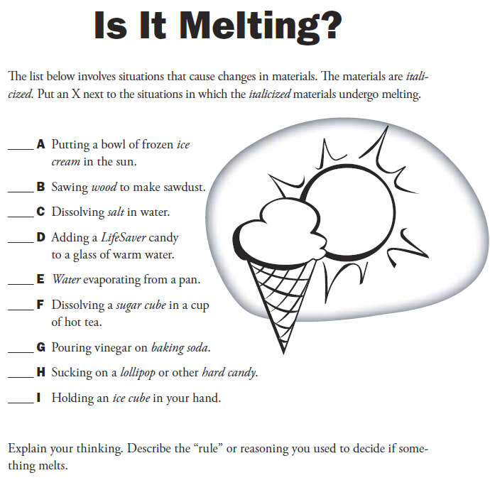
Notes:
We have focused on the SEPs and now we would like to look at formative assessment. Let’s uncover some of our thinking.
You will select from the list online, but just think about your “rule” for now. You will be engaging in a protocol to develop your explanation.
Keeley, P., Eberle, F., & Farrin, L. (2005). Uncovering student ideas in science (Vol. 1, p. 73). Arlington, Va.: NSTA Press.
Permissions:
Permission is granted in advance for photocopying brief excerpts for one-time use in a classroom or workshop.

Slide 32
Make Your Probe Explanation
Cl-Ev-R
Claim
Relevant
Stands Alone
Evidence
Appropriate
Sufficient
Reasoning
Stands Out
Link Between Claim and Evidence
Notes:
Your team will come up with an explanation or “rule” for why you selected the choices you did. Follow the protocol.
Handout
Adapted from a poster designed by William Rewitz, Puyallup, WA based on Explanation Analysis from Science Formative
Assessment, Keeley 2008. Based on the C-E-R Framework, McNeil et al. 2011.

Slide 33
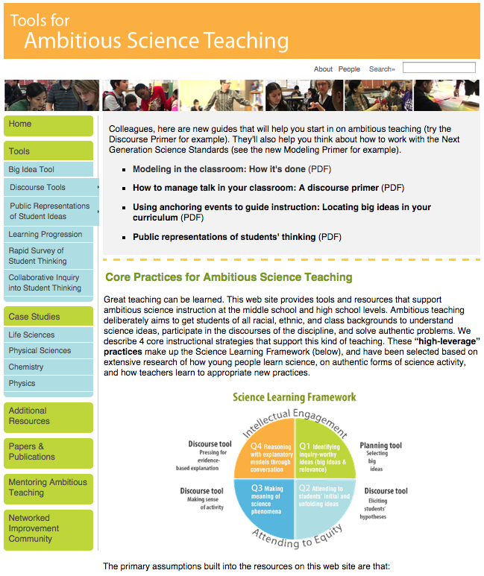
Supporting Your Work
tools4teachingscience.org
Public representations of students’ thinking (PDF)
Notes:
Show how to get to the document that shares the various strategies we presented today. You may want to make copies if your participants don’t have access to web enabled devices, however it is 13 pages.

Slide 34
Reflecting on Formative Assessment
Reflect on the use of the Sticky-notes and Language Scaffolds, the “Gotta-have” checklist, and your small group model:
as an illustration of developing and modifying models
as a formative assessment tool
Reflect on the use of the probe as an assessment tool.
Notes:
Reflecting on Developing and Using Models
Reflect on the use of the sticky-notes and Language Scaffolds, the “Gotta-have” checklist, and your small group model:
as an illustration of developing and modifying models
as a formative assessment tool
Reflect on the use of the probe as an assessment tool.

Slide 35
Wrapping Up
Complete your postcard reminder and place it on the table in front.
Respond to the Levels of Use Probe and place it on the table in front.
Take the AESD Survey found here...

Slide 36
Workshop Goals
What might infusing “Practices” and “Crosscutting Concepts” look like in practice?
Apply the practice of Developing and Using Models to instructional design.
Connect the practices called Constructing Explanations & Designing Solutions, Engaging in Argument from Evidence to Developing and Using Models and WA State Learning Standards (ELA).
Develop the capacity to engage all learners in classroom discourse and the public representation of their ideas.
Craft common messages back to district.
Notes:
Goals were developed based on participant feedback from Spring.

Slide 37
Science Leadership Network
Fall 2014

