Slide 1
Science Leadership Network
Winter 2015
Facilitators:
Brian MacNevin, NWESD Regional Science Coordinator
Joanne Johnson, NW LASER Alliance Director

Slide 2
WELCOME
Network Access UID: visitor PWD: Seahawks
Parking Lot: todaysmeet.com/2015-01-NWSLN
Please silence cell phones

Slide 3
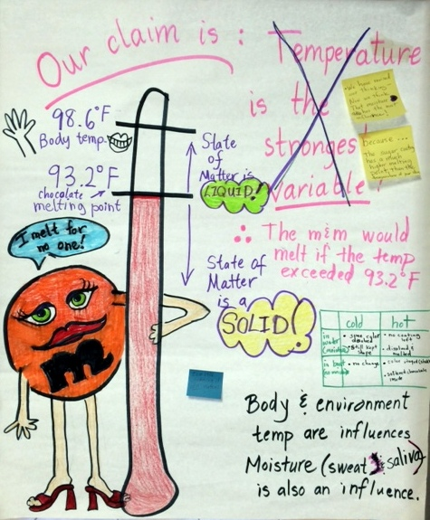
Flashback to Fall

Slide 4
NW SLN GOALS
Support WA NGSS Implementation Timeline Implementing SEP’s and CC’s.
Inform Washington State Transition Plans Feedback from sessions
Bring Tools and Information to District Session activities and team planning

Slide 5
AGENDA
SEP’s, Modeling, and Engineering
11:30- 12:30 LUNCH
Crosscutting Concepts
Evidence Statements
District Planning/Messaging

Slide 6
Sharing
Number off from 1-6 (this is your number for today)
Decide on a time keeper
2 3
4 5 6

Slide 7
Sharing
How have you (or someone you know) incorporated the Science and Engineering Practice(s) of
Developing and Using Models
Constructing Explanations and Designing Solutions
Engaging in Argument from Evidence
in the classroom?

Slide 8
SEP Self-Assessment
Complete the Assessment for SEPs #2, #6, #7
Determine your overall score for each
Place your sticky dot on the corresponding chart

Slide 9
Self assessment from…
Tools to help introduce colleagues and administrators to the NGSS.

Slide 10
Call the Plumber!
An engineering challenge

Slide 11
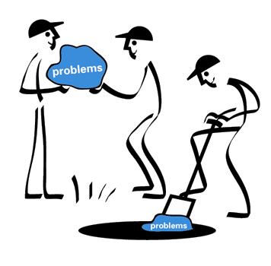

Slide 12
Engineering Challenge
Imagine a short steel pipe imbedded in the concrete floor of a bare room. The inside diameter of the pipe is just larger than the ping pong ball resting at the bottom of the pipe.
Remove the ball without damaging the ball, the pipe or the floor
You have only the following materials:
A meter of string, a ruler, a tongue depressor, an orange, a sponge, paperclip, two tea bags, a straw, a coffee stirrer, and some candy (Tootsie rolls and Jolly Ranchers).
Adapted from James Adams; Conceptual Blockbusting, A Guide to Better Ideas, and Dr. Ann McMahon.

Slide 13
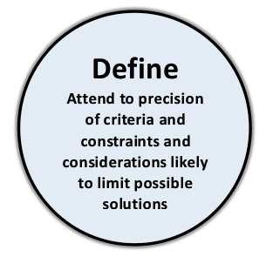
Engineering Challenge
A meter of string, a ruler, a tongue depressor, an orange, a sponge, paperclip, two tea bags, a straw, a coffee stirrer, and some candy (Tootsie rolls and Jolly Ranchers).
What are the criteria and constraints associated with this problem?

Slide 14
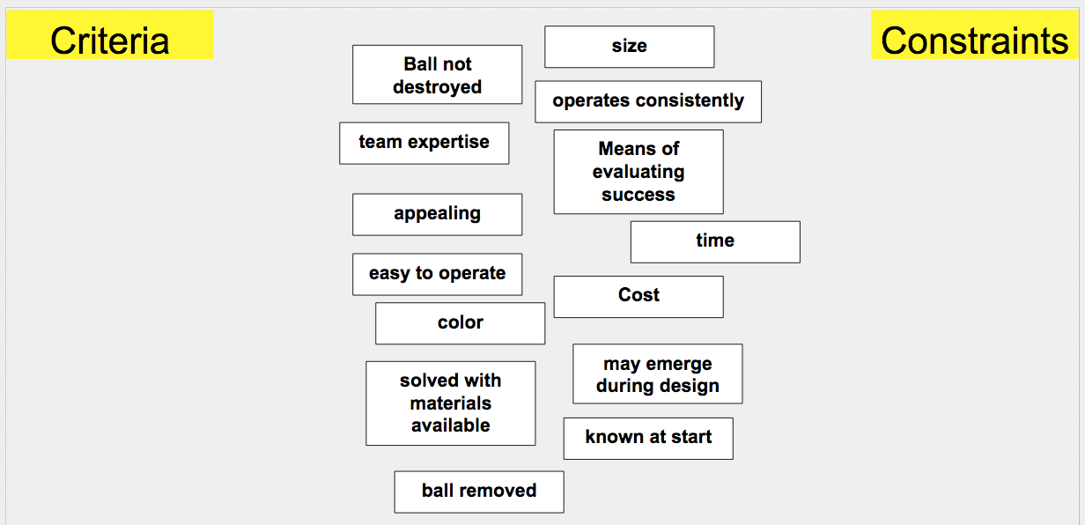

Slide 16
Engineering Challenge
A meter of string, a ruler, a tongue depressor, an orange, a sponge, paperclip, two tea bags, a straw, a coffee stirrer, and some candy (Tootsie rolls and Jolly Ranchers).
At your table, list all the ways you can think of to remove the ball without damaging it, the pipe, or the floor.
Put each solution on a separate Post-It note & post them on chart paper

Slide 17
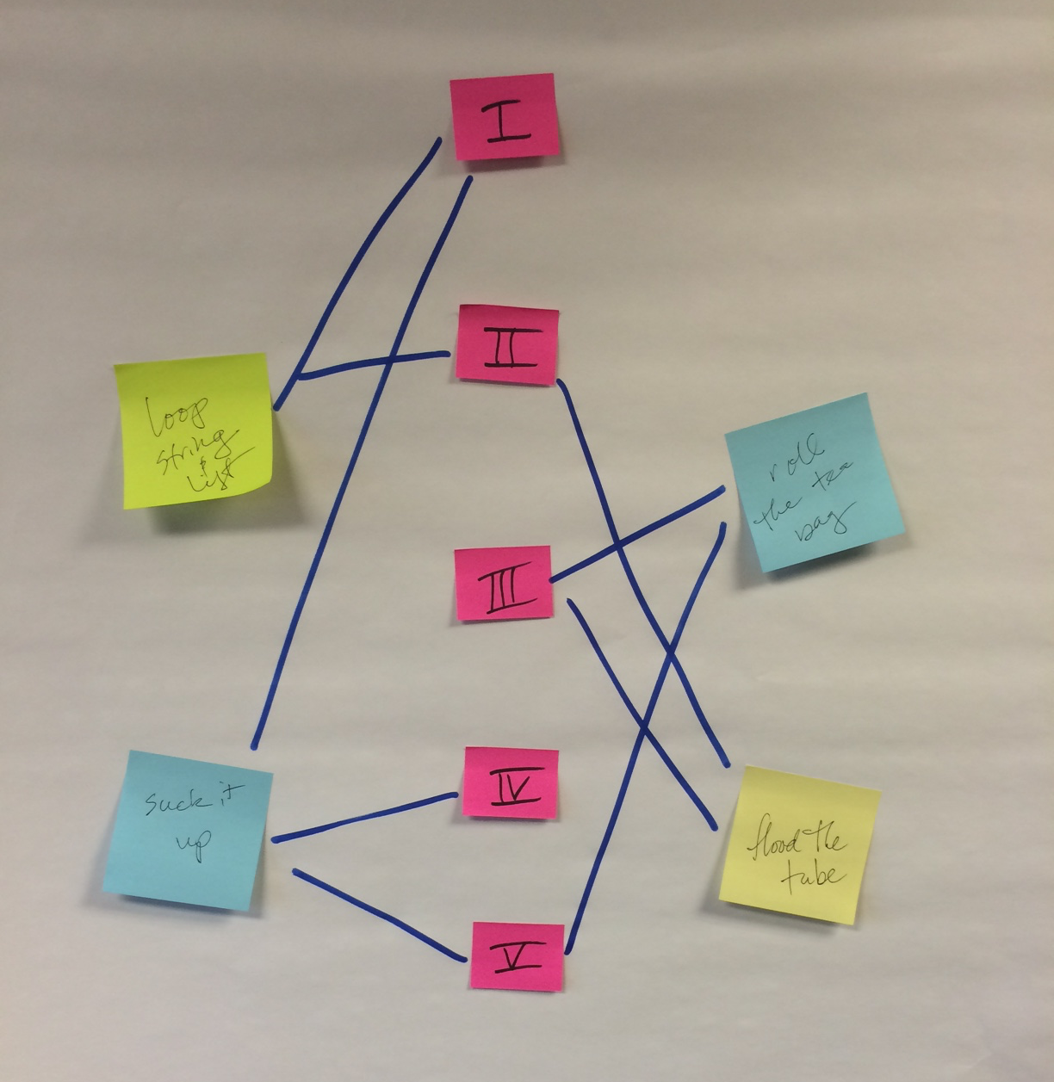
Making Connections
Using the list of physical science Disciplinary Core Ideas
Tag DCI parts to your solutions

Slide 18
Generate a Tentative Argument
In engineering, reasoning and argument are essential for finding the best solution to a problem. Engineers collaborate with their peers throughout the design process. With a critical stage being the selection of the most promising solution among a field of competing ideas. Engineers use systematic methods to compare alternatives, formulate evidence based on test data, make arguments to defend their conclusions, critically evaluate the ideas of others, and revise their designs in order to identify the best solution.

Slide 19
Engineering Challenge
Try out one of your designs
Have a table discussion about the results and bring the “tagged” DCIs into the conversation

Slide 20
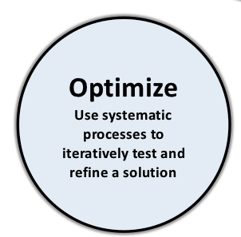
Engineering Challenge
ITEM | COST
string | $10/length
tongue depressor | $25 ea
orange | $0.35 ea
coffee stirrer | $0.75 ea
sponge | $0.75 ea
paperclip | $1.25 ea
tea bags | $2.00 ea
straw | $50 ea
tootsie rolls | $7.50 ea
jolly ranchers | $0.35 ea
ruler | $12.00 ea
Oops! we forgot to tell you.

Slide 21
Engineering Challenge
ITEM | COST
string | $10/length
tongue depressor | $25 ea
orange | $0.35 ea
coffee stirrer | $0.75 ea
sponge | $0.75 ea
paperclip | $1.25 ea
tea bags | $2.00 ea
straw | $50 ea
tootsie rolls | $7.50 ea
jolly ranchers | $0.35 ea
ruler | $12.00 ea
Plan for a change to your solution.
Create an explanation for your change, include a connection to your “tagged” DCI

Slide 22
Regrounding in the Crosscutting Concepts
Appendix G (http://bit.ly/ngss_app_g)
Assign CC’s to each person at table.
Read your CC. Record its title on a sticky note plus connections to other CC’s.
Going in order, share your CC and place on chart paper.
When connections exist, draw a labeled line to show connections between CC’s.
Do there appear to be any natural groups of CC’s?

Slide 23
Crosscutting Concepts (1-7)
Appendix G (http://bit.ly/ngss_app_g)
Assign CC’s to each person at table.
Read your CC. Record its title on a sticky note plus connections to other CC’s.
Going in order, share your CC and place on chart paper.
When connections exist, draw a labeled line to show connections between CC’s.
Do there appear to be any natural groups of CC’s?

Slide 24
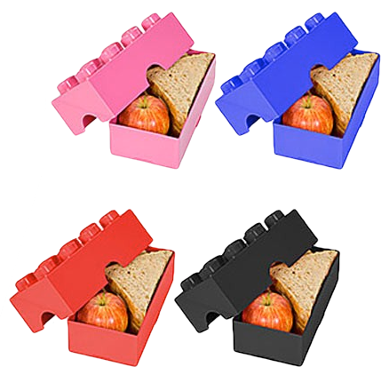
LUNCH 60 min nom nom nom

Slide 25
NGSS Evidence Statements
So far, high school only are released.
Important Front Matter
Today we’re just going to explore to raise awareness and questions

Slide 26
Developing and Using Models
Are the engineering design processes we examined models?
Read pages 56-59 of The Framework for K12 Science Education.
Gather evidence to support your claim.
http://bit.ly/framework_models

Slide 27
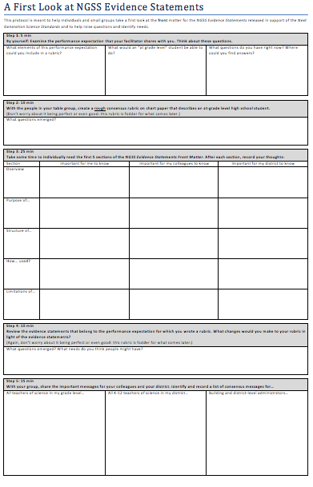

Slide 29
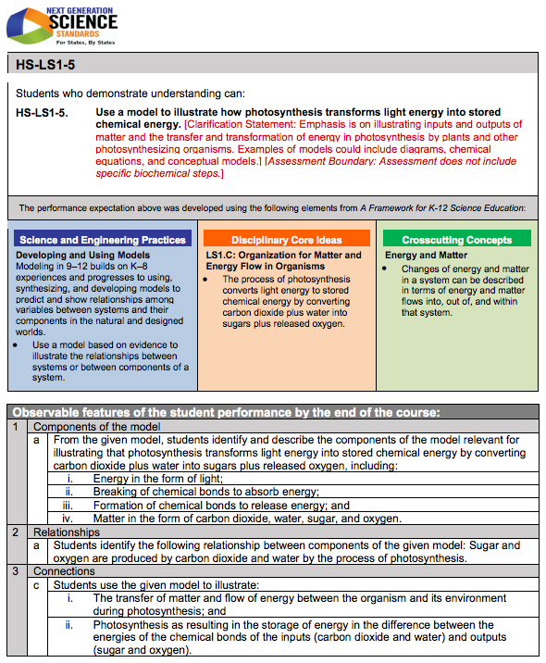

Slide 30
Messages in the Front Matter
What messages do people need to hear?
What needs are likely to emerge?

