Slide 1

Collaborative Inquiry Cycle
Collaborative Inquiry Cycle
One Day Training Session
June 21, 2012
Bruce Camblin – Math Kathy Darrow-Joiner – Science
David Heaton-Bush – Math
Kathy Shoop, Asst. Superintendent for Teaching and Learning
Notes:
Opening Slide

Slide 2
Welcome!
Who is here?

Slide 3
1
2
Experience the Collaborative Inquiry Cycle and understand its key components.
Analyze capacity for school-based / District-wide collaborative program and examine implications for action.
3
4
Conceptualize a school-wide or District-wide professional collaborative cycle.
Develop a 30-60-90 day plan to initiate a sustainable school-based / District-wide collaborative practice.

Slide 4
Focus of the Collaborative Inquiry Cycle
Need for this TOSA Project was determined by:
District Superintendents within the NWESD 189
Focus for this TOSA Project was identified by:
District Curriculum Directors within the NWESD 189
In the Areas of Science and Mathematics
Content Knowledge Standards Knowledge
Formative Assessments Instructional Best Practices
Notes:
Dr. Shoop

Slide 5
Identified Areas of Concern
Deepen Knowledge of Content
Deepen Knowledge of Standards
Concepts and Processes Include:
Fractions Energy Forms
Geometry Rock Cycle
Probability Input/Output Sys.
Statistics Matter Properties
Problem Solving Force & Motion
Using the Standards as the framework for building :
Learning Progressions
Lesson Plans
Increased Use of Formative Assessments
Knowledge of Instructional Best Practices
From the Learning Progressions and the Lesson Plans, attention is focused on appropriate and associated Formative Assessments with multiple formats to inform instruction and learning.
All Lessons need to be based on Research-Supported Best Practices, especially with focus in the 3 areas of
Student Discourse,
Conceptual Understanding and
Authentic Questioning.
Focus on Student Discourse is clearly identified within
The Common Core State Standards
Notes:
Dr. Shoop

Slide 6





Guides in the Development of the CIC
Common Core State Standards
English Language Arts
Mathematics
Washington State Learning Standards
National Science Education Standards
Classroom Assessment for Student Learning –
by Chappuis, Stiggins, Chappuis, Arter
Notes:
Dr. Shoop

Slide 7
3 TOSAs
17 Buildings in 10 Districts
85 Educators
Nearly 4000 Students
Notes:
David (19) present scope of our audience: 10 districts, 17 buildings, 76 teachers, 9 administrators, about 3900 students. Goal: year 1 = 2 cycles and year 2 = 3 cycles with decreased TOSA leadership and increased teacher ownership of the application of more cycles. (20) Effect: increase teachers' learning so they can better gauge students' understanding and the direction of future instruction. Apply current educational research that is supportive of Collaborative Professional Development and instruction.

Slide 8

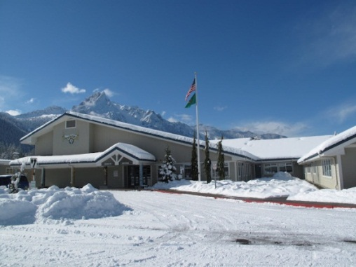
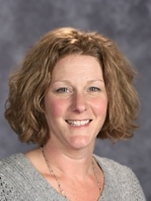
“Impact on Faculty - The staff is taking the planning process you brought to us and incorporating it into different subject areas.
Instructional Best Practices - Honestly, the project, along with your expertise met our staff where we were and took us to a higher level. The project validated the need to use more than just one ‘program’ but that it can take several different pieces to fit the puzzle together.
Content Knowledge - There were many moments where I heard teachers say “I knew that”. They had been caught in the curriculum vs. standards debate.
Formative Assessments - The emphasis on ‘what do the students know now and what do they need to know’ was the foundation of the planning.
Meeting the Standards – I believe the TOSA project reenergized the staff in the area of mathematics and introduced the staff to the transition between the CCSS and the state standards.”
Tracy Franke,
Principal
Notes:
Bruce

Slide 9
SESSION NORMS by R. J. Garmston
Promote a spirit of inquiry
Pause
Paraphrase
Probe
Put ideas on the table
Pay attention to oneself and others
Presume positive intentions
Notes:
Kathy DJ

Slide 10
Today’s Learning Targets
Experience the Collaborative Inquiry Cycle and understand its key components
Analyze capacity for a school-based and/or District-wide collaborative program and examine implications for action
Conceptualize a school-based or District-wide professional collaborative culture
Develop a 30-60-90 day plan to initiate a sustainable school-based and/or District-wide collaborative practice
Notes:
David

Slide 11
The Importance of Collaboration
Collaboration allows teachers to create a common vision and purpose, meaningful power-sharing, mutual learning, and mutual accountability for results.
Professional communities thrive where collaboration, experimentation, and challenging discourse are possible and welcome.
Sharing among educators allows them to feel supported by other educators in their quest to better serve the needs of their students.
Notes:
Bruce

Slide 12
Developmental vs Supportive Collaboration
Collaboration — enhancing the capacity of others for mutual
benefit, and to achieve a common purpose.
Supportive Collaboration – working together by pooling of
knowledge and resources towards a common goal.
Developmental Collaboration - working together through networking, coordinating, and cooperating that
builds collegiality.
Notes:
Bruce

Slide 13
Collaborative Inquiry Cycle Teams Personnel
By Specific Grade Level bands
By Curricular Disciplines
By Interdisciplinary Teams
By Whole School Teams
By Multi-School Teams
(horizontal)
(vertical)
(multiple academics)
(vertical & systemic)
(systemic)
Notes:
Bruce

Slide 14
Team Activity
With your Group…
Design a Collaborative Inquiry Cycle
What are the steps?
How many steps are there?
Put each step on a sticky note and arrange them on your group’s poster in whichever order you decide is best.
Notes:
David

Slide 15
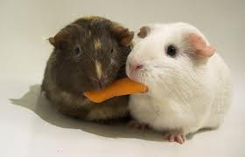
Sharing Time
www.healthwise-everythinghealth.blogspot.com
What does your group’s cycle look like?
Notes:
David

Slide 16
1
Experience the Collaborative Inquiry Cycle and understand its key components.

Slide 17
Collaborative Inquiry Cycle
CRAFT UNIT LEARNING TARGET
DEVELOP LEARNING PROGRESSION
PLAN
LESSON
TEACH/OBSERVE LESSON
ANALYZE
& ADJUST
Notes:
Kathy

Slide 18
CRAFT UNIT LEARNING TARGET
“I learned how to collaborate ideas of science
standards and targets . . . to streamline curriculum
choices that address state standards more directly.”
“Realizing that there were places in the FOSS [science] kits that lend themselves to taking the teaching deeper than what was presented in the curriculum manual made me think about how I set up each lesson.”
“I am noticing that [previously] we have not been specific in our science goals, and we have not been intentionally aligning with the standards.”

Slide 19
Identified
Performance Expectation, Washington State Standard,
or
Common Core State Standard Is the Target

Slide 20

Guides in the Development of the CIC
Common Core State Standards
English Language Arts
Mathematics
Washington State Learning Standards
National Science Education Standards
National Curriculum Standards for Social Studies
Notes:
Kathy

Slide 21
Possible Learning Targets -
Represent fractions that have denominators of 2, 3, 4, 5, 6, 8, 9, 10, and 12 as parts of a whole, parts of a set, and points on the number line.
Construct a relief map of Washington State.
Draw a labeled diagram of the water cycle.
Write a Sonnet.
Establish a productive classroom where discourse strengthens students’ thinking and reasoning.
Describe in depth a character, setting, or event in a story or drama, drawing on specific details in the text.

Slide 22
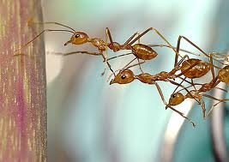
Group Work
Work with your team to Craft your Learning Target.
Is it something you could teach today?
www.flickr.com
10 Minutes

Slide 23
DEVELOP LEARNING PROGRESSION
“Developing the learning progression was a
great way to really take apart what the
standard said and then sequence the learning/lessons
to get students there.”
“I love the learning progression. It keeps me focused
and organized.”
“The most impressive aspect was the overall rigor and
pacing of this progression.”
“Working back from the standard goal helped me
organize my thinking as well as structure lessons!”
Notes:
Kathy

Slide 24
Lesson Progression Parts Included in the CIC
Select the Standard learning target
Identify all the sub skills necessary to acquire the target mastery
Sequence the sub skill lessons building to the target (back mapping)
Complete the “I can…” student statements
Determine multiple formats that students can use to demonstrate lesson attainment
Notes:
Kathy

Slide 25
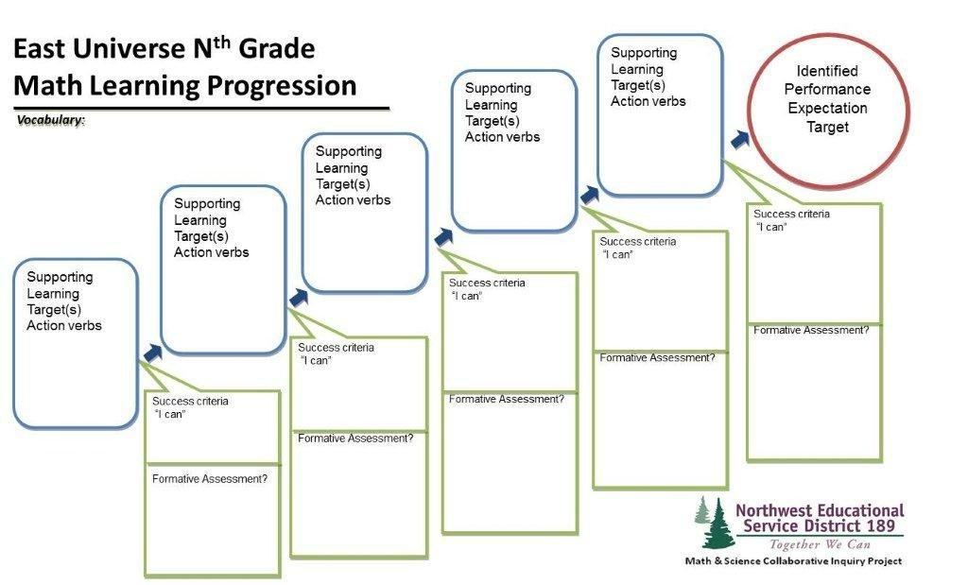
Learning Progression Format
“I love the Learning Progression. It keeps me focused and organized.”
Notes:
Kathy

Slide 26
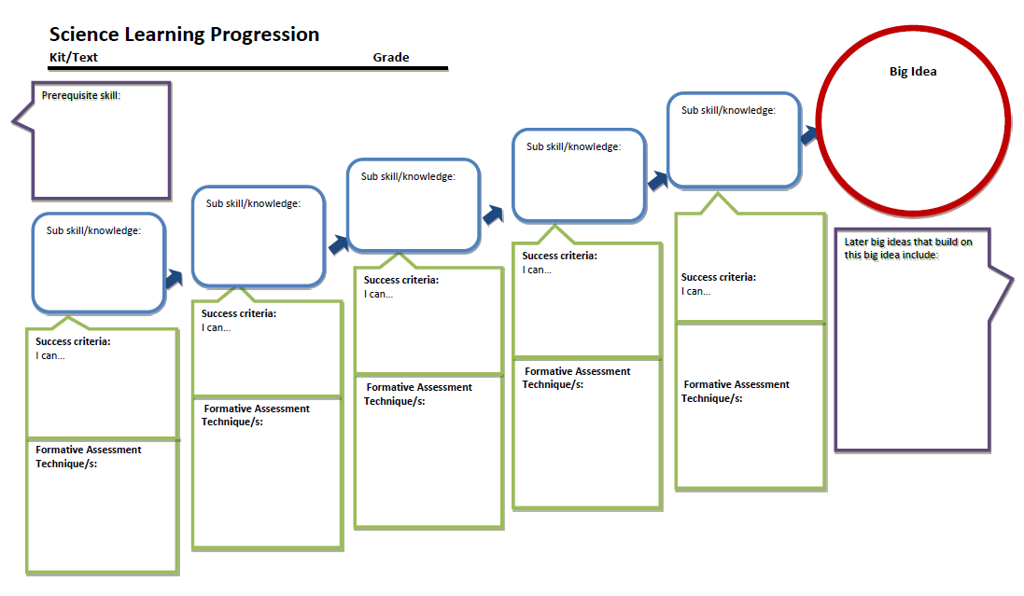
Science Learning Progression
Notes:
Kathy

Slide 27
Group Work
Work with your team and Coach to Develop a Learning Progression.
www.flickr.com
40 Minutes

Slide 28
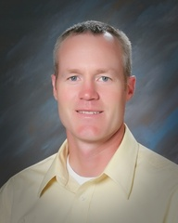
Haller Middle School (Arlington)
“The impact on teachers following the process was common language, better understanding and use of formative assessments, strategies for student engagement, and team-building.”
“Going through the cycle with the math team was also a productive experience for me. Other subject areas and teachers benefitted indirectly as a result of my participation [in the Collaborative Inquiry Cycle].”
-Eric DeJong, Principal

Slide 29
2
Analyze capacity for school-based / District-wide collaborative program and examine implications for action.

Slide 30
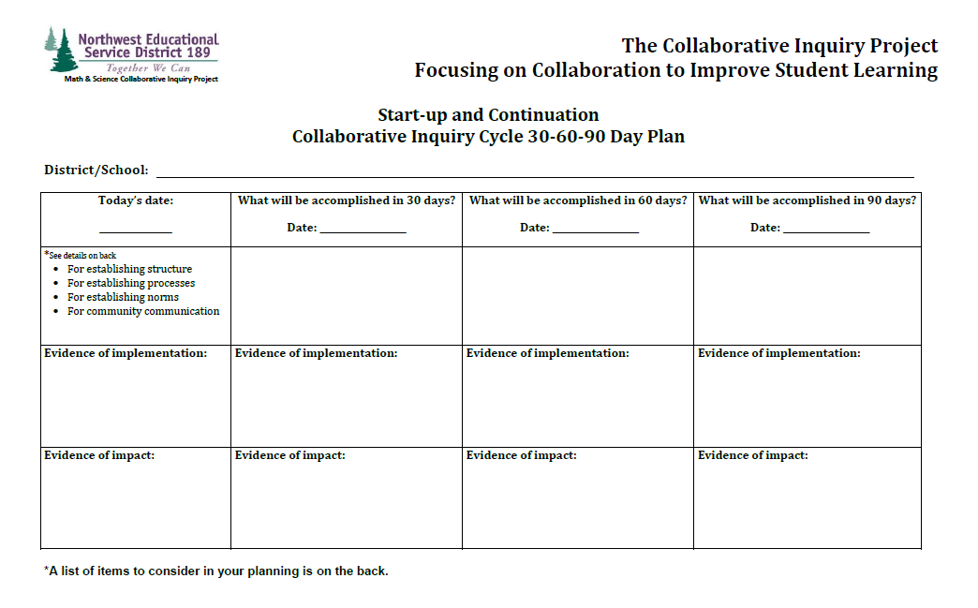
Collaborative Inquiry Cycle 30-60-90 Day Plan
Notes:
Kathy

Slide 31
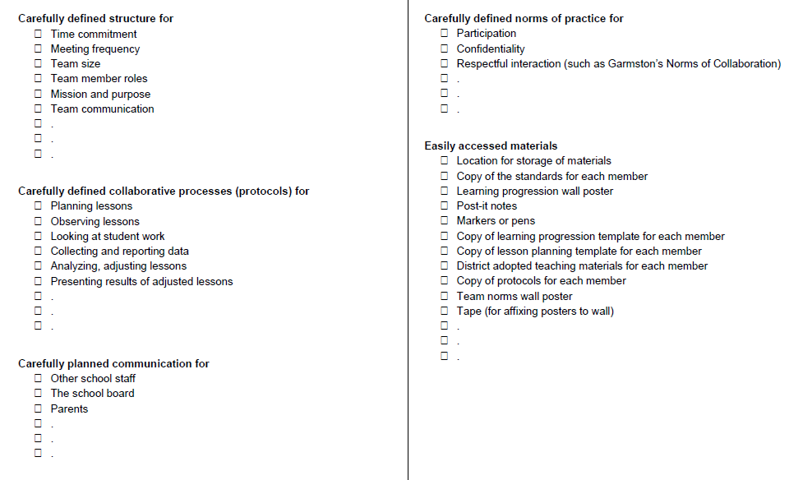
Systems and Structures of Collaborative Practice

Slide 32
Break 10 Minutes, Please

Slide 33
PLAN
LESSON
“I gained several new strategies for teaching
fractions to my fifth graders.”
“I learned Earth science content (soil, fossils, and
rocks); I am gaining confidence as a science
teacher.”
“This lesson is much better than one I could have
planned alone.”
“Taking our staff K-6 through this process was very beneficial. Knowing the Common Core is vital. The ‘learning progressions’ and ‘lesson plans’ were extremely good thinking and training.”
Notes:
Bruce

Slide 34
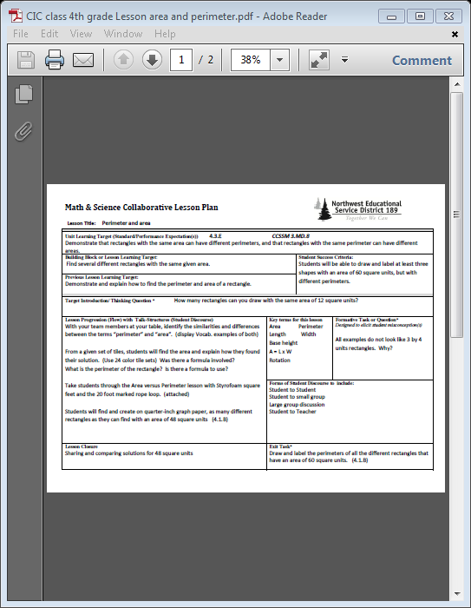
Sample Lesson

Slide 35
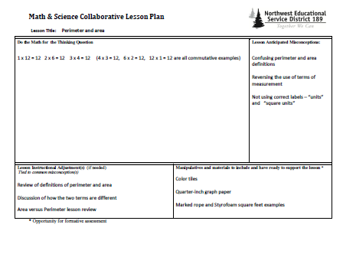

Slide 36
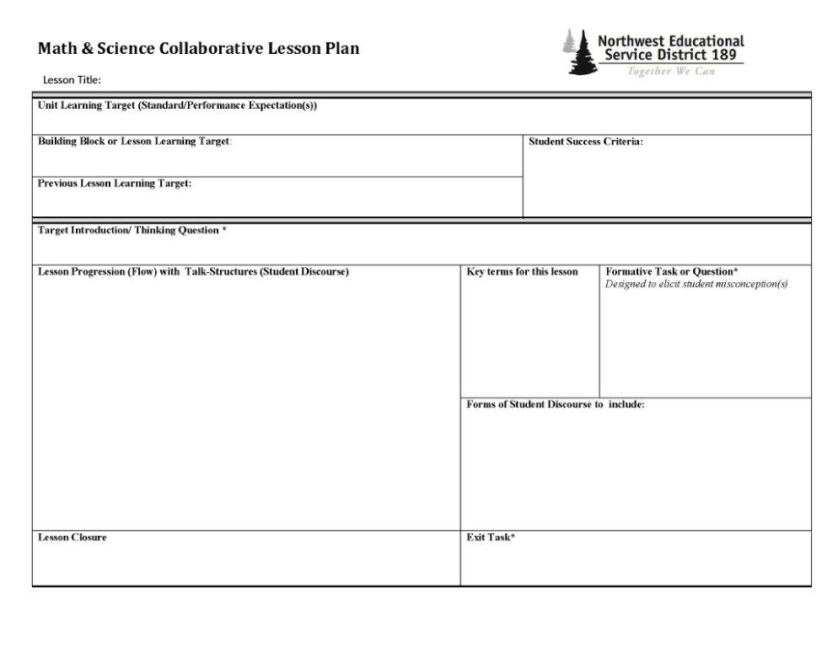
Format for a Collaborative Lesson Plan
“This lesson is much better than one I could have planned alone.”
Notes:
Bruce

Slide 37
Parts Included in Lesson Planning
Lesson Learning Target (Standard or PE)
Actual Lesson Target (Focus of Instruction)
Previous Lesson Target (make connections)
Opening Thinking Question (build the focus)
Lesson Vocabulary (do not assume!)
Student Misconceptions (distractions)
Lesson Flow by Steps (scaffolding)
Lesson Closure and Exit Task (tie together)
Notes:
Bruce

Slide 38
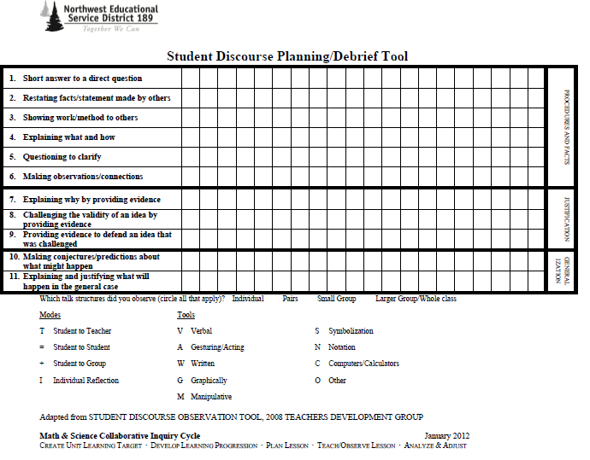
Format for Observing Student Discourse
“Teaching in front of my peers was a very positive growing experience!”
Notes:
David

Slide 39
Group Work
Work with your team and Coach to Plan a Lesson
Include
student to student discourse
www.flickr.com
35 Minutes

Slide 40

www.foodie-isms.com
One Hour

Slide 41
Collaborative Inquiry Cycle 30-60-90 Day Plan
Notes:
Kathy

Slide 42
TEACH/OBSERVE LESSON
“I gained new understandings in the
experience of being observed and
receiving feedback by other teachers.”
“Observing peers has been a great way to think about what I’m doing / not doing in my room that is valuable.”
“The intense focus on student interactions with the
content and instruction helps teachers adjust and
streamline their instructional practice.”
“The time as a staff talking about the same subject with instruction on how to work together from grade-to-grade has been invaluable. .”
Notes:
David

Slide 43
Lesson Observation Protocols
Refrain from evaluating the demonstrating teacher
Take notes on individual student responses, using names when possible
Observe and note how the students react to the lesson parts
Document the variety of strategies student use and types of student talk
Minimize interaction with students
Eliminate side conversations during the observation
Notes:
David

Slide 44
Noticing Versus Evaluative Statements
A) Students discussed denominators in small groups. | B) The students did not understand explanation of satire.
C) Rizzo was grabbing all the materials in her group. | D) Two students had their heads down.
A) In Group 3, one student did all the talking. | B) Three girls did an engaging lab in front of the whole class
C) Three students weren’t interested in the lesson. | D) Danny had his hand up for three minutes.

Slide 45
Noticing Versus Evaluative Statements
Sandy used her calculator for all the simple multiplication.
Frenchie was using the manipulatives to try to understand the problem.

Slide 46
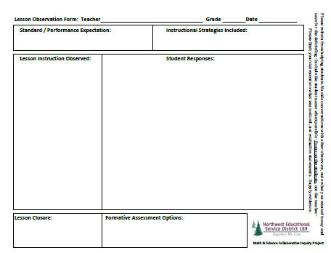
Detailed Lesson Observation Form
“The students never wavered in their enthusiasm, their focus, or their comprehension of concepts they were learning.”
Notes:
David

Slide 47
ANALYZE
& ADJUST
“This will make me analyze my own
lessons to try to improve them.”
“I learned that debriefing after the lesson
is SUPER important (I learned a lot from our
debrief).”
“This one lesson encompassed what would possibly
have been taught (in another circumstance) over the
course of a week.”
“Working back from the standard goal helped me
organize my thinking as well as structure lessons!”

Slide 48
Sample Lessons

Slide 49
3
Conceptualize a school-wide or District-wide professional collaborative cycle.

Slide 50
Collaborative Inquiry Cycle 30-60-90 Day Plan
Notes:
Kathy

Slide 51

Break 10 Minutes,Please
www.flickr.com

Slide 52

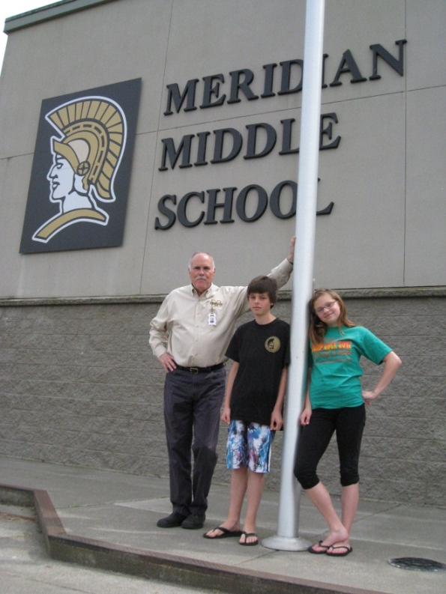
Jerry Sanderson
Principal
Our team has worked together to analyze, evaluate and determine learning targets. We were able to develop instructional strategies that focus on best practices for helping improve student achievement. This has led to the creation of relevant and engaging lessons.
Teachers have also developed an increased understanding of the learning expectations and have been introduced to common core standards.
This process has allowed for long range planning and curriculum alignment across grade levels and provided for an increased awareness of different instructional strategies and techniques.
As a building administrator I learned how I can be more involved in the planning of student experiences, how to help facilitate the work of teachers across the district and generalize this experience to other content areas.

Slide 53
Impact of the CIC Formative Assessments
Sharper focus towards the identified learning
Increased diagnostics of student learning needs
Stronger evidence of learning attainment
Decreased interference by student misconceptions
Improvement of effective learning environments

Slide 54
Other Feedback from CIC Participants
“I learned how to collaborate ideas in science standards and targets”
“I gained several new strategies for teaching fractions”
“The most impressive aspect was the overall rigor and pacing in the
progression”
“I will look more closely at the standards, and not the curriculum to
determine my goals”

Slide 55
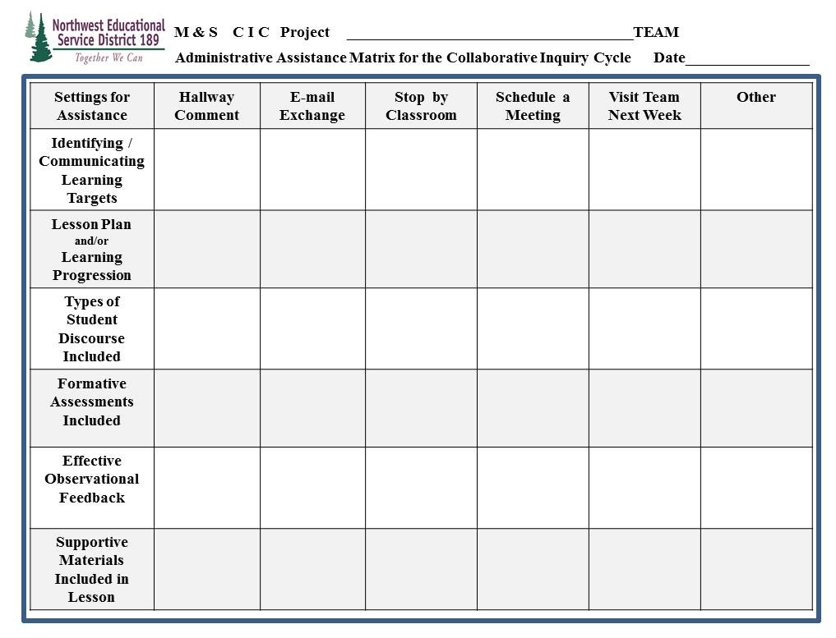
Administrative Assistance Matrix

Slide 56

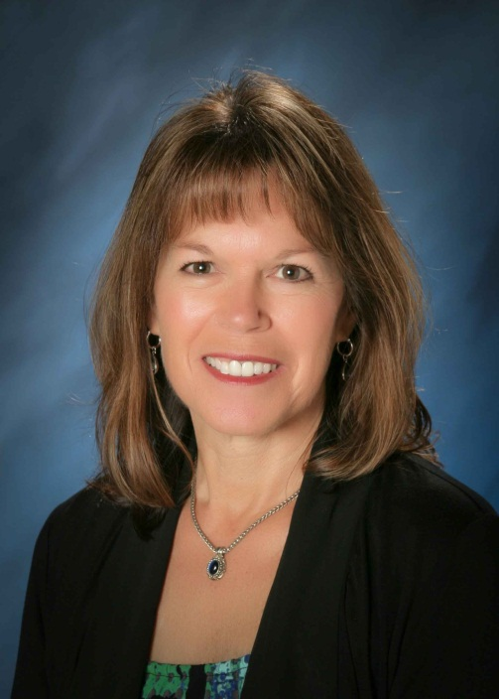
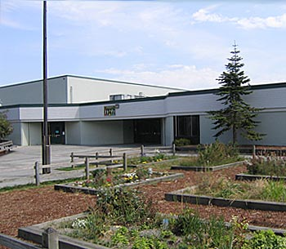
I want to let you know how valuable participating in the ESD TOSA Project has been for our school. Our sixth grade team participated in the project for two years and our third grade team joined this year. The TOSA’s knowledge of content and best practices in Science was invaluable. Her talents in the area of group processing were a huge factor in moving a somewhat dysfunctional team to the point where they truly collaborated and came to agreement around science instruction for their students.
Because of this opportunity through the ESD, we now have school wide commitments not only around what needs to be done to improve science instruction, but how to do it. The TOSA Project was the first step in transforming science instruction at my school.
Paula Nelson, Principal

Slide 57
4
Develop a 30-60-90
day plan to initiate a sustainable school-based / District-wide collaborative practice.

Slide 58
Thank you and enjoy this wonderful professional growth opportunity!
CRAFT UNIT LEARNING TARGET
DEVELOP LEARNING PROGRESSION
PLAN
LESSON
TEACH/OBSERVE LESSON
ANALYZE
& ADJUST

