Slide 1
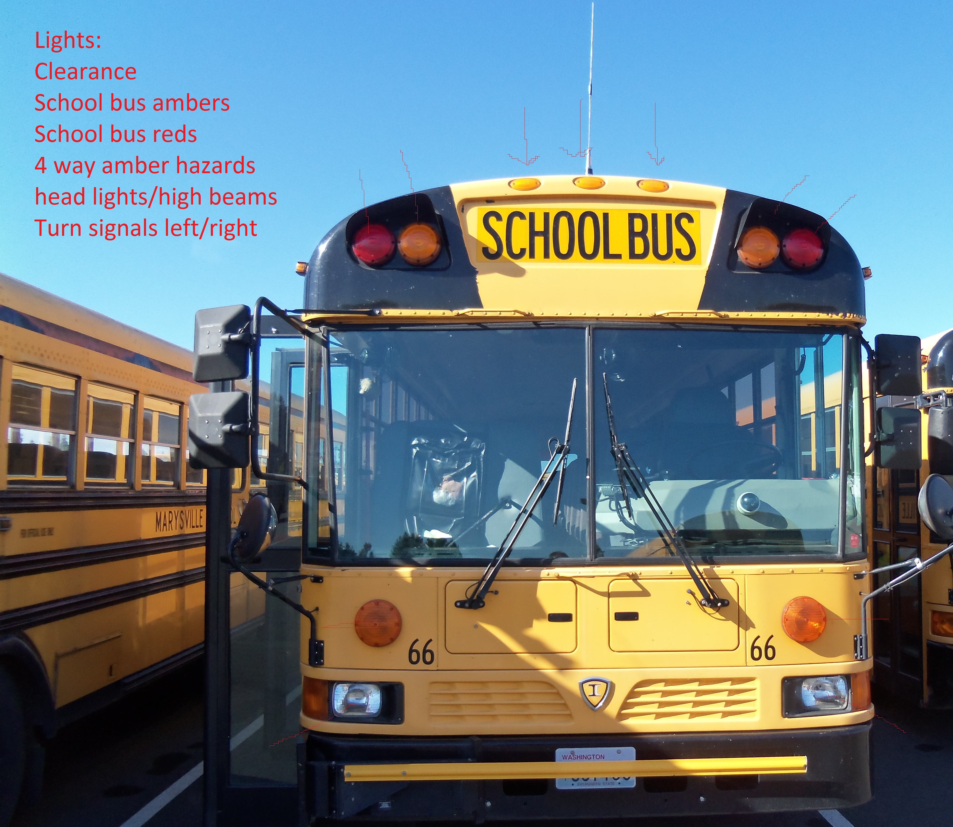
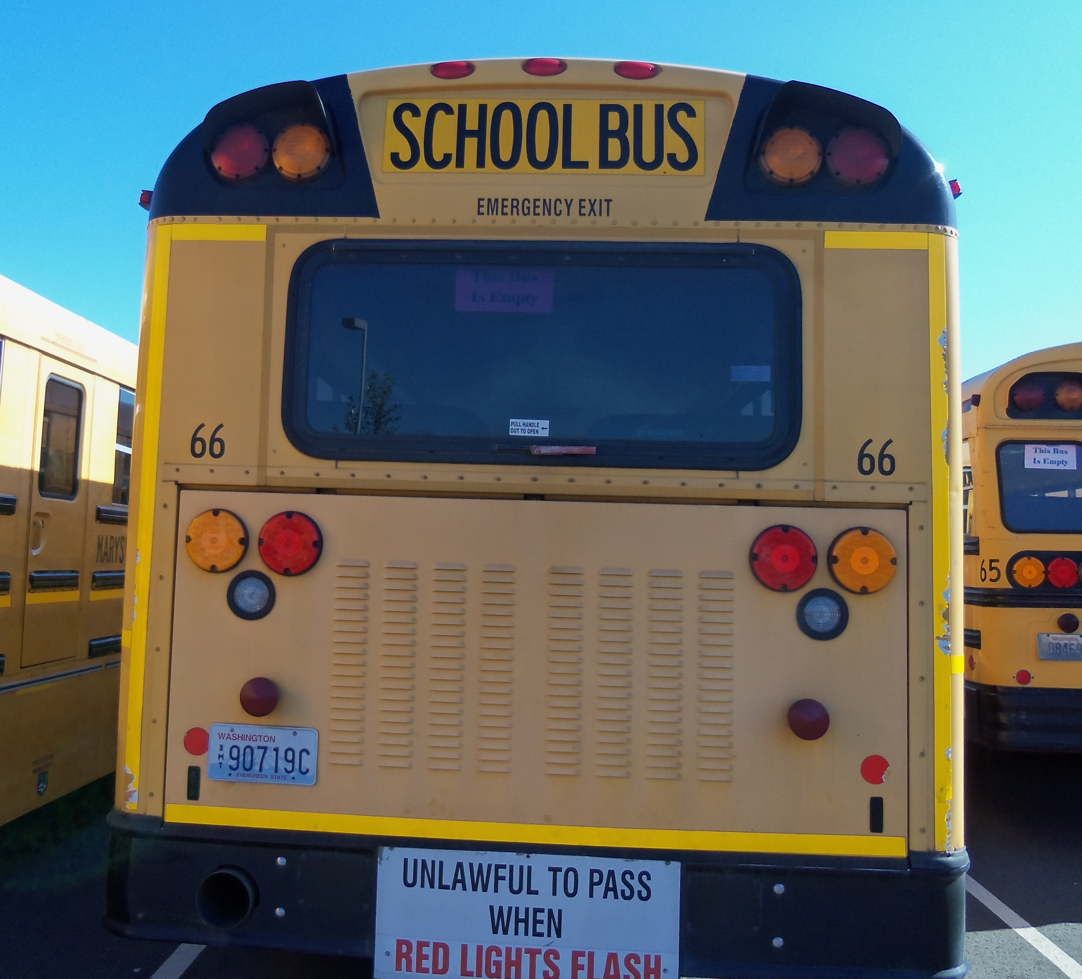
Exterior light check must be done in all three zones completely. Front Side Rear
Clean
Not Damaged
Proper color for their function
Pg 11-11 & 11-12
Lights

Slide 2
Pg 11-11 & 11-12
Lights

Slide 3
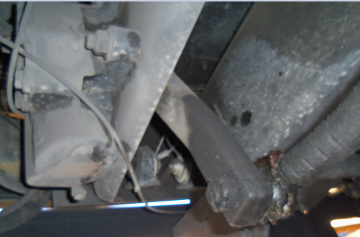
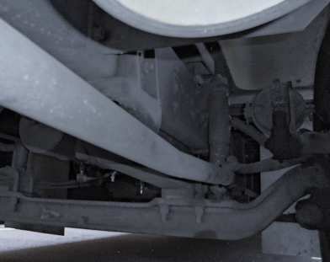
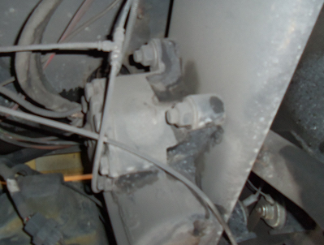
Steering
Steering Box/Hoses
Secure, not leaking
Not missing nuts and bolts
Steering Linkage
Link, rod, arm from box to wheel not worn or cracked
Joints and sockets not worn or loose.
No missing nuts,bolts, cotter key

Slide 4
1.
2.

Slide 5
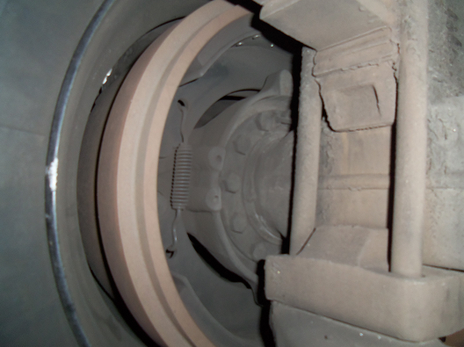
Brake Drums/Linings
Brake Linings
Brake linings should not be worn dangerously thin.
Check the brake linings for contaminants, such as grease, oil, etc.
Brake Drum:
No cracks, dents, or holes
No contaminates

Slide 7
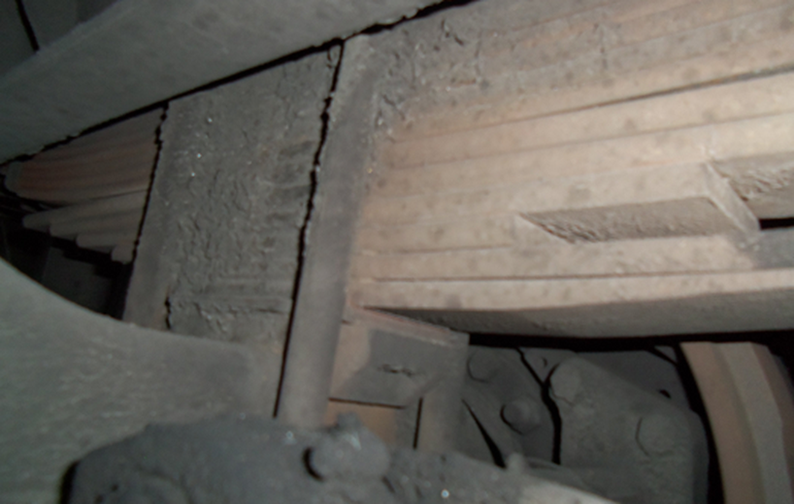
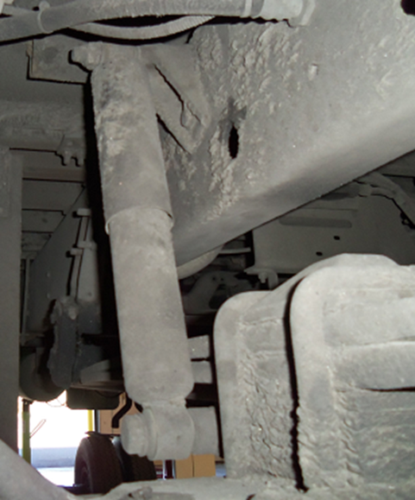
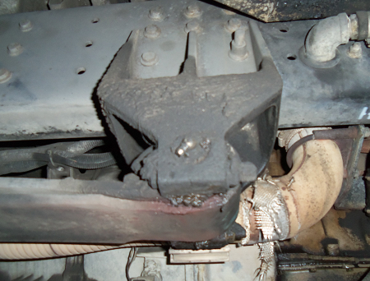
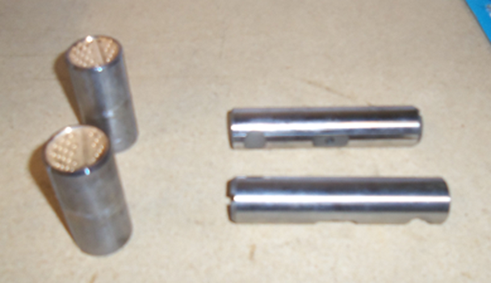
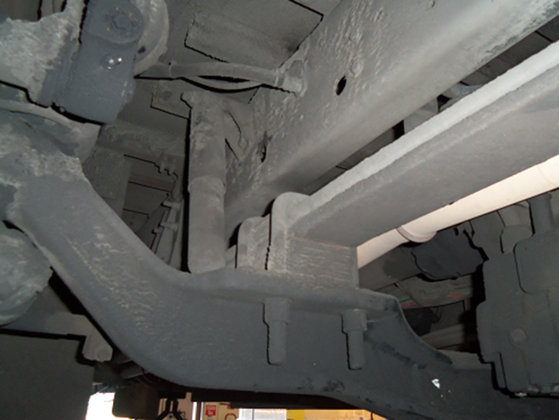
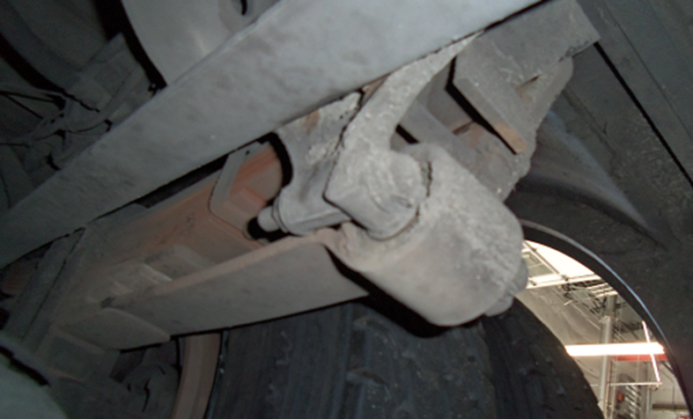
Spring hanger/mount
Cracked or broken hanger
Missing or damaged bushing
Springs
Missing, shifted, cracked, or broken leaf springs
Shock absorber
Secure and no leaks
Bushing
U-bolt
Broken, loose, missing bolt, u-bolts or other axle mounting parts
Suspension:
Springs
Hangers/Bushing
U-Bolts
Shock Absorber

Slide 8
Suspension:

Slide 9
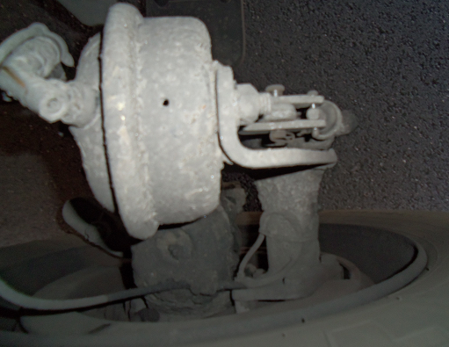
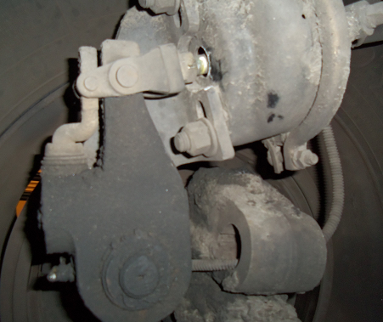
Slack Adjuster-Push rod
Slack Adjuster and pushrod
Securely mounted slack adjuster and pushrod
Bent, broken, loose or missing parts
Adjusted, not move more than 1 inch when pulled by hand

Slide 11
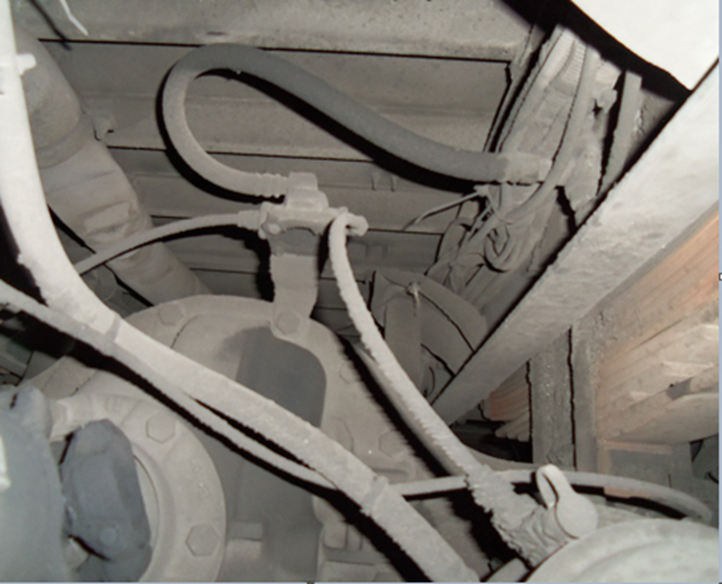
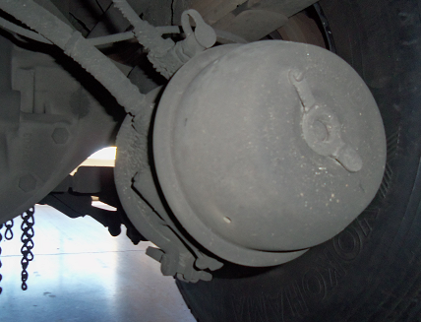
Brake Chamber/Brake Hoses
Brake Chamber
Not leaking, cracked or dented
Mounted securely
No loose or missing clamps
Hoses/Lines
Cracked, worn, frayed or leaking from hose and couplings
Connections, coupling fittings, secure not leaking

Slide 13
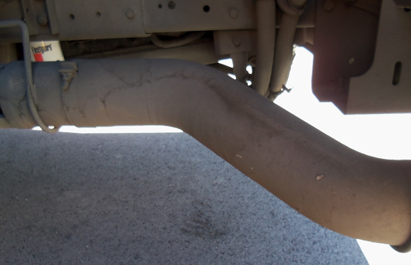
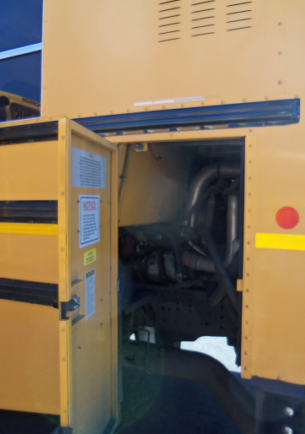
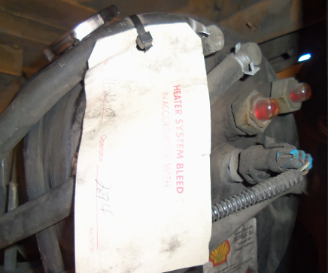
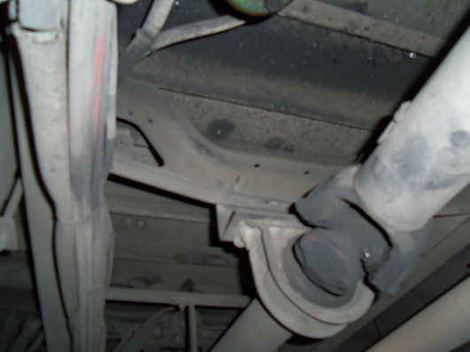
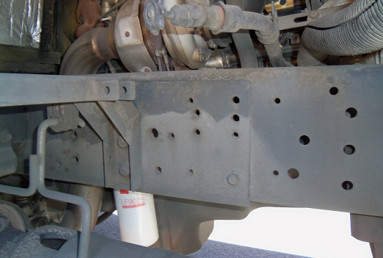
Coolant Drive Shaft Exhaust Frame
Coolant
Sight glass for level
Or cap if not hot
Exhaust
Damage, signs of leaks, rust or carbon soot
Tightly connected and securely mounted no loose clamps
No cracks, holes or severe dents
Drive Shaft
Not bent, cracked or twisted
Couplings or u-joints secure and free of foreign objects
Frame
Cracks, bends, broken welds, holes or other damage to longitudinal frame
Look for loose, cracked, bent, broken or missing cross members

Slide 15
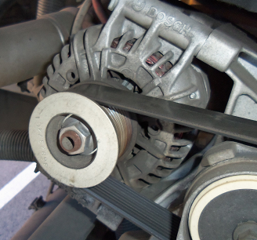
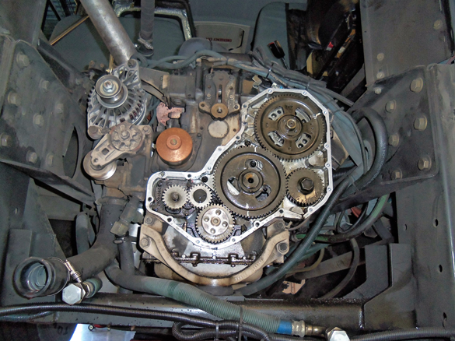
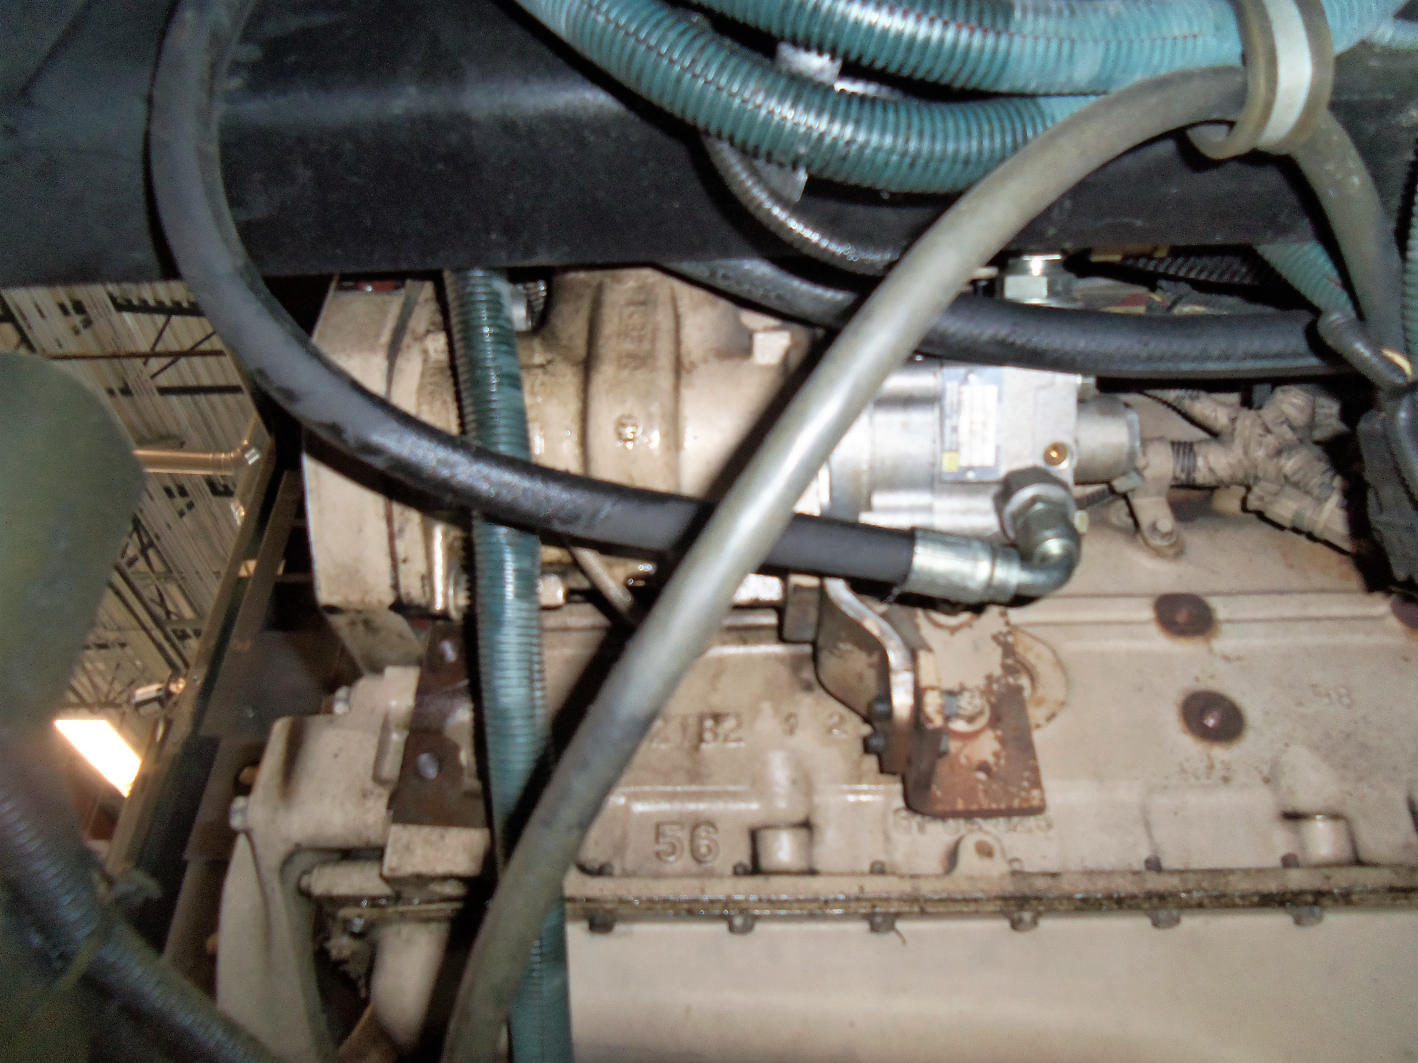
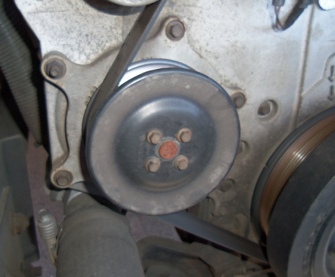
Alternator/Water pump/Air Compressor/Power steering unit Belts-Gear
Alternator:
Mounted securely
Not damaged
Wires securely fastened
Operates properly
Belts:
½ - 3/4 deflection
No cracks, frays, wear
Gear:
Operates properly
Not damaged, leaking
Mounted securely
Power steering unit:
Mounted securely
Not damaged
Not leaking
Operates properly
Water pump:
Mounted securely
Not damaged
Not leaking
Operates properly
Air compressor:
Mounted securely
Not damaged
Not leaking
Operates properly

Slide 16
Belts:
Gear:

