Slide 1
Vehicle Inspection Test
2017 Sept 1st changes

Slide 2
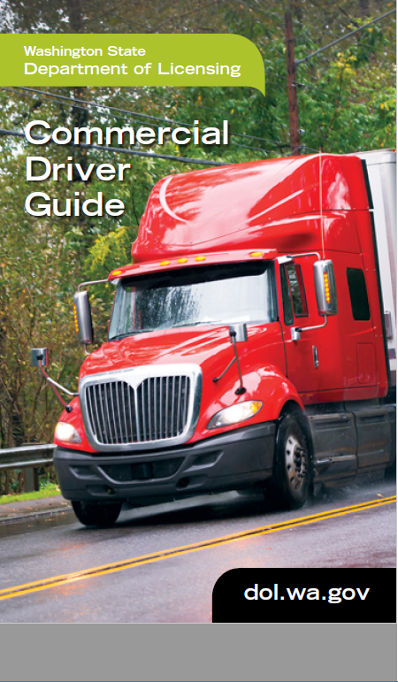
New book

Slide 3
Things to take note on:
Air Dryer/Governor at beginning of Air supply check. ( issues?)Noted now on pg 11-13 start below 90. Must start Air Supply test with this check or DQ
Snug is gone from belts
Light check has changed. Tester directed at beginning of test. Cannot use method 2. Must fully inspect at each zone. Front, side, rear.
Excessively dirty gone
Baggage check is one demo door then method 2. Inspect all the same. Say it once.
DOL asked us to quit teaching “kick out windows”
Demo both horns. Electric and air only one has to work
If equipped must talk about strobe light
Still have method 1 and method 2
65 possible points on pretrip
Test failure 1 time = form goes back home with trainer, fail 2 times= get whole new form from DOL.

Slide 4
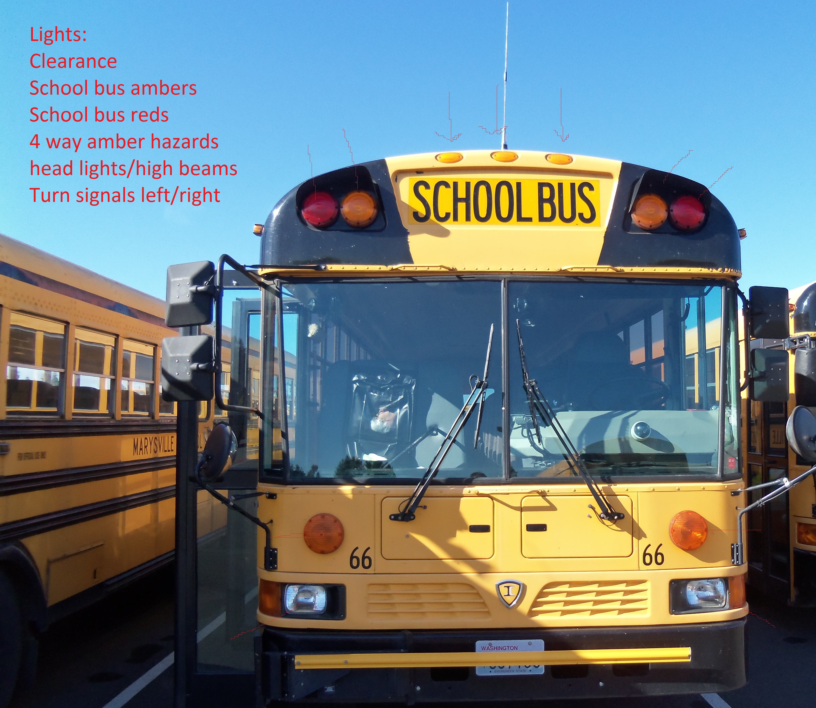
Lights
Examiner Directs light check
Driver must tell examiner to check school bus ambers/reds. Both front and rear.

Slide 5
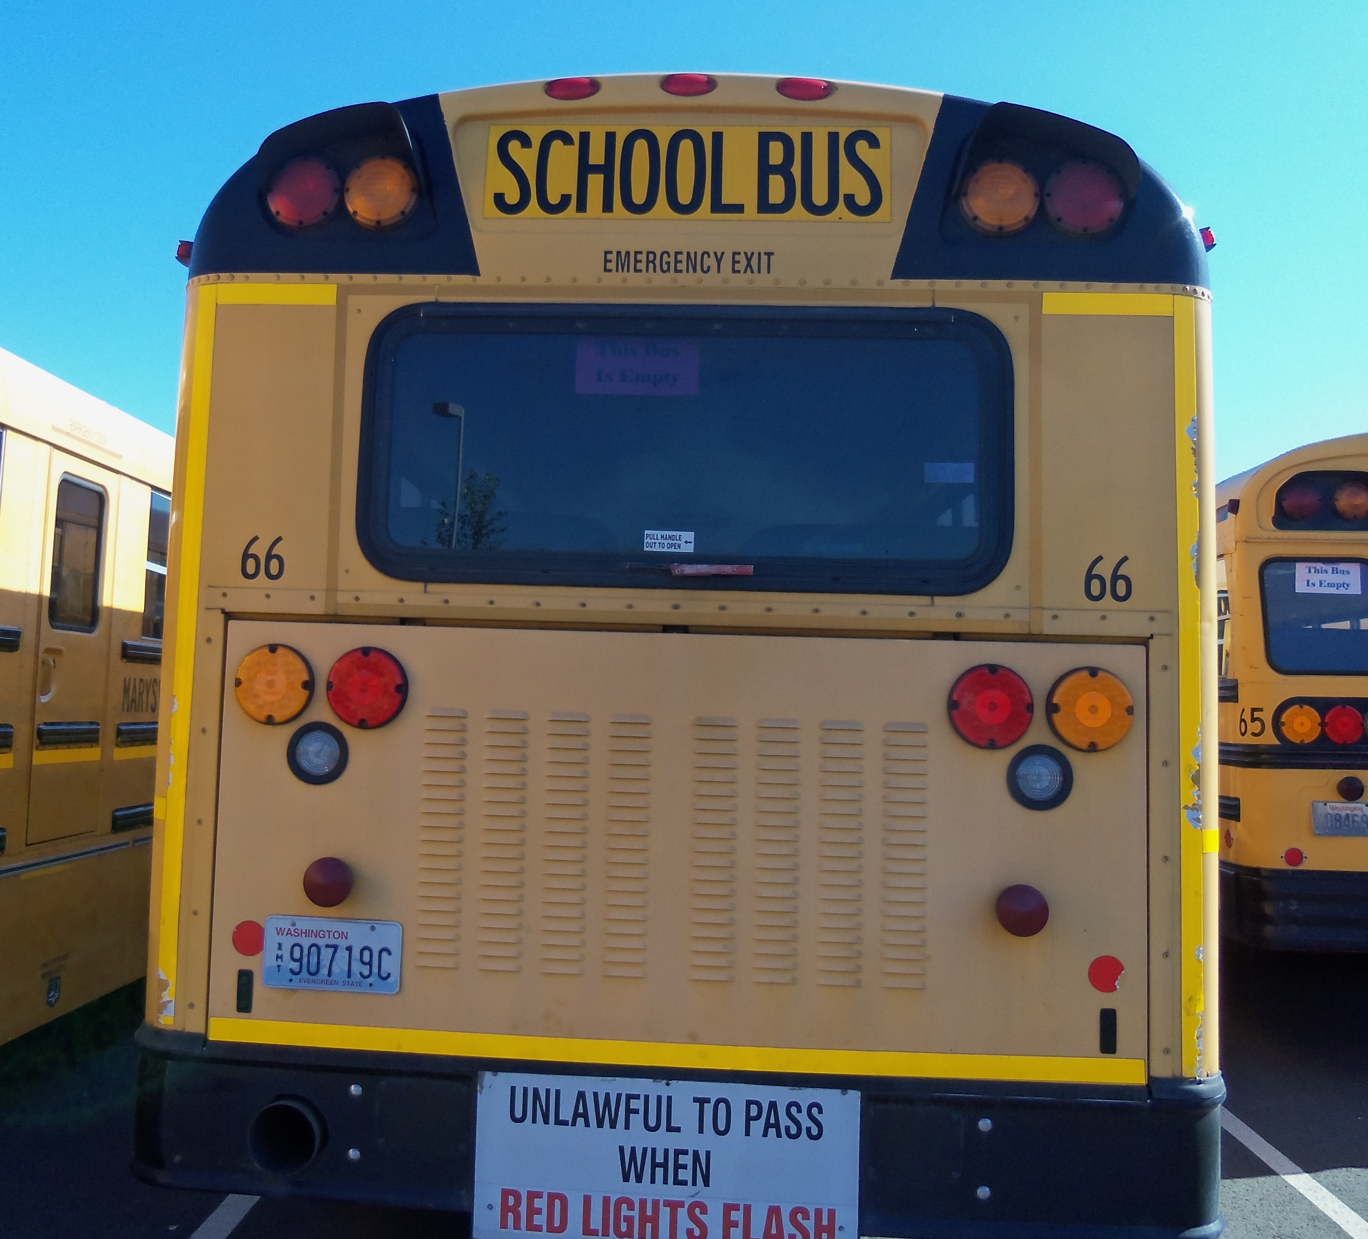
Exterior light check must be done in all three zones completely. Front Side Rear
Clean
Not Damaged
Proper color for their function
Pg 11-11 & 11-12
Lights

Slide 6
Pg 11-25 Baggage compartments
Not damaged
Operates properly
Latches securely
Method 2
Can say “I would inspect all doors this same way”
Must Demo at least 1 door

Slide 7
Clarification
There is a limit on the times we can ask for more information
Must be able to read GVWR on bus or read VIN # to verify weight rating.
Must be able to see Insurance expiration date.
Jan 1st new CLP. (6 months to adjust) good for 180 days. You will notice it is a separate document that must be carried with the DL. Also endorsement/restriction may look like double
Probing vs prompting
Probing: you have mentioned the component and I ask for more information
Prompting: you have not mentioned the component and I cannot ask you a question or give you a hint you forgot something.

Slide 8
Things to take note on:
Can test in Air over hydraulic but that would be only class of vehicle you can drive.
You can use cell phone to time air leak check.
If you bring a bus with wheelchair lift you must inspect it.
If you bring a bus with out air ride components you do not have to say the inspection criteria.

Slide 9
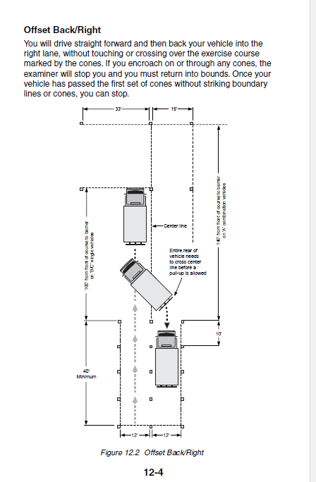
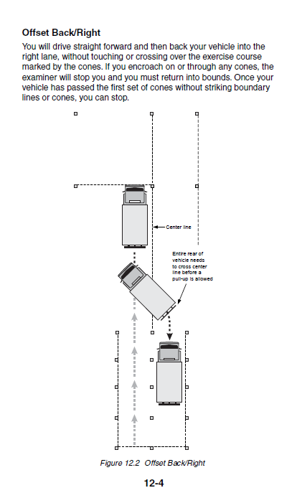
Please use past information on the backing/controls portion of your test. Examiners are no longer able to answer these types of questions. Ex: How many cones? What is measurements between cones? Please note in new DOL book
2016 DOL book
2017 DOL book

Slide 10
Drive test
Any reverse on the drive test is a disqualification unless police officer assists.
Stopping to adjust seat or mirrors once drive test has started is a disqualification. That must be done before drive test starts. It starts when directions are read.
If reds come out @ RR it is a DA or VIO
Stop at all RR crossing while on test. (Exempt Track) Treat them all as active.
Student stop can say 10 or 12 feet out. Both correct.
Permit is separate document, must accompany the DL.

Slide 11
Don’t forget to bring on the day of test
- CDL Medical - Expiration Date. - Candidates expiration not Dr. And watch date closely.
- STRF - DOL box Tested by – ESD (skills test results form)
- DOL 520-335 form correctly filled out. (Commercial Driver License Third Party Examiner Request Form)
- New Permit to carry coming January 2017
If Candidate does not pass, complete STRF will be given back. You must bring the whole form back when 2nd test is performed along with new 520-335 form (including new control # from ESD 112)

Slide 12
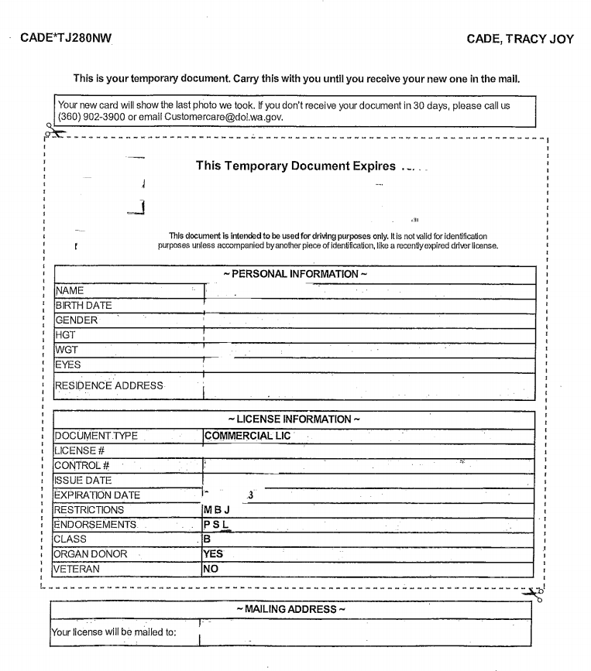
Endorsements & Restrictions
Note:
Restriction “B” =corrective lenses
Restriction “L” = No air brakes
Endorsement “L” = Motorcycles

Slide 13
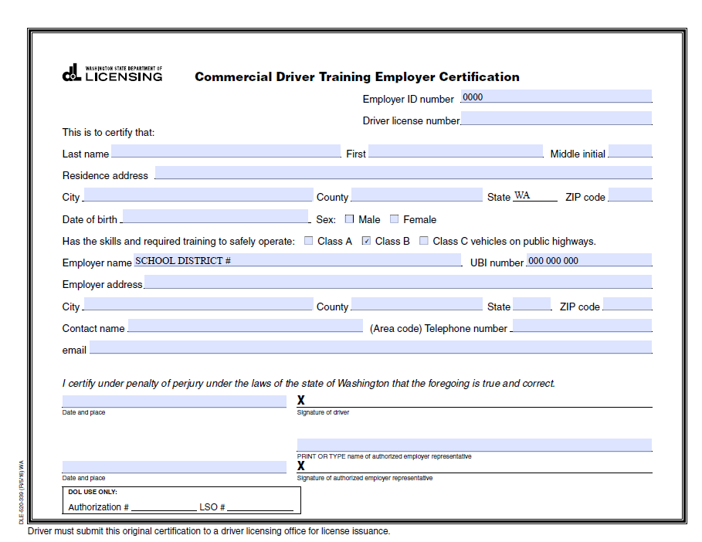
Employer Certificate
Must be registered with DOL to sign.
If not a registered/authorized to sign can disqualify an applicant’s CDL. Not all driver trainers are registered.
If you change districts make sure you become an authorized signer before signing the certificate.

Slide 14
Questions?

