Slide 1
Pre Trip Pictures
Parts of a School BUs

Slide 2
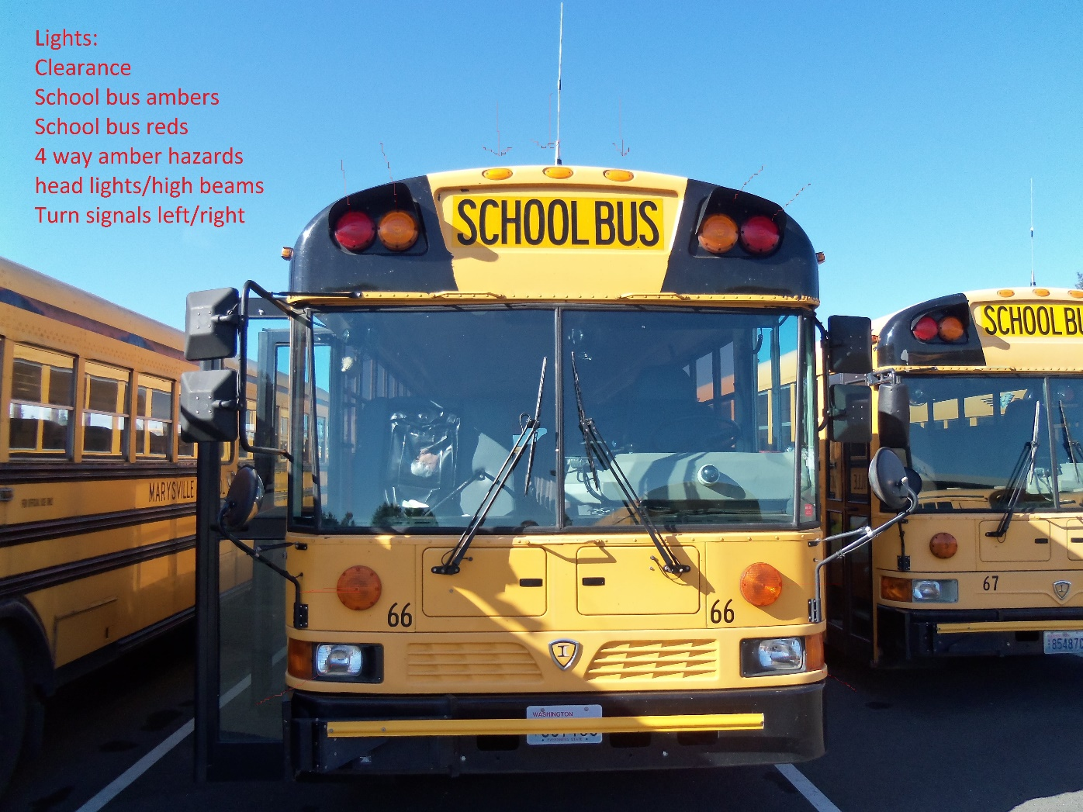
Front of Bus

Slide 3
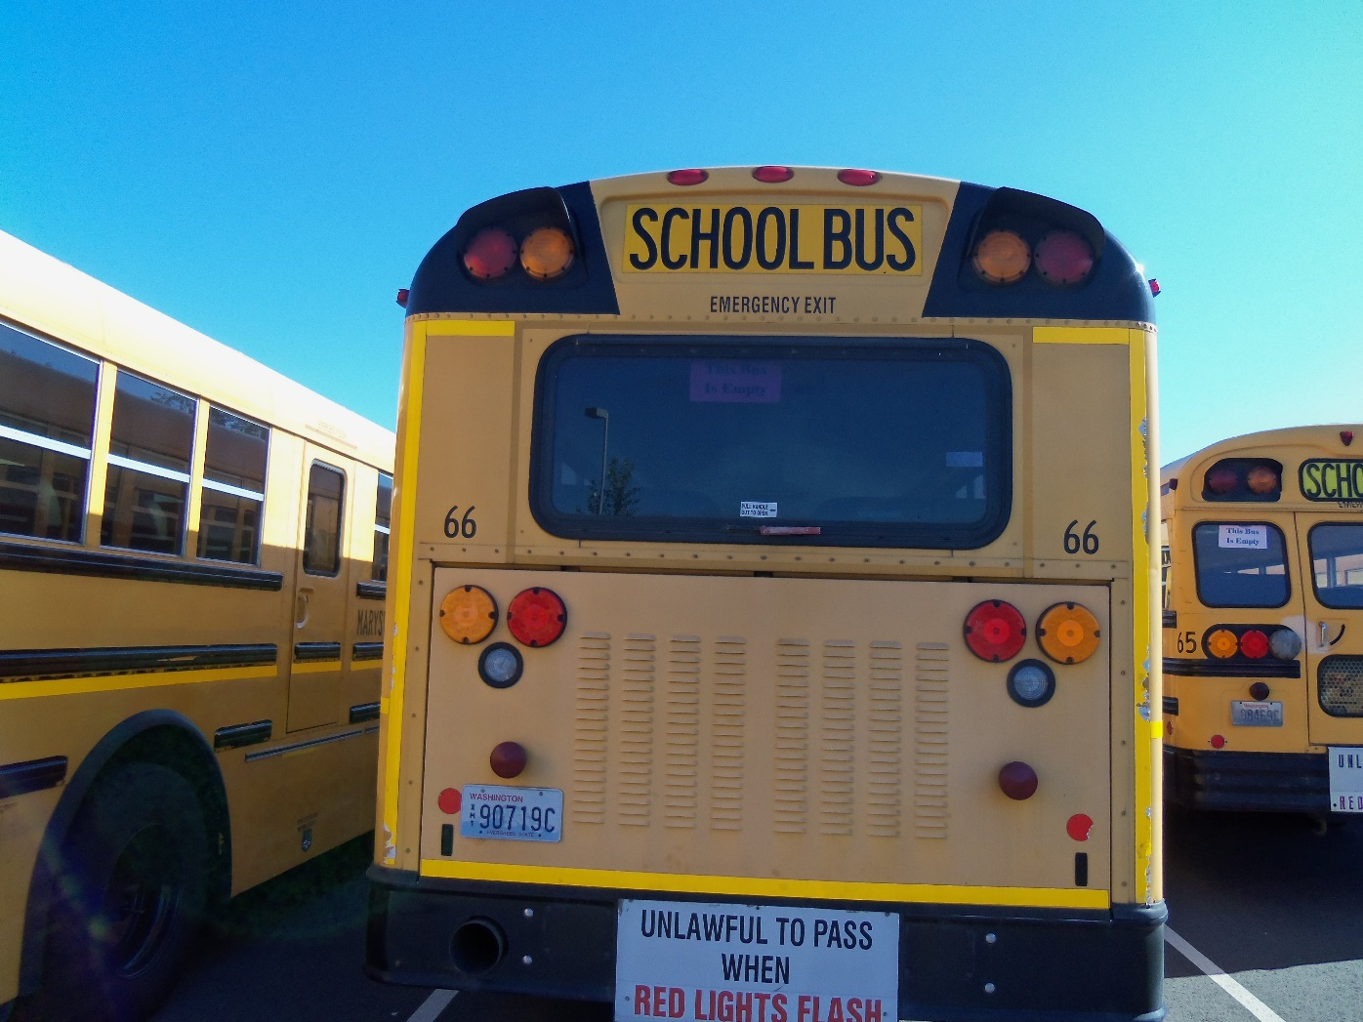
Back of Bus

Slide 4
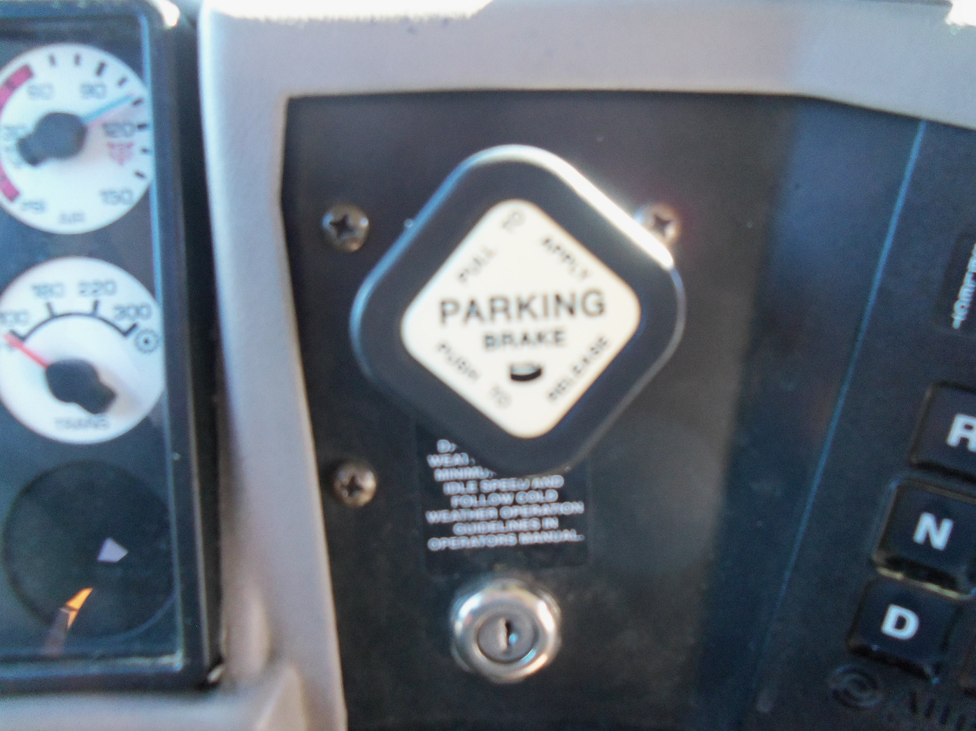
Parking Brake

Slide 5
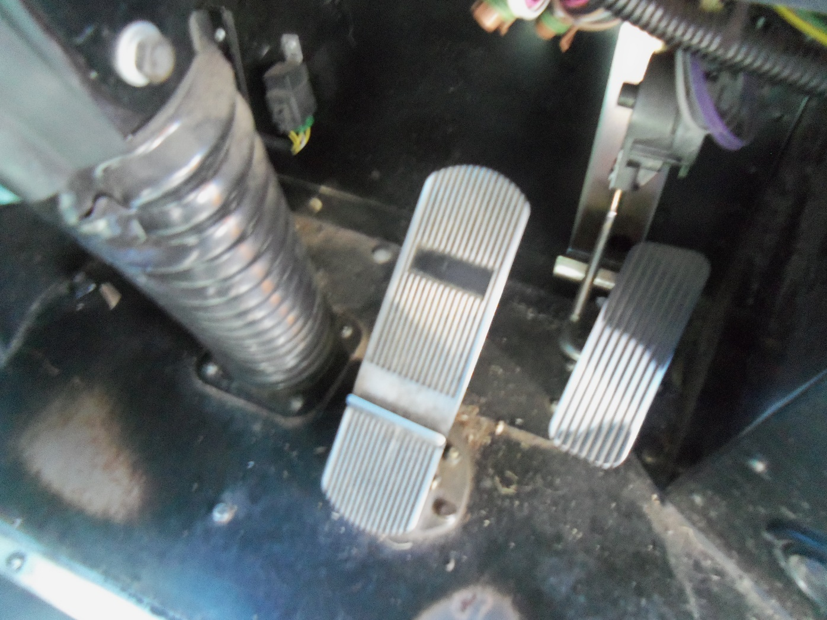
Service Brake

Slide 6
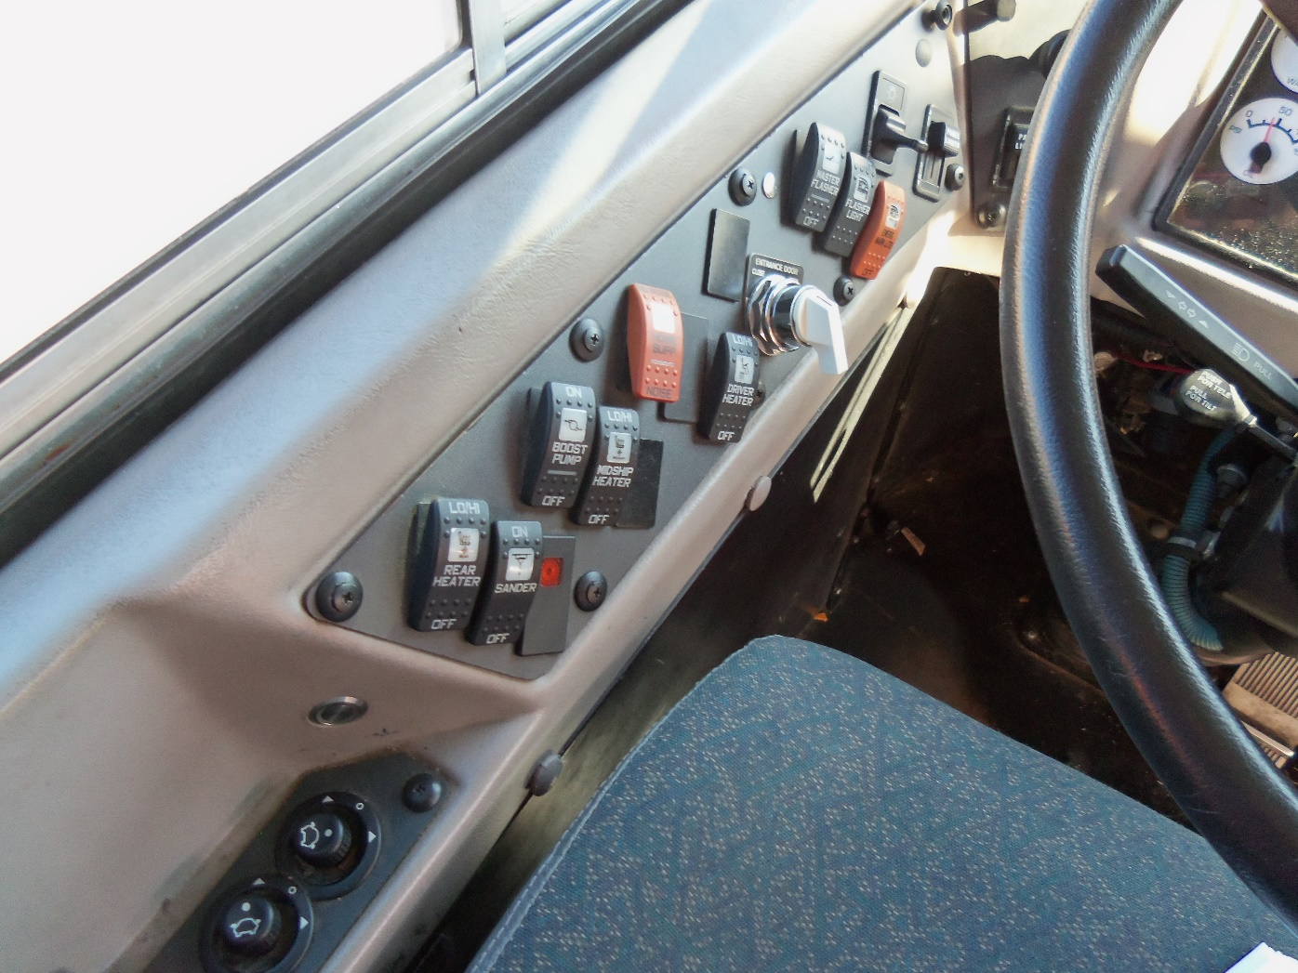
Dash Items:
Door Switch, Heaters & Mirror Adjustment

Slide 7
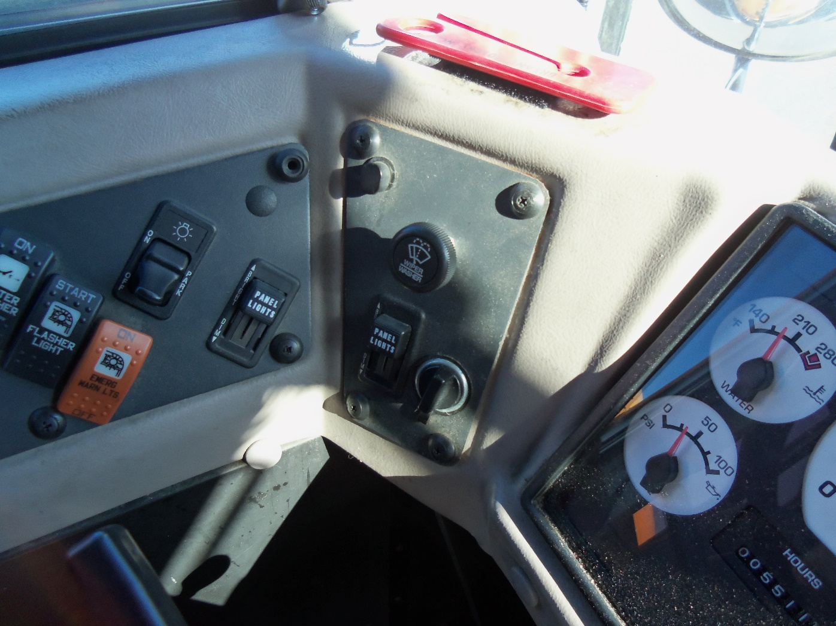
Wipers, Lights and 8-Light System Controls

Slide 8
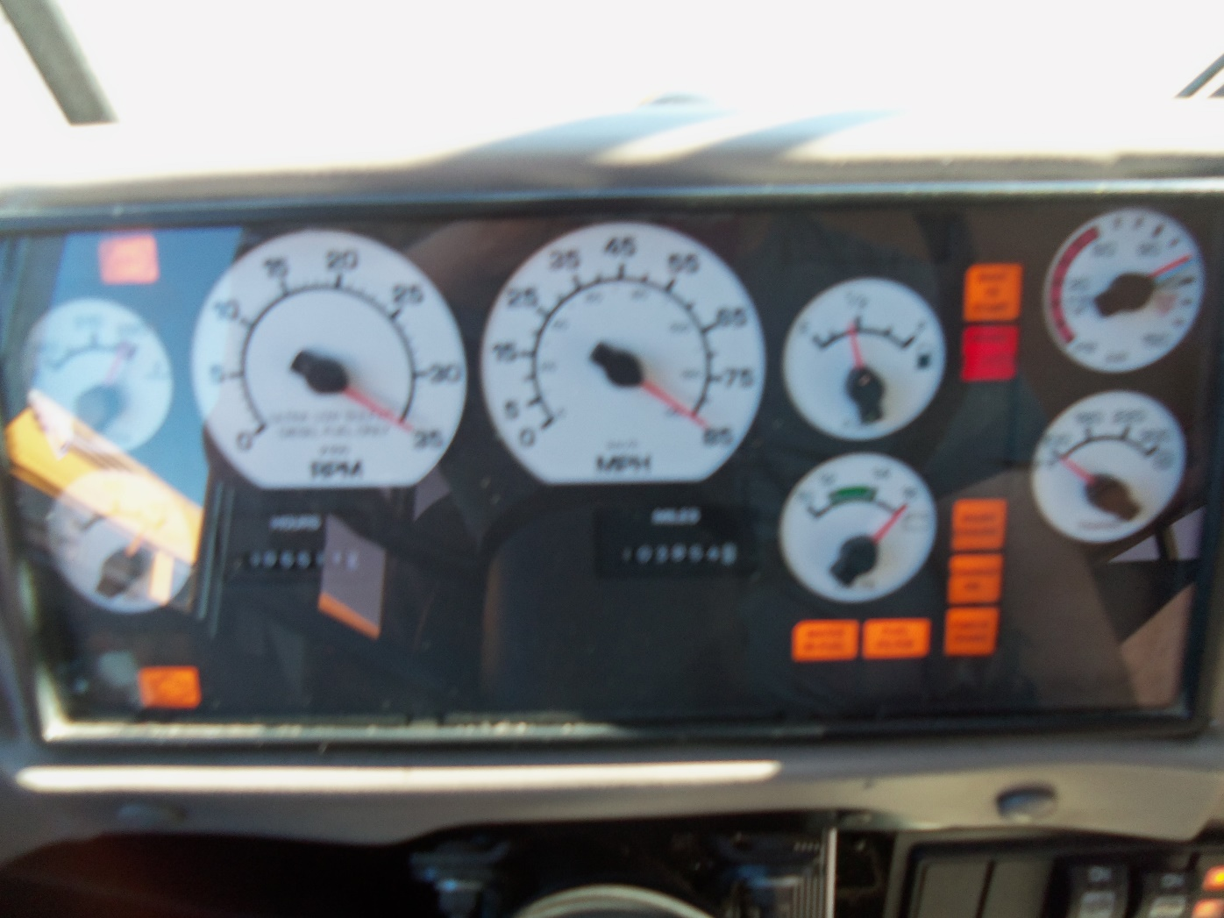
Dash Area

Slide 9
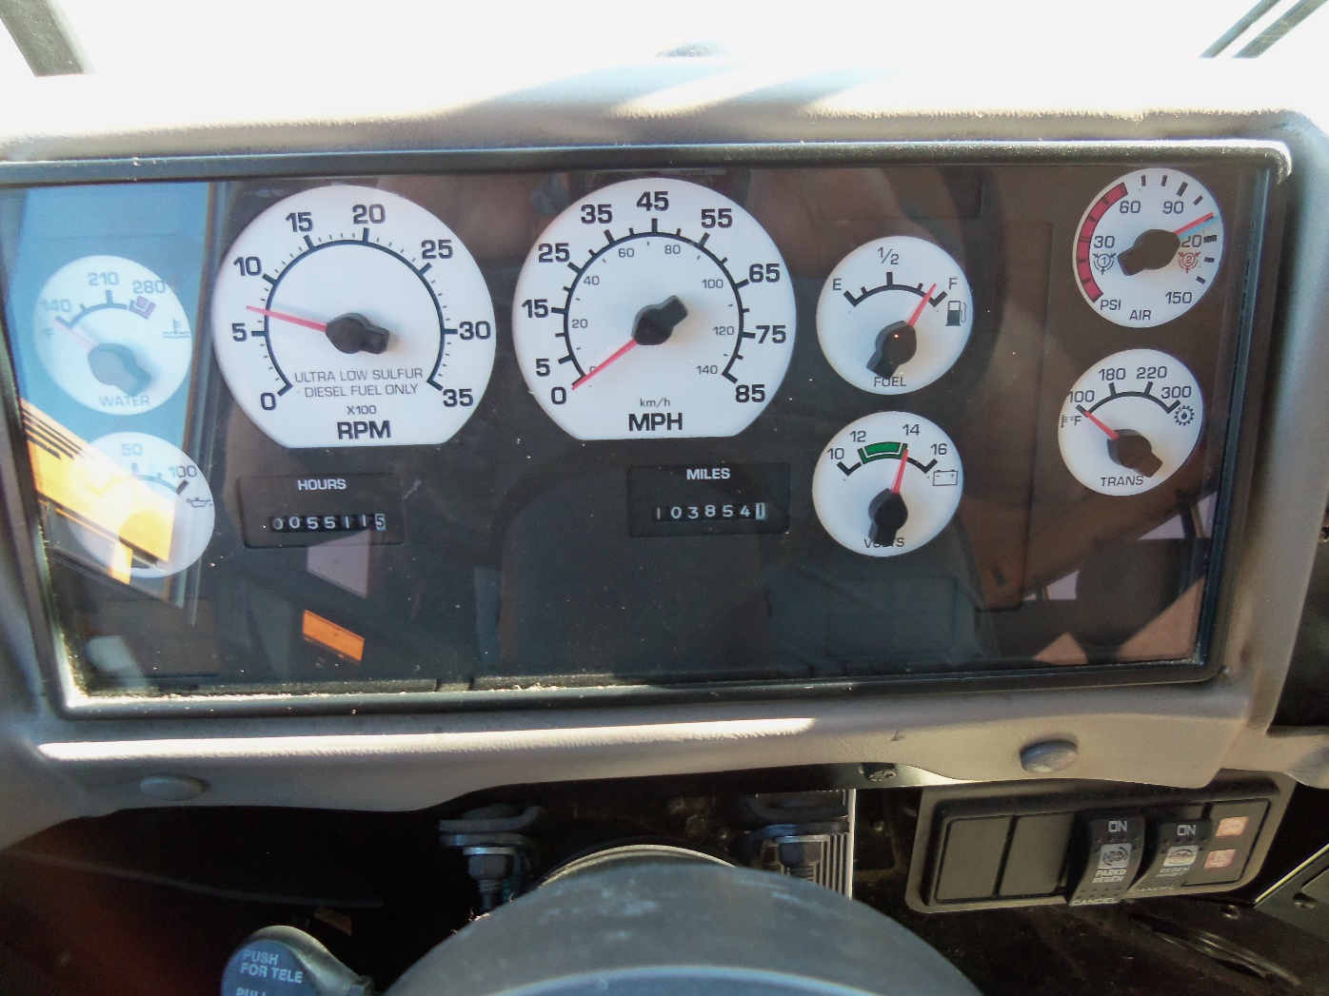
Gauges

Slide 10
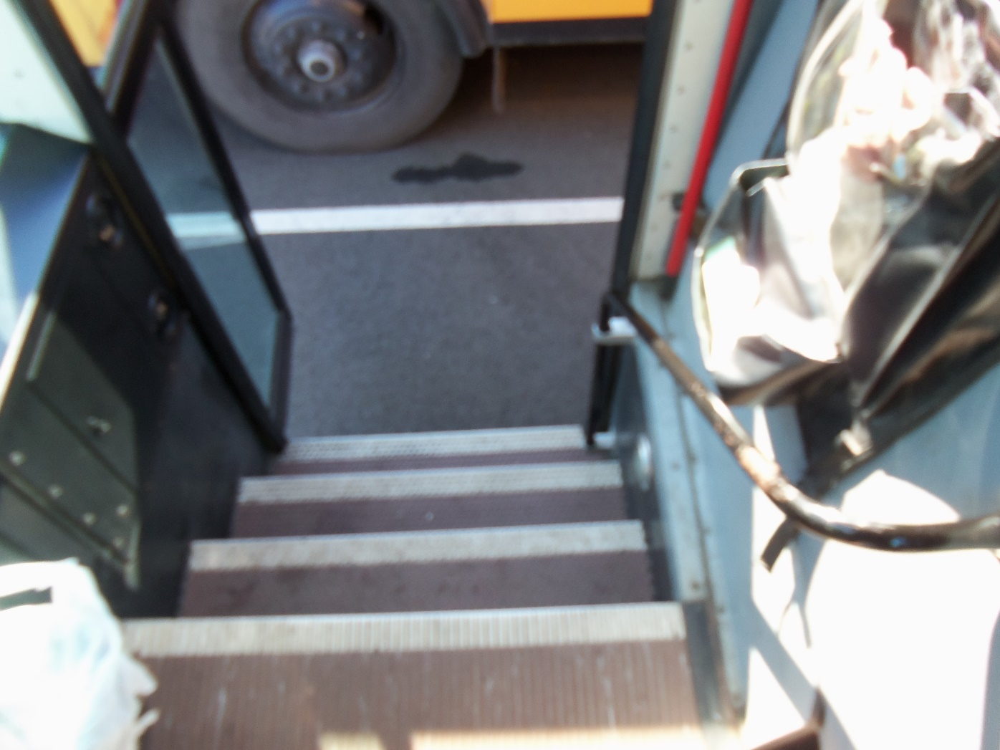
Entry Handrail

Slide 11
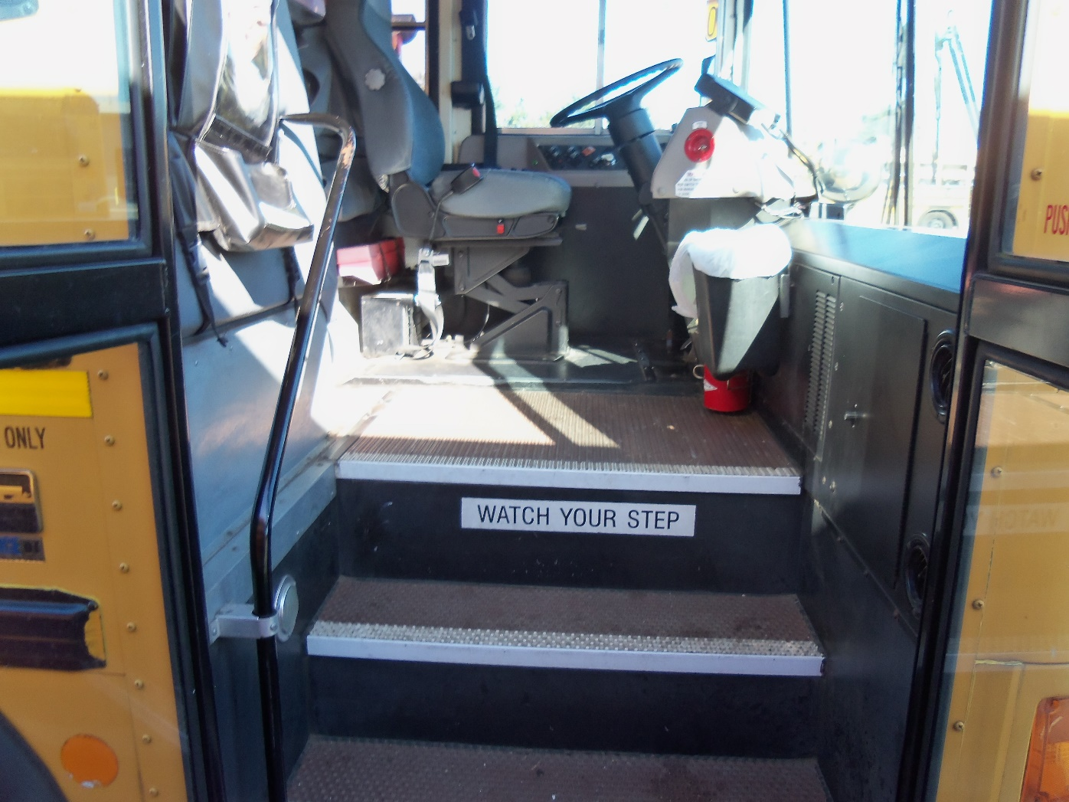
Entry Emergency Equipment –
Driver Seat Area

Slide 12
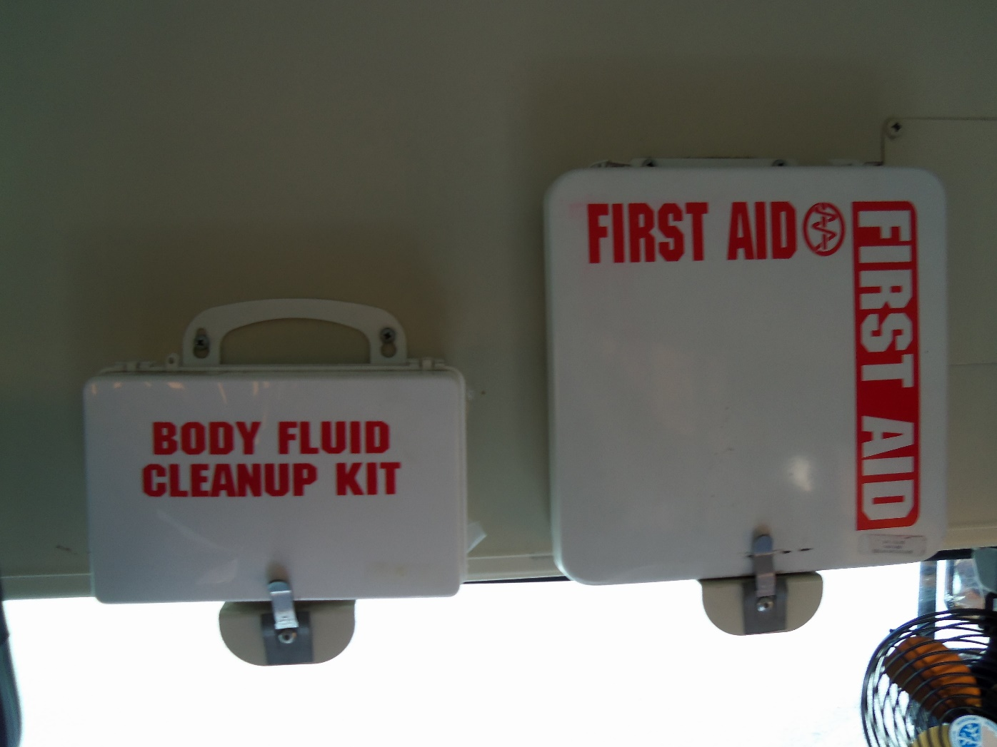
First Aid and body Fluid Cleanup Kit

Slide 13
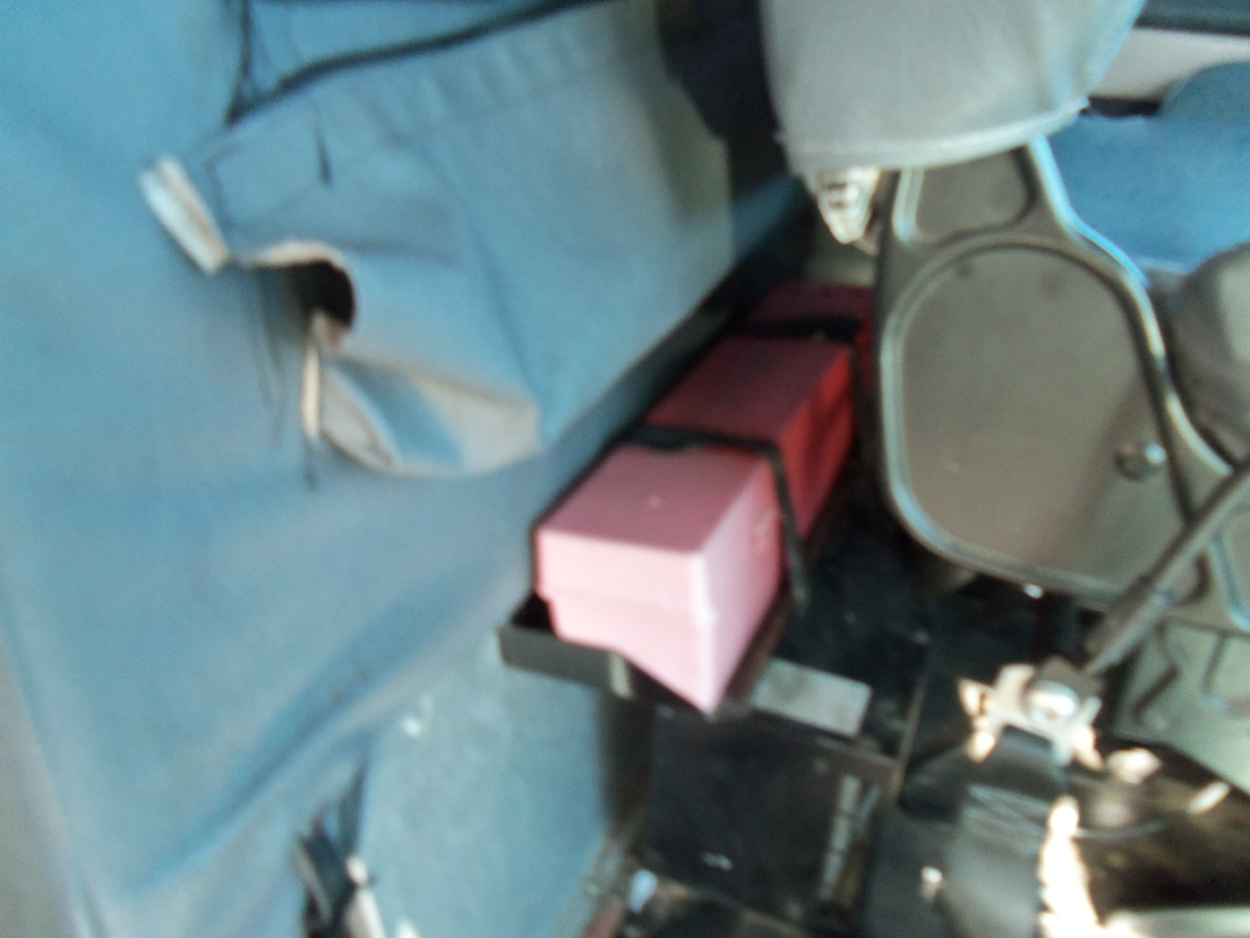
Reflectors (three)

Slide 14
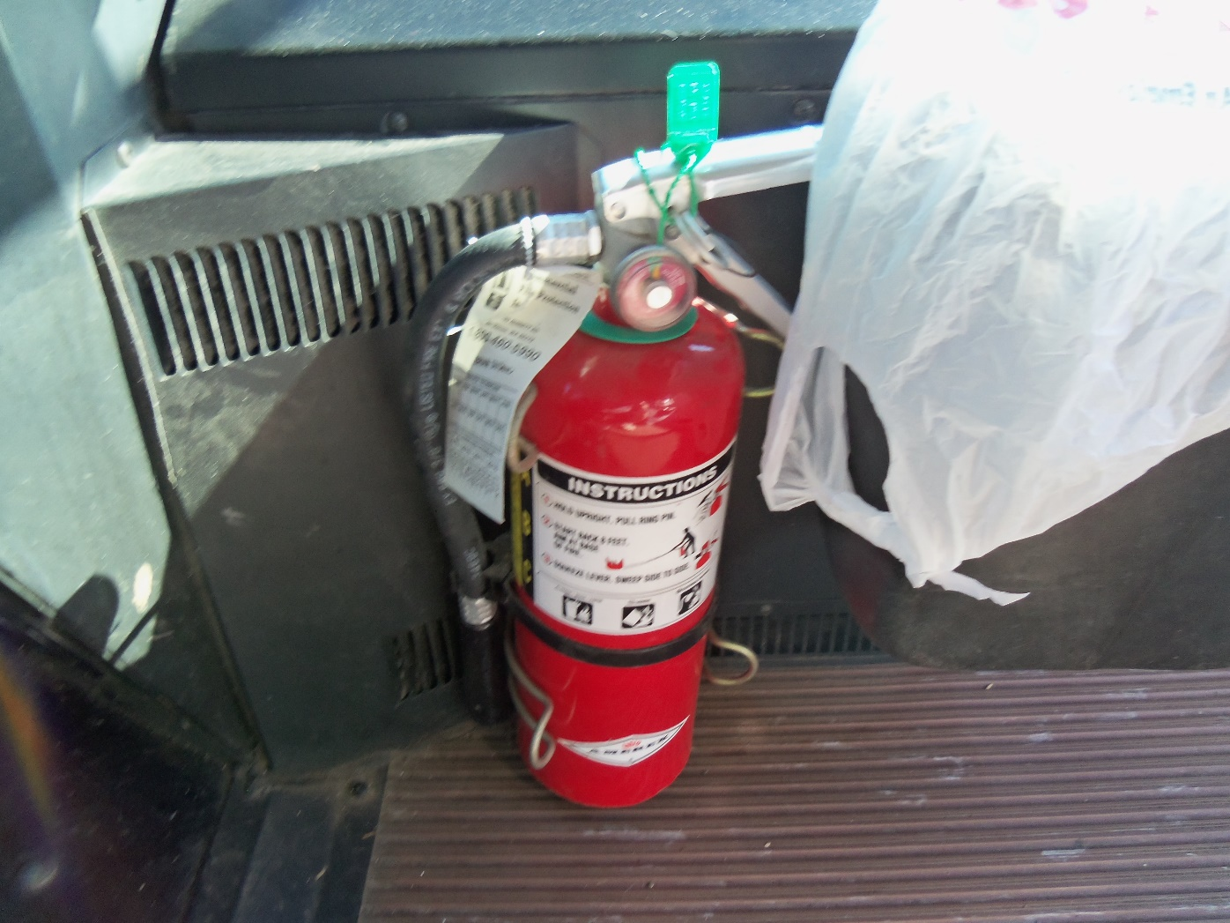
Fire Extinguisher

Slide 15
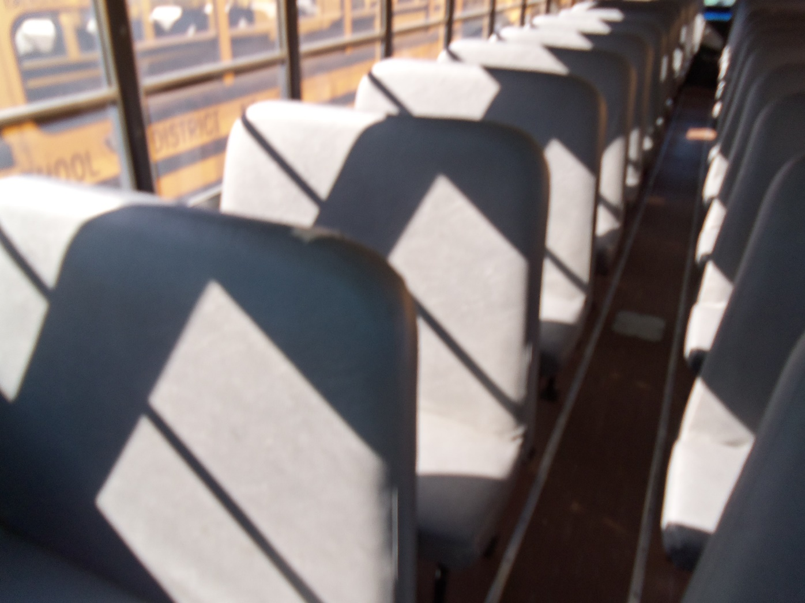
Bus Seats

Slide 16
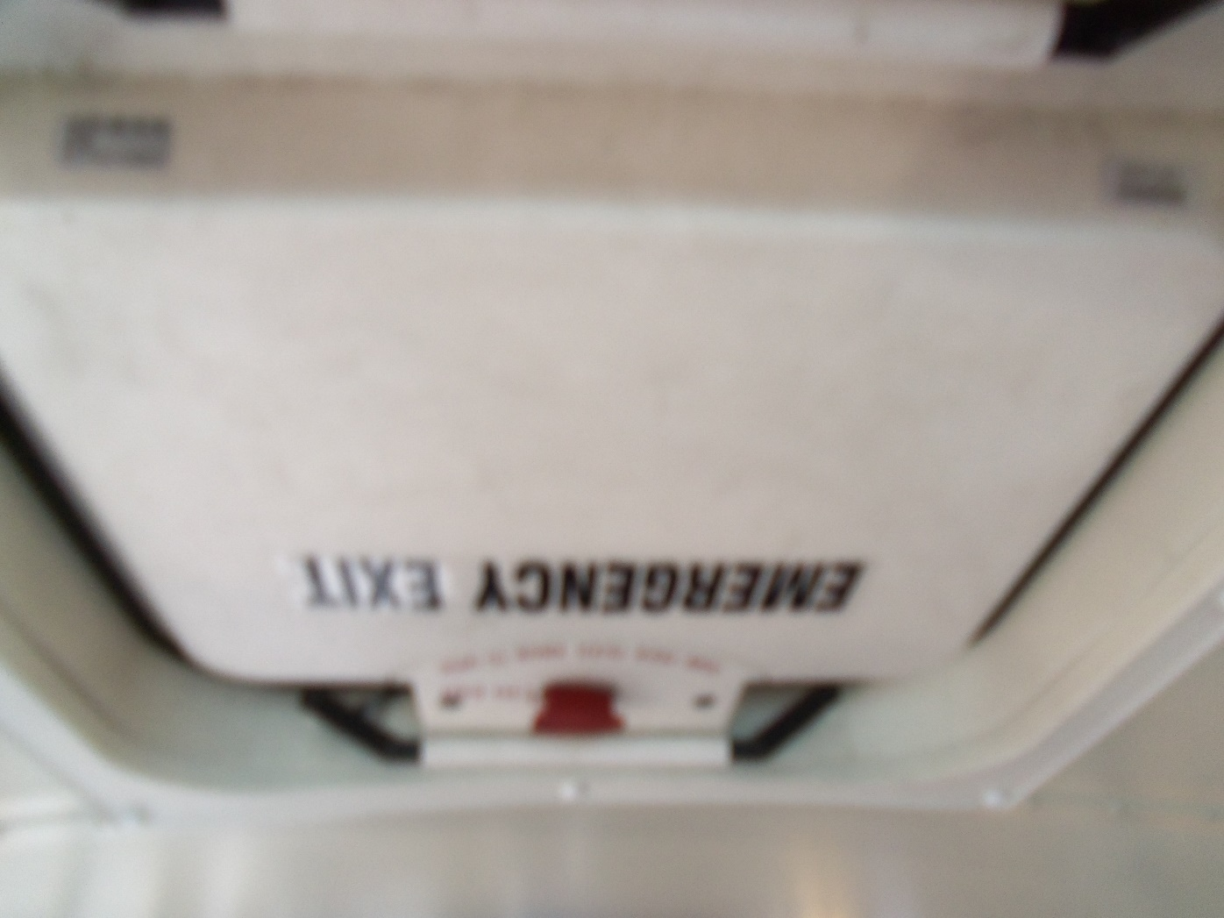
Roof Hatch

Slide 17
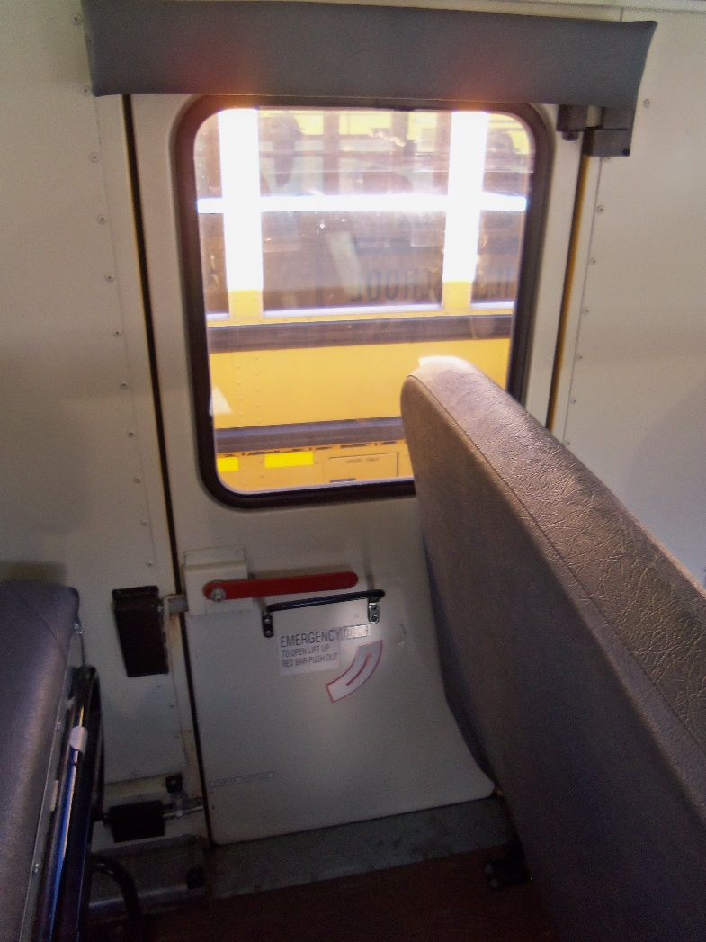
Side Emergency Exit Door

Slide 18
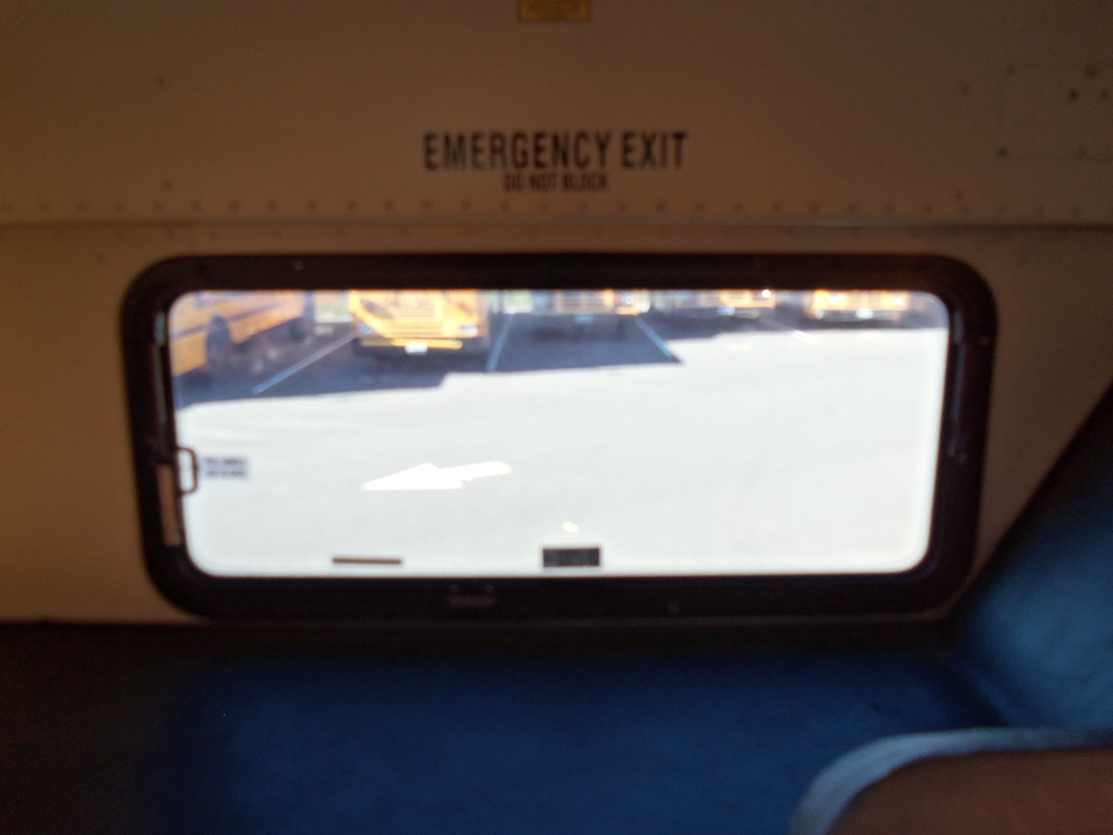
Rear Emergency Exit Window

Slide 19
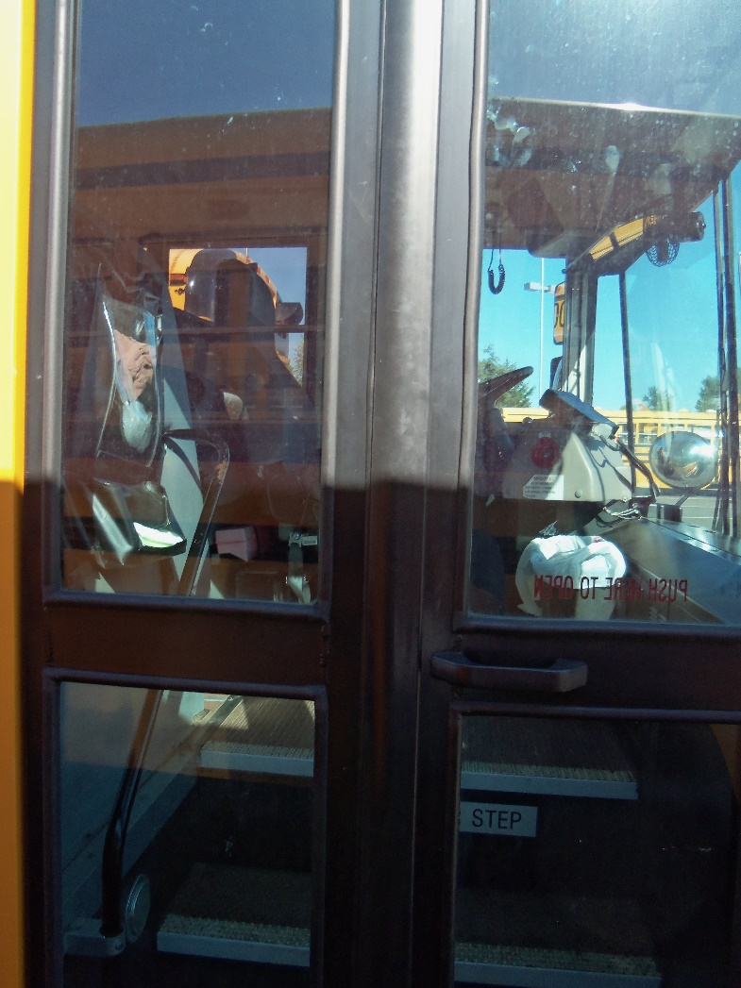
Front Service Door

Slide 20
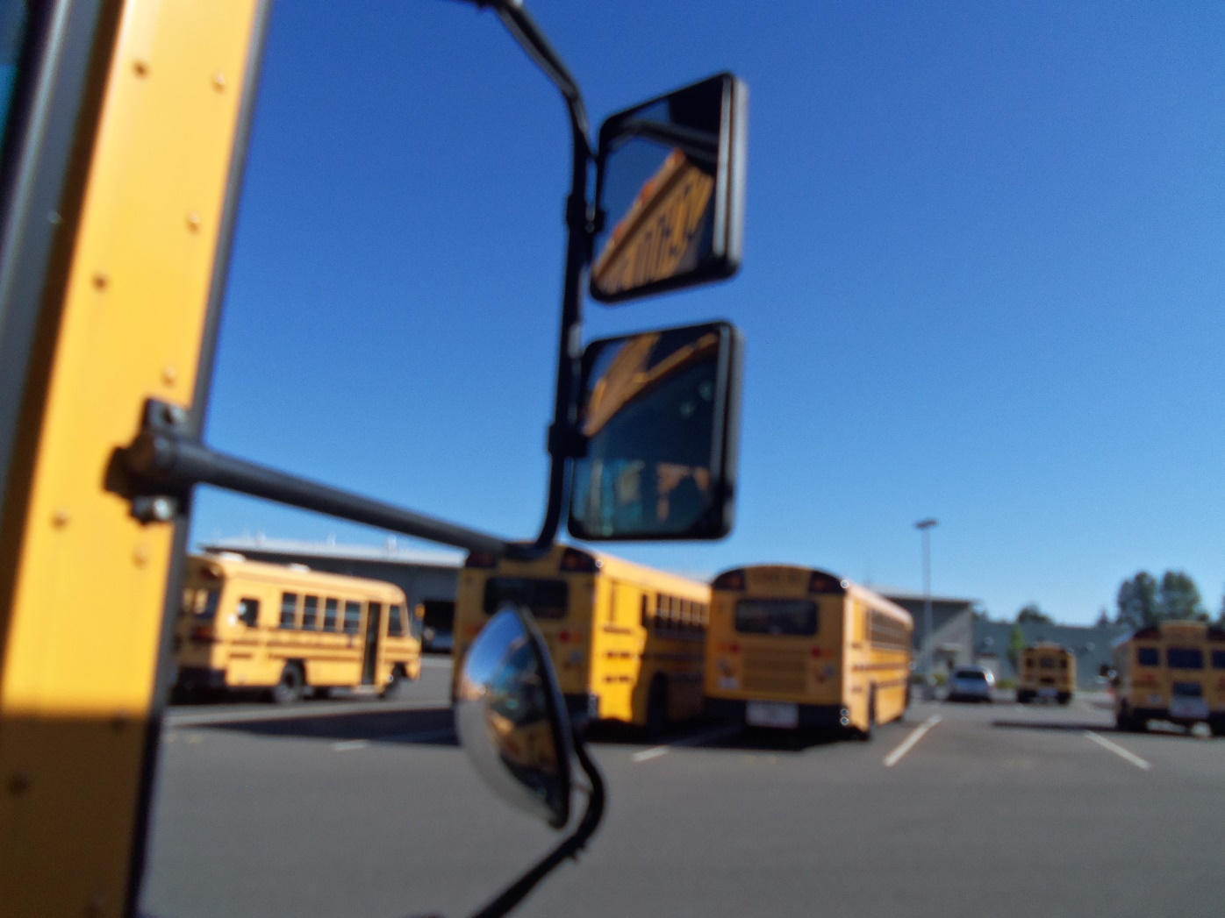
Side Mirrors

Slide 21
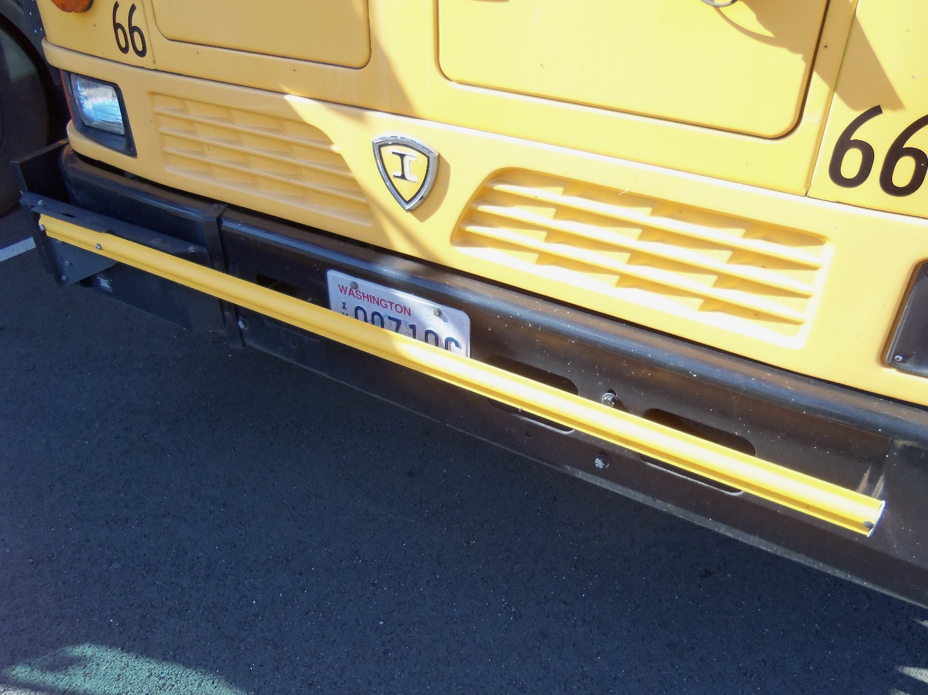
Crossing Arm

Slide 22
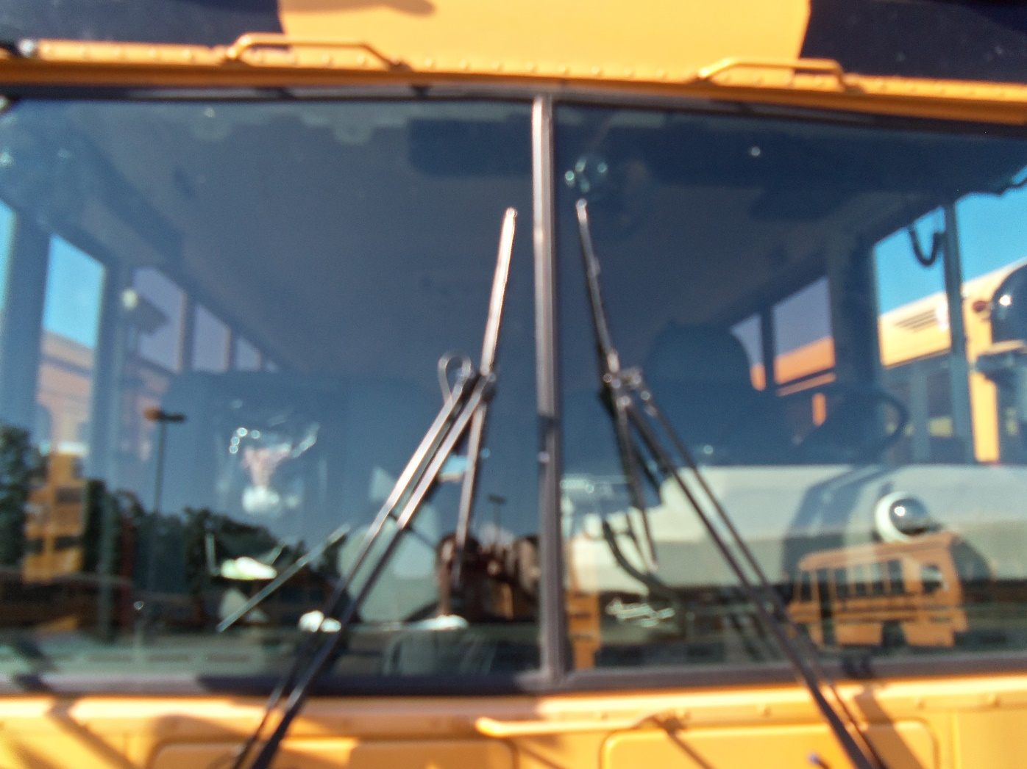
Windshield

Slide 23

Eight-Light System

Slide 24
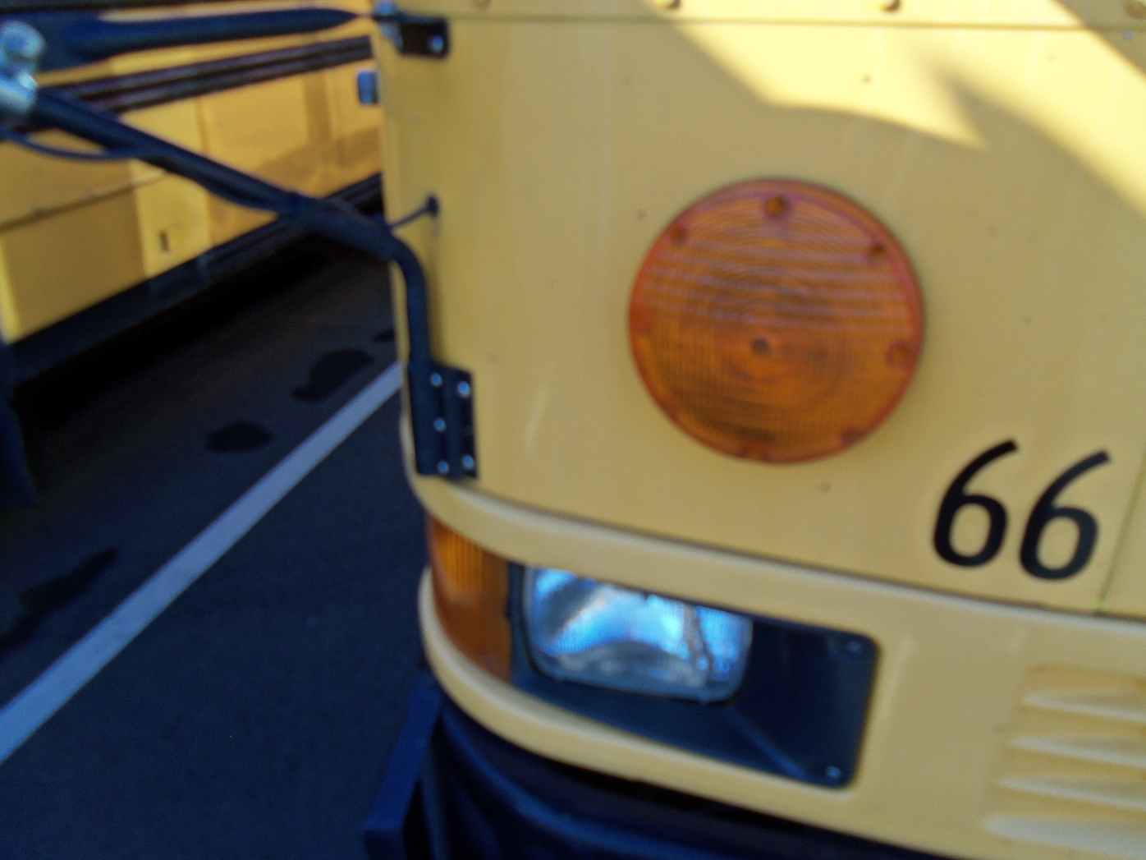
Turn Signals

Slide 25
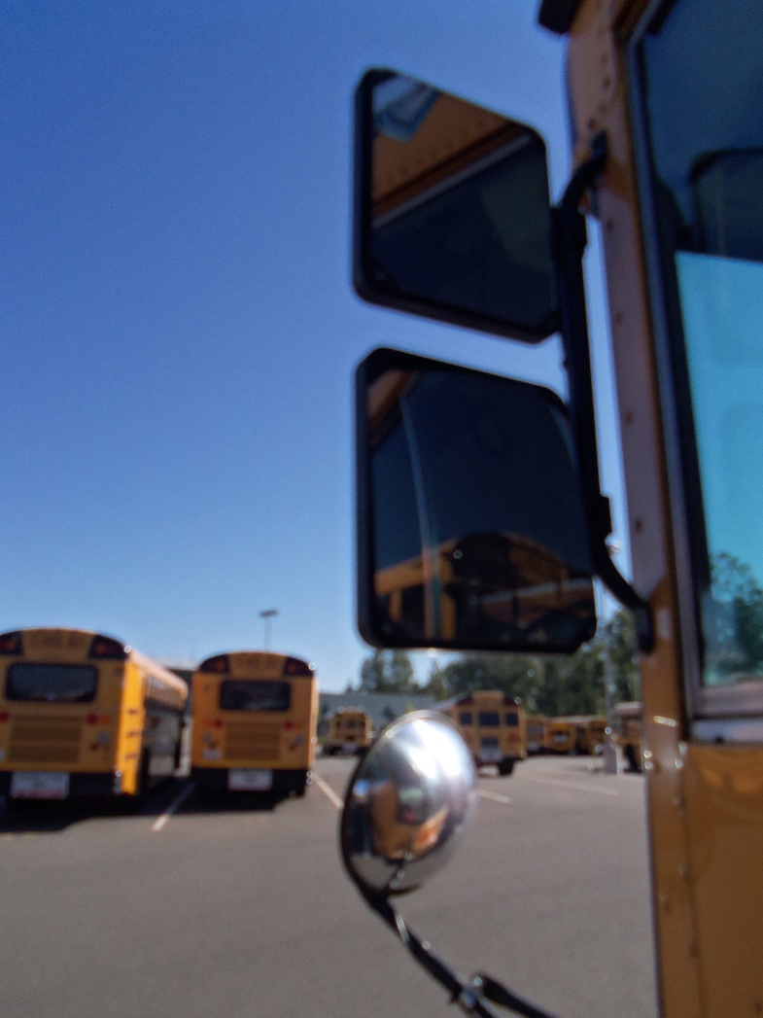
Left Side Mirrors

Slide 26
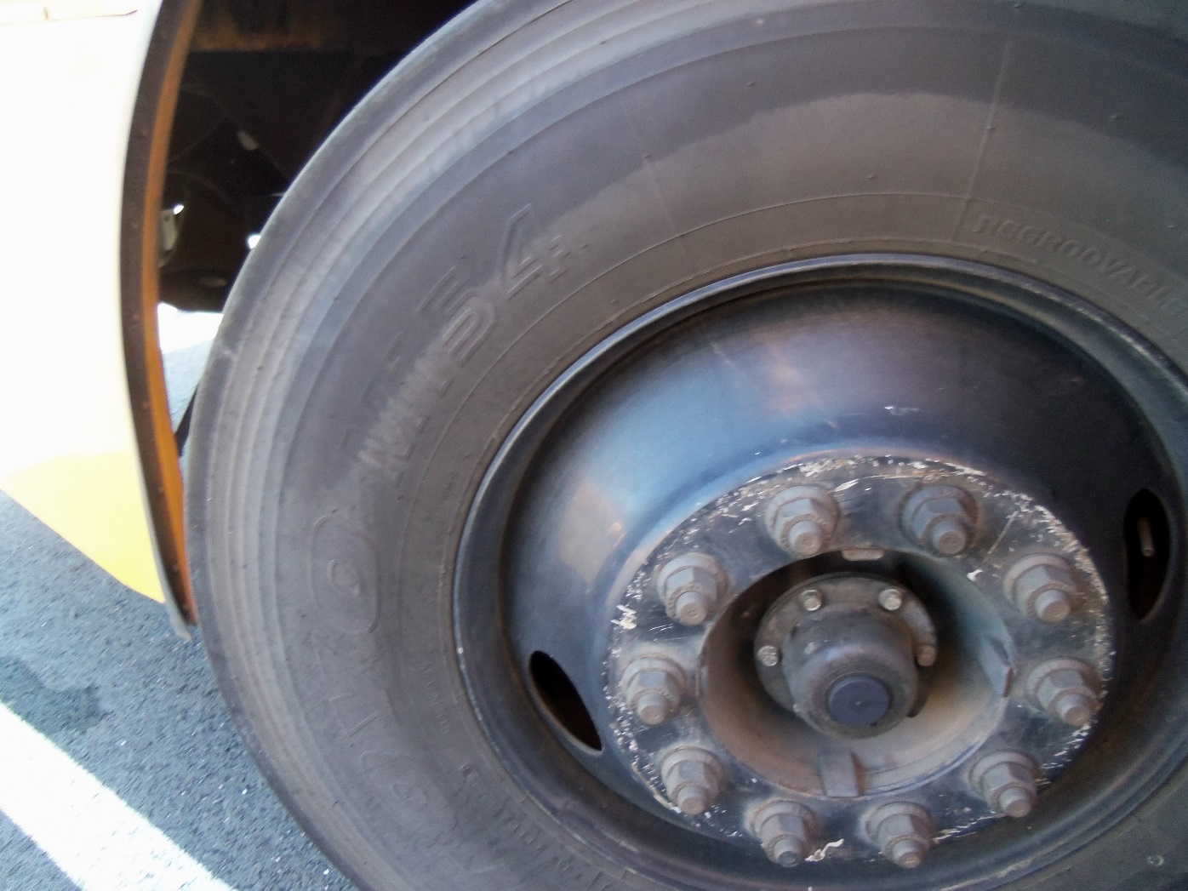
Front Tire

Slide 27
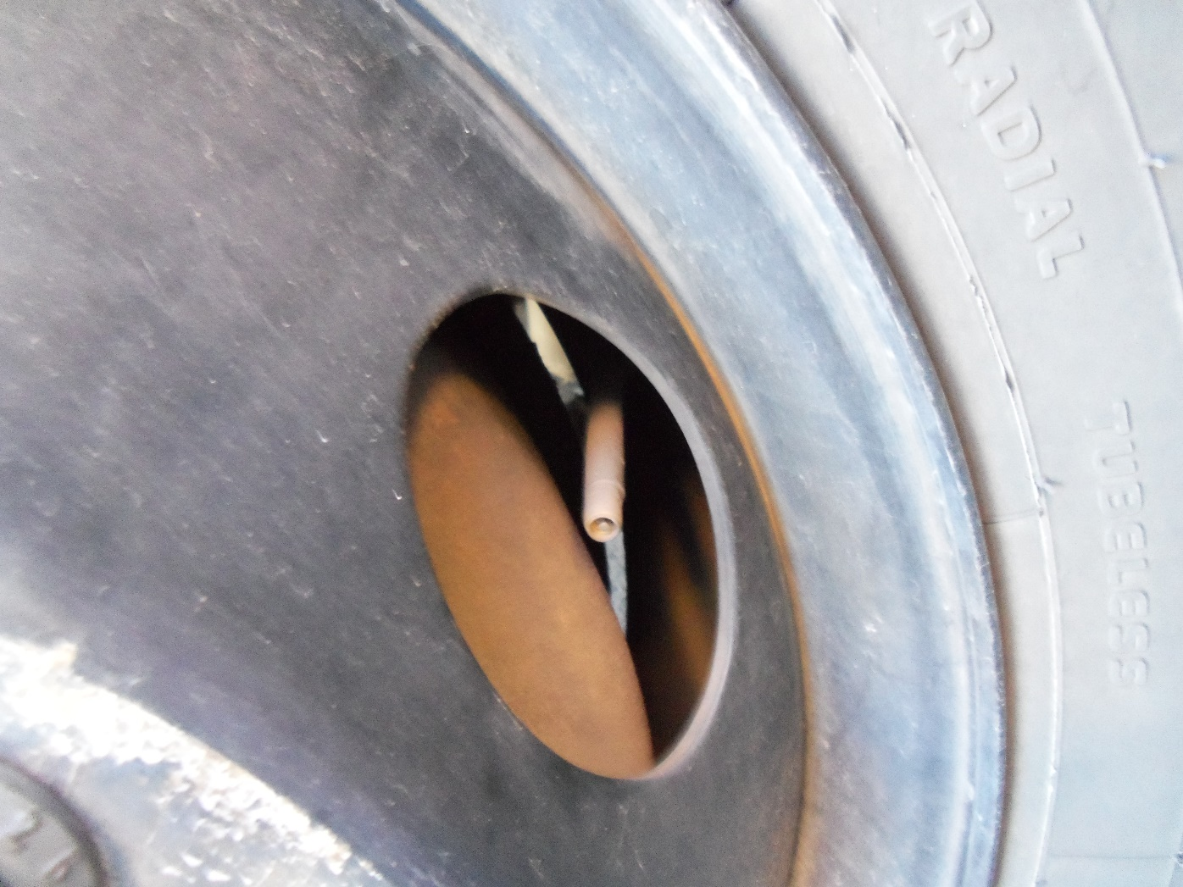
Valve Stem

Slide 28
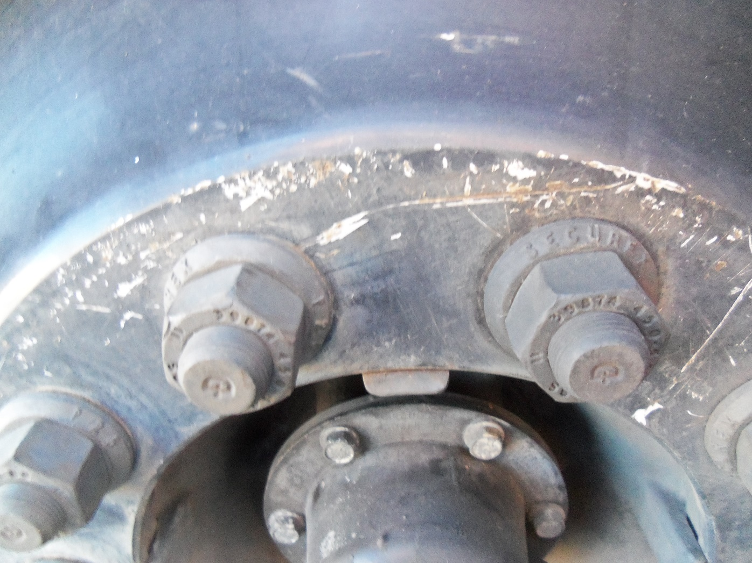
Lug Nut

Slide 29
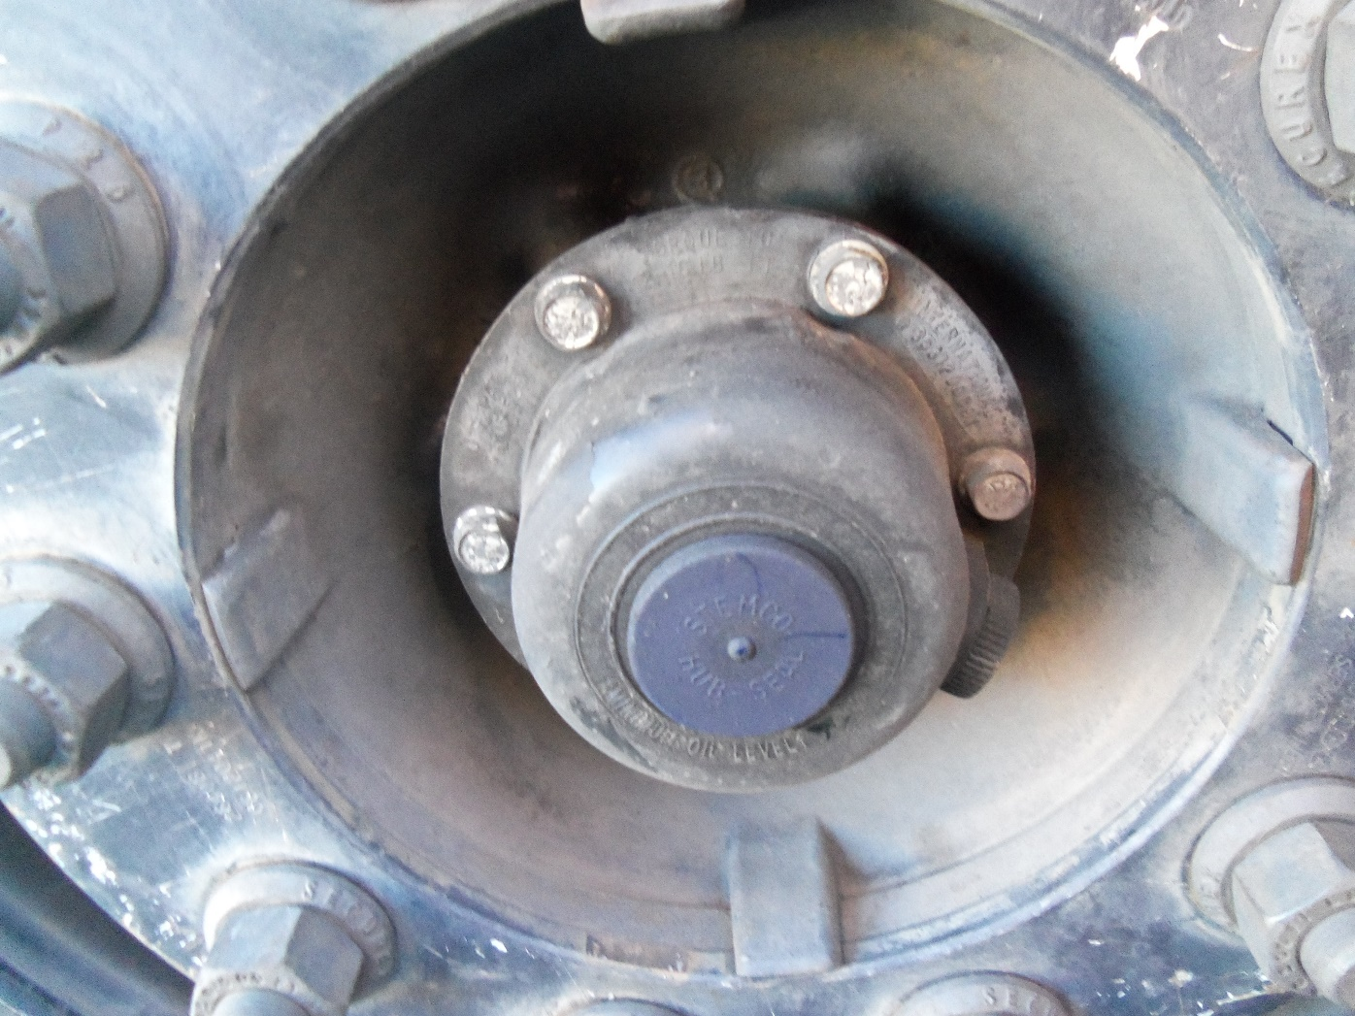
Hub Seal (front)

Slide 30
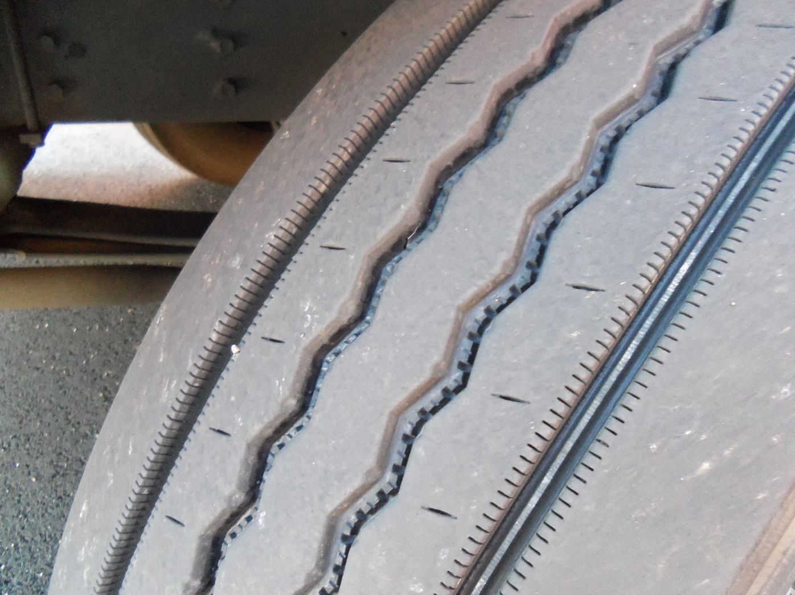
Tire Tread (front)

Slide 31
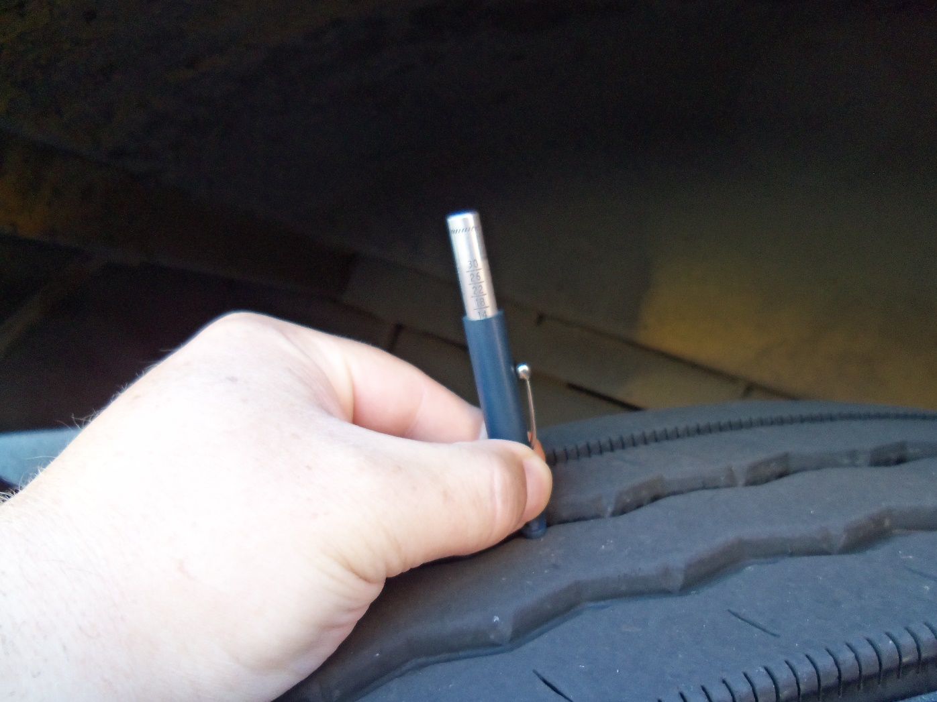
Tire Tread (front) with Tool

Slide 32
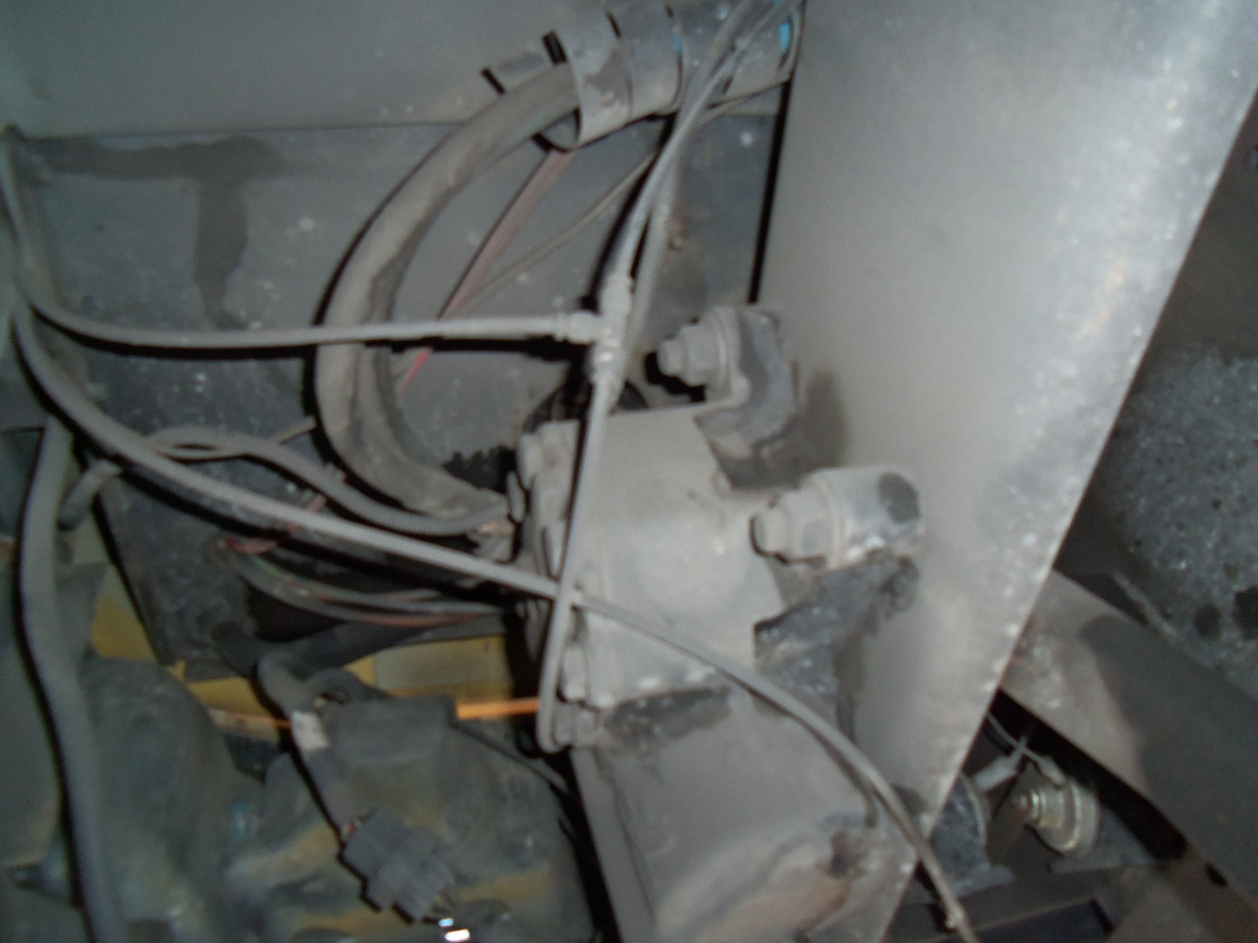
Steering Box and Hoses

Slide 33
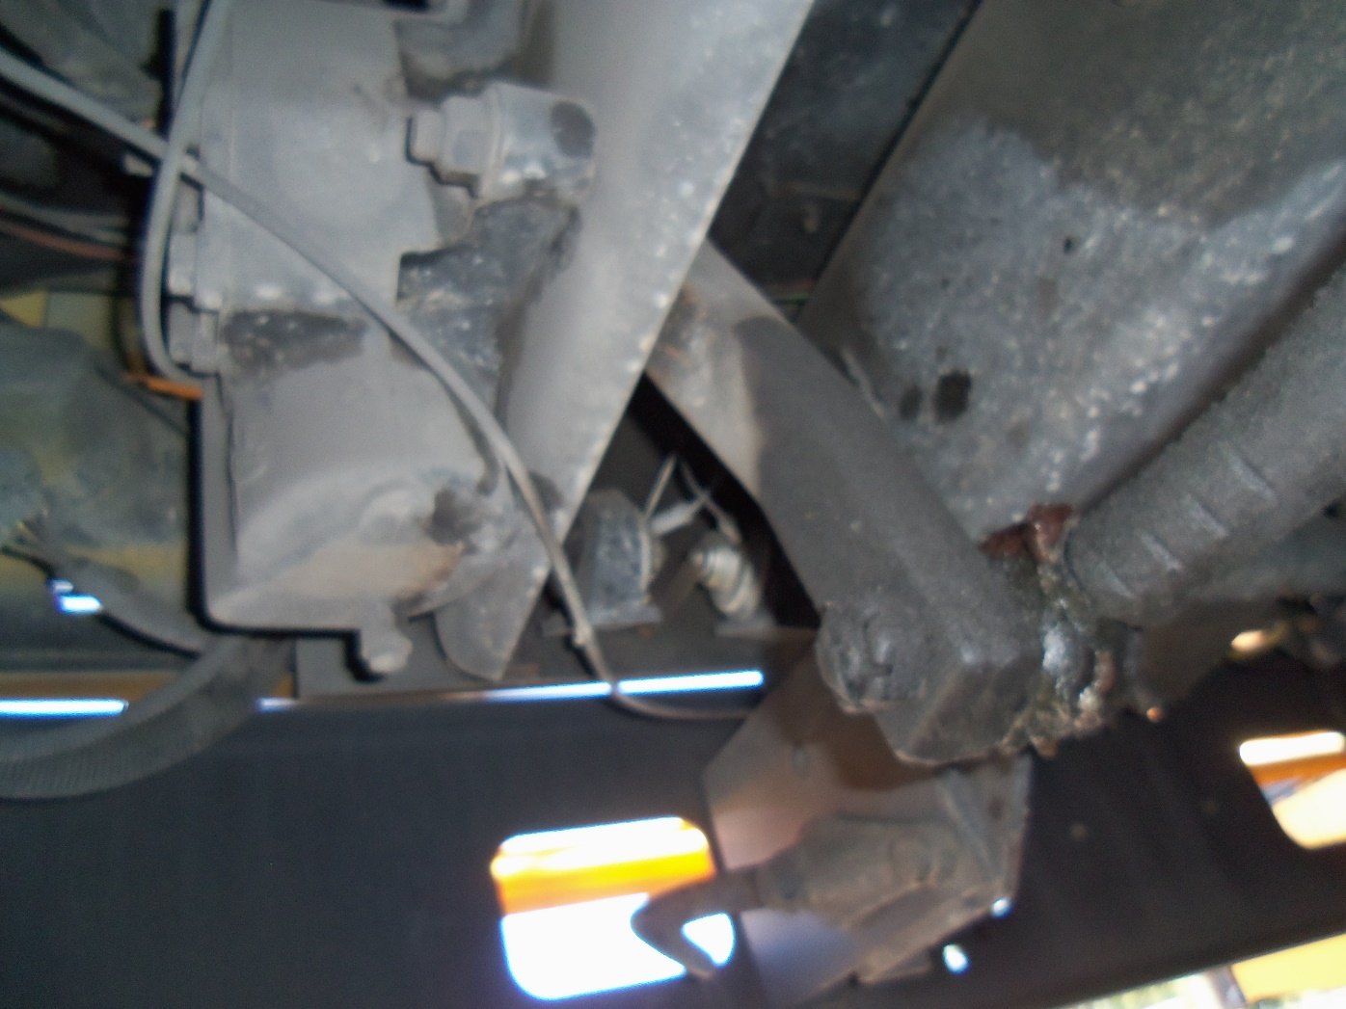
Steering Linkage with Cotter Key

Slide 34
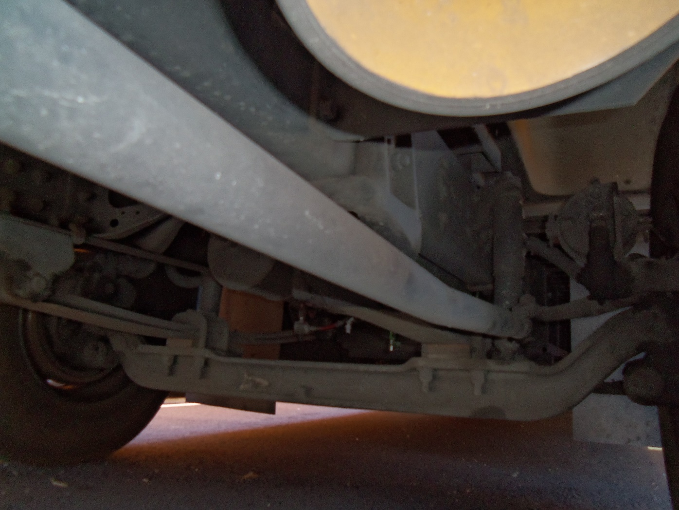
Steering Link Rod & Arm including
Axle Shock Absorber

Slide 35
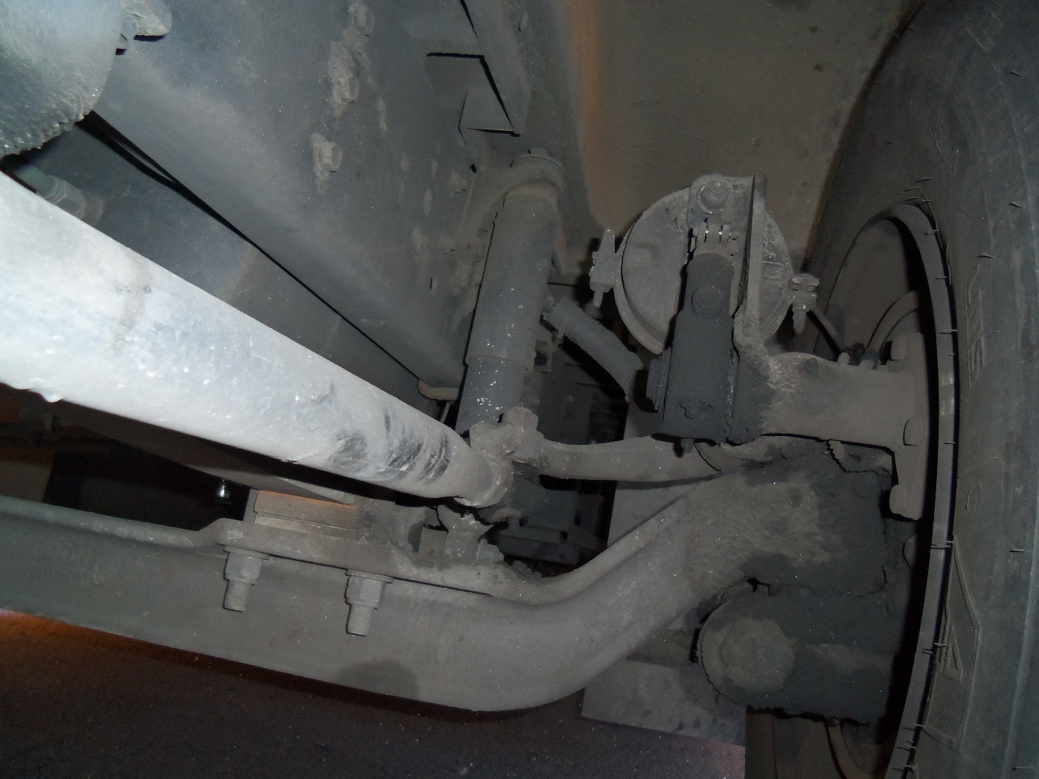
Shock Absorber, Brake Can, Slack Adjuster

Slide 36
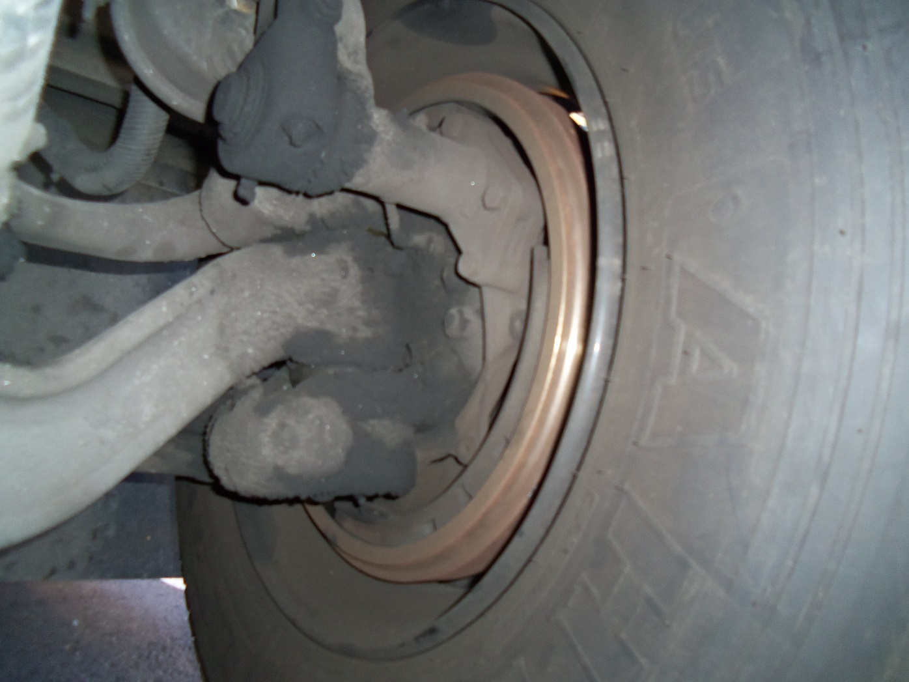
Inside Brake Drum

Slide 37

Stop Sign (stop paddle)

Slide 38
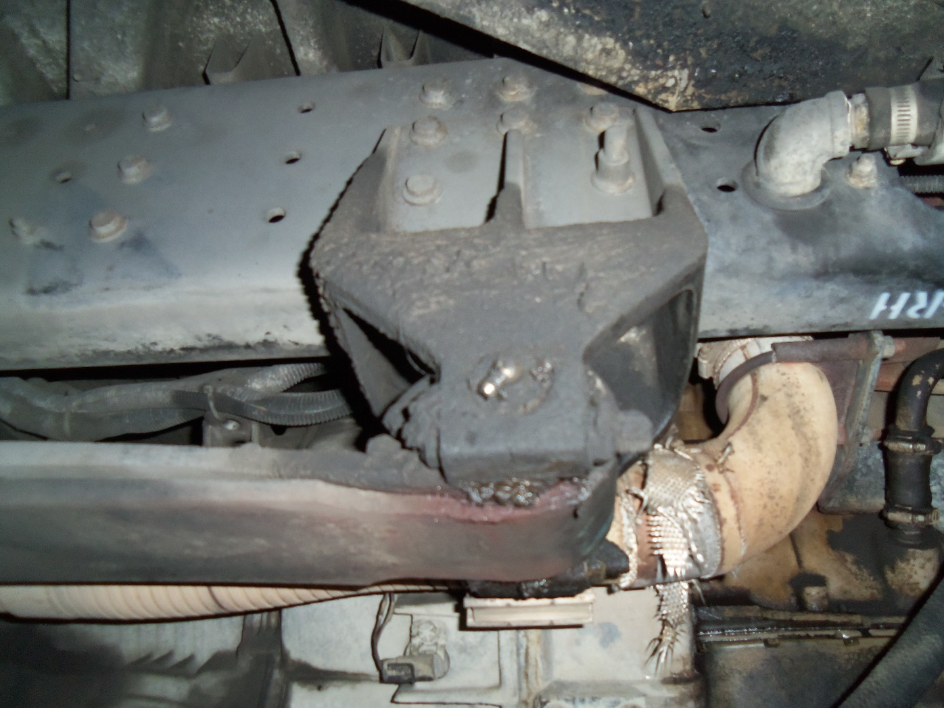
Spring Hanger

Slide 39
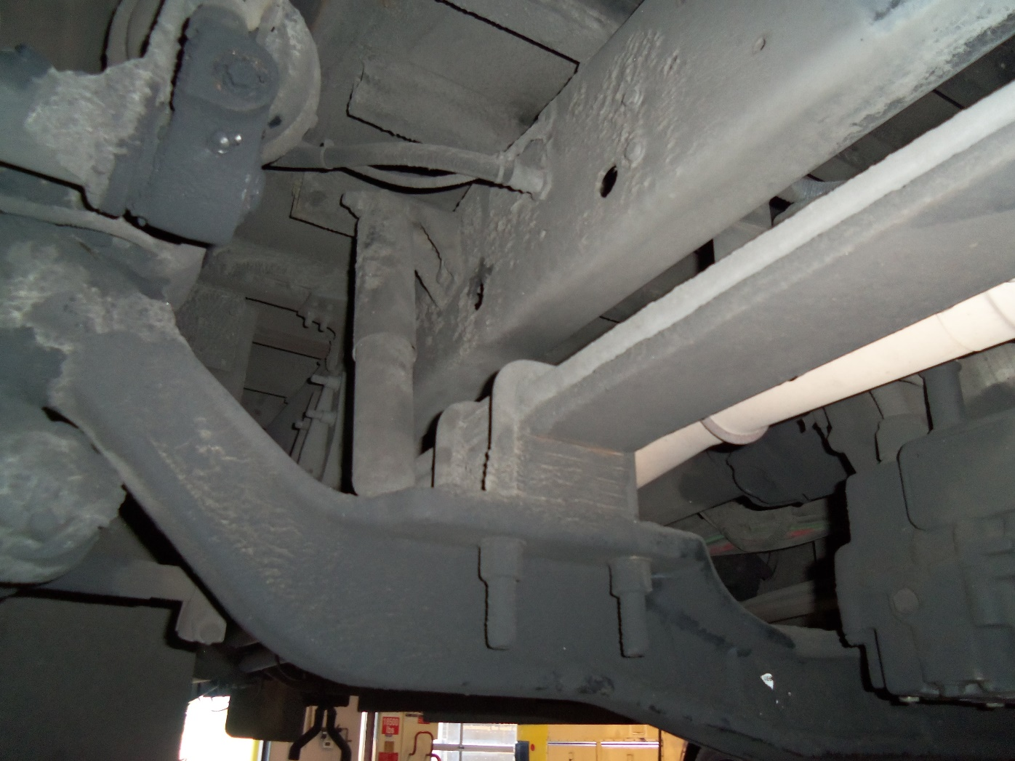
U-Bolt

Slide 40
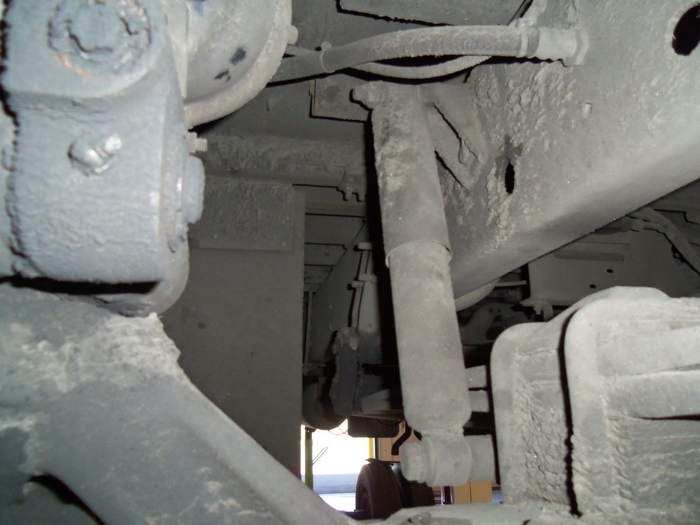
Shock Absorber

Slide 41
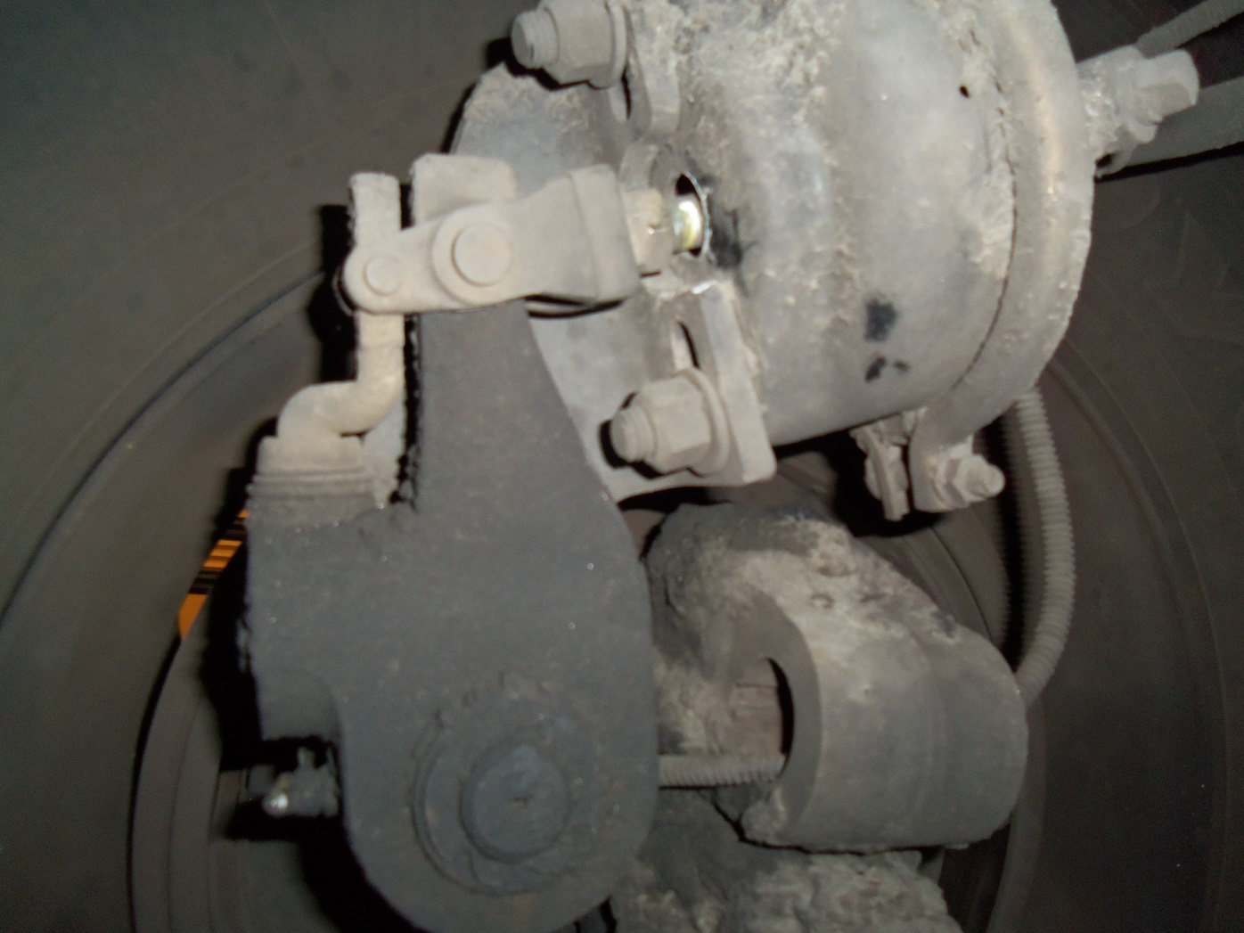
Slack Adjuster

Slide 42
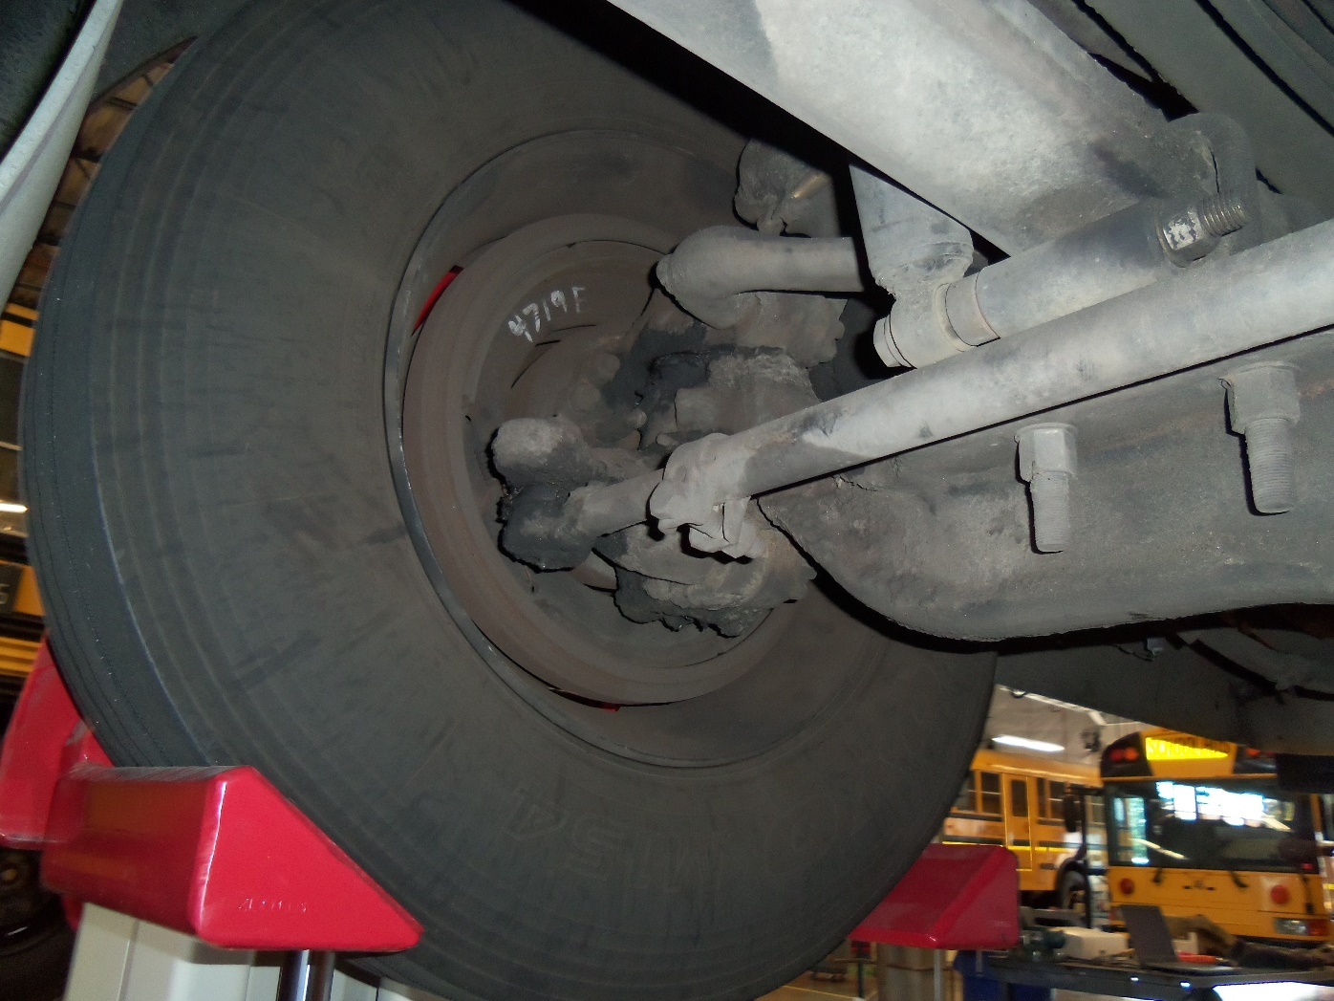
Inside Brake Drum

Slide 43
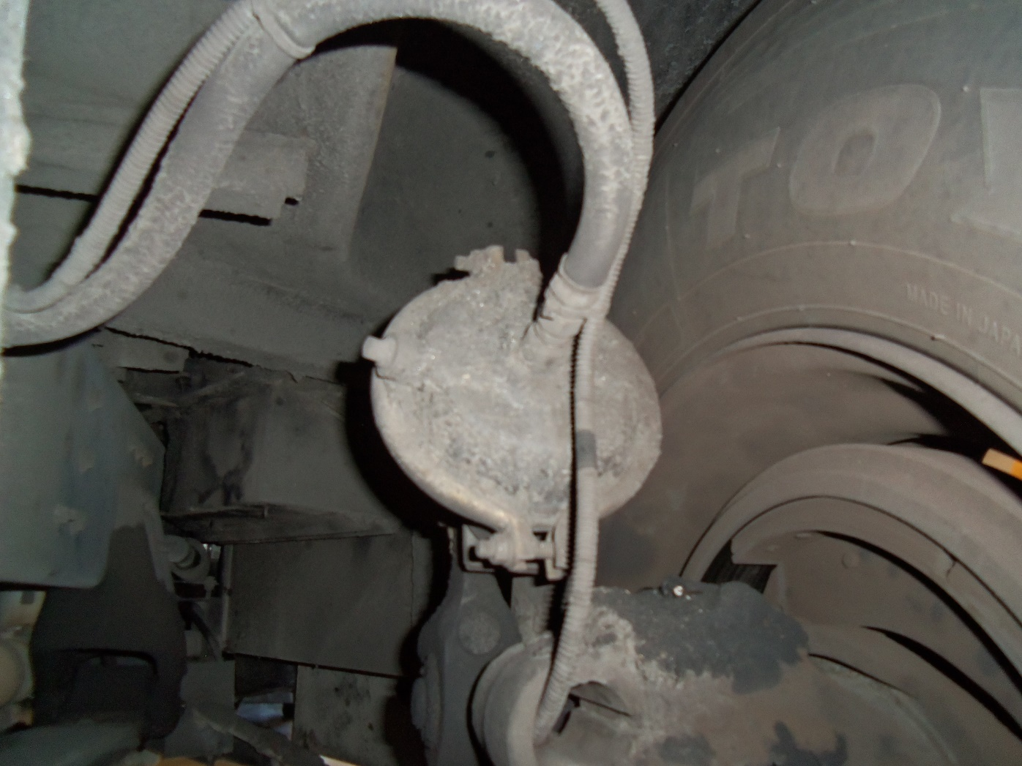
Brake Hoses

Slide 44
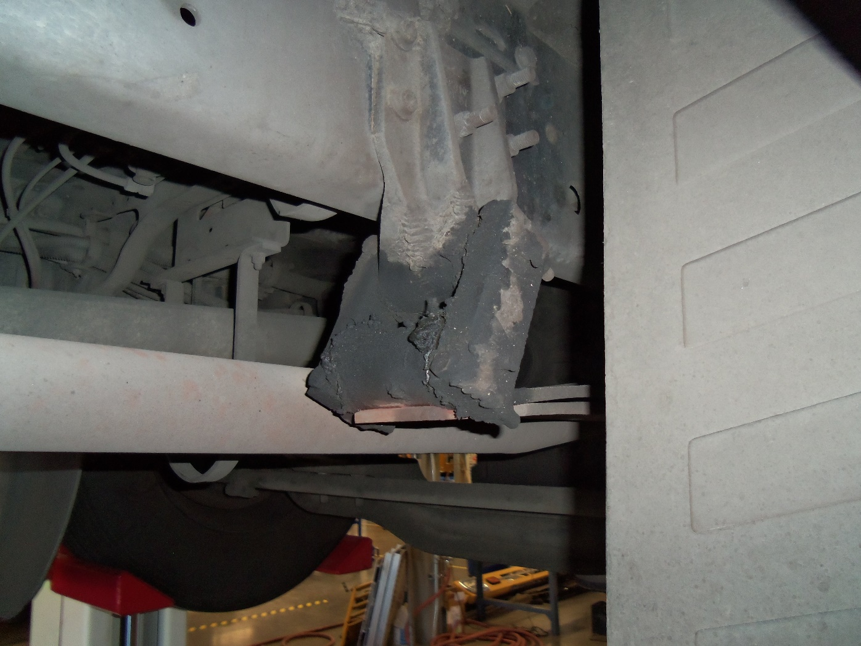
Spring Hanger

Slide 45
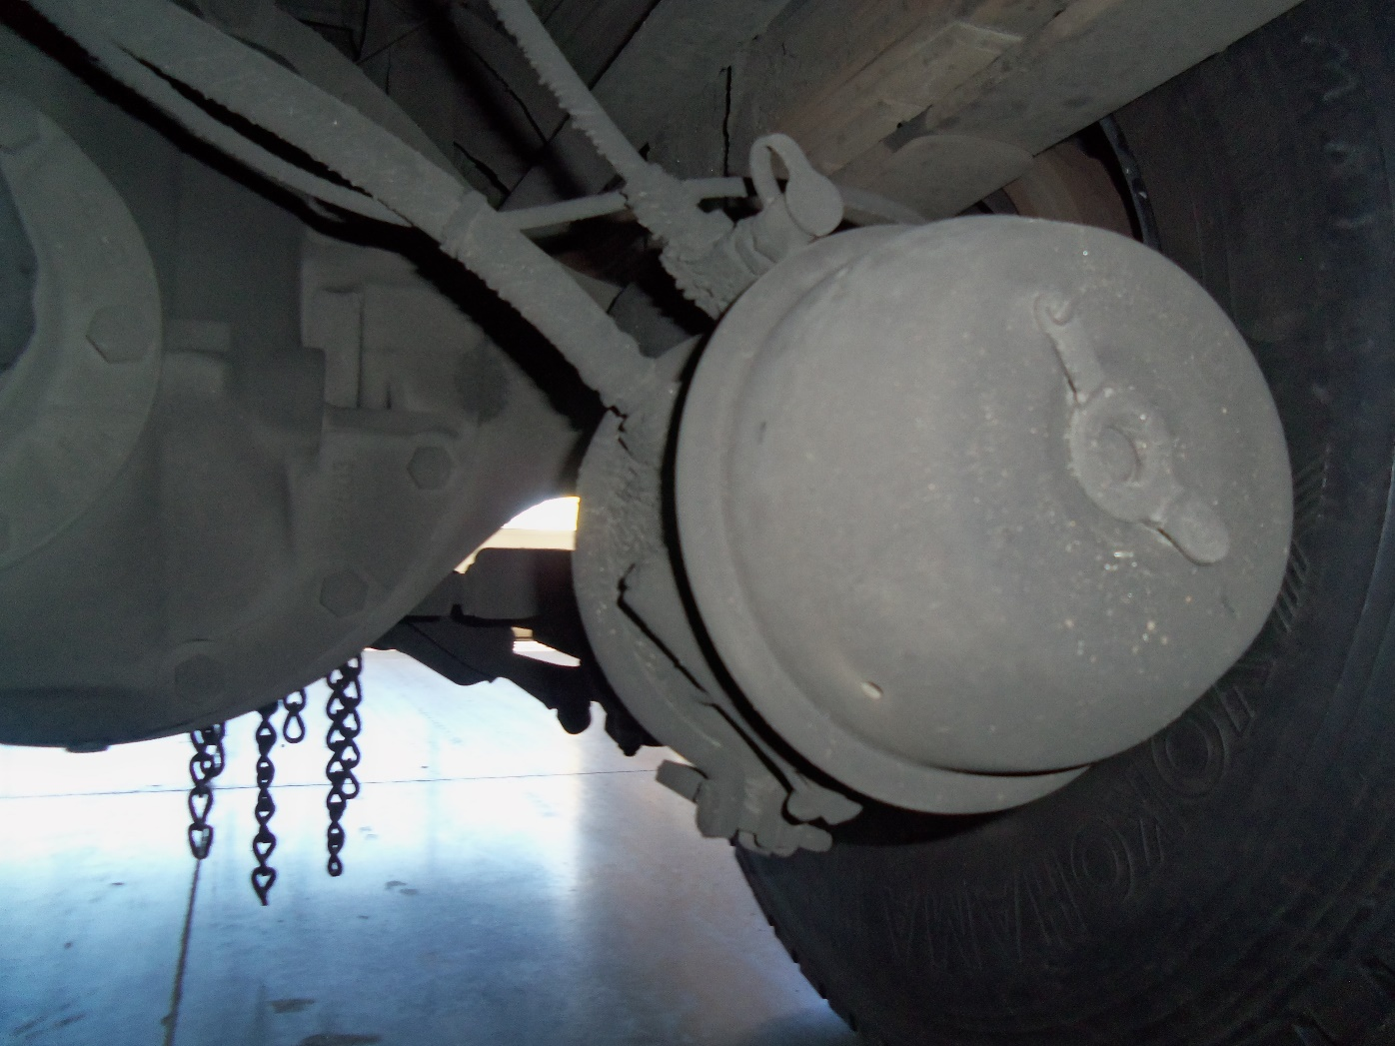
Brake Air Can

Slide 46
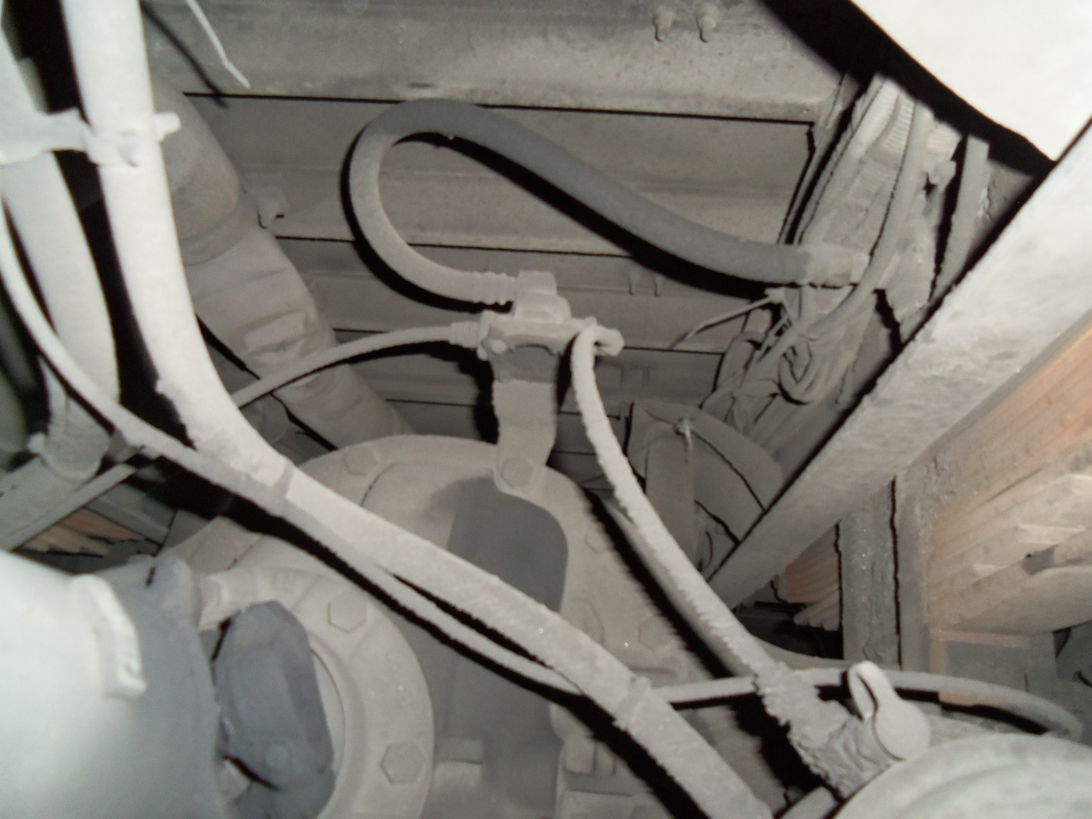
Brake Hoses

Slide 47
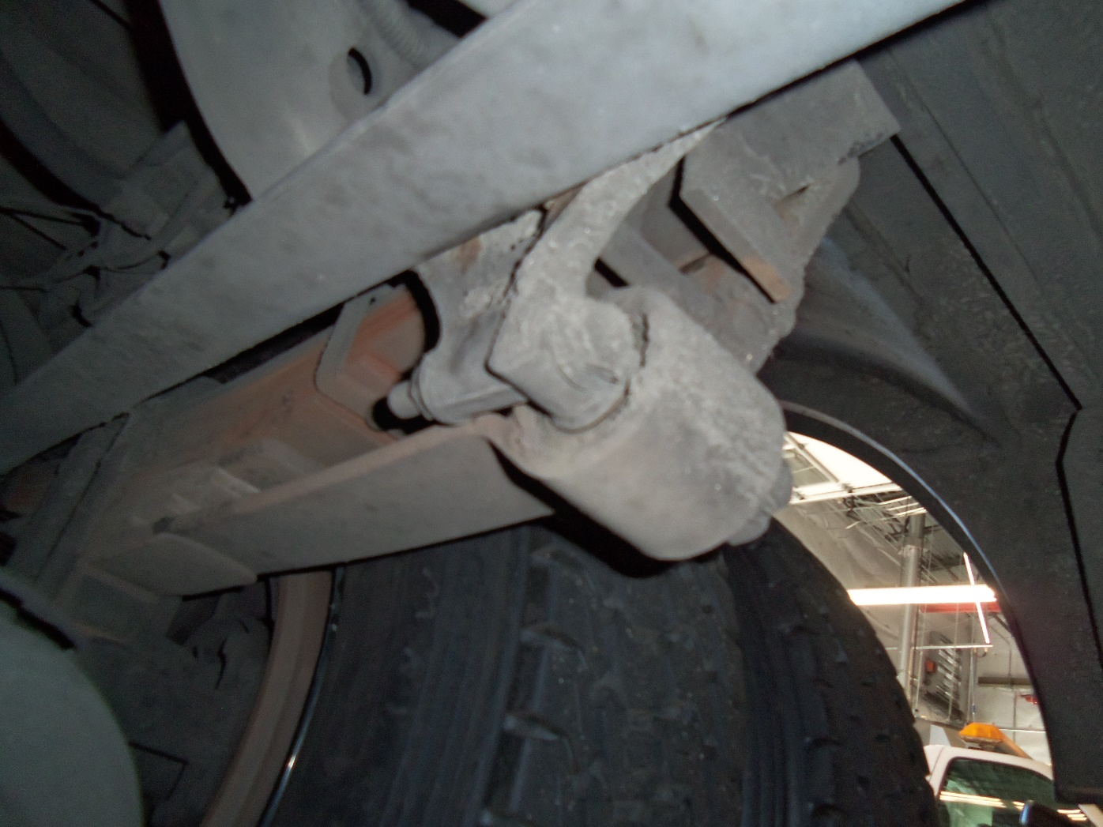
Springs

Slide 48
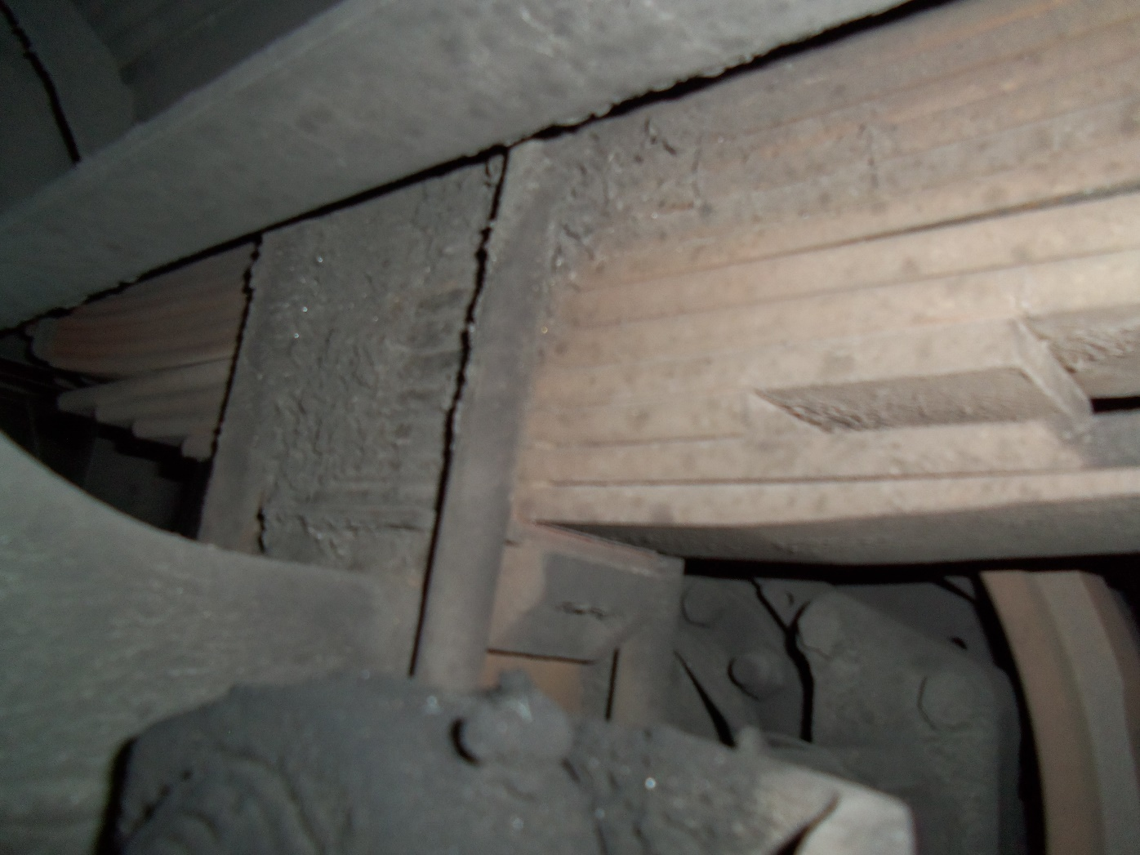
Leaf Springs with U-bolt

Slide 49
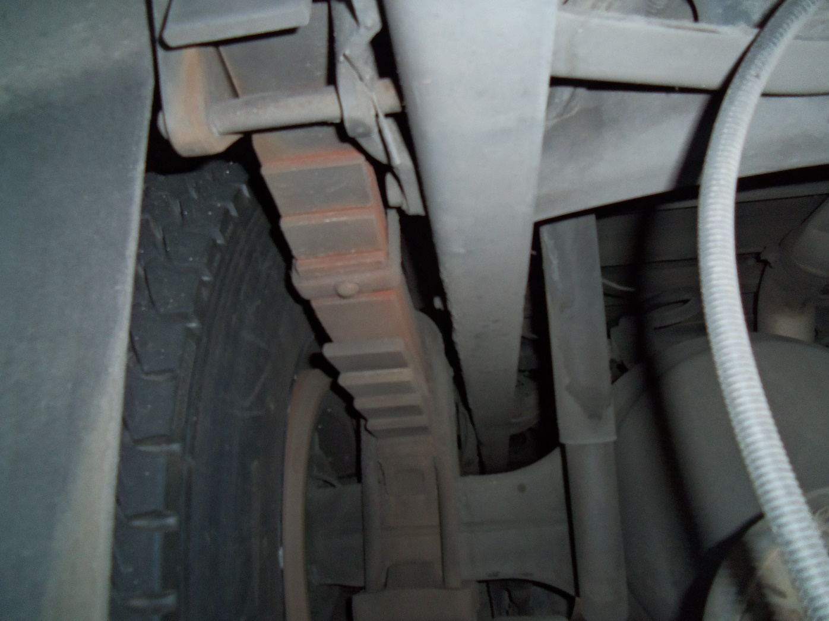
More Springs

Slide 50
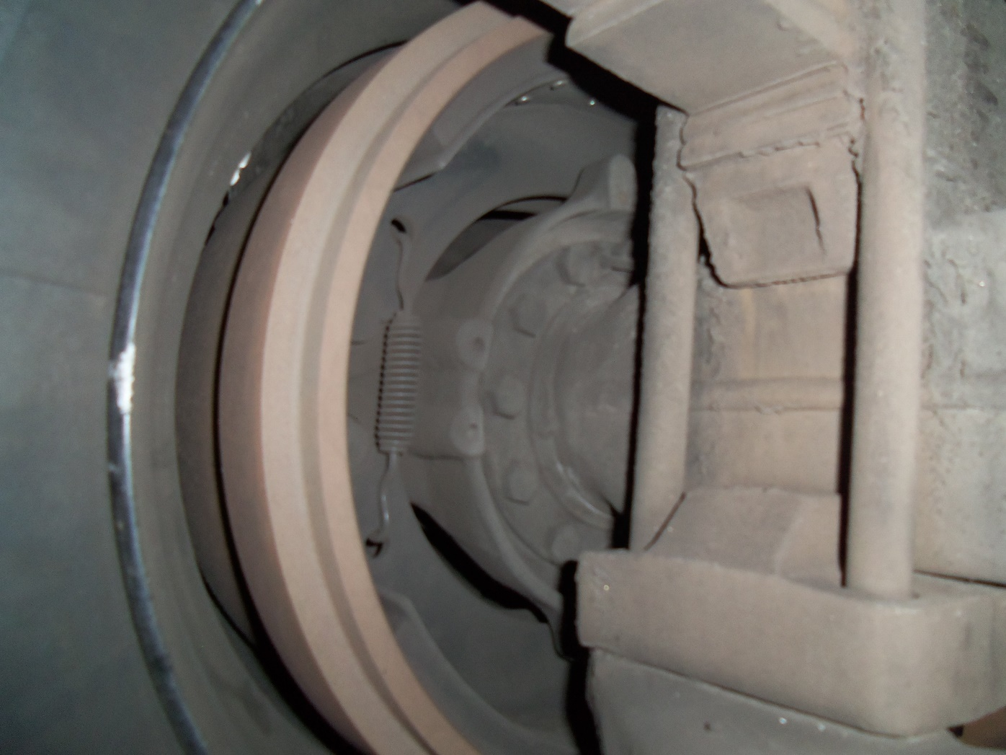
Brake Drum Lining

Slide 51
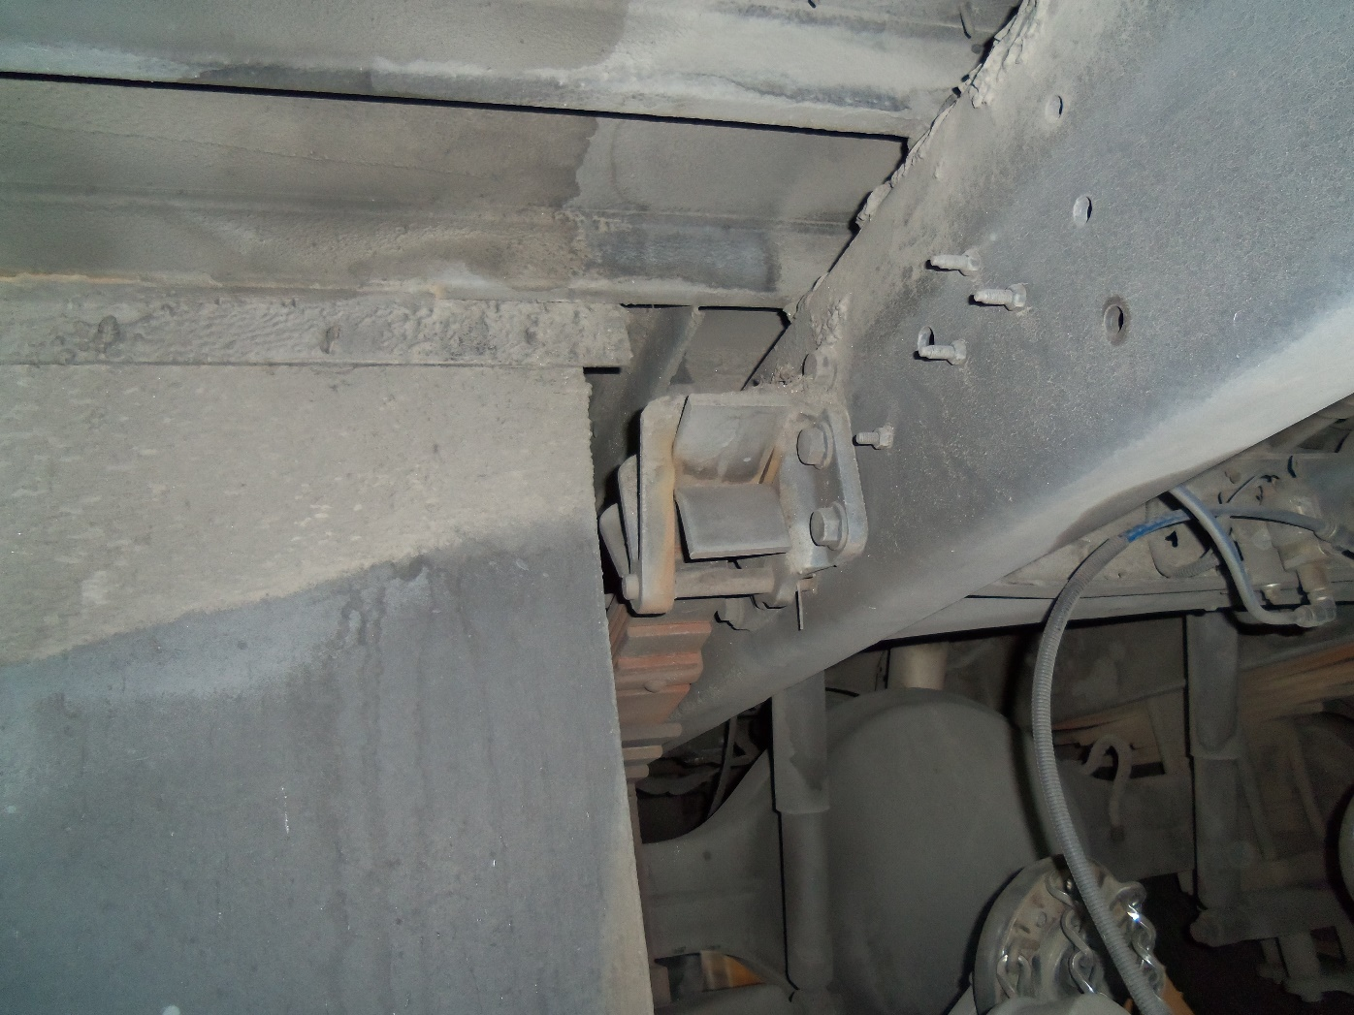
Spring Hanger (attached to frame)

Slide 52
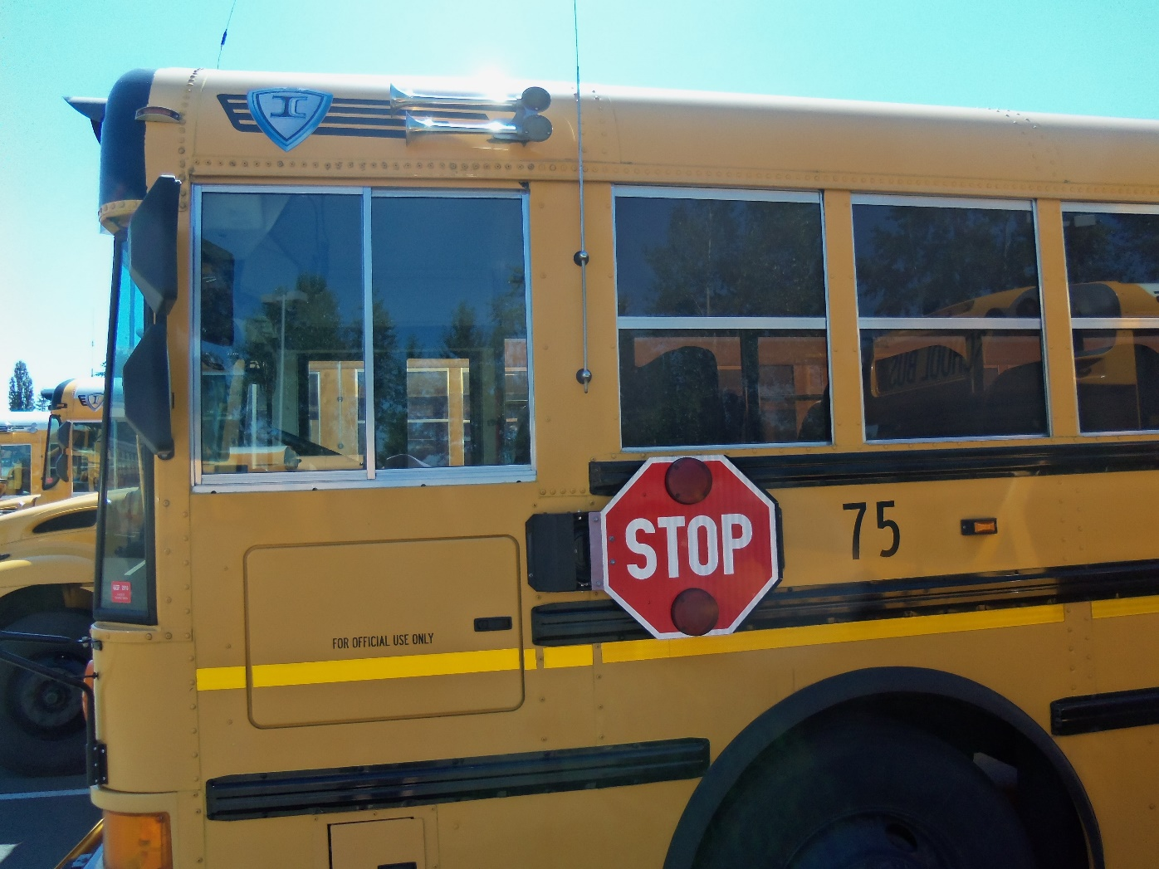
Front Side of Bus

Slide 53
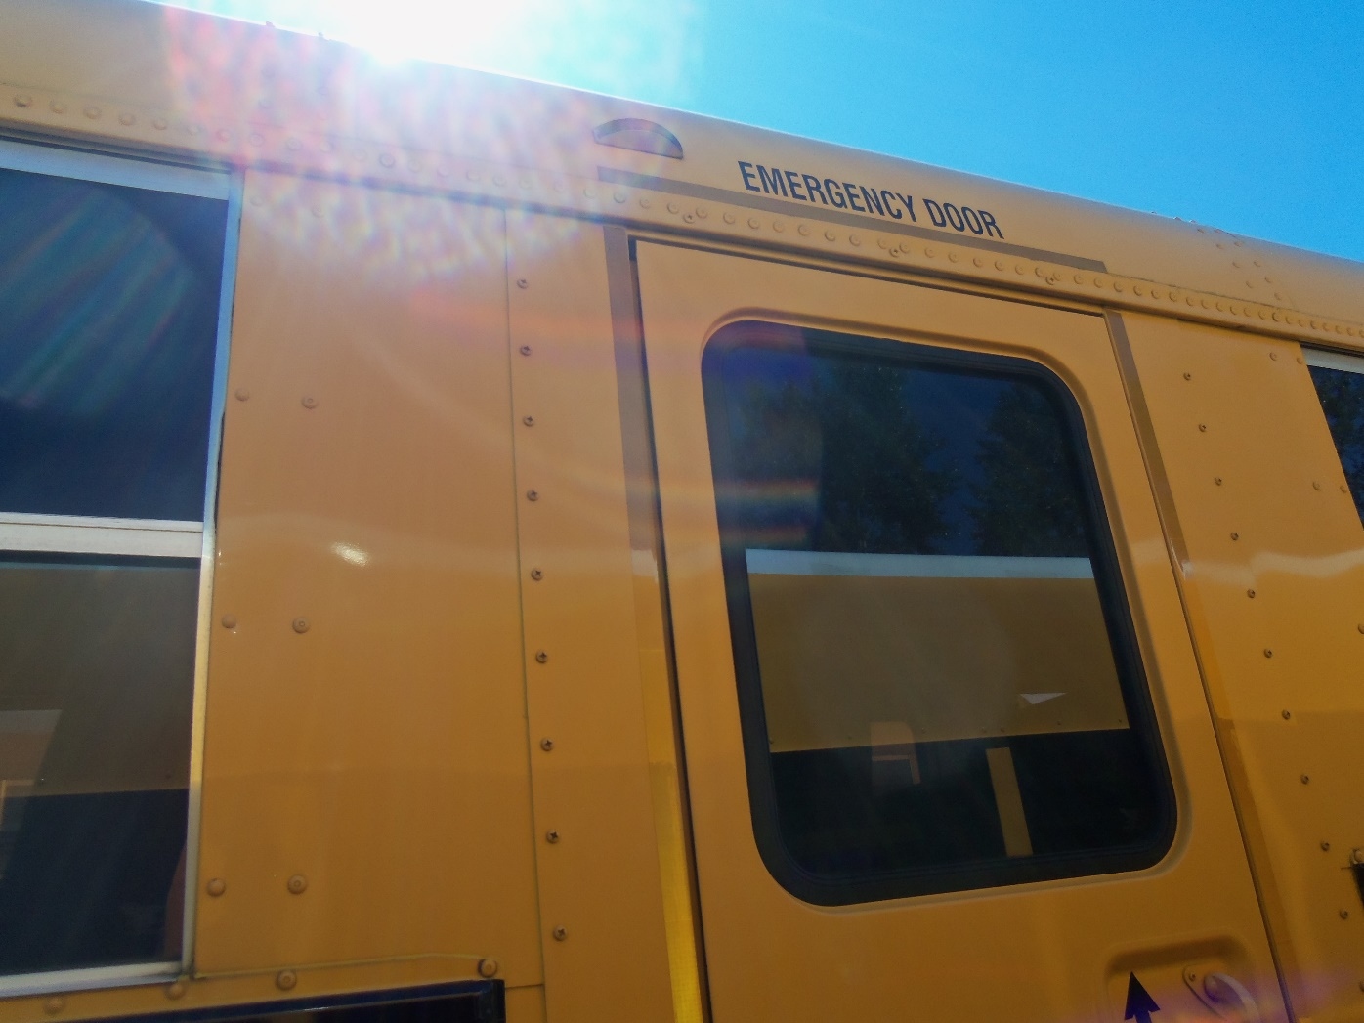
Side Marker – Clearance Light

Slide 54

Under Storage – Side Compartment

Slide 55

Emergency Side Exit Door (outside view)

Slide 56

Emergency Door – Lock Open

Slide 57

Rear Tires

Slide 58

Rear Hub is Sealed

Slide 59

Rear Tire Tread

Slide 60

Air Ride Stabilizer Part

Slide 61

Air Bag

Slide 62

Rear Compartment Door –
Reflective Tape

Slide 63

Frame Exhaust

Slide 64

Drive Shaft

Slide 65

Exhaust

Slide 66

Exhaust

Slide 67

Frame

Slide 68

Coolant Cap & Fill Bubbles

Slide 69

Engine Hoses (side view)

Slide 70

Belt Alternator

Slide 71

Water Pump and Belt

Slide 72

Alternator

Slide 73

Power Steering Fluid and Hose

Slide 74

Air Compressor (underside)

Slide 75

Engine Oil – Dip Stick

Slide 76

Ground Leaks

Slide 77

Seat Belt (top)

Slide 78

Seat Belt Assembly

Slide 79

Seat Belt Assembly - Buckled

Slide 80

Seat belt Assembly – Secured to Floor

Slide 81

Seatbelt Assembly – Secured to Wall

Slide 82

Seat Belt on wall

Slide 83

Student Mirror

Slide 84

Student Mirror Bracket

Slide 85

Overhead Storage for Fuses

Slide 86

Seats Secured to Floor

Slide 87

Slack Adjustor/Push Rod (top view)

Slide 88

Frame Cross Member

Slide 89

Cross Member & Drive Shaft Coupling

Slide 90

Fuel Door

Slide 91

Fuel Cap

Slide 92

Air Compressor & Power Steering Unit

Slide 93

Fuel Tank and Frame

Slide 94

Bushings from Inside Spring Hanger

