Slide 1
CDL Permit Class
Prepared By
Rhonda Wilcoxson
Traci Tobler
Notes:
Trainer note: Class takes about 3 hours
Today’s class is to help you to study for your CDL permit. After today’s class it is expected that you will need to study more. Today’s class is intended to let you know what you need to study, and how to study for your written test at the DOL. It is also to prepare you for what to expect when you go to the DOL. Our goal is to prepare you to pass your permit test the first time. So let’s get started.
Please have your books out and turn to the pages as we go through the presentation. Some things we will just glance at, others we may read from the book or there may be something in the book I want you to take note of. It would be a good idea to write in your book or highlight the things I am talking to you about today.

Slide 2
DOL Required Tests/Fees
School Bus Driver
CDL Permit
Tests
General Knowledge – Sections 1-3
Passenger Endorsement – Section 4
Air Brake Restriction Removed – Section 5
School Bus Endorsement – Section 10
Out of Pocket Cost
$35 – Each Time/Each Test $35 All Four Tests Same Time
$40 - Permit
Notes:
There are 4 tests you will be taking at the DOL: The general Knowledge, Passenger Endorsement, Air Brake restriction removed and School bus Endorsement. You must pass all 4 tests to get your permit. Think about the first time you got your drivers license. You took a written test at DOL then practice, practice, practice, driving and then you did a drive test. The same thing goes for getting your CDL.
Taking the written test costs $35 and if you fail any of the 4 tests it is $35 to retake the written test. After passing all 4 tests you then can purchase the permit and add it to your existing drivers license and that is a $40 fee.

Slide 3
Getting a Permit
Valid Washington State driver license
Valid Social Security number
Provide Proof of Permanent Residency
Birth Certificate/Marriage Certificates/Divorce Decrees (Prove all name changes)
Names of all states where you had held a driver license
Pass written tests (4)
Pay $40 – Permit
Notes:
You must go to the DOL prepared to apply for your permit. You can find the application requirements on page 1-3 through 1-4.
The things I want you to take note of are :
SS card
All name changes from birth including birth certificate (marriage certificate, divorce certificate)
Proof of residency (birth certificate/passport/ resident card/naturalization/certificate of citizenship/consular report of birth abroad)
Please note birth certificate must be certified. The original from the hospital is not accepted.

Slide 4
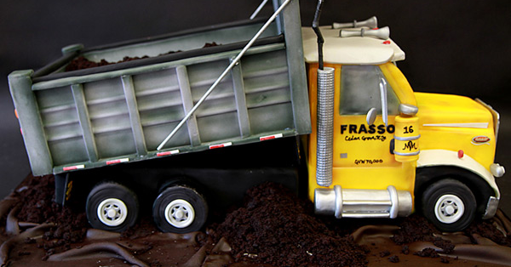

General Knowledge Test
Sections 1 – 3
50 Questions
40 right
Think dump truck and trailer
Notes:
General knowledge covers the following information
Section 1 – Introduction
Section 2 – Driving Safely
Section 3 – Transporting Cargo Safely

Slide 5
Section 1 - Introduction
Section 1.1 – Commercial Driver
License Tests
Section 1.2 – Medical Documentation
Requirements
Section 1.3 – CDL Disqualifications
Section 1.4 – Other CDL Rules
Section 1.5 – International
Section 1.6 – Washington State Laws
and Rules
Notes:
4 Written tests
Medical examiner medical certificate – DOT Medical Card
Disqualifications
Your general knowledge test may have questions in these areas.

Slide 6

Section 2 – Driving Safely
Study all 24 subsections
Largest Section
Answer “Test Your Knowledge” questions
Notes:
Handout with “Test Your Knowledge” questions
This permit test will become your study guide. As you find the answers I want you to write in your answer.
We will be spending more time with this document in a little bit.
Read all sections even though it may seem that they do not apply to a school bus driver.
We are going to cover some common items that could show up on your test. It is ok to take notes on the back side of your study guide.

Slide 7
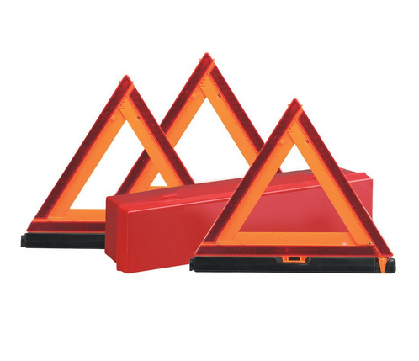
Reflective Triangle
Placement
100’
10’
100’
10’ 100’
100’ 10’
200’ 100’
200’
10’
100’
One-way or Divided Highway
Two-way or Undivided Highway
Notes:
Two way/Undivided Highway
One way or Divided Highway

Slide 8
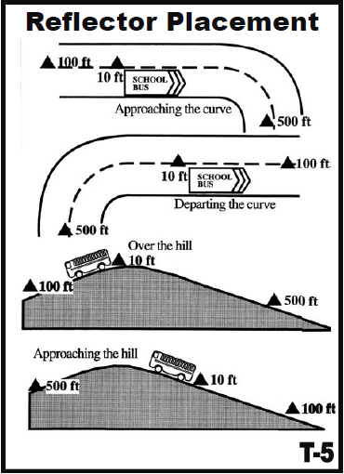
Hills & Curves
Reflective Triangle Placement
Notes:
Curves/Hills
If line of sight obstructed within 500 ‘, move last triangle back down road so warning is provided (500’)
10’ behind
100’ behind
500’ in front/behind

Slide 9
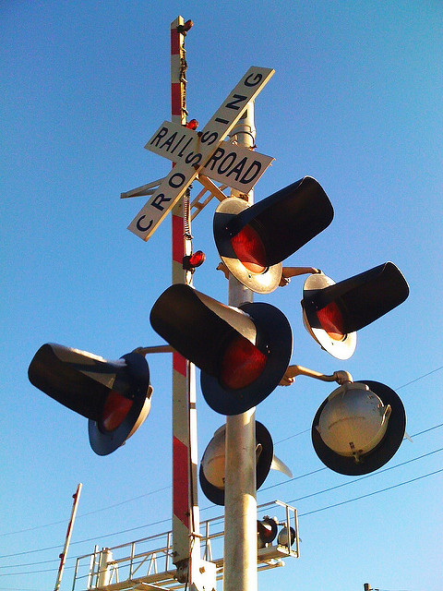
Railroad Highway Grade Crossings
Passive Crossing
Active Crossing
Number of Tracks
Notes:
Passive Crossing – no traffic control devices
Active Crossing – Traffic control devices: Lights, bells, and/or crossing gates
How many tracks?

Slide 10
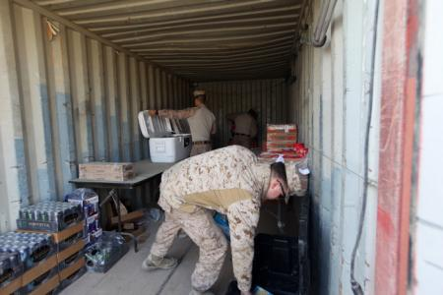
Section 3 – Transporting Cargo Safely
Inspecting Cargo
Cargo Weight & Balance
Securing Cargo
Cargo Needing Special Attention
Notes:
Section 3 covers cargo. You might be tempted to skip this section but it is in the general knowledge section and you will miss some questions if you skip it. All class B operators must know how to inspect their cargo, secure cargo, balance cargo, etc..

Slide 11
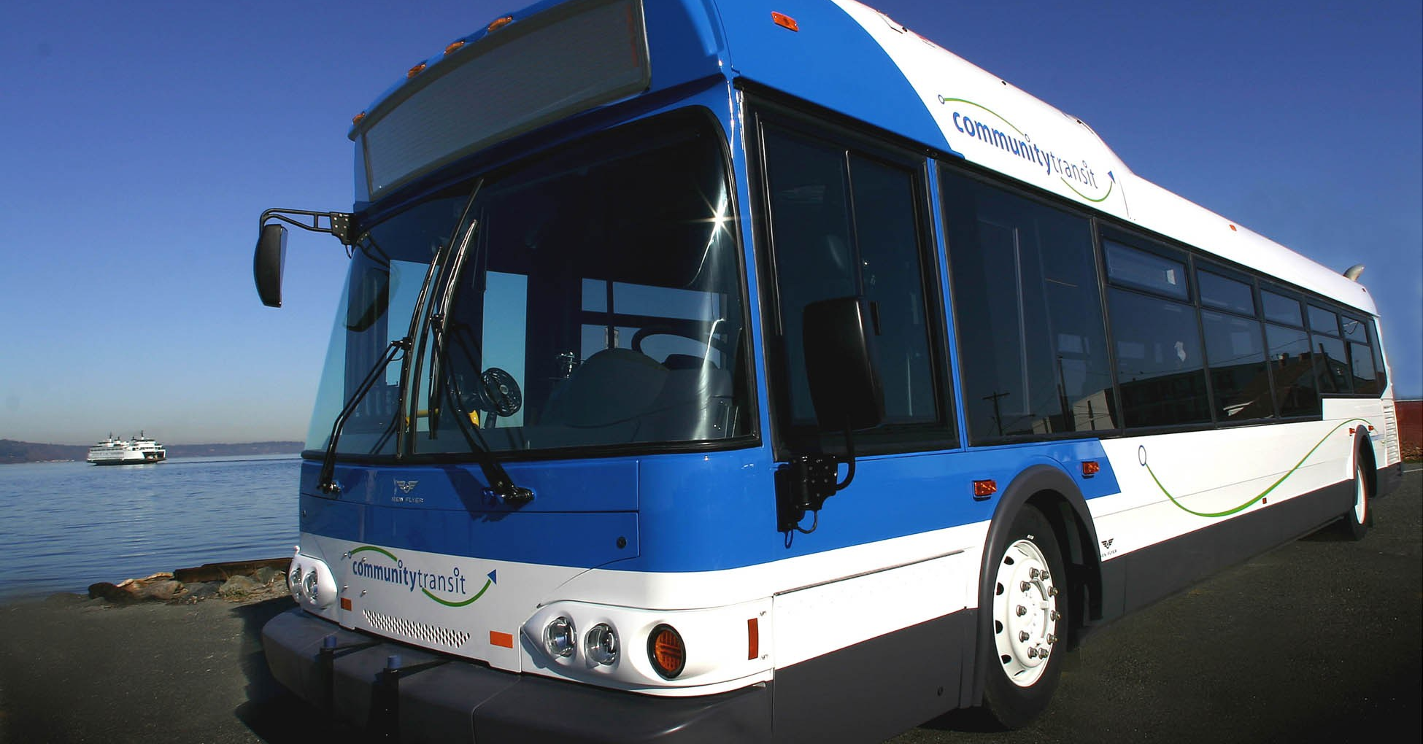
Passenger Test
Section 4
20 Questions
Must Answer 16 Right
Think City Bus
Notes:
Different rules for city bus vs school bus

Slide 12
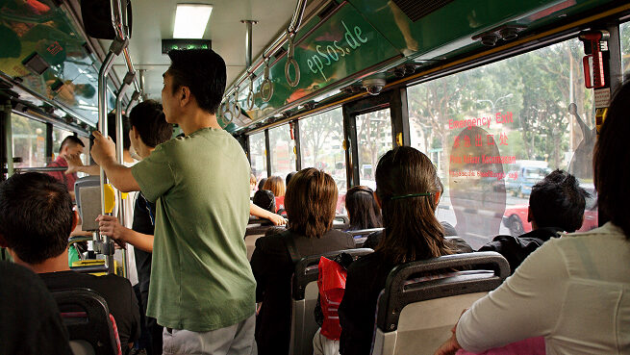
Transporting Passengers Safely
Section 4
Vehicle Inspection
Loading
On the Road
After-trip Inspection
Prohibited Practices
Use of Brake-Door Interlocks
Notes:
Passenger endorsement is required in addition to the school bus endorsement.
These are the subjects covered in this section

Slide 13
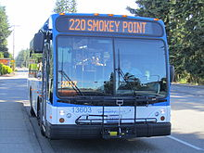
City Bus
Hazardous Material
  Firearm
  Ammunition – ORM-D
Standee Line
Passenger Supervision
Railroad –Highway Grade Crossings
Drawbridges
Notes:
Firearms are allowed on city buses as long as they have a concealed weapons permit
Small arms ammunition labeled ORM-D – no more than 100 lbs
Riders can stand as long as they stay behind the “standee line”
City buses also have rules, monitor passengers, may have to remind of the rules
Must stop at RR crossings, open front door and look and listen
Stop at drawbridges with no attendant or signal light
Do not have to stop if signal light is green or there is an attendant who controls traffic when bridge is open.

Slide 14

City Bus
Fueling Procedures
Disabled Bus
Interlock Brake/Door System
Fuel With Passengers On Board
Notes:
Do not fuel with people on board (this includes the driver)
Do not push a disabled bus with passengers on board
The interlock system applies the brake and holds the engine at idle when the rear door is opened. DO NOT use this in place of the parking brake.

Slide 15
Air Brake Restriction Removed Test
Section 5
25 Questions
Must Answer 20 Right
Most Failed Test
Notes:
Air Brake test is the most failed test.
Study it carefully

Slide 16
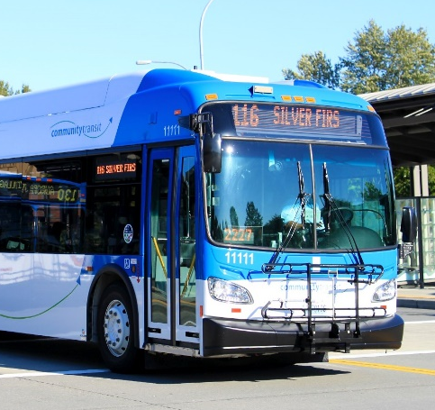
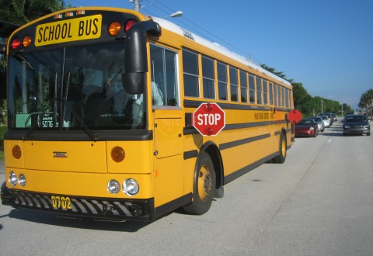
Air Brakes – Section 5
Air Brake System Parts
Dual Air Brake Systems
Inspecting Air Brakes
Using Air Brakes
Notes:
Please turn to section 5 now. This is the most commonly missed test. We will spend the most time covering this section today.

Slide 17
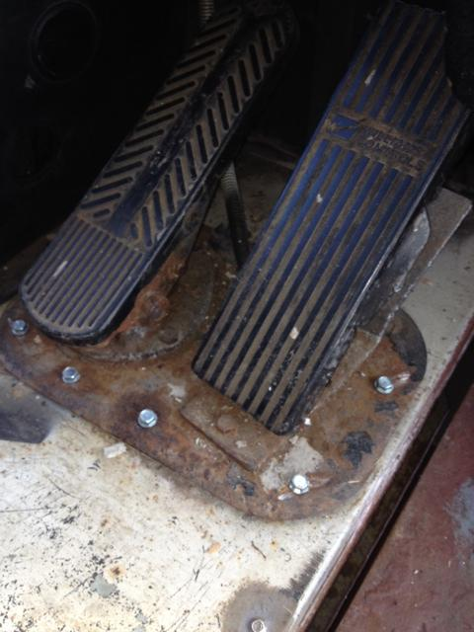
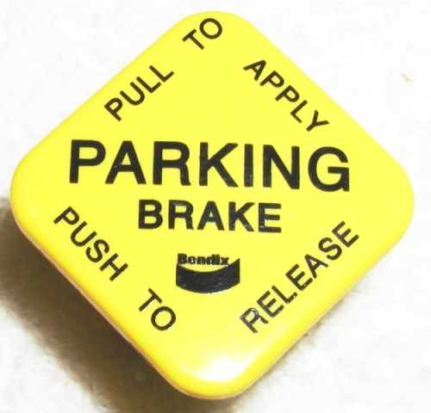
Braking Systems
Three Different Braking Systems
    Service Brake System
    Parking Brake System
    Emergency Brake System
Notes:
Service brake system applies and releases the brakes when the service brake is applied.
Parking Brake System applies and releases the parking brakes when the parking brake knob is applied
Emergency Brake System uses parts of the service brake and parking brake system when there is a failure of the brake system

Slide 18
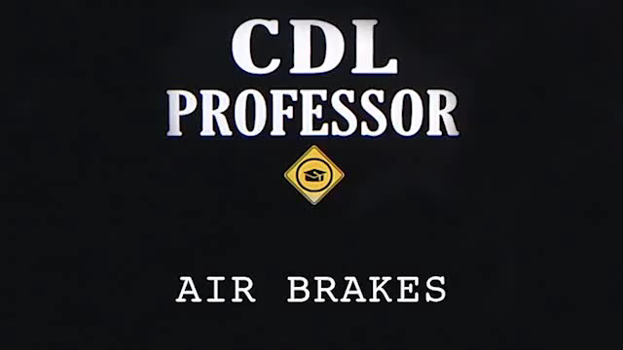
Notes:
Show VIDEO
CDL Professor: http://www.youtube.com/watch?v=UuajFbUNydo&list=PLUDm9wi1KwdSbbg_lDy0RgonSqzOxn7aJ&index=1
Understanding Air Brakes Jefferson County Schools: https://www.youtube.com/watch?v=likqvlyOhDQ

Slide 19
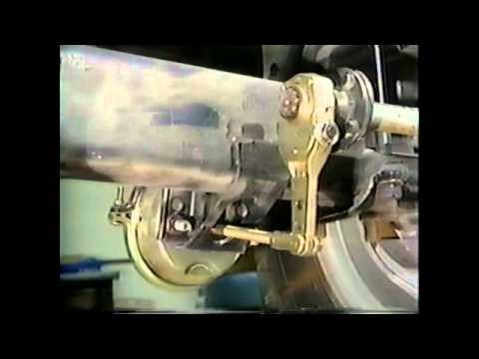
S-Cam
Air Brakes
By Crash Forensics
Notes:
Show Video
S-Cam Air Brakes Crash Forensics: https://www.youtube.com/watch?v=3mrUMTP4thI

Slide 20
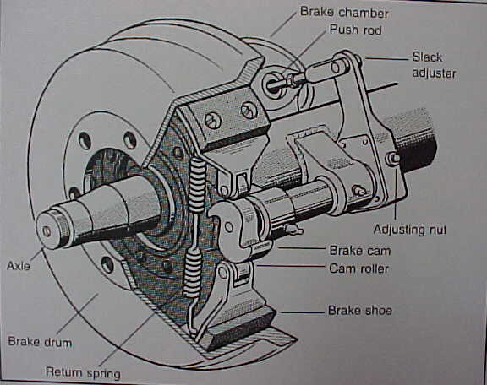
Brake Parts
Notes:
Go over each brake part
Show the brake parts we have

Slide 21
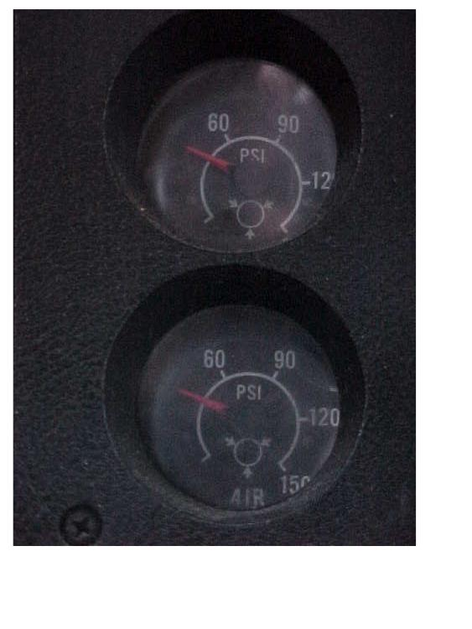
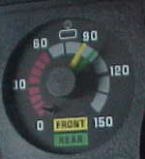
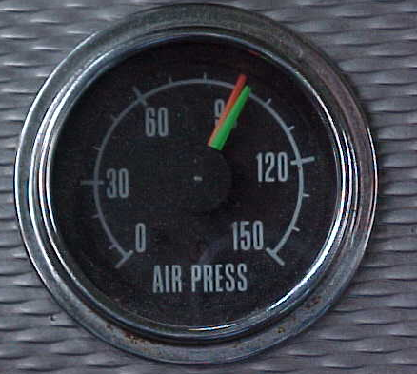
Air Gauges
Notes:
Different buses have different gauges.
On the left there is one gauge with 2 needles, 1 for the front air tank and 1 for the rear air tank.
The center, again, has 2 needles, but looks different.
On the right there are separate gauges for the front and the rear.

Slide 22
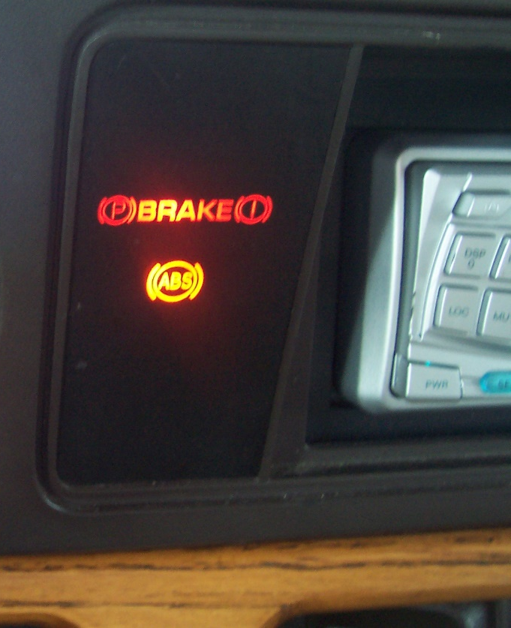
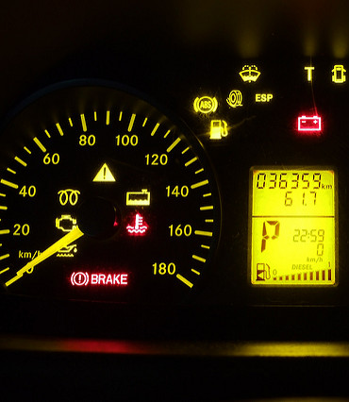
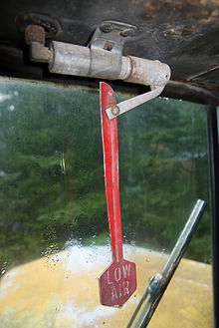
Low Air Warning Lights/Equipment/ABS Light
Low Air Warning Wigwag
Notes:
The low air warning lights will look different depending on what bus you are driving.
On the left, the lights are at the far left side of the dashboard.
The center light is at the bottom of the speedometer.
On the right is a very old wigwag mounted on the bulkhead in the center of the windshield. It will fall down and swing back and forth when the air pressure falls too low.

Slide 23
Air Supply System Check
Four Tests
  Air Leakage Rate
  Low Air Warning Light/Buzzer
  Parking Brake
  Air Governor Cut in/Cutout
Notes:
There are 4 different tests that make up the Air Supply System Check.
Air leakage rate
Low air warning light/buzzer
Parking brake
Air governor cutout

Slide 24
Static Air Leak Test
Engine Off – Key On
Service Brake On
Parking Brake Off
Let gauges settle, hold for 1 min
Cannot lose more than 3 psi in 1 min
Notes:
To perform the air leak test you need to build your air to maximum and listen for the air governor to cutout.
With the engine off and the key in the “on” position
Make sure your foot is on the service brake before releasing the parking brake, otherwise the bus might roll.
Release the parking brake.
Let gauges settle, hold brake for 1 min. (time with a watch or cell phone)
Cannot lose more than 3 psi in 1 minute.

Slide 25
Low Air Warning Light/Buzzer Test
Pump service brake to fan air down
Low Air Warning Light/Buzzer should activate at
60 psi or above
Notes:
For the low air warning light/buzzer test you need to press and release the service brake to fan the air down. The low air warning light and buzzer should activate at 60 psi or above.

Slide 26
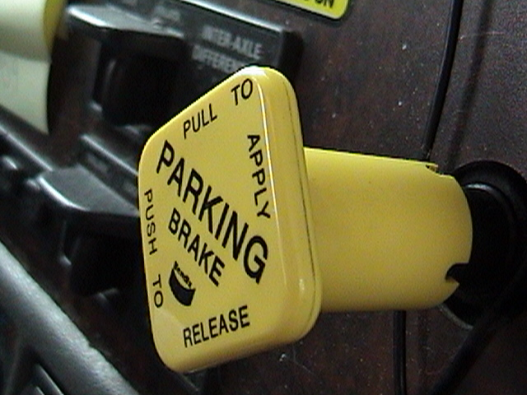
Spring/Parking/Emergency Brake Test
Continue to fan air brakes down
Spring/Parking/Emergency Brake should activate at approximately 40 psi or manufacturer’s specification (20-45 psi okay)
Notes:
Parking brake vs Emergency brake
Continue to fan down air with the service brake and the emergency brake should pop at approximately 40 psi (okay to say 20-45 psi) or manufacturer’s specification.

Slide 27
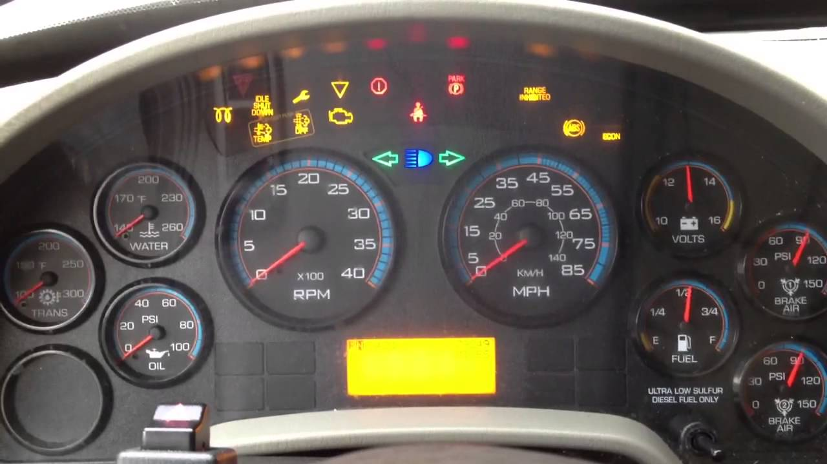
Rate of Air Pressure Buildup
With Engine at operating RPMs (1200-1500) pressure should build from 85 to 100 psi in 45 seconds in dual air systems
Notes:
You will need to time the rate of the air pressure buildup. Bring the RPM’s up to 1200-1500 and pressure should build from 85 psi to 100 psi in 45 seconds in dual air systems.

Slide 28
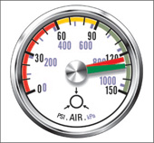
Air Governor Cut In/Cutout
Air governor should:
Cut in (start) at 100 psi
Cutout (stop) at 120-140 psi
Notes:
Air governor should cut in when air pressure drops below 100 psi
When filling air tanks, air compressor governor should shut off at manufacturers specifications, usually between 120-140 psi, about 125

Slide 29
Review
100-125 PSI – Air Governor Cut Out
100 PSI – Compressor Cut In
120-140 PSI – Air Supply Gauge Governor Cut Out
150 PSI – Safety Valve
100 PSI – Adequate Air
3 PSI – 1 Min Air Leak
60 PSI or Above – Low Air Warn
20-45 PSI – Air Brake Setup
85-100 PSI in 45 sec – Air Build Up
Notes:
Please take notes and write down these numbers on the back of your study guide. You will need to know these numbers for your air brake test.
100 psi – Adequate air supply
Not more than 3 psi – 1 min air leak test
60 psi or above – low air warning light and buzzer
20-45 psi – air brake setup
85-100 psi in 45 sec. – air build up
100-125 psi – air governor cut out
100 psi – Compressor cut in
120-140 psi – air supply gauge governor cut out
150 psi – Safety valve

Slide 30
School Bus Test
Section 10
20 Questions
Must have 16 right
Think School Bus
Notes:
You will have 20 questions to answer, you must get 16 right to pass. When taking this test, think “School Bus”.

Slide 31
School Buses – Section 10
Danger Zones and Use of Mirrors
Loading and Unloading
Emergency Exit and Evacuation
Railroad Highway Grade Crossings
Student Management
Antilock Braking Systems
Special Safety Considerations
Notes:
Section 10 in the CDL Guide is for School Buses. It covers the following material:
Danger zones and use of mirrors
Loading and unloading
Emergency exit and evacuation
Railroad highway grade crossings
Student management
Antilock braking system
Special safety considerations

Slide 32
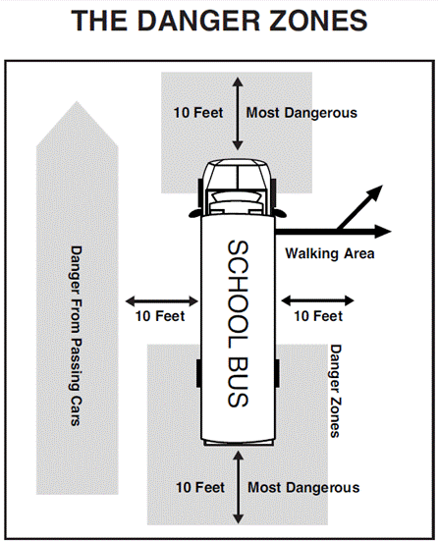
Danger Zones
Notes:
There are danger zones on each side of the bus that every school bus driver must be aware of. They are:
10’ in front of the bus
10’ on the left side of the bus
10’ behind the bus
10’ on the right side of the bus

Slide 33
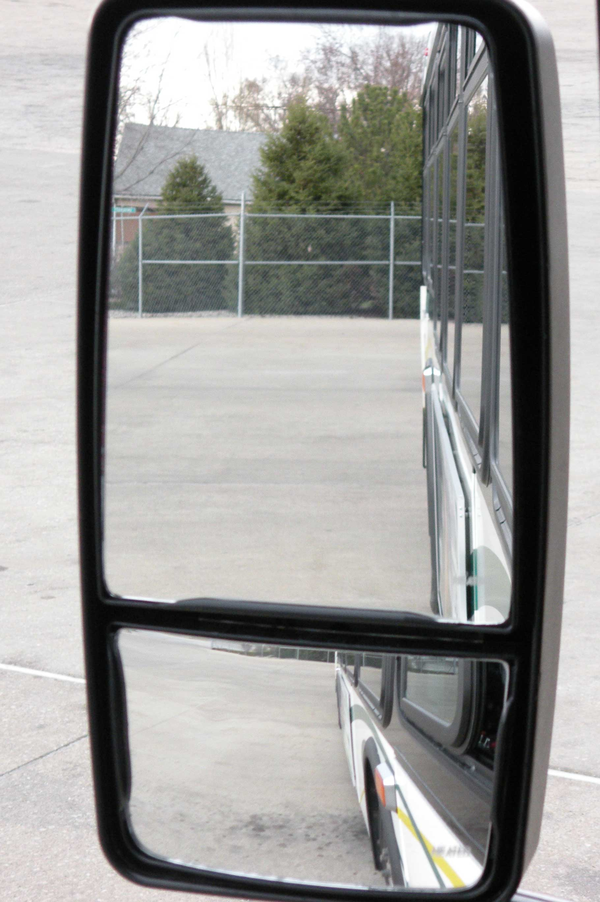
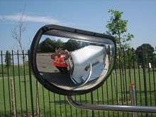
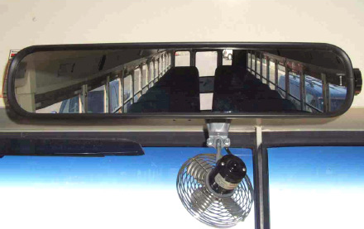
Mirror Adjustments
Flat Mirrors – Left & Right
Convex Mirrors – Left & Right
Crossover Mirrors – Left & Right
Student Mirror - Inside
Notes:
Left & Right side mirrors –
top mirror is the flat mirror –
bottom mirror is the convex mirror – it’s curved, things look smaller
Left & Right crossover mirrors – also curved, things look distorted.

Slide 34
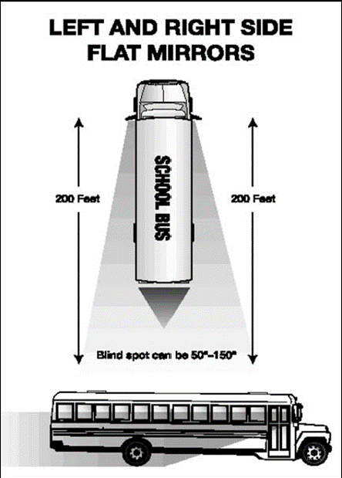
Left & Right Flat Mirror
200’ behind the bus (4 bus lengths)
Along the sides of the bus
The rear tires touching the ground
Notes:
With the left and right flat mirrors the driver should be able to see 200’ behind the bus – (approximately 4 bus lengths)
Along the side of the bus
The rear tires or duals touching the ground

Slide 35
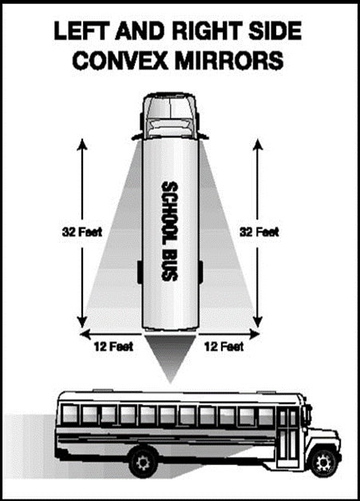
Left & Right Convex Mirror
Entire side of bus up to the mirror mounts
Front of the rear tires touching the ground
At least one traffic lane on either side of the bus (12’ out to the side at 32’ back)
Notes:
Using the left and right convex mirrors the driver should see:
The entire side of the bus up to the mirror mounts
The front of the rear tires (duals) touching the ground
At least 1 traffic lane on either side of the bus (2’ out to the side at a distance of 32’ back.

Slide 36
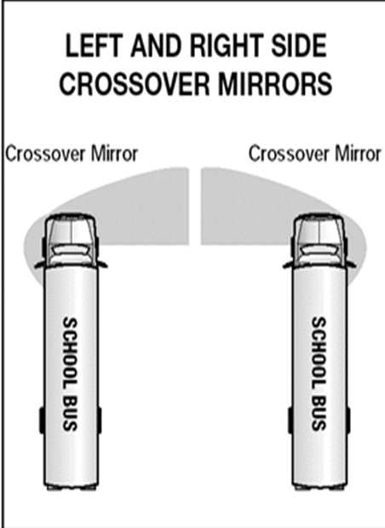
Left & Right Crossover Mirrors
Entire area in front of the bus to a point where direct vision is possible
The right & left front tires touching the ground
Area from front of bus to the service door
Notes:
Using the left and right crossover mirrors the driver should see:
The entire area in front of the bus to a point where direct vision is possible.
The right and left front tires touching the ground
The area from the front of the bus around the right corner to the service door and the area from the front of the bus around the left corner at least to the tire.

Slide 37
Interior Student Mirror
Top of the rear window in top of mirror
All students including heads of students right behind you
Notes:
Class A trucks do not have this mirror
With the interior student mirror the driver should see the top of the rear window in the top of the mirror.
Driver should see all students including the heads of the students right behind you.

Slide 38
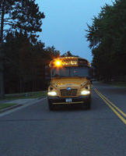
School Bus Amber Warning Lights
On Approach
  Turn on Amber School Bus Lights 100’-300’ before stop if posted speed is 35 mph or less.
  Turn on Amber School Bus Lights 300’-500’ before stop if posted speed is over 35 mph
Notes:
From 100 to 300 feet 35 mph or less. Traveling slower needs less notice.
From 300 to 500 feet is 35 mph or fast. Traveling fast needs more notice.
Common number here is 35 mph.

Slide 39
School Bus Amber Warning Lights
100’
300’
500’
35 MPH
Notes:
If posted speed is 35 mph or under turn on amber school bus light 100’-300’ before the stop.
If posted speed is over 35 mph turn on amber school bus lights 300’-500’ before the stop.

Slide 40
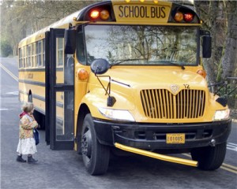
Loading/Unloading Procedures
After exiting bus, students should walk at least 10’ away from bus
Students should stand at least 10’ in front of right corner bumper while waiting to cross street
Notes:
Students should walk at least 10’ out from bus and stand 10’ in front of the right corner bumper while waiting to cross the street.
Students should look at the driver and wait for them to signal that it is safe to cross the street.

Slide 41
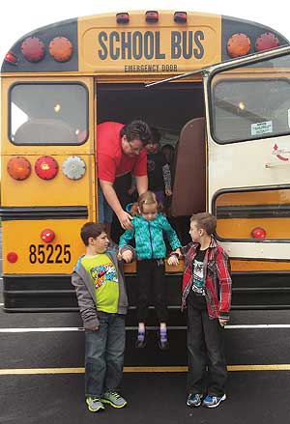
Emergency Evacuation
Evacuate only if there is danger of being harmed by staying on the bus, i.e.
  Fire
  Bus stalled on or adjacent to railroad grade crossing
  Bus being hit
Notes:
The safest place is on the bus unless, there is danger of being harmed by staying on the bus.
Such as:
Fire
Bus stalled on or adjacent to railroad grade crossing.
If the bus is in danger of being hit again.

Slide 42
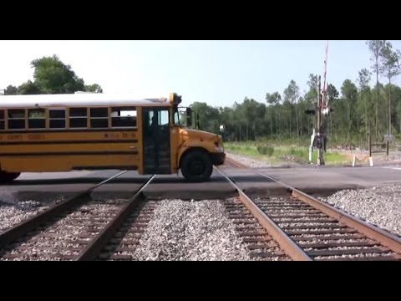
Railroad-Highway Crossings
Passive Crossings
Active Crossings
Crossing Procedures
Notes:
You will need to know about:
Passive crossings
Active crossings
Crossing procedures

Slide 43
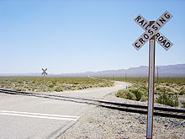
Passive Crossing
No traffic control devices
Must follow district RR procedure
Decision to proceed is up to driver
Yellow circular advance warning signs
Notes:
A passive crossing is one which has no traffic control devices such as a stop sign, flashing lights, or crossing arm.
Drivers must follow their district railroad procedures
The decision is proceed is up to the driver.
There may be a yellow circular advance warning sign.

Slide 44
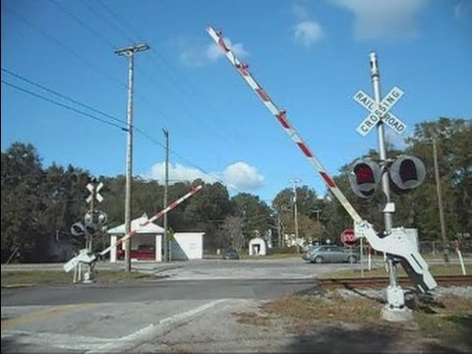
Active Crossing
Traffic Control Devices
  Flashing Red Lights
  May have bells
  Crossing Gates
Notes:
Active crossing has:
Flashing red lights
May have bells
Crossing arms/gates

Slide 45
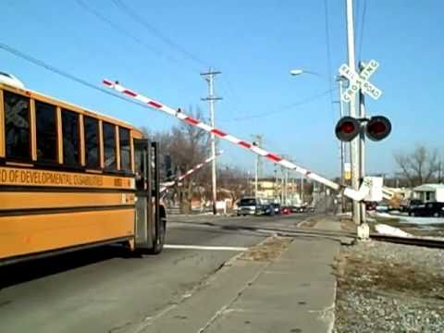
RR Crossing Procedures
Activate amber flashing hazard lights within 200’ before stopping
Stop 15’-50’ from nearest rail
Secure the bus (place in neutral and set parking brake)
Open driver’s window and service door
Look left and right
Close door
Check RR lights one more time
Proceed across tracks
Notes:
These procedures apply to both active and passive crossings.
Driver must activate amber flashing hazard lights within 200’ and before stopping.
Stop no closer than 15’ and no farther than 50’ from the nearest rail.
Secure the bus (place transmission in neutral and set parking brake).
Open driver’s window and service door.
Look left, look right.
Close door.
Check railroad lights one more time.
Proceed across tracks.

Slide 46
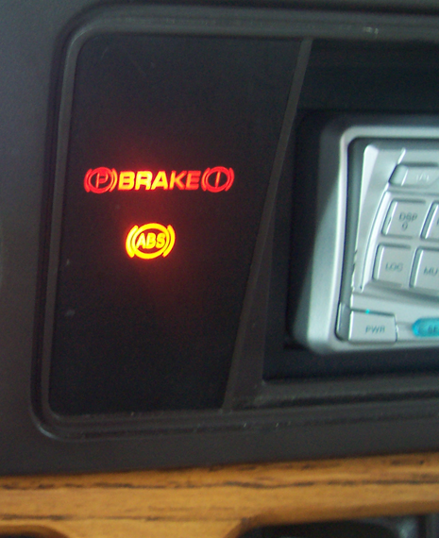
ABS Brakes
ABS helps you avoid wheel lock up and maintain control
Braking with ABS
  Use only the braking force necessary to stop safely and stay in control
  Brake the same way regardless of whether or not you have ABS on the bus. In emergency braking do not pump the brakes on a bus with ABS
  As you slow down monitor your bus and back off the brakes, if it is safe, to stay in control
Notes:
ABS will help you avoid wheel lockup and maintain control.
When braking with ABS
Use only the breaking force necessary to stop safely and stay in control.
Brake the same way regardless of whether or not you have ABS on the bus. In emergency braking do not pump the brakes on a bus with ABS.
As you slow down monitor your bus and back off the brakes, if it is safe, to stay in control.

Slide 47
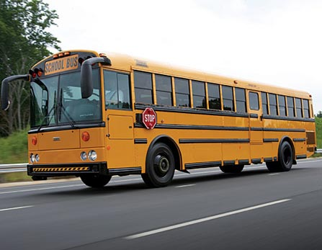
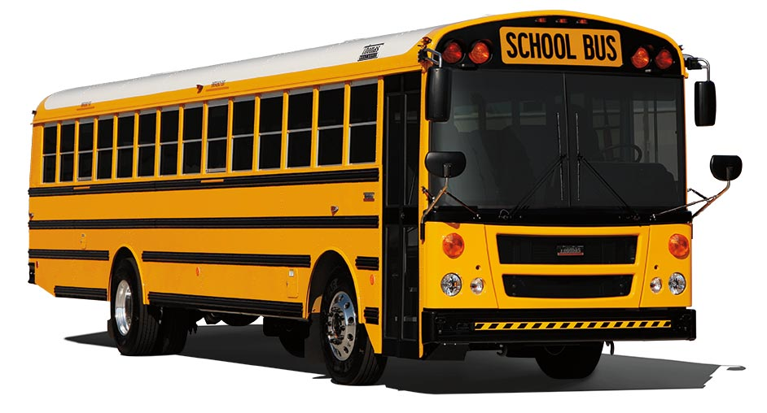
Tail Swing
Up to a 3’ tail swing
Monitor opposite mirror for tail swing
Notes:
Length of tail swing depends on the length of the wheel base. You can have up to a 3’ tail swing.
Shorter wheel base = longer tail swing
Longer wheel base = shorter tail swing
When making a right or left hand turn you should always monitor your tail swing in the opposite mirror.

Slide 48
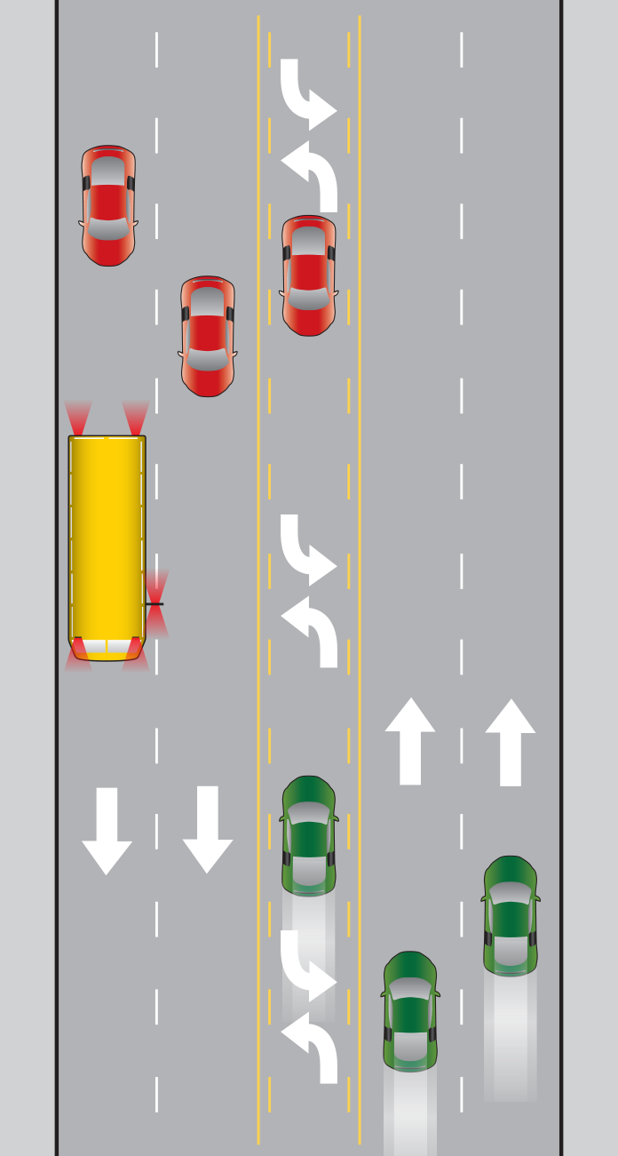
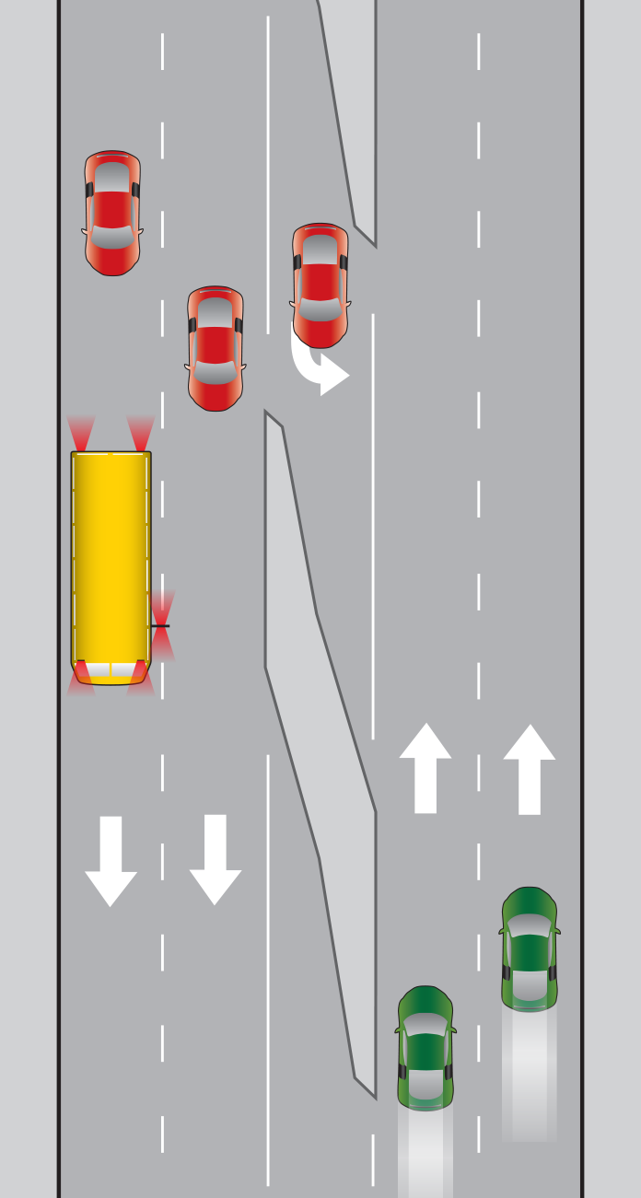
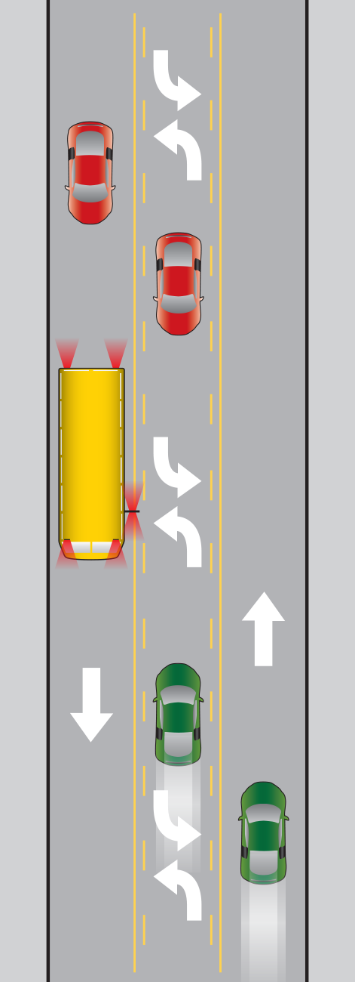
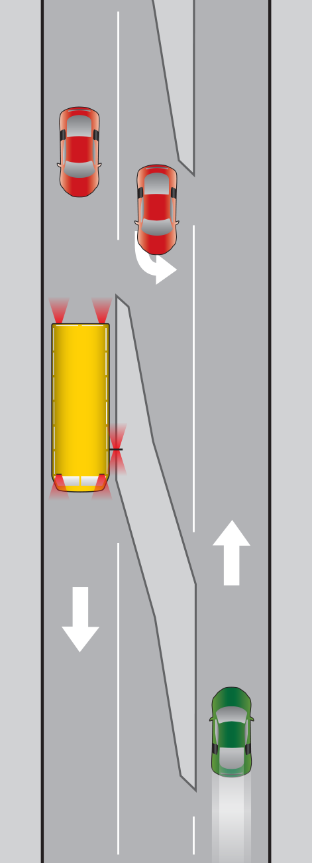
Who Goes ? Who Stops?
4 Lane w/Center Turn Lane
4 Lane w/Dedicated Turn Lane
2 Lane w/Center Turn Lane
2 Lane w/Dedicated Turn Lane
Notes:
2 lane road, both lanes stop
4 lane with center turn lane
road cars traveling in opposite direction go
cars traveling in same direction stop
4 lane road with dedicated turn lane
cars traveling opposite direction go
cars traveling same direction stop
2 lane road with center left turn lane
cars traveling opposite direction go
cars traveling same direction stop

Slide 49
Testing Strategies
Skip Button
Reminder: Think Dump Truck, City Bus, or School Bus when taking test
Take Practice Test Online:
http://www.dol.wa.gov/driverslicense/cdlpractice.html
Notes:
There is a SKIP button – use it! If you don’t know the answer skip the question.
Reminder:
General Knowledge – think dump truck
Passenger – think city bus
School Bus – think school bus
Take the practice tests online before you go to DOL.

Slide 50

Questions ?

Slide 51
Read, Study, & Pass
Get permit by_______________
Cannot drive the bus on the road until you have a permit
Class starts _____________________

