Slide 1



ELPA21 Assessment Update
January 2016

Slide 2
Q: Why ELPA21? A: New standards, so new assessments!
Fewer, clearer standards with strategic correspondences to
ELA & Literacy
Mathematics
NGSS
Addressing the unique language acquisition needs of English Language Learners (ELLs)

Slide 3
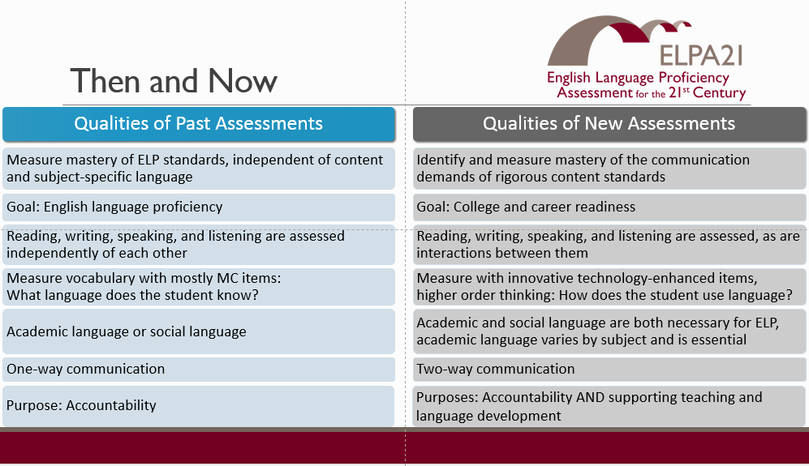

Slide 4
WELPA vs ELPA21
WELPA
Paper & pencil only
Speaking test given 1:1
Assessed students on 4 levels of proficiency
ELPA 21
Online*
Assesses students on 5 levels of proficiency
Speaking test in small groups
Determines continued placement in ELL Program
Requires students to use academic language
Assesses proficiency in 4 domains
* K and 1 students do writing test on paper

Slide 5
Annual Assessment
ELPA21 IMPORTANT DATES
Practice Test MIGHT BE available Jan 11
Coordinator and Administration Manuals available January 14
State ELPA21 Annual assessment window is February 2 - March 11

Slide 6
Scores and Reports
The goal of ELPA21 is to deliver the test and reports online.
Reports will be provided at the state, district, school, and classroom levels.
ELPA21 assessment scores will inform ELL program eligibility and exit decisions, provide English language proficiency progress monitoring, indicate instructional needs of ELL students and resource needs of ELL teachers, and provide evidence of program effectiveness.

Slide 7
ELPA21 Proficiency Levels
The ELPA21 assessment is designed for five (5) proficiency levels (Beginning, Early Intermediate, Intermediate, Early Advanced, Advanced) aligned to the ELPs
Level 4 (Early Advanced) is intended to serve as the transitional level
Level 5 (Advanced) demonstrates a higher proficiency level offering more details about student proficiency with English
Until there is student performance data available to conduct analyses, WA, as a member of the ELPA21 consortium, will use the five proficiency levels.
Through these planned analyses ELPA21 will be better able to determine a need for any adjustments in reporting levels.

Slide 8
ELPA21 Headsets & Microphones
Headsets with microphones are required for ELPA21. The microphone is necessary for administration of the Speaking subtest
Information on headset specifications can be found at: http://www.k12.wa.us/ELPA21/default.aspx
AIR offering option to purchase headsets (w/ built-in microphone).
Available option for districts still needing to purchase headsets.
Headsets cost $25.00/set. Order Optional AIR Headsets

Slide 9
Enhanced Computer-Based Format
Computer-based testing provides an opportunity to move students and educators toward information and skills needed for college-&-career.
The assessment system will incorporate technology-enhanced items that allow students to indicate their responses in ways other than traditional item types (e.g., multiple choice).
Format includes item styles that are more interactive, especially for speaking and listening tests.

Slide 10
ELPA21 Online Test Engine
The online test engine incorporates a multitude of embedded usability, accessibility, and accommodations features that were not possible with the previous paper/pencil English language test, the Washington English Language Proficiency Assessment (WELPA).
In addition, the test questions presented online are more engaging than test questions appearing on paper test booklets; this is especially important for English language learners.
There is one portion of the ELPA21 Writing test for students in K and 1, which will be administered on paper. The K-1 paper writing materials will be secure materials.

Slide 11
K and Grade 1 Writing
K and 1 Writing: In an effort to more accurately measure the basic writing skills of our youngest ELLs, students in kindergarten and first grade will be provided with a paper-and-pencil test booklet for a small portion of the writing test.
This will allow students the opportunity to demonstrate their ability to write and trace letters, and perform other writing tasks typical of early writers.
Districts will receive booklets for each of the kindergarten and first grade students and will receive detailed directions about how to assign, collect and mail the booklets.

Slide 12
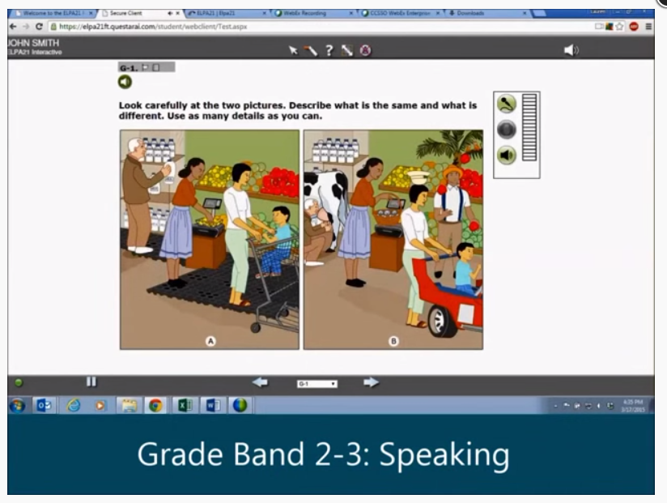
Sample Items http://www.elpa21.org/assessment-system/sample-items

Slide 13
ELPA21 Subtests
The assessment is presented as one test with 4 segments (Listening, Reading, Writing, Speaking).
Subtests must be taken in order but students may proceed at their own pace.
Skipping is permissible.
Speaking will require a separate login.
Each individual subtest (domain segment) should be completed in the same day.
Not all subtest segments must be taken in the same day
Example – Listening & Reading Day 1, Writing & Speaking Day 2.
Students asked to review answers in current segment before submitting answers and ahead of entering next segment.
Once current segment is exited students cannot go back to review answers.

Slide 14
ELPA21 Subtests
Listening Subtest
During the Listening subtest, students will hear the prompts through their headphones and then respond by clicking on a multiple-choice answer or by dragging and dropping a graphic or a piece of text. At the beginning of the Listening subtest, all students are prompted to check the sound in their headphones; if the sound needs adjusting or is not working, they are asked to raise their hand.
Speaking Subtest
During the Speaking subtest, students will hear the prompts through their headphones and then record their answers. To record an answer, the student clicks on the icon, speaks, and then clicks on the STOP icon. The student can then listen to his or her recorded response by clicking on the LISTEN icon. If the student is not satisfied, he or she can re-record a response by clicking on the RECORD icon again.

Slide 15
ELPA21 Subtests
Reading Subtest
During the Reading subtest, students will read different types of text including short correspondence, procedural, literary, and informational passages. They will demonstrate comprehension by answering multiple-choice as well as drag-and-drop questions.
Writing Subtest
During the computerized portion of the Writing subtest, students in the lower grades (K and 1) demonstrate knowledge of writing by dragging letters to form words and by dragging words to complete or form sentences. At the higher grades, students also respond to Writing prompts by typing. For students in grades K and 1, a paper-and-pencil Writing form will also be administered. Administrators will consult the Directions for Administration for paper-and-pencil Writing, which will be included along with the materials provided to schools.

Slide 16
Approximate Test Times
Grade Bands: K, 1, 2–3, 4–5, 6–8, and 9–12.
Four Domains: Reading, Writing, Listening, and Speaking
Estimated ELPA21 Annual test times are based on feedback from the field test. These times may be modified. Actual times will vary dependent upon variables specific to your district. We suggest adding an additional 15-20 minutes for test proctor activities.
Grade Band | Domain Times | Total
K and 1 | 20 Minutes | 1 Hour and 20 Minutes
2-3 | 25 Minutes | 1 Hour and 40 Minutes
4-5 | 25 Minutes | 1 Hour and 40 Minutes
6-8 | 30 Minutes | 2 Hours
9-12 | 30 Minutes | 2 Hours

Slide 17
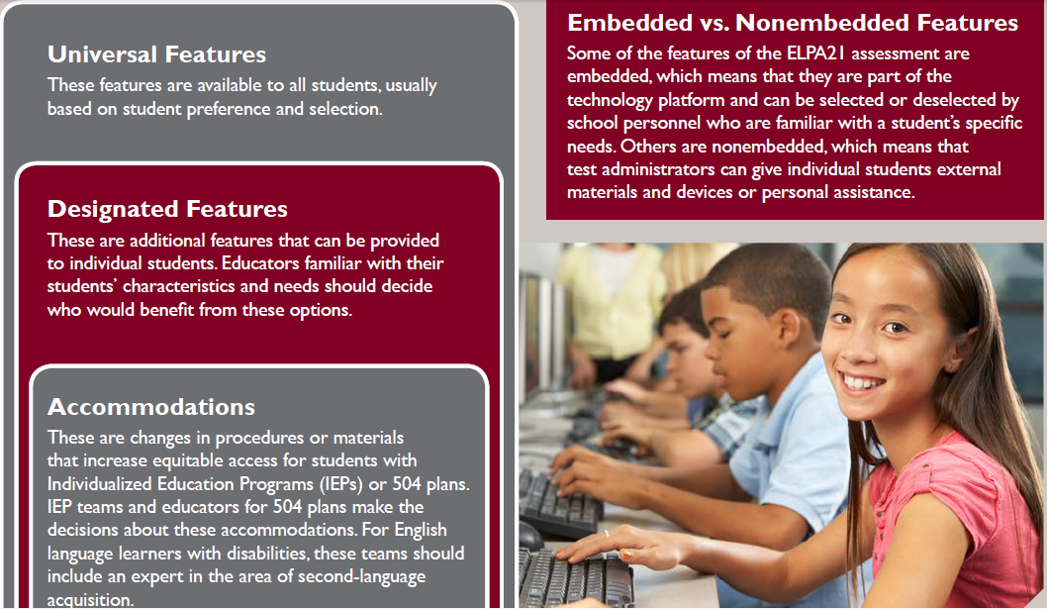
Tiered Approach to ELPA21 Accessibility and Accommodations Features

Slide 18
Personal Needs Profiles
Personal Needs Profile (PNP) – designed to aid administrators (proctors) with identifying needed features to give students needed access to the test.
Necessary for students with IEPs or 504 to use programmed accommodations with the online test
Designed for completion no later than 24 hours prior to testing
Processes to implement the PNP will be part of planned training and administration manuals
Designed to support practice test and operational

Slide 19

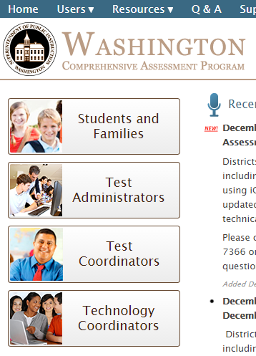


Slide 20
ELPA21 Trainings
TIDE System on Dec 15 is posted on WCAP Portal
TDS/ORS on Jan 7, 3:00-4:00, will be posted on WCAP Portal
Training Test might open on January 11
The ELPA21 Training Test is a practice tool designed to allow students and (TAs) to interface with the online testing system before taking the ELPA21 assessment. It is intended to help TAs guide students through the assessment, ensuring that students practice using all of the tools and functionality available. All students should have the opportunity to access the Training Test and work their way through the questions. The Training Test may be accessed as many times as needed.
Notes:
The ELPA21 TAM will be distributed with a 1:5 ration instead of the standard 1:20.
ELPA21 information is in included in the TIDE Guide, as well as the TA User Guide

Slide 21
ELPA21 Manuals
ELPA21 Accessibility and Accommodations Manual is posted in TIDE and on the OSPI ELPA21 webpage. Accessibility and Accommodations Manual. Students will have the option of using accommodations during the training test.
Test Administration Manual (TAM) covers grades K-12 and the Directions for Administration (DFA) address the K-1 writing. Anticipated January 14 release.
Notes:
The ELPA21 TAM will be distributed with a 1:5 ration instead of the standard 1:20.
ELPA21 information is in included in the TIDE Guide, as well as the TA User Guide

Slide 22
Where To Find More ELPA21 Information?
OSPI ELPA21 Link
http://www.k12.wa.us/ELPA21/default.aspx
ELPA21 Website
http://www.elpa21.org
ELPA21 Newsletter
http://www.elpa21.org/learn-more

