Slide 1
Student Growth Percentiles in Transition
What to expect from the 2015 data

Slide 2
Impacts of Transition to Smarter Balanced
SGPs will not be reported for high school students
English Language Arts (ELA) will be reported as Reading in SGP results
Students scoring the Highest Obtainable Scale Score (HOSS) will be given an SGP of 99

Slide 3
SGPs will not be calculated for high school students
Since the census test is now 11th grade, calculated SGPs would represent growth over a three-year span.
Is difficult to interpret SGPs over a three-year span
Varying enrollment and course-taking patterns of students
To ensure reasonable and appropriate interpretation, we will not be calculating HS SGPs

Slide 4
SGPs and the 2014 Smarter Balanced field test
Students who field tested in 2014:
One-third of students took the Smarter Balanced field test and did not receive test scores for the 2014 school year.
SGPs require at least two consecutive years of valid scores. Therefore, SGPs for the 2015 school year cannot be calculated for students who took the field test.
Students who took MSP in 2014:
Interpretation nuances!
For 2014, we calculated “Baseline” SGPs (2014 scores applied to the coefficient matrix from a previous year).
MSP and Smarter Balanced have different scales, so we needed to calculate “cohort” SGPs for 2015.

Slide 5
Who What When Where
Who: Last year’s 4th through 8th graders who had scores for 2014 and 2015
Students who took 2014 Smarter Balanced field test will not have SGPs
What / Where
Individual student SGP reports – a PDF for each student (WAMS)
Data file (WAMS)
New public web tool (OSPI web site)
District and school-level bubble charts, similar to previous years
More functionality / interactivity (filters, selections, etc.)
When
WAMS material: January 15
Website: mid-February

Slide 6
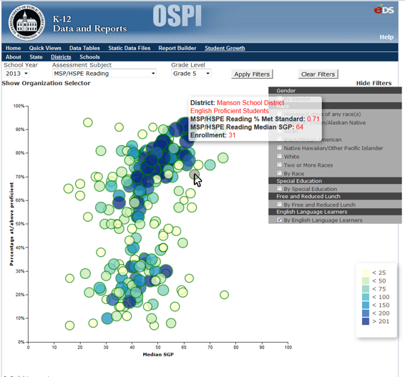
New Web Tool
Notes:
Filter by:
School Year
Assessment Subject
Grade Level
Organization
Gender
Race
Special Education
Free and Reduced Lunch
English Language Learners
Size and color of the bubble represents the number of students.

Slide 7
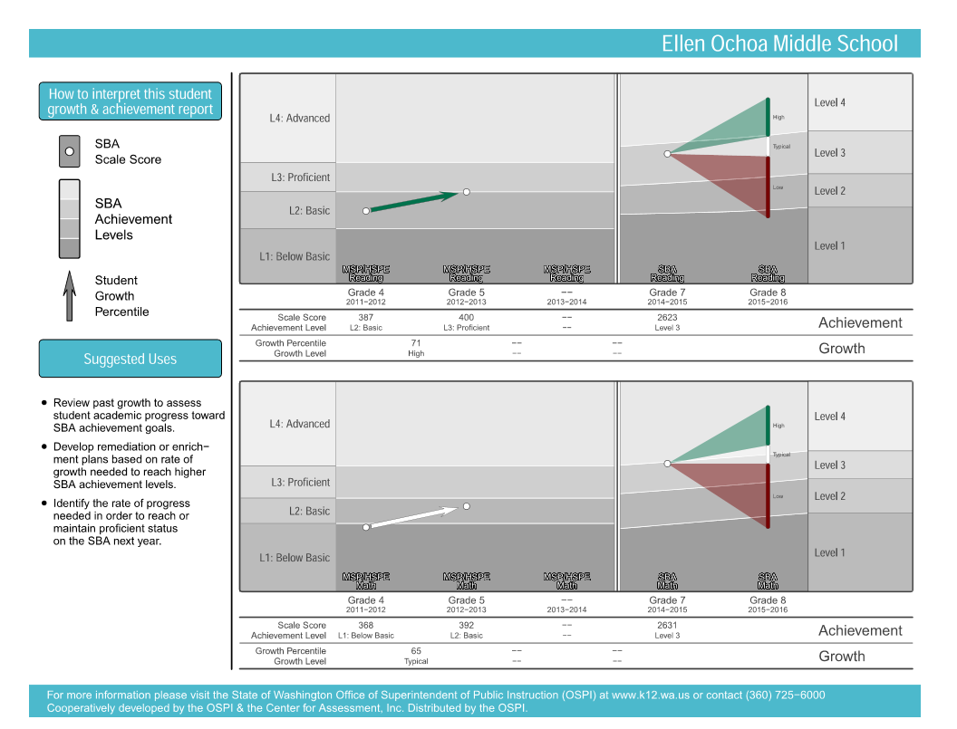
Sample Student Growth Plot
DRAFT
Notes:
This is a sample student growth plot for a student participating in the field test in 2014. Things to point out:
There is no scale score/achievement level for 2014, hence the missing data point and arrow (from 2012-2013 to 2013-2014) representing SGP.
Students who participated in the field test did not receive SGPs in 2014 and will not receive them in 2015, hence the missing values and lack of arrows.

Slide 8

Sample Student Growth Plot
DRAFT
Notes:
This is a sample student growth plot for a student with a baseline SGP in 2014. Things to point out:
There is a scale score/achievement level for 2014.
Students who took the MSP/HSPE in 2014 received baseline adjusted SPGs for that year. Because baseline SGPs have a different interpretation than cohort SGPs, they will not be included in the 2015 student growth plots, leading to the missing value and arrow representing the SGP for this sampled student.

