Slide 1
New District/School Test Coordinator Training
Agenda for Today
Assessments
EDS Application Access
WCAP Portal Cards
Thursday, December 10, 2015
Notes:
Handout = H/O
OPENING:
K, T – Introduction
K, T – Welcome
K – Survey who is new this year in a coordinator role? 1 year or more years? The state level has also been impacted with recent turnover (OPS intro, Data)
T – How many are a one man team? And how many of those wear 2 hats?
K – Agenda today is to talk about 3 important aspects.
Assessments
Access to Applications– what you need in EDS
Resources – where to find what you need in WCAP
T – H/O – Test session timelines (Time saving techniques)
Annual State Assessments Monthly Activities – when to take a vacation – look at January when only assessment not touched Spring MSP & EOC. This is a VERY high level view and should not be used as a work plan because it does not capture all of the facets of the assessment cycle, but it is an overview of how many tasks there are and how often the tasks overlap.
Buy Ablebits! Compare ELPA21 list to the SIS extract in a snap. Very user friendly and inexpensive.
T – H/O – Acronyms for today (grey)
K – Questions on topic, please share right away. Questions off topic can be addressed at the end, we will stay.

Slide 2

Assessments
WaKIDS
ELPA21
HSPE Grade 12
MSP Science Grades 5 & 8 (default is online)
Smarter Balanced
End of Course (EOC) Math & Science
Alternate Assessments:
WA-AIM
Engagement Rubric
Graduation Options:
Off-Grade Level (ELA, Math, & Science)
Basic level
CAA Options:
College Admissions Tests
GPA Comparison
Collection of Evidence
CIA Options:
LDA
Awareness Level Waiver
Notes:
T – We provided the colored Annual State Assessment Flowchart H/O. Now we would like to talk about what is new within the Assessments and options.
K – What’s New? ELPA21 is online, HSPE Gr. 12 only, MSP Science default is online, Smarter Balanced HS (last 12 weeks, not 7 weeks) testing begins March 7

Slide 3
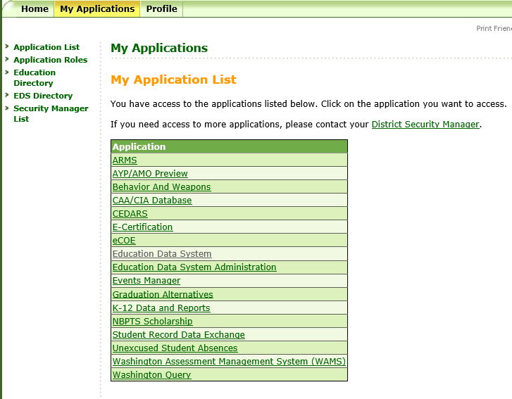
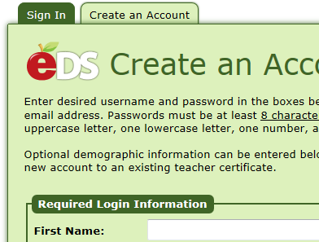
Application Access
EDS Accessed at: https://eds.ospi.k12.wa.us/Login.aspx
Notes:
T – Part 2 of the Agenda, an overview of EDS and applications you should have access to. This is a screenshot of my list, refer to the H/O (light blue, take notes on the handout, we will talk about it in more detail later).
WAMS – Next 2 slides demonstrates some frequent used areas in WAMS
The others we will discuss after referring to the handout
K – Already a designated DC, you should only need to Sign In. Otherwise, select the Create an Account tab & your district security manager will receive an email to setup role or access to applications.
– Locate Security Manager list on the left sidebar.

Slide 4
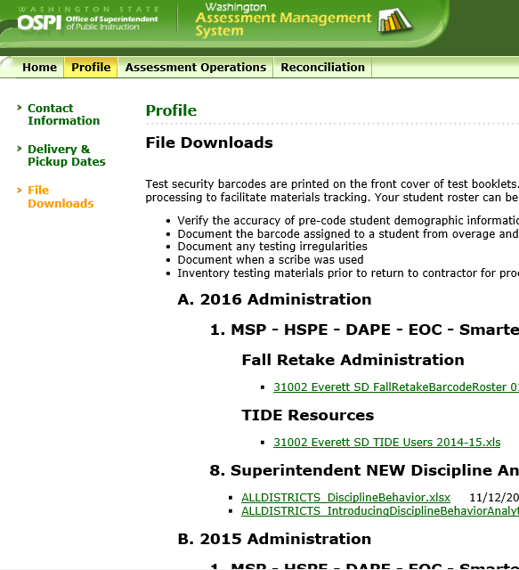
WAMS Profile
Notes:
T – WAMS – Under the Profile Tab on the toolbar
K – Contact Information: WAMS (PRIMARY communication & shipments) and TIDE (needs to be confirmed ONLY for material orders)
K – Delivery & Pick-up dates – for paper-pencil tests delivery, EOC ONLY
T – In this screen shot you see the File downloads are sorted by school year – to download flat files of pre-ID list/roster and score results for all asmts. Check often for new files or updates to a previous version.
Fall Retake Administration – barcode list
TIDE list of users
New discipline reports
AMAO results for ELL
Student Growth Percentile file
CAA or CIA Certificate printing

Slide 5
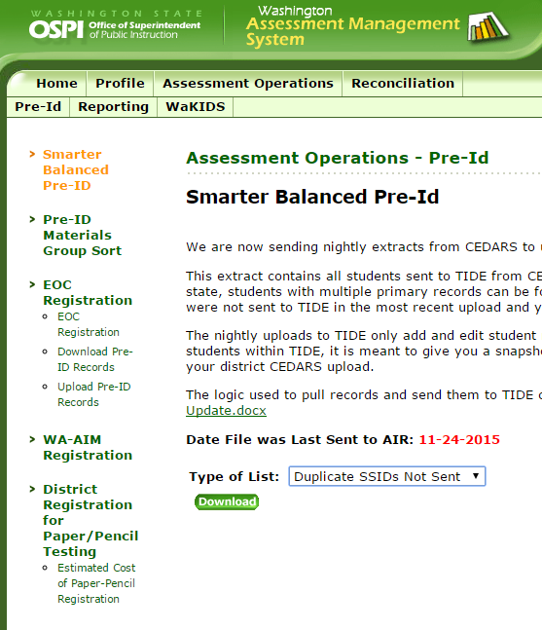
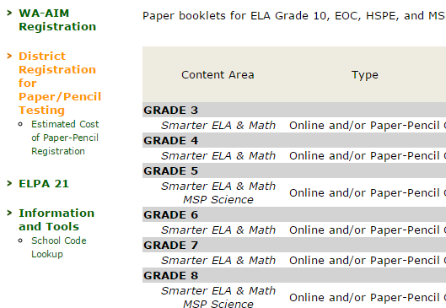
WAMS/Operations
Notes:
T – WAMS – Assessment Operations Tab
Under Pre-ID tab – (Review the options down the left)
First Item on the left sidebar is Smarter Balanced Pre-ID has 2: Under “Type of List” Options to Download files – The orange text is what is opened in WAMS
“Last Sent to Vendor” list of student that will be in TIDE for Pre-ID (TIDE: On-time Initial Orders for how many test booklets ship)
“Duplicate SSIDs Not Sent” to TIDE due to overlapping enrollment between districts, these students need corrective action to appear in TIDE
T – EOC Registration: State Pre-IDs, but DCs can modify, for example registered for Alg. 1 but are also eligible to take Geo.
T – WA-AIM Registration: to load students to EngradePro, a WA-AIM online application
K – Under District Registration for paper-pencil testing: (DC registration schl participation P-P MSP & SBA) - Unless you selected P-P by Nov. 25, online default.
NOTES: Costs associated with SB only. HSPE and EOC is paper only
*K – ELPA21: to view/VERIFY Pre-ID students for ELPA21 1) changes made in CEDARS by 12/12 2) pre-ID file passed to AIR EOD 12/13. (no differences in pre-ID processes from past years)
T – School Code Lookup: to view OSPI codes for each school (Co-Dist 5-digit and School 4-digit codes)
T – Pull out the blue handout H/O EDS Applications (we will discuss areas not already addressed)

Slide 6
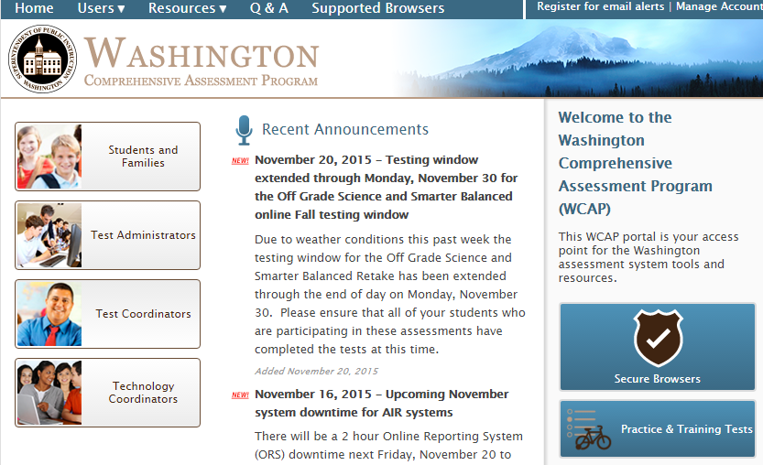
Portal
WCAP Portal: wa.portal.airast.org
Notes:
Now for part 3 of the Agenda
K – The WCAP Portal is the home to testing applications and systems.
Portal link available at the top of this slide.
Information is available to supports Families, Test Administrators, Test & Technology Coordinators
Email alerts: Sign up (notifies of page update ONLY not specific doc)
The following slide will provide an overview of the Test Coordinators User Card

Slide 7
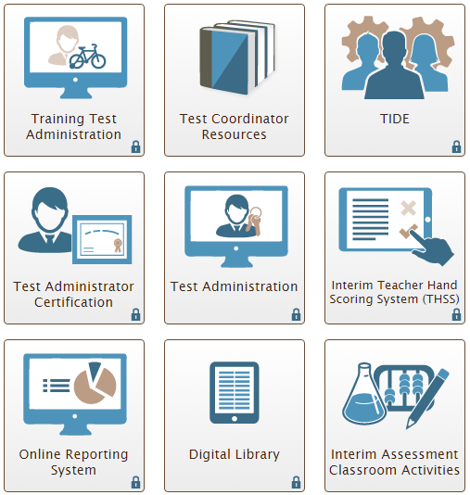
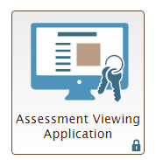
Portal Cards
Notes:
Having selected the Test Coordinator Access card, here are the portal cards in WCAP
T – Any Portal Card with a Lock requires your WCAP login. Forgotten passwords can be retrieved by the user in TIDE.
Digital Library has a different log in and must be reset by the district.
Each year we upload new staff members and remove those who have moved or retired.
Here is a brief description of each portal, most we will expand on
T – Training Test Administration Card: TA administrator can access practice tests for SBA & MSP practice sessions.
It is important to remember that the Training sessions are grade band 3-5, so a TA can log in and select grade 3 and think that it is a really hard question, actually it may be a grade 5 type problem. There are only 6-8 questions and the primary purpose is to understand how to use the tools. Practice sessions are grade level specific and about 30 questions and help instruct on the question types. These are not secure so encourage TAs to use overhead projectors and practice with the class the type of questions and the use of tools.
With the change in science being online in our district, students & staff should be given an opportunity to practice the MSP interface. There are in-class activities for the practice test in the resource section.
T – Test Coordinator or Test Administrator Resources – (will be discussed in an upcoming slide)
T – TIDE (will be discussed in an upcoming slide)
K, T – Test Administrator Certification (STATE is not required at this time but highly recommended for TA and SCs) (TERRY-In Everett, we use the “train the trainer” model so I completed the certification and made sure that all of the components were in my presentation and training materials.
T – Test Administration used to launch both the summative & interim assessments and has a new look easier to select exact test.
T – Interim Hand Scoring System – Must hand score both PT & CAT sections to get a score in ELA or math
T – Online Reporting System - (will be discussed in an upcoming slide)
T – Digital Library – Resources for teachers based on CCSS
T – Interim Assessment Classroom Activities - (will be discussed in an upcoming slide)
T – Assessment Viewing Application - (will be discussed in an upcoming slide)

Slide 8

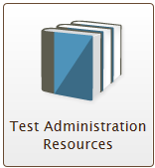
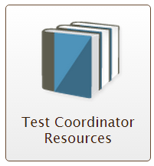

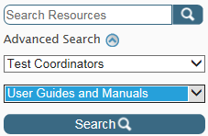
TA & Test Coordinator User Cards include 4 sections
General Information
User Guides and Manuals
Assessment Resources
Modules
Advanced Search Option Available
Within User Card, click “Resources” on top toolbar and select appropriate user
Upper left side of screen, enter search criteria
Click Search button
Notes:
K – H/O There are multiple sections within each User Card. The DC and TA User Cards contain four sections: Refer to SEC 3.2.4 pg 17
General Information
User Guides and Manuals
3. Assessment Resources
4. Modules
K – An advanced search option: Refine your search.
Example: locate all Test Administration Manuals
K – In this PPT there are 4 hidden slides (12, 13, 14, 15) that provide a brief overview of the TA and Test Coordinator Resource sections

Slide 9
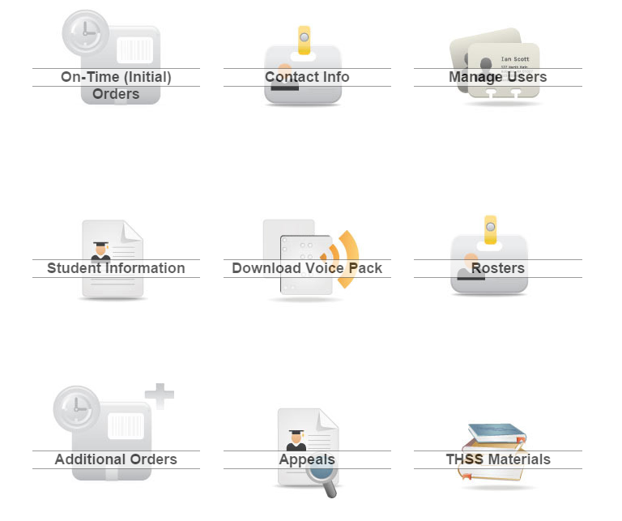

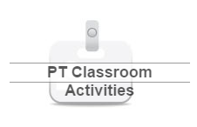
TIDE Icons
Notes:
Now more information inside of TIDE:
K – TIDE icons: the first one On-Time Initial Orders. Who was Pre-ID and materials ordered in the initial order.
K – Contact Info: As previously noted, verification is necessary for access to materials orders (System issue) not relevant to communication OR delivery of materials
K – Manage Users: Change roles. Only the DC can add another SC to the building.
T – Student Info: SC/DC can make changes to student designated options or upload accommodation file. Changes made to stud info, may take up to 24 hours. TA can make some designated options in the TA interface but they only stay for that assessment. The SC must make the change in TIDE for it to be permanent.
T – Rosters: DC / DA or SCcan upload or manager rosters in TIDE (TA can manage rosters in ORS)
K – Additional Orders: Order additional materials for paper-pencil assessments. (winter) only after receipt & inventory of materials)
K, T – Appeals: (roles and access till determine who can generate an appeal and who can approve or reject an appeal.
K – To reset (State level permission only) removes all work, i.e. a student started Gr. 11 when it should have been off-grade
K – Reopen current test segment, student submitted before reviewing or error
K – This year, can Reopen Current Segment (DC) and Previous Segment (State?)
K – Can reopen entire test, but only with state approval
K – A support document is being created to detail appeals and testing incidents
T – Everett has the following procedures in place
T – THSS: Interim Hand-scoring Materials: As mentioned, this is the incorrect location, it will be moving to the THSS portal card
T – Test Incident Codes: Upper right hand corner of the toolbar – used to identify reason not tested. Provide to schools a way to record reason not tested.
T – PT Classroom Activities: As recently communicated, not required to administer, but still available for use. PDF of the activities for your school. DC sees all activities. TA will see their school only. DC can reset Activity for a new student not assigned to your school yet in TIDE.

Slide 10
Score Reports
Manage rosters
Rosters determine data sorts
Consider establishing rosters for small groups or special programs
Roster upload examples:
Elementary by homeroom teacher
Middle school by Math & ELA teacher and period
High School by grade, teacher, period
Test Management Center
Test completion rates (by content area)
Plan and manage testing (have/have not completed)
Retrieve student results (download excel files by school,
grade, teacher, etc.)
Notes:
T – ORS has 2 main components.
Score Reports and Test Management. This system will provide ways to manage rosters (previously referred to as “group data” sorts), track sessions, and monitor completion rates. After testing, confirm that the appropriate tests were administered and identify who may need to complete on another day.
Rostering students can be uploaded or hand selected. Students can be in more than one group. For example, create a roster group for the 5th grade teacher who provides math instruction to all students.
T – the TA can create and manage rosters in ORS

Slide 11
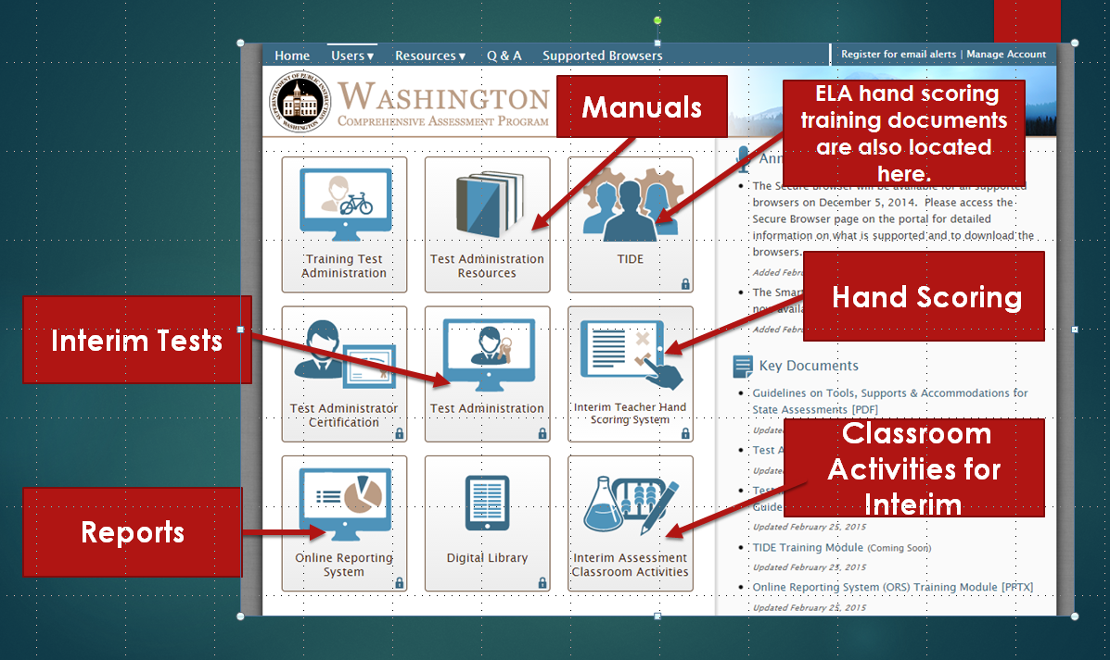
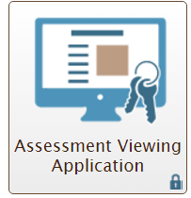

Interims
Interim Access Points
Notes:
As Promised, an overview of Interim Assessments:
T – Interim Asmt. Information and Access Points
First let’s start with AVA. Teachers can now review the interim assessments through the AVA Card (comprehensive and block) and determine which block most closely matches an area of instruction.
Interim Assessments for students are administered thru the Test Administration portal card.
Print in-class activities from the portal card.
Hand scoring guides are in TIDE to aid teacher on calibrating and scoring the interim assessment.
The THSS portal card must be accessed for hand scoring of the actual interim assessments.
The ORS portal card reports score results
An electronic copy of the notebook that Everett has put together (note, copy on table) will be provided to WERA for attendees access.

Slide 12
Test Coordinator Resources (4 sections)
1. General Information
Score Reports & Claims Factsheet
Material Orders/Shipment Schedules
All SBA Assessment Blueprints
Required documents
Links to State Webinars
Communication Toolkit (parent handout, newsletter articles, talking points)
TA Security Forms | Irregularity Reports (group and individual)
Site Security Reports | Do not disturb signs
Training Logs | Glossaries
Notes:
T - Differences in the SC & TA access:
Test Coordinator or Test Administrator Resources – Refer to the Assessment Resource User Guide H/O: Chapter XX, identifies 4 Sections: 1. General Information 2. User Guides and Manuals 3. Assessment Resources 4. Modules
When you access WCAP resources through the Test Coordinator “card.”
You will see 4 sections within the resource area:
General Information –You will find information and forms that the SC needs.
User Guides
Assessment Resources
Modules

Slide 13
Test Coordinator Resources (continued)
2. User Guides and Manuals
AVA User Guide & Manuals
Test Administration Manual (TAM) (HSPE, MSP, EOC, SBA)
Test Coordinator Manual (TCM) (HSPE, MSP, EOC, SBA)
User Guides for THSS, TIDE, ORS
3. Assessment Resources
Achievement Level Descriptors
In-class Performance Task Activity for Practice Test
4. Modules
Administration Training PowerPoints (from districts)
SBA Summary Q&A from all webinars
ORS Training
Interim Hand Scoring
Student and TA Interface Training
TIDE Training
Notes:
2. User Guides & Manuals – All state assessment manuals even P/P
3. Assessment Resources & Modules
When working with TAs to administer practice and TA interface opportunities, there are in-class activities available for those practice tests.
Achievement Level Descriptors, for example, are not available when a TA accesses Resources page.

Slide 14
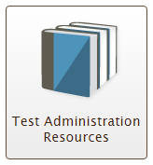
TA (Proctor/Teacher) Resources (4 sections)
1. General Information
Score Reports & Claims Factsheet
All SBA Assessment Blueprints
Document Resources
Links to State Webinars
2. User Guides and Manuals
AVA User Guide for Interim Assessments
Test Coordinators manual (HSPE, MSP, EOC, SBA)
User Guides for THSS, ORS
Math Video & ELA Hand Scoring Guides
Glossaries | Formula and Conversion Guidelines
Material List for Students | Items Specifications
Keyboard Shortcuts | Item Type Quicksheet
Notes:
The next 2 slides are a look at the options that are visible when a TA accesses the Resource card.
1. General Information - TA has formulas and testing materials that are not on the coordinator site but as an SC, you can be accessed by using the left panel.
2. User Guides – Manuals for all state asmts. even P/P exams. In the User Guide & Manual area, the TA has access to hand scoring guides that are not on the Coordinator’s Resources site.

Slide 15
TA Resources
TA (Proctor/Teacher) Resources (continued)
3. Assessment Resources
In-class Performance Task Activity for Practice Test
4. Modules
Read-aloud Demo
Translated Assessments Demo
ORS Training
Teacher Hand Scoring System for Interim Assessments
Student and TA Interface Training
TIDE Training
Notes:
T – Asmt. Resources: Practice tests in-class activities for PT
Modules:
The TA has the demos that will help students prepare for testing as well as teacher training materials.

Slide 16
Planning
Get to know your CEDARS Admin & Network Security
Using TCM, TAM, DFA guidelines
Create a “Test Security & Building Plan” for each state assessment.
Receive and provide training to district and school staffs, certify where appropriate
Make yourself available all day as readily available point of contact, or designate a point of contact
Testing Incidents and Appeals
Monitor school testing throughout the test administrations (or train the SC)
Notes:
K, T – Manuals: TCM (for assessments online/paper, ELPA has it’s own), DFA (HSPE & ELPA21) & TAM (SB, EOC, Off-Grade, ELPA21, MSP)
T – Manuals, Guidelines: Save to desktop for easy access and electronic search on the PDF for the key word (Cntl F)
Test Coordinators Manual (TCM)
Directions for Administration (DFA)
Test Administrators Manual (TAM)
Technology
GTSA
T – H/O (Green) Test Security & Building Plan sample you have today if for ELPA21. Everett will be providing templates for other assessments building plans.
Plans are based on TCM requirements and serve as a guide for the principal to prepare for each state assessment. The sample you have today is ELPA21. This also serves as a guide for principals to understand the changes, identify who will be responsible for what and sign off on the process. We have several other samples that will be part of the zip file we will share with you.
Identifies Building Schedules for DC approval, as required by the state.
K – Testing Incidents, Appeals, and reporting: ARMs vs. TIDE
T, K – Availability and Monitoring
– Observe daily procedures and security processes are understood and being followed
– The proctor will have the appropriate administration manual, be sure they have contact info during training of who to contact during testing if an urgent issue arises.

Slide 17
Documentation
Required Docs & Retention
Required documentation to DC
Testing Materials – Inventory
Test Proctor Training (Certification) Logs
Test Security Assurance Forms
Printed copy of the signed roster (paper/eRoster) to District Assessment Coordinator
Report of students not tested and why (Refused, Absent, NNEP etc.)
School Site Administration and Security Report
Irregularity Reports in ARMS
Retain at the school (or district)
Daily check in/out logs
Send to OSPI
District Security Report
Irregularity Forms as required by OSPI
Notes:
T, K – Documentation we send pick-up / wrap up reminder with the required documentation list

Slide 18
Resources
Email alerts and bulletins
WAW Newsletter
Receive Individual updates on the following pages of the OSPI Web site:
State Testing
eCOE
WA-AIM
Bulletins and Memos
Notes:
K – Overview of newsletter
K – Who can and how to sign up for the WAW Newsletter
T – WAW internal distribution lists (numbering the bullets)
T – General overview of helpful resources on the web. The bulleted list included OSPI web pages that you can sign up for email alerts. You will need to right-mouse click on the link above and select open hyperlink to access that web page.

Slide 19
Handouts
Printed Hand Outs
State Assessment Monthly Activities (White)
What’s New in acronyms (Salmon)
EDS Access to Applications/Systems (Blue)
Building Plan (ELPA21 sample) (Green)
Graduation Alternatives/COE Flowchart (White B2B)
Graduation Asmt. Requirements – Class of 2016 & 2017
Assessment Resource User Guide
Key Dates
Non-enrolled Form
Test Administration Material Supports
Available Online
Additional Building Plan
Interim Asmt. Basic Facts & Access to Materials & Resources
National Asmt. Proctor Guides
Notes:
T – There a few other handouts that were not part of the presentation.
Graduation Alternative flow chart. New that out of state basic level is now eligible for the waiver.
Graduation requirements – Class of 2016 & 2017, great for students or counselors.
K – Key dates! The handouts provided today are included in this list. Also included are online materials. WERA will post our materials that was presented today, however, if you have a data stick we are happy to copy the information for you before we leave. You may also email either of us for a copy.

Slide 20
Questions
Terry Campbell
(425) 385-4057
E-mail: TCampbell@everettsd.org
Kimberly DeRousie
Cell (360) 870-4860
E-mail Kimberly.DeRousie@k12.wa.us

