Slide 1


School Coordinator & test administrator Training
ELPA21 2016-17

Slide 2
Introductions
ASSESSMENT & RESEARCH DEPARTMENT
Catherine Matthews, Director
Terry Campbell, Student Assessment Coordinator (District Coordinator-DC)
Annalise Schiessl, Administrative Assistant
Jamie Pickering, Administrative Assistant
CATEGORICAL (EL) DEPARTMENT
Cynthia Jones, Director
Deb Ritchhart, EL K-12 Facilitator
Holly Im-Hamper, EL Elementary Coach
Kristie Gooding, EL Elementary Coach
Ali McElwee, EL Elementary Coach
Yu-Chin Huang, EL Administrative Assistant

Slide 3

Acronyms
DC: District Coordinator (formerly DAC)
ELPA21: English Language Proficiency Assessment for the 21st Century
GTSA: Guidelines on Tools, Supports, & Accommodations
PIRG: Professional Standards, Incident, and Reporting Guidelines
ORS: Online Reporting System
PNP: Personal Needs Profile planning tool
SC: School/Test Coordinator (formerly SAC)
TA: Test Administrator (formerly Proctor)
TAM: Test Administrator Manual (includes “DFA”)
TIDE: Test Information Distribution Engine
WCAP: WA Comprehensive Assessment Program
Notes:
This is a list of acronyms for ELPA21 (as if we didn’t have enough already) but a couple of key ones to remember are TA replaces proctor and SC is the School Coordinator. SC is also a designation in TIDE that provides access to adjust Accommodations; change or create rosters in TIDE. Consider who at your building needs SC access and email that request to our department.
TAM: There are several times that I refer to needing to confirm information in the TAM. Please make a note or highlight and be sure to look up the item in the TAM.

Slide 4
Important dates
January - Attend a proctor training session
- Create rosters in TIDE
January 25 - K and 1 Writing booklets delivered to district
(Maintenance to deliver to schools on January 26 or 31)
February 1 - March 30 – Testing Window
Follow your school’s building plan
March 30 – Return K and 1 Writing Booklets & DFAs directly to the vendor.
April 13 – Submit required documentations to A&R
Notes:
Important dates to share with appropriate staff. For example, the office manager may be the one who needs to know when the K and 1 booklets and DFAs will arrive at your school.
Yu-Chin is working with Annalise and will be done by the end of the month.

Slide 5
WHAT’S NEW?
      WA-AIM EL students take ACCESS paper exam March 6-30 (Grades 1-12)
      Exemption for students with documented disabilities, precluding testing in a domain
      One-page accommodation sheet has some new option name changes
      Rerecord two times or replay two times without an accommodation, TA monitors use
      Monitoring Test Progress now in TIDE
      Three student proficiency statuses:
      1. Emerging (qualifies for program)
      2. Progressing (qualifies for program) or
      3. Proficient (exits program)
Notes:
Special Services has identified WA-AIM EL student who will take the ACCESS ELPA paper exam.
Update accommodation reference sheet.
Two time limit on rerecording or replaying. Unlimited in the system so the TA needs to monitor
Monitoring Test Progress now located in TIDE, not ORS
Naming convention for proficiency status. Listed in eSP as 1, 2, or 3

Slide 6
    ELPA21 PURPOSE
      To determine the progress English learners (EL) and Native Americans have made in learning English
    To determine which students are eligible to continue to receive supplemental English language development (ELD) services
Notes:
I’m sure everyone here knows the purpose of the Annual Asmt. To determine progress and eligibility.
6

Slide 7
Who Takes the Annual Test
All emerging and progressing students (level 1-2) and new students who qualify for EL services must take ELPA21.
  This includes: transfer students who qualified for EL services from another WA school district and students who are dually qualified but only access Special Education services.
Native American students in a Title III program.
Students whose parents have declined services.
Qualified students attending private schools within our district.
Foreign language exchange students on an F-1 Visa
Note: To decline ELPA21 testing, parent(s) must complete the “Parent Refusal Form” used for all state assessments.
Notes:
This slide is a reminder of who needs to take the asmt. Remember to test students whose parents have declined services and qualified students that attend private schools in the district.

Slide 8
Participation Requirements for the 2017 annual elpa21
If the student : | Must Test in 2017 | Will Test in 2018
Enrolled in a previous year and still receiving ELD services |  | If not tested as Level 3 Proficient in a previous year
Qualified* for services on or before March 17
Qualified* for services after March 17
*Qualified for services based on the Placement Test administered within 10 days of enrollment.
Notes:
A visual of the annual asmt. participation requirements.
The placement test is administered within 10 days of enrollment, and that arrival date determines if there is enough time to administer the annual as well.

Slide 9

Professional Standards, incident, and Reporting Guidelines (PIRG)
It is your responsibility to read the PIRG and ensure that standard procedures are adhered to.
  Ensure understanding of test protocol.
  Confirm the student matches booklet name.
  Watch for irregularities during testing.
  Document any inappropriate behavior.
  Follow the Code of Professional Conduct
  Chapter 181-87 WAC.
  Volunteers are not allowed in a testing room.
Chapter 181-87 WAC
Detailed information is available on the OSPI Web site at the following link:
www.k12.wa.us/ProfPractices/CodeConduct.aspx
Notes:
Reminder of the expectations, as with any state assessment, our responsibilities as noted in the TAM and state law.
There is a link to the Professional Code of Conduct.
Reminding you that reviewing and disclosing test questions is a violation of state law.
As with any state assessment test security protocols must be adhered to and volunteers may not be in the classroom. This would also be true for interim assessments.

Slide 10
Test Security Materials
Test tickets must be locked up when not in use. Tickets may be reused but must be secured between uses.
  Do not write the session ID on the ticket.
  Test tickets printed from Cognos may include student not yet in TIDE
Scratch paper (lined) must be available for students. Use Scratch Paper Log (appendix C pg. 47 in GTSA).
K and 1 Writing Test Booklets – Sign out/in as tested
Notes:
Test tickets have student information on them and need to be secured. They can be locked up and used for another session or for interims, therefore do not have students write the session on the card.
Make scratch paper available, if a student wants to use paper, ask them to write their name on the sheet(s) and collect when testing is done.
Record on the scratch paper log.
Log out/in K-1 test booklets.

Slide 11
TEST INFORMATION

Slide 12

subTest information
  The assessment is presented in 4 segments (Listening, Reading, Writing, Speaking). Subtests must be taken in order. The session ID opens access to all 4 segments. However, approval is granted by the TA to access the next segment.
  If administering one segment at a time, follow the directions denying access to the next segment.
  If administering more than one segment at a time, proctors must read the directions for the next segment before the student begins testing. The student access will be in a “waiting for segment approval” mode.
    After reading directions for the next segment, you must then approve access.
A new session ID will be required when access to the next segment is denied.
Notes:
First there are 4 segments to the exam. They may be referred to as subtests or domains, but they remain: Listening, Reading, Writing & Speaking.
Because they are part of the one grade level exam, the sequence is pre-determined by the computer system.
Directions for the next segment will be needed for the student. The TAM will provide clear directions once it is published.
Subtests should be finished in the day started. In the rare instance when the student needs more time, they will return within the segment.
When possible, predetermine whether you will administer one segment or more than one in the day. However, classroom management can be used to determine if a small group should continue on while others in the room remain in the current segment.

Slide 13
subTest information
Listening Subtest
  During the Listening subtest, students will hear the prompts through their headsets and then respond by clicking on a multiple-choice answer or by dragging and dropping a graphic or a piece of text.
Reading Subtest
  During the Reading subtest, students will read different types of text including short correspondence, procedural, literary, and informational passages. They will demonstrate comprehension by answering multiple-choice as well as drag-and-drop questions.
Notes:
Listening needs audio sound so students are prompted to check the volume and raise their hands if they need assistance.
Reading: Different type of texts and responses consist of multiple choice and drag and drop questions.

Slide 14
SubTest information
Writing Subtest
  During the computerized portion of the Writing subtest, students:
  In the lower grades (K and 1) demonstrate knowledge of writing by dragging letters to form words and by dragging words to complete or form sentences.
    For students in grades K and 1, a paper-and-pencil Writing form will also be administered. Administrators will consult the Directions for Administration which will be included with the materials provided to schools.
  At the higher grades, students will also have to type out responses to Writing prompts.
Notes:
Writing: Lower grades drag & drop letters or words to form sentences. Higher grades will also type responses.
There will be a DFA sent with test materials for the K-1 Writing.

Slide 15


SubTest information
Speaking Subtest (small groups recommended)
  During the Speaking subtest, students will hear the prompts through their headsets and then record their answers. To record an answer, the student clicks the MICROPHONE icon, speaks into the headset microphone, and then clicks the STOP icon to end the recording of their answer.
  The student can then listen to his or her recorded response by clicking on the PLAY icon. If the student is not satisfied, he or she can re-record a response by clicking on the MICROPHONE icon up to two times.
Notes:
Speaking: Requires a headset with microphone, stop when done and listen to their response. If not satisfied, re-record by selecting Record again.
Students will need practice with this feature especially. They have 2 opportunities to re-record without an IEP or 504 plan.

Slide 16
Pausing within segments
Students can pause their test at any time. They will be presented with a warning message asking them to verify that they want to pause the test. If they choose to pause, they will be logged out of the test.
When students resume the test, they will be able to continue working within the last answered question in the unfinished segment. They cannot go back to previous segments.
If their test is idle for 20 minutes, the system will automatically pause the test and log them out.
All answers are saved immediately; students do not lose answers when the test is paused.
Notes:
TA Pause lasts 20 minutes
When the student finishes a segment/subtest, they will be reminded that they cannot go back so they must review before they submit.
The test can be paused to use the restroom or a quick break. But pausing for lunch extends the 20 minute rule and will likely require starting a new session ID. Again, this is an assessment application feature that needs to be confirmed in the TAM.
ELPA21 has same segment rules as ELA - SBA

Slide 17
K and 1 writing Test booklets
  Principal, EL Designee or Office Manager signs for the materials
  Check quantities of test materials against the packing list. If errors, contact Yu-Chin Huang X4031
    Notify Yu-Chin if you need additional materials
  Use the “School Security Checklist” to manage and control the books as they go OUT / IN.
  Use the “ELPA21 Testing Roster” sent by Yu-Chin via DocuShare, to record booklet numbers and the date the K and 1 exam was administered.
Notes:
Since we still have paper-pencil for K-1, we will follow the procedures for securing test materials at all times.
Inventory, sign out process and be sure to record which students used which booklet!
This is required, we cannot request a score review or merge 2 IDs if we don’t know the booklet #’s tested.
In the unlikely event that a booklet is missing, it is imperative that we have the record of each number.
In TIDE, run Plan and Manage Testing to verify completed segments in the test.
You will also want to record when all students are assessed to begin running reports in ORS score reports.

Slide 18
TEST PREPARATION

Slide 19
Test scheduling
Grade/Grade Band | Proctor : Student Ratio | Subtest Times | Total
K and 1 | 1 : 5 | 20 Minutes | 1 Hour and 20 Minutes
2-3 | 1 : 8 | 25 Minutes | 1 Hour and 40 Minutes
4-5 | 1 : 10 | 25 Minutes | 1 Hour and 40 Minutes
6-8 | 1 : 15 | 30 Minutes | 2 Hours
9-12 | 1 : 15 | 30 Minutes | 2 Hours
Notes:
This is suggested times for planning purposes and is in the building plan.

Slide 20
TEST Preparation
Read the TAM, GTSA, PIRG & K-1 DFA
Execute the Building Plan schedule
Schedule TA testing locations and testing plan
Confirm all applicable staff have TA or SC access
  The SC can add TA roles
  First enter email address and click on “Forgot my Password” to verify if account exists.
Ensure that all students have had an opportunity to practice using tools and item structures
Notes:
The next 2 slides will discuss some key decisions and steps that need to be completed prior to testing.
Read the required manuals.
Execute the building plan – much of what we discuss will be in the plan for you to assign or delegate the task.
Understand your role in TIDE.
Confirm TAs at your site, TAs can be added by SCs
Contact our office to add another SC role

Slide 21
Tools, Supports & Accommodations
Review the Tools, Supports and Accommodations for Online State Assessments Summary sheet
  Personal Needs Profile (PNP) Planning Tool
  Embedded vs. Non-Embedded
Enter new designated or accommodation options and/or modify universal tools for new students or students with changes.
If there are students currently using Assistive Technology Devices, please contact Terry Campbell & Special Services with the application name & SSID.
  Refer to the GTSA
Confirm accommodations in TIDE (Confer with SC).
Note: Changes in universal and designated options update in real time.
Notes:
Special Services is uploading accommodation for dually qualified students prior to February testing.
FYI – Students with IEP changes that are entered into IEP Plus by Feb. 18 will be uploaded by Spec. Services
Enter designated or accommodation options for the remaining population at your building using the PNP.
SC has access to add designated embedded and non-embedded options in TIDE.
If you have students who will need Assistive Technology Device to use during testing, please contact our office and IT with specifics.

Slide 22



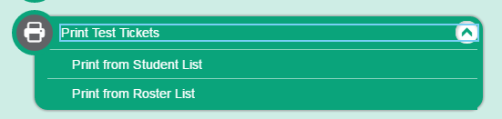
Printing Test Tickets
eSchoolPlus link to Cognos Reports
TIDE – Print roster list to ensure students are actually in TIDE
  Administering Tests
    Print Test Tickets – select from student list or roster list
TAC – Teacher Access Center
Notes:
Tickets may be printed ahead of time and saved for the next test session..
There are 3 ways to print test tickets
Use the Cognos links, there are 2 that start with ELPA21.
TIDE will allow you to print by grade level or select students individually. Print a roster from TIDE to ensure that students are in TIDE.
3. You may use TAC for a teacher classroom printout of tickets.

Slide 23
TEST ADMINISTRATION

Slide 24
TA Interface
Start a session by logging into WCAP no more than 20 minutes prior to testing
Select the appropriate grade level test
Approve student access
  The TA approves when all students have logged into each segment. Students will only have access to their appropriate grade level test.
Monitor student progress (16/20)
Print Test Session before stopping the session.
TAs will be automatically logged out (session stops) after 30 minutes of inactivity. Activity includes the students actively clicking next or back.
Notes:
The session cannot be started more than 20 minutes prior or the students will get an error message as they try to log in that the session does not exist.
A TA can administer the test to students taking different grade levels.
Ensure that all TAs are familiar with:
Starting a testing session,
How a student accesses the session, on time or late,
How to approve students joining the session.
TA Interface and Student login process provided in Docushare

Slide 25
Student Interface
Students log into the Session using their SSID number and legal first name as indicated on their test tickets, and the session ID.
  If students are unable to log in by themselves assist them with entering their login information correctly.
If a student arrives late:
  the student can join the session in progress with TA approval
  the TA can add another grade level test to the session already in progress, if necessary
Students can only access their grade level exam.
Notes:
Student login is the same for practice, interim or summative assessments.
Name needs to be entered exactly as it appears on test tickets. If incorrect, change the name in student information system.
If you want to administer 7th grade interim assessment to 6th graders, the SC must change the grade level to 7.

Slide 26
Test Security - Room Setting
Instructional materials related to the content of the assessments are not visible
Student seats are far enough apart to prevent students from viewing other screens
TA is prepared to respond to students asking for help:
  Students may look to the TA to verify that they have used the technology (such as recording a spoken response) correctly. The TA is allowed to acknowledge that the student has used the system correctly or redirect the student on how to properly use the technology.
  TA may Assist students as needed when indicated in the DFA
  Students can re-record or replay up to 2 times without an accommodation.
Notes:
Preparing the classroom according to test security guidelines.
Walls are free of materials that would guide student responses.
Desks are placed in an exam layout as opposed to a collaborative setting.

Slide 27
During testing

Slide 28
During Testing
Proctors move around the room
Post “Testing Do NOT Disturb” signs (Spanish)
Have a supply of No. 2 pencils with erasers for K-1 Writing
Keep K-1 Writing Test Booklets Secure
Verify that students are working independently
Volunteers are not allowed in any testing locations
Notes:
Reminders for what needs to be done during testing:
Post Do Not Disturb signs
Move around the room
Ensure security protocols are being followed.
And again, no volunteers and this pertains to interims as well.

Slide 29
Common chromebook (CB) solutions
  If the student is having technical difficulties, try these solutions:
  Replace the Chromebook
    Note the CB number and SC can notify IT if necessary
  Have the student log out and back in to the same session
  Call Assessment & Research Department x4057 or x4054
  Request technical help from Help Desk
  Error message “Recording is too soft” - Microphone is too close.
TA Interface has the ability to view test setting options before approving the student into the session. If options need to be changed, the SC will make the changes in TIDE and the student will need to log back into the session and will immediately see the changes.
Notes:
If the student has a text to speech working and shouldn’t have it. The student logs back in and the TA clicks on the eye icon to view the options and notify SC to make changes before approving the student back into the session.
SC will need to fix it in TIDE for immediate change.

Slide 30
New Student
eSP → CEDARS → TIDE
Students receive an SSID once uploaded to CEDARS.
  Students without an SSID number
    If enrolled for longer than a week, generate an LMS work order
    If newly enrolled, an SSID is generated in 3-5 days, remember that this is a testing window when scheduling new students to test.
  Students with an SSID but not showing up in TIDE
    Generate an LMS work order
In any case, an SSID will not be available until the next day.
Testing Private Students
  Work with Yu-Chin to verify their testing requirement
  May need an LMS work order
Notes:
Students receive an SSID the 1st time they are uploaded from eSP (SIS) to CEDARS. TIDE gets its information from CEDARS.
If CEDARS does not accept the request, the student will remain in eSP but not make it to TIDE.
If you are unable to find the SSID in TIDE generate an LMS work order with the student # and the enrollment date. Directions for LMS work orders can be found in Docushare under TA Materials.
If the student has an SSID and it is in TIDE we can begin testing even if the student is NOT enrolled in our district.
LMS has ways to circumvent the standard process to speed up the entry into TIDE (EDS screen entry).

Slide 31
Irregularities
Report any testing incidents or irregularities to the SC or Principal immediately to determine if a report is necessary.
Low/Impropriety: Issue is addressed in district and may need to be reported to OSPI
Medium/Irregularity: Issue is addressed in district and may need to be reported to OSPI
High/Breach: Issue will be reported to OSPI for discussion and resolution suggestions by OSPI
SC must report to the DC as soon as possible and no later than the end of the day.
Notes:
OSPI has broken out 3 areas of irregularity.
Level 1 is in-district
Level 2 may go to OSPI
Level 3 will go to OSPI
Report any concerns to your principal and the principal will contact the DC.

Slide 32
Required Documentation
eRoster for K-1 paper-pencil assessments
  Signed copy of the printed eRoster for paper-pencil assessments
Tracking Log for online testing; include any reason for not testing
TA Training Log
Test Security Assurance Forms
  Review the answer to the question about irregularities, “Have you reported all test security irregularities…?”
  If yes is marked, there should be comments in the top section or note referring to attached copy. If no irregularities, mark N/A.
Irregularity Forms (if any)
School Site Administration and Security Report
Notes:
These forms are required to be sent to our office.
Staff will still need to complete the TSA form, be sure that if a proctor answers yes to the reporting irregularity question that they reported an irregularity and we have the documentation. Please check these before submitting to us. If there was no irregularity mark N/A
We will send a reminder as testing nears the end.

Slide 33
Materials on Docushare
Required Documentation and Additional Forms
TSA – All Staff
School Security Report
Irregularity Forms
Parent Refusal Form
Required Reading Documents
TAM-SC (DFA included)
GTSA and PIRG
One-page Accommodations summary page
TA Materials
LMS Work Order Directions
Practice & Training TA Instructions
Do Not Disturb Signs (English & Spanish)
How the SC manages rosters
Print test tickets using TAC
Notes:
Let’s go over the list of materials on Docushare.
Required Documents
Required reading – TAM and DFA
One page reference
TA Materials
LMS work order
TA instructions
Do not disturb signs

Slide 34
Questions
Who to call after you talk with the principal:
Assessment & Research:
Terry Campbell ~ x4057
Annalise Schiessl ~ x4054
EL Department:
Deb Ritchhart ~ x4066
Yu-Chin Huang ~ x4031
  If instructed to contact Technical Support:
  American Institute of Research - Washington Help Desk
  wahelpdesk@air.org
  1.844.560.7366

Slide 35
Test Management

Slide 36
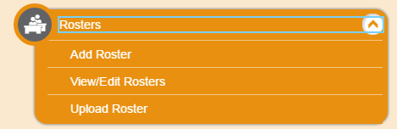
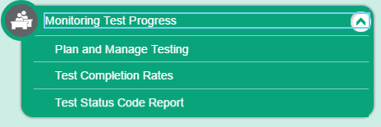
TIDE
  Rosters
    How the SC can Manage rosters
      Rosters determine data sorts
      Consider establishing rosters for small groups or special programs
    A&R uploads standard classroom rosters in TIDE
      SC should verify rosters and add new students before testing is completed.
  Monitoring Test Progress
    Plan and manage testing (have/have not completed)
    Test completion rates
    Test Status Code Report (confirm if a student paused a test instead of submitted)
Notes:
A&R will upload a roster groups for each EL specialists at the school by grade level.
Only the SC can create the roster in TIDE.
TIDE now provides ways to manage rosters, track sessions, and monitor completion rates. After testing, confirm that the appropriate tests were administered and who may need to complete on another day.

Slide 37
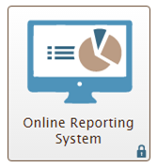
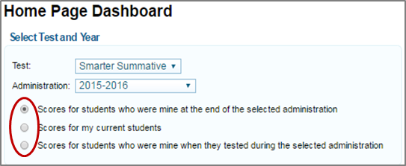
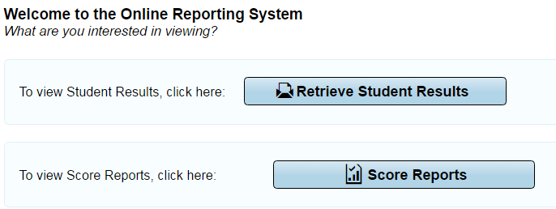
Online Reporting System
  Score Reports
    Score reports are test results populated into ORS of students tested when all components are scored for the student. This is a report OF TESTED, it does not consider accountability.
  Retrieve Student Results
    Download excel files by grade, by teacher, or roster. PDFs of individual student reports can be downloaded by group. Use student search to lookup an individual student’s report.
Notes:
T – ORS has 2 main components.
Score Reports and Retrieve Student Results.
Score reports or retrieving student results can be generated as test results are populated into ORS. This takes 2 to 3 weeks for results to show up. This is a report OF TESTED, it does not consider accountability.
In all cases, (interims or summative) the score will not be reported until all components are scored.
Regardless which of these two exporting features you want to use, always begin with Score Report to set your category of student score results.

Slide 38
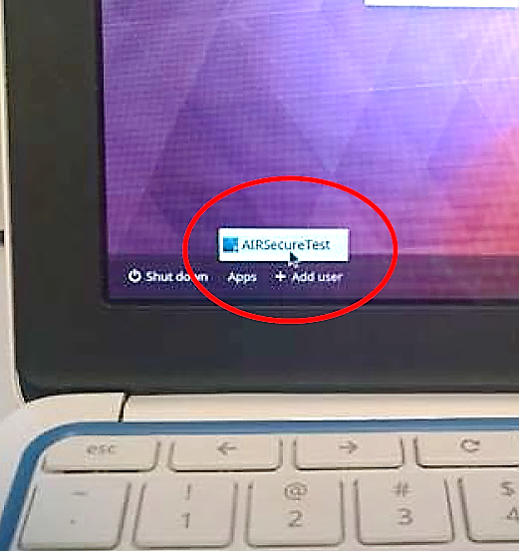
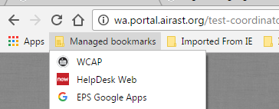
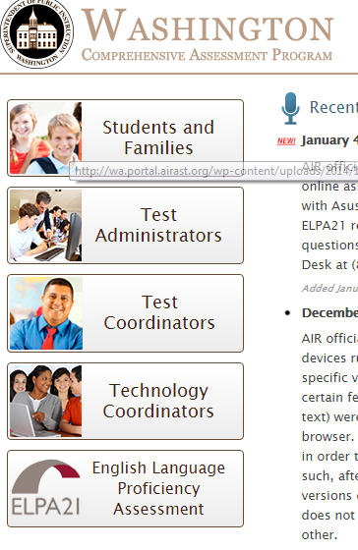
Navigating WCAP
http://wa.portal.airast.org/
Notes:
What browser MUST you use for state assessments?
In Chrome there is an easy access link to WCAP – Managed Bookmarks
Discuss the difference between accessing resources as test coordinators (SC) vs. test administrators (proctor). If as an SC, you need TA information use the left panel to access TA information. Either way, there is a search bar on the left inside of resources that is very useful.
Be sure to have students open the secure browser before testing.

Slide 39
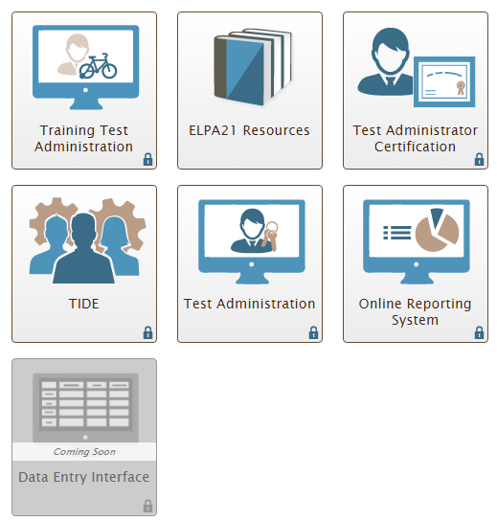
Allows TAs to practice administering tests and students to practice taking tests online and using test tools.
Allows TAs to administer operational tests. Access to ELPA21 Summative Assessment
View score reports, download student data files containing test scores and some demographic information.
Input student data from the paper/pencil and Braille versions of the test
Notes:
WCAP Portal Cards
ELPA21 training is in the Training Test Administration card
Test Administration launches the actual assessment
Online Reporting System to view scores
Data Entry Interface – Input student data from the p/p and braille versions of the test

