Slide 1
Assessment Update Webinar (excerpts for NWESD DAC meeting)
SY 16-17 Update #7
March 14, 2017

Slide 2
System Downtimes
The following AIR system downtimes are scheduled for March—May 2017:
Monthly Maintenance – The monthly scheduled maintenance for all AIR systems (TIDE, TDS, ORS, AIR Ways, AVA, and THSS) begins on Friday, March 24 at 6:00 pm. All systems will be back online by Sunday, March 26 at 7:00 pm. The next monthly maintenance for April 21-23 and May 19-21.
Test Delivery System (TDS) – TDS has a scheduled downtime all day on Friday, April 14 to prepare for the deployment of the MSP Science test on Monday, April 17. To minimize additional downtime in April, TDS will have downtime on the evening of Thursday, April 27 from 6pm -7pm only and Friday, April 28 beginning at 6pm through Saturday, April 29 ending at 6 pm, to prepare for the deployment of the NGSS High School Field Test that is opening on Monday, May 1.
Notes:
The next monthly scheduled maintenance for all AIR systems (TIDE, TDS, ORS, AIR Ways, AVA and THSS) will be the weekend of March 24-26, April 21-23, and May 19-21. All monthly maintenance downtimes begin at 6:00pm on Friday and conclude at 7:00 pm on Sunday. No special testing schedules can be approved during this time.
The Test Delivery System has a scheduled downtime all day on Friday, April 17, beginning at 12:00 am, to prepare for the deployment of the online MSP Science Summative assessments. These assessments will be available at 7:00 am on Monday, April 17 on the WCAP portal. News as of this morning, To minimize additional downtime in April, TDS will have downtime on the evening of Thursday, April 27 from 6pm -7pm only and Friday, April 28 beginning at 6pm –Saturday, April 29 ending at 6 pm to prepare for the deployment of the NGSS High School Field Test that is opening on Monday, May 1.
Please take time to review your schedules to ensure that testing sessions are not established during these downtimes. This should also include review of your ELPA21 test schedules.

Slide 3
Test Windows
Extended Testing Window
The online window for the Smarter Balanced online Math and ELA has been extended through end of day June 15. This applies to both on-grade and off-grade testers.
Grade 3 testing window
This is a reminder that Grade 3 ELA does not have a separate testing window from grades 3-8 math and grades 4-8 ELA, as the requirements for meeting with parents/guardians changed.
Additional information about SSB 5803 and mandates for K-4 literacy can be found at http://www.k12.wa.us/SSEO/K4LiteracyData.aspx .
Notes:
OSPI and AIR have been in conversation regarding the inclement weather that has hit much of Washington and the option of extending any of the windows for the Spring administration. We have confirmed that we are able to extend the Online Smarter Balanced ELA and Math testing window from June 9 until the end-of-day on June 15. This extension applies only to Smarter Balanced online on grade and OGL assessments for students in grades 3-8 and 10-12.
As a reminder, the Substitute Senate Bill 5803 for K-4 literacy changed in 2016. Students in grade 3 are no longer assessed in a separate (earlier) testing window. The testing window for grades 3-8 math and ELA are on the same schedule. Additional information can be found under the K4LiteracyData link on this slide

Slide 4
TIDE
Enhancements
Updates to View/Edit/Export students settings have been implemented over the last two weeks to align with the GTSA. The final updates will conclude on March 19 for access on March 20
Included are updates to Test Window and View/Edit/Export students New TIDE Test Windows application available on March 20
TIDE Appeals enhancements include:
Comments applied when appeals are submitted, now appear in the export file
DCs and DAs submit appeals after researching the situation
Incorrect student settings now corrected in TIDE View/Edit/Export, with exception to Braille, ASL, and Spanish
Reset and Reopen Previous Test Segments or Test appeal approvals are extremely limited for unique circumstances.
Notes:
The Student Information View/Edit/Export Settings application is where you can view and edit or upload student settings (OGL, Tools, Supports, & Accommodations). Updates have taken place over the last two weeks to better align options to the information found in the GTSA. The last of the updates will conclude on March 19 for district access on March 20. A search/export records function of students by tools, designated supports, and accommodations is now available and can be used as a communication tool with TAs.
The Test Windows application in TIDE, is being updated now and will be fully operational by March 20. This application can be utilized by DCs to establish summative testing schedules for each school. By setting a school schedule, the summative assessments will not appear for TAs until the first day that the DC has set the window to open. Setting the Summative windows within TIDE will help to eliminate a TAs incorrect test selection of a Summative Assessment when the intent is to administer an Interim Assessment. The windows are available for review by SCs and TAs.
Even though the application is active, please do not attempt to set schedules until March 20, as the data selected prior to March 20 will not be saved.
As a reminder, the TIDE appeals system has been enhanced this spring. Some of the enhancements include:
DC and DA access for submitting appeals. This means that the district office receives direct communication from the state and contractor regarding the submission.
Comments applied when appeals are created, now appear in the export file.
The export file can be merged with the Test Incident Excel log that is available on the WCAP Portal.
Appeals are no longer needed for student test setting changes in TIDE, with exception to the Braille, ASL, and Spanish Stacked Translation tests. TIDE updates are real-time, allowing the student to immediately re-enter his or her current test session.
Approvals for Reset appeals are extremely limited to unique situations such as a student being assessed on a standard form when the student should have taken a Braille, ASL, or Spanish test. Another situation would be if an ineligible student was assessed or a student being assessed on the incorrect grade level assessment.
Approvals for Reopen Previous Segments or Tests appeals are also extremely limited. An example of a situation allowing an approval, would be a system or technology issue logging the student out of his or her test session. A request to reopen a test or previous segment due to a student moving through the multiple warning messages and ending his or her test, would not likely be approved.

Slide 5
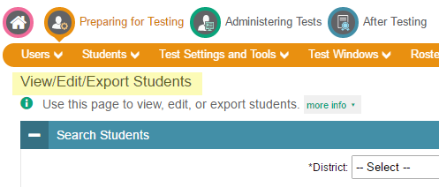
TIDE View/Edit Student
Test Settings
Students testing on grade level automatically see tests in the test delivery system (TDS)
Off-Grade Level (OGL); identified on the View/Edit Student settings page in TIDE
Braille or Spanish Stacked Translation; identified under accommodation—Presentation label in TIDE
Student Test Settings are updated in TIDE prior to testing
Test settings not correctly identified in TIDE; pause the test and modify TIDE. Updates apply immediately
Incorrect test given to a student; submit an appeal in TIDE to reset the test opportunity
Notes:
Students who are testing online with the on grade level assessments will automatically see tests available in the test delivery system (TDS), based on their enrolled grade level as reported in CEDARS.
If you have students testing Off-Grade Level (OGL) for either Smarter Balanced or Science, please make sure the student has the OGL setting applied on the View/Edit Student settings page in TIDE. This is necessary for the OGL to be presented to the student in the TDS.
OGL testers will see both the on grade level test and the OGL test when they log in to a test session. TAs will need to provide direction to the students as to what test is being administered during the current session. If the student selects the incorrect test, the TA should Deny access to the student so that the correct test can be selected.
In addition for students testing online with the Braille or Spanish Stacked Translation accommodation, the Presentation setting must be set on the View/Edit Student settings page in TIDE for students to see the tests in TDS.
If a students test setting was not correctly identified in TIDE prior to the student beginning a test session, the TA should immediately pause the test and alert the SC to modify TIDE. The View/Edit Student settings are real-time so that the student can immediately rejoin the current session with the correct accessibility supports. This applies to all settings, with exception of Braille, Spanish Stacked Translation, and ASL.
When a student has been incorrectly assessed with an on grade level assessment or a standard form and should have received the Braille, Spanish, or ASL, the DC will need to submit an appeal to Reset the incorrect test, so that the student can complete their testing opportunity.

Slide 6
Best Practices
Tips for Testing
Staff training is required annually, prior to the administration of Spring assessments.
When a test incident occurs or a student is provided the incorrect test or accessibility feature, immediately pause the test until the situation is resolved.
Calculator use on a non-calculator portion of an assessment requires an invalidation appeal to be set by the DC in TIDE.
Students should attempt their best response prior to moving on from an item
Correct test selection by the TA for student access to the test session is critical
Students in grades K and 1 taking the ELPA21 assessment must be assessed on both the online writing test and the paper-Pencil Writing Supplement in order to obtain a score
Notes:
Staff training is required prior to the administration of spring assessments. Training materials and templates are available on the WCAP Portal to support coordinator and TA training. It is important that all staff review the Guidelines for Tools, Supports, and Accommodations (the GTSA) and the Professional Standards and Security Incident and Reporting Guidelines (PIRG) documents, as well as documentation that is specific to the responsibilities of that staff member who is supporting the preparation or administration of state assessments.
When a test incident occurs or a student is provided the incorrect test or accessibility feature, the TA should immediately pause the test until corrective action has been taken to mitigate the incident.
Refer to the Calculator and Electronic Device Policy for availability, use, and restrictions of electronic devices. Student access to a non-approved calculator or calculator use on a non-calculator portion of an assessment automatically results in invalidation of the students test. The DC will need to set the invalidation in TIDE.
Students must enter an answer for each item on a screen before they will be able to move to the next screen. Although students can mark a question for review to answer at a later time, it is best to instruct students to attempt their best response for each question prior to moving on or marking the question for review. If a student enters random text [gibberish] to move ahead to the next question of the assessment, the system will count the question as answered, and the student may not be able to return to the question for the following situations:
Test is timed out for 30 minutes or the test is paused for more than 50 minutes.
A system of technology issue occurs in which the student is logged out of the test
A student becomes ill and needs to leave the test session
A student mistakenly moves beyond a segment (ignoring warning messages) prior to reviewing flagged questions or completing all questions in that segment or test.
Once a test (such as MSP or ELPA21) or segment (such as CAT or PT) is submitted, students cannot go back and review questions, even if marked for review.
When teachers are proctoring students through the training and practice tests, it is a great time to share this type of information with students. The TA Script of Student Directions also includes a SAY box alerting students to this best practice.
TAs should be reminded of the importance to only select the assessment being administered during that TAs test session. This will eliminate a student accidentally requesting access to the incorrect test. The TA Script of Student Directions provides graphics of both the highly recommended and Not recommended methods for test selection.
With the closing of the ELPA21 test window on March 30, it is important to take inventory of whether or not all eligible grade K and 1 students have completed the Writing Supplement. Students in grades K and 1 must have completed both the Online Writing Assessment and the Paper-Pencil Writing Supplement in order to receive a score in Writing.

Slide 7
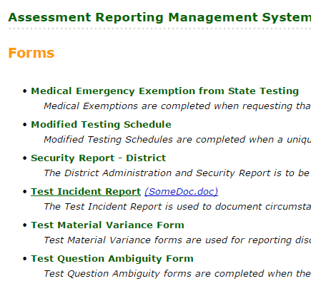
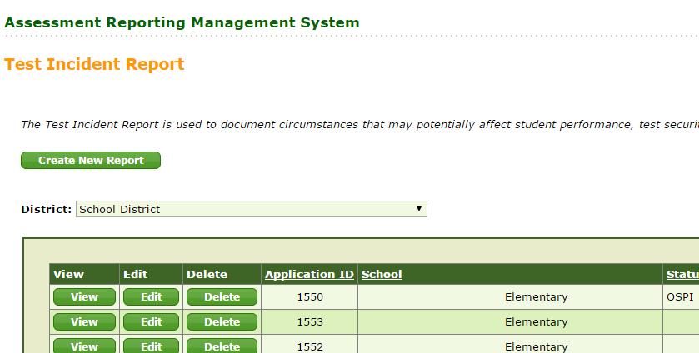
Reporting
ARMS (Assessment Reporting Management System)
ARMS – Test Incidents
New online reporting system for Test Incidents
SCs creates report, submits for DC approval. DC retains report or sends to state.
Filling out the ARMS form will create an exportable version of the Test Incident report to mirror what is currently available on the WCAP Portal.
ARMS is also being designed to replace the paper process for:
Modified Testing Schedules
District Security Reports
Test Material Variance Forms
Test Question Ambiguity Forms
Notes:
The Assessment Reporting Management System, or ARMS, is a system in EDS for securely reporting Test Incidents. Enhancement are being finalized. We anticipate ARMS being available in the next couple weeks to support the spring administration. Please continue to use the paper process until these enhancements go live.
The user role can be limited to DCs or it can include DAs and SCs. As an example: In ARMS, the SCs creates the report and submits for DC approval. The DC then retains the report at the district level, or escalates to state if needed.
Filling out the ARMS form will create an exportable version of the Test Incident report to mirror the Excel spreadsheet currently available on the WCAP Portal. For this spring, the option to upload files is for record only. The uploads of student data will not be included in the export file. However, we are working to implement that feature in 2018.
Before ARMS becomes operational, we will provide a training PowerPoint to support DCs with this new process. OSPI is working to load all DC access to ARMS. DCs would then be responsible in working with your District Security Manager to add DAs or SCs, as desired.
ARMS is also being designed to replace the paper process for:
Modified Testing Schedules;
District Security Reports;
Test Material Variance Forms; and
Test Question Ambiguity Forms.

Slide 8
WCAP Portal Material Updates
Materials Recently Posted to the Portal
TAMs for Spring Assessments—Online and Paper-Pencil
TA Script of Student Directions—Smarter Balanced Online
PIRG—information includes security, professional practices, incidents, investigations, and reporting
Simplified Test Directions Guidelines—Designated Support
Calculator and Electronic Device Policy—Includes calculator use and restrictions, Demos calculator overview, and Bring Your Own Devices to school
Coordinator and TA Training PPTs—These state created PowerPoints should be supplemented with information specific to your school district
Excel Testing Incident Log—Electronic delivery of incidents and includes dropdowns for quick reporting
TIDE System and User Guide—Updates support student settings and appeals sections
Key Dates Excel Calendar—Posted often to support schedule updates
Multiplication Table
Scratch Paper Log
100’s Table
Materials Pending Posting
ELPA21 Domain Exemption Template—This template was created by Everett SD and provides guidance in determining and collecting domain exemptions
GTSA—Updates in the final stages and include enhancements and clarification on settings in TIDE.
Notes:
The green labeled box of Materials Recently Posted to the Portal displays materials recently posted to the WCAP Portal. – within the last several weeks
TAMs for Spring Assessments—includes the Online TAM supporting Smarter Balanced Math and ELA, as well as MSP Science. The Paper TAM includes Smarter Balanced, MSP, EOC, and OGL assessments.
TA Script of Student Directions—is available as a stand-alone document that can be printed and is specific to the test being administered. The Smarter Balanced Online script is posted now and will be followed shortly by the MSP Online, Smarter Balanced and MSP paper, and EOC scripts. Having the directions to the student in separate documents allows TAs to review the TAMs online, eliminating additional printing.
Professional Standards and Security, Incident, Reporting Guidelines—provides information to support professional standards and ethical testing practices including policies, responsibilities, and permissions. It also provides detailed information regarding test security, incident processing and reporting.
Simplified Test Direction Guidelines—The TA simplifies or paraphrases the test directions found in the Test Administration Manual according to the Simplified Test Directions Guidelines. TAs must be familiar with these guidelines prior to use of this support. These guidelines are posted in the GTSA location on the Manuals and User Guides sub-folder of TIDE.
Calculator and Electronic Device Policy—has been updated and now includes calculator use and restrictions for each assessment.
Coordinator and TA Training PPTs—are state created training PowerPoints to support DCs in the training of DAs and SCs in the management and preparation of the spring 2017 administration of state assessments. These resources should be supplemented with information specific to the school’s in your district.
Excel Testing Incident Log—is available to support electronic delivery of testing anomalies.
TIDE System and User Guide—has been updated in support of the recent changes implemented in TIDE under the student settings and appeals sections.
Now moving to the orange Materials Pending Posting label
ELPA21 Domain Exemption Template—is a district created resource that has been shared by Everett SD. This resource may be a support in your schools to help determine and document domain exemptions.
GTSA—is in the final stages of updates, which include enhancements and clarification on settings in TIDE. As a reminder, the accommodation policies and guidelines apply to the grade level of the test, not the grade of the student. These policies are based on the construct being measured which is defined by the grade content not by the age/grade of the student.

Slide 9
Reminders and Timelines
Upcoming Timelines
March 13: EOC spring initial order window (view only) in TIDE closes
March 6: Online test window opened for Smarter Balanced, on grade and Off-Grade Level
March 6: Paper-pencil test window opened for Smarter Balanced grades 3-8
March 20: Smarter Balanced test scores available in ORS
March 27: TIDE opens for setting invalidations from Winter EOC administration
March 30: ELPA21 testing concludes
April 3: All ELPA21 entries must be submitted in the Data Entry Interface (DEI)
Notes:
On this slide, you will find a brief list of upcoming date reminders and timelines for Spring testing.
The initial order window for spring EOC testing remains view-only in TIDE from February 27 through March 13. The quantities for initial orders are based off students pre-identified in the WAMS spring EOC pre-ID application.
The online test window for Smarter Balanced on grade and Off-Grade Level testing opened in TDS on March 6 and closes June 15. Note that the closing date has been extended from June 9.
The paper/pencil test window for grades 3 through 8 Smarter Balanced assessments also opened March 6 and closes May 19.
On March 20, Smarter Balanced test score begin rolling into ORS, becoming available for districts to view.
TIDE will open on March 27 for setting invalidations from the Winter EOC retake administration.
With the closing of the ELPA21 test window on March 30, it is important to schedule enter all student responses for braille into the Data Entry Interface by no later than close of business on Monday, April 3.

Slide 10
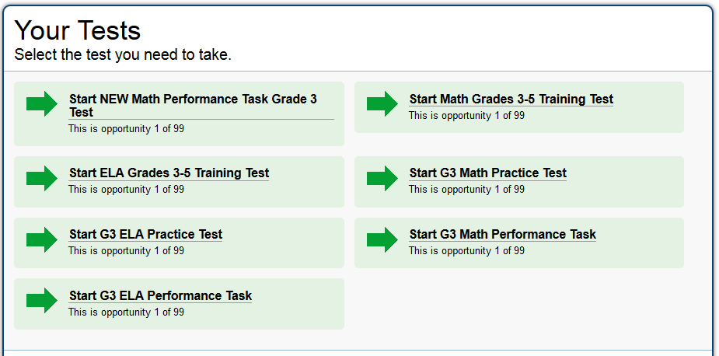
New Mathematics Practice PTs
Smarter Balanced released new Practice Performance Tasks for grades 3–8 and HS
Available on the Smarter Balanced Practice and Training Test page
Scoring guides are available in Resources section
Reminder: no student responses are saved and no data results are generated for any practice test
Scoring guides can be used to inform educators of expectations prior to student taking a practice test or used at the same time as students are taking the practice test
Practice tests are not secure
Posting to WCAP Portal
Working with AIR to post these new PTs to WCAP Portal in the Practice and Training Test section
Plan to have both the old PTs and new PTs on the WCAP Portal
Notes:
Smarter Balanced has released new practice performance tasks in mathematics for grades 3 through 8 and high school. Currently they are available on the Smarter Balanced practice and training test page, available via the first hyperlink here. As the screenshot for grade 3 shows, these performance tasks are labeled “NEW” and the old performance tasks are still available. Similarly to the old practice performance tasks, there are scoring guides for these new performance tasks in the practice test resources section on the Smarter Balanced page, available via the second hyperlink here. Please remember that no student responses or data are generated for the practice tests; scoring guides could be used for educator professional development or while students are taking a practice test because the practice tests and their scoring materials are not secure.
We are working with AIR to post these new performance tasks to the WCAP Portal on the Practice and Training Test section, available via the last hyperlink here. As with the Smarter Balanced page, the plan is to include both those new performance tasks and the old performance tasks on the page. The tentative schedule is to have them available sometime around March 24, but you can access them right now, if desired, through the Smarter Balanced site.

Slide 11
Teacher Recruitment: Smarter Balanced
Recruitment information was sent to everyone subscribed to the Math, ELA, and Digital Library Email alerts lists on February 7
Deadline for teachers to apply was February 16
Over 200 educators applied!
Nominated educators and alternates:
OSPI notified all applicants of status
Smarter Balanced will make the final selection based on representation of grade levels, content, and demographic data across states
Educators will be contacted directly by Smarter Balanced or vendors managing the projects
Notes:
A reminder that OSPI recently recruited educators to participate in a wide range of activities working for Smarter Balanced between now and the end of the calendar year. Although this particular recruitment window closed in February, we were excited by the interest in these activities as we had over 200 educators who applied. We have passed along the Washington nominees to Smarter Balanced, so either they or the vendor running the meetings will be contacting selected educators directly with specific details.

Slide 12
Teacher Recruitment: WA specific
In addition to Smarter Balanced opportunities…
ELA and Mathematics content teams will be doing “Member-managed” item development
Washington educators will work with OSPI staff to write and review assessment items that will be used on Smarter Balanced assessments
Mathematics: writing items April 19–21 and reviewing items April 26–27
ELA: writing items April 17–21 and reviewing items April 26–28
Recruitment sent March 9 to the Math and ELA Email updates lists: Due March 24
ELA recruitment application
Mathematics recruitment application
Notes:
In a similar way, OSPI is recruiting educators from our state for a round of member-managed item writing. This is in addition to the Smarter Balanced teacher recruitment described on the previous slide. This member-managed work is an opportunity for educators to write and review items with guidance from OSPI staff using Smarter Balanced item development resources. Both mathematics and ELA opportunities will be the last two weeks in April, with specific dates shown for both content areas and committees. Educators who are signed up to receive email and text alerts from the ELA and mathematics assessment offices should have received a link to the application last Thursday. More information about each committee’s work is available through the two application links on this slide. Any interested educators are encouraged to apply by March 24.

Slide 13
High School Next Generation Science Field Test—Update
Registration Window Extended: December 1, 2016 through April 30th
Test Window: May 1 through June 15, 2017
Teachers coordinate with their principals and District Assessment Coordinators to participate.
No extra steps are needed to participate in elementary and middle school field testing as this is already part of the online Spring MSP.
Contact: science@k12.wa.us with questions
Notes:
Due to popular demand, we are keeping the registration application in WAMS open and available through the end of April.

Slide 14
Inventory of Time Students Spent Testing for the 2015-16 School Year
Report to the Legislature posted (2017 list, “Assessment Inventory”): http://www.k12.wa.us/LegisGov/Reports.aspx
Unknown if the Legislature will ask for this data for 2016-17.
Can use the same worksheet to gather data from schools this current year.
Contact Kara Todd kara.todd@k12.wa.us with questions
Notes:
The results of the Inventory of Time Students Spent Testing for the 2015-16 School Year is posted to the OSPI Legislative Reports webpage. The link to the page is on the slide. Look at the 2017 list, look for the Assessment Inventory pdf at the bottom on the 2017 list (just above the 2016).
We do not know if the legislature will request this type of information for the 2016-17 school year.
We know that some of you elected to keep track during this school year just in case, and you are welcome to use the same data collection worksheet to gather the information. We have posted the file, called “AssessmentInventory_DataCollection_worksheet” to the Test Coordinators Resources General Information file on the Portal.
We likely won’t know if the Legislature will request the information again until they pass a budget—since the request last year was part of the budget bill.

Slide 15
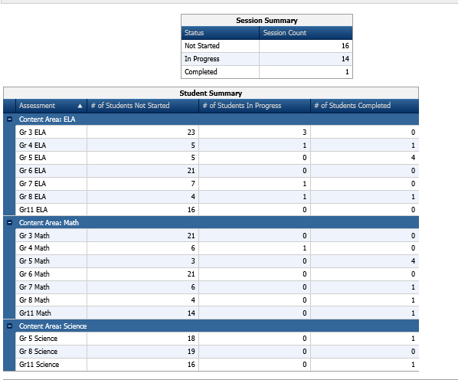
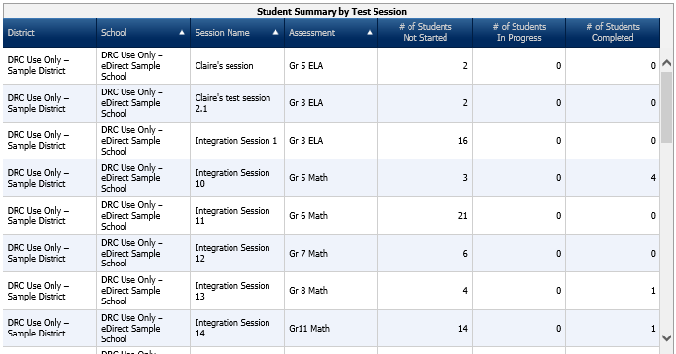
WA-AIM – Window closes April 7, 2017 at 5:00 PM
To check district/school progress:
Log into eDirect
Click Test Management>Manage Test Sessions
Click Show Sessions > Status Summary
Notes:
The WA-AIM test window closes April 7, 2017 at 5:00 pm. District and school test coordinators are encourage to use the Test Management menu tab to monitor their district or school submission progress. Directions for accessing this feature are provided on the slide. You will be able to look at the Status Summary by content and grade level and by Test Session.

Slide 16
Collection of Evidence (COE) Winter
Scoring is underway – January 30 – April 7:
ELA is in process = January 30 – February 24 - COMPLETED
Math scoring = February 27 – March 17 7 {COMPLETED}
Biology scoring = March 27 – April 7
Submission counts total 3,893
ELA – 1,060
Math – 1,231
Biology – 1,602
Scores will be released by content area (all dates tentative):
ELA = March 10 - COMPLETED
Math = March 31 MARCH 17
Biology = April 14

Slide 17
Graduation Alternatives - Eligibility
Present statutory language establishes eligibility to access assessment graduation alternatives with a requirement that students previously participate in a “statewide student assessment”.
OSPI is working to clarify the meaning of “statewide student assessment” for this purpose, but doesn’t expect resolution prior to completion of spring testing.
Therefore, as with earlier guidance for Class of 2017 (and earlier) students, Class of 2018 students will be considered participants in a “statewide student assessment” and may access assessment graduation alternatives if:
The student’s assessment is state-administered, and
The assessment is applicable for the student to use to fulfill an assessment graduation requirement

Slide 18
2016-2017 ELPA21 Status
Through Wednesday, March 8, the state has completed approximately 75% of anticipated testing
The test window closes for regular administration of ELPA21 – March 30

Slide 19
Assessing Students with Significant Cognitive Challenges
Memo was released March 9 addressing the assessment to be administered with the specific students.
ELPA21 not WIDATM Alternate ACCESS for ELLs
Test Window – April 12-May 26, 2017
Additional guidance, specific to the students’ needs, will be forthcoming; guidance will center on:
“Stopping” rules
Domain exemption considerations
Alternative response options

Slide 20
2017-2018 EL Screening
The ELPA21 screener will be used for the first time for the 2017-2018 school year.
Those districts that conduct early Kindergartner screening (“Kindergartner Round-Up”) will have access to the ELPA21 screener starting in May.
Initial Testing (access) Date – TBD
Associated administration manuals available in April
The ELPA21 screener is only for students needing program identification for the 2017-2018 school year
Late arriving students in the 2016-2017 school year are to be screened using the WELPA screener.

