Slide 1
TIDE Training
Agenda for Today
What goes into TIDE?
Users
Students
Rosters
What can I get out of TIDE?
Plan & Manage Testing
Test Completion Rates
Student List
Roster List
Test Tickets
PreID Labels
Student Settings
February 28, 2017
Notes:
Agenda for Today:
We’re going to look at what information comprises the Testing Information Distribution Center
How we can extract that data for our use
Ablebits

Slide 2
TIDE & ORS Overview
TIDE
Plan & Manage Testing
Test Completion Rates
Test Status Code
ORS
Score Reports
Retrieve
Search Student
ISR
Assessments Completed

Slide 3
What goes into TIDE
Users
Upload SC and TA roles
SC can add TA and IS roles
SC can verify TA has an account and email is correct
TA can now directly request “Forgot my password”
DC adds the SC role
Student Information
Download a grade level file and Ablebits to your active students to generate a list of SIS students not in TIDE
Test Settings and Tools
Student Testing Options
Rosters
Rosters determine the data a TA can see
Rosters create data sorts and data reports
Consider Rosters for:
Group instruction
Special programs
Grade level for instructional team planning
Notes:
Overview of the 4 main components
Under Preparing for Testing -
1. USERs (TAs and SCs, DAs, DCs etc) and each has an account based on email address. SC can add TA and IS only
2. Student Information – download an excel file to Ablebits to active student list (more later)
3. Test Settings and Tools- Accommodations are added to the students through Test Settings and Tools (or through Student Information).
4. ROSTERS - Students are added to a TA roster connecting the email address (user) to the student and roster name for score reporting. This is very important to set up before testing so TAs can see the scores of their students who are testing now, AND the scores of their current students from previous years.
We will go into more detail in ORS training.
Users, students and rostering can be uploaded or hand selected and managed. Students can be in more than one group. For example, create a roster group for the 5th grade teacher who provides math instruction to all students.
NOTE: The SC can create and manage rosters in ORS if you notice a student missing from a score report you don’t need to go back out to TIDE to make corrections.

Slide 4
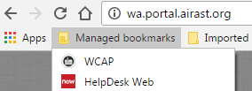
Student Information System (SIS)
SIS → CEDARS → TIDE
Students receive an SSID once uploaded to CEDARS.
Students without an SSID number
If newly enrolled, the SSID is generated 24 hours after a successful CEDARS upload
If enrolled prior to the last CEDARS upload, then there must be an issue with the student information or duplicate SSID
Students with an SSID but not showing up in TIDE
Prior district has not exited the student
SIS is missing required key data points (such as, date enrolled in US EL students) ELPA eligible but LEP = No
WA-AIM student in one content area or ELPA eligible
Private Students for ELPA or SBA
CEDARS manager must request an SSID in EDS/CEDARS
Notes:
Before we go into more detail about TIDE, I want to share some background information on eSP → to CEDARS → TIDE.
Students receive an SSID the 1st time they are uploaded from eSP (SIS) to CEDARS. TIDE gets its information from CEDARS.
If CEDARS does not accept the request, the student will remain in eSP but not make it into to TIDE.
If you are unable to find the student in TIDE:
Without SSID and not in TIDE
Students with an SSID and not in TIDE
Private students or non-enrolled need an SSID to test. Students do not need to be enrolled to test at our schools, but they need an SSID that is/was in TIDE at one point.
LMS has ways to circumvent the standard process to speed up the entry into TIDE (EDS screen entry). But this should be done on a limited basis.

Slide 5
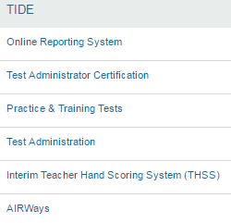
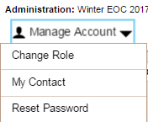
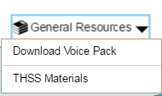
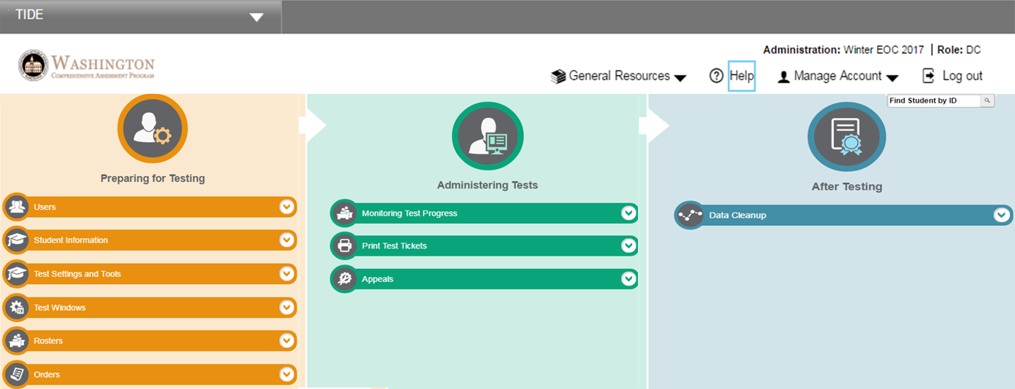
TIDE
Notes:
FIRST AN OVERVIEW OF the Test Information and Distribution Engine
There are three sections to TIDE 1) Preparing for Testing 2) Administering Tests 3) After Testing which we will discuss in more detail in future slides.
Single Sign On to all WCAP applications, meaning that at any time you can move from TIDE to ORS to AIRWays, etc..
Note the THSS calibration support materials located under General Resources for now.
Manage account – Manage account is where a duplicate account holder could “change role” from TA to IS, for example, but can be confusing if the TA is under the IS role, he/she will not have the same access as a TA. It is best to give users only one role. Delete the IS and leave the TA role only.
Also use “Change Role” to switch to a different test administration.

Slide 6
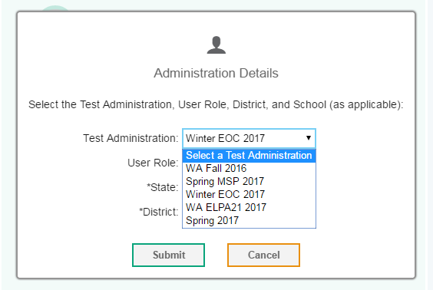
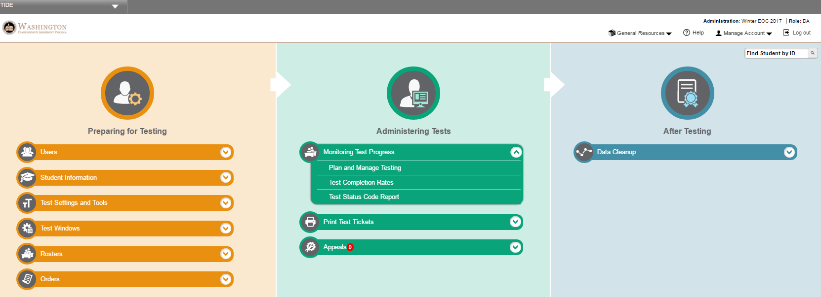
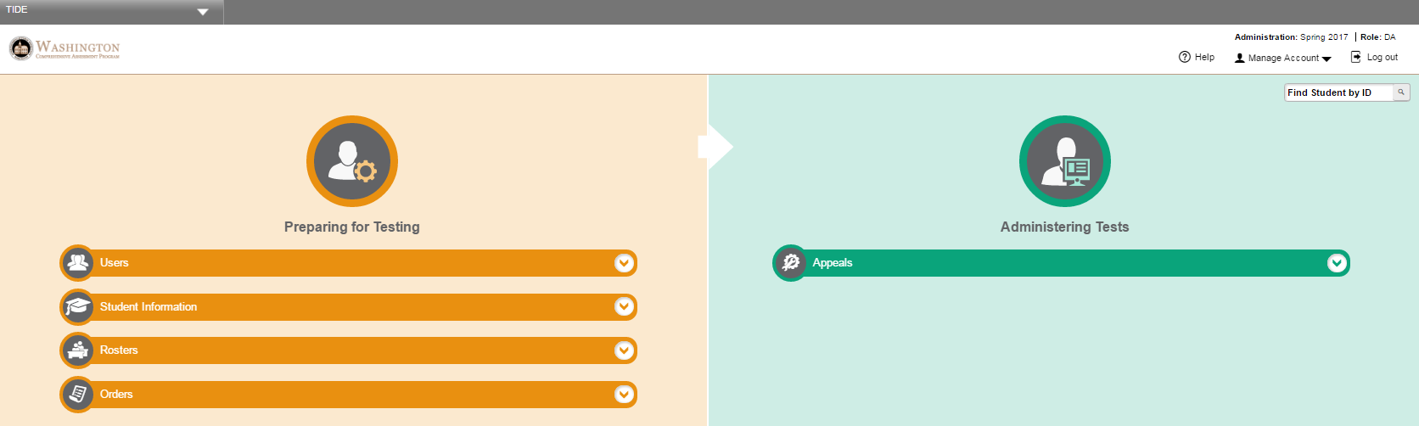
TIDE
Current home screen for
Winter EOC 2017
Change role to switch to another test administration
Current home screen for WA ELPA21 2017 and Spring 2017
Notes:
You now can see the difference between these two test administration areas, EOC and ELPA (Spring 2017) i.e., ELPA21 doesn’t have Print Test Tickets but EOC has access to print ELPA tickets and rosters (even though testing is done).
If you do not see a TIDE option you were expecting to have access to, go to “change role” to select another test administration without logging out and back in.

Slide 7

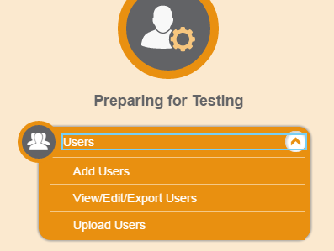
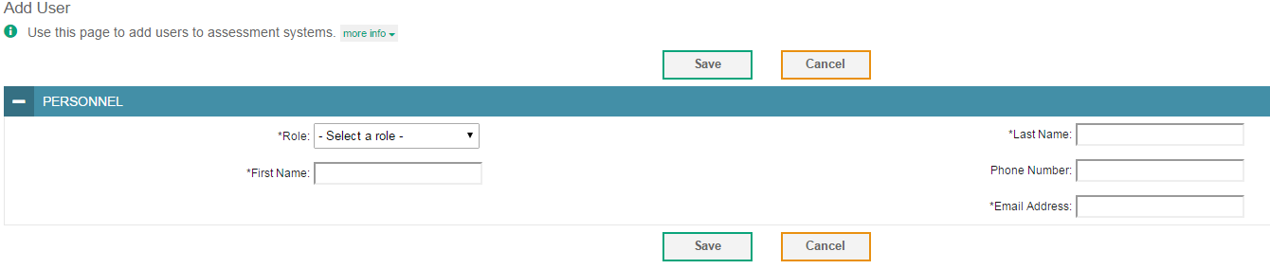
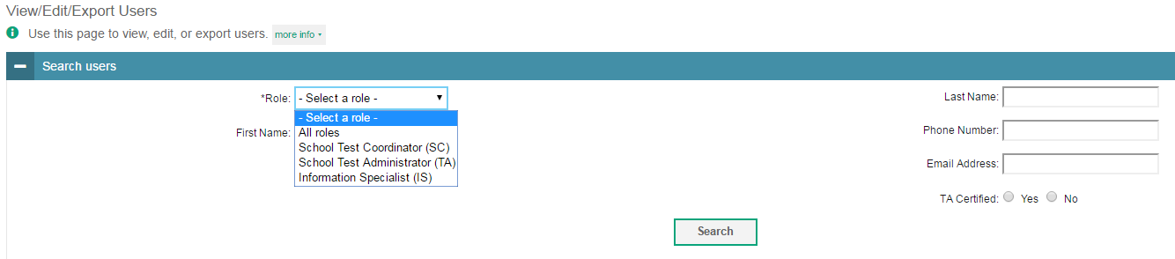
Add Users
Add User Screen
View/Edit/Export User Screen
Notes:
First notice the Instructional Resources sticker – that means there are screenshots for step by step directions.
We’ll start under the first component Preparing for Testing USERS
Add Users
View/Edit/Export Users
Upload Users – Staff are added in early September by A&R
Practice:
Add a USER:
Add TA or IS role – complete the required (*) information
View/Edit a USER:
View if email is in the system and correct
View email address, how many accounts?
View/Edit – Edit Staff name, not email address. They will need to be deleted and re added.
DC can add all roles
SC can add TA and IS roles
SC cannot add additional SCs

Slide 8
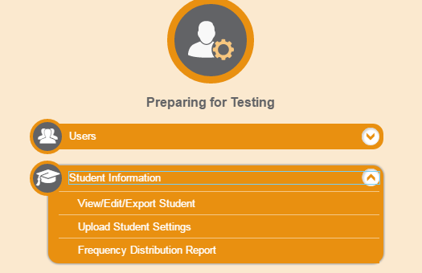
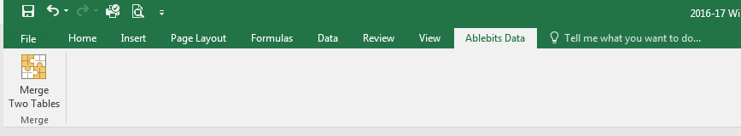
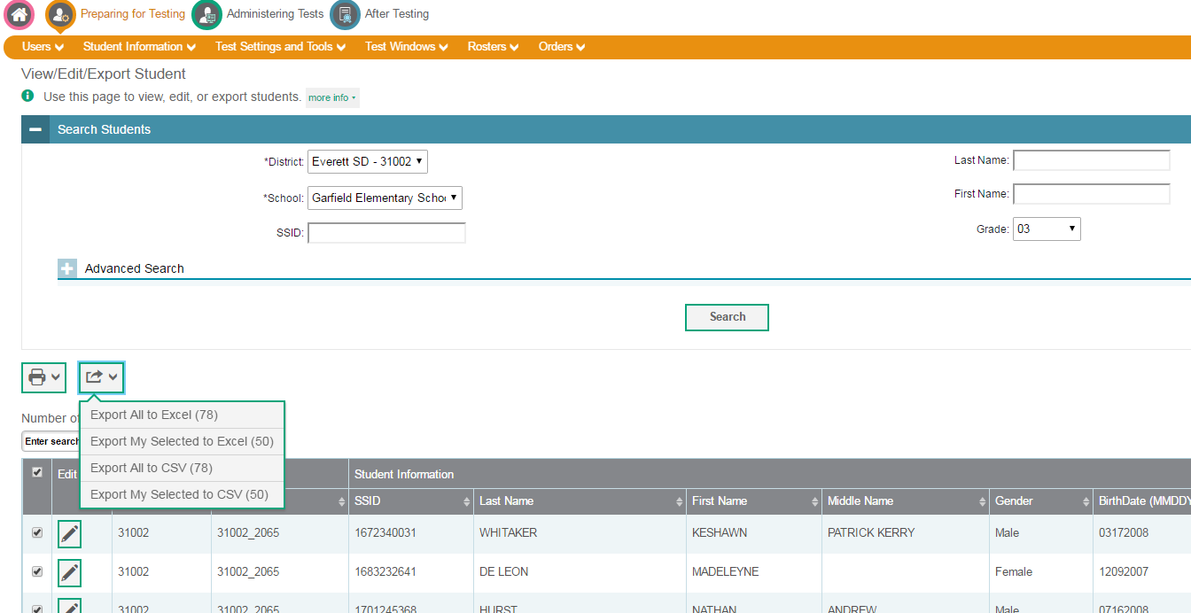
Export Student List
Notes:
Under Preparing for Testing (Sticky note)
Student Information
View/Edit/Export Student
Upload student settings – large # of changes
Frequency distribution report of demographics & coded fields from TIDE. I would prefer to use our active list and ablebits to score file.
The SC role can view and Edit student testing options individually, demographic information comes from eSP and must be corrected there.
Note: Once you check a box next to the student the Print options become available. Without selecting a student, the Print Options are greyed out.

Slide 9
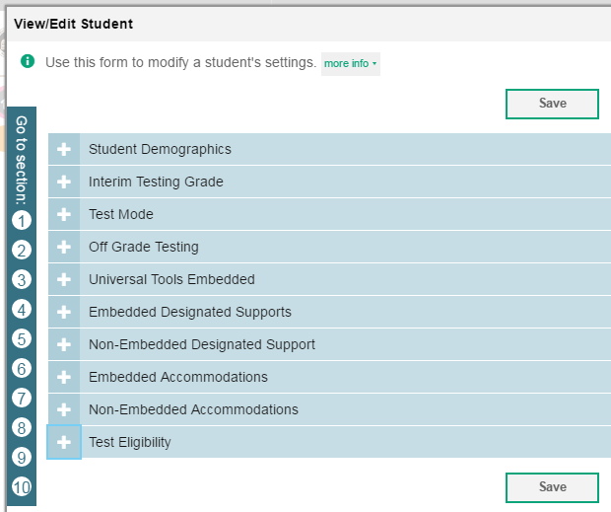
Test Settings and Tools
Universal, Designated, and Accommodations
Student Demographics
Interim Testing Grade
Test Mode
Off-Grade Testing (High School)
Universal Tools Embedded
Embedded Designated Supports
Non-Embedded Designated Support
Embedded Accommodations
Non-Embedded Accommodations
Test Eligibility – test “work around” for some testing access issues
New: Testing Options that do not appear at the beginning of testing, may be updated in TIDE in real-time. The student will need to log back into the session to continue testing with the new option.
Notes:
Under Preparing for Testing H/O 1 page accommodation with these notes on the back.
You will be able to set and manage student test settings.
SC/DC can individually make changes to test options or upload student files.
All student settings are now applied in TIDE real-time, and are no longer in TA Interface
Real-time applies to all student settings with exception of the Braille, stacked Spanish, and ASL settings.
You may have noticed some confusing entries between embedded/non embedded accommodations and designations. If not, I’ll show you.
Let’s review some of the common options and options that are not intuitive within their designation. We provided the note sheet for this slide on the back of the 1 page option sheet.
This is a screenshot of collapsed student information, with corresponding numbers.
2. Set Interim Test Grade Levels
4. Set Off-Grade testing level for High School students (student must be assigned to your school/district in TIDE)
5. Universal Tools – Embedded
turn off Strikethrough
6. Embedded – Designated Supports
Zoom (1, 1.5, 1.75, 2.5, or 3 times) for the whole test (Streamlined mode for larger font)
Text-to-Speech for Accommodations – ELA CAT, One option is to select “passages (accommodations)”, however, the student will not have Text-to-Speech for items. Be sure to select “passages/stimuli/items” to have complete Text-to-Speech testing options.
Math Glossaries
7. Non Embedded – Designated Supports
Read-aloud Designation – human reader for stimuli and items (no place to mark accommodations reading stimuli/passages)
8. Embedded – Accommodations
Math Stacked Spanish is really a designated option
Braille
Print on Demand – GTSA has this option listed under Non-Embedded Accommodations, yet TIDE has is set in Embedded Accommodations and Non-Embedded Accommodations (ELPA is a Non-Embedded Designation but is in TIDE as Embedded Accommodation).
9. Non Embedded – Accommodations
Speech-to-Text (must have Permissive Mode Enabled in Embedded Accommodations)
Any Questions?

Slide 10
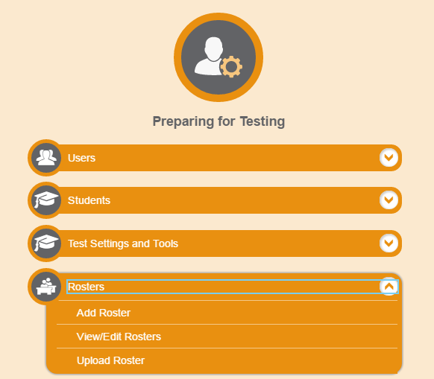
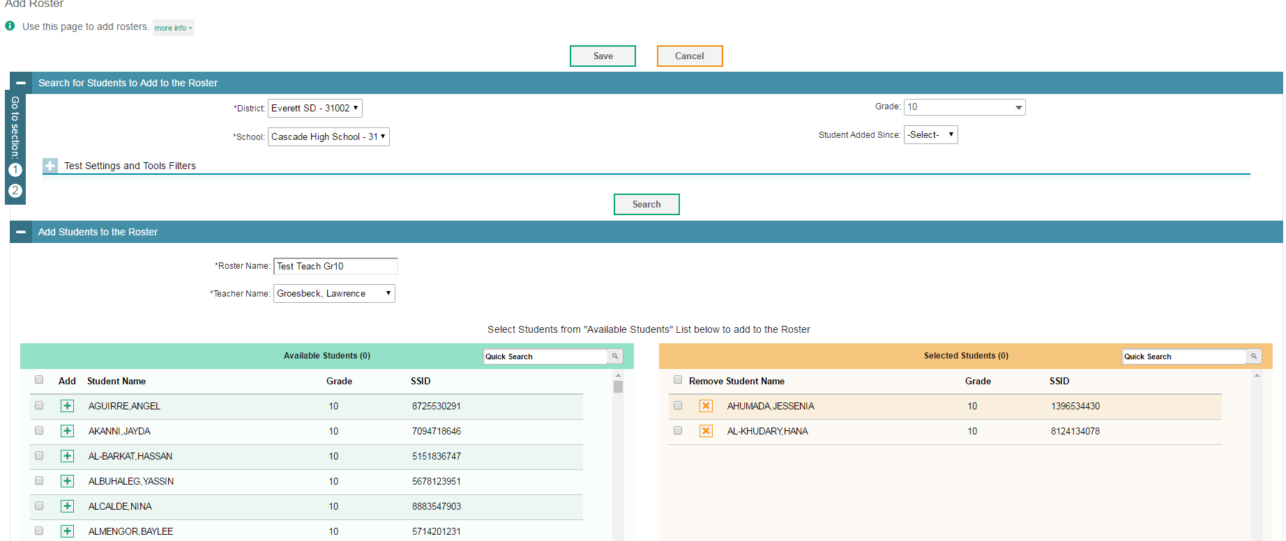
Create Rosters
Notes:
Under Preparing for Testing (sticky note)
It is important to note that score reports are extracted by Rosters/ownership in TIDE: Rosters determine the scores a TA can see. TA can’t see scores in AIRWays or ORS if not rostered.
1. Students who were mine at the end of the selected administration does not include scores for anyone who exited TIDE (enrolled in another school) before testing ended. Partially tested, will also not display if the student exits from TIDE
2. My current students – Current roster of students (in TIDE) regardless of where they tested. A TA can see scores for last year’s results (SBA or interim)
3. Mine when tested - students need to be rostered to a TA for him/her to see the scores. This is why rostering is so important.
What is the definition of the score category?
MINE means they were associated with “you” in TIDE. “You” is SC school, DC district or Roster to a TA.
We need to know this now to help us set up Rosters in TIDE. SC doesn’t need rosters.

Slide 11

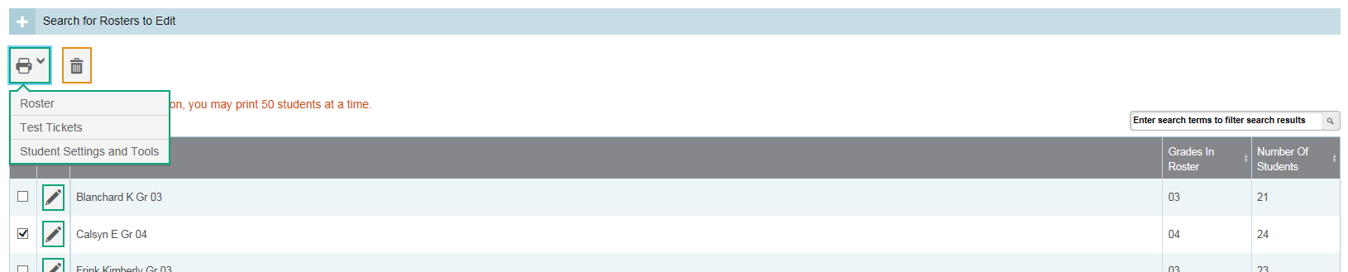
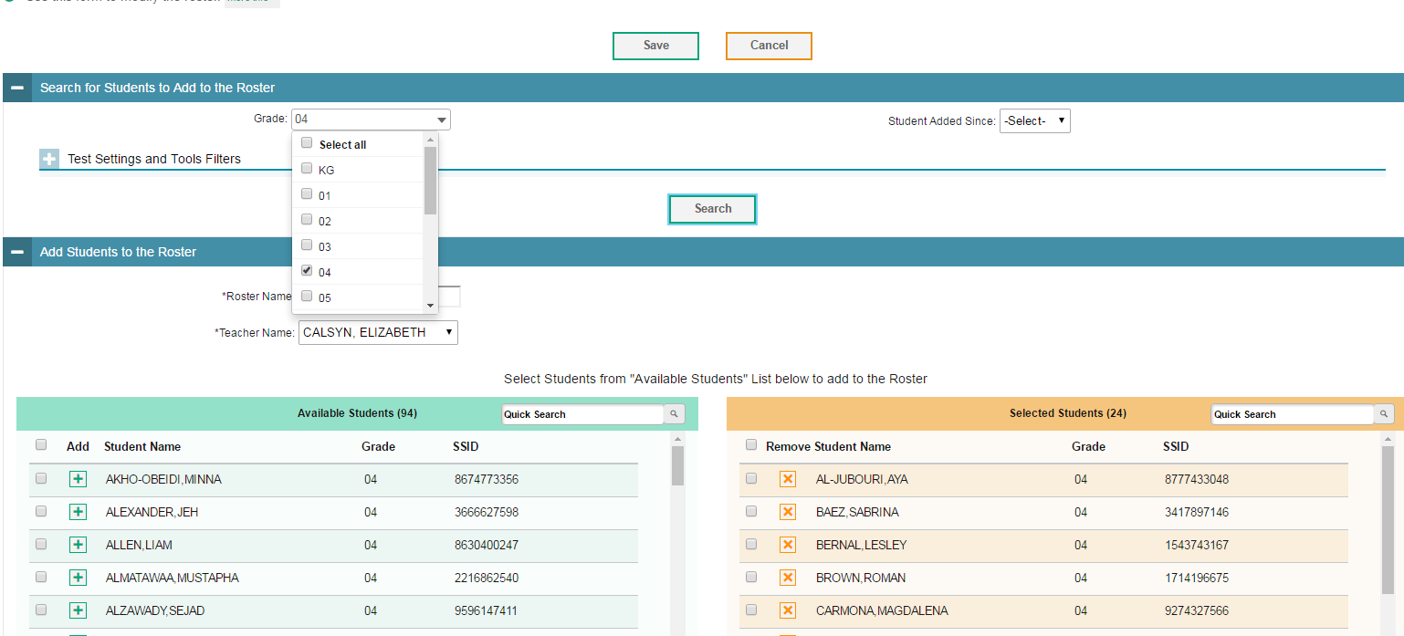
Add/Remove Students in Rosters
Notes:
To: Manage a Roster already created:
Select the Roster Name and teacher to add a new student to teacher relationship in TIDE.
Select the grade so those student names will appear on the left.
You can move students in or out of the roster.
Don’t forget to save!
Note: There is a print option which is useful to show the TA which students are on which rosters and then the TA could let the SC know when students need to be added or deleted from their roster.

Slide 12
What can we extract from TIDE
Test Completion Reports
Printing:
Test Tickets and Labels
Student List
Rosters, Verifying TIDE account
Student Settings

Slide 13

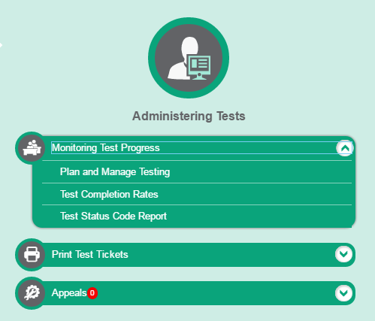
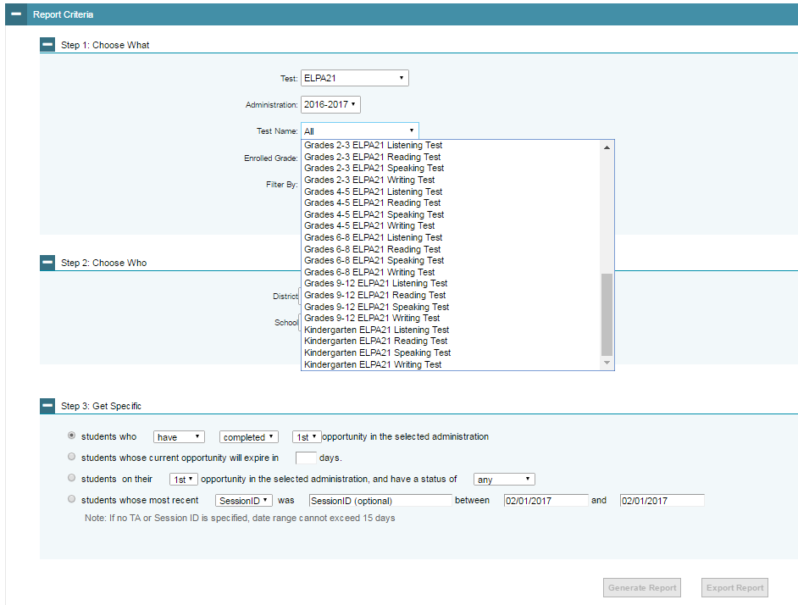
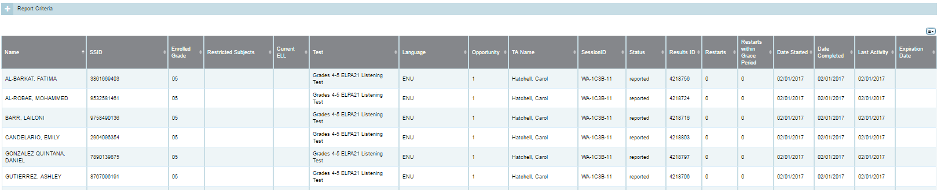
Administering Tests
Monitoring Test Progress
Plan and Manage Testing
Report that indicates which students have and have not completed specific tests
Notes:
Now moving to the 2nd component “Administering Tests”
TIDE is NOW where you find Monitoring Test Progress which includes 3 options:
First, is Plan and Manage Testing – Use this tool to identify by: exam; by grade; by session ID; or by TA who have not completed an exam. Plan and manage is very detailed to a specific test, session ID, TA Name.
You can also look for students whose exams are:
about to expire
students in a particular status i.e. started, paused, expired
reports by session ID which are also helpful monitoring interim assessments
Use these reports to determine who needs a makeup session.

Slide 14
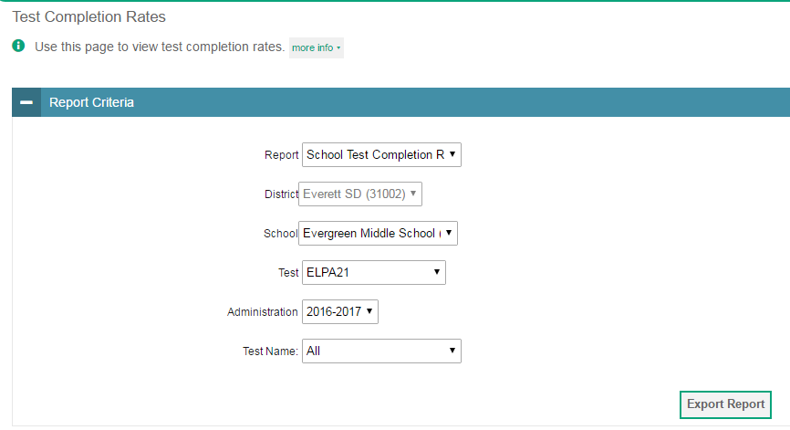
Administering Tests
Monitoring Test Progress
Test Completion Rates
Generate report by student by specific test content area
Notes:
2. Test Completion Rate – helps you monitor to a 100% completion per exam, based on all students who have started the test (not based on enrolled) If a student leaves the school you will not reach 100%.
This can give you a quick idea but you should run more specific reports to ensure students have finished all exams.

Slide 15
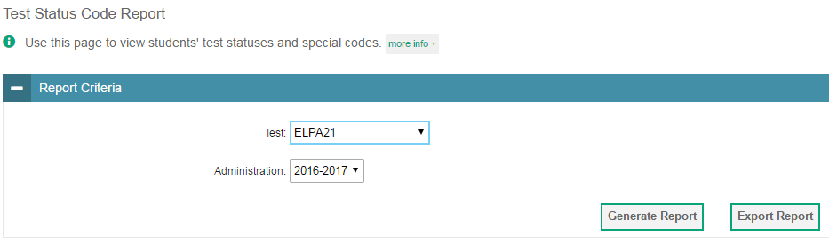
Administering Tests
Monitoring Test Progress
Test Status Code Report
Displays by all status codes for a test administration
Notes:
Still in Administering Tests (sticky note)
3. Test Status Code Report – Status of where each student is by exam started, paused, reported within each domain.
As testing window comes to an end, export excel file and review any student not “reported”. You can filter by test status or domain.

Slide 16
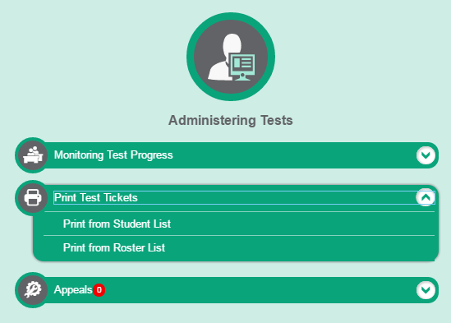
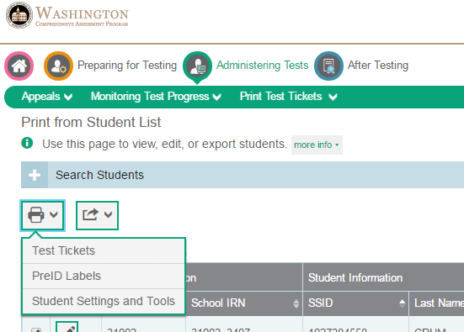
Print Pre-ID Labels
Student List:
Individual students can be selected from TIDE for:
Test Tickets
PreID Labels
Student Settings & Tools
Printing PreID labels is only available under Print Test Tickets → Print from Student List
Notes:
Under Administering Tests – Print Test Tickets – (sticky note)
Print from Student List– (Print or View PDF)
Print PreID labels are only accessible under student list
Print test tickets and student setting & tools included list is also available
Note: in order to see printing options, a student must be selected (bottom of right hand screen shot)
Practice: AS to pull up on screen
Sample of 3 students PreID labels
5047436045
4310193976
3276540595
Note: the list of students you are selecting does not remain on the screen. But will appear in the PDF to print.

Slide 17
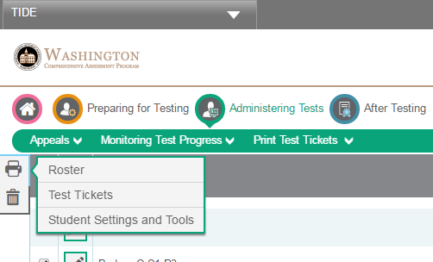
Print Rosters or a Test Ticket
Roster List:
Rosters can be selected to print:
A Roster List
Test Tickets
Student Settings & Tools
The TA can also print a TIDE Roster List ahead of time to identify students that may not be in TIDE.
Notes:
Administering Tests – Print Test Tickets (sticky note)
Print from Roster List– (Print or View PDF)
Is the only place to print a roster
You may also print test tickets and student settings and tools
Printing a TIDE roster can help identify missing students.
Note: test tickets and student settings and tools can be printed from either selection. Currently, student settings and tools print out is a run on list, but AIR is working on a revision.

Slide 18
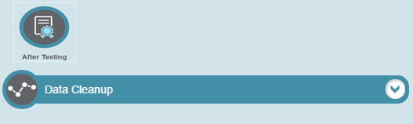
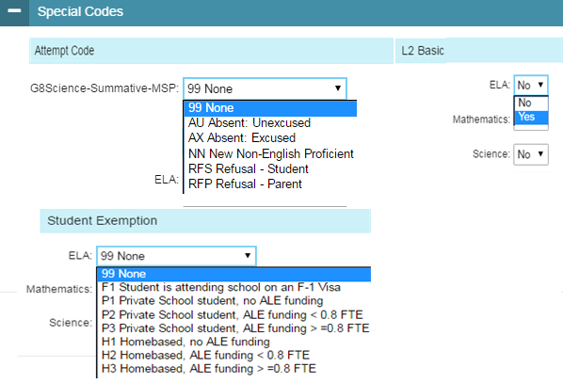
Data Cleanup
Notes:
Data Cleanup clean up data, including applying Participation Codes and Discrepancy Resolution
Participation Codes Formerly Test Incident Codes
1. Basic Level 2 is required here to display in report card as met standard. – Basic must be entered in TIDE before testing is completed.
Exemptions codes that effect participation are 1) NNEP, Private, Homebased, F-1 Visa.
NNEP is managed as a student test code but falls into participation. LEP first year in country must participate in math but does not need to participate in ELA. The NNEP identifies if included or excluded from participation.
If NNEP is coded correctly in CEDAR, no need to mark here.
Can use this system for documenting if desired, but not needed.
We will run a report of all the exemption codes in SIS and then send to schools for verification, i.e if they have a F1 not on the list they need to make the correction in eSP.

Slide 19
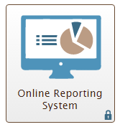
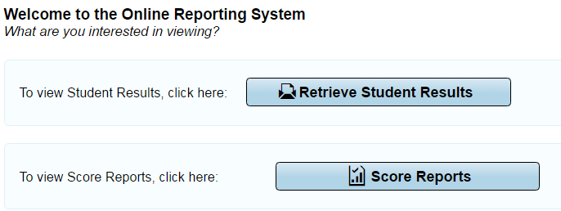
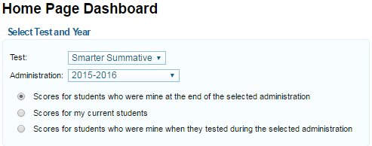
Score Reports
Score reports are test results populated into ORS of students tested when all components are scored for the student. This is a report OF TESTED, it does not consider accountability.
Retrieve Student Results
Download excel files by grade, by teacher, or roster. PDFs of individual student reports can be downloaded by group. Use student search to lookup an individual student’s report.
Note: Regardless of the report you are looking for, always begin with Score Report to set your category of student score results.
Notes:
ORS has 2 main components.
Score Reports and Retrieve Student Results.
Student score results are generated as early as 3 weeks after testing begins and are populated into ORS. This is a report OF TESTED, it does not consider accountability.
In all cases, (interims or summative) the score will not be reported until all components are scored (CAT and PT).
Regardless which of these two exporting features you want to use, always begin with Score Report to set your score category of student results.
There are 3 scoring categories.

Slide 20
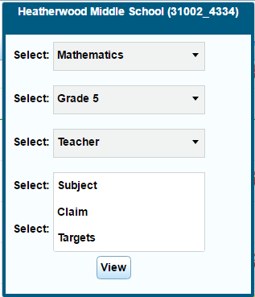
Definitions of the score categories for student results
1. Students who were mine at the end
2. My current students
3. Mine when tested
Select the grade level of the students when they took the test
DC can select school, and drill down to teacher, the teacher’s rosters, and down to a list of the individual students results.
SC can select reports by teacher, roster, or student
Leave the selection at subject to see proficiency and achievement level.
Subject drop down can be changed to view claims or target results.
Notes:
Let’s all take the role of a TA for starters
It is important to note that ORS score reports are extracted by Rosters/ownership in TIDE:
Students who were mine “rostered to me” at the end of the selected administration does not include scores for anyone who exited TIDE before testing ended. To exit TIDE student must enroll in another school. Partially tested, will also not display if the student exits from TIDE (this would help identify accountability results)
My current students – Current students and rostered to me in TIDE regardless of where they tested. A TA can see his/her current students scores for last year’s tests (ELPA, SBA or interim)
Mine when tested – Students “rostered to me” when tested. Students need to be rostered to a TA for him/her to see the scores. This is why rostering is so important.
What is the definition of the category?
MINE means they were associated with “you”, rostered to you in TIDE. Rostered to the classroom in the school does not.
You need to understand this as you are setting up Rosters in TIDE. SC represents the school and doesn’t need rosters since they see entire student body.
For example, I give a test to a student that is not on my roster. If the TA selects #3 in ORS the score will not display. Once the student is added to the TA roster, selecting #2 will see the score results. Remember, the roster determines who can see the data.

Slide 21
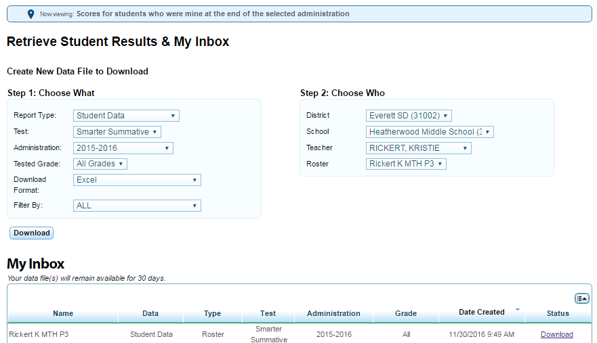
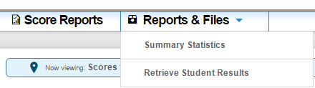
Download files based on specific parameters for an administration:
Generate a data excel file of preliminary score results
Data files include students’ personal information, enrolled school and district, grade level, and the selected test scores and reporting category scores.
Can filter on some demographics
Once you select download, your request will be queued and you will receive an email when your file is ready.
Notes:
Reminder, to retrieve student results by selecting score category first in score reports and then retrieve student results under reports and files (top right screen shot)
Download files to retrieve preliminary student results beginning a few weeks after testing has started. Results can be generated based on district level, school, grade level, teacher, and even teacher classroom if you rostered by period. You can choose the detail of the report in Retrieve Student Results.
There is some demographic information, but I prefer to ablebits against my active student list.
This is the report used to drill down to all levels.

Slide 22
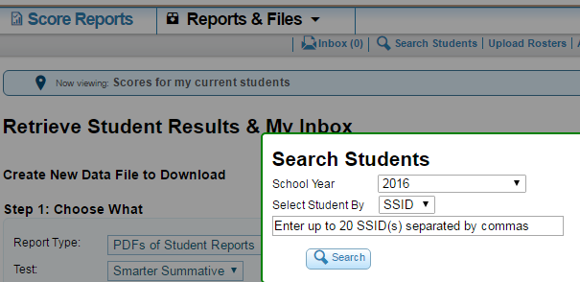
Search Students:
1. PDF of ISRs
2. List of tests completed
List of tests completed:
Click on exam name to print ISR
Notes:
Search Students is always available in ORS and is a great way to print a PDF of an Individual Score Report or to search on a new student to see what tests have already been completed and if the SSID is in TIDE in your building.

Slide 23
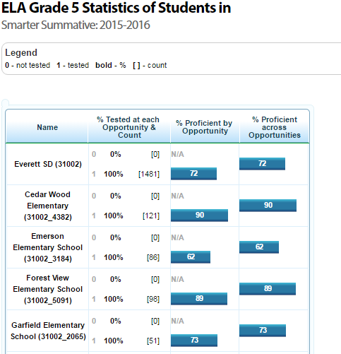
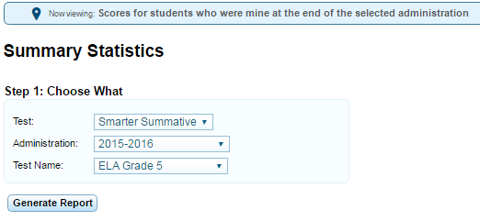
Summary of Proficiency by test name (ELA or Math) and grade
Under score reports, you will need to define the category of student score results (students who were mine at the end, current students, mine when tested)
Select test, administration year, and test name. Generate report
Notes:
Summary of proficiency level by grade and subject
Gives you a quick look at proficiency by test, administration year or test name.
Remember to go through Score Reports to define your score category.

Slide 24
Questions
Terry Campbell
Work (425) 385-4057
E-mail: TCampbell@everettsd.org

