Slide 1

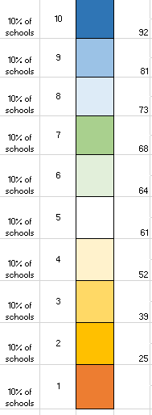
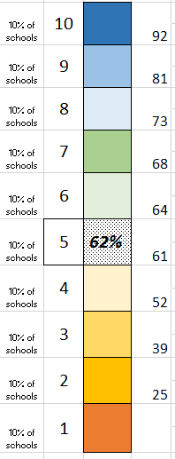
School performance by measure
  1-10 scale, such that ~10% of schools in each– an even spread of schools from 1-10
  School’s performance on a measure translates to a box (decile)
Notes:
Historically there were hard cut lines. What occurred is a lot of grouping in the middle.
The schools per their MM scores are equally distributed among the 10 boxes. But the scores are not equally distributed. Many schools MM score clumped in the middle, so the middle needed to be spread out. (10% of the schools fall between the 61 and 64% cut score band. 10% of schools fall between the 52 and 61% cut score band)
Will not be reevaluated in 3 years—not every year.

Slide 2
School example #1
A look at a K-12 school (All Indicators) that have measurements in all areas:
15% Academic Achievement in ELA
15% Academic Achievement in Math
25% Growth
25% graduation
5% EL Progress
15% School quality or student success indicators

Slide 3
Example: K-12 Schools (All Indicators)
 | Proficiency | Growth | Graduation | EL Progress | SQSS
K–12 Schools (All Indicators) | 30% | 25% | 25% | 5% | 15%
Coming Soon
5+7=12 / 2 = 6
6*30% = 1.8
3+5=8 / 2 = 4
4*25% = 1
1*5%=.05
3*25%=.75
3+6+5=14 / 3 = 4.66
4.66*15%=.7
Overall Multiple Measure Score
1.8+1+.05+.75+.7=4.3
Notes:
This shows all of the measures falling under each index. They are calculated independently before they get rolled over. Science is not included in this three year calculation. Will be included in future iterations.
Walk through the proficiency as an example. Average those index scores and then the weighting is added. That is how the index score is combined and then the weight is added.
This is a mock up of a typical K-12 school with all indicators. And it relates to slide 8 in how each measure is weighted. For example the three proficiency scores are combined, averaged and then multiplied by the % weighted for a typical K-12 school which is 30% which is 15% + 15% for those two columns.
Science will not be added until 2020.

Slide 4

Combined Multiple Measures and Lowest Performing 5%
All the schools’ combined Multiple Measure Scores are ranked.
A threshold is set at the lowest performing 5% of schools.
Schools below the threshold are identified for Comprehensive support.
The same threshold will be used to identify schools for Targeted Support for underperforming subgroups.
The threshold is also referred to as the cut score or Multiple Measure Index (MMI).
5% of Schools
ID’ed for Comprehensive Support
Notes:
All of the scores for all of the schools are ranked.
Historic data would be somewhere in the range of a 2.15 for the all students group.
The lowest 5% will set cut score for All Students.

Slide 5
Use Comprehensive Threshold to Identify Subgroups for Targeted Support
Combined Multiple Measure
Threshold for Comp Support
Identified for Targeted Support
Notes:
Perform the same calculation for each of the student groups in a school. That combined multiple measure 2.15 cut score that is created for All Students at 5% will be applied across all student groups at each school. Any student group that falls below that will get targeted support.
A student can appear in multiple subgroups. But only once in the overall Comprehensive threshold score.

Slide 6
Multiple Measures Index vs. Indicator Deciles
Deciles ensure that 10% of the entire population is represented in each of the ten score points for each indicator.
Weighted calculations combine all relevant indicator deciles (proficiency, growth, SQSS, etc.) to create a combined Multiple Measure Index (MMI) on a scale from 1-10.
The Multiple Measures Index (MMI) does not represent deciles.
All schools are rank ordered from highest to lowest, using their “All Student” group MMI.
The population of all school MMI scores will naturally fall into a distribution that is close to a bell-shaped curve. Most schools will be in the middle, with fewer scoring at the extremes.
5% of Schools
ID’ed for Comprehensive Support
Notes:
All of the scores for all of the schools are ranked.
Historic data would be somewhere in the range of a 2.15 for the all students group.
The lowest 5% will set cut score for All Students.

Slide 7
Multiple Measures Index vs. Indicator Deciles
5% of Schools
ID’ed for Comprehensive Support
Notes:
All of the scores for all of the schools are ranked.
Historic data would be somewhere in the range of a 2.15 for the all students group.
The lowest 5% will set cut score for All Students.

Slide 8
Multiple Measures Index vs. Indicator Deciles
ID’ed for Comprehensive Support
5% of Schools
Notes:
All of the scores for all of the schools are ranked.
Historic data would be somewhere in the range of a 2.15 for the all students group.
The lowest 5% will set cut score for All Students.

Slide 9
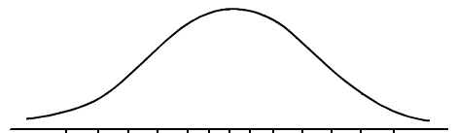
Multiple Measures Index vs. Indicator Deciles
ID’ed for Comprehensive Support
5% of Schools
Notes:
All of the scores for all of the schools are ranked.
Historic data would be somewhere in the range of a 2.15 for the all students group.
The lowest 5% will set cut score for All Students.

Slide 10
Multiple Measures Index vs. Indicator Deciles
All schools are rank ordered from highest to lowest, using their “All Student” group MMI.
The lowest 5% of all schools, ranked by their MMI, are identified for Comprehensive Support.
ID’ed for Comprehensive Support
5% of Schools
Notes:
All of the scores for all of the schools are ranked.
Historic data would be somewhere in the range of a 2.15 for the all students group.
The lowest 5% will set cut score for All Students.

Slide 11
Multiple Measures Index and Targeted Support
That MMI cut score value from the “All Student” group is also used as the cut score for each of the student subgroups – this time to identify schools in need of targeted support by subgroup.
Student populations for targeted support are identified by each subgroup’s combined MMI – the calculation using multiple indicators, such as proficiency, growth, SQSS, etc.
A subgroup’s individual indicator measures can be used to isolate specific areas of need.
ID’ed for Comprehensive Support
5% of Schools
Notes:
All of the scores for all of the schools are ranked.
Historic data would be somewhere in the range of a 2.15 for the all students group.
The lowest 5% will set cut score for All Students.

