Slide 1
Accountability Within
Every Student Succeeds Act
(ESSA)
What an Administrator Needs to Know
ESSA Webinar
Provides broad overview of
accountability within ESSA
ESSA Information from OSPI
Provides "snapshots" of the many different sections of ESSA and the implications for building leaders.

Slide 2
Goals for our session today:
Walk away with a great enough understanding that you can explain to a colleague the changes to ESSA and the implications for building leaders
Part I: Broad Overview
What is measured
How schools will be "identified"
Consider holding any questions you have during this overview....
they will most likely be answered in Part II
Part II: Deep Dive in Details
Weighting for your school
Three-year "bucket" time period
Timelines
Which students "count"
How proficiency and growth is calculated
How grad rate works
How English language learning progress works
What are SQSS
Explore on your own

Slide 3
Biggest Differences between NCLB and ESSA
Emphasis on *growth over proficiency
Weighting of new and different indicators
Focus on identifying schools by both overall performance and by subgroup
Focus on identifying schools based on performance over time rather than year-to-year
Supportive in nature rather than punitive
*except at the high school where students don't generate an SGP
Notes:
*except at high school level where students don't generate an SGP

Slide 4
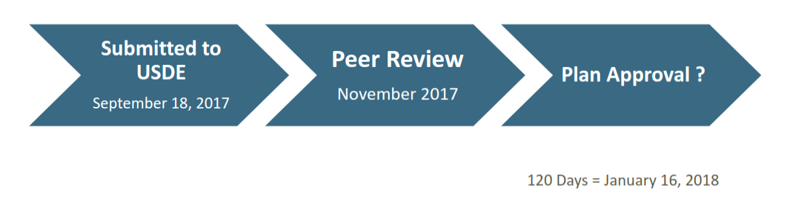
Not approved by feds yet, but changes will most likely be negligible (mostly clarification pieces).
Notes:
Changes are minor at this point (just clarifying how some of the scores are calculated); however, there may be a significant change to the expectation for the number of students who progress through English language acquisition.

Slide 5
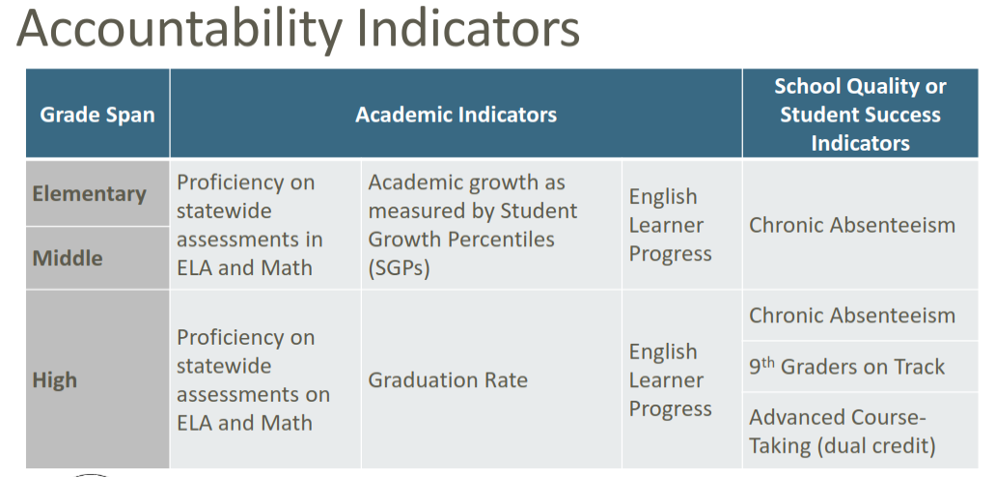
What is measured?
Referred to as SQSS
"Phase Two" - Science (WCAS) will be added in 2021
"Phase Two" - items that may be added include discipline disproportionality, climate surveys, further dual credit courses like Industry Certification, etc. in 2021

Slide 6
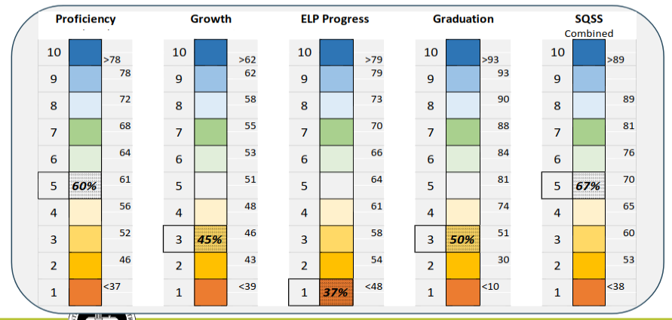
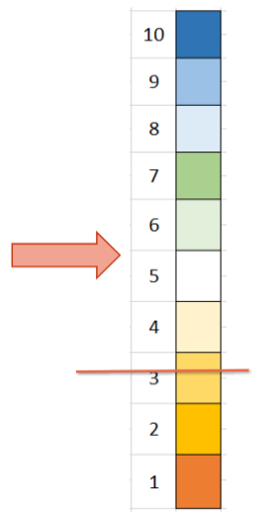
"Comprehensive Support" - multiple sources of data
Lowest 5% are identified as "in need of comprehensive support." This comprehensive identification process happens every three years.
Notes:
Achievement Index is calculated by
1. multiple measures by subgroup (not by all students or by school)
2. then the lowest performing 5% from that
3. will result in considerable increase since there is no longer a threshold
4. so a high-achieving school may end up with targeted for support school in one subgroup "Happy Valley School is targeted for support in the ELL subgroup."
5. If identified, then add how to support this subgroup in particular in the SIP

Slide 7
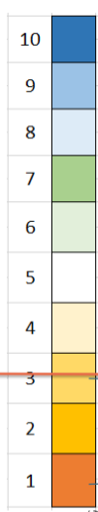
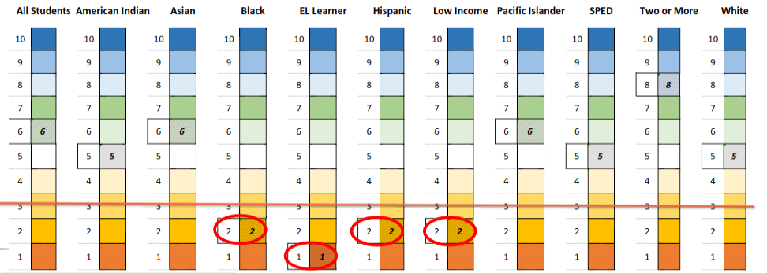
"Targeted" Support - specific subgroup data
Any area that is below the orange line are identified as "in need of targeted support." Targeted support identification happens every year.
So...a very high performing school could be targeted for support in one area.
Notes:
Achievement Index is calculated by
1. multiple measures by subgroup (not by all students or by school)
2. then the lowest performing 5% from that
3. will result in considerable increase since there is no longer a threshold
4. so a high-achieving school may end up with targeted for support school in one subgroup "Happy Valley School is targeted for support in the ELL subgroup."
5. If identified, then add how to support this subgroup in particular in the SIP

Slide 8
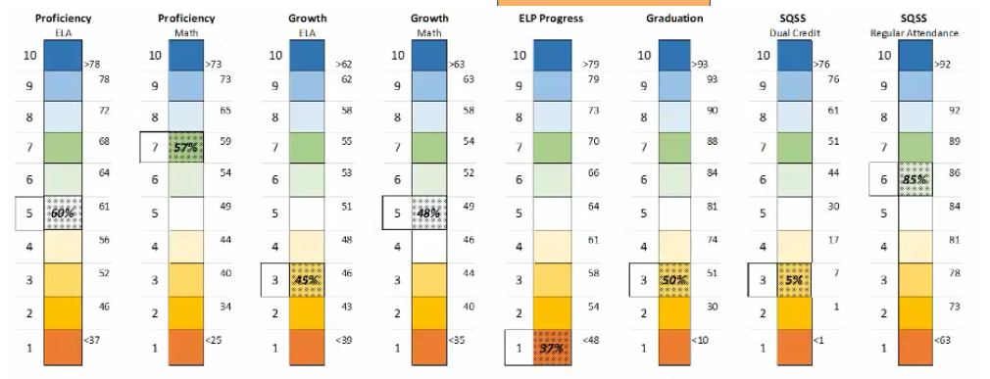
How is the decile number assigned?
Top 10% of all schools in State
in that category
Top 20% of all schools in State
in that category
Bottom 20% of all schools in State
in that category
Bottom 10% of all schools in State
in that category
Each category has cut score "threshold" assigned. This determines the decile "number" that your building earns.
Deciles for the allow us to see how a school is doing in as specific category compared to every other school in the state in that category

Slide 9
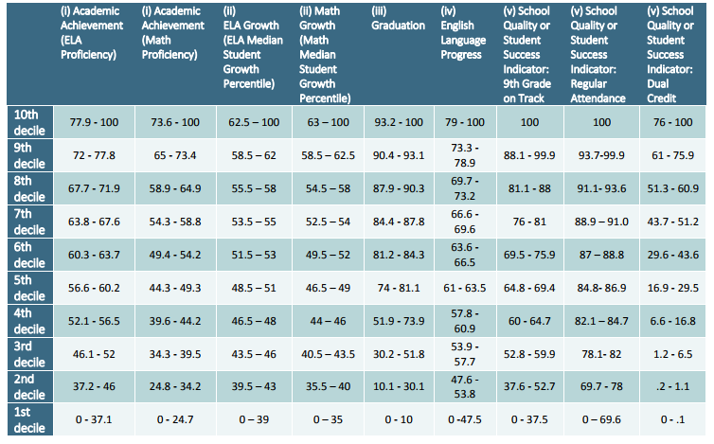

Slide 10
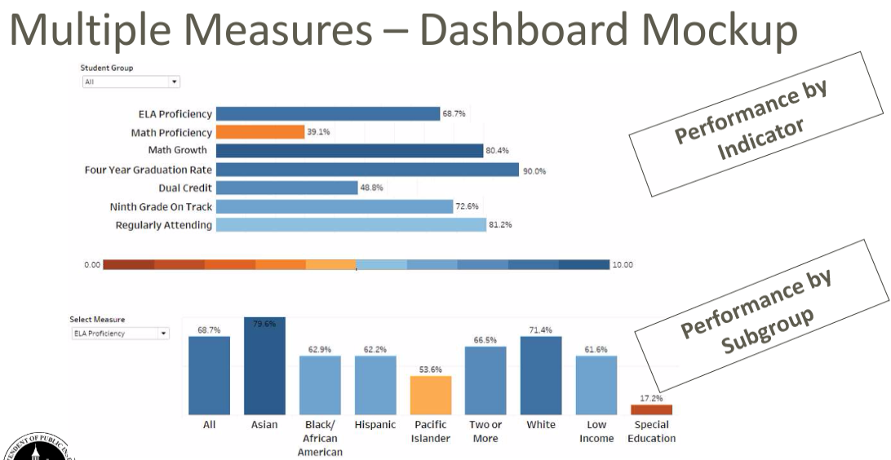
What will the public see?

Slide 11
Part II: Deep Dive
Weighting for your school
Three-year "bucket" time period
Timelines
Which students "count"
How proficiency and growth is calculated
How grad rate works
How English language learning progress works
What are SQSS
Explore on your own

Slide 12
Proposed Weighting
Type of School in LSSD | Proficiency | Growth (SGP) | Graduation | ELL Progress | SQSS
Elementaries Middles Mid-High | 40% | 50% | 0% | 5% | 5%
High School | 30% | 0% | 50% | 5% | 15%
HomeLink | 30% | 25% | 25% | 5% | 15%

Slide 13
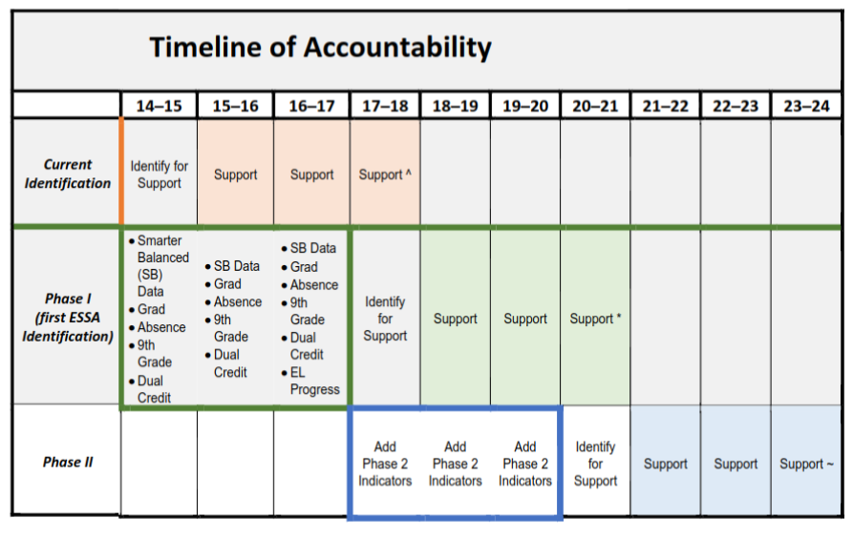
When does this all start?
Identification Process for This Year
Mid December: preliminary notification to schools
Early February: additional re-run of data to validate
Mid February: official notification to schools
March: public release of information
First Identification Window
In spring 2018...
Schools will be identified
based on 14-15, 15-16, and 16-17 data
Next Identification Window
in spring 2021...
Schools will be identified
based on 17-18, 18-19, and 19-20 data
Also in 2021...
WCAS is added
Additional SQSS added
Notes:
14-15, 15-16, and 16-17 = 17/18 identified for support; reported publicly spring 2018
17-18, 18-19, and 19/20 = 20/21 identify for support; reported publicly spring 21
in 20/21: WCAS will be added as well as others that are TBD (such a disproportionate discipline or school climate surveys)

Slide 14
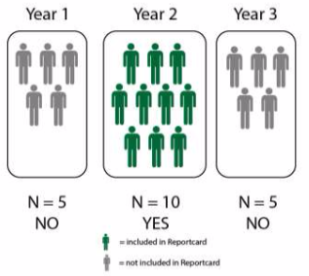
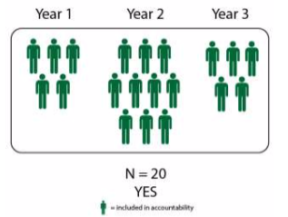
N Size for a subgroup for data to "show"
Previous: 10 in a single year
Proposed: 20 total over a 3 year time period
Important! In order to generate an overall score, students must have proficiency AND growth scores. If it seems weird that you are missing a subgroup's data, call Gina.
Notes:
Ensures subgroups with small N sizes that might have been overlooked in the past are "seen"
Example: MP had enough ELL students during the three-year "bucket" to meet the n of 20. However, not enough students had both proficiency scores AND SGP scores. Most likely this is because they tested in 3rd grade but not again in 4th grade or tested in 4th grade but not again in 5th grade. This could be due to moving out of the school.

Slide 15
Which students are "counted"?
Previous: "Continuous Enrollment" -
Enrolled from October 1 through testing window
What did this mean for us?
A student who attends October 1-December 1, and then re-enrolls January 24-May 15 didn't "count"
New: "Half Year Enrollment" -
Enrolled on October 1 and enrolled for 150 cumulative calendar days
What does this mean for us?
A student who attends October 1-December 1, and then re-enrolls January 24-May 15 "counts"

Slide 16
What is proficiency? What is growth?
Proficiency
ELA and Math (Level 3 and 4)
Science starting in 2021
Enrolled 150 cumulative calendar days
ALE: At this time, >.80 FTE counts; proposed is >.50 FTE will count
Growth
Median of all students who generate an SGP record (every SGP is a record so a student might show up twice)
For example...
1. Fourth grade SGP for every student in 2017
2. Fifth grade SGP for every student from both 2017 and 2018
3. All scores are ranked high to low
Median becomes the school SGP

Slide 17
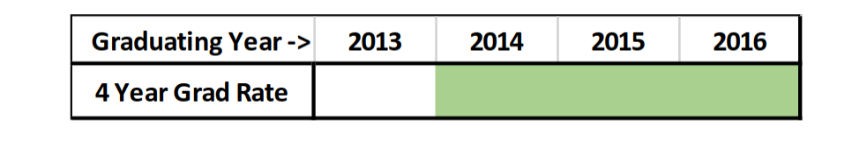
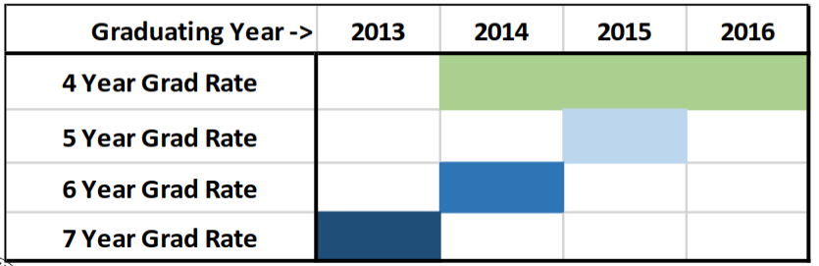
Three-Year Graduation Rate AND Extended Grade Rate
Schools that keep "super seniors" and thereby increase the number of graduates over five, six, or seven years get "extra credit" on the 1-10 scale

Slide 18
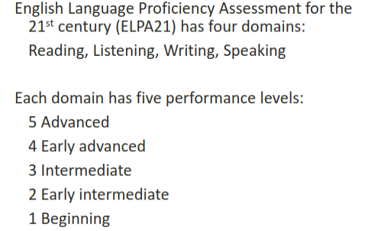
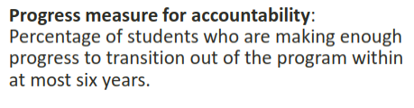
*Progress on English Language Development
Achievement Levels:
Emerging
Progressing 1 (P1)
Progressing 2 (P2)
Progressing (P3) -- takes place over two years
Transition
Notes:
Note - ELPA21 is new, and some have identified issues in the data. This area of Accountability will be reviewed and may change based on more years of ELPA data

Slide 19
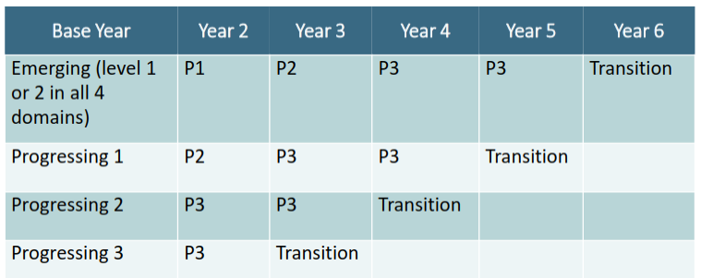
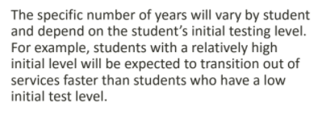
ELL Progress
Compare "Base Year" (first time student tested) to Year 2 to see if student is on track for transitioning on time
Additional Schools with the lowest performance of ELL progress shall be designated for ELL support

Slide 20
School Quality or Student Success (SQSS)
Chronic Absenteeism
(All schools)
Percentage of students missing "significant amounts of instruction time"
Average more than 2 full day absences (excused or unexcused) for however long they are enrolled
Total number of absences divided by total number of days of enrolled to that point
Sports? Field trips? OSPI currently counting these as absences...BUT they are revising this
Dual Credit Enrollment
(LSHS and Cav)
Sum of students who complete College in the High School, A.P., or Running Start classes
**Credit earned = applicable
Grade earned = not applicable
Certification earned = not applicable
Test score earned = not applicable
Ninth Grade On Track
(Cav)
Percentage of students who did not earn credit in 9th grade
Sum of credits earned is equal to number of credits attempted
"Incomplete" counts as a failure if it remains incomplete after August
Possibilities in the future (2021)....
Discipline disproportionality, further dual credit courses like Industry Certification, climate surveys, etc.
This change was made in response to federal gov't feedback; however, we are waiting on OSPI to clarify whether "complete a course" means earn credit or just not withdraw.

Slide 21
How do I read my school's data?
Here's What?
Which subgroup has high scores in which category?
Where are my lower scores?
So What?
What positive trends do we see? What is happening that has gotten us there?
What areas of focus can we identify? What kinds of things can we strengthen, abandon, or add to help this?
Now What?
For next year, what kinds of things could you and your data teams put into place in response?
Our schools' data (not live yet...)

Slide 22
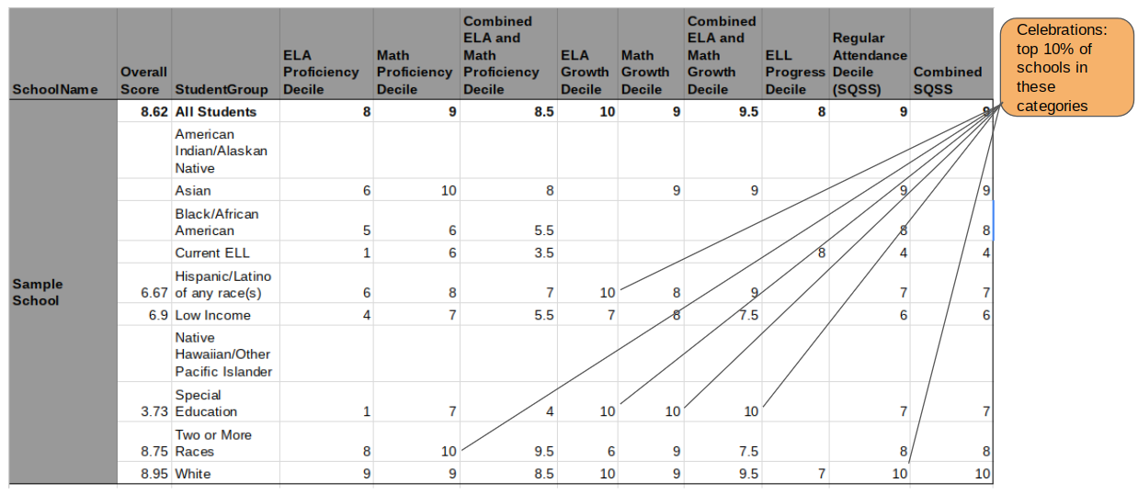
Here's What

Slide 23
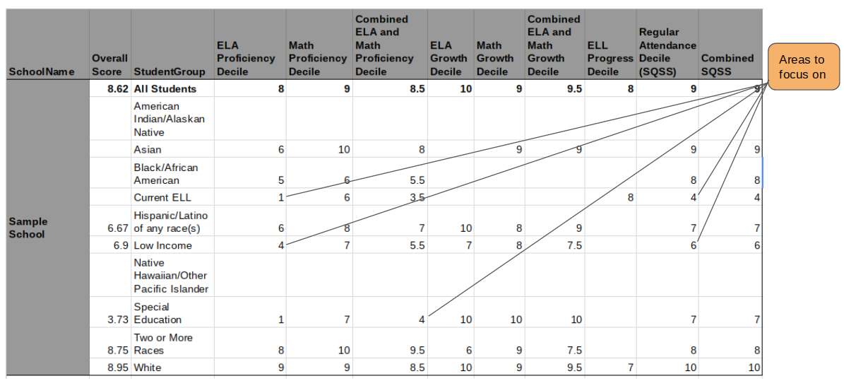
Here's What

Slide 24
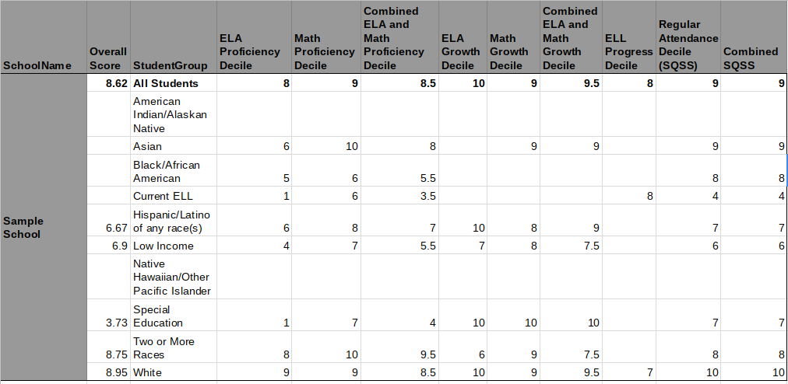
So What? Now What?
So What?
What led us to the successes?
What things are happening that could be causing the lower areas?
Now What?
What things could we strengthen, abandon, modify, or start in response?

Slide 25
Explore your data now...
Here's What
So What?
Now What?
Our schools' data
Learn about the various indicators
Explore proficiency vs. growth (SGP)

