Slide 1
Test Coordinator Training
Spring 2018 ELPA21 Testing
Required for DCs, DAs, and SCs
English Language Proficiency assessment for the 21st century (ELPA21)
Published: January 11, 2018
This presentation contains a script in the notes section. If you are accessing this information with a screen reader, be sure you are reading the notes section as well as the text contained in the slides.
Notes:
This PPT was created to support training of District Test Coordinators (DCs), District Administrators (DAs) and School Test Coordinators (SCs). Please supplement with information specific to your district and schools.
Considerations
During your training, you can demonstrate the WCAP Portal “User Cards” by accessing the portal online and sharing the purpose of each card as you are walking the audience through it.

Slide 2
Introductions
  ____________________________, District Test Coordinator (DC)
  ____________________________, District Administrator (DA)
  ____________________________, Assistant Superintendent
Notes:
You may want to consider including an introduction to each team member presenting this training. You may also want to make note if you have an assistant superintendent attending.

Slide 3
Acronyms
Acronym | Definition (Systems, applications, materials, test components)
AVA | Assessment Viewing Application
DEI | Data Entry Interface
DFA | Directions for Administration
GTSA | Guidelines on Tools, Supports, & Accommodations
ORS | Online Reporting System
PIRG | Professional Standards and Security, Incident, & Reporting Guidelines
SRMAAG | Student Records Management for Assessment and Accountability
TAM | Test Administration Manual
TAUG | TA User Guide
TSBP | Test Security and Building Plan
TDS | Test Delivery System
TIDE | Test Information Distribution Engine
WCAP | Washington Comprehensive Assessment Program
Acronym | Definition (Users)
DC | District Test Coordinator
DA | District Administrator
SC | School Test Coordinator
TA | Test Administrator
IS | Instructional Specialist
Notes:
As we move through this slide deck, there will be times that acronyms are used instead of fully displaying the name of a system or material. This slide displays several acronyms that include the definition. There also is a Definitions and Acronyms document posted to the WCAP Portal.

Slide 4
Materials Required for ELPA Test Coordinators
Guidelines | Manuals/User Guides | Modules | Documents
GTSA | DEI User Guide ORS User Guide TA User Guide TIDE User Guide | TIDE Module Assessment Update Webinars | AIR Systems Downtimes
PIRG | TCM TAM DFA | Test Material Processing Training | State Testing Calendar
 | Quick Start Guide SRMAAG | Coordinator Training | Checklists for Coordinators and TAs
DCs, DAs and SCs
Other training resources may also be required at a local level
Resources are located on the WCAP Portal
Notes:
Included on this slide is a summary of the materials required to be reviewed annually by DCs, DAs, and SCs. School districts may also have additional resources that are required for review.
The items listed in this slide are required by the state for yearly review.

Slide 5

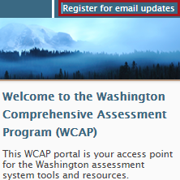
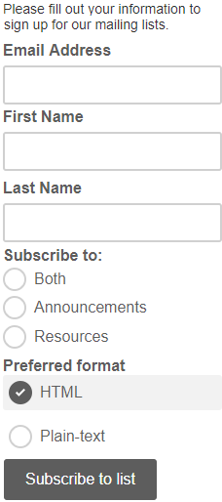
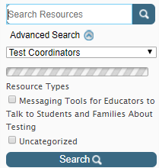
Navigating the Portal
Access Systems and resources from these User Cards
Register for email updates alerting when new announcements or resources are posted
Search the Portal for desired materials
Notes:
The WCAP Portal homepage is a great source for information to support students and families, TAs, teachers, and coordinators.
The ELPA21 User Card is your source for accessing systems, applications, and support resources needed for the test administration.
There is a search option tool available for locating materials. To access the search tool:
Click on the Resources tab in the upper toolbar on the homepage.
This will open the page, allowing you to refine your search by entering a specific word (“translation”) or by entering the name of the document (“TAM”) into the search bar.
A list will be displayed of all documents that relate to the information entered into the search field.

Slide 6
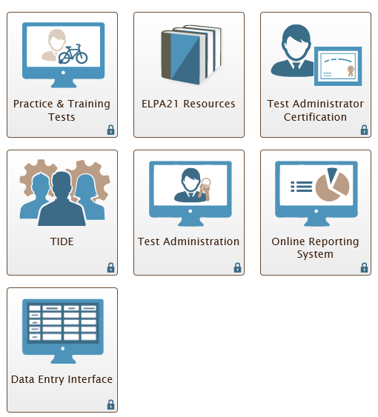
System and Resource Card Access Points
These cards are all available for access from the Test Coordinator user card
Notes:
Shown on this slide are the system and resource cards presented to Test Coordinators after selecting the Test Coordinator User Card on the WCAP Portal landing page. When a lock icon appears in the lower right corner of a card, it requires user login credentials for AIR systems.
Forgotten passwords can be retrieved by selecting the “Forgot Your Password?” link
Additional details will be provided on the next two slides.

Slide 7
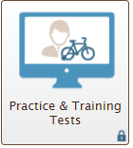

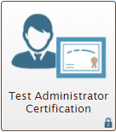
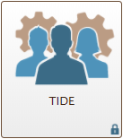
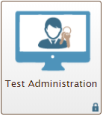
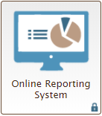
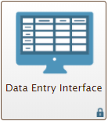
Overview System & Resource Cards
ELPA Resources card: access resources and training materials.
Practice & Training Test Administration card: securely administer Training and Practice Tests.
Test Administrator Certification card: training for TA Interface, security, monitoring, and data review.
TIDE card: view/edit student settings, manage rosters, print test tickets and labels, and order materials.
Online Reporting System card: access score reports and student results.
Data Entry Interface card: enter student responses from paper tests.
Test Administration card: access Interim and Summative state assessments.
Notes:
The ELPA21 user card includes access to multiple components within the WCAP Portal.
The Practice and Training Tests allows authorized users to administer Training Tests and Practice Tests in a secure environment.
The ELPA21 Resources provides access to resources and training materials needed for administration of the ELPA21 assessments.
The Test Administrator Certification training provides an animated overview of TA Interface, data review, security, and test monitoring. This training resource is highly recommended by the state and consortium for TAs, but a district or school may require this as part of their training package.
The Test Information Distribution Engine (TIDE) is used to add and manage users, view and edit student test settings, create and manage rosters, print test tickets and labels, request appeals, and order additional materials, as well as to access THSS hand scoring training materials.
The Test Administration provides access to Interim and Summative state assessments.
The Online Reporting System allows authorized users access to view score reports, generate and export summary statistics, and student results.
The Data Entry Interface allows users to enter student responses from paper-based test forms for the ELPA21 assessments.

Slide 8
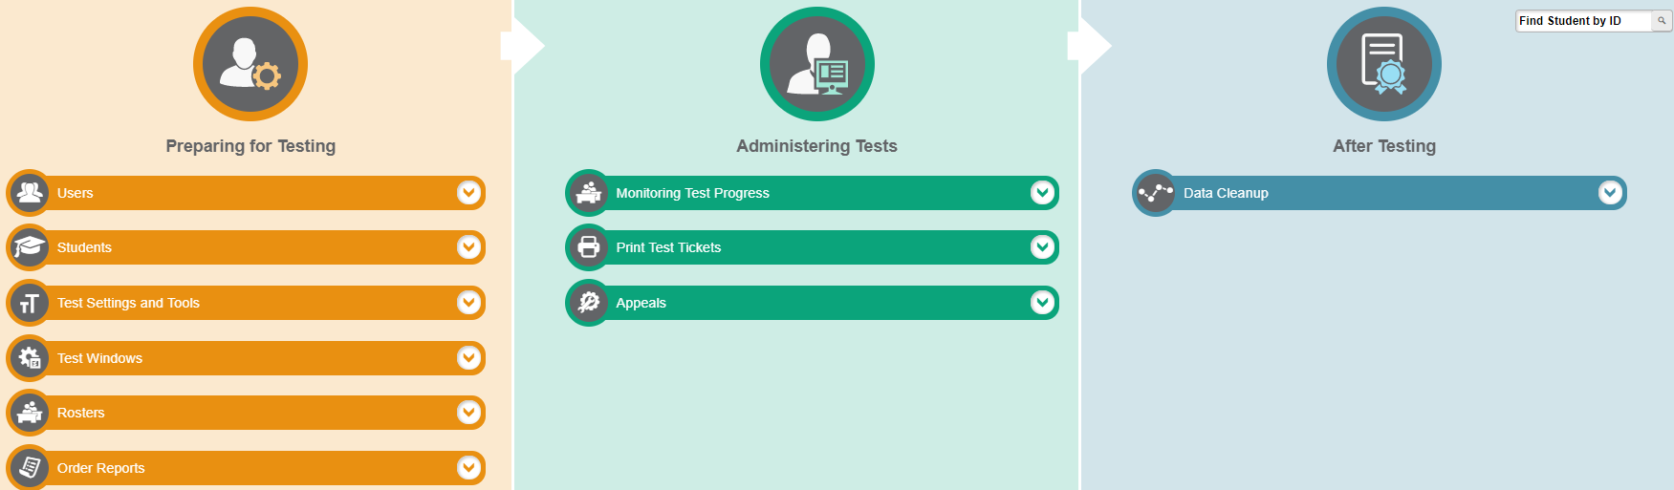
TIDE Overview
Notes:
On the main TIDE Dashboard there are three sections:
Preparing for Testing
Administering Tests
After Testing
The next three slides will cover each of these sections in greater detail.

Slide 9
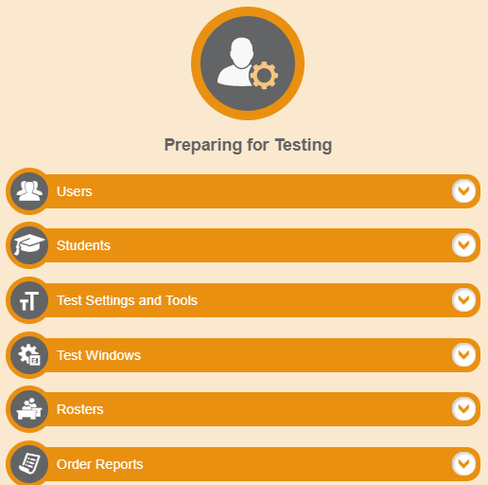
TIDE Preparing for Testing Overview
Within the TIDE Dashboard under Preparing for Testing, you will:
Select Users dropdown to add, View, Edit, Export, and Upload Users
Select Students dropdown to View, Edit, Export Students, Add Students With Temporary ID, and Upload Student Settings
Select Test Settings and Tools to View, Edit, Export, and Upload Test Settings and Tools
Select Rosters to Add, View, Edit, and Upload rosters
Select Orders to view Order History and Summary and to Track Shipments
Select Test Windows to View, Edit, Export, and Upload Test Windows
Notes:
The Preparing for Testing section of the TIDE Dashboard includes several applications that support activities in preparation for testing.
In the Users application, you can select to add or upload users, and view/edit/export users already in the system.
The Students section is where you can view, edit, upload, or export student test settings (Tools, Supports, and Accommodations) and add students with a temporary ID. This also is the location to access the Frequency Distribution Report.
In the Test Settings and Tools section, you can view, edit, upload, and export student test settings.
In the Rosters section, you can add, view, edit, and upload rosters
Place additional orders, view your order history and summary, and track order shipments in the Orders application. Refer to the Additional Orders schedule on the WCAP Portal, under the General Information sub-folder, for information pertaining to each test administration order window.
The Test Windows section can be utilized by districts to establish school testing schedules for the summative assessments. By setting a school schedule, the summative assessments will not appear for TAs until the first day the window opens. This will help to eliminate TAs incorrect test selection when their intent is to administer an interim assessment. The windows are available for SCs and TAs to view. Test windows can be modified by the DC or DA at any time.

Slide 10
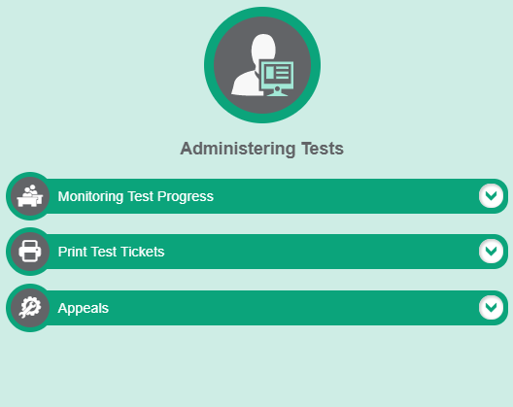
TIDE Administering Tests Overview
Within the TIDE Dashboard under Administering Tests, you will:
Select Appeals dropdown to Create, View, and Export requests
Select Monitoring Test Progress dropdown to Generate Reports on Test Status and Completion Rates
Select Print Test Tickets dropdown to print a test ticket or student label
Notes:
The Administering Tests section of the TIDE Dashboard includes several applications that support activities during testing.
The Monitoring Test Progress can be used to generate reports on test status and completion rates. This can support DCs, DAs, and SCs. TAs can monitor student progress within the TA Interface.
You can print Test Tickets from your student list or rosters in support of student login to the test session. It is important to ensure security of test tickets, before, during, and after testing.
The Appeals application can be accessed by a DC or DA for submitting appeals during test administrations. Appeals are submitted for online testers to either allow a student access to their testing opportunity or to invalidate a students test results.
TIDE Appeals does not serve as a log for all incidents. Districts will still need to submit a Testing Incident report through ARMS, or via paper if ARMS training has not concluded. The TIDE appeals extract can be uploaded to ARMS in support of the incident being reported.

Slide 11
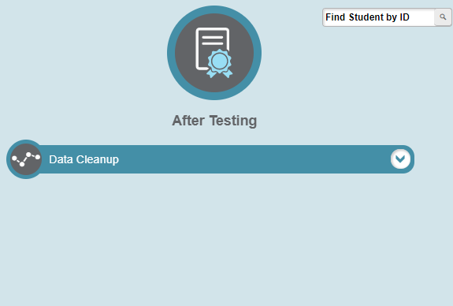
TIDE After Testing Overview
Within the TIDE Dashboard under After Testing, you will:
Select Data Cleanup dropdown to apply student participation codes
Notes:
The After Testing section of the TIDE Dashboard allows staff to flag students with participation codes (reason not tested) and exemptions (medial exemptions, NNEP).
Exemptions codes that affect participation are NNEP, Private, Homebased, and F-1 Visa. All of which are pulled from CEDARS, not TIDE
NNEP is managed as a student test code but falls into participation. LEP first year in country must participate in math and science but does not need to participate in ELA. The NNEP identifies if included or excluded from participation.
TIDE Participation Codes is a location primarily for district use, if desired.
L2 Basic is the only Participation Code required to be set in TIDE in order for basic to display correctly in ORS.
The other codes are documented for district use only.

Slide 12
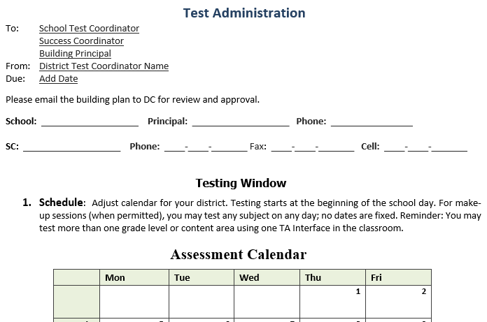
Building Plans
Test Security and Building Plan Template
  WHAT
  Test security and building plans are documents formatted to support critical aspects of the testing process.
  WHO
  DCs work with other key building staff to create a test security and building plan
  PLAN SHOULD INCLUDE
  testing schedules, responsibilities, chain of custody for secure materials, supplies, student participation, and communication
  RESOURCES
  PIRG, template building plan, state testing windows
Notes:
Test security and building plans are documents formatted to support critical aspects of the testing process. Plans are required to be in place prior to administering state assessments.
DCs work with other key building staff to create a test security and building plan
Plans should include:
test schedules and locations (alternate sites and times are permitted)
staff responsibilities
chain of custody for secure materials
ancillary testing supplies
student participation
communication with school staff, students, and families
A Test Security and Building Plan template, created by Everett Public Schools and modified by OSPI to support districts statewide, if use is desired. The template is available on the Portal, under the General Information sub-folder. Search for the template by entering Test Security and Building Plan.
The last page provides a list of things to consider when creating and approving a school’s building plan.
The PIRG is a great resource in support of completing a plan.
You should also take into consideration local activities, holidays, and the State Testing Schedule to reduce the chance of conflicts in testing.
This template may be given to SCs to use as a worksheet as it highlights specific tasks that should be kept in mind.

Slide 13
ELPA Key Dates
Activity | Date(s)
Annual ELPA21 and Alternate paper test materials due in district | Jan. 22 - 24, 2018
TIDE: Additional Order window for ordering Annual ELPA21 testing materials | January 23, 2018
Last day to train Test Administrators and complete Training Log | Day before testing
Online testing window for Annual ELPA21 assessments | Feb. 1 – March 30
Paper testing window for Annual ELPA21 assessments | Feb. 1 – March 30
Schools submit School Security Report to District Coordinators | Last day of testing
To schedule a material return date, contact FedEx at least 5 business days prior to the scheduled return of secure test materials to MI | Within five business days after each school completes testing, but no later than April 6
District Coordinator submits District Administration Security Report | Within five business days after testing is completed, but no later than April 6
Notes:
Key dates include the dates for delivery and return of materials, the additional material order window, training timelines, and the schedule for processing Security Reports.
The additional order schedule for ELPA21 will be posted by the end of January to the Portal in the Test Coordinator Resources – General Information section.
DCs are required to schedule a material pickup date with FedEx for return of ELPA21 secure test materials. Refer to the Test Material Processing PowerPoint for specific details.
The Test Security Staff Assurance Report is available from the portal at: http://wa.portal.airast.org(Test Coordinators>General Information)
The school and district level security reports may be submitted electronically through ARMS, if you have met training criteria and have been granted access. Until training is complete, the school and district forms are also available on the WCAP Portal.
District level security reports must be submitted to the state by no later than five business days after completion of all schools testing or after the end of the testing window, whichever occurs first. The latest date to submit ELPA21 district level security reports is April 6. If you experience a circumstance that limits your ability to submit your district level report, please notify the State Test Coordinator, Kimberly DeRousie by email at Kimberly.DeRousie@k12.wa.us.

Slide 14
Tools, Supports, Accommodations
  The GTSA details approved materials, manipulatives and accessibility supports
        If it’s not listed in the GTSA or MASA appendix A of GTSA, it is not allowed without state approval
        Some tools are universal allowing all students access:
        Universal Tools are not required by the state to be documented in TIDE
        A few Universal Tools can be turned off in TIDE; if distracting for students
      Scratch Paper Log template for tracking student use
Notes:
Supports and accommodations may be needed, refer to the Guidelines on Tools, Supports, & Accommodations for specific questions about appropriate use and restrictions.
In unique circumstances in which a student with a documented disability requires a support or accommodation not detailed in the GTSA, a Non-Standard Accommodation and Designated Support Request may be submitted to OSPI for review. This form can be found on the WCAP Portal and must be submitted well before the test administration window.
Verify that supports have been accurately entered for students in TIDE. TAs should work with the SC prior to testing if changes are necessary.
Any allowed tool, support, or accommodation used on a state assessment should be familiar to the student.
Some permitted materials need to be placed in a location where students can access them, if they elect to use them. The list is outlines on the next slide.
The Materials Available for Student Access document provides a quick list of materials that should be available for student use, as applicable to each test content. Student accessibility features not listed in the GTSA, are not allowed.
All of the above documents can be found on the WCAP Portal, under the Test Coordinator Resources.

Slide 15
Material (Tools/Supports) Locally Supplied
Material Available | Description
Color Overlay | Designated Support, locally supplied when identified
Headsets | Universal Tool, students may use personal headsets. Be sure to test compatibility on the practice or training tests
Magnification | Designated Support, locally supplied when identified
Pencils | Universal Tool, locally supplied
Scratch Paper | Universal Tool, locally supplied
Simplified Test Directions | Designated Support, locally supplied when identified
Tool Button Sheet | Universal Tool, available for print from the WCAP Portal
Translated Test Directions | Designated Support, locally supplied when identified. Available for print from the Portal
Notes:
This table provides the materials that are permitted on ELPA assessments and that are provided locally. Materials should be inventoried for availability.

Slide 16
Additional Preparation and Technology
Ensure that each student has access to a headset, when required by the test
Identify students with difficulties in auditory processing, short term memory, attention or decoding difficulties, who may benefit from Simplified Test Directions.
Confirm accommodations already entered in TIDE
  Modify testing options and other student designations
Students eligible for assistive technology
    Set Permissive Mode in TIDE for:
    Magnification greater than 3X
    Speech-to-text software
Computers with the above software need current browser and system software.
Notes:
When Headsets are required, they must be available for student use. It is important to have enough headsets available for each student testing. Student are permitted to use their own devices, but should verify that they work through the practice test prior to use on a summative assessment.
Simplified Test Directions are an available designated support for students identified as needing this support. The Simplified Test Directions script is available within the GTSA and also as an individual document available for download from the WCAP Portal, under the User Guides and Manuals sub-folder.
TAs must be trained, and students should be familiar with this support in everyday classroom activities and school level assessments.
Be sure to review student settings in TIDE and modify as needed, prior to the students testing session.
It is important to identify students who need assistive technology and work with your Technology Coordinator to ensure that the device is set up appropriately prior to the students testing session. It is highly recommended that you allow the student to use the accessibility feature and device during a practice test to ensure compatibility and student familiarity.

Slide 17
Common Chromebook (CB) Solutions
  If the student is having technical difficulties, the screen freezes, or a strange icon appears, try these solutions:
  Have student pause the test, close the secure browser, shut down CB
  Replace the Chromebook
          If necessary, create work order with IT and note the CB number
  Log back into same session using a new CB. (try this up to 3 times)
  Contact the SC and/or Technology Coordinator and report the issue, session ID, and Test Question
  Request help from the Help Desk for power issues
Notes:
On rare occasion, during testing, the screen may freeze or a strange icon appears. Student work is automatically saved.
Bullets one through five are the most common steps to take to resolve an issue with the CBs and in this order.
Students should be instructed to pause their test. Then close the secure browser and shut down the Chromebook.
AIR has reported that replacing the Chromebook is a quick method that will likely allow the student to continue to test with little interruption.
Log the student back in using the new Chromebook. It is often difficult to determine the root cause of the glitch, but using the age old "third-times-a-charm" trick can resolve most issues.
If the student is unable to continue testing, notify your Technology Coordinator or the AIR WA Help Desk. You will need to provide the Session ID.

Slide 18
New Student & SSID
SIS → CEDARS → TIDE
  Students receive an SSID once uploaded to CEDARS
  Students without an SSID number
        If newly enrolled, the SSID is generated 24 hours after a successful CEDARS upload
        If enrolled prior to the last CEDARS upload, then there must be an issue with the student information or duplicate SSID
  Students with an SSID but not showing up in TIDE
    Prior district has not exited the student
    SIS is missing required key data points (date enrolled in US EL students, LEP status not identified)
Private Students for ELPA or SBA
  CEDARS manager must request an SSID in EDS/CEDARS
Notes:
This section will provide background information on the flow of districts Student Information System data from SIS → to CEDARS → to TIDE.
Students receive an SSID the first time they are uploaded from the Student Information System (SIS) to CEDARS. TIDE gets its student information from CEDARS.
If CEDARS does not accept the request, the student will remain in SIS but not make it into to TIDE.
If you are unable to find the student in TIDE:
Without SSID and therefore, not in TIDE, do an SSID issuance or wait for nightly file transfer to TIDE if recently uploaded to CEDARS.
Students with an SSID and not displaying in TIDE are typically not exited from the previous school or district or missing a required field in CEDARS such as Date Enrolled in US or LEP Status not identified.
Private school students or non-enrolled students need an SSID to test. Students do not need to be enrolled to test at your schools, but they need an SSID that is in TIDE or that was in TIDE at one point.
On a limited emergent basis, DCs can circumvent the standard process to speed up the student SSID entry through the EDS screen entry process for loading into TIDE, or create a temporary ID for a student in TIDE.
Note: for unique situations were a student is sitting at a device during a testing session, and they do not have a test available, the DC should contact the Assessment Analysts (assessmentanalysts@k12.wa.us) to help support immediate entry of the student in TIDE so that he or she can continue test during the current session.

Slide 19
ELPA21 Pause Rule
The pause rule has changed to 20 minutes.
Students should take the practice test to become familiar with the pause rules.
Students can pause their test at any time, they will be presented with a warning message asking them to verify that they want to pause the test.
  The warning message also states that they may not be able to go back to previous questions. This is a standard system message that does not apply to ELPA21 test segments.
  Students are instructed to alert the TA. If they choose to pause the test, they will be logged out of the test.
  All answers are saved immediately; students do not lose answers when the test is paused.
  When students resume the test, they will see the first page that has unanswered questions.
  They will be able to view and change answers to questions they already answered within the current test, including previous pages. They cannot go back to previously completed segment (domain).
Notes:
The pause rule has changed back to 20 minutes.
While taking the ELPA21 assessments students can pause their tests at any time. When a student pauses their test a warning message appears. The warning message states that they may not be able to go back to previous questions. This is a standard system message that does not apply to ELPA21 tests.
If a student’s test is idle for 20 minutes, the system will automatically pause the test and log them out. To resume the test, the student will have to go through the log in steps again, including TA approval.
When students resume testing, the system will take the student back to the first page that has unanswered questions.

Slide 20
    Security, Policies, & Responsibilities
Policies, laws, practices, and prohibited behaviors are located in the PIRG
State and local laws and policies specify practices to ensure test security of
standardized and ethical administration of assessments.
Student monitoring throughout testing
RCWs and WACs are listed in the Policies and Test Securities section
Only assessment specific trained staff members can administer or be
in a testing room
Volunteers or media are not allowed in a testing room
DCs, DAs, and SCs are required to read the PIRG
  Professional Code of Conduct
  The Professional Code of Conduct is codified by the Washington State Legislature in WACs and RCWs. A list of complete rules and regulations can be found online: www.k12.wa.us/ProfPractices/CodeConduct.aspx.
  The Office of Professional Practices (OPP) is charged with enforcement, including discipline of educational practitioners for violation of the Professional Code of Conduct. The office receives, investigates, and makes legal findings regarding complaints. Unprofessional conduct is reported to OPP (360) 725-6130.
Notes:
As with all state assessments, state laws must be adhered to and best practices followed in the classroom.
This is part of the state Professional Standards and Security, Incident, and Reporting Guidelines (PIRG).
Allowable and prohibited behaviors are detailed in PIRG.
Know who should and should not be in the testing environment. DCs and/or SCs should actively monitor testing locations to ensure adequate support. Trained staff can be in a testing room, under the general supervision of a certified staff member. Volunteers, students who are not being assessed during the current segment, and media are not allowed.
DCs and SCs should actively monitor testing locations to ensure adequate support.
Reviewing and disclosing test questions is a violation of state law.
The Office of Professional Practices (OPP) is charged with enforcement, including discipline of educational practitioners for violation of the Professional Code of Conduct. OPP receives, investigates, and makes legal findings regarding complaints.
A complete list of rules and regulations can be found online: www.k12.wa.us/ProfPractices/CodeConduct.aspx

Slide 21
Training Requirements
  REQUIREMENTS
  Annual training is required for all staff supporting testing.
  All new staff supporting testing must be trained before testing, on all required materials.
  Seasoned staff must have a clear and thorough knowledge and understanding of the training resources, and must review all resources for updates new to 2018 administrations.
  Make sure all staff understand their roles and responsibilities for supporting assessments.
  BEST PRACTICES
  Know who should be trained
  what is and is not allowed for testing.
  Make sure all students have access to the accessibility features they need.
  Make sure all staff supporting testing have a very clear understanding of the difference between the Practice, Training, Interim, and Summative tests.
Notes:
Annual training is required for all staff supporting testing.
All new staff supporting test administration activities must be trained and review all required materials.
Seasoned staff must attend required spring annual trainings.
If staff have a clear and thorough knowledge and understanding of the training resources, they do not have to review all of the documents and modules again.
However, they must review all resources for updates new to 2018 administrations.
OSPI will try to call out changes in sections to make that easier. Example – Page 8 of the GTSA details out key changes to the 2017-18 Guidelines.
Best Practices
Under best practices, a few areas are outlined to help minimize the need to report incidents. Applying best practices is communication can help eliminate issues during testing.

Slide 22
Document Retention and Audit Report
Required documentation to DC
  TA Training Logs
  Printed copy of the signed roster (paper/eRoster), if required by DC
  Report of students not tested and why (Refused, Absent, NNEP etc.), if required by DC
  Test Security Staff Assurance Forms
  School Site Administration and Security Report
  Test incident reports (ARMS or paper)
Retain at the school (or district)
  Daily material check in/out logs
Submit to OSPI
  Modified Testing Schedules
  Medical Exemption Requests
  Test Question Ambiguity Forms
  District Security Report
  Test incident reports, as required
Required documentation outlined in PIRG
Follow the WA State Retention Guidelines and District Policy
Notes:
The WA State Auditors Office has implemented a process for auditing schools and the state. They are looking to ensure that school districts have a building plan in place and that it is being followed by the school and district staff.
They also ensure that all required documentation is readily available.
This year the state was audited. To ensure compliance we have.
Implemented a process for identifying whether District Administration Security Reports were submitted within 5-business days
Created a notification process to sent early reminders and missed deadline alerts.
Security reports document that staff completed training and that test security protocols were followed.
The Test Security Staff Assurance Reports are submitted to the SC on the day of completion of each test administration.
The School Site Administration and Security Reports are submitted to the DC no later than one day after conclusion of each test administration.
The District Administration and Security Report requires Superintendent review and signature prior to submitting to the OSPI State Test Coordinator. The report is due to OSPI no later than 5 business days of the conclusion of each test administration.
For the ELPA21 screener, the reports follow the schedule above, with exception of the last administration of the screener test would be considered the end of the administration window.
Remember, only the district level security report is to be submitted to the state.
Retain a copy of security reports at district for purpose of state audit.
Retention of materials should following the WA State Retention Guidelines and your local school district policy.

Slide 23
Testing Incidents
When testing incidents occur, it is important to:
  Stop the testing session for the individual student or class
  Take corrective action to mitigate the incident.
  TAs report incidents to the SC, who contacts the DC. The DC works with OSPI when required.
  Incidents must be documented by the end of the day and reviewed by DC or state within 24 hours.
  If required, TIDE appeals are submitted by the DC or DA. Approval is required at a state level. Appeals will be processed within 24 hours.
  Breaches must be reported to SC, DC, and to the State immediately and documented.
Notes:
There are several types of Test Incidents. Each type may be addressed differently. All incidents must be documented and reported by TAs to the SC promptly. This helps to ensure a fair and equitable testing environment for all students. Refer to the PIRG document for full details.
Stop the student(s) testing session.
Take corrective action to mitigate the incident and gather all necessary information to be reported.
Document with as much detail as possible, including information such as date, time of day, who was involved (SSID), and the item number (when applicable). For technology or system related issues, please be ready to provide:
TA session ID, device used during testing, network configuration, and operating system
Prompt communication is important and should follow the PIRG.
Frequently reported incidents include:
Student using non-approved electronic devices during testing or break times
TAs deviating from the TA Script of Student Directions
Students gaining access to tools or materials not permitted on state assessments
Materials not being removed from walls within the testing site
Test materials returned after prescribed schedule or without proper transcription
Breaches are considered a high risk. An example would be if a student or adult had collected or released secure test content or student responses. This is immediately reported to the SC, DC, and state. Do not use electronic devices or email for transferring secure/confidential information.

Slide 24
Responsibilities
District Test Coordinator
  Trainings
    Become familiar with GTSA, PIRG, System, and Administration manuals
    Attend required trainings and webinars
  Communication
    Read the WAW newsletter and share information as it pertains to staff responsibilities
    Communicate directly with staff regarding questions about assessments
    Communicate training schedules to SCs, TAs etc.
    Communicate with the State Testing Coordinator about testing incidents, appeals, medical exemptions etc.
  Implementation
    Implement each school’s Test Security and Building Plan
    Monitor testing schedules
Notes:
DCs must become proficient with the user guides, manuals, modules, and PPTs posted to the WCAP Portal. To keep up-to-date, it is important to attend required trainings and webinars. Current updates and new information is communicated through the WAW newsletter and Assessment Update Webinars. DCs can add additional staff (DAs), through WAMS-Profile, to receive these communications.
It is up to the DC to make sure that staff is trained and that they have the information they need to implement assessments effectively.
Ensure DAs and SCs have appropriate access to TIDE and can navigate the system.
Each school is required to provide proposed testing schedules for DC review/approval. Verify that schedules do not fall outside of the state-mandated windows.
Communication of schedules, attendance, and reporting is important to school staff, students, and families. Outline your training plan and communicate with appropriate staff.
Verify that each school’s Test Security and Building Plan has been implemented and that security protocols are followed.
Actively monitor testing locations during the assessment window.
When a testing issue is reported (technical, damaged test booklet):
Ensure that those involved understand that the issue is being reported and that an opportunity to complete testing will be provided.
Technical issues are reported to your technology coordinator and then to AIR, if needed.
Some situations may take a little longer to resolve. Determine if students need to leave the testing location while the issue is being resolved.
Incidents required to be reported to the state are submitted via a testing incident log.
For a complete list of DC responsibilities, see the PIRG document.

Slide 25
Responsibilities
Principal
  Trainings
    Attend all required trainings
    Verify staff has received appropriate training
  Overall Planning and Scheduling
    Appoint staff members to support test administration
    Assign testing areas; ensure test security of materials; plan testing schedules, locations, and testing population. Ensure adequate staff to supports testing locations. Develop and have approved your school’s Test Security and Building Plan
    Headsets are required and must be provided to students that need them
  Communication
    Approve communication for parents and all staff members
  Implementation
    Implement all school and district policies and procedures
    Ensure that each school has an approved testing schedule
Notes:
Attend all required trainings and ensure that all applicable staff, as their responsibilities support state testing, have also attended required trainings.
Appoint SCs and assign TAs.
When assigning testing areas, ensure sufficient space for students and the security of test materials. Provide adequate staff to support testing locations.
Headsets are required for some portions of tests. Headsets are provided by the school district, however, students may use personal headsets during testing.
Communicate with parents, staff members, and departments regarding testing schedules, importance of attendance, and how test results will be reported. OSPI created Principal letter templates are available on the portal.
Implement your school’s and district’s policies and procedures. Review the approved Test Security and Building Plan for each school and ensure staff are familiar with content.
Each school’s testing schedule must be approved by the DC and align to the state mandated test window.
For a complete list of Principal responsibilities, see the PIRG.

Slide 26
Responsibilities
School Test Coordinator
  Trainings
    Attend required trainings and familiarize yourself with documents
  Communication
    Communicate with staff and parents
  Implementation
    Verify your school’s Test Security and Building Plan
    Verify supports and accommodations needed for each student. Provide TAs with a list.
    Inventory all test material upon receipt; request additional materials, if necessary.
    Ensure TA rosters are set up correctly; request new students be added in CEDARS
    Maintain security of all testing materials and distribute test materials only on testing days
    Monitor test administration and report and report all test incidents promptly to the DC
    Collect and inventory all test materials promptly at conclusion of test sessions
    Securely dispose of ancillary materials according to the TSBP
    Complete School Site Administration and Security Reports and documentation
Notes:
SCs must become proficient with user guides, manuals, modules, and PPTs. To keep up-to-date, it is important to attend required trainings and webinars. For a complete list of SC responsibilities, see the PIRG document.
It is the responsibility of the SC to ensure that TAs, individuals supporting testing accommodations, and other staff who process materials attend required trainings and have the information they need to administer the test. Ensure staff are familiar with your school’s Test Security and Building Plan and that security protocols are followed.
Make sure all TAs have appropriate access to TIDE.
Encourage a positive testing situation for students and staff.
Communicate with parents and staff members regarding schedule, attendance, and reporting.
It is important to work with your Special Education department to upload all supports and accommodations needed for each student during testing. Provide TAs with the student accommodation lists to support testing.
Inventory any paper materials immediately upon arrival and order additional materials if necessary. Include inventory of district specific materials (i.e., pencils, paper).
Verify that TA rosters are set up correctly. New or non-enrolled students must have the SSID issuance (include school and grade) in CEDARS to display in TIDE.
Print any necessary student labels for test booklets.
Verify that tools, supports, and accommodations have been accurately entered in TIDE for students.
Some common issues include not ordering accommodated materials in advance of testing, not documenting testing incidents, not verifying that students are in TIDE before testing day, or not keeping adequate records of who has the testing materials.
Taking the time to document the process for preparing testing can help to ensure that testing goes smoothly.
Have a tracking process to account for secure materials while transferring to testing locations and back at completion of each testing session.
Actively monitor testing locations during the assessment window.
Be sure to report all testing incidents to your DC. Include in your report all details, documentation, and any recommendations for invalidations.
Follow your school’s Test Security and Building Plan for processing of secure materials. All secure materials are required to be inventoried and returned on schedule. This includes all ancillary papers (student notes, scratch paper, graph paper, etc.). All materials provided during testing sessions must be securely destroyed, as per the state and district policy.

Slide 27
Responsibilities
Special Education & Bilingual Coordinators
  Attend all required trainings
  Work closely with the SCs and TAs to ensure each student has access to their permitted tools, supports, and/or accommodations needed for students
  Any settings adjustments must be completed prior to materials arriving in district, so that the DC will have time to request additional materials or non standard accommodations before testing begins.
Notes:
Attend all required training sessions.
Work closely with your SC and TAs to ensure each student has been identified for the correct accessibility supports.
Make sure students identified for supports, large print, Braille, or standard print paper forms (IEP required) are reported to your DC so there is plenty of time to order accommodated forms or to provide appropriate tools, supports, or accommodations.

Slide 28
Contact Us:
  School Test Coordinators
      Contact the District Test Coordinator
      Phone (office): (__ __ __) __ __ __ - __ __ __ __
  Phone (Mobile): (__ __ __) __ __ __ - __ __ __ __
  District Test Coordinators
      Contact OSPI Assessment Office (360) 725-6348 or
      the State Test Coordinator, Kimberly DeRousie (360) 725-6353
  District Technology Coordinators
      Contact WCAP Help Desk (844) 560-7366 or by email : wahelpdesk@air.org
Notes:
DCs please remove OSPI contact information prior to sharing this PPT with school staff.
SC’s contact the appropriate person in your district if you have questions. OSPI will refer all school staff to the DC.

Slide 29
Revision Log:
Updates to the Module after January 10, 2018 are noted below.
Slide | Section | Description of Revision | Revision Date
Notes:
If updates are needed throughout the school year, they will be outlined on this revision log and communicated in the WAW newsletter.

