Slide 1
Interpreting Summative Score Reports: Math, Science, ELA
WERA
December 6, 2018
Office of Superintendent of Public Instruction
Chris Reykdal, State Superintendent

Slide 2
Values:
Vision:
All students prepared for post-secondary pathways, careers, and civic engagement.
Mission:
Transform K–12 education to a system that is centered on closing opportunity gaps and is characterized by high expectations for all students and educators. We achieve this by developing equity-based policies and supports that empower educators, families, and communities.
Ensuring Equity
Collaboration and Service
Achieving Excellence through Continuous Improvement
Focus on the Whole Child
Notes:
This slide contains the agency’s new Vision and Mission statements and key values.
You’ve likely seen the Vision statement in agency email signature blocks.
Related to the agency Mission, the assessment development team is committed to providing supports to empower educators’ understanding of the standards, assessment, and assessment results. This webinar is work to provide you with resources to better understand the score reports for the Smarter Balanced and communicate results with parents.
From the values, we are providing and posting these slides and a recording of the webinar to increase equitable access to the information. You are welcome to use these slides, modified as you need, in any way you would like with your colleagues, parents, or others. As we can improve our practice related to these webinars, please do let us know using the Q&A feature or by email.

Slide 3
Assessment Development
Our Belief:
OSPI provides educators with critical tools, resources, and professional development to determine and communicate where students are in their learning and growth. An end-of-year, summative assessment is one tool for gaining information about student learning achievements during the year.
Our Goals:
Continue to develop high quality assessments that add value to Phase I of Superintendent Reykdal’s K–12 Education Vision for 2017–19.
Promote the message that a summative assessment is one tool for gaining information about student learning and growth.
Promote and expand relationships with the OSPI Career and Technical Education and Learning and Teaching departments, and establish and promote relationships with the Migrant & Bilingual Education, Educator Growth and Development, and Special Education departments to enhance educators’ understanding of student learning and assessment.
Continue to improve the quality and equitable access of the state assessments and the quality, equitable access, and usability of assessment resources that we make available to educators and district staff.
Notes:
This is our department’s belief around our role in the education community and the role of summative assessment. Specifically, we are committed to providing resources and support to educators to increase student learning and growth. We believe that summative assessment plays a role in that support as one of multiple measures about student learning during a year.
Our goals reflect a commitment to the superintendent’s vision and collaborative, ongoing work to support educators in moving student learning forward.

Slide 4
Introductions
Anton Jackson – Director of Assessment Development
anton.jackson@k12.wa.us
Shelley O’Dell – ELA Assessment Specialist
shelley.odell@k12.wa.us
Dawn Cope – Science Assessment Lead
dawn.cope@k12.wa.us
Jacob Parikh – Science Assessment Specialist
jacob.parikh@k12.wa.us
Kara Todd – Content Coordinator for Test Development
kara.todd@k12.wa.us
Notes:
Staff in the assessment development office and their contact information

Slide 5
Goals and Objectives
We want to share what data is available
How scores are calculated
Online Reporting System
State Report Card
Family Reports
We want to discuss:
Communicating the data
Resources
Interpreting the data

Slide 6
Determining Scores
How scores are calculated

Slide 7
Assessment Types
Smarter Balanced Assessment
Washington Comprehensive Assessment of Science
Online Adaptive
Interim assessments
Training Tests
Practice Tests
Digital Library
Online Fixed Form
Training Tests

Slide 8
How are scores determined on the SBA?
A score is about estimating ability based on evidence
Evidence comes from points earned and item difficulty
Item difficulty is generated based on student performance in field testing
Easy
Moderate
Difficult
Notes:
When determining a student's score, the items the students answers contribute to evidence that the system uses to estimate the student’s ability.
Item difficulty is based on actual student performance on an item during field testing.
Three general item difficulty groupings:
Easy: 67-100% of students got the item Correct
Moderate: 34-66% of students got the item Correct
Difficult: 0-33% of students got the item Correct
It’s difficulty and whether the student got the item correct that provides the evidence to generate the student’s score.

Slide 9




Difficulty: Each claim has a number of items with a varying range of difficulties intended to assess a range of student performance levels.
Item Difficulty:
Difficult
Moderate
Easy
Notes:
Large green marbles = difficult items
Medium gold marbles = moderate items
Small blue marbles = easy items

Slide 10
Test Map vs. Difficulty
Blueprints only determine distribution of items. Student performance on those items determines difficulty of future items for the student.
Student who answers many difficult items correctly
Student who answers easy items correctly but misses difficult items
Notes:
The blueprint describes the distribution of content of the items and the standards assessed; it is not the same as item difficulty
The blueprint describes the types of items students will get.
Difficulty is about how students performed on the items, and is used in the adaptive algorithm of the test to determine future items that students get while testing during the Computer Adaptive Test (CAT) portion.
Pictures show comparison of a student who answers many difficult items versus a student who answers many easy items.

Slide 11





How a student performs across all claims generates their overall score
Overall Scale Score
“Estimation of Ability”
Level 4
Claim 1
Claim 2
Level 3
Level 2
Level 1
Claim 3
Claim 4
Notes:
This model/concept applies for both math and ELA.
Jars on the left represent items in each of the 4 claims the student get correct. The beaker on the right is the overall claim score.
Evidence from the claims contribute to the overall scale score together.

Slide 12




Example: Student A
Student A answers ~30 items correctly, most of which are difficult
Overall Scale Score
“Estimation of Ability”
Level 4
Level 3
Level 2
Level 1
Notes:
Student A: answered about 30 items, most are difficult.
Because of the difficulty items, the student has demonstrated skill at the Level 4 range. It’s about the difficulty of the items, not from which jar the items come. All jars/claims go together to produce the scale score.

Slide 13
Example: Student B
Student B answers ~30 items correctly, most of which are easy
Overall Scale Score
“Estimation of Ability”
Level 4
Level 3
Level 2
Level 1
Notes:
Student B: answered about 30 items, most are easy.
Because of the easy items, the student has demonstrated skill only at the Level 1 range.
Note that student A and student B answered the same number of items correct. The scale score is not based on answering a certain percent of items correct; that thinking does not apply to an adaptive test.

Slide 14



Comparison of Sample Students
Both students answered approximately the same number of items correctly…
The variance of scale scores based on difficulty of items answered correctly
Level 4
Level 4
Level 3
Level 3
Level 2
Level 2
Level 1
Level 1
Student A
Student B
Notes:
The test is adaptive to gather evidence of what a student is able to do.
As students answer more difficult questions, they will continue to get difficult questions. If they can only answer easy items correctly, they will continue to get easy items. The system adapts to get the best information about a student.

Slide 15
How are scores determined on the WCAS?
A score is based on the number of points the student earns on the test
All points are weighted equally
Points can come from any reporting area

Slide 16
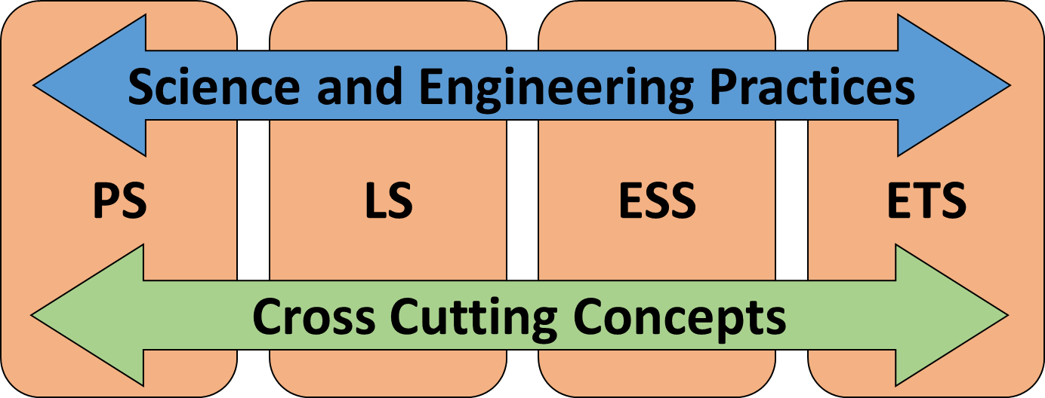
The 3-Dimensional nature of the Next Generation Science Standards (NGSS)…
…is measured by the WCAS. An overall scale score as well as three sub-scores are reported:
PS
LS
ESS
SEP
SEP
SEP
CCC
CCC
CCC
ETS

Slide 17
Sample Cluster Alignment
Sample Cluster | Item Type | Score Point | Performance Expectation Alignment | Science & Engineering Practice | Disciplinary Core Idea | Crosscutting Concept
Item 1 | Multiple Select | 1 | HS-LS2-3 | Constructing Explanations and Designing Solutions | LS2.B | Energy and Matter
Item 2 | Table Match | 1 | HS-LS2-3 HS-ETS1-3 | Constructing Explanations and Designing Solutions | LS2.B ETS1.B | Influence of Science, Engineering, and Technology on Society and the Natural World
Item 3 | Graphic Gap Match | 2 | HS-LS2-3 | - | LS2.B | Energy and Matter
Item 4 | Edit Task Inline Choice | 1 | HS-LS2-3 HS-ETS1-3 | Constructing Explanations and Designing Solutions | LS2.B ETS1.B | Influence of Science, Engineering, and Technology on Society and the Natural World

Slide 18

A student who correctly answers all of the items from the sample cluster earns five points, all in the reporting area “Practices and Crosscutting Concepts in Life Sciences”
All points are weighted equally (same size spheres)
The number of points needed to meet standard varies by grade level
PS
LS
ESS
SEP
SEP
SEP
CCC
CCC
CCC
ETS

Slide 19
Reporting
What data and reports are available?

Slide 20
What’s the same across content areas?
Student results
Overall score
Achievement Level
Sub-scores
Reporting
Levels
Classroom/Roster
Teacher
School
District
Methods
Report Card
Online Reporting System (ORS)
Paper Family Reports
Notes:
Claims and Reporting Areas are sub-scores

Slide 21
Online Reporting System (ORS)
Smarter Balanced
WCAS

Slide 22
Online Reporting System (ORS)
Note: Results/reports only include students who tested
Sharing individual student results with parents
Usually by June 1, SBA results are ready to share
Usually by August 15, WCAS results are ready to share
Parents/guardians must only see their student’s information
Features
Printing Individual SBA Student Reports in Spanish
Next Steps for SBA claim performance
Notes:
What information is in ORS and how it might be used.
ORS only includes students who tested, not all students. This is different that the accountability data that will be publically available through the state Report Card after testing is complete.
Considerations when sharing with parents:
Timeline: after June 1 is pretty safe to share data from ORS
Be cognizant of FERPA and student privacy; parents/guardians should only have access to only their student’s results
When sharing with colleagues, also be cognizant of the same student privacy considerations; educators should only have access to only the students that are appropriate for that educator.
Next Steps: share with parents or talk with colleagues. Next Steps describe possible activities to do with students in the different areas.
Features
Printing Individual SBA Student Reports in Spanish
Under Print, select Language: Spanish
Next Steps for claim performance
On Individual Student Report in Performance by Claim area

Slide 23
Family Reports
A tool to communicate summative test results with parents and families

Slide 24
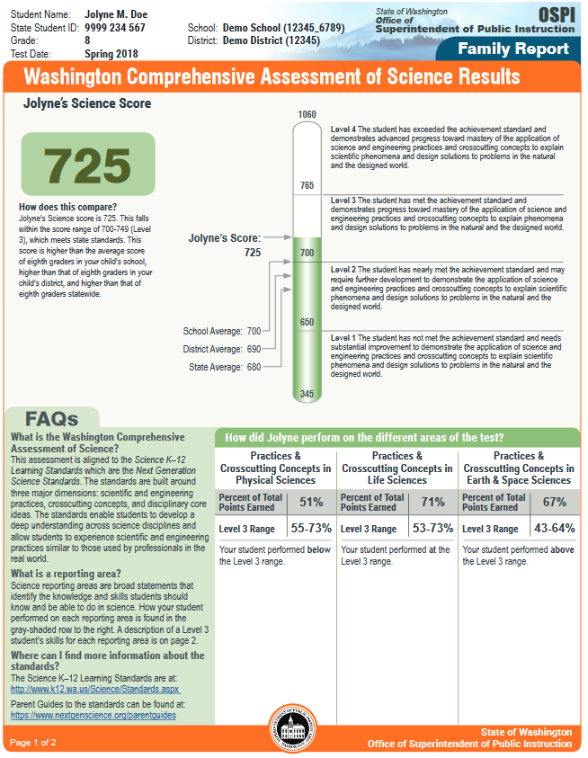
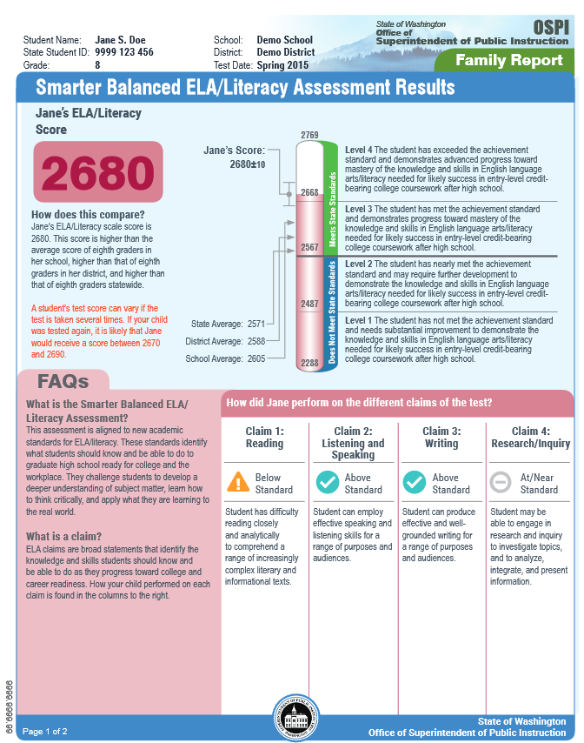
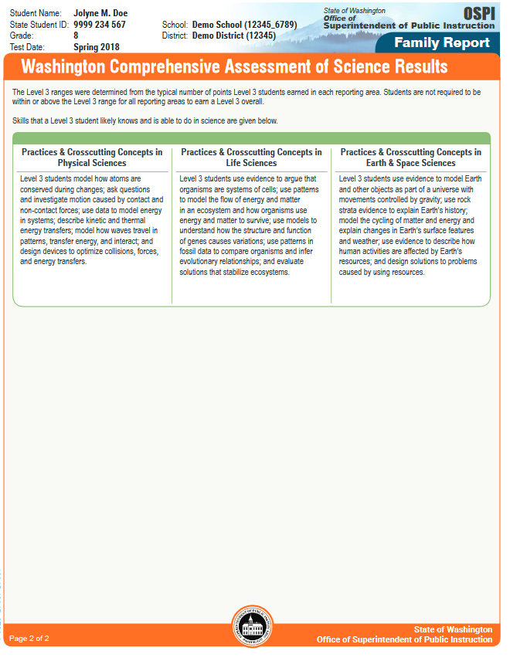
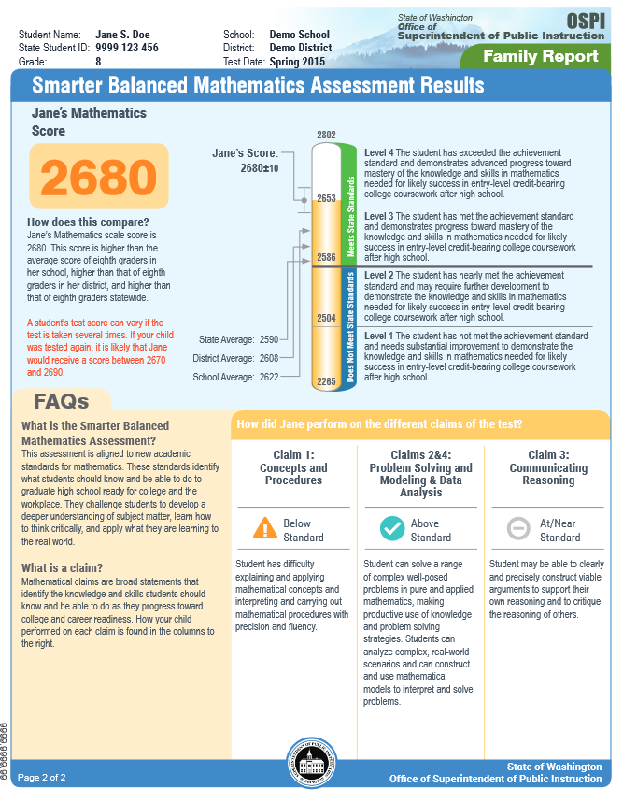
2018 Versions

Slide 25
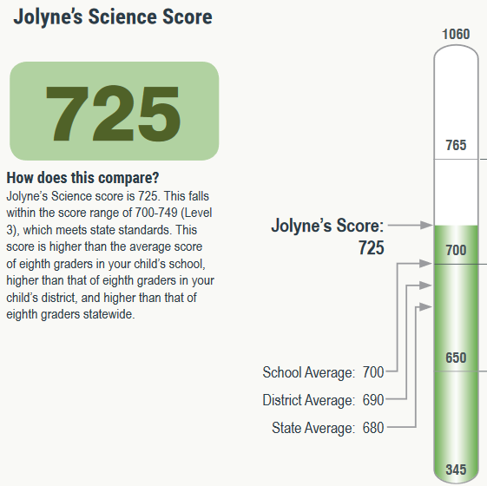
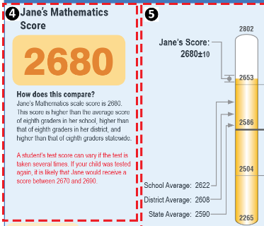
Overall Scale Score
Scale score alone IS student’s score
Examples show
Mathematics score of 2680
Science score of 725
*Source: http://testscoreguide.org/wa/sample/
*Source: http://www.k12.wa.us/assessment/StateTesting/ScoreReport.aspx
Notes:
Snips are provided from the paper Individual Student Report (ISR)
Scale score: this is the student’s score and why the number is nice a big in the sample
The +/- is a theoretical score: shows the standard error of measure/variability. To get a test without standard error, we would need a much longer test.
Important: the +/- score doesn’t mean that you add or subtract that value from the student student’s scale score to get their “real” score. The scale score (nice a big on this snip) is the student’s “real” score.

Slide 26
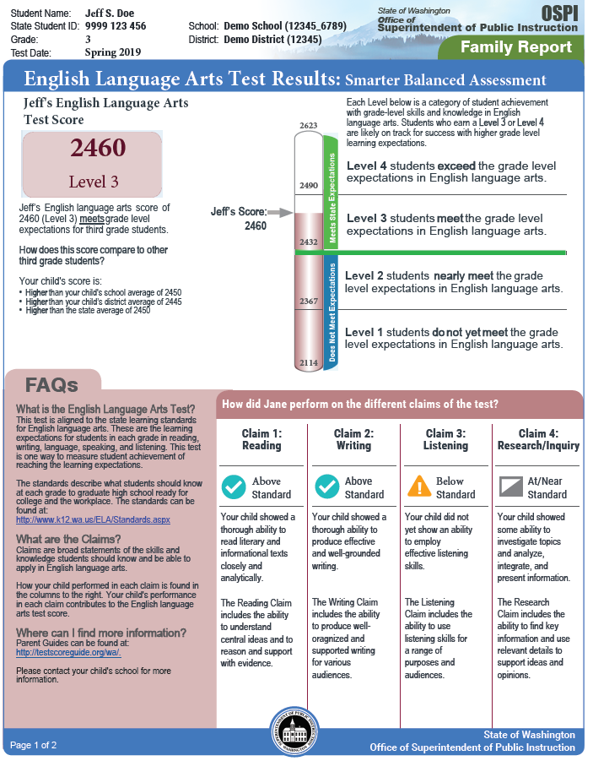
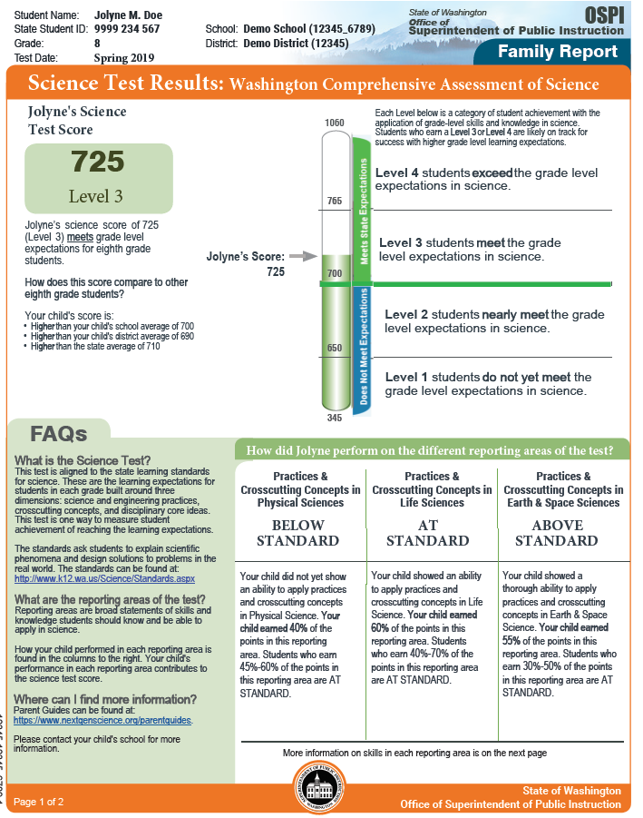
2019 Family Reports
Redesigning the Family Reports
Reduce text
Increase readability
Provide additional information
Notes:
Mockup shown; actual reports may vary slightly from mockup and by content area.

Slide 27
State Report Card
Overview

Slide 28
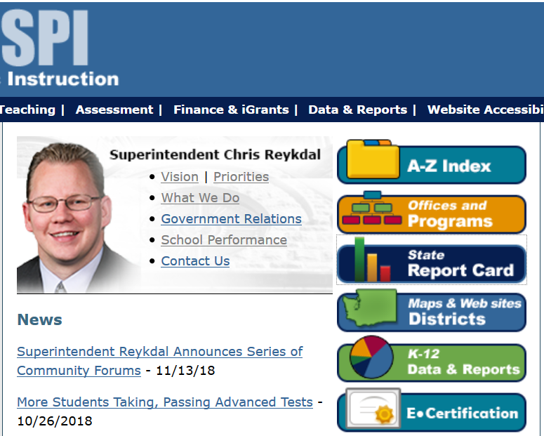
Dashboard
Navigating from the OSPI homepage

Slide 29
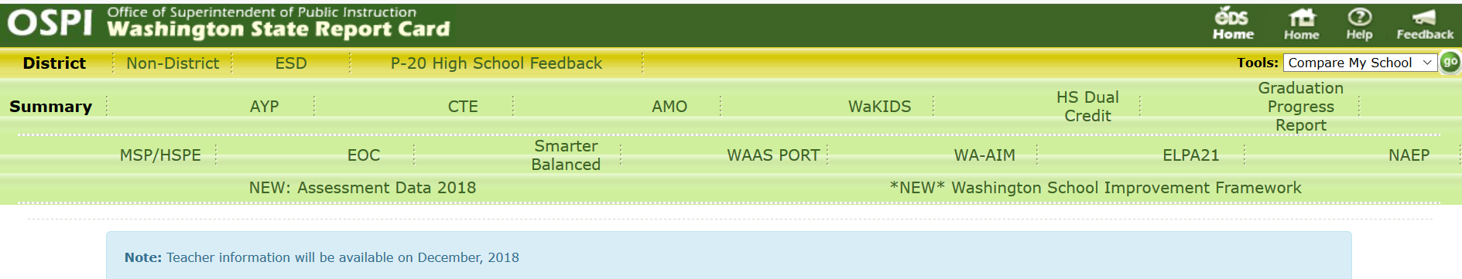
Spring 2018 Data
Navigating from the State Report Card Dashboard

Slide 30
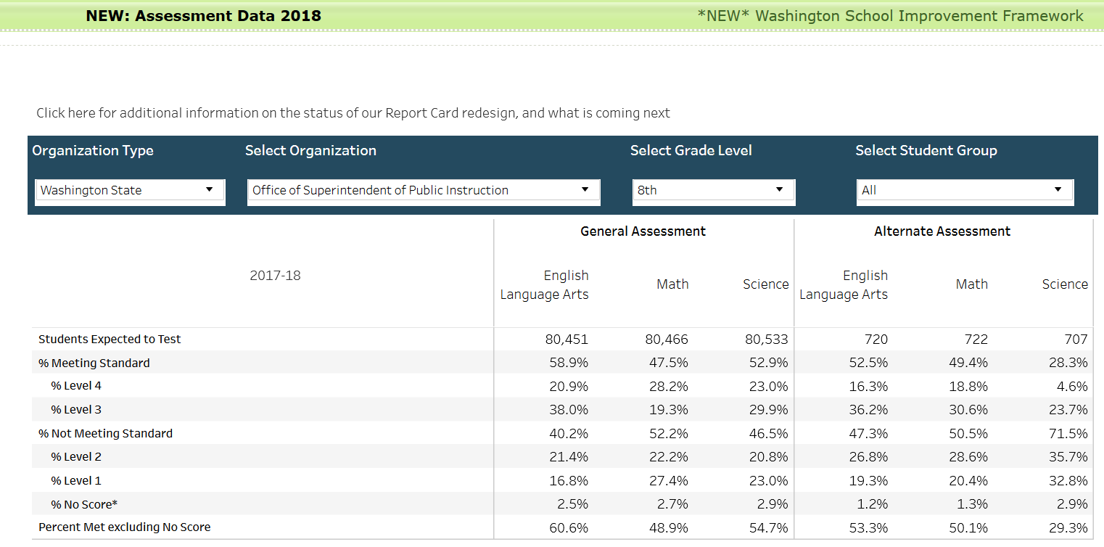
Spring 2018 Data: General and Alternate
Notes:
Slide has animations:
Click once to highlight the selection drop-downs to pick the data you want to view (at the top in red)
Click again to highlight the categories of the data available/levels (on the left in blue)
Click again to highlight the General Assessments data (in the middle in green)
Click one last time to highlight the Alternate Assessments (on the right in purple)
Alternate assessments: WA-AIM assessment

Slide 31
Report Card: Available/Coming Soon
Questions and comments: use link on Report Card site

Slide 32
What is different for Reporting?
SBA
WCAS

Slide 33
Performance Levels: SBA
Student performance at Level 3 and Level 4 is considered “on track” to College and Career Ready
For accountability purposes, Level 3 and Level 4 are considered “Proficient” under Washington School Improvement Framework (WSIF)
For more information: WISF Framework or Proficiency Infographic
Graduation cut scores apply only to high school
ELA Graduation cut score is 2548
Math Graduation cut score is 2595
Levels are determined by student performance on all items across both Computer Adaptive Test (CAT) and Performance Task (PT)
Notes:
Levels 3 and 4 are considered to be on track for career and college ready, and for accountability purposes are considered to be proficient (for WSIF purposes)
WSIF Framework: http://reportcard.ospi.k12.wa.us/SchoolIndex_2018.aspx?groupLevel=District&schoolId=1&reportLevel=State&yrs=2016-17&year=2016-17
Online Proficiency infographic http://www.k12.wa.us/esea/essa/pubdocs/7WSIFProficiency.pdf
The graduation cut scores are slightly different than the Level cut scores, and only apply to high school testing and only for purposes for graduation. These graduation cut scores did not change.
Levels and score are determined by all items across all items on the test, CAT and PT

Slide 34
Performance Levels: WCAS
Student performance at Level 3 and Level 4 is considered likely ready for subsequent grade level coursework
For accountability purposes, Level 3 and Level 4 are considered “Proficient” under Washington School Improvement Framework (WSIF)
For more information: WISF Framework or Proficiency Infographic
Currently no graduation requirement
Requirement for classes of 2021 and beyond
Those student would first take the WCAS in spring 2020
Levels are determined by student performance on all items across all the WCAS
Notes:
Levels 3 and 4 are considered to indicate a student is likely ready for coursework in subsequent grades, and for accountability purposes are considered to be proficient (for WSIF purposes)
WSIF Framework: http://reportcard.ospi.k12.wa.us/SchoolIndex_2018.aspx?groupLevel=District&schoolId=1&reportLevel=State&yrs=2016-17&year=2016-17
Online Proficiency infographic http://www.k12.wa.us/esea/essa/pubdocs/7WSIFProficiency.pdf
There is no WCAS graduation requirement. Current legislation is that science assessment graduation requirement will be for classes of 2021 and beyond.
Levels and score are determined by all items across all items on the test.

Slide 35
Claim Scores: SBA
Claims
Broad statements of skills and knowledge
Claim scores
Includes items from CAT and PT – both math and ELA
Example from ELA:
Writing claim score is from both CAT & PT
Full write is only part of writing claim score ( + 9 writing items in CAT)
At/Near Claim score means
Students are around Level 3 cut score – could be just below, just above, or at line
For more information see: Understanding Smarter Balanced Assessment Scores module
“Weighting”
Total scale score is not “weighted” by claim, CAT, or PT
All items contribute to total scale score
Notes:
Understanding Smarter Balanced Assessment Scores module is located in the WCAP: Test Coordinators > Test Resources > Modules
Claims, CAT, and PT are not “weighted” for scale score
Claims are categories of skills and knowledge assessed. These help us categorize the results. Claims go across both the CAT and the PT.
For the Writing Claim, the misnomer is that the Full Write is the only part of that Claim score; let’s bust that myth.
At/Near category: Could be just below the Level 3 cut score or could be just above it. It’s not exact, and is a broad category of student performance near the Level 3 cut score. Can be very vague, but is distinct from student performance that is “Below” the standard or “Above” the standard
Weighting: No weighting done by content, CAT or PT, or other aspects of the testing. Weighting is just by item difficulty. See images on these next set of slides.

Slide 36
Reporting Areas: WCAS
Reporting Area
Broad statements of skills and knowledge
Reporting Area scores
Includes items from WCAS only
All points are weighted equally
All items contribute to total scale score

Slide 37
Data Use Practices

Slide 38
Limitations of a single test results
Our belief: An end-of-year, summative assessment is one tool for gaining information about student learning achievements during the year.
In order to use results to inform instruction and help student learning moving forward:
Use results as one of multiple measures about student learning
Use to evaluate instruction systemically at district, building, classroom levels
To make district-driven decisions based on data:
Inform system evaluations
Use longitudinal data
Notes:
Our belief: An end-of-year, summative assessment is one tool for gaining information about student learning achievements during the year.
There should be multiple measures to help inform instruction and move student learning forward.
Summative results can be used to evaluate system-level, not so much individual student-level, decisions such as at the school or district. These results can include longitudinal evaluations of the data.

Slide 39
Resources

Slide 40
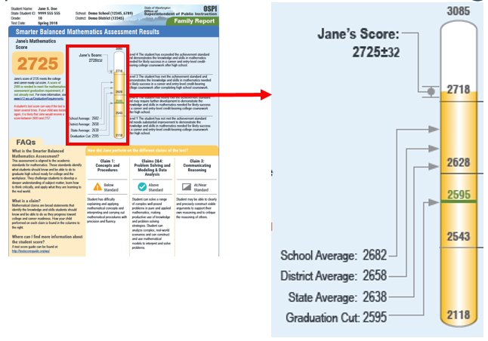
Paper Reports and TestScoreGuide.org
More Information on TestScoreGuide.org “Sample Student Score Report” webpage
Notes:
Paper reports due in district in October.
The callout shows a sample math high school score report with highlighting the scores included on the paper reports, including:
The student's score
The school average score
The district average score
The state average score
And the cut scores needed for each level
URL for Sample Student Score Report webpage: http://testscoreguide.org/wa/sample/
A great resource to communicate with parents.

Slide 41
TestScoreGuide and ReadyWA websites
TestScoreGuide Website
“Understanding Scores”
“Sample Student Score Report”
“Student’s Progress”
“Resources” with “Parent Roadmaps”
ReadyWA website
“For Educators”
“For Families”
“For Students”
Notes:
Lots of resources on these two websites
Parent Roadmap: where students should be at each grade level and are on track for learning at the next grade.
Use these resources to supplement sharing the ISRs and answer parent qustions.
URL for TestScoreGuide website: www.testscoreguide.org/wa
URL for ReadyWA website: www.readywa.org

Slide 42
Question and Answer
Notes:
Set aside 15 minutes for this section of the presentation, out of the 75 minutes total presentation time.

Slide 43
Thank you!
For more information, email any of the assessment specialists,
or email asi@k12.wa.us

