Slide 1
District Test Coordinator and Administrator Boot Camp
Assessment Cycle and
System Overview
WERA 34th Annual Conference
December 7, 2018
Session #: 4.04

Slide 2
GETTING STARTED
  Who Are You? Responsibilities
  Systems and Applications Permissions
  Quick Start Guide
  Communication
  Training
  Resources
  State Assessment Flowchart
  Building Plans
  Test Windows

Slide 3
Who Are You? Responsibilities
Well-defined user roles with responsibilities, helps an assessment program to function effectively.
  The duties of a DC include a broad oversite of testing.
    DCs establish a system to balance responsibilities.
  The duties of a DA include supporting activities outlined by the DC.
    DA access to AIR systems and applications mirror that of a DC.
  SCs, under the direction of a DC or DA, provide general oversight of school level administration activities.
  TAs are trained staff who proctor state assessments.
There are no restrictions on who can be identified in the role of a DC, DA, SC, or TA as long as the staff member is on contract with the district.

Slide 4
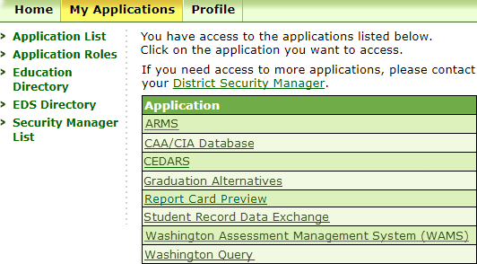
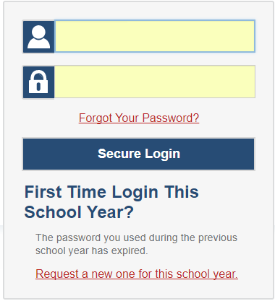
System and Application Permissions
EDS accessed at: https://eds.ospi.k12.wa.us/Login.aspx
AIR systems accessed at: https://maac.sso.airast.org/

Slide 5
Quick Start Guide
The Quick Start Guide provides information in support of the DC role, including details on OSPI and contractors’ systems and applications, how to access them, and the available training resources for the various areas of state testing.
  The Student Records Management for Assessment and Accountability Guidelines (SRMAAG) details when and how to pre-ID students, and gives information on TIDE student records, files layouts, and participation attempt codes.
  The Test Coordinator Manual (TCM) provides information on the test administration requirements at the district and school levels, test security building plans, testing schedules, and student participation and accessibility.
  The Professional Standards and Security, Incident, and Reporting Guidelines (PIRG) provides information to support professional standards and ethical testing practices including policies, responsibilities, and permissions. It also provides detailed information regarding test security, incident processing, and reporting.

Slide 6
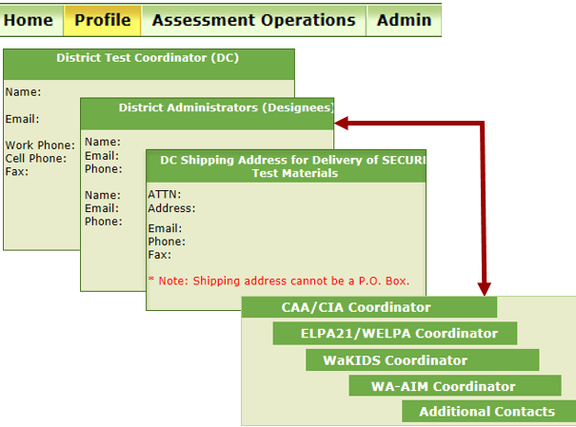
Communication
WAMS-Profile: https://eds.ospi.k12.wa.us/Login.aspx
Receive current information, updates, and alerts
  WAW Newsletter
  Assessment Update Webinars
  Testing Alert Emails
  WCAP Portal Homepage Alerts
Receive individual updates on the following pages of the OSPI Web site:
  Bulletins and Memos
  State Testing
  Graduation Alternatives, ELPA21, WA-AIM, WaKIDS
Share information with school staff, students, and families

Slide 7
Training
REQUIREMENTS
Annual training is required for all staff who will support state test administration activities.
All new staff must be fully trained.
Seasoned staff must have thorough knowledge of the training resources, and review resources for updates new to 2018-19 administrations.
Make sure all staff understand their roles and responsibilities for the duties assigned.
As the DC, it is your responsibility to train your DAs.
Training of the SCs or TAs may be assigned to another staff, as determined by the DC.
BEST PRACTICES
Know who should be trained.
Know what is, and is not allowed for testing.
Make sure all students have access to the accessibility features they need.
All staff must be trained and understand the difference between the Practice, Training, Interim, and Summative assessments, PRIOR to proctoring them.

Slide 8
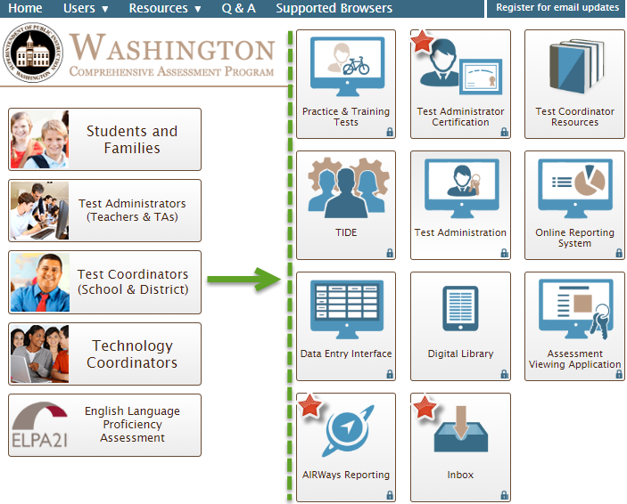
Resources

Slide 9
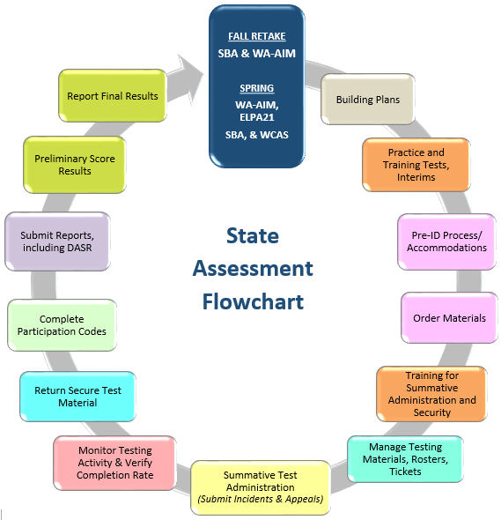
Flowchart
This State Assessment Flowchart shows the circle of tasks required throughout the year

Slide 10
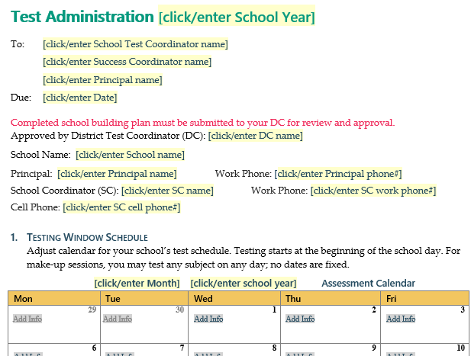
Building Plans
Test Security and Building Plan Template
WHAT
Test Security and Building Plans (TSBPs) are documents formatted to support critical aspects of the state testing process.
WHO
DCs work with other key building staff to create a TSBP
PLANS SHOULD INCLUDE
Test schedules, responsibilities, chain of custody for secure materials, supplies, student participation, and communication
RESOURCES
PIRG, template building plan, state testing windows

Slide 11
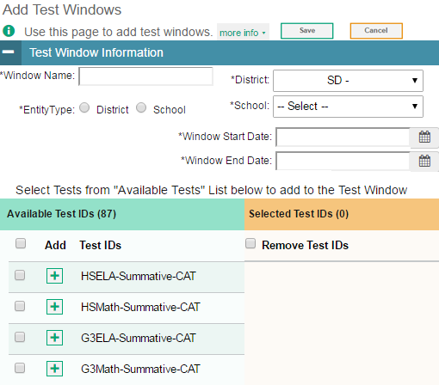
TIDE Test Windows
School test windows are required to be set in TIDE.
Multiple windows can also be set in TIDE through a file upload.

Slide 12
ASSESSMENTS AND GRADUATION
  Assessments in 2019
  High School Assessments and Graduation Requirements
  Graduation Alternatives

Slide 13
Assessments in 2019
SUMMATIVE ASSESSMENTS REQUIRED FOR ACCOUNTABILITY | K | 1 | 2 | 3 | 4 | 5 | 6 | 7 | 8 | 9 | 10 | 11 | 12
ELPA21 or WIDA |  |  |  |  |  |  |  |  |  |  |  |  | 
SBA or WA-AIM ELA & Math |  |  |  |  |  |  |  |  |  |  | 
WCAS or WA-AIM Science |  |  |  |  |  |  |  |  |  |  |  | 
Other Assessments | K | 1 | 2 | 3 | 4 | 5 | 6 | 7 | 8 | 9 | 10 | 11 | 12
Arts |  |  |  |  |  |  |  |  |  |  |  |  | 
Civics |  |  |  |  |  |  |  |  |  |  |  |  | 
Health and Physical Education |  |  |  |  |  |  |  |  |  |  |  |  | 
Social Studies |  |  |  |  |  |  |  |  |  |  |  |  | 
Educational Technology (Arts) |  |  |  |  |  |  |  |  |  |  | 
Educational Technology (ELA) |  |  |  |  |  |  |  |  |  |  |  |  | 
Educational Technology (Science, Math, Health) |  |  |  |  |  |  |  |  | 
Educational Technology (Social Studies) |  |  |  |  |  |  |  |  |  |  |  |  | 
Other State Mandated Tests | 2
Second Grade Reading Assessment | 
National Assessments | 4 | 8
National Assessment of Educational Progress |  | 

Slide 14
HS Assessment & Graduation Requirements
 | SY 2018-19 | SY 2019-20 | SY 2020-21 | SY 2021-22
Tests | Smarter Balanced ELA– Gr 10, 11, 12 Smarter Balanced Math– Gr 10, 11, 12 WCAS Science–Gr 11 | Smarter Balanced ELA– Gr 10, 11, 12 Smarter Balanced Math– Gr 10, 11, 12 WCAS Science–Gr 11 | Smarter Balanced ELA– Gr 10, 11, 12 Smarter Balanced Math– Gr 10, 11, 12 WCAS Science–Gr 11 | Smarter Balanced ELA– Gr 10, 11, 12 Smarter Balanced Math– Gr 10, 11, 12 WCAS Science–Gr 11
Tests that Fulfill Graduation Requirements by Class | Class of 2019: ELA–SBA by Exit Exam cut score Math–SBA by Exit Exam cut score | Class of 2020: ELA–SBA by Exit Exam cut score Math–SBA by Exit Exam cut score | Class of 2021: ELA–SBA by Exit Exam cut score Math–SBA by Exit Exam cut score Science–WCAS by Exit Exam cut score | Class of 2022: ELA–SBA by Exit Exam cut score Math–SBA by Exit Exam cut score Science–WCAS by Exit Exam cut score
Test by | Student Class Of | Student Class Of | Student Class Of | Student Class Of
Grade 12 | 2019: ELA & Math retakes as needed | 2020: ELA & Math retakes as needed | 2021: ELA, Math, Science retakes as needed | 2022: ELA, Math, Science retakes as needed
Grade 11 | 2020: ELA & Math retakes as needed Science WCAS (accountability) | 2021: ELA & Math retakes as needed Science WCAS (graduation, accountability) | 2022: ELA & Math retakes as needed Science WCAS (graduation, accountability)
Grade 10 | 2021: ELA & Math SBA (graduation, accountability) | 2022: ELA & Math SBA (graduation, accountability)

Slide 15
Graduation Alternatives
What are Assessment Graduation Alternatives?
  Assessment graduation alternatives are associated with the assessment graduation requirement for Washington state students. They are options available to students who meet specific eligibility criteria.
Who can access Assessment Graduation Alternatives?
  Student eligibility for access is based on a student’s testing history, and (as applicable) transfer status.
What are the different Assessment Graduation Alternatives options?
  Once eligibility is determined, students have the following options for meeting graduation requirements.
CAA Options
      GPA Comparison
      College Admission/AP/IB Tests
      Dual Credit Courses
      LAA/LDC
CIA Options
(for students, if specified in their IEPs)
      CIA Cut Score on regular (on grade) assessment
      Off-Grade Level Assessment on regular or alternate assessment*
      Locally Determined Assessments (LDA)
Assessment Waivers
Out of State Transfer Waiver
Special, Unavoidable Circumstance Appeal (SUCA)
http://www.k12.wa.us/assessment/GraduationAlternatives/default.aspx

Slide 16
PRE-ID
  WAMS-Pre-ID
  CEDARS
  CEDARS SSID
  CEDARS Students
  Pre-identify Student Settings
  Pre-Registration of Students Receiving Services
  Paper Test Materials

Slide 17
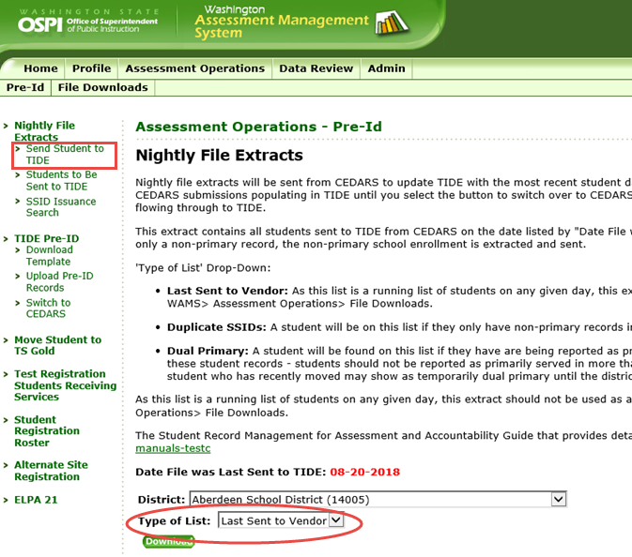
WAMS Pre-ID
Nightly File Extracts

Slide 18
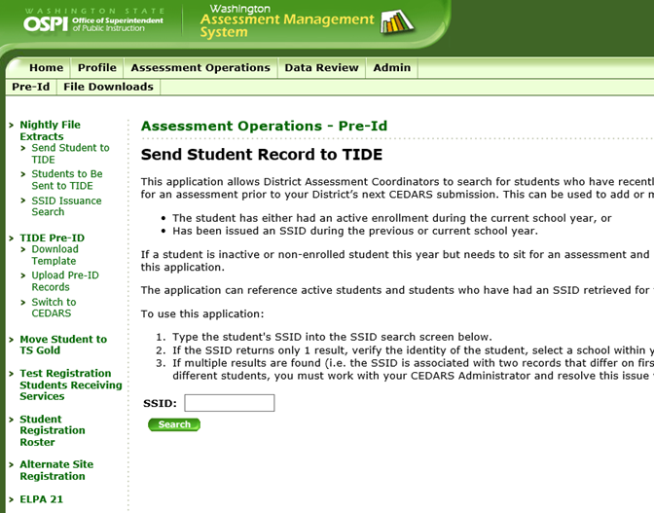
WAMS Pre-ID
Send Student to TIDE

Slide 19
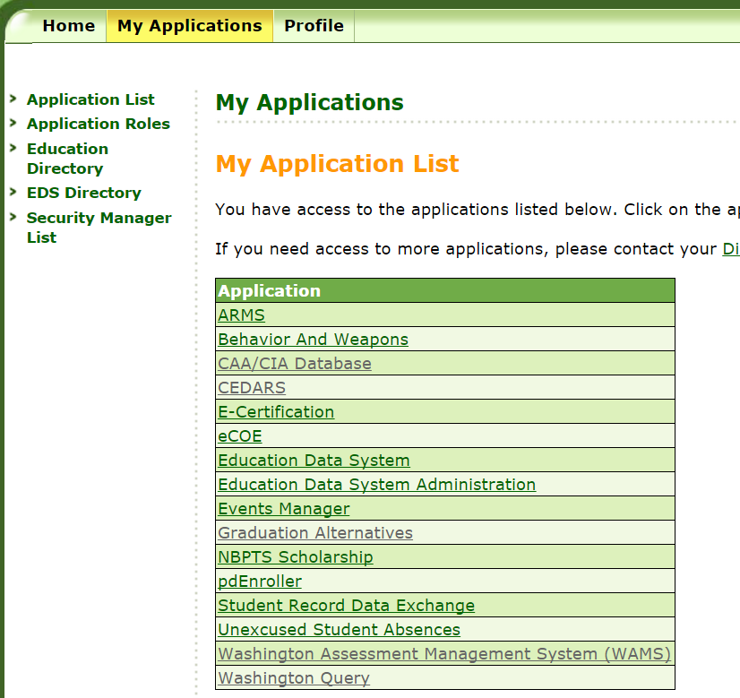
CEDARS

Slide 20
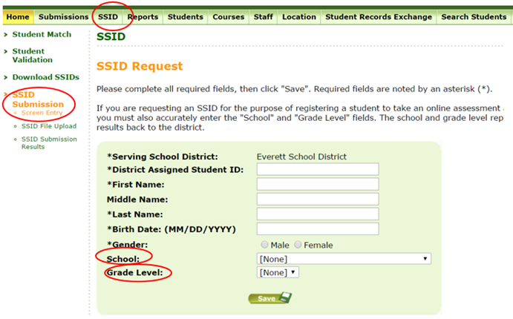
CEDARS
SSID

Slide 21
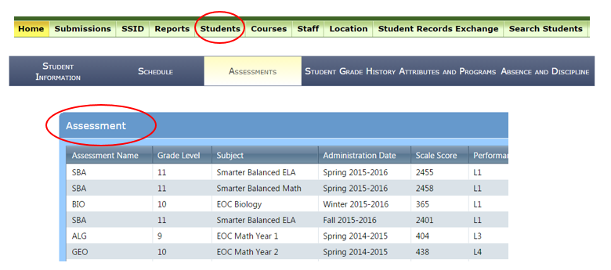
CEDARS
Students

Slide 22
Pre-Identify Student Settings
TIDE Student Settings
Accessibility Features, such as designated supports and accommodations are set in TIDE.
You can also turn off individual Universal Tools, when documented.
GTSA
You should become thoroughly familiar with the GTSA to know what materials can be accessed by all students (Universal Tools) and what accessibility features are available for use on each assessment.

Slide 23
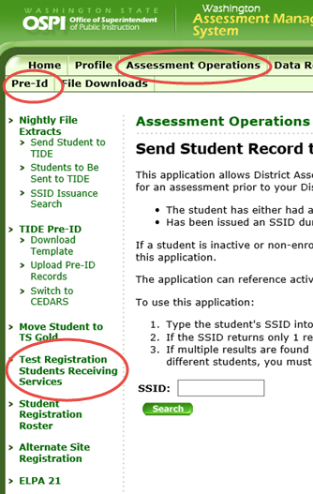
Pre-Registration of Students Receiving Services
Pre-Registration of Students Receiving Services can be found in
WAMS > Assessment Operations > Pre-Id > Test Registration Students Receiving Services
This application is for three student populations: students with IEPs, students with 504 plans, and EL students, as identified in CEDARS, who require WA-AIM, or paper accommodated forms for Smarter Balanced or WCAS.
Using this feature will ensure that the test forms selected are included in your district’s initial shipment of test materials.

Slide 24
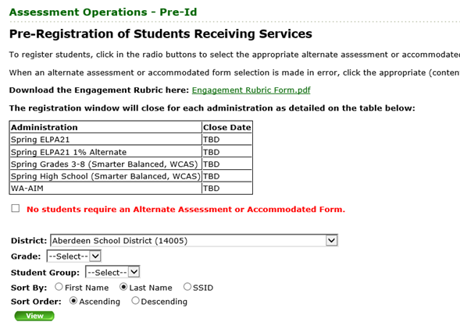
Pre-Registration of Students Receiving Services
It is important to begin working with your special services departments to identify students needing accommodated forms as early as possible.
Any additional accommodated forms needed after the close date will be ordered through TIDE during the assessment’s additional order window.

Slide 25
Paper Test Materials
Order, Delivery, Return Schedule
All WCAP assessments are administered online. Paper testing is only students receiving services (IEP or 504 plans) who require paper tests.
Paper-Pencil Test Administration | Grade | Material: Due in District | Additional Orders Window | Paper Test Window | Material to Contractor: No later than
SBA & OGL Fall Retakes | HS | N/A | 9/24 – 11/6/18 | 10/22 – 11/16/18 | 11/27/18
ELPA21 Annual | K-12 | 1/17/19 | 1/18 – 3/8/19 | 1/28 – 3/22/19 | 3/29/19
SBA Spring | 3-8 | 4/1/19 | 4/2 – 5/10/19 | 4/15 – 5/24/19 | 5/31/19
WCAS Spring | 5-8 | 4/1/19 | 4/2 – 5/10/19 | 4/15 – 5/24/19 | 5/31/19
SBA Spring | HS | 4/22/19 | 4/23 – 5/10/19 | 5/3 – 5/24/19 | 5/31/19
WCAS Spring | 11 | 4/22/19 | 4/23 – 5/10/19 | 5/3 – 5/24/19 | 5/31/19

Slide 26
Material Available and Locally Supplied
Materials Available | Description
100’s Number Table | Available for print from the WCAP Portal
Abacus | Locally supplied
Bilingual Dictionary | Locally supplied (word-for-word)
Calculator | Locally supplied (calculator approved section of paper test only)
English Dictionary | Locally supplied
English Glossary | Available for print from the WCAP Portal (state approved only, when permitted)
Graph Paper | Locally supplied
Headsets | Locally supplied (students personal headsets can be used after compatibility check)
Multiplication Table | Available for print from the WCAP Portal
Pencils | Locally supplied
Periodic Table | Available for print from the WCAP Portal
Scratch Paper | Locally supplied
Thesaurus | Locally supplied

Slide 27
REPORTING
  Participation Codes
  TIDE Appeals
  Assessment Reporting Management System
  Electronic and Paper Reporting
  Document Retention and Audit Report
  Request to View

Slide 28
Participation Codes
2) PARTICIPATION CODES
  Participation codes are for district reference
  Documentation is moving from to TIDE to WAMS for 2018-19
    One location to record for your reference
    WAMS better aligned to “Accountability” than TIDE

Slide 29
TIDE Appeals
TIDE appeals support incidents that involve a student and online test.
Washington is collaborating with other states on policy updates for TIDE appeal processing. New considerations include:
Ability to Re-Open or Reset tests when an accommodation or designated support was not provided.
    Actions Required: Incident reported to state, via ARMS, prior to score results loading to ORS and team meeting prior to testing student again.
Not permitting appeals when a student submits the test, but states that the test was not complete.
    Students receive three warning messages prior to submitting the test.

Slide 30
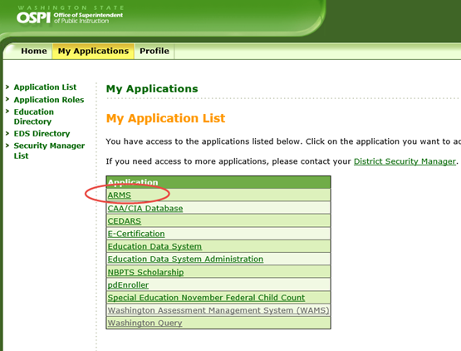
Assessment Reporting Management System (ARMS)
Online system for form processing through EDS
DCs determine user access within district and schools
DC, DA, and SC users are required to review the training PPT prior to being granted access to ARMS
  Roles assigned by your DDSM:
        ARMS_District Test Coordinator (DC)
        ARMS_District Administrator (DA)
        ARMS_School Test Coordinator (SC)
        ARMS_School Principal
        ARMS_District Superintendent

Slide 31
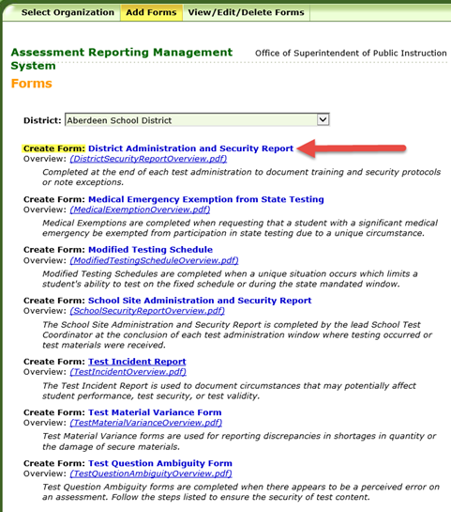
Accessing Forms in ARMS
To create a report, click on the name of the report, next to Create Form.
For an overview of the form, and instructions on how to fill it out, click on the PDF link next to Overview

Slide 32
Electronic and Paper Reporting
ORS, Query, & Paper Reporting
  ELA and Math scores for online testers automatically populate in ORS
  WCAS and ELPA21 score results are loaded into ORS based on an approved date
  Paper testers score results are loaded to ORS based on an approved date as well
Assessment | Scores in ORS
2019 Spring Smarter Balanced (online) | March 18, 2019
2019 Spring ELPA21 Annual | May 21, 2019
2019 Spring WCAS (online & paper) | August 23, 2019

Slide 33
Document Retention and Audit Report
Required documentation to DC
  TA Training Logs
  Printed copy of the signed roster (paper/eRoster), if required by DC
  Report of students not tested and why (Refused, Absent, NNEP etc.)
  Test Security Staff Assurance Forms
  School Site Administration and Security Report
  Test incident reports (ARMS or paper)
Retain at the school (or district)
  Daily material check in/out logs
Submit to OSPI
  District Security Report
  Test incident reports, as required
Required documentation is outlined in the PIRG
WA State Auditors Office
WA State Retention Guidelines and District Policy
www.sos.wa.gov/_assets/archives/recordsmanagement/schools%20districts%20and%20esds%208.2.pdf
www.sos.wa.gov/_assets/archives/recordsmanagement/local-government-common-records-retention-schedule-(core)-v.3.3-(october-2016).pdf

Slide 34
Request to View (RTV)
What is a RTV? How are they initiated?
The RTV process allows Parents/Legal Guardians and/or Students (who are 18 years old or emancipated) to have the opportunity to view their child’s assessment as provided by the Family Educational Rights and Privacy Act (FERPA).
The parent/legal guardian fills out a RTV form, which is available on the WCAP Portal, in the Students & Families Resources - General Information section, and submits it to the state.
The test will be provided to the DC in an online or paper format, depending on platform that the student tested.
Review the RTV Guidelines for specific details.

Slide 35
Q and A Session
  Questions?

Slide 36
Contacts
OSPI Assessment Operations for assessment policy and test materials
Assessment Operations: assessment@k12.wa.us (360) 725-6348 or (800) 725-4311, press option 3
OSPI Assessment Analysts for student data issues
OSPI Assessment Analysts: assessmentanalysts@k12.wa.us 360-725-6109
AIR Help Desk for Technical, Network, and password issues
AIR Help Desk: wahelpdesk@air.org 1-844-560-7366

Slide 37
AIR Applications
TIDE
Test Information Distribution Engine
Practice and Training Tests
Test Administration
Summative Assessments
Interim Assessments
DEI
Data Entry Interface
AVA
Assessment Viewing Application
AIRWays Reporting
ORS
Online Reporting System
Used to transcribe student assessment responses from paper-pencil accommodated forms for WCAS and ELPA21 assessments for scoring.
Provides score reports for each student who takes a WCAP assessment.
Provides student performance reports for Smarter Balanced interim assessments.
Allows users to review Smarter Balanced ICAs and IABs for administrative and instructional purposes.
Secure site that students practice using the accessibility supports and testing formats used during summative assessments.

Slide 38
OSPI Applications
WAMS
Washington Assessment Management System
CEDARS
Comprehensive Educational Data and Research System
ARMS
Assessment Records Management Systems
CIA/CAA
Database
Reports
Profile
Pre-ID
Nightly File Extracts
Submissions
Students
Graduation Database
CAA Options
Retro Basic
Create Forms
District Administration and Security Report
View/Edit/Delete Forms
Contact Information
Registration of Students Receiving Services
Alternate Test Registration
TIDE Pre-ID
District Student Attribute Enrollment
P210 Withdrawal Preview
Disability Status
Submission List
Submission Exceptions
Search Students

