Slide 1


Assessment Directors’ Meeting November 30, 2018
Welcome & Introductions
Updates from OSPI
Sharing Data and Student Growth
District Sharing:
Mukilteo & Monroe
Reflection & Close

Slide 2





Since We Last Met…
CPR
…life has been like which book, movie, or song?

Slide 3




Purpose?
What is the purpose of these meetings?
What do you get out of these meetings?
What do you want or need to get out of these meetings?

Slide 4
OSPI Assessment Update The NWESD Highlights
SY 18-19 UPDATE #4
NOVEMBER 13, 2018

Slide 5
Today’s Topics
Content
Paper/Pencil Testing
Blueprint Changes
Committees for Science Bias and Fairness
Operations
Administration Resources
WaKIDS
Percentage of Completion
Next Steps
Select Assessments
ELPA21
WIDA
WA-AIM
IEP Guidance
Technology
Chrome iOS 69/70
Forbidden Apps
Mac OS X
See you at WERA!
This presentation contains a script in the notes
Section. If you are accessing this information with a
screen reader, be sure you are reading the notes
Section as well as the text contained in the slides.
Notes:
The draft version of this slide deck is posted in WAMS. Go to: WAMS>Assessment Operations>File Downloads>2019 Administration>7. Administration Training Resources

Slide 6
Planning for Paper-Pencil testing
Students with an IEP or 504 plan may access paper-pencil versions of these tests.
ELPA21, Smarter Balanced, and WCAS were designed to be administered online.
Embedded tools, supports, and accommodations to make the online tests accessible.
Use the practice and training tests to try out different settings with the students.
Notes:
Although summative testing seems far away, we know that you are busy planning for it. We’d like to give you some things to keep in mind as you prepare for paper-pencil testing—we know it is a small population of students, but there are a lot of little details..
First, students must have an IEP or a 504 plan to access the paper-pencil tests. We hope that the IEP and 504 decision making teams, who must make these determinations at the individual student level, will take into consideration the fact that ELPA21, Smarter Balanced, and the WCAS were all designed to be administered online. In fact, the adaptive nature of the Smarter Balanced tests only works in the online version of the test. In addition, there are many tools, supports, and accommodations available to make the online tests accessible to the majority of students. For example: print-on-demand, zoom, or color contrast.
We encourage the use of the practice and training tests to try out the different settings available online with the students, to see if the use of those settings will enable the student to take the online test.

Slide 7
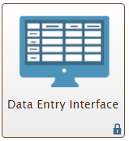
Use of Date Entry Interface (DEI)
ELPA21—Four steps:
Student answers Listening, Reading, and Writing in their booklet.
TA enters the student’s Listening and Reading responses into DEI.
TA records the student’s responses to the Speaking questions directly into DEI.
TA enters the student’s Writing responses into DEI.
Smarter Balanced—Not used.
WCAS—Two steps:
Student answers all the questions in their booklet.
TA enters all of the students’ responses into DEI.
Notes:
Another reason for the small ratios is the use of the Data Entry Interface system, or DEI.
The DEI is used for both the ELPA21 and the WCAS. It is a system on the WCAP portal, and does have a User Guide and Training Module available.
For ELPA21 there is a 4 step process. First, the student answers the Listening, Reading and Writing questions directly in their booklet. Second, the TA then transcribes the student’s Listening and Reading responses into DEI. Third, the student sits near the TA computer wearing a headset with a microphone, and the TA records the student’s answers to the Speaking questions directly into the DEI. Lastly, the TA transcribes the student’s Writing responses into DEI. While the student only has to be present for recording the Speaking items, this does need to part of your thinking for scheduling the different sections of the ELPA21.
It’s less complicated for the WCAS. For the science test, the students answer all of the questions in the booklet, then the TA transcribes their answers into the DEI. We highly recommend that the TA be the one to enter the WCAS responses, and that they do it as soon as possible after the student has completed testing. Our reason for this is that there are some special instructions in the secure TA Say Script document for how to transcribe some item responses.
Please be sure to include time for DEI entry in your staff schedules toward the end of the paper-pencil test window.

Slide 8
Paper-pencil planning summary
Carefully consider which students will do paper-pencil tests.
Plan for the necessary teacher:student ratio.
Schedule time for DEI entry.
Return the booklets and materials carefully.
Notes:
As we get closer to the test windows, we’ll have more reminders and details about the booklets and DEI.
To summarize, we hope that district and school teams will carefully consider which students actually need to do paper-pencil tests. Please plan your staffing and test schedules around the necessary teacher to student ratios. For ELPA21 and WCAS tests, plan for the time to enter the student responses into DEI. Be sure your staff are trained ahead of time in how to use the DEI system and transcribe student responses accurately. Then, be sure to put the booklets into the correct type of box when returning them to our vendor.
We hope this overview will help you start thinking and planning.

Slide 9
New Smarter Balanced Summative Blueprint for 2018–19
Posted to WCAP Portal in General Information folder
WAW Articles:
September 20: First announcement regarding new blueprint
October 11: Brief FAQ on new blueprint
Shared with Regional Coordinators and Fellows
Shared with OSSI Continuous Improvement Partners
Also sent through OSPI Email Alerts
Notes:
We want to shine a bright light on information sent out about the new Smarter Balanced blueprints that will be used for testing during the 2018-19 school year. Those blueprints, both math and ELA, are now posted in the General Information folder on the WCAP Portal. You can access this folder through either the Test Administrator or Test Coordinator card on the WCAP Portal home page.
In an effort to get this information out to all educators across the state, there were a couple articles sent out in the WAW, one on September 20 with the announcement and another just last week with a brief FAQ based on that September announcement. We also sent notification of the new blueprint out to the Regional Math and Literacy Coordinators and Fellows network, the Office of System and School Improvement Continuous Improvement Partners, and through OSPI’s Email Alert.

Slide 10
ELA Blueprint Changes by Claim
Claim 1 (Reading):
Grades 3, 4, 5: All short-answer CAT items removed
All grades: Total CAT items for Reading remains the same
Claim 2 (Writing):
Grades 3, 4, 5: All brief write CAT items removed
All grades: Total CAT items for Writing reduced from 10 to 6
Additional evidence for the Writing claim from trait scores on the PT
Claim 3 (Listening): No changes
Claim 4 (Research):
All grades: Research items in the PT reduced from 3 to 1 at all grades
To compensate, 2 machine-scored items added to the CAT at each grade
9 Research items total: 8 items in the CAT plus the 1 item in the PT
Notes:
Here’s a breakdown of the changes, by claim, for the ELA blueprint. [read slide]
Even with these changes to the ELA blueprint, it is important for students to engage in a variety of writing activities in the classroom, starting at early grades. Classroom instruction based on standards engages students in activities where they write about what they have read, using evidence from texts to present analyses, defend claims, and present clear information. To prepare for future academic success, and for students to be truly college and career ready, regular classroom practice in these skills should continue to be a high priority.

Slide 11
Summary of ELA changes
Grades 3-5:
CAT: No constructed responses items for reading or writing claims
PT: Reduced items on Part 1 - one research item, either table or constructed response (Full write remains the same)
ALL grades:
PT: Reduced items on Part 1 - one research item, either table or constructed response (Full write remains the same)
CAT: 3 Fewer writing items, 2 additional research items

Slide 12
Math Blueprint Changes
Grades 6–8 and High School
No hand-scored CAT items
Brings these grades in line with grades 3–5 which had no hand-scored item in CAT in 2017–18
All Grades: Short-answer items remain on the PT
Notes:
And here’s a breakdown of the changes for the math blueprint. [read slide]
We want to stress that the blueprint changes do not change the content that the test measures. The updated blueprint reduces the total number of items administered to students, including fewer hand-scored items, which are typically more time-consuming for students to complete.

Slide 13
A few answers to FAQs:
Interims are intended to support and inform classroom instruction aligned to the standards.
The new blueprint has not resulted in any changes to interims.
Yes, some interims include item types no longer on the summative for some grade levels.
The summative test continues to measure the same content; therefore, performance on the summative test remains comparable across years.
Contact us with any questions
Notes:
Finally, a few comments on frequently asked questions, mostly about interims. There is no plan to update interims to reflect the new summative blueprint. The interims can continue to support classroom instruction by providing additional information about student learning. We encourage educators to use the Assessment Viewing Application (AVA) to explore which interims are most appropriate for students based on teaching scope and sequence.
The summative test continues to measure the same content; therefore, performance on the summative test remains comparable across years. The content of the summative assessment continues to be grounded in the standards. The ELA standards expect students to engage in a variety of writing activities in all grades, specifically writing about what they read, using evidence and elaboration strategies, and demonstrating knowledge of standard conventions.
As you have other questions about the new summative blueprints, please feel free to contact us at asi@k12.wa.us. Thank you.

Slide 14
Bias and Sensitivity Committee
OSPI is seeking participants for Bias and Sensitivity Committees
Bias and Sensitivity participants review WCAS test questions to eliminate non-science content that might offend or disadvantage students based on:
Race • Disability • Ethnicity
Gender • Self-identity • Socioeconomic status
Committee members represent Washington’s diverse population
Roles that fit well with the committee’s work include:
Community liaisons • Student-group advocates
Parent-group advocates • Family engagement specialists
Notes:
On behalf of the assessment development team, OSPI is seeking new participants for Bias and Sensitivity committees. All questions on state assessments go through Bias and Sensitivity reviews. For the Smarter Balanced assessments, that review is done by educators from across the consortium. For the Washington Comprehensive Assessment of Science, or WCAS, the review is done by folks in Washington. We’re looking to enhance the pool of individuals who participate in the review of WCAS questions, and are reaching out to you first to get your thoughts.
First, though, a little background on the Bias and Sensitivity committee. The Bias and Sensitivity participants review WCAS questions for content—not related to the science standards—that might offend, disadvantage, or be a barrier to students based on their ethnicity, background, or experiences. Committee members recommend changes to WCAS questions to remove these barriers and increase the access for all students to the test.
Participants on the committee represent the diverse population of students in Washington. What we’re looking for is district staff who are not classroom educators; classroom educators already review all WCAS questions during Content Review committees. Rather, we’re looking for folks in roles such as community liaison or family engagement specialist or who otherwise work with individuals in specific outreach and support ways to be on this committee.

Slide 15
Call for Bias and Sensitivity Participants
Does your district employ staff (not classroom educators) who support and provide outreach to groups like these?
Native families • LGBTQ+ community
Families of color • Community-based organizations
Migrant families • Students experiencing homelessness
Immigrant families • Non-native English speaking families
If you think there would be interest in participating on a Bias and Sensitivity committee, please enter in the Chat box:
Your district’s name
The group or groups name(s)
Additional thoughts after the webinar?
Email Anton Jackson at anton.jackson@k12.wa.us
Notes:
Now, we have a sense that many districts employ staff who would be well-suited for the Bias and Sensitivity committee. For example, one district in the Puget Sound region has four different community liaisons who support Spanish, Somali, Nepali, and Burmese families. And there may be other staff in that same district, but we just don’t know the specifics.
So the ask we have of you today is to please let us know if you have district staff in these roles who support these students, parents, and communities. Do you think they might be interested in participating in this Bias and Sensitivity committee? If you would take a moment to consider the groups listed, which is not exhaustive of all possible groups, and let us know if your district employs staff specifically in these kinds of support roles.
If you think there would be interest from your district and these staff to be involved in the work of Bias and Sensitivity reviews, please enter your district’s name and the group or groups name that staff support in the Chat box at this time. OSPI will then reach out to these staff to provide more information and coordinate their involvement in upcoming committees.
We’ll pause here for a moment to give you time to enter your thoughts into the Chat box, and thank you for your consideration and the information.
[Pause for a moment]
Thank you for your thoughts. [Click to enable animation on this slide] If you have additional thoughts after the webinar, please email those to Anton Jackson.

Slide 16
Administration Resources
Resources and Training Materials | Posted to the Portal
Security Reports School Site Administration and Security Report Test Security Staff Assurance Report Training Log for State Assessments Test Question Ambiguity Form | 10/17
TIDE Training Module (Updated) | 10/23
AVA Training Module | 10/29
TDS-TA/Student Interface Module | 10/30
DEI User Guide | 11/9
Test Material Processing Training PPT (Fall) | 11/9
Smarter Balanced Glossaries | 11/9
Posted to EDS WAMS:
Assessment Operations > File Downloads > 2019
TIDE Training Module Audio (mp4)
Need help, email the Operations Team at: Assessment@k12.wa.us
Notes:
This slide shows administration resources recently posted to the Portal, and to WAMS. As always, if you need help, you can send an email to the Operations Team, and we will be happy to assist you.

Slide 17
Did your district print translated student score reports from ORS to provide to families this fall?
60 participated in the poll question.
Yes, we used the Spanish versions for Smarter Balanced scores. 20%
Yes, we used the languages available for ELPA21 Annual. 20%
Yes, we used the languages available for ELPA21 Screener. 20%
No, we did not use them. 42%
Wait, there are translated versions available? 17%
Why are there no translated versions available for the WCAS? 10%
I am not sure. 30%

Slide 18
WaKIDS
Fall Assessment is Complete
99% completion
All tabs within GOLD have now rolled over into in winter checkpoint dates
Notes:
As of October 31st at 9:00pm, we have completed the fall checkpoint for the WaKIDS assessment. We allowed DACs a few extra days to follow up with teachers and encourage them to finalize and this proved to be part of the success and high percentage of completion.

Slide 19
WaKIDS
Refer back to the Quick Start Guide for detailed responsibilities.
New webcasts for support
Pull your reports now
District level: Snapshot Birth-Third Grade, Snapshot and Snapshot by Dimension
Class level: Snapshot, Development and Learning, Class Profile and Individual Child Report
Report Card
Notes:
With the fall checkpoint done, WaKIDS assessment may be complete but full-day Kindergarten is not over. Check out the Quick Start Guide again and review the responsibilities for the next steps.
We now move to the next stage, Data Analysis. We have new webcasts on our materials page to support you through out the year and we will be adding more. http://www.k12.wa.us/WaKIDS/Materials/ So, keep checking back.
You can pull reports in GOLD the minute the teachers have finalized. Districts often pull the Snapshot Birth-3rd Grade report, Snapshot report and the Snapshot by Dimension. There are other reports you can access. These are the just most popular.
Teachers can pull class level reports as well. Some of the popular ones are the Snapshot report, Development and Learning, Class profile and the Individual Child Report.
The Report Card is another tool that many districts are using. It’s a strength based report card that is aligned with the assessment, easy for teachers use, to create goals, and to share with families.

Slide 20
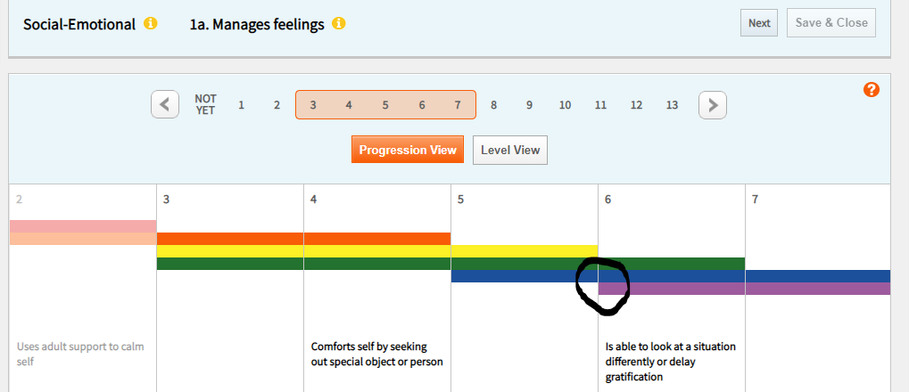
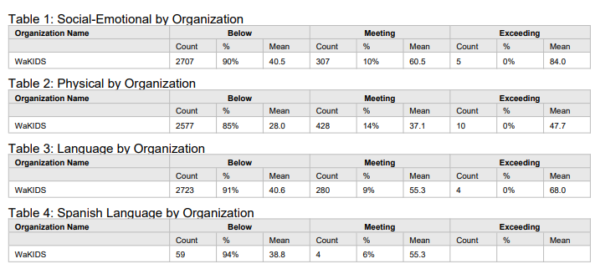
Snapshot Birth – 3rd grade
Widely Held Expectations and Kindergarten Readiness
Snapshot Birth through Third Grade

Slide 21
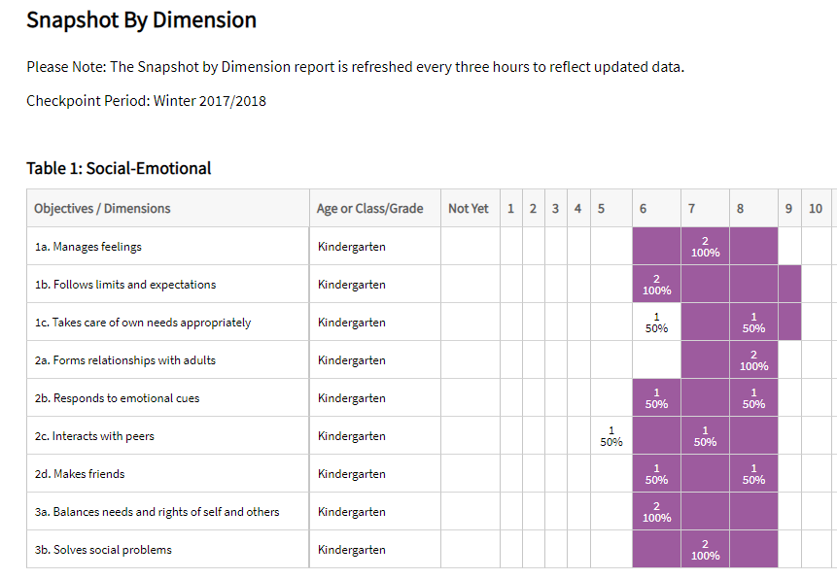
Snapshot by Dimension
Notes:
This Snapshot report is generated from checkpoint data associated with the objectives for development and learning for birth through third grade. It displays the levels of a given objective or dimension, showing the number or percentage of children at levels along the progression. The report includes colored bands, enabling you to visually compare the assessment results against widely held expectations.

Slide 22
Winter Checkpoint
Districts and teachers are welcome use the tool through out the year.
GOLD functions just as it does in Fall
Winter checkpoint is March 31st
Spring Checkpoint is June 22nd
Notes:
Each year more districts chose to use the tool beyond the KEA. The tool is available with full functionality throughout the year. Teachers use it to track growth in all or specific children, they can assess all the objectives and dimensions or target areas of concern.
The checkpoint for winter is March 31st and June 22nd is the spring check point.
As always, if you have questions, contact me in the early learning department here at OSPI.

Slide 23
ELPA Assessment Updates
Students who will take the WIDA Alternate ACCESS this year will need to be identified in WAMS by December 4.
A recorded training for TAs administering the WIDA Alternate ACCESS will be available in Canvas by the end of the month.
Updated slides for ELPA21 Annual training will also be available by the end of the month.
Notes:
In January we will begin ELP testing. Please make sure your records are correct in WAMS for ELPA21 testing, paying special attention to kindergarten and first grade students as all of these students will need the writing supplement. This information needs to be accurate in CEDARS by November 14.
Students taking the WIDA Alternate ACCESS, will need to be identified by December 4 in WAMS.
New training will be available through Canvas for the WIDA Alternate ACCESS. This training will follow the same procedure as the ELPA21 training this summer. TAs will need to view the recorded training, earn a minimum score on a quiz, and register their score and training completion through Survey Gizmo.
The training slides for the ELPA21 annual test will be updated and available to districts by the end of November.

Slide 24
WA-AIM Upcoming Dates
Fall WA-AIM Retakes
Window closes November 16 @ 5:00 PM
Contact toni.wheeler@k12.wa.us for manual registration of students into eDirect
Scores due back after Winter Break
Spring WA-AIM
Student registration in WAMS is open
User Management opens November 19
eDirect and Data Collection Platform (DCP) User Guide
Notes:
A couple of reminders for upcoming WA-AIM dates.
The fall WA-AIM retake window closes on November 16. Please contact Toni Wheeler for manual registration of any students who need to have assessments submitted during the fall window. Results from the Fall WA-AIM retakes will be in your district shortly after winter break.
The spring WA-AIM window is open. Districts should be registering all WA-AIM eligible students in WAMS. User Management will open on November 19. District Test Coordinators will need to create accounts for new users. For users with an existing account, DTC’s will need to add the Spring 2019 administration to those accounts. Directions for this can be found in the eDirect and Data Collection Platform User Guide found at: http://www.k12.wa.us/Assessment/WA-AIM/pubdocs/WA-AIMeDIRECTandDataCollectionPlatformUserGuide2018-2019.pdf.

Slide 25
Guidance for IEP Teams: Student Participation in Statewide Assessments for Accountability and Graduation
Replaces: IEP Team Decision-Making Guidelines
Purpose: IEP teams guidance on their authority related to decisions around accountability and graduation and to help guide IEP teams in determining the appropriate assessment for accountability or graduation purposes.
No changes to the WA-AIM or the WIDA Alternate Access eligibility criteria
New Tools and Graphics:
Decision-making flowchart to assist IEP teams in making decisions about how a student will participate in assessments for ELA, math, science, and English language acquisition.
Descriptions of the state assessments and the assessment graduation alternatives.
Graphic of graduation pathways for students with disabilities.
Notes:
The document previously titled IEP Team Decision-Making Guidelines has been updated, revamped, and re-titled to Guidance for Individualized Education Program Teams: Student Participation in Statewide Assessments for Accountability and Graduation.
The purpose of the updated document is to provide guidance to Individualized Education Program (IEP) teams on their authority related to decisions around accountability and graduation and to help guide IEP teams in determining the appropriate assessment for accountability or graduation purposes. While eligibility criteria have not changed for the WA-AIM or the WIDA Alternate Access, they have been incorporated into a decision-making flowchart to assist IEP teams in making decisions about how a student will participate in the state assessments for English Language Arts, mathematics, science, and English language acquisition. Descriptions of the state assessments and the assessment graduation alternatives are provided.

Slide 26
Guidance for Individualized Education Program Teams: Student Participation in Statewide Assessments for Accountability and Graduation (cont.)
Posted to the Special Education Resource Library , Technical Assistance page for Statewide Assessment , the WA-AIM page under Guidelines and Supports, and on the WCAP Portal.
If you have questions regarding the content, please contact for:
ELPA 21 and WIDA Alternate Access: Leslie Huff at 360-725-6338 or email at ELPA21@k12.wa.us or leslie.huff@k12.wa.us
WA-AIM Alternate Assessment: Toni Wheeler at 360-725-6032 or email at wa.aim@k12.wa.us or toni-wheeler@k12.wa.us
Graduation Assessment Alternative: Clarisse Leong at 360-725-6223 or email at graduation.alternatives@k12.wa.us or clarrise.leong@k12.wa.us
Special Education at 360-725-6075 or speced@k12.wa.us
Notes:
The document is posted in the OSPI Special Education Resource Library, the special education Technical Assistance Statewide Assessment pages, as well as the OSPI WA-AIM page under Guidelines and Supports, and finally on the WCAP Portal under the Parent and Student, Test Administrators, and Test Coordinator cards. We are also working to get it posted on ELP assessment page.

Slide 27
Technology Updates – Chrome, iOS, Windows
Chrome OS 69 & OS 70 are now supported
iOS 12.1 is working fine on iPads
Julie Voice Pack Invalid Certificate – incorrect message
Ignore invalid certificate error; click Advanced & download voice pack.
Forbidden Apps update
Apps are terminated in the background if running when Secure Browser is launched
Complete list is posted on WCAP in Tech Coordinators Resources

Slide 28
Technology Updates – Mac OS X
AIR has discovered security issue with Mac OS 10.13 and 10.14 (Mojave) and Secure Browser; updated version of 2018-19 Mac OS X Secure Browser (10.5) will be available Nov.19
Updated version will work with all Mac OS X versions
If you downloaded Mac OS X 10.5 version after Oct.18 but are not running Mac OS 10.13 or 10.14, don’t need to update again

Slide 29
WERA/OSPI Annual Conference
December 5-7, 2018
SeaTac Hilton
Hope to see you there!
2018 WERA Conference Information

Slide 30
OSPI Special Education:
Initiatives & Assessment Priorities
Tania May, tania.may@k12.wa.us
OSPI Special Education
November 14, 2018

Slide 31

What does the say?
Over 80 years of research has shown
that placement in the general education setting positively impacts outcomes!
Carlberg & Kavale (1980)
50 research studies from 1932 – 1970
Wang & Baker (1985)
Meta-analysis from 1975 – 1984
Oh-Young & Filler (2015)
Research studies from 1980 – 2013
Theobald, et al. (2018)
WA Study on CTE & Outcomes
Notes:
Carlberg & Kavale – 50 research studies from 1932 – 1970
Wang & Baker – meta-analysis from 1975 – 1984
Oh-Young & Filler from 1980 – 2013
Theobald – WA-state study on impact of CTE on postschool outcomes; found outcomes highest for students placed in gened 80-100% of the day

Slide 32
What this means for assessment…
Revisiting purpose: testing for accountability versus testing for graduation
(Updated) Guidance for IEP Teams: Student Participation in Statewide Assessments for Accountability & Graduation
IEP team authority re: state and district-wide assessments:
Determine appropriate accommodations on state- & district-wide assessments;
Determine student need to take an alternate assessment.
Note: For graduation purposes, the IEP team also makes decisions on appropriate graduation alternatives, once a student has attempted initial on-grade-level assessments in high school.
Notes:
For accountability purposes, the IEP has the authority to determine appropriate accommodations and/or the need to participate in an alternate assessment. The IEP team does not have the authority to change assessment requirements, exempt a student from testing, or, select graduation alternatives before the student is eligible to access them.

Slide 33
Graduation Pathways for Students with Disabilities
Notes:
The purpose of the updated document is to provide guidance to Individualized Education Program (IEP) teams on their authority related to decisions around accountability and graduation and to help guide IEP teams in determining the appropriate assessment for accountability or graduation purposes.

Slide 34
Statewide Assessment Implementation: Understanding the Systems and Resources for a Successful Administration
WERA/OPSI Annual Conference
Preconference Session #12
December 5, 2018
Presented by:
Kimberly DeRousie
Leslie Huff
Anton Jackson
Clarisse Leong
Mike Middleton
Lucas Snider
Tony Wheeler

Slide 35
Assessment Overview and Process Cycles
Breakout Groups
Appropriate accommodations, identification, and process
Graduation alternatives and tracking processes
Classroom-based formative processes, interims, Digital Library
Systems nuts and bolts, WAMS, CEDARS, TIDE
Reporting, Reporting Tools, Accountability with Query, Report Card, Online Reporting System

Slide 36

Give One to Get One
Thinking about state test data…
On a post-it, write down one piece of data that is of high value to teachers? To school leaders?
Find a partner, share your notes, and exchange notes
Repeat – do that two more times
What did you learn to share with all?

Slide 37

District Sharing
Graduation Follow-up with Pete Bylsma from Mukilteo
iReady Assessments with Nick French from Monroe

Slide 38
Purpose?
What is the purpose of these meetings?
What do you get out of these meetings?
What do you want or need to get out of these meetings?
What would you like to contribute?
Upcoming meetings:
Jan 25, Mar 22, Jun 10

