Slide 1

NWESD Assessment Directors’ Meeting
November 7, 2019

Slide 2
Today’s Agenda
Welcome
Updates from OSPI Assessment
  OSPI Assessment Update
Problem of Practice
  Accommodations and Supports in Testing
Local Knowledge
  Real-time agenda and issues
Reflection and Closing

Slide 3
Resources for DACs
OSPI Navigating the Portal for Interim Assessments – Sept 25
Graduation Pathways Informational Meeting – Nov 18 at NWESD
  Afternoon is a CTE focus; NWRDC leads My School Data session
OSPI New DAC trainings – posted Dec 2 to Portal or WAMS
  Covers TIDE, TDS, ORS and ARMS usage
OSPI/WSAC Webinar: Updated Graduation Requirements – Dec 4
WERA/OSPI Conference – Dec 11-13 at Seattle Airport Hilton
  Keynotes: Beverly Tatum, Juli Coleman, Chris Reykdal
  Preconference and DAC meeting
  Early bird registration ends today
Notes:
“Why Are All the Black Kids Sitting Together in the Cafeteria?” And Other Conversations about Race
www.beverlydanieltatum.com/;
Improvement science
https://coredistricts.org/team/juli-coleman/

Slide 4
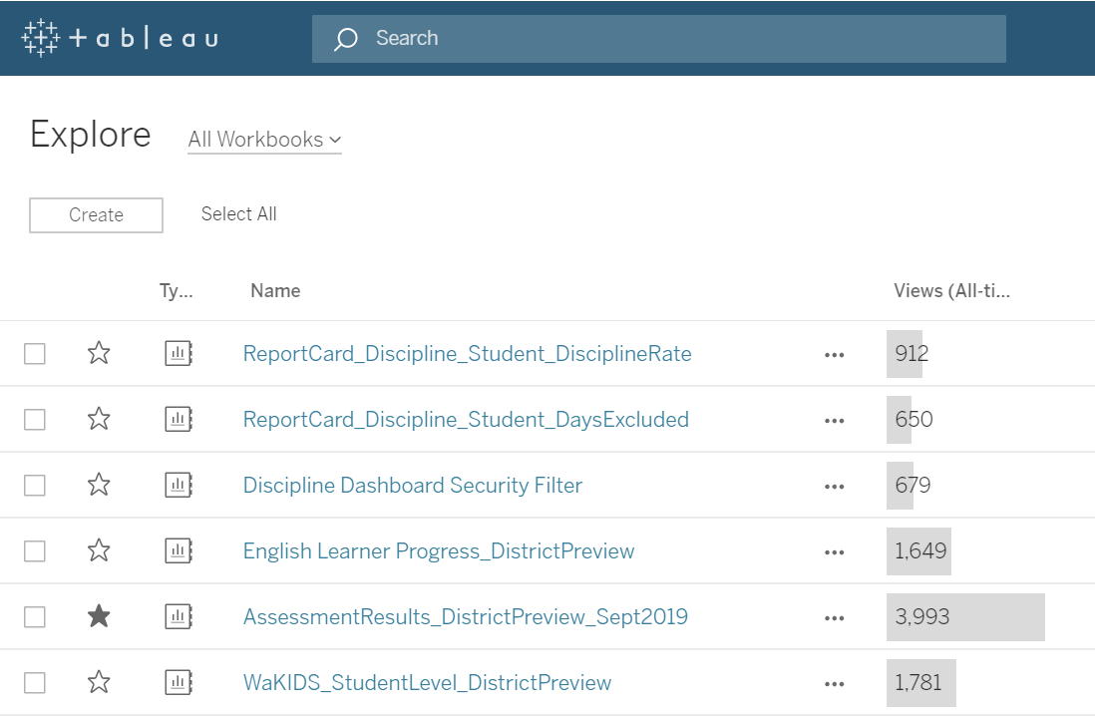
Tableau Server in EDS
Notes:
“Why Are All the Black Kids Sitting Together in the Cafeteria?” And Other Conversations about Race
www.beverlydanieltatum.com/;
Improvement science
https://coredistricts.org/team/juli-coleman/

Slide 5
Assessment Update Webcast
Highlights for NWESD
SY 19-20
Update #3
October 16, 2019

Slide 6
Today’s Topics
Development
  Inventory of Time Spent Testing
  Staff Update
  Interims
  Language Glossaries
WaKIDS
  Student Import
  ECEAP and Prior Data
  Monitoring the Assessment
Data
  Temporary ID
  Federated Single Sign On (SSO)
  Hard Copy Materials
  Special Characters
Operations
  Spring Retake
  Material Schedule
Select Assessments
  ELP Assessments
  Graduation Pathways Update
  COE (Huh?)
Technology
  Secure Browser
  Chrome OS
Miscellaneous
  WCAP Contacts

Slide 7
Interim Updates
All systems within the WCAP Portal are now available
New Say-Script for the Interim Assessments
  Located in General Information folder
  File titled: Interim Test Administration Manual and TA Script of Student Directions
Notes:
All systems in the Portal have launched since our last webinar. AVA and AIRWays are up and running. We are still waiting for some Focused Interim Connections Playlists, and some of the hand-scoring materials to be linked with their IABs.
There is a new Interim Say-Script for teachers this year. The file is available within the general resources folder. If you scroll all the way down to the bottom within that folder you will find the file titled: Interim Test Administration Manual and TA Script of Student Directions.
The document covers a variety of topics including standardized vs. non-standardized administrations, interim checklists for before, during, and after administration, pause rules, how to administer an interim, and student directions for all phases of interim testing, as well as other general interim information.

Slide 8
Navigating the Testing Portal for Interim Assessments Moodle
Participation for clock hours still available
  Link to the Moodle on the Math Assessment page
  Video for webinar uploaded
  Questions from the webinar are answered
  The registration link for the November 15th webinar
  Clock hours evaluation will be available after second webinar
Self-registration is password protected
  Enrollment Key: Interims2019
Notes:
We held our Navigating the Testing Portal for Interim Assessments webinar last week. We have a Moodle linked to the math assessment page for those who were not able to attend during the scheduled time, and for those that want clock hours for participating in the webinar series.
The video of the webinar, presentation slides, and participant questions are all loaded and available within the Moodle, as well as the registration link for the November webinar.
Because the Moodle is exclusively for folks in Washington, it does have an enrollment key which is Interims2019.

Slide 9
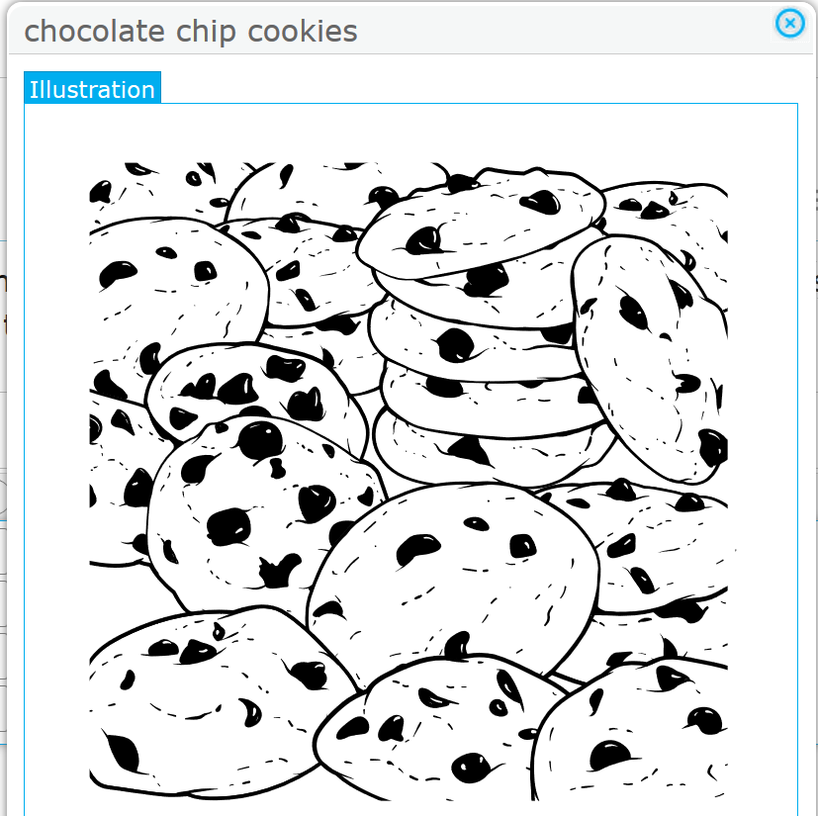
Illustration Glossary Available for Math
New glossary option available this school year
Presents a picture of select words
Explore through the Smarter Balanced Sample Test webpage
  On Choose Settings page, select “Illustration Glossary: Show Illustration Glossary”
Set in TIDE under Embedded Designated Support
  In the “Glossary - English” drop-down menu for math
  Currently working to update TIDE to allow students to select both an Illustration Glossary and a language glossary
Notes:
We wanted to share a bit about a new feature that is available for math testing, starting this year. Smarter Balanced has created an illustrated glossary for select words on the math tests. For example, (click to show picture) students might click on the words “chocolate chip cookies,” and would be shown this image. The illustration glossary work very similarly to the English or other language glossaries, where students click on words or phrases in test items. (click to hide picture)
We would encourage folks to explore this support on the Smarter Balanced Sample Test Website. The text on this slide is hyperlinked to that page, and the URL for the Smarter Balanced Practice Website is provided in the slide notes (https://sample.smarterbalanced.org/student/). Select any math test, then on the Choose Settings page, select “Illustration Glossary: Show Illustration Glossary”
To set this options for a student in TIDE, go to the Embedded Designated Supports and select Illustration Glossary from the Glossary – English drop-down menu.
We are currently working with AIR to update TIDE so that both the illustration math glossary and other language glossaries can be selected for a student.

Slide 10
Language Glossaries: Math and Science
English Glossary is on as Embedded Universal Tool
Additional language glossaries are Embedded Designated Supports
  Under “Glossary - English”
  Includes options for both language and language and English
    Example: “Arabic Glossary” and “Arabic and English Glossary”
Want to clarify differences students see with these two similar-named options
  If a student has “Arabic Glossary” selected, they will not see the English Glossary words
Notes:
And speaking of other language glossaries.
First, all students have an English language glossary available to them for the math and science tests as an Embedded Universal Tool. Select students can also have glossaries in a variety of languages, such as Spanish, Somali, Arabic and others as listed in the GTSA. Those designated supports can be set at the individual student level in TIDE.
In TIDE, there’s a long drop-down with many options under Glossary – English. For this presentation, I’m going to use the examples of the “Arabic Glossary” and the “Arabic and English Glossary” options. I want to clarify that students see different things with these two similar-named options, and specifically that if the “Arabic Glossary” is selected, or any glossary that doesn’t say “and English,” the student will not see the English Glossary words.

Slide 11
Glossary Selection
Ensure that the most appropriate glossary option is selected for students
  Including new Illustration Glossary
Encourage use of the Practice Test, Training Test, or interim tests to make a selection
Notes:
We want to share this information to ensure the most appropriate glossary selection is made for a student, including the use of the new Illustration glossary option. We encourage students to explore the Practice Test, Training Test, or interim tests to help them see the different options and to make a selection.

Slide 12


X
Student Import
Approximately 77,000 students imported.
Children should have been entered into the GOLD as of 10/15
Children entering the classroom 10/16 or after do not need to be added or assessed until after 11/05
Teachers not trained cannot administer the assessment. Children should not be added to GOLD
Notes:
The student import is done! We have currently imported more 77,000 students.
Our average end number is around 80,000
Children should have been entered into the classroom as of 10/15
Children entering the classroom 10/16 or after should not be added to GOLD or assessed until after 11/5. WAMS closed between 10/16-11/5. We halt the import and transfers to allow class lists to stabilize for teachers to assess.
Teachers not trained cannot administer the assessment. Children should not be added to GOLD and a classroom should not be created in GOLD.

Slide 13
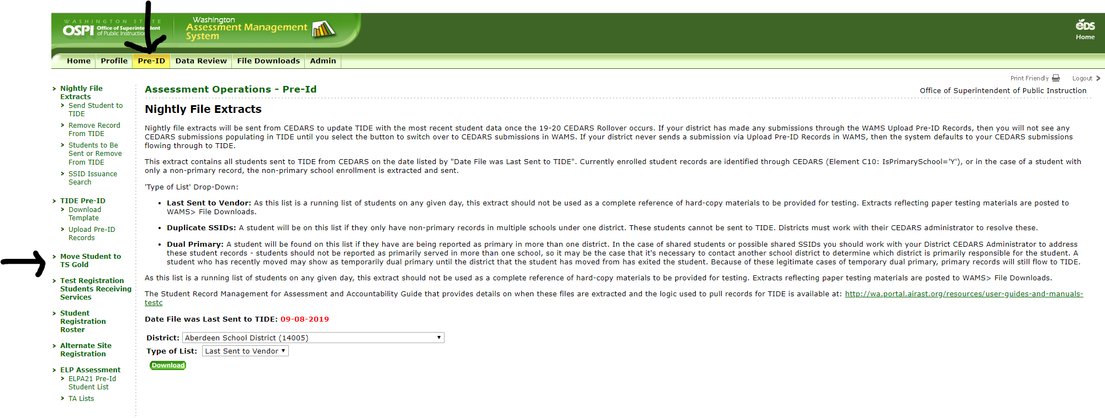
WAMS Transfer Application
Notes:
On November 5th WAMS will open back up. Districts using GOLD as a formative assessment year round will have access to start transferring children into their district again.
We are still finding that there are many DACs that are not aware of this process.
You can find the application in the Pre-ID tab and then click on the Move Student to TS GOLD. The application will ask for the same information as the import template.
Be advised that the transfer process can take up to 24 hours to complete. If you do not see the children you transferred after 24 hours contact wakids@k12.wa.us.

Slide 14
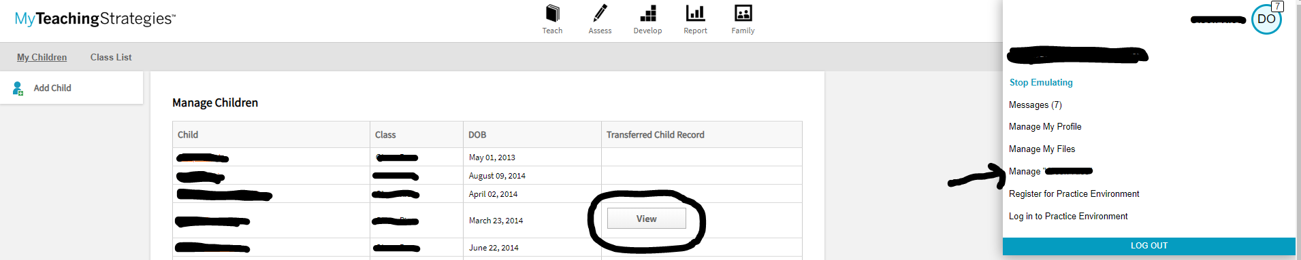
ECEAP Children and Prior Data
Notes:
We have several classrooms that now have ECEAP data attached to their children. To access this data, teachers must click on their initials bubble in the upper right hand corner of the screen. It will open up a list of options and they will choose Manage “their class name”. This will open their class list and if a child has any prior data, it will show in the Transferred Child Record column with a View box to click.

Slide 15
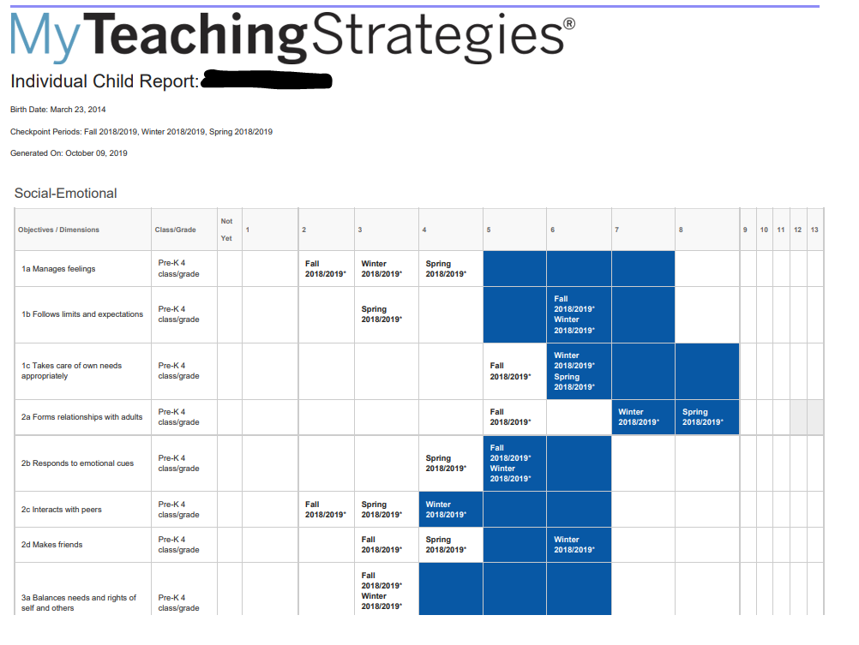
My Teaching Strategies
Notes:
When teachers click on the View box this is what they will see. If you’ll notice, this child has data from fall of 2018 through spring of 2019. This is a tool for teachers to better understand children and what their skills and abilities were in preschool.

Slide 16

WAKIDS Supports
WaKIDS for Administrators
  A new canvas course for Administrators
WaKIDS Implementation Support
  For teachers who would like direct support from
  OSPI year round.
  To register, contact Early Learning Office wakids@k12.wa.us
Notes:
Available now are 2 courses. One for administrators and the other for existing kindergarten teachers.
It has been long in coming but we are happy to introduce the first WaKIDS course for administrators. This 3-hour online course walks administrators through all parts of Washington States full-day kindergarten requirements. Administrators will learn about the full-day kindergarten statute, ways to support teachers through successful implementation of the assessment known as the Washington Kindergarten Inventory of Developing Skills (WaKIDS) and how to use the data to inform teacher practices and improve student, school and district outcomes.
OSPI has created a free online implementation support course for all teachers implementing WaKIDS. Those who join this course will receive on-going support throughout the year. The goal of this space is to provide a platform of support, where teachers can post questions, receive guidance, and share tips with your fellow kindergarten teachers.
To register, contact the Early Learning Office here at OSPI.

Slide 17
Temporary ID Cleanup Timelines
Continue merging any/all Temp ID records in TIDE
WAMS “ELPA21 Temp ID Cleanup” application will open by end of week
Upload paired Temp IDs and SSIDs into WAMS through mid-late November (exact date TBD)
Data Analysts review uploaded records through early December for duplication issues and valid SSIDs
Data Analysts provide list to AIR by end of December
Remaining TempID records deactivated in January 2020

Slide 18
Federated Single Sign-on (SSO)
Set to go live on November 7, 2019
Your TIDE username and password will be your Digital Library login credentials
If you are logged in to WCAP, you’re logged in to the Digital Library
More communication coming ASAP with details on fringe cases, troubleshooting, self-registration, and helpdesk contacts

Slide 19
Ordering Hard-Copy Materials – Initial
NEW: hard-copy accommodated forms assigned to students in TIDE rather than WAMS
Test-specific hard-copy materials defined under “Non-Embedded Accommodations”
ELPA21 Initial Orders Deadline: October 28
Other timelines in Student Records Management for Assessment and Accountability User Guide
Additional Orders process unchanged from 2018-19

Slide 20
Add Special Characters to TIDE?
Feedback needed: should OSPI start sending “Special Characters” to TIDE?
Pros: students and families see students’ names as they are intended to be spelled in WCAP and on reports
Cons: students must type in first name as it appears in TIDE as login credential
Email assessmentanalysts@k12.wa.us with feedback or use chat/questions with “SPECIAL CHARACTERS” in the post
ŸÀÁÂÃÄÅÆÇÈÉÊËÌÍÎÏÐÑÒÓÔÕÖØÙÚÛÜÝÞßàáâãäåæçèéêëìíîïðñòóôõöøùúûüýþÿ

Slide 21
Spring 2020 HS Retake
Statute: Concluding with the Class of 2019, opportunities to retake the Smarter Balanced ELA and mathematics assessment at least twice a year shall be available to each school district.
Two discrete (mini) windows in Spring 2020
(approx. March 2 through April 10 and May 4 through June 5)
  First window will allow for scores to be returned in ORS prior to 2nd window opportunity.
Students may choose the assessment retake option while pursuing other pathways, including the EAA.
Off grade and paper accommodations will be available.
Notes:
Late this summer, we announced the elimination of the fall Smarter Balanced retake.
In House Bill 1599 it states Concluding with the Class of 2019, opportunities to retake the Smarter Balanced ELA and mathematics assessment at least twice a year shall be available to each school district.
For the students in the Class of 2019 and earlier who choose the assessment pathway, two discrete (mini) windows will be available in Spring 2020
(approx. March 2 through April 10 and May 4 through June 5).
This first window will allow for scores to be returned in ORS prior to 2nd window opportunity.
Two mini windows will be available for these students through the spring of 2022.
It is important to keep in mind that these students also have the Expedited Assessment Appeal as an option. More information about this waiver is available on OSPI’s Expedited Assessment Appeal Waiver webpage.
Off grade and paper accommodations will be available will be available in spring 2020.

Slide 22
Spring 2020 HS Retake cont.
Spring retakes will continue for students in the Class of 2020 and beyond who choose the state assessment as a pathway. For these students there will be one opportunity each spring.
More details will be available as we work with AIR and MI on system considerations.

Slide 23
Projected Testing Material Schedule
When user guides and manuals will be available on the WCAP Portal
OCTOBER
AVA User Guide
Test Coordinator’s Manual
Professional Standards & Security, Incident, & Reporting Guidelines
Model Inter-district Agreement
NOVEMBER
TIDE User Guide
TA User Guide
ORS User Guide
AIRWays Reporting User Guide
DEI Manual
Assistive Technology Braille Manual
DECEMBER
ELPA21 Summative TAM
Notes:
Here is an update on projected dates for the user guides and manuals to be available on the Portal. We also added the anticipated posting of the Model Inter-district agreement.
As always, once materials are posted to the Portal, we will communicate it in the WAW newsletter. Until the new materials are posted, the 2018-19 versions are still available, and as always, you are welcome to contact the Operations team with any questions you might have.

Slide 24
ELP Assessment Update
ELPA21 is offering 2 workshops in Washington this fall. Both workshops are developed to support general education teachers’ efforts to better serve EL students.
Workshop 1: ELP Standards, Assessments, and Scores Workshop
All sessions are FULL
October 18: ESD 105 (Yakima)
October 21: The Evergreen State College (Olympia)
October 22: Edmonds School District
The number of people signed up on the waitlist for each session will be used will be used to determine if additional workshops are needed.
Workshop 2: Differentiating for ELs Based on English Language Proficiency Level
All sessions will be held the first week of December at the following locations:
  ESD 105 (Yakima)
  The Evergreen State College (Olympia)
  Edmonds School District
Registration will likely open for December sessions next week in PdEnroller. The first workshops filled quickly.
Notes:
ELPA21 is offering 2 workshops in Washington the fall to support teachers’ use of ELP standards and assessment results in the instruction of English learners. The October workshops are full. If you have teachers that are interested, but were unable to get a seat, please have them sign up on the waitlist in PdEnroller. We will use the waitlist to help determine if additional sessions of either workshop are needed and where.

Slide 25
WIDA Alternate ACCESS – Identify in WAMS
  As with any other alternate assessment, students are identified for WIDA Alternate ACCESS by their IEP teams. Students must be identified in WAMS by December 6.
  Special Education Guidance (link)
    OSPI has developed guidance for IEP teams considering alternate assessments for a student.
  Domain Exemption Guidance. (link)
    OSPI has developed guidance to assist IEP teams with making decisions around exempting students from a language domain (reading, writing, speaking, or listening). This guidance includes student examples and reasoning for exempting or not exempting a student.
Notes:
As you are preparing for IEP team meetings and making assessment decisions, we want to remind you of resources that can support these decision-making discussions and processes. The first is a document located in the Resource Library on the Special Education page of OSPI’s website. This document walks through the criteria for identifying a student for an alternate assessment. The second is guidance developed by the Assessment office in collaboration with the Special and Bilingual Education Offices to help IEP teams make decisions around domain exemption. These two resources have not changed from last year, but are available to your IEP teams.

Slide 26
Dual Credit
New submission process using the Graduation Alternatives application.
Information will also be in the October 11 WAW.

Slide 27
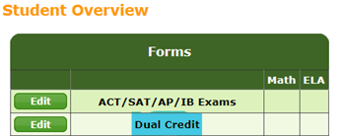
Dual Credit - Process
Once in the application, you will see a “Dual Credit” form.
The submission (high school transcript and course information) can be started by anyone having access to the application. District Assessment Coordinator (DAC) or Designee reviews/approves the application.
Please remember to upload additional information if the college course equivalency is not classified as an “English” or “Mathematics” course (i.e. ENGL 101 or MATH 107). Definitions, documentation requirements and more information can be found on the website.
Dual Credit submissions for Career and Technical Education (CTE) courses require the upload of your district’s current articulation agreement.
Once approved by DAC (or designee), OSPI will review for final approval or contact the district for additional information is needed.
Notes:
As always, if you have questions do not hesitate to contact OSPI at either 360.725.6223 or graduation.alternatives@k12.wa.us

Slide 28
COE
The previous COE materials are being reviewed to approve for placement on the Moodle sites.
Availability should be set November 8.
Instructions for accessing the sites will be provided by link in an upcoming WAW.
Notes:
Thought it was gone, didn’t ya’?!

Slide 29
Secure Browsers for 2019-2020: iOS
New iOS Secure Browser for 2019-20 will likely be released in coming weeks, now that iOS 13 and iPadOS 13 are available
For now, iOS 13 is blocked, so wait to update if possible
iOS 11.4 will be minimum iOS supported at that time
  Note: iPads 1-4 are no longer supported

Slide 30
Clarifying support for Chrome OS for 19-20
Chrome devices need to be able to run at least Chrome OS 75 to use the AIR Secure Browser for online assessments (Chrome OS 76 is also supported).
In general, the Auto Update Expiration (AUE) document at https://support.google.com/chrome/a/answer/6220366 is Google’s authoritative guide to which devices are still being supported for updates.
OSPI has heard from several districts about a few Chrome devices listed as no longer supported by Google that HAVE been able to be updated to OS 75.
AIR’s Secure Browser only checks to see if the Chrome OS is 75 or higher, not the underlying hardware that is being used.
So if your older and no-longer-supported device runs Chrome OS 75+, it will run the Secure Browser even though it is not “officially” supported by Google. If you report an issue to the AIR Help Desk, they will only be able to assist you with software troubleshooting on that device.

Slide 31
Problem of Practice
2 minutes: Overview of the process/ground rules
4-5 minutes: One member shares a challenge/problem
4-5 minutes: Critical friends ask questions for clarification.
2 minutes: Friends silently consider what they’ve heard
2 minutes: Friends share suggestions with their ‘elbow’ partners
4-5 minutes: Friends offer suggestions, recommend strategies, etc.
3-5 minutes: Presenter reflects on the comments and next steps
3-5 minutes: Friends identify something they heard which they may use to improve their practice
Notes:
Testing supports and accommodations used with greatly varying instances across our 22 schools.
Schools with similar populations but very different in use of text-to-speech, scribes, word prediction.
Anecdotally, looks like supports and accommodations used on district and state tests more than with classroom instruction and assessments.
Pulled IEP Online accommodations on state tests, by school and grade, found hot spots and shared with Special Ed. As a state test, easy to elevate this.
Pulled IEP Online accommodations for MAP tests and found similar data.
Pulled features/accommodations settings in MAP and found some mismatch between IEPO and MAP.
However for supports/features that are determined by the educator, I don’t have in IEPO.
Know that technology confounds this – text-to-speech vs. read aloud
Purpose of supports/accommodations for accessibility – I don’t know why the usage is so variable.
Not to be used to increase likelihood of higher test scores – we want/need accurate test scores.

Slide 32
Local Knowledge
You write down two dilemmas or questions for the group
You share with table, any ask clarifying questions; rotate
Table selects one to present to the room
Room addresses the issue; repeat
#3 Room
Table
Table
Table
Table
#2 Table
1
2
3
4
#1
You

Slide 33

Happy November!
January 24, 1 pm
March 20, 1 pm
June 12, 9 am

