Slide 1
School Coordinator Training
Smarter Balanced Assessments
Spring 2016 - Created by Everett Public Schools

Slide 2
Introductions

Slide 3
Smarter Balanced Assessments (SBA) Acronyms
AVA: Assessment Viewing Application (Interim)
ARMS: Assessment Reporting Mgmt. System
CAT: Computer Adaptive Test
DC: District Coordinator (formerly DAC)
GTSA: Guidelines on Tools, Supports, & Accommodations
GTII Guidelines on Test Incidents and Investigations
ORS: Online Reporting System
PT: Performance Task
SC: School/Test Coordinator (formerly SAC)
TA: Test Administrator (formerly Proctor)
TAM: Test Administrator Manual (includes “DFA”)
TIDE: Test Information Distribution Engine
WCAP: WA Comprehensive Assessment Program
Notes:
This PPT follows the TAM and the relevant information is in the binder provided, one per school.
This is a list of acronyms for Smarter Balanced (as if we didn’t have enough already) but a couple of key ones to remember are TA replaces proctor and SC is the School Coordinator. SC is also a designation in TIDE that provides access to adjust Accommodations; change or create rosters, and add Tas. Consider who at your building needs SC access and email that request to our department. GTSA is a new acronym for the guidelines that are now referred to as Tools and Supports (referring to universal and Designated).

Slide 4
District Resources
Notes:
The C & A department has created quite the extensive website for Smarter Balanced information. We have FAQ’s, most of which were generated from in house questions; links to WCAP with a brief description of each access “card on the portal” as well as informative and training videos. In addition to Practice and Training Scoring guides.
Staff will need to login to view staff specific documents.
Click on the icon to few the website.
There is also a live link in the PPT that will direct you to these reports in DocuShare.

Slide 5
SBA Preparation: February Timeline
Identify students eligible for assistive technology requiring additional applications installed.
Magnification greater than 3.0
Speech to text
Identify the computers the students are using and notify IT to ensure compatibility.
HELP Desk at AIR if needed 844.560.7366
Confirm accommodations already entered in TIDE by special services and categorical for ELL students
Modify testing options when appropriate and add new students after the February 19 upload
Notes:
Identify with special services any students that may require unique access to TIDE
Verify student access options entered in TIDE by Special services and categorical. These should be confirmed prior to testing, or observed during practice and interim assessments.
Enter designated tools for the remaining population at your building.
FYI- We put a work order into AIR requesting the ability to download a list with each students options, but we were told that it will not be available until next year.
SC in TIDE permanently adds designated embedded and non-embedded items

Slide 6
SBA Preparation: March Timeline
Read the TAM
Read TIDE User manual paying special attention to:
IV. Managing TIDE users
V. Working with student information
Read the Guidelines on Test Incidents and Investigations
Ensure that all students have had an opportunity to practice item structures and use of tools
SBA, MSP, ELPA21
Notes:
For the next 3 slides we will discuss some key decisions and steps that need to be completed over the next two months:
Read the required manuals.
Understand your role in TIDE.
Complete the building plan – much of what we discuss will be in the plan for you to assign or delegate the task.
Adding and removing TAs at your site
Contact our office to add another SC role

Slide 7
SBA Preparation: March/April Timeline
Complete the Building Plan
Implement the communication plan according to your Building Plan
Remind parents and students that students are allowed to use personal headsets
Schedule TA testing locations and testing schedule
Confirm all applicable staff have TA or SC access
Print Classroom Activities and distribute distribute to TAs prior to testing.
Print test tickets using Cognos or TIDE ‬
Notes:
April
After we return from spring break,
Remind parents to send in headsets, if they prefer
Decide the printing and distribution process for in-class activities
And how you will manage the printing for test tickets. You can use the test ticket printing in TIDE but that is grade level only or individual (not teacher).
The Cognos report allows you to print based on teacher name, class period, or by student ID for small groups. (think of this as the “group sort” we did for test booklets.)

Slide 8
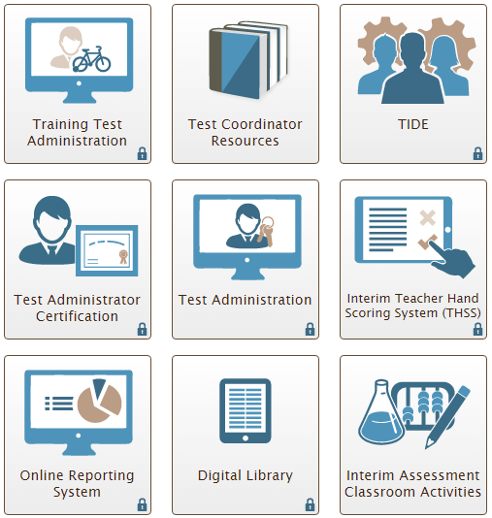
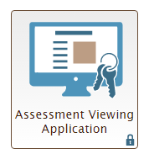
Portal Cards
Notes:
Having selected the Test Coordinator Access card, here are the portal cards in WCAP
Any Portal Card with a Lock requires a WCAP login. Forgotten passwords can be retrieved by the user by clicking on any locked portal card & clicking on “Forgot Your Password”? link.
As a reminder, SBA system is three parts – Summative, Interim (we will touch on that later), and Digital Library.
Digital Library has a different log in and must be reset by the district coordinator.
I want to take a minute to talk about Training Test Administration Card: for Summative Assessments. The TA can access practice tests for SBA, MSP, and ELPA21 sessions.
It is important to remember that the Training sessions for SBA are grade band 3-5, so a TA can log in and select grade 3 and think that it is a really hard question, actually it may be a grade 5 type problem. There are only 6-8 questions in the training section and the primary purpose is to understand how to use the tools. Practice sessions are grade level specific and about 30 questions and students practice the actual question types. These are not secure so encourage TAs to use overhead projectors and provide instruction with the class on the type of questions and the use of tools.

Slide 9
Navigating WCAP
TIDE card on the portal
Add new TAs in TIDE if not part of the district upload in the fall
Update student accommodation & designated options (may require 24 hours for student access)
Update or create new Rosters
Test Coordinator Resources card on the portal
User Guides and Testing Manuals
Training Test Administration card on the portal
Practice and Training Sessions
Test Administration card on the portal
Launch Secure Test Sessions (Summative and Interim)
Online Reporting System (ORS) card on the portal
Plan and Manage Testing – participation reports
Score Reports – Interim & Summative
Notes:
Click on the icon and link to the WCAP website.
Review what is located under each of the “Portal cards” using the one-page guide.
We will be providing additional information on ORS use and reports outside of this training. Today we will focus on the summative assessment.

Slide 10
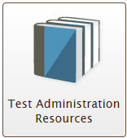
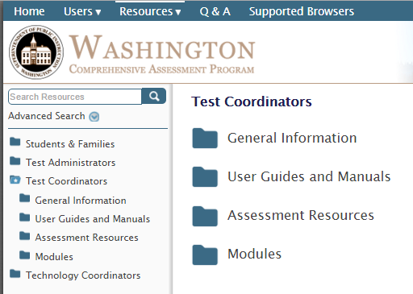
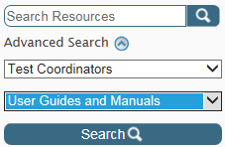
Test Administrator Resources
TA & Test Coordinator User Cards include 4 sections
General Information
User Guides and Manuals
Assessment Resources
Modules
Search Resources
Notes:
The second portal in WCAP is Resources:
Test Administrator & Test Coordinator Resources options in WCAP Portal include 4 sections.
I understand the state is going to be providing filters for the resources, but for now I want to point out two things.
Regardless of how you enter, you can switch back and forth on the left sidebar, or
Just type in “Search Resources” and regardless of the section the item is stored in, you will see the resource.
Items are stored differently in each of the four (student & family, administrators, coordinators, and technology) access point. But, all roles can access any of the materials, making the search option a great resource.
For example: TA Assessment Resources has the classroom activities for the practice tests and the Test Coordinator has achievement level descriptors. But a search on “descriptors will provide the TA with the document.

Slide 11
EPS Assessment Schedule
Elementary Schedule
Middle School Schedule
High School Schedule
Grade 10 ELA (Some students eligible for Math)
Grade 11 ELA and Math
Notes:
We have included all grade level schedules in the binder and they are posted on the calendar page of our department website.
Be sure all onsite staff are aware of the testing days.

Slide 12
Tools, Supports & Accommodations
Headsets required for:
ELA CAT listening portion, some PT tasks and for students requiring text-to-speech
Math CAT & PT for students requiring audio glossaries and text-to-speech
Scratch Paper (Make available for all grade levels, use scratch paper log Append. C in GTSA)
Graph paper – Math only –Required to be available for grade 6 and above
Plain or yellow-lined scratch paper – ELA & Math
Review the accommodation one-page sheet
Note: Changes in universal tools, designated supports and accommodations may take up to 24 hours to appear
Notes:
When the student sees the “audio test” as they log in, this is the indication that a headset is required for this student or within this segment.
Please note that graph paper is required for grades 6 and above and will be distributed to middle and high schools later this month. Scratch paper will be distributed to all schools. Make the paper available in the classroom, have Tas note on the sign out sheet who they distributed paper to and be sure to collect it after testing.
Refer to the accommodations tab one page sheet and we will discuss the differences between universal TOOLS, designated SUPPORTS and accommodations options (embedded and non-embedded)
Review one-page reference sheet

Slide 13
Security Protocols
Policies, laws, practices and prohibited behaviors are detailed on pages 40-41 of the GTSA.
State and local laws and policies specify practices to ensure test security of standardized and ethical administration of assessments.
Student monitoring must be maintained throughout testing.
Notes:
As with all state assessments, state laws must be adhered to.

Slide 14
Security Regulations
Notes:
This is in the GTSA and serves as a reminder that reviewing and disclosing test questions is a violation of state law.
A complete list of rules and regulations can be found on the websites listed above.

Slide 15
Test Security Room Setting
Before:
Instructional materials related to the content of the assessments are not visible, proper signage, seating
During:
Quiet, proper supervision, using secure browser
Support the student concerned about an item: “Try your best and choose the answer that makes the most sense to you. If you are unsure about how a question works, select Tutorial from the context menu to view a short video.”
After:
No test materials used for instruction, destroy secure materials
Notes:
Preparing the classroom according to test security guidelines. Refer to pages 14 and 15 in the TAM for Before During and After Testing protocols.
Walls are free of materials that would guide student responses. Special care and caution should be taken regarding recently discussed in-class activities.
Desks are placed in an exam layout as opposed to a collaborative setting.

Slide 16
Test Security Materials
Math CAT and PT scratch paper (graph or lined) must be collected after each session and shredded.
ELA CAT scratch paper (lined) must be collected after each session and shredded.
ELA PT1 scratch paper (lined) must be redistributed for PT2 and shredded at completion of PT2.
Test tickets must be locked up when not in use. Tickets may be reused but must be secured between uses.
Do not write the session ID on the ticket.
Notes:
Test tickets have student information on them and need to be secured. They can be locked up and used for another session or for interims, therefore do not have students write the session on the card.

Slide 17
New Student
Student will receive an SSID once enrolled in the student information system (eSP) and uploaded to CEDARS.
If the student was previously in a WA state school use EDS – CEDARS “Search Students” look-up for location information or “Students” tab to view: student information, schedule, assessment history & scores, programs, etc.
Remember that this is a testing window when considering administering the test to a new student.
If an SSID number is needed prior to the next CEDARS upload, contact your CEDARS manager.
Notes:
Once you have located the SSID number for a student the student can test at any location.

Slide 18
TA Interface
Start a session by logging into WCAP no more than 20 minutes prior to testing
Select the appropriate test(s)
Students are displayed on the TA interface grouped by test.
Approve student access
When more than one test type is open for a grade level in a session, the student will see both test options. The TA approves each student within each test type and should deny access if the student has logged into the wrong test.
Monitor student progress (16/44)
The monitor may indicate 44 but a student may end on question 46 because tests questions and number can vary.
TAs will be automatically logged out (session stops) after 30 minutes of inactivity. Activity includes the students actively clicking next or back.
Notes:
Remind staff that the session cannot be started more than 20 minutes prior or the students will get an error message as they try to log in that the session does not exist.
A TA can administer the test to students taking different exams. Carefully approve the student to his or her correct exam.
Ensure that all TAs are familiar with:
Starting a testing session,
Approve students joining the session. If the designations do not appear to be accurate, use the “eye” lookup and if changes need to be made, deny the student, have them log out. Make changes and have the student log back into the same session.
Students can join a session already in progress.
TA can add an exam to a session already in progress.
Note that a student may get to the last question on 43 or 46 (computer adaptive) even thought the TA interface still shows 44

Slide 19
Student Interface
Students log into the Session using their legal first name, as listed in eSchoolPlus, SSID number and session ID.
If students are unable to log in, verify that they are entering their login information correctly.
If a student arrives late:
the student can join the session in progress with TA approval
the TA can add another content area or grade level test to the session already in progress, if necessary
Students will only see their grade level exams.
Notes:
Student login is the same for practice, interim or summative assessments.

Slide 20
Common Chromebook (CB) Solutions
If the student is having technical difficulties, try these solutions:
Pause the test, close the secure browser, shut down CB.
Log back into same session. (try this up to 3 times)
Replace the Chromebook
Note the CB number and notify IT
Request help from Help Desk
Call Assessment & Research Department x4057 or x4054
TA Interface has the ability to view and set some test setting options before approving the student into the session. If the student did not have an appropriate designated option, the student will need to log out, the TA can set the option, the student will need to log back into the session.
Permanent changes need to be made in TIDE by the SC.
Notes:
If the student has a text to speech working and shouldn’t have it. The student logs back in and the TA clicks on the eye icon to view the options and uncheck it for this assessment before approving the student into the session.
SC will need to fix it in TIDE for permanent change.

Slide 21
SBA Segments
Math
Classroom Activity (school specific)
Performance Task (1)
school specific
all one segment
CAT
one long segment
ELA
Classroom Activity
(school/test specific)
Performance Task (1 & 2)
school specific
two segments in the PT (Cannot return to segment 1 from 2)
CAT
one long segment
Notes:
Reminder of what makes up the SBA

Slide 22
SBA Pause Rules
Pausing for less than 20 minutes, the student will:
Return using the same session ID and
Be able to review responses or change answers within any segment
Stopping the test for lunch or for more than 20 minutes, the student:
Performance Tasks:
Will have all highlighted text saved for review
Can continue to add text or change answers within the segment
Cannot return to segment 1 once they begin working in segment 2 (without using the appeal process)
Computer Adaptive Tests (CAT):
Cannot go back and review responses or change previous answers
Will continue where they left an unanswered question
CAT Important reminders for TAs and students:
Because CAT questions cannot be reviewed backwards after 20 minutes, DO NOT release students for lunch with the intention of reviewing later. If all the questions are answered, the test is automatically submitted after a pause of 30 minutes.
Notes:
Students should pause the test for a bathroom break.
When the test is being stopped for lunch for more than 20 minutes, we really are stopping the test.
Stopping the test means two different things for PT or a CAT
PT they come back to where they were and have freedom to review within the segment.
CAT they come back to the last question only. Cannot review previous questions.
This happened often enough last year that clearly there is a misunderstanding. On a CAT you can’t go back after 20 minutes, so it doesn’t make any sense to break for lunch with the intention of reviewing after lunch.
If you need to stop a CAT on a day for a student to return, find a breaking point, be sure all questions have been reviewed and final answers are marked. Student will start on 1st unanswered question.

Slide 23
End of ELA PT1 Segment
Students receive a clear message that they are leaving PT 1 segment (3 to 5 questions) and going into the long write – PT2.
On rare occasion a student may inadvertently submit before finishing Segment 1. Contact the District Assessment Coordinator to see if the incident qualifies for reopening the student exam.
Notes:
The ELA performance task is presented in segments. When students reach the end of PT1, they will receive a warning message asking them to confirm that they want to move on to the next segment. The warning also advises that they cannot return to change their answers in the current segment once they have moved on.

Slide 24
Ending a Session
Quoting from the directions on page 45 in the TAM, we will remind students the session is about to end:
When there are approximately ten minutes left in the test session, the TA should give students a brief warning.
SAY: We are nearing the end of this test session. Please review any completed or marked for review items now. Do not submit your test unless you have answered all of the questions.
If you need additional time let me know.
The student will PAUSE the session if they need more time and SUBMIT the test if they are finished.
After all students have indicated they have paused or submitted, the TA will stop this session by selecting “Stop Session” on top left.
Notes:
Ending a session means student work, while saved all along, is saved with additional restrictions on returning to the test:
CAT - every answer is accepted and cannot be changed, even flagged responses. They return to the last unanswered question.
PT - they can return to the segment and can make changes within the segment.
Either- They can never go back to a previous segment.

Slide 25
Irregularities
Must be reported to DC by end of the day
Low/Impropriety: Issue is addressed in district and may need to be entered into TIDE
Medium/Irregularity: Issue is addressed in district and may need to be entered into TIDE for resolution by OSPI
High/Breach: Issue will be entered into TIDE for resolution by OSPI
Notes:
Refer to TAM pages 17 – 19 for reporting and responding descriptions and the irregularity guidelines section of your binder.
TIDE – Section XI Working with Appeals
TIDE user guide is in DocuShare (and in TIDE)
OSPI has broken out 3 areas of irregularity.
Level 1 is in-district
Level 2 may go to OSPI
Level 3 will go to OSPI

Slide 26
Appeals
Notes:
The next 2 slides are segments from pages 20 and 21 in the TAM referring to the appeal options.
TIDE appeals involve an action for the test such as reset, reopen, invalidate or extension to review. Appeals must be entered in TIDE within 24 hours. Allow at least 48 hours for approval of an appeal that requires state approval.
Refer to the TAM for complete definitions.
Contact me if you have any questions about a scenario specific to a student.

Slide 27
Appeals
Notes:
TIDE appeals involve an action for the test such as reset, reopen, invalidate or extension to review. Appeals must be entered in TIDE within 24 hours. Allow at least 48 hours for approval of an appeal that requires state approval.
Refer to the TIDE manual for available appeals based on test status.
Contact me if you have any questions about a scenario specific to a student.

Slide 28
Required Documentation
TA Training Log
Tracking log for online testing listing the reason for a student not tested (Refused, not tested, etc.)
Test Security Assurance Form
Review the answer to the question about irregularities, “Have you reported all test security irregularities…?”
If yes is marked, there should be comments in the top section or note referring to attached copy. If no irregularities, mark N/A.
Irregularity Forms (if any)
School Site Administration and Security Report
Notes:
After each session, the TA can print a session schedule. We will discuss this during the TA training PPT.
Please collect these, use them to monitor makeups and to preserve the session ID number used.
These forms are in the binder:
Staff will still need to complete the TSA form, and we provided irregularity reports if necessary.

Slide 29
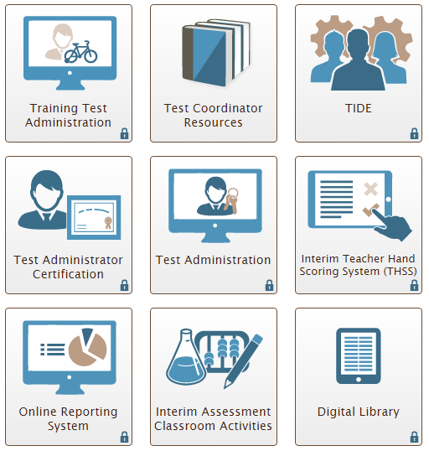
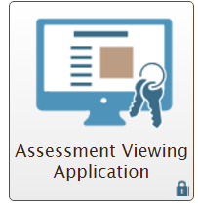
Interim Access Points
Interim Blueprints, AVA and THSS guides and training
Administer Secure Interim Assessments
PowerPoint on Scoring and
ELA & Math Exemplar Sets and Training Guides for Calibration
Hand Scoring system
Score Reports
View Interim Assessments before administration
Classroom Activities for Interim Assessments
Notes:
While our focus is SBA training today, I wanted to provide an overview of Interim Assessments:
Interim Asmt. Access Points
First, The interim blueprints and training guides are in the Resource Portal.
AVA. Teachers can now review the interim assessments through the AVA Card (comprehensive and block) and determine which blocks most closely match an area of current instruction.
Hand scoring guides are available to TAs in TIDE to aid teacher on calibrating and scoring the interim assessment.
Print in-class activities from the Classroom Activities portal card.
Interim Assessments for students are administered thru the Test Administration portal card.
The THSS portal card is the access to hand scoring open-ended interim block or comprehensive assessments.
The ORS portal card reports score results. Must administer both the PT and the CAT in a comprehensive assessment to see the score in ORS.

Slide 30
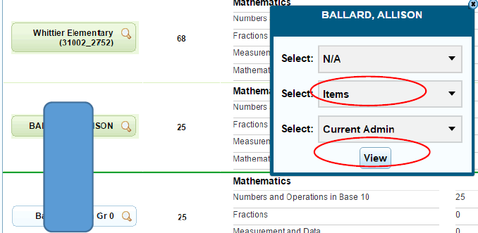
Interim Block
Item Number and Target Results by Class
Notes:
H/O with screen shots of how to access target results for Tas
This is also why Rostering is important.
Since interim blocks are getting more Activity this year we created screenshot steps to view the target results for the class, and steps to view the results by student.

Slide 31
Online Reporting System
Test Management Center
Participation Reports in Plan and Manage Testing (have/have not completed)
Test completion rates (by school, grade, subject and opportunity)
Summary Statistics (percent proficient, not avail. For IAB)
Retrieve student results (download excel files by district, school, teacher, and roster)
Score Reports
Interim Assessments
Summative
MSP/EOC/HSPE
Notes:
Online Reporting System to monitor testing and then print score Reports
ORS has two main components.
Test Management and Score Reports. But there is also the ability to manage a roster in ORS (which is connected to TIDE) rather than going back to TIDE. And you can search a SSID and see what tests the students has completed even if new to your district.
Test Management Center for the DC or SC: track sessions, and monitor completion rates. After testing, confirm that the appropriate tests were administered and identify who may need to complete on another day.
Score reports can be generated by rosters (previously referred to as “group data” sorts.) Good Rostering makes it easier for TAs to view the results for their students. Students can be in more than one group. For example, the SC creates a roster group for the 5th grade teacher who provides math instruction to all students.

Slide 32
For Assistance
Test Administrators:
Contact the School Coordinator
School Coordinator:
Contacts the District Assessment Coordinator
District Assessment Coordinator:
Contacts OSPI
Technical Support:
American Institute of Research - Washington Help Desk
wahelpdesk@air.org
1.844.560.7366

