Slide 1
Statewide Assessment Implementation: Understanding the Systems and Resources for a Successful Administration
WERA/OPSI Annual Conference
Preconference Session #12
December 5, 2018
Presented by:
Anton Jackson
Clarisse Leong
Mike Middleton
Susan Seegers
Lucas Snider
Toni Wheeler

Slide 2
Four Sections
1) Assessment Overview and Process Cycles (60 minutes)
2) Breakout Groups - select three (20 minutes each, 60 minutes)
Appropriate accommodations, identification, and process
Graduation alternatives and tracking processes
Classroom-based formative processes, interims, Digital Library, and resources
Systems nuts and bolts, WAMS, CEDARS, TIDE
3) Reporting, Reporting Tools, Accountability with Query, Report Card, Online Reporting System (60 minutes)
4) Questions (10 minutes)

Slide 3
Section 1: Assessment Overview and Process Cycles (50 minutes)
Overview of the assessment systems: standards adoption, content development, administration, scoring, and reporting.

Slide 4
Development of Tests and Test Items
Standards
Testing Policies and
Specifications/Blueprints for Test Content
Item/Cluster/Stimuli/Task
Development
Item Content Review
and Bias Review
Field Testing
Item Preparation
for students
Item Content Review
with Data
Item Field Test
Rangefinding and
Rubric Validation
Field Test
Scoring
Test Evaluation Studies
Operational
Scoring and
Reporting
Item Operational
Rangefinding/Rubric
Validation
Operational
Testing
4
Notes:
Flowchart from Standards to reporting on student performance on testing
Everything starts with the standards, and everything comes back to standards
Green steps: input from educators
Blue steps: input/touch points with students
Gray steps: OSPI staff and state testing/reporting vendors

Slide 5
ELPA21 Development Process
Content review by ELPA21 and educators from consortium member states.
Bias/Sensitivity Review by community
ELPA21 & Item development Vendor develop test items and item specifications
ELPA21 trains educator item writers from consortium member states
ELPA21 and educators from consortium member states review clusters for content
Pilot scoring by contractor under consortium supervision
Pilot Rangefinding and Rubric Validation of constructed response and TEI items by consortium member state educators
Field Testing
Pilot testing of items in the initial item bank
Operational Rangefinding to confirm pilot rangefinding by consortium and contractors with member states
Content Review of data with all items by consortium member states and contractors
ELPA21 and contractors use test map to build operational test; Test given to students
Operational scoring by contractor with consortium supervision

Slide 6
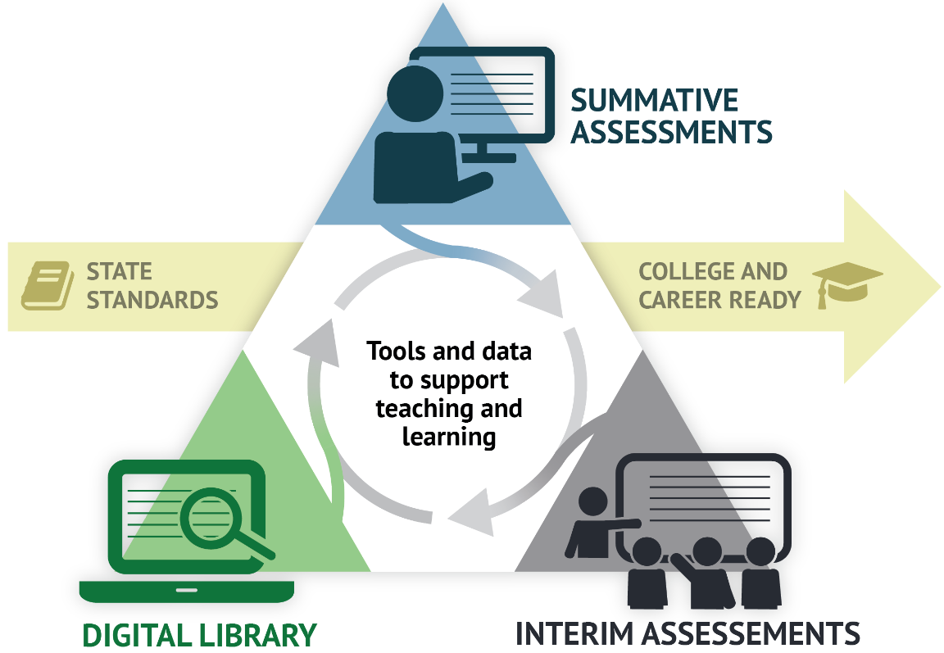
A Balanced Assessment System
Notes:
Whole System
Focus for the conversation will be on the parts other than the Summative Assessment

Slide 7
Assessment Functions
Training Tests – grade bands
Practice tests – each grade, CAT-like and PT
Interim Assessments – each grade, some topic-specific
Interim Comprehensive Assessment (ICA)
Interim Assessment Blocks (IAB)
Formative Assessment Resources – Digital Library
Summative Assessment – each grade, CAT and PT
Notes:
Green assessments: can be used as part of formative assessment process

Slide 8















Cedars has all the kids but WAMS directs traffic and tells them what type of test they’ll need. WAMS is in EDS
Report Card Assessments Process Overview
District puts enrollment info on CEDARS at OSPI
OSPI sends enrollment info to Vendor and they put it in TIDE
District can see info
in TIDES
(Pre ID file goes from OSPI to
districts and Vendor.
Contains demographic info. Paper process.) Vendor uses it to create customized tests for students
Info correct?
yes
District corrects/ updates info on CEDARS
no
Late spring
Students take online tests during testing window
Online Reporting System
(ORS) a subsystem of TIDE, calculates score. Districts can see results in ORS (very basic data, maybe 10 fields)
Vendor publishes spec changes at start of year that drive changes to the application
Issues to correct include mobility and students who haven’t yet taken exams
OSPI gets remaining “Non-Nightly” data files (science, wa- aim, all paper results, BS leftovers)
Schools make corrections directly in CEDARS
Results are merged and published on the Assessment Review Page, available to Schools for corrections
Doug matches data from ORS with CEDARS.
Vendor sends latest student score files to OSPI on a nightly basis
Deadline for corrections is
Data from vendor does not meet specs
July 10
ETL: From the Final Score File data Doug uses SQL to create the Report Assessment Master (a data table on SQL 03 that aggregates test results)
Put into preview screen for districts to check over but nothing should change. Its more of a heads up.
OSPI loads data into multiple views including dashboard, Carolyn’s DB, Report Card public and private, other
Deadline is Sept 11
IT unit merges CEDARS and ORS data into X- 60 /Final Score File which resides in SQL table (SQL 3)
Lucas compares numbers from SPSS and SQL processes to find errors in application of business rules. Work with Doug to correct errors.
New Report Card info published on web
ETL: Lucas pulls same information from Final Score File and uses ETL in SPSS to create his own file
Split into one file per district and send out individualized results
Maintenance and
iterations
Generally end of July

Slide 9
AIR Systems
TIDE
Test Information Distribution Engine
Practice and Training Tests
Test Administration
Summative Asessments
Interim Assessments
DEI
Data Entry Interface
AVA
Assessment Viewing Application
AIRWays Reporting
ORS
Online Reporting System
Used to transcribe student assessment responses from paper-pencil accommodated forms for WCAS and ELPA21 assessments for scoring.
Provides score reports for each student who takes a WCAP assessment.
Provides student performance reports for Smarter Balanced interim assessments.
Allows users to review Smarter Balanced ICAs and IABs for administrative and instructional purposes.
Secure site that students practice using the accessibility supports and testing formats used during summative assessments.

Slide 10
OSPI Systems
WAMS
Washington Assessment Management System
CEDARS
Comprehensive Educational Data and Research System
ARMS
Assessment Records Management Systems
CIA/CAA
Database
Reports
Profile
Pre-ID
Nightly File Extracts
Submissions
Students
Graduation Database
CAA Options
Retro Basic
Create Forms
District Administration and Security Report
View/Edit/Delete Forms
Contact Information
Registration of Students Receiving Services
Alternate Test Registration
TIDE Pre-ID
District Student Attribute Enrollment
P210 Withdrawl Preview
Disability Status
Submission List
Submission Exceptions
Search Students

Slide 11
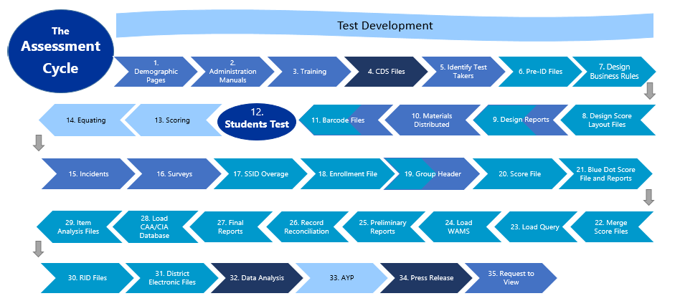

Slide 12
Section 2: Breakout Groups (60 minutes, 20 minutes per discussion)
Attendees move to one of four quadrants for smaller group discussion. Attendees may participate in up to three breakout groups
Group One: Appropriate accommodations, identification, and process
Group Two: Graduation alternatives and tracking processes
Group Three: Classroom-based formative processes, interims, Digital Library, and resources
Group Four: Systems nuts and bolts, WAMS, CEDARS, TIDE

Slide 13
Group Sessions and Topics
Group 1: Appropriate accommodations and identification process | Group 2: Graduation alternatives Tracking processes
Group 3: Classroom-based formative processes Interims Digital Library Resources | Group 4: Systems nuts and bolts: WAMS CEDARS TIDE

Slide 14
10 Minute break

Slide 15
Group Sessions and Topics
Group 1: Appropriate accommodations and identification process | Group 2: Graduation alternatives Tracking processes
Group 3: Classroom-based formative processes Interims Digital Library Resources | Group 4: Systems nuts and bolts: WAMS CEDARS TIDE

Slide 16
Assessment Types
1
All students must participate in the statewide assessment system in the required grades and content areas through:
Regular
Smarter Balanced ELA and Math
Washington Comprehensive Assessment of Science
Regular with Accommodations
(students with disabilities)
Smarter Balanced ELA and Math
Alternate
(students with significant cognitive disabilities)
Washington Access to Instruction & Measurement
Washington Comprehensive Assessment of Science
ELPA21
ELPA21
WIDA Alternate ACCESS
Guidance for Individualized Education Program Teams: Student Participation in Statewide Assessments for Accountability and Graduation
IEP Team Process

Slide 17
What processes are in place in your district to ensure students are taking the right assessment type?
1

Slide 18
Tools, Supports, and Accommodations
1
Step 1: Expect Students to Achieve Grade-level Standards
Step 2: Learn About Accessibility Supports for Instruction and Assessment
Step 3: Identify Accessibility Supports for Instruction and Assessment
Step 4: Administer Accessibility Supports During Instruction and Assessment
Step 5: Evaluate Use of Accessibility Supports in Instruction and Assessment
Five-step Decision-making Process
Notes:
Full title is CCSSO Accessibility Manual: How To Select, Administer, And Evaluate Use Of Accessibility Supports For Instruction And Assessment Of All Students, Copyright © 2016 by the Council of Chief State School Officers, Washington, DC.

Slide 19
What processes are in place in your district to ensure all student have the necessary tools, supports, and accommodations available for the instruction and assessment?
1

Slide 20
Graduation Alternatives Breakout Session
2
Diploma Requirements
Pathways to CAA/CIA/Waiver
Discussion Topics

Slide 21
Diploma Requirements
2
CAA
or
DIPLOMA
HS and Beyond Plan
Credit Requirements
Local Requirements
CIA
or
Waiver

Slide 22

Pathways to CAA/CIA/Waiver
2
CAA
Yes
Retake SBA
SAT/ACT
AP/IB
Dual credit
LAA/LDC
Grades compare
SBA 10th grade
Met
Cut-Score?
Student without
Disability
No
CIA
Student with
Disability
If is in IEP and other alternatives are not appropriate
Retake SBA
SAT/ACT
AP/IB
Dual credit
LAA/LDC
Grades compare
Or
L2 / Basic
Off Grade SBA
LDA
Students with significant cognitive disability
WA-AIM
Off Grade WA-AIM
LDA
EAA Waiver
SUCA
OOS Test Waiver
Awareness Waiver
Waiver
No
Met
Cut-Score?
Yes

Slide 23
Discussion Topics
2
What systems or processes do you use to identify students who need a graduation alternative?
How do you identify the appropriate graduation alternative for each student?
How can we better help you and your students?

Slide 24
Assessment Purposes
3
Training: familiarity with testing system
Practice: practice with content and item types, mini version of test map
Interim: gather data to inform classroom practices, formative assessment processes
Formative Assessment Resources: ongoing practice of knowing where students are in their learning to identify how to move learning forward
Summative: gather data to inform school/district systems
Notes:
Green assessments: can be used as part of formative assessment process

Slide 25

Formative Assessment
3
The garden analogy… If we think of our children as plants
Summative assessment of the plants is the process of measuring them. It is interesting and important to compare and analyze measurements but, in itself, this does not affect the growth of the plants.
Formative assessment, on the other hand, is the equivalent of feeding and watering the plants appropriate to their needs – directly affecting their growth.

Slide 26

3

Slide 27
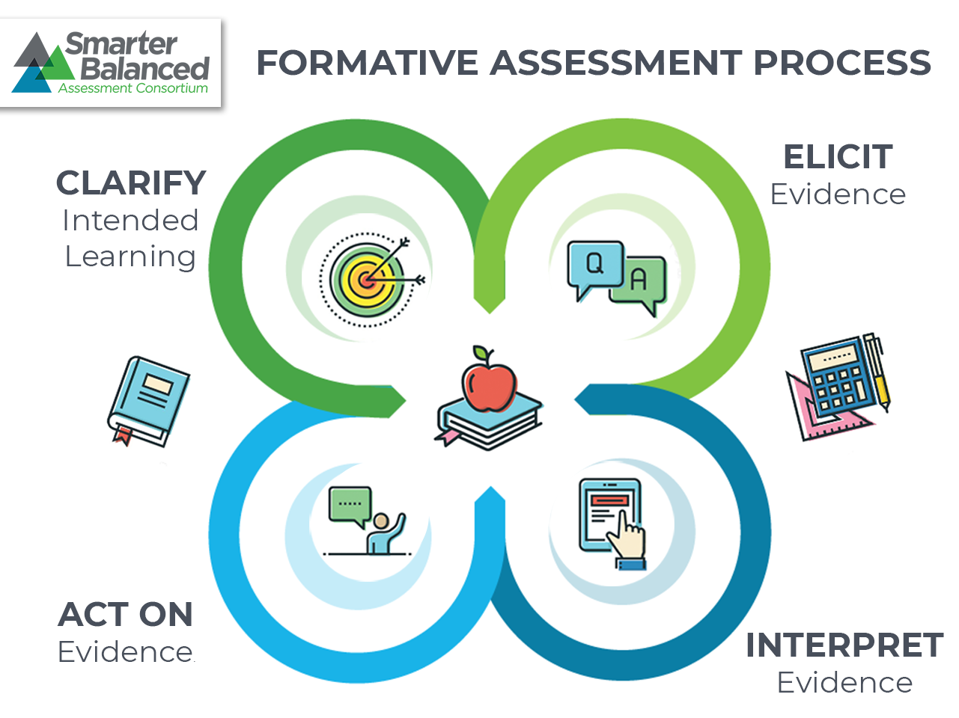
Formative Assessment Cycle
3

Slide 28
Conversation Questions
3
In your schools and districts:
What approaches have worked well to implement formative assessment practices?
What barriers have you faced in implementing formative assessment practices?
What do you see as next steps needed to implement formative assessment practices?

Slide 29
10 Minute Break

Slide 30
Section 3: Reporting, Reporting Tools, Accountability with Query, Report Card, Online Reporting System (45 minutes)

Slide 31
Reporting
ORS Remaining Data Releases
WCAS
EDS Data Releases (CAA/CIA, Query, WAMS)
ELA and math (Smarter + WA-AIM)
Depends on WA-AIM data quality in ‘preliminary’ file due to OSPI 8/21
Science (WCAS + WA-AIM)
Note: full scorefile will be recreated/re-released to merge science with ela and math
State-level Aggregate Data
Report Card Preview w/ ELA and math: target is 8/26 pending WA-AIM data quality
Sciency pre-liminary report likely in October
ESSA Compliant Report Card by end of year (including science)
Notes:
Moving on to high school, we have had several questions about who tests for science, math, and ELA. Again, the WA-AIM window has closed, but information on student testing expectations are included here. First and most straightforward, for science, all 11th graders are expected to test on the Washington Comprehensive Assessment of Science, or WCAS, or WA-AIM, for eligible students, which are the tests required for federal and state accountability--even if a student took the Biology EOC in a previous year, whether or not they met standard. As with elementary and middle grades, we want to ensure all students have an opportunity to assess using on-grade-level assessments.
It gets a bit more complicated for math and ELA. First, all 10th graders are expected to test on the Smarter Balanced math and ELA or WA-AIM tests in Spring 2018. These tests are also required for state and federal accountability. Then, there are 11th and 12th graders who either never tested in math and/or ELA, or, if they did test, did not meet the graduation cut-score. The Smarter Balanced and WA-AIM tests for math and ELA will be available to any of these 11th or 12th grader. Both 11th and 12th graders can use the test to meet the assessment graduation requirements for math and ELA as part of earning a diploma. Also, as a reminder, students must make at least one attempt on the math and ELA Smarter Balanced or WA-AIM tests before they can access any of the assessment graduation alternatives.
We appreciate your support in communicating these testing requirements for spring 2018 to all educators across the state. Thank you.

Slide 32
TIDE – Start of Year Inputs
TIDE GoLive
August 6 – users can start reactivating accounts
OSPI and AIR looking into special handling of TA accounts to require re-adds
CEDARS Go Live
Target date August 15, each district’s first submission on a local timeline
Adding Records to TIDE pre-CEDARS
Send Student to TIDE, Bulk Upload, other WAMS functions scheduled for August 7
Same validations as 2017-18
Build for 2018-19 to look for more than SSIDs issued “this year.” How far back TBD depending on system stress
Currently investigating adding a “delete record” to Send Student to TIDE
Notes:
Moving on to high school, we have had several questions about who tests for science, math, and ELA. Again, the WA-AIM window has closed, but information on student testing expectations are included here. First and most straightforward, for science, all 11th graders are expected to test on the Washington Comprehensive Assessment of Science, or WCAS, or WA-AIM, for eligible students, which are the tests required for federal and state accountability--even if a student took the Biology EOC in a previous year, whether or not they met standard. As with elementary and middle grades, we want to ensure all students have an opportunity to assess using on-grade-level assessments.
It gets a bit more complicated for math and ELA. First, all 10th graders are expected to test on the Smarter Balanced math and ELA or WA-AIM tests in Spring 2018. These tests are also required for state and federal accountability. Then, there are 11th and 12th graders who either never tested in math and/or ELA, or, if they did test, did not meet the graduation cut-score. The Smarter Balanced and WA-AIM tests for math and ELA will be available to any of these 11th or 12th grader. Both 11th and 12th graders can use the test to meet the assessment graduation requirements for math and ELA as part of earning a diploma. Also, as a reminder, students must make at least one attempt on the math and ELA Smarter Balanced or WA-AIM tests before they can access any of the assessment graduation alternatives.
We appreciate your support in communicating these testing requirements for spring 2018 to all educators across the state. Thank you.

Slide 33
Other Start of Year Inputs
WaKIDS
Records loaded directly to WaKIDS Assessment Platform
New “Move Student Between Districts” function being built in WAMS
Will require SSID is real and SSID be in WaKIDS
ELPA21 Screener
Long Article in WAW about creating records with and without TempIDs
Short version: if screening during June, create records now; if screening during August, create records in August
Added capacity to migrate screener scores from TempIDs to SSIDs via new WAMS app
Can be used to migrate other scores (Smarter WCAS) from one SSID to another – complete instructions forthcoming pending further discussion from AIR
Notes:
Moving on to high school, we have had several questions about who tests for science, math, and ELA. Again, the WA-AIM window has closed, but information on student testing expectations are included here. First and most straightforward, for science, all 11th graders are expected to test on the Washington Comprehensive Assessment of Science, or WCAS, or WA-AIM, for eligible students, which are the tests required for federal and state accountability--even if a student took the Biology EOC in a previous year, whether or not they met standard. As with elementary and middle grades, we want to ensure all students have an opportunity to assess using on-grade-level assessments.
It gets a bit more complicated for math and ELA. First, all 10th graders are expected to test on the Smarter Balanced math and ELA or WA-AIM tests in Spring 2018. These tests are also required for state and federal accountability. Then, there are 11th and 12th graders who either never tested in math and/or ELA, or, if they did test, did not meet the graduation cut-score. The Smarter Balanced and WA-AIM tests for math and ELA will be available to any of these 11th or 12th grader. Both 11th and 12th graders can use the test to meet the assessment graduation requirements for math and ELA as part of earning a diploma. Also, as a reminder, students must make at least one attempt on the math and ELA Smarter Balanced or WA-AIM tests before they can access any of the assessment graduation alternatives.
We appreciate your support in communicating these testing requirements for spring 2018 to all educators across the state. Thank you.

Slide 34
WCAP Support for Policy and Materials
Questions regarding information in the Test Administration Manuals, general administration questions, and policy:
Test Administrators and School Test Coordinators, contact your District Test Coordinator.
District Test Coordinators contact the OSPI Assessment Operations Team at: Assessment@k12.wa.us .

Slide 35
WCAP Support for Technology and System Issues
TAs, SCs, and DCs contact the WCAP Help Desk (TAs and SCs must also alert the DC and Technology Coordinator of issues).
The WCAP Help Desk is open Monday–Friday from 6:00 a.m. to 6:00 p.m. PT (except holidays or as otherwise indicated on the Washington Comprehensive Assessment Program Portal).
Washington Comprehensive Assessment Program Help Desk
Toll-Free Phone Support: 1-844-560-7366
Email Support: wahelpdesk@air.org

Slide 36
WCAP Contacts
AIR Help Desk for Technical, Network, and password issues
AIR Help Desk: wahelpdesk@air.org 1-844-560-7366
OSPI Assessment Analysts for student data issues
OSPI Assessment Analysts: assessmentanalysts@k12.wa.us 360-725-6109
OSPI Assessment Operations for assessment policy and test materials
Assessment Operations Assessment@k12.wa.us (360) 725-6348 or (800) 725-4311, press option 3
Smarter Balanced Click to go to the Smarter Balanced website.

Slide 37
Questions

Slide 38

Thank You!

