Slide 1
High School
Science Field Test Information
Online only
Test Window: May 1-June 15, 2017
Notes:
This PowerPoint presentation contains information about a unique testing opportunity for high school students in Washington this spring (2017).
The Washington State 2013 K-12 Science Learning Standards (Next Generation Science Standards) will be assessed for the first time in spring 2018. Before test forms can be constructed, newly developed test items must be field tested to ensure that the items are accessible to all students and that they produce results that are valid, reliable, and fair. These new, online field test items can be embedded in the online Measurements of Student Progress (MSP) in grades 5 and 8, but the paper-pencil Biology End-of-Course exam does not provide that same opportunity for the new high school items. This separate online field test for high school will ensure that the statistics used to construct future high school test forms are as accurate as possible.

Slide 2
High School Next Generation Science
Field Test—Online
Important Dates and Times
  Registration Window: December 1, 2016 through January 31, 2017
  Test Window: May 1 through June 15, 2017
  Test Length: 50 minutes; one class period
    Schools can schedule more time than 50 minutes
    Students should complete in one sitting.
    Pause the test if not done at the end of the time. No need to return and finish.
    Schools can administer multiple ‘sittings’
Note: The operational test in 2018 will have more items and will take longer.
Notes:
The registration is open through the end of this month.
The test window starts May 1st and closes on the last possible day that AIR systems will be available for the school year.
The field test should only take about 50 minutes, including directions. This should be about one class period per group of students.
[CLICK] Schools are welcome to schedule a longer period of time, but we would like the items to be completed in one sitting. If you only schedule a class period, and students are not finished at the end of that time, please PAUSE the test and log out. The items that were completed will be submitted. There is no need to have students log in again to finish the other items.
Schools can administer multiple sittings of the Field Test, and they can be on different days. For example, Mr. Rogers can give the test to his 1st and 3rd period classes on Tuesday, and then to his 2nd and 4th period classes on Wednesday. And Mrs. Kennedy can give it to her students on Thursday. We are hoping to increase participation by being very flexible about this.
[CLICK] Please not that students will only see about 10 items each in this field test, so it is not a full compliment of items that will be on the eventual operational test. The operational test in 2018 will have more items and will take longer. The test map is still a work-in-progress, and likely won’t be published until next fall.

Slide 3
High School Next Generation Science
Field Test—Online
Participation
  Target population: students in Grade 11
  Can also participate: students in Grades 10 and 12
  Not able to participate: students in Grade 9
  Science course taking history of students not necessary
  Can be given in non-science classes
Notes:
The majority of students who participate in the Field Test should be in Grade 11. This is the grade level of students who will need to take the new test for accountability starting in 2018.
Science course taking history is not necessary. The field test does not have to be given in a science class. It can be given in ELA, history, CTE, choir classes…again, we hope to increase our participation by being as flexible as possible.

Slide 4
High School Next Generation Science
Field Test—Online
#1 reason to participate:
To have your students represented in the information/data used to make crucial decisions about the operational test in 2018 (and beyond)
Notes:
The biggest reason to participate is [CLICK] to have your students represented when crucial decisions are being made about the test this coming summer and fall. These decisions will have an impact on the high school science test, not only in 2018, but also in the years beyond that.
To understand what I mean, we have to look at where these items will go after students participate in the Field Test…

Slide 5
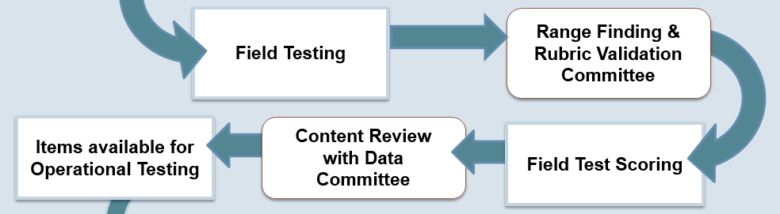
High School Next Generation Science
Field Test—Online
Notes:
The next stop for the constructed response items (like short answer questions) and technology enhanced items (like graphs) is a committee of Washington teachers. These teachers will work with OSPI and our vendors to do what is called “Range Finding” and “Rubric Validation.” The teachers look at a range of actual student responses to each question and decide how to score each student response. The scoring rubrics are refined and materials used to score the field test items are created by this committee.
Then all the items (including the multiple choice and multiple select items) will be scored by our vendor.
After that, data about the item performance is seen by another committee of teachers called “Content Review with Data.”
The teachers will see data for each item that answers questions like:
How many students answered each item correctly?
Which “wrong” answers were chosen by the most students?
Did students of a particular gender or ethnicity answer an item differently than the rest of the students?
The teachers will use all of this data, as well as their science content knowledge, to decide if the items should advance into the item bank for use on the 2018 and future operational tests.

Slide 6
High School Next Generation Science
Field Test—Online
Decisions affecting future tests
  Rubrics and scoring decisions
  Scorer training materials
  To include (or not) in the item bank for use on future tests
Notes:
By choosing to have your students participate in the field test, your students will be represented in the responses and data seen by those two teacher committees.
We want the Range Finding and Rubric Validation committee to see the broadest possible range and diversity of answers students give to these field test questions.
We want the item level data seen by the Content Review with Data committee to represent the diversity of the students in our high schools, resulting in more reliable data for them to make their decisions with.
The rubrics and training materials will be used again each time the item is tested, and items are used many times before they are retired from the item bank, so these decisions are far reaching.

Slide 7
High School Next Generation Science
Field Test—Online
#2 reason to participate:
See how your students react to the technology and to the rigor of the questions
#3 reason to participate:
Go through the test administration steps in a low-pressure situation
Notes:
Another reason to participate is that you’ll be able to see how your students react to the technology and to the rigor of the questions. Again, TA’s can’t look at the questions…but your student’s reactions will tell a story.
The third big reason to participate is to go through the test administration steps in a low-pressure situation. If the teachers who participate in this field test have not been TA’s for any Smarter Balanced testing, this might be their first experience with AIRs systems. Many districts who participated in the Smarter Balanced Field Test in 2014 told OSPI that their teachers were much less stressed about the test in spring 2015 when it was “the real-deal” since they already had experience with the system in the previous year.

Slide 8
High School Next Generation Science
Field Test—Online
Why won’t we get any data?
The students are not seeing a full-length test.
Students will see different sets of items.
Some of the items might not be accepted by the Content Review with Data committee.
Lessons Learned document to be posted fall 2017
Notes:
One other question we get asked is: Why won’t we get any data from the field test?
[CLICK] The first reason is that the students are not seeing a full-length test. They are only taking about 10 items, and those items won’t fully cover the breadth of the future operational test.
[CLICK] The second reason is that students will see different sets of items. Christopher might see a set of physical science items and a set of life science items, Lucas might see a set of Earth and space items along with a different set of physical science items, and Tony will see a completely different set of items. The sets of items might be worth different numbers of raw points, and some combinations of items might be harder than others. It would not be right to release any data from such different combinations of items. That data might lead to incorrect conclusions about what Christopher, Lucas, and Tony know.
[CLICK] The third, and most important reason, is that some of the items may not make it into the operational bank; they might be rejected by the Content Review with Data committee. It would definitely be unfair to Lucas if we connected data to him that came from those rejected items.
And just as a reminder, there was no data at the individual, school, or district level from the Smarter Balanced Field Test in 2015.
One thing that teachers will get [CLICK] is a Lessons Learned from Scoring Student Work document. We’ll produce this document after the Content Review with Data meeting. We’ll share observations about student responses and areas where students appear to be struggling.

Slide 9

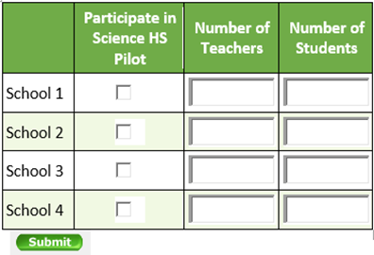
High School Next Generation Science
Field Test—Online
Registration will be done by District Assessment Coordinators in WAMS.
Registration Window: December 1, 2016 through January 31, 2017
Notes:
Registration will be done by District Assessment Coordinators in WAMS. The registration opened last month and will be available until at least the end of this month.

Slide 10
High School Next Generation Science
Field Test—Online
Security
  Field Test items are secure items
  All test security protocols must be followed
Notes:
Reminder…Field test items are secure items. Teachers don’t get to see any more of these high school field test items than they would of the online ELA or Mathematics tests. The 5th and 8th grade field test items will be part of the online MSP, so all security protocols will be followed there; the high school field test administration will mimic that experience.

Slide 11
High School Next Generation Science
Field Test—Online
Note: The 5th and 8th grade Field Test items will also have these formats.
Format
  One or more stimuli on left side of screen, items on the right side
  Item Types:
      Selected Response—multiple choice, multiple select
      Technology enhanced—ex: drag and drop, drop-down choices, simulations
      Constructed Response—ex: equation builder, short answer
  Multi-part items
    Parts labeled with letters A, B, and C.
    May have a mix of item types. May ask for evidence to support answer in previous part of the item.
Notes:
Most items are part of a group of items using common stimuli that students will react to and use in answering the items. The stimuli will be on the left and the items will be on the right.
[CLICK] Item Types [slide]
[CLICK] Multi-part items [slide]
[CLICK] Please note that the 5th and 8th grade field test items will also have these formats

Slide 12
High School Next Generation Science
Field Test—Online
Note: The 5th and 8th grade Field Test items will also have these features.
Features
  Collapsing stimuli:
      First stimulus is hidden when second stimulus is provided
      Both stimuli are available to the student
  Locking items:
      Student can only answer the question one time
      Allows subsequent questions to update with correct information
      An “attention” box warns student that they won’t be able to change their answer
Notes:
The Next Generation Science Assessments will have two newly developed features. These two features have been included in the Student Interface Training Modules because we knew that they would be in the online science tests this year.
The first is called Collapsing Stimuli.
The stimuli are broken into small chunks of information to help students focus on the part of the stimulus necessary to address the question. As additional information is needed, another stimulus is provided with the items. For example, a student might see Stimulus #1 and 2 items. After they complete those 2 items and select the “NEXT” button, Stimulus #2 will appear along with 2-3 new items. Stimulus #1 will be “collapsed” above Stimulus #2, and can be read again by clicking on the plus ( + ) sign next to it. This collapsing action is helping us to eliminate vertical scrolling as much as possible, and also eliminates the need for students to use the “BACK” button in order to see Stimulus #1.
The second feature is called Locking items [CLICK]
Locking items are allowing us to do what’s called “blocking and updating.” For example, it enables us to ask students to build a graph based on some data we gave them as question #1, lock #1, then give them a correct graph in question #2 and ask them questions based on the correct graph. This way we can see what they know on their own in #1, but then prevent them from carrying any errors forward into #2. Another example is that we might ask a constructed response item as #1 to get the big picture of what the student knows about a standard, then lock #1 and use questions 2-5 to get down to the component parts of the standard. Questions 2-5 might give away, or clue, the answer to #1, which is why we will lock #1. As we’ve written these items, teachers have really liked that we can ask a group of questions that really lets us discriminate what students know and can do. (More about how this works on the next slide.)
[CLICK] Please note that the 5th and 8th grade field test items will also have these features

Slide 13
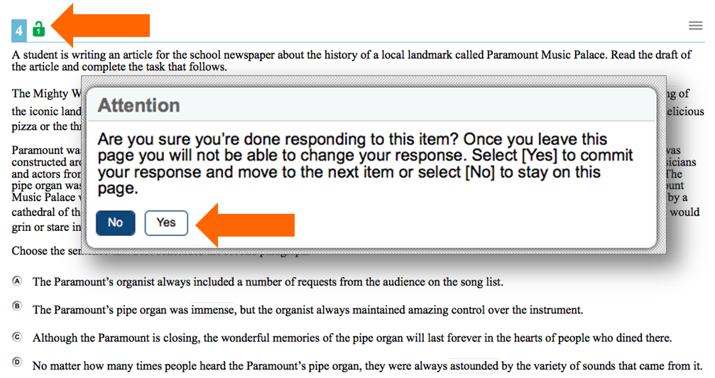
High School Next Generation Science
Field Test—Online
Locking item:
Notes:
The first time a locking item is seen, there will be a green unlocked padlock next to the item number. The student can work with this item, and any other items that are with it, as much as they want until they click the “NEXT” button. When they click the “NEXT” button, this “Attention” box will appear. [PAUSE]
When the student selects “Yes”, the system will move to the next set of items and this item will be locked. If the student uses the “BACK” button, or looks at this item from their Review page, they will still be able to see the item and their response, but it will be greyed out, the padlock will be red and locked, and they won’t be able to change their answer.

Slide 14
High School Next Generation Science
Field Test—Online
Reminders
  Voluntary by district
  Science course taking history of students not necessary
  Scores will not be provided
  Elementary and middle school items will be field tested as part of the online Spring MSP
  Science teachers coordinate with their principals and District Assessment Coordinators to participate.
Notes:
“Voluntary by district” really means that registration is done by district, and that teachers who want to volunteer need to coordinate with DACs.
Course taking history is not necessary. The field test does not have to be given in a science class. It can be given in ELA, history, CTE, choir classes…again, we hope to increase our participation by being as flexible as possible about this.
As with all field tests, no scores will be provided. We are testing the items, not the students. Achievement levels will be set in Summer of 2018 based on the first full exam, so there are not any bars to compare performance to at this time.
5th and 8th grade items will be field tested as part of MSP, just like they were last spring.
Science teachers on our Science Assessment GovDelivery list were sent a message on Friday with most of the information we included in the WAW article. We are directing them to their principals and DCs to volunteer.

Slide 15
High School Next Generation Science
Field Test—Online
Questions?
Contact: science@k12.wa.us
Notes:
We hope that you will decide to participate in this unique field test opportunity.
If you have any questions, please contact the Science Assessment team at science@k12.wa.us

