Slide 1

Curriculum Directors Zoom Meeting June 17, 2020
Northwest Educational Service District 189
Notes:
Pam

Slide 2
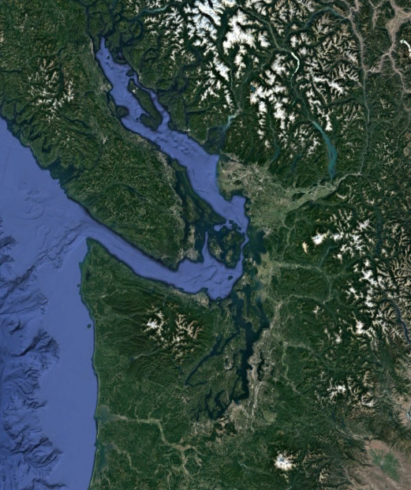
Gathered on Indigenous Lands
I would like to acknowledge that I am meeting with you from the ancestral homelands of the Coast Salish Peoples, who have lived throughout the San Juan Islands and the North Cascades watershed, from time immemorial. I would like to express my deepest respect and gratitude for our indigenous neighbors -- The Samish Indian Nation and The Swinomish Indian Tribal Community -- for their enduring care and protection of our shared lands and waterways.
Notes:
Salish Sea Satellite image Public Domain [LINK]

Slide 3
With great compassion, we would like to acknowledge the pain and trauma resulting from horrific recent events and 400 years of racism in the United States.
We stand with our communities of color, especially those who identify as and/or are categorized as African American and/or Black. We will continue to center our work in leading with racial equity.
We want to offer a moment, and then offer the chat box if folks would like to a share a comment or resources.
An abridged version of a statement from PSESD.

Slide 4
TODAY
Sharing how districts are handling closing of school-equipment; summer programs, ESY for special needs
Collaboration on Reopening of schools

Slide 5
Planning
Planning for closing out of the school year
How are you handling material and equipment returns?
Summer school and/or incompletes
Plans for Extended School Year (ESY) for students receiving special services

Slide 6
Announcements:
Template from OSPI for school district plans
FAQ coming from OSPI-webinars on Tuesday had many questions posed
There are still questions about 6 foot social distancing requirements-plan for as much space as possible
Screening protocols can include families and staff screening at home
Senator Wellman working on an app for schools to use.
Masks will be the standard to plan for

Slide 7
Reopening Washington Schools
Guidance from OSPI-updated and now 58 pages
Superintendent Reykdal:
“To be clear, it is my expectation that schools will open this fall for in-person instruction.”

Slide 8
OSPI 20-21 Commitments
Page 8-9
Support Students furthest from Educational Justice
Prepare for Health & Safety
Invest in Connectivity and Hardware
Leverage local expertise and provide training

Slide 9
Health & Safety Requirements (p.16-20)
The Science of COVID-19 will evolve over the summer and into the school year. Districts need to plan ahead and have contingency plans.
Consider staff and students at High-Risk for Health problems
Consider your drop-off and pick up plans
Health screening at entry
Consider grouping students and physical distancing (p. 18 discusses fieldtrips, large gatherings, and high risk activities)
Passing periods; arrival/dismissal times; limiting visitors; cross-school transfers; recess
Meals
Cloth face coverings
Transportation

Slide 10
Reopening Washington's Schools: Worksite Employee Requirements
Pages 24-25

Slide 11
Reopening Key Requirements (p 27-28)
School districts Reopening Plans
Instructional Hours/Days
1027 average hours and 180 days-
Attendance
Required to take attendance
Assessments
Waiting for Federal guidelines re: waiver for 20-21
Grading
Emergency rule of no “F” for 19-20 only

Slide 12
Schedules concepts (p. 30)
Split or rotating schedules with continuous remote learning
Phased-in opening with continuous remote learning
Continuous Learning 2.0

Slide 13
Actions for implementation (p. 33)
Professional Development
Feedback in the virtual setting
Safety training and orientation
Supporting transitions for students
Diagnostics or screeners
Universal screening that includes social emotional, academic
Leading with Social Emotional Needs
Community Partners and Communication
Family and Student Voice
Classroom and Schoolwide Behavior Supports
Condensed template on page 40-42

Slide 14
Student Achievement Partners Achievethecore.org

Slide 15
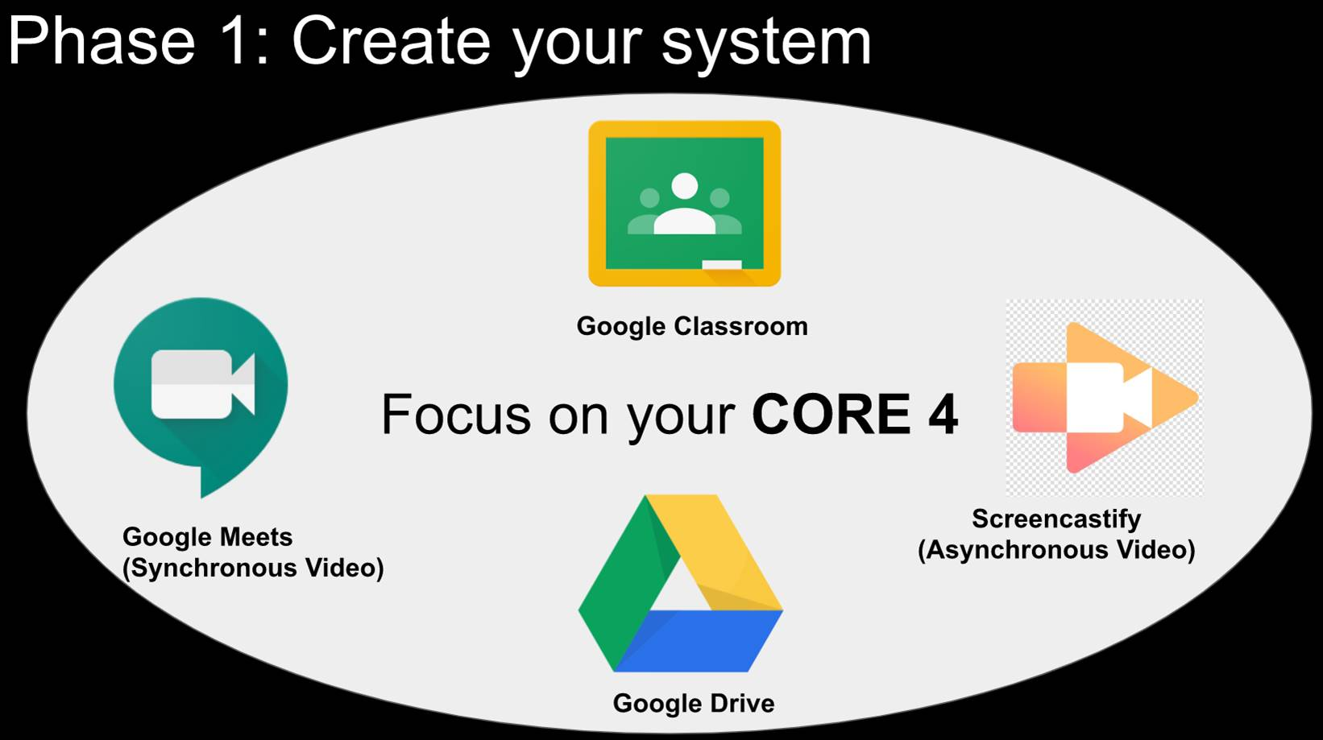

Slide 16
District Sharing
Bellingham SD

Slide 17

District Sharing & Questions Breakout rooms

Slide 18
Announcements
FELLOWS APPLICATIONS-(September)
WA Kids-Trainings will be done online through OSPI (more from Sarah)
Still waiting on guidance re: Wakids assessment and Covid
SCIENCE UPDATES (email yesterday from Jennifer)

Slide 19
Curriculum Director’s 20-21
Northwest Educational Service District 189
Notes:
Pam

