Slide 1

Curriculum Directors Zoom Meeting May 21, 2020
Northwest Educational Service District 189
Notes:
Pam

Slide 2
Announcements
K-4 OSPI Expectations
Inclusionary Practices
Climate Science Courses
Continuous Learning Plans due to OSPI

Slide 3
Announcements
Graduation Ceremony guidance –DOH
CDC 65 page document—page 45 Schools
Draft of 7 possible reopening scenarios
Reopening Planning-OSPI 2 page document

Slide 4
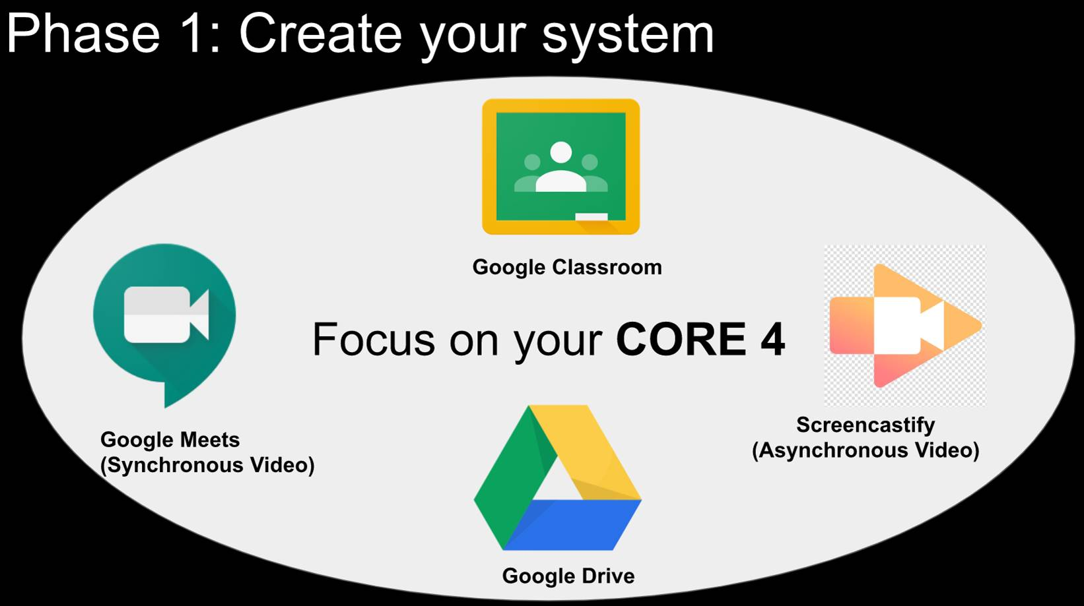

Slide 5
Core 4 Usage in NWESD Region
Home Base/LMS |  | Asynchronous Video
Districts | NWESD Internal | Districts | NWESD Internal
Google Classroom (23) | Google Classroom (46) | Screencastify (18) | None (33)
Canvas (12) | Canvas (20) | Zoom Recordings (15) | Zoom Recordings (16)
Microsoft Teams (6) | Microsoft Teams (6) | Loom (3) | Screencastify (13)
Seesaw for Elem (7)
Synchronous Video |  | File Storage
Districts | NWESD Internal | Districts | NWESD Internal
Zoom (26) | Zoom (66) | Google Drive (19) | Google Drive (58)
Google Meets (16) | Google Meets (18) | Microsoft OneDrive (7) | Microsoft OneDrive (15)
Microsoft Team (4) | Microsoft Teams (6) |  | Internal Drives (2)

Slide 6
Shifting Schools
Update:
Shifting Schools Cohort 4-June
Shifting Schools 201-AESD working on
What support does your district need as we move forward with distance learning?
Enter your response in the google form

Slide 7
Planning
Plans for summer school and/or incompletes
Plans for Extended School Year (ESY) for students receiving special services
Planning for reopening
Planning for assessing your student’s progress?
How is your district going to update enduring understandings or grade level standards?

Slide 8

District Sharing & Questions

Slide 9
Curriculum Director’s Zoom Meeting Next: June 11, 10:00
Northwest Educational Service District 189
Notes:
Pam

