Slide 1

NWESD ELL Cooperative Year-2 Paraeducator Training #1
October 3, 2018
Sarah Southard - NWESD 189
Amanda Rodriguez - MVSD
Notes:
Sarah

Slide 2

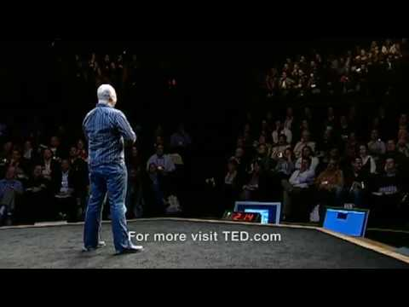
Welcome!!!
Introductions - Stand up if...
In your table groups, please share:
Your name
Your school
Your role
How does this video connect or not connect to your work?
Notes:
SArah
Welcome and introductions
Topics are aligned with NEW Specialist/Teacher training

Slide 3
Welcome!!!
Introductions
Wednesday, October 3rd, 2018
9-2:30pm “Who are my students and what do they need?”
Tuesday, January 22nd, 2019
9-2:30 pm “What is oracy and why is it so important?”
Tuesday, March 19th, 2019
9-2:30 pm “Which words are the most important to learn?”
Notes:
SArah
Welcome and introductions
Topics are aligned with NEW Specialist/Teacher training

Slide 4

Today’s Agenda
Stages of Language Acquisition
Scheduling
Getting to Know Students & Families
Newcomer Focus
Collaboration & Planning
We are our students’ BEST advocates!
Notes:
Sarah

Slide 5

Session #1 - Who are my students and what do they need?
I can identify stages of, and approaches to, language acquisition through the lens of my own students.
I have a plan to engage with my students and their families in a way that prepares them for success for the school year.
I am developing a professional network with one another to support ongoing learning, sharing, and collaboration.
Notes:
Sarah
Welcome and introductions
Topics are aligned with NEW Specialist/Teacher training

Slide 6
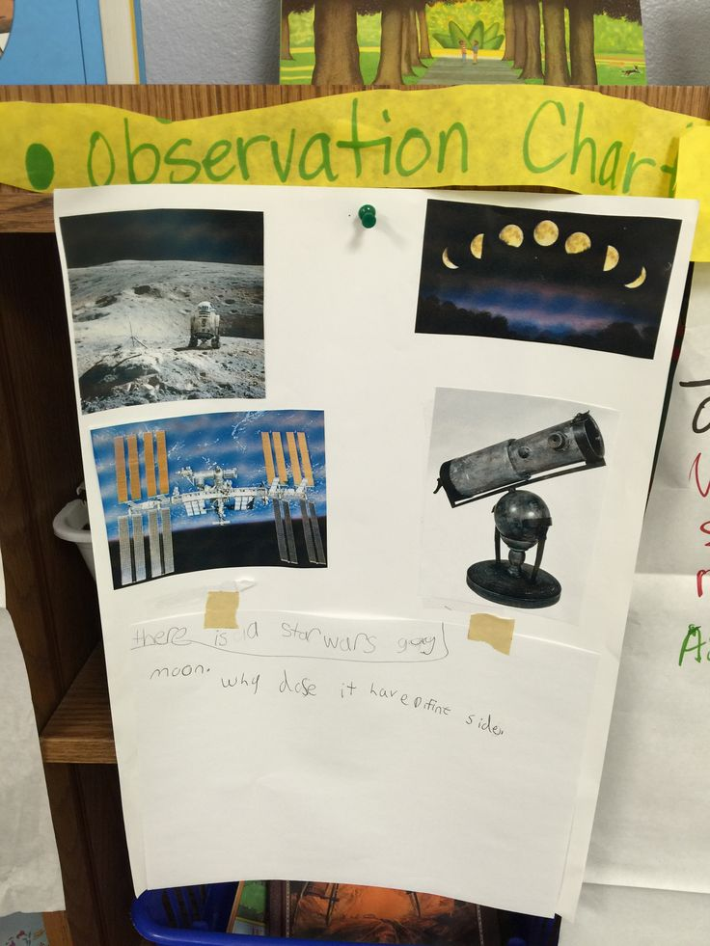
Observation Charts
With a partner, look at each observation chart and connect what you see to your own students or your role.
Share your reflection out loud in your language of choice and then choose one person to record your response for each chart (alternate with each chart). You may use words or images to record your response.
Notes:
Sarah

Slide 7
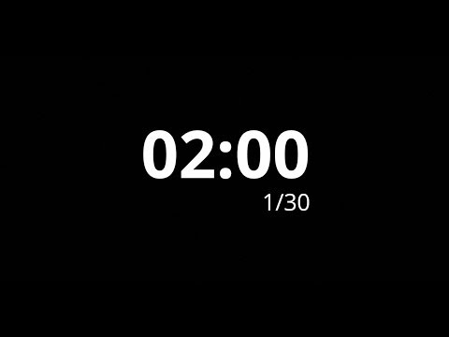
Observation Charts
What do you notice?
What connections do you make?
What do you wonder?
Notes:
SArah-

Slide 8

Poster #1
What did you notice?
What connections did you make?
What do you wonder?
Notes:
Sarah
Share out from wherever you ended up- could share what you contributed or something that you noticed that someone else did.

Slide 9
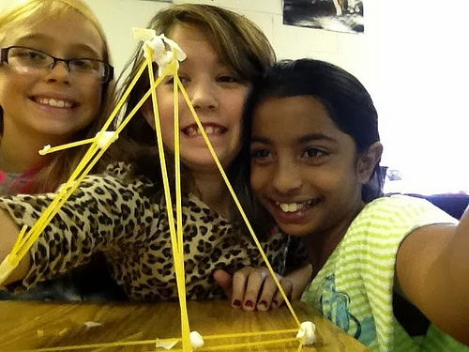
Poster #2
What did you notice?
What connections did you make?
What do you wonder?
Notes:
Sarah

Slide 10
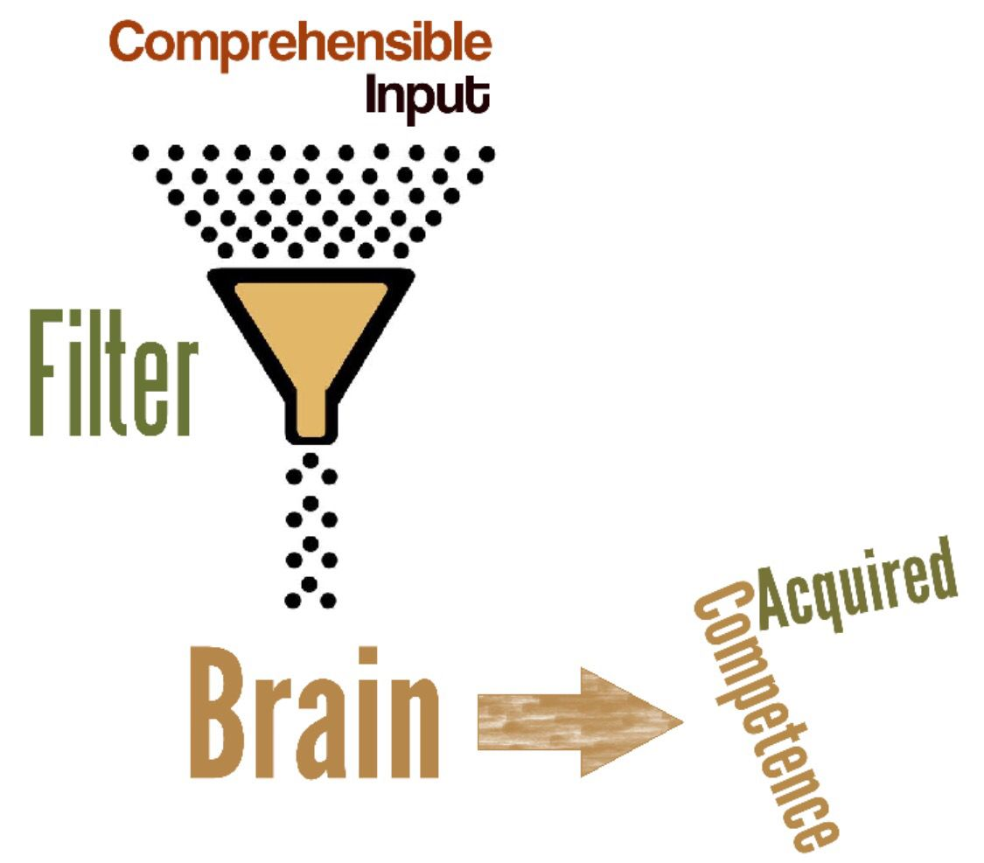
Poster #3
What did you notice?
What connections did you make?
What do you wonder?
Notes:
Sarah

Slide 11
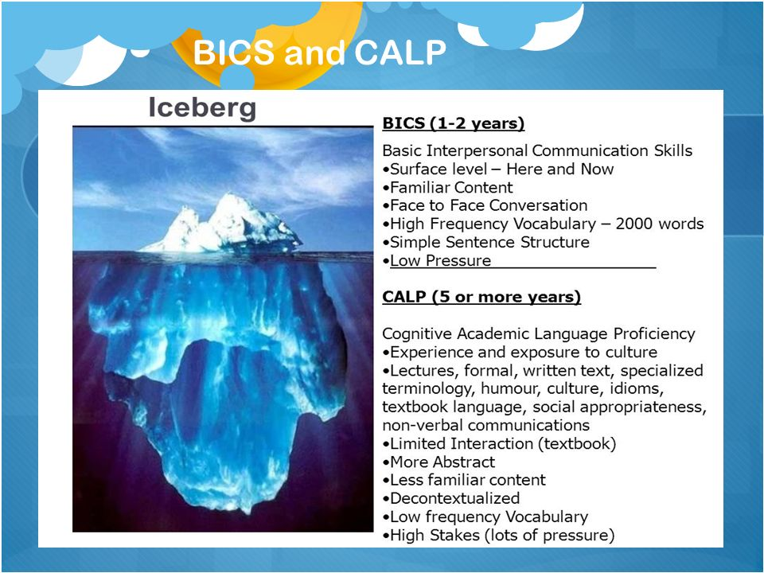
Poster #4
What did you notice?
What connections did you make?
What do you wonder?
Notes:
Sarah

Slide 12
Stages of Language Acquisition Review
Notes:
Sarah

Slide 13
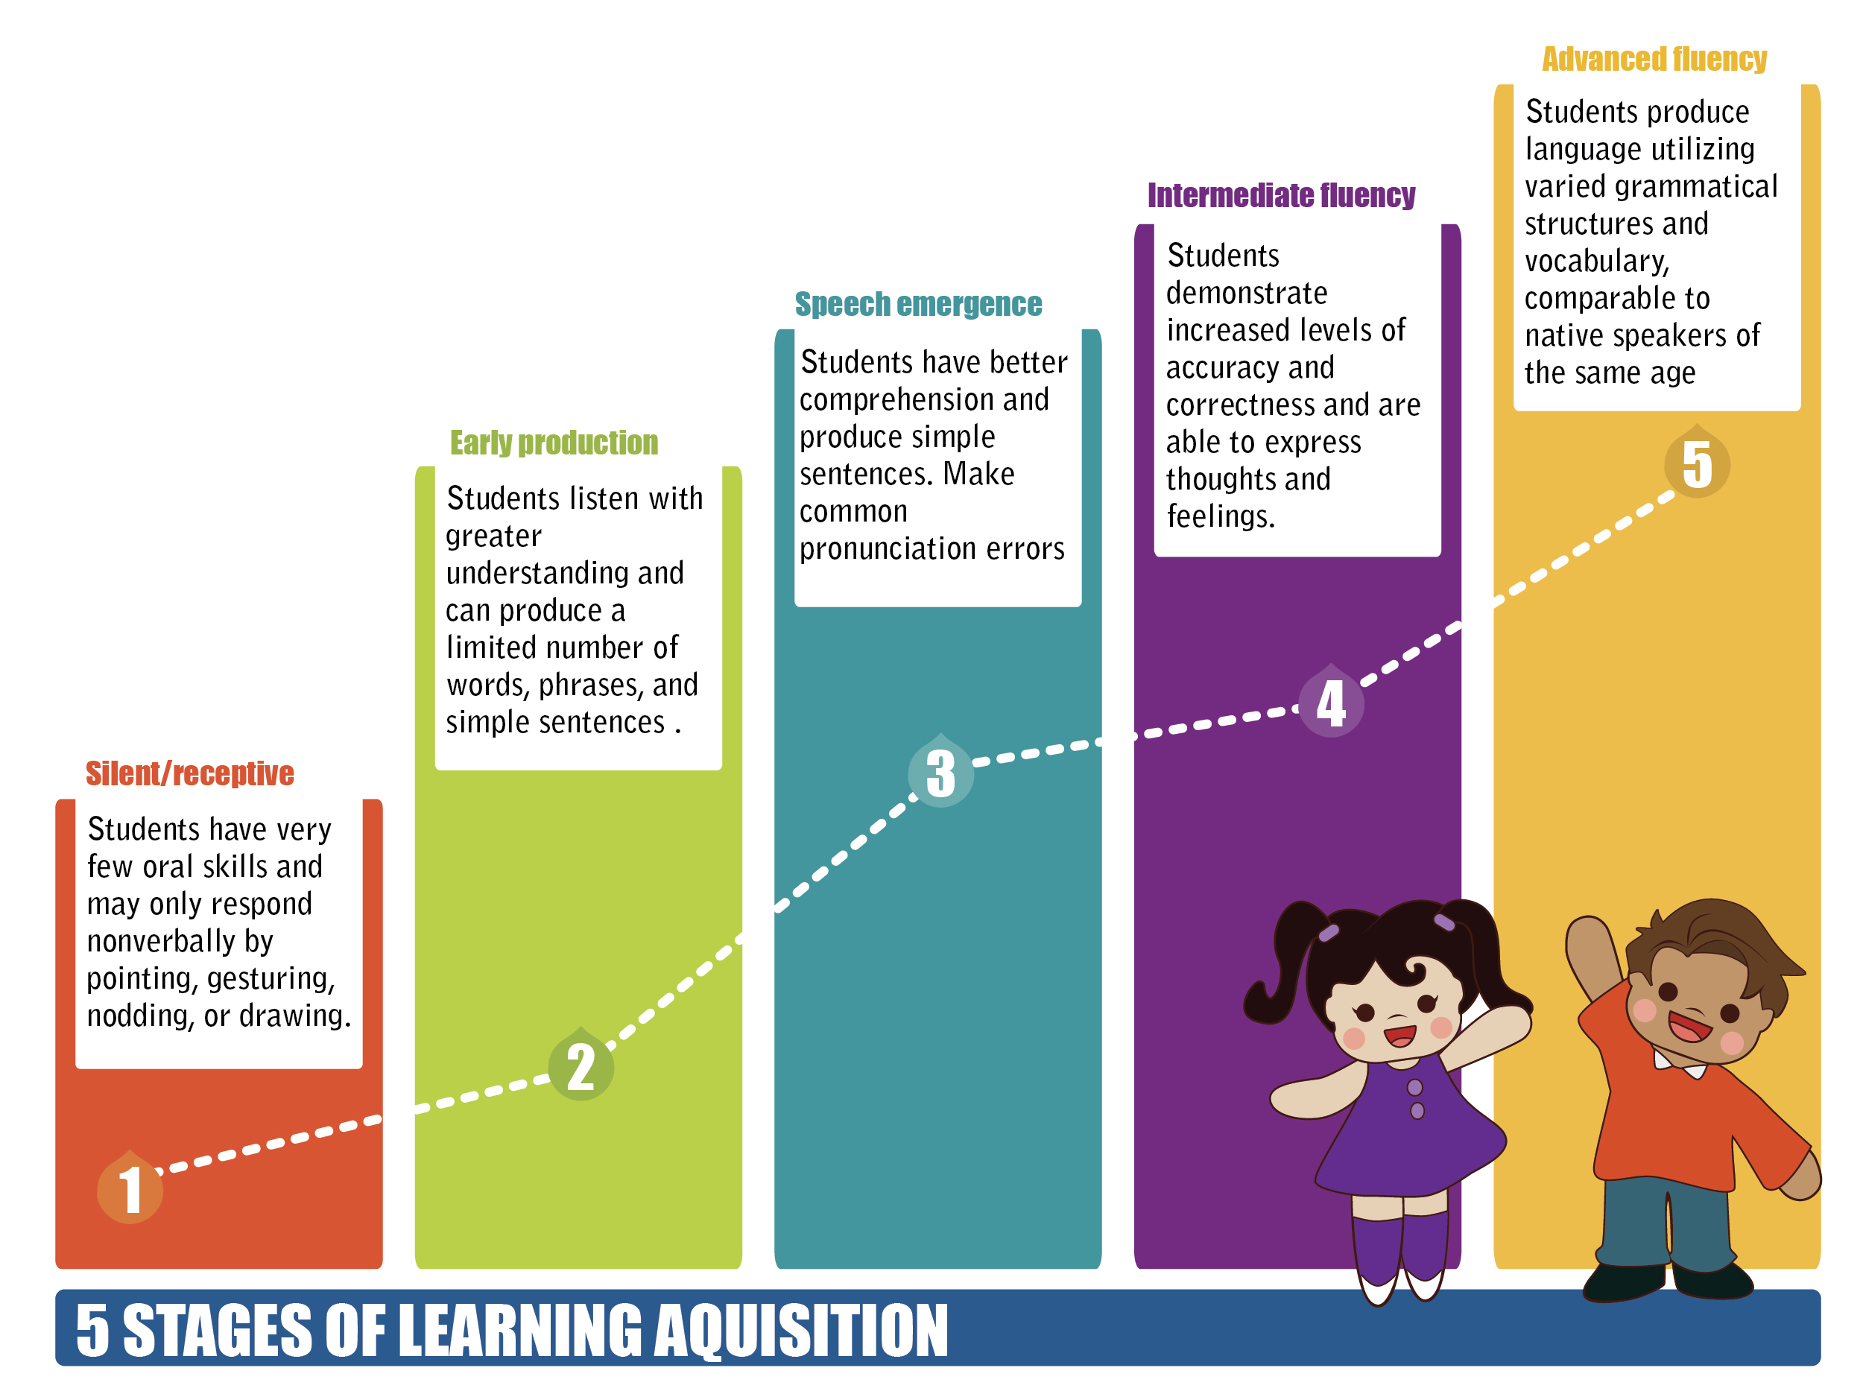
Review: Stages of Language Acquisition
Notes:
SArah
Just a quick reminder of the 5 stages of language acquisition. You may remember this from last year.

Slide 14

Language Acquisition Chart
Stage | Characteristics | Approximate Time Frame | Teacher Prompts
Pre-production |  |  | Show me … Circle the … Where is …? Who has …?
 | The student Has limited comprehension Produces one- or two-word responses. Uses key words and familiar phrases. Uses present-tense verbs.
Notes:
Sarah
Find someone who has the same version of the grid as you. In pairs, use pencil to complete empty squares in your grid. We provide 4 versions of “incomplete” grid.

Slide 15
Language Acquisition Chart -
Completed version
Look at the completed version and discuss:
How did you do?
What surprised you?
Make any adjustments to your grid, based on this information
Please thank your partner and head back to your seat.
Notes:
SArah
How did you do? What surprised you? Make any adjustments to your grid, based on this information.

Slide 16
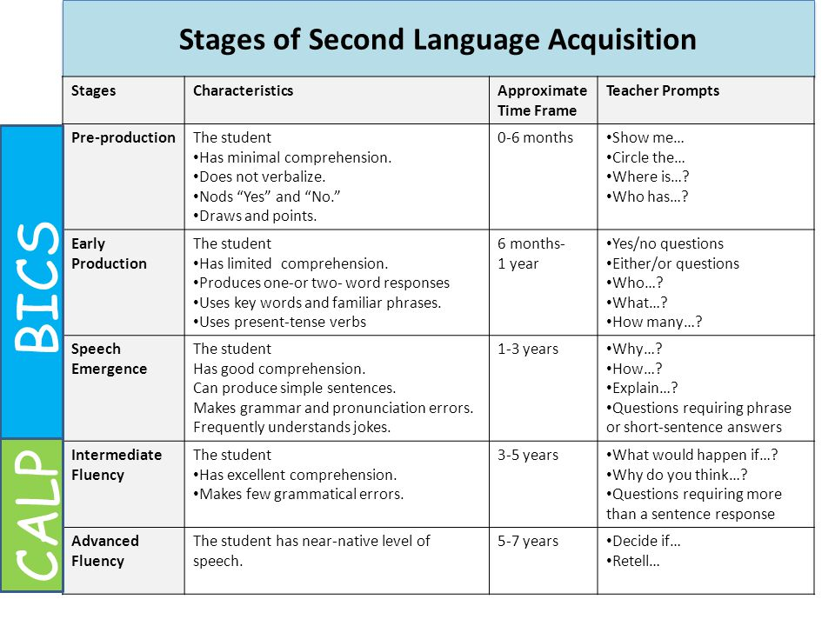
Notes:
Sarah
This the same information, broken down by BICS and CALP.

Slide 17
Sentence Stem
I used to think_________.
Now I think _________.

Slide 18
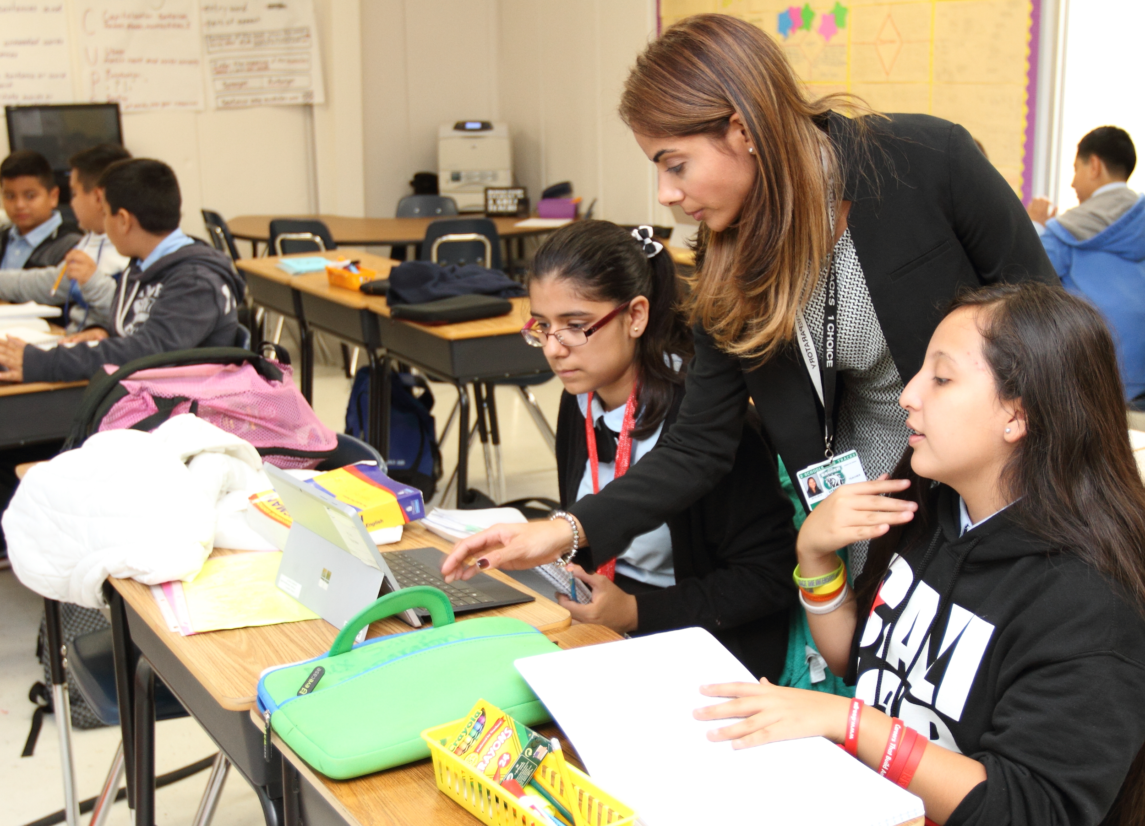
YOUR Students
Based on this information, where do you think your students might be in their language development?
Add students’ names into your chart.
Overall Language Categories:
Emerging
(Level 1’s and 2’s in each domain)
Progressing
(Combination of domain levels)
Proficient
(Level 4’s and 5’s in each domain)
Notes:
SArah

Slide 19

Notes:
AMANDA

Slide 20
Session #1 - Who are my students and what do they need?
I can identify stages of, and approaches to, language acquisition through the lens of my own students.
I have a plan to engage with my students and their families in a way that prepares them for success for the school year.
I am developing a professional network with one another to support ongoing learning, sharing, and collaboration.
Notes:
Sarah

Slide 21
How can my schedule best serve my students?
Notes:
SArah - AManda hands out schedule

Slide 22
What Do You Notice & Wonder?
What do you notice about this schedule?
What are some questions about this schedule and/or the students being served?
Write your question(s) on a sticky note and have a runner bring them to the front.
Enjoy your break!
Notes:
Sarah
What are some questions that you might ask to get the information that you need?
PUt name on sticky
Amanda and Sarah categorize during break

Slide 23

Questions and Answers
Questions that we can attempt to answer:
If you didn’t hear your question, feel free to retrieve your sticky and ask the question in your district. It may be a question that can only be answered locally by:
EL Specialist
Classroom Teacher
Principal
EL Director
Assessment Coordinator
Other Paraeducator
Notes:
AMANDA & SARAH

Slide 24

What I Need to Know...
Look at your grid, with students’ names.
Look at the sample schedule or your schedule (if you have it).
Considering all of this information:
What are some questions you have about your schedule and/or the students you are serving? Capture your questions on the blue paper.
Notes:
AMANDA
Look at your grid, with students’ names. Look at the sample schedule and/or your schedule. Given all of this, what questions do you have about serving your students.
At 5 minutes hand out “Potential Questions” page

Slide 25

Who? What? Where? When? How? Why?
Potential Questions:
How might I find information about my students’ ELPA levels in each language domain (Listening, Speaking, Reading, and Writing)?
When looking at my schedule, how many hours of my day should be dedicated to each funding source (EL, Migrant, LAP, Title, SpEd, Gen Ed, etc.)?
What is the focus for serving our EL students? Which types of students are we serving in this program? (Only newcomers? Oral language focus? Pushing in during reading?, etc.).
Notes:
AMANDA
Some questions might be more simple and easily answered.
Look at their questions on the blue paper that they would like to ask in their context. Check the questions that are easier to get answers for and that you can address more quickly.

Slide 26

Who? What? Where? When? How? Why?
Potential Questions:
Who is responsible for directing and supporting my work (not necessarily an evaluator)?
When looking at my schedule, how many hours of my day should be dedicated to each funding source (EL, Migrant, LAP, Title, SpEd, Gen Ed, etc.)?
How is it decided which students we are serving in different capacities? (Only newcomers? Oral language focus? Pushing in during reading?, etc.).
Notes:
AMANDA
Some questions might be more complex and require a deeper conversation. These questions, we want to support, because they’re important and difficult to broach. Students will benefit from you having these conversations in meaningful ways with your colleagues.
Look at the questions that you wrote down,that you would like to ask of your colleagues. Put a star next to the questions that you expect to more complex or take more time.

Slide 27
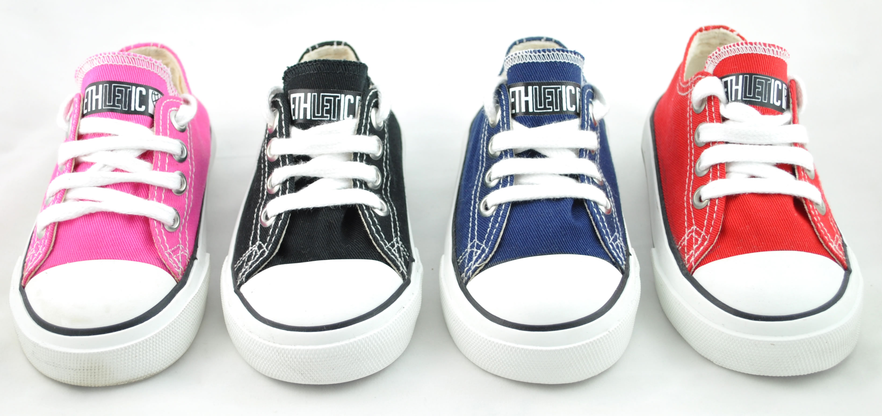
“Sole Mate”
Choose your top 3 questions that you want to try out
Find a “sole mate” and take turns sharing and giving feedback on the questions.
Notes:
AMANDA

Slide 28

Notes:
AMANDA

Slide 29
Session #1 - Who are my students and what do they need?
I can identify stages of, and approaches to, language acquisition through the lens of my own students.
I have a plan to engage with my students and their families in a way that prepares them for success for the school year.
I am developing a professional network with one another to support ongoing learning, sharing, and collaboration.
Notes:
AMANDA
Ask participants to show fist to five, how well to the feel like they can do the first learning target/success criterion

Slide 30
Getting to know your students and families.
Notes:
AMANDA

Slide 31
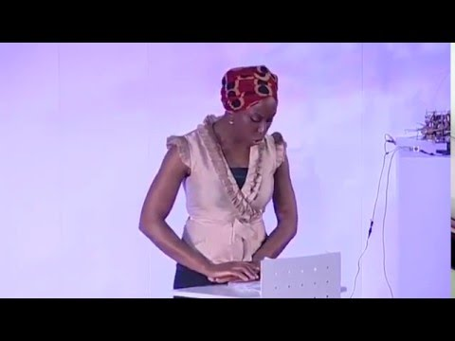
“The Danger of a Single Story”
Think to Yourself
What are some single stories that I might currently believe?
How are we unintentionally contributing to the idea of a single story about our students?
Turn and talk with your table group:
How can we stop reinforcing the single story about the EL students that we work with?
Notes:
AMANDA

Slide 32

How do we go beyond a single story of our students?
Supporting the use of home language
Shared experiences to build background together (field trips, excursions, etc.)
Encouraging & shaping social interactions (among students and with other professionals)
Academic support, including clubs/activities/sports
Serving as a bridge or liaison with other students - ADVOCATE
Notes:
AMANDA
2 minute graffiti wall with “Beyond the Single Story” in the middle. Each person gets a different pan and writes any thoughts or examples of these 5 things.
2 minute share out with in group
Share out to whole group

Slide 33
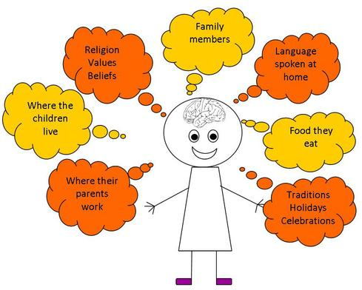
What is “Funds of Knowledge”?
The belief that all students come to school with valuable knowledge, abilities, and sets of information that are worth sharing with their school and community!
Notes:
AMANDA
Yes worth sharing but enhance learning for all

Slide 34

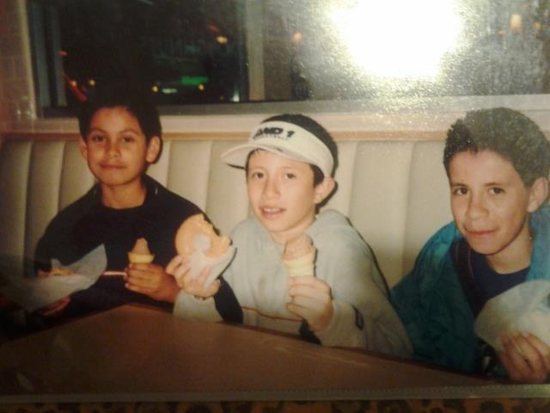
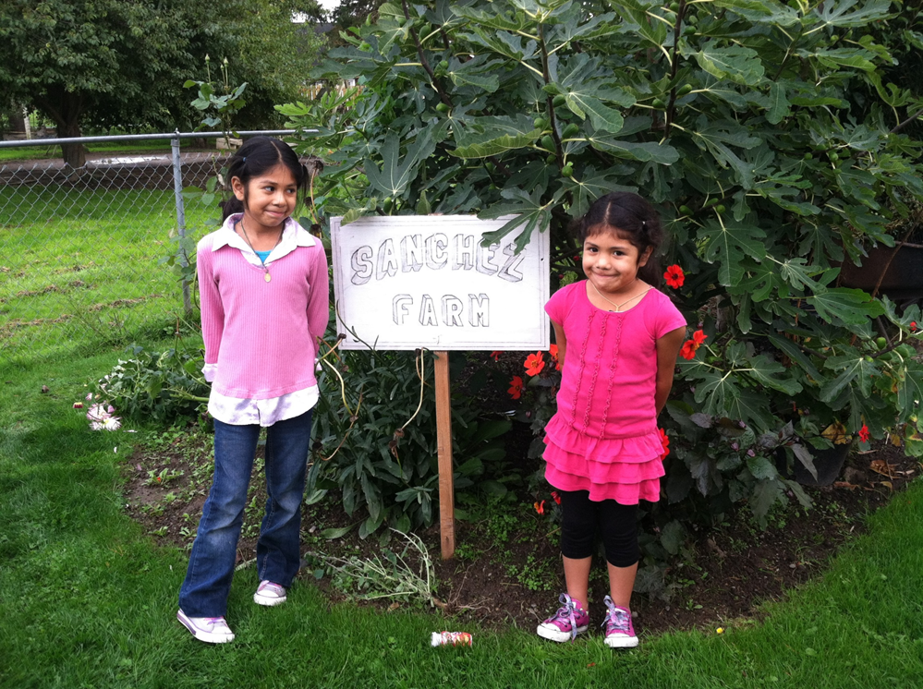
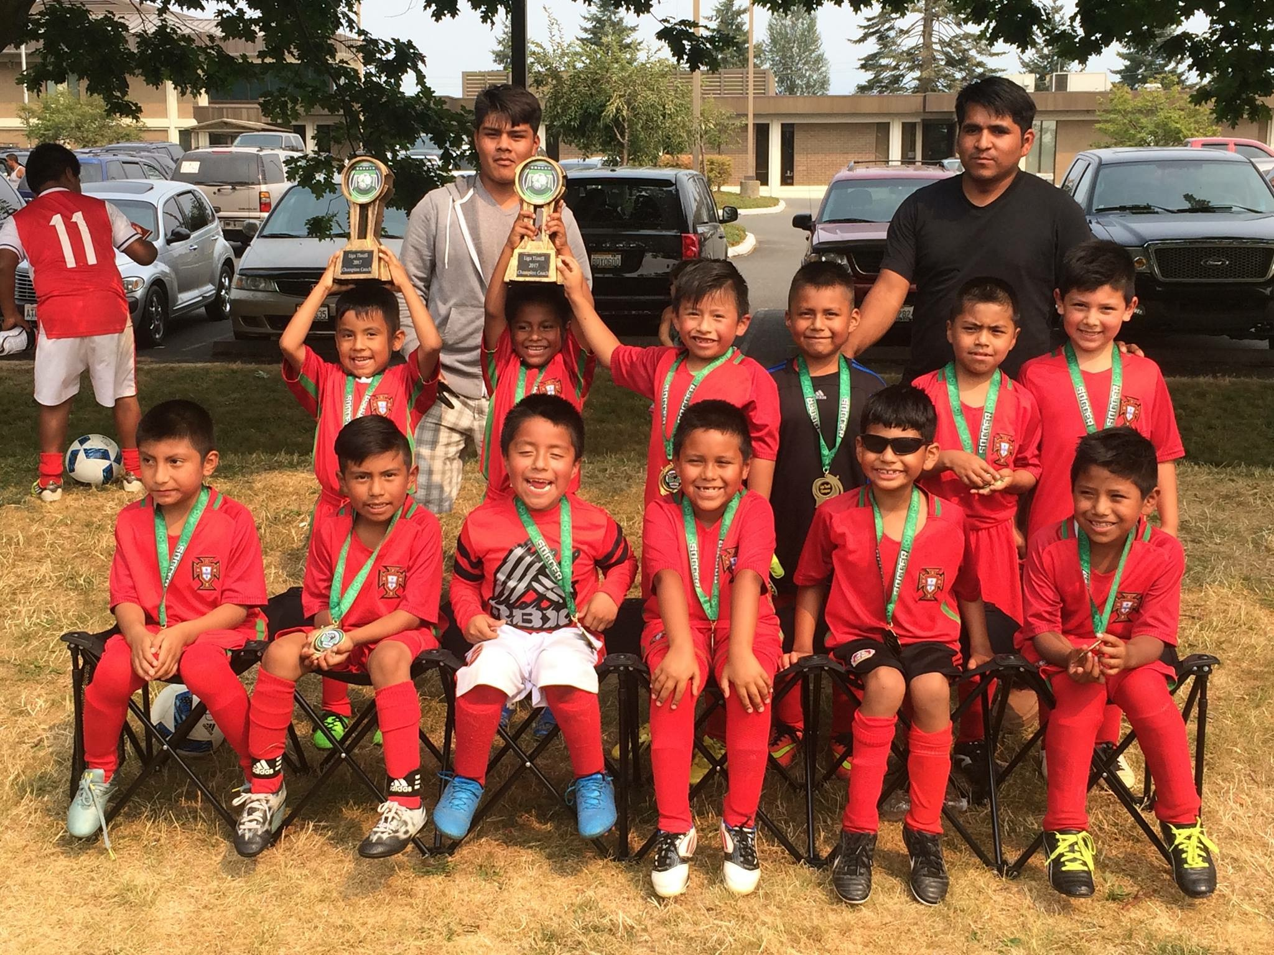
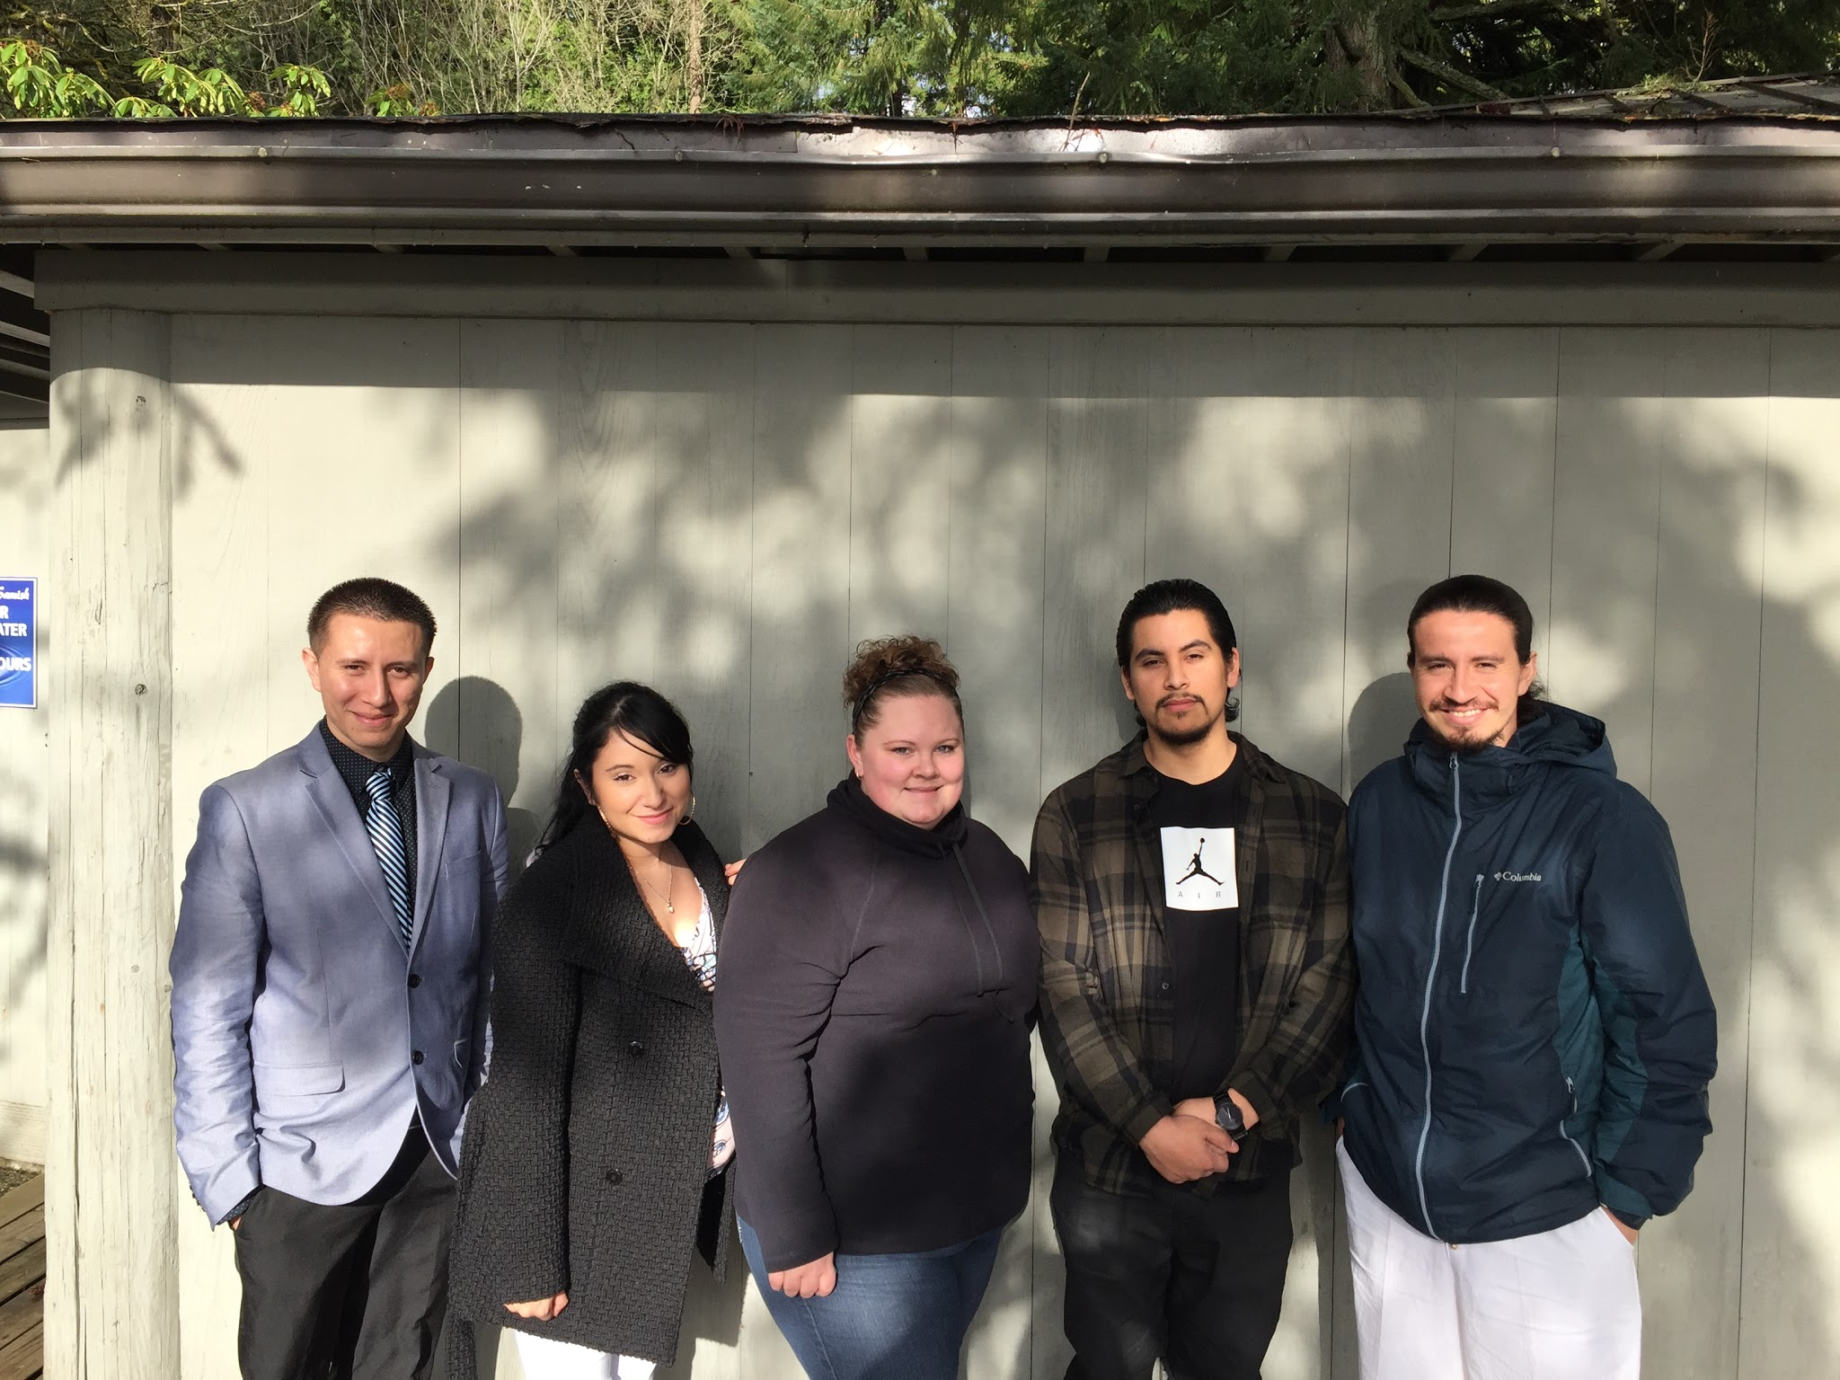
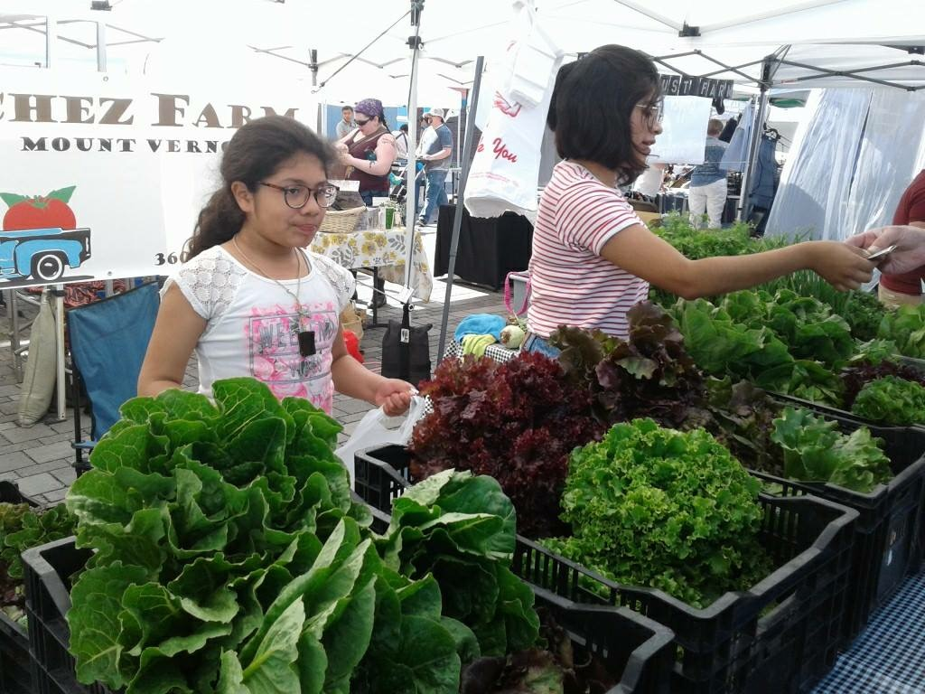
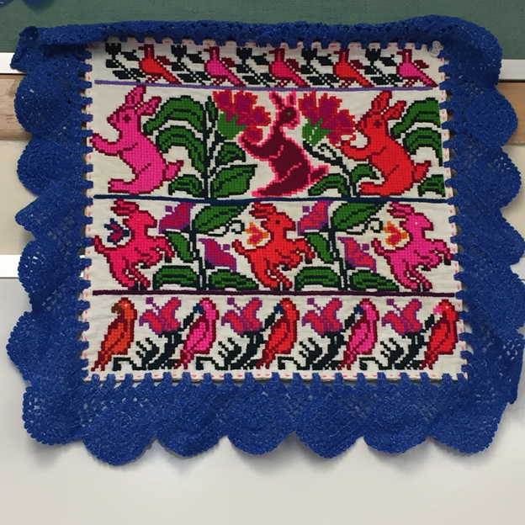
What is “Funds of Knowledge”?
5
1
3
7
6
2
4
Notes:
AMANDA

Slide 35


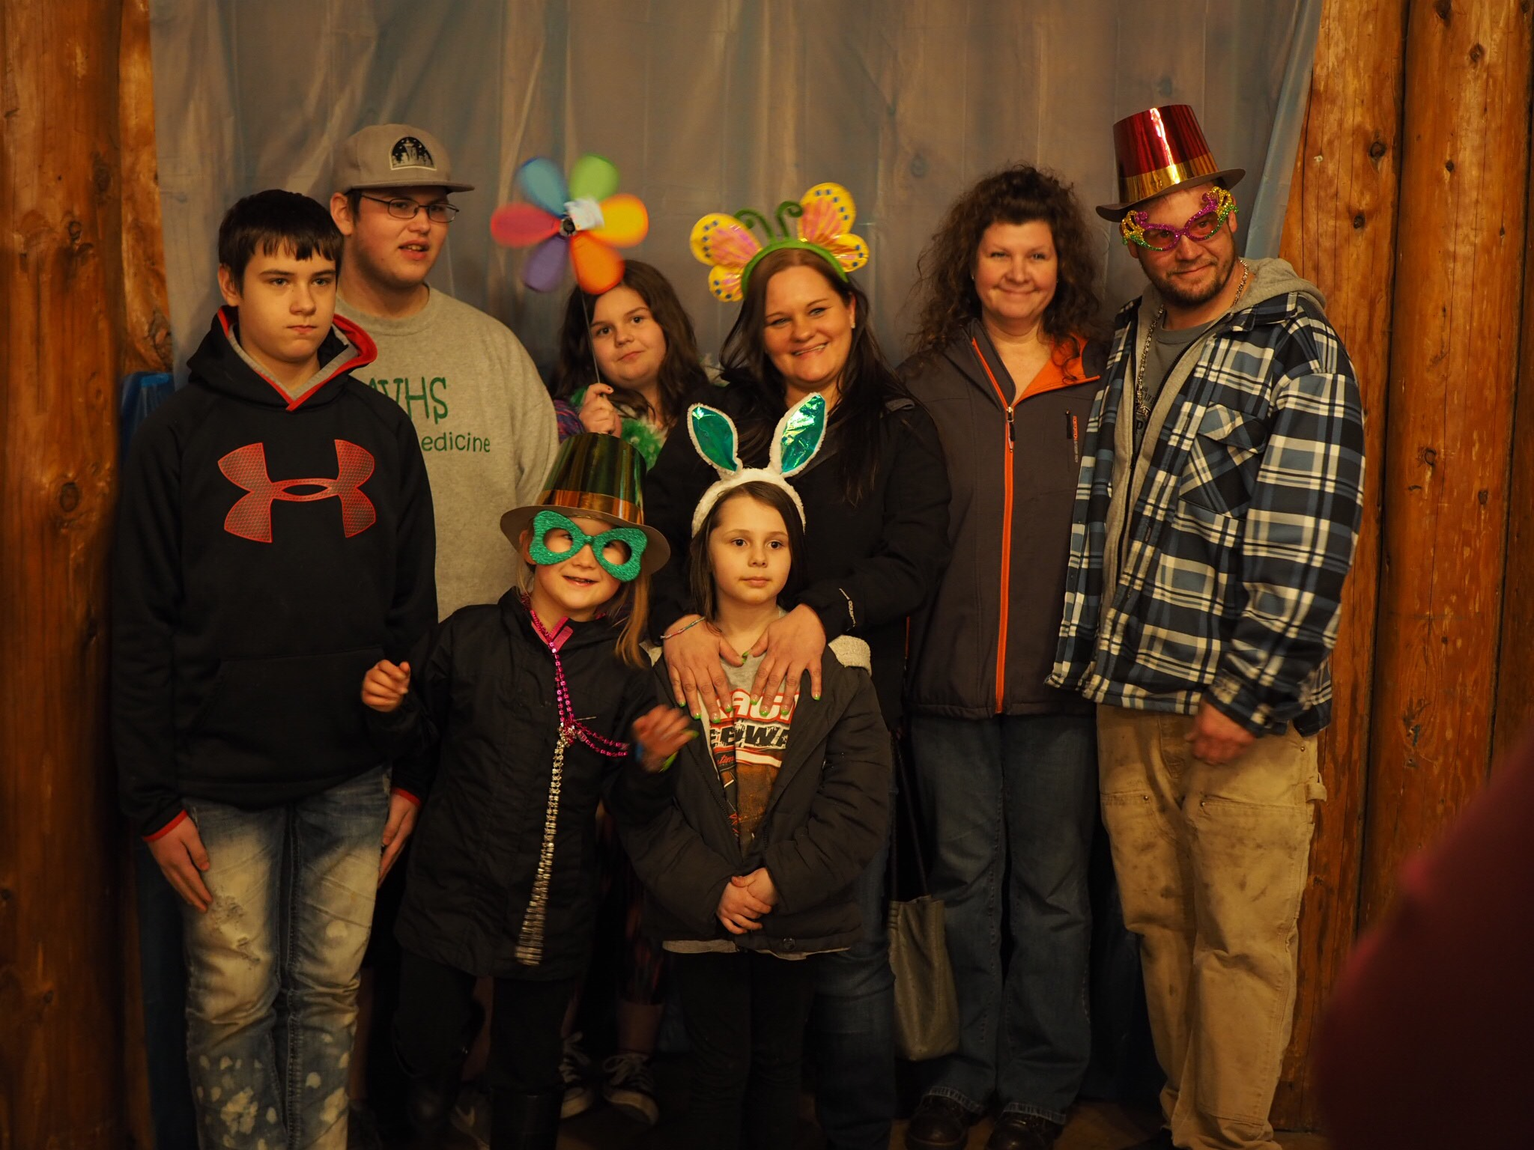
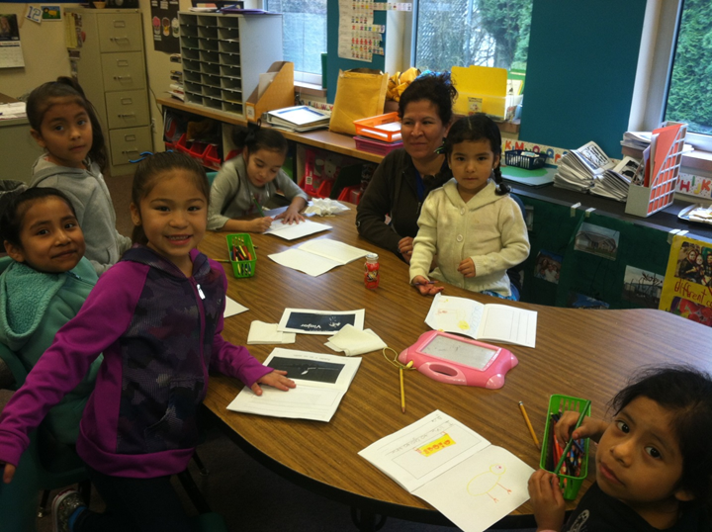
How do we learn our families’ stories?
Neighborhood visit
Welcome families and students
Invite families to a school event
Deliver gifts during December
Family visit to selected student(s)
Notes:
AMANDA

Slide 36


Reflection - How do you connect with families?
Think of a particular family
What “Funds of Knowledge” do they bring to your school?
How do we use that knowledge and those assets to increase student learning?
What else would I still like to know about this student and/or their family?
Share your favorite experience with a “stranger
from across the crowded room” about this specific
student and their FUNDS OF KNOWLEDGE.
Notes:
AMANDA

Slide 37
What do my NEWCOMERS need right now?
Notes:
Sarah

Slide 38
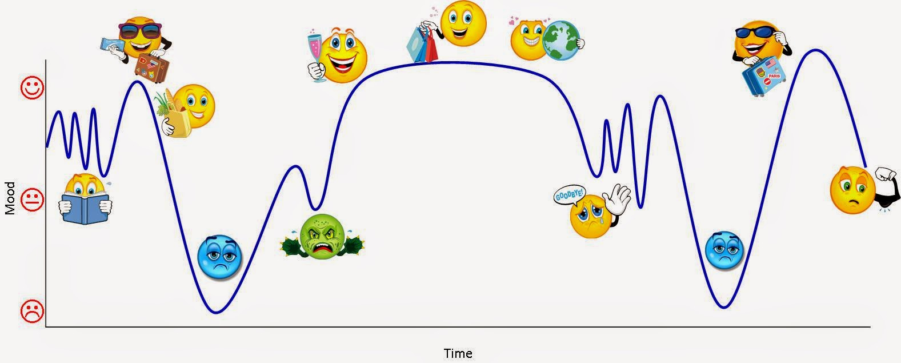
Stages of Culture Shock
Notes:
Sarah
Think of a student you have right now - share an example with an elbow partner

Slide 39
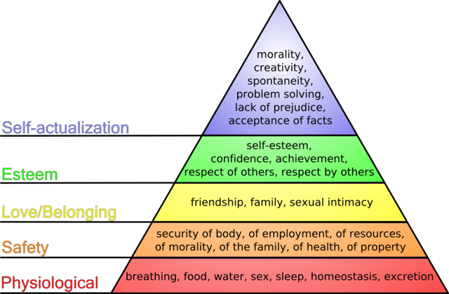
Where are my NEWCOMERS right now?
Notes:
Sarah share some background about Maslow’s hierarchy - look for a video about this phenomenon- try for secondary newcomer example (maybe about refugees. At very least a quick reference or article to show where this comes from.

Slide 40
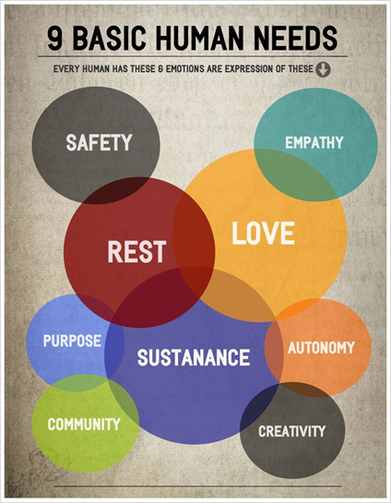
Another way to look at this!
There has been some additional thinking about Maslow’s hierarchy since its original conception.
What do you notice about this graphic, in contrast?
Why do you think it’s organized in this way?
https://www.google.com/search?q=9+basic+human+needs&rlz=1C1GGRV_enUS748US748&source=lnms&tbm=isch&sa=X&ved=0ahUKEwju3czU0tbdAhWeCTQIHQtODf0Q_AUIDigB&biw=1024&bih=679#imgrc=xTIdmYFfhYLddM
Notes:
Sarah

Slide 41
Next Steps…..
Notes:
Sarah
During the 7 hours a day we are with our students, what can I do to ensure that their basic needs are met and they are moving into a place where they can learn.

Slide 42
Reflection Questions
Who are my Newcomers right now?
What connections have I made with them within the last week?
What are some areas of excitement for my students?
What are some areas of needed support for my students?
Discuss at your table what are some of the things that you’re thinking about now.
Be prepared to share your ideas about what you want to do when you get back to school.
Notes:
Sarah
Discuss at your table what are some of the things that you’re thinking about now. Be prepared to share your ideas about what you want to do when you get back to school.

Slide 43
US DEA Newcomer Toolkit
https://www2.ed.gov/about/offices/list/oela/newcomers-toolkit/ncomertoolkit.pdf

Slide 44
Session #1 - Who are my students and what do they need?
I can identify stages of, and approaches to, language acquisition through the lens of my own students.
I have a plan to engage with my students and their families in a way that prepares them for success for the school year.
I am developing a professional network with one another to support ongoing learning, sharing, and collaboration.
Notes:
SArah
Ask participants to show fist to five, how well to the feel like they can do the second learning target/success criterion

Slide 45
“Paraeducator Pen Pals”
Notes:
AMANDA

Slide 46

Make 4 “Business Cards”
Name
Position
Grade Level(s)
School District
Email
When working with my EL students, I think I do a great job at _______________ and _______________________.
Notes:
AMANDA

Slide 47
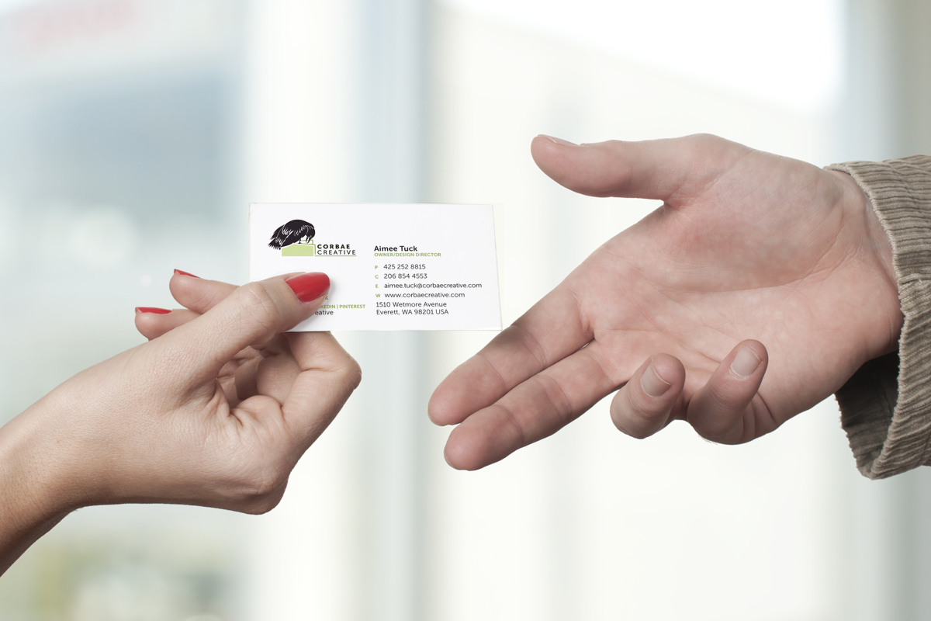
Give One, Get One
Find someone, then trade business cards and share your name, your role, and what you’re good at…..
From your district
In the same position or role
Same grade levels
Open meet and greet
Notes:
AMANDA
Find a partner based on our grouping, then they trade one business card and share your name, your role, and what you’re good at.

Slide 48
Session #1 - Who are my students and what do they need?
I can identify stages of, and approaches to, language acquisition through the lens of my own students.
I have a plan to engage with my students and their families in a way that prepares them for success for the school year.
I am developing a professional network with one another to support ongoing learning, sharing, and collaboration.
Notes:
AMANDA
Ask participants to show fist to five, how well to the feel like they can do the second learning target/success criterion
Additional questions as needed

Slide 49
Planning to share what I’ve learned.
Notes:
Sarah

Slide 50

List of Ideas
Create and Distribute Student list with Data
Share graphic of Language Acquisition Stages
Share “The Danger of a Single Story” video
Staff meeting, email, conversations, discussion with individual(s)
Share ideas around “Funds of Knowledge” and what that means for your students
Scheduling conversation with Supervisor or Work Director - utilize examples if needed
Support a colleague with a home visit
Notes:
SArah

Slide 51

Planning Template
What action do I want to take? | Why do I want to do this? | Who do I need to connect with? | By when will I make this happen? | What will be the impact for students and families?
Notes:
SArah

Slide 52

THANK YOU!
Sarah Southard - NWESD 189
ssouthard@nwesd.org
Amanda Rodriguez - MVSD
amandarodriguez@mvsd320.org
Notes:
Sarah

Slide 53

Exit Slip
Today I really enjoyed…..
Today I was hoping to learn more about…..
Something that got in the way of my learning was…..
Something I want to try before our next session is…..
Notes:
SArah

