Slide 1
EL Cooperative PLC
February 14th, 2017
8:30-3:00

Slide 2
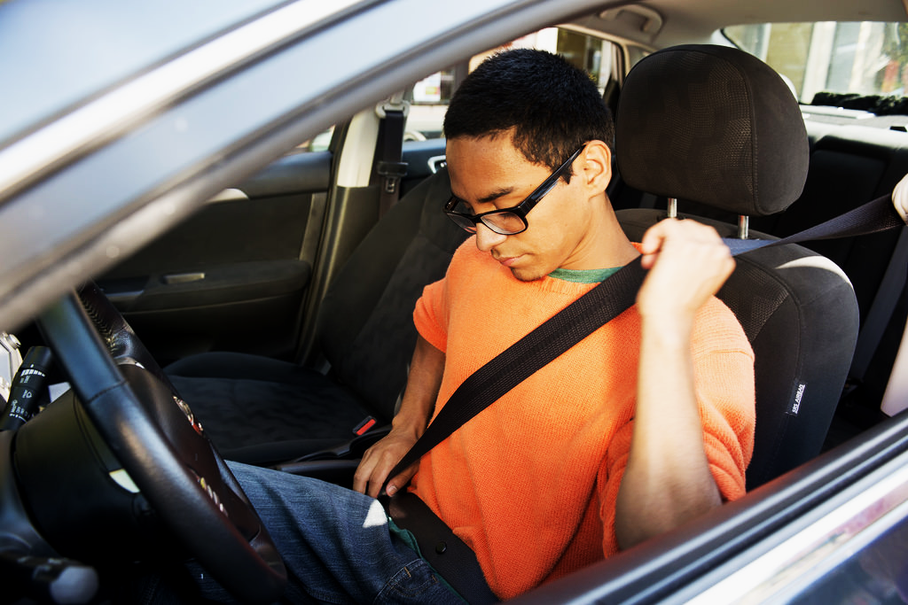
Buckle up your seatbelts!

Slide 3
Revista del Cooperativo para EL
Hasta ahora este año...
EL COOP PLC 1
Formación de especialistas 1: Adquisición y desarrollo del idioma
Formación de maestros 1: Adquisición y desarrollo del idioma
Formación de especialistas 2: Participación estudiantil
Formación de maestros 2: Participación estudiantil
EL COOP PLC 2
Lo que todavia esperamos...
Formación de especialistas 3: Lenguaje académico
Formación de maestros 3: Lenguaje académico
EL COOP PLC 3
Notes:
8:45-8:50

Slide 4

Agenda
8:30-11:30 Administradores y Especialistas
11:30-12:00 Almuerzo
12:00-3:00 Administradores con Gayle Everly
Reunión del Consejo de Cooperación
Especialistas con Sarah Southard y Anne Jones

Slide 5
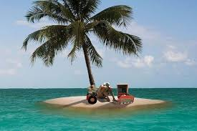
Introducciones: CHEQUEA & CONECTA
En las mesas, tomen turnos compartiendo su respuesta a la pregunta para chequea y conecta:
Si estuvieras varado en una isla desierta, ¿cual 3 OBJETOS traerías contigo?
Notes:
8:30-8:45
Anne, Sarah and Gayle model
ASk a few to share out

Slide 6
Let’s Explore
In your team, discuss whichever question(s) speak to you for the next 7 minutes:
How well were you able to understand and participate in the opening of our workshop? Why?
How do you currently feel about your ability to speak, listen, read and write? Why? Is it different than how you felt before we started?
What about the design and delivery made it easier or harder for you to understand and participate?
Who had privilege in the context that we created? Who was able to use their full linguistic repertoire?
What else could we have done to ensure that everyone could understand and participate?
How does this connect with the experiences of our English learners?
Notes:
Sarah
8:50-9:20

Slide 7
Groups’ Reflections

Slide 8
The Wisdom of Roberto Dansie
LOCAL

Slide 9
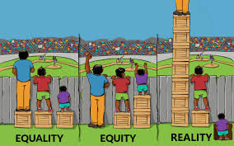
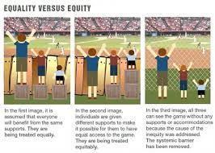

How are these pictures like or unlike our school contexts for EL Students?

Slide 10
Introductions: CHECK & CONNECT
At your tables take turns sharing your answer to the CHECK & CONNECT question:
If you were stranded on a deserted island, what 3 OBJECTS would you bring with you?
Notes:
8:30-8:45
Anne, Sarah and Gayle model
ASk a few to share out

Slide 11
Agenda
8:30-11:30 Administrators and EL Specialists
11:30-12:00 Lunch
12:00-3:00 Administrators with Gayle Everly
EL Specialists with Sarah Southard and Anne Jones

Slide 12
EL COOP Review
SO FAR THIS YEAR...
EL COOP PLC 1
EL Specialist Training 1: Language Acquisition & Development
Teacher Training 1: Language Acquisition & Development
EL Specialist Training 2: Student Engagement
Teacher Training 2: Student Engagement
EL COOP PLC 2
STILL TO COME...
EL Specialist Training 3: Academic language
Teacher Training 3: Academic Language
EL COOP PLC 3
Notes:
8:45-8:50

Slide 13
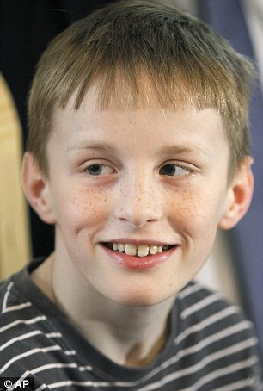
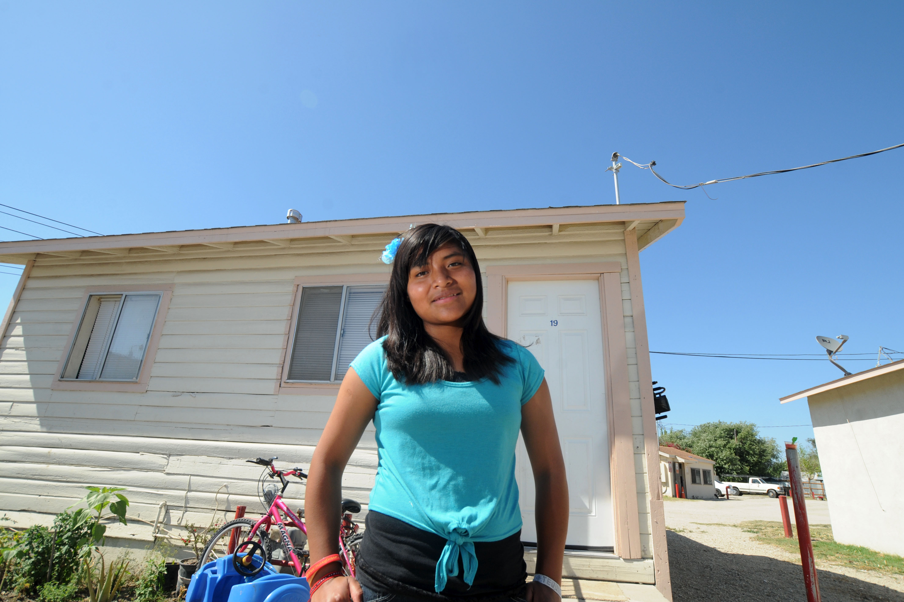
Needs and Strengths scenarios
Notes:
9:20-9:25 Anne

Slide 14
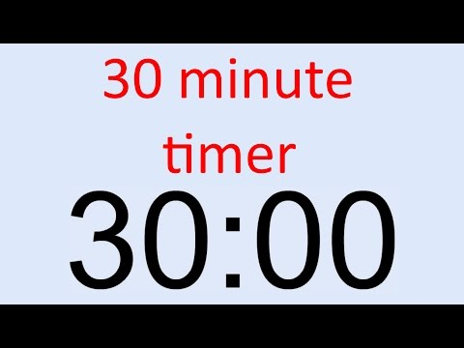
Needs and Strengths Activity
What’s going well? | How do you know? | What is a need for you? | Why is that an area of concern?
Family Engagement
Interventions
Primary Language
Newcomers
Professional Learning
Notes:
9:25- 9:55 Anne - Ask people to include their district’s name next to strengths that they’re sharing to inform our planning for the next PLC.
Spend as much time minutes at each poster, in your district team to read what’s there, reflect and record on the posters.

Slide 15

Notes:
9:55-10:05 Anne

Slide 16

Prioritize for Later
With your team, decide which 3 areas are the most important for further exploration.
Notes:
10:10-10:15 Anne

Slide 17
Topic conversations
As a district team, choose 3 topics you would like to learn about.
Join a table discussion for the next 20 minutes.
Primary Language
Family Engagement
Professional Learning
interventions
newcomers
Notes:
10:15-11:15 Anne

Slide 18

5 Topics - Artifact Box
Assign a timekeeper.
Find a resource in the Artifact Box that you’d like to explore and work independently (5 minutes)
Have a discussion in your group about your topic of choice, informed by the resources that you explored and the posters at your table.
Create a visual representation of your group’s understanding.
As a team, capture some big ideas about this area on your planning document
Find a new table topic.
Notes:
Anne

Slide 19

Reflection
What are the next steps in each of these areas?
Notes:
Gayle 11:15-11:30

Slide 20

Notes:
11:30-12:00 All together

Slide 21

Canvas Training
Notes:
12:00-12:15 ESD personnel

Slide 22
Synthesizing our learning and building connections
Family Engagement
What we learned/What I am excited about... | Who is a resource?
Notes:
Anne 12:15-12:20 Share out their take-aways from each of the categories whole group
Record visually for them

Slide 23
Synthesizing our learning and building connections
newcomers
What we learned/What I am excited about... | Who is a resource?
Notes:
12:20-12:25Share out their take-aways from each of the categories whole group
Record visually for them

Slide 24
Synthesizing our learning and building connections
interventions
What we learned/What I am excited about... | Who is a resource?
Notes:
12:25-12:30 Share out their take-aways from each of the categories whole group
Record visually for them

Slide 25
Synthesizing our learning and building connections
Primary Language
What we learned/What I am excited about... | Who is a resource?
Notes:
12:35-12:40 Share out their take-aways from each of the categories whole group
Record visually for them

Slide 26
Synthesizing our learning and building connections
Professional Learning
What we learned/What I am excited about... | Who is a resource?
Notes:
12:45-12:50 Share out their take-aways from each of the categories whole group
Record visually for them

Slide 27
Deepening Conversations
Take a card.
If you have a black card you will be a learner first. If you have a red card you will be a resource first.
Go to the area where you want to learn or share.
Share for 10 minutes, then switch to another group.
Now, if you are a red card you are a learner and if you have a black card you are a resource..
FInd your group and share for 10 minutes.
We will continue this for a total of 4 rounds.
Notes:
12:50-1:20 Sarah
Meet in groups

Slide 28
Tuning Protocol
Notes:
1:20-1:55 Sarah

Slide 29

Reflection
What is a takeaway from today that you can implement right away?
What is something that you are eager to learn more about?
What feedback can you share with us about this PLC experience (what went particularly well or what would you like to see changed for the future)?
Notes:
Sarah-2:25-2:30

