Slide 1
Student Engagement
Training of Trainers
January 24th
8:30-3:00PM
Notes:
Help people group by elementary or secondary, if that’s what they want. Could table tent accordingly.

Slide 2
Overview of Our Three Day Series
Day 1: Enhancing our understanding of:
How language is acquired and language levels
How primary language can support development of content understanding and developing additional languages
Comprehensible Input
Day 2: Enhancing our understanding of:
How to create environments where ELs are meaningfully engaged in classroom activities in which they can develop oral language and content area understandings.
Day 3: Enhancing our understanding of:
The language demands of classroom activities
The language proficiencies of our students (ELPs)
How to use scaffolds to support them in developing and using academic language in reading, writing, listening and speaking

Slide 3

Agenda:
Welcome Introductions
Learning Targets & Success Criteria
The importance or Oral Language Development
Promoting Student Engagement-Social/Emotional Environment
Lunch 11:45-12:15
Promoting Student Engagement-Physical Environment
Promoting Student Engagement-Academic Environment
Notes:
Sarah
8:40-8:45

Slide 4

Learning Targets
Success Criteria
Deepen understanding of social/emotional classroom environments necessary to actively engage EL students in classroom learning.
Deepen understanding of physical classroom environments necessary to actively engage EL students in classroom learning.
Improve awareness of the academic environments (and scaffolds) necessary to actively engage EL students in classroom learning.
I can write a quick plan for making adjustments to the social/emotional environment in my classroom to improve active engagement of EL students..
.
I can explain one way in which I will adjust my physical classroom environment to better engage EL students in classroom learning.
I can engage in discussions with my team about routines and scaffolds that are beneficial to actively engage EL students in classroom learning.
Notes:
Sarah

Slide 5


Introductions (in your group…)
If you could have a talent right now, without any practice, what would it be and why?
Notes:
Sarah
8:45-8:50- use timer
Use name picker to get a couple people to share

Slide 6
Equity- Who has the language of leadership in the classroom?
In your group, discuss how the reality of these two statements creates challenges for English learners in school and in their lives beyond k-12:
“The art of communication is the language of leadership.” - James Humes 34
“It is virtually impossible to express oneself in a new language without making mistakes and being exposed to ridicule.” –Fisher, Frey, Rothenberg, 2008
Notes:
Sarah-

Slide 7
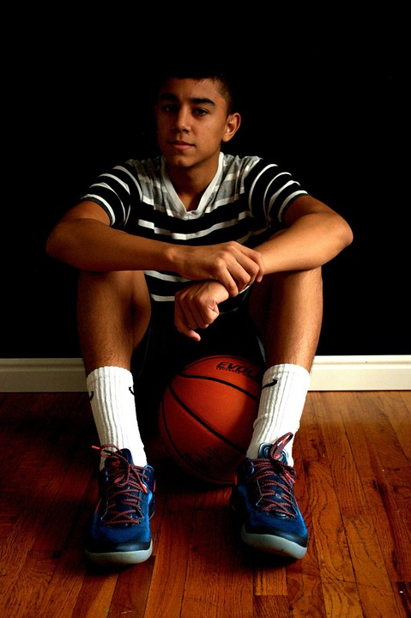

How do we support Juan to develop the language of leadership?
Meet Juan. He is:
13 years old
Was born in the US
Speaks Spanish at home
Scored 2s, 3s and 4s on his ELPA last Spring…
What are important aspects of learning environments that will engage him?
Notes:
Juan is very popular with his peers, he plays sports and is very involved in school and extracurricular activities. His teachers sometimes ask why he is still an “ELL” since his English doesn’t have an accent and he doesn’t speak in Spanish with his siblings or read or write in Spanish. Juan is the 3rd child in his family and when he came to school, he had already been exposed to a lot of English from his older siblings, TV, and his neighborhood. Spanish is starting to become a minority language in his home, making meaningful communication with his monolingual Spanish parents difficult. You could say the Juan’s first language was really bilingual.

Slide 8

How do we support Mai to develop the language of leadership?
Meet Mai. She is:
10 years old
In her first year in the US
She speaks Vietnamese at home
She scored 1s and 2s on her WELPA this fall…
What are important aspects of learning environments that will engage her?
Notes:
Classroom scenario
My classroom phone rang, and the secretary told me the custodian was bringing down an extra desk because I was getting a new student. The secretary came down with my new student, Mai, her mother, father, and two younger siblings. Mai looked nervous as the secretary introduced me to she and her parents in Vietnamese. I told her I was excited to have her in our classroom and asked her if she wanted to hang up her jacket and go see her new desk. Blank stares and no response. The secretary immediately translated, and we headed into the classroom. She explained to me that the parents wanted Mai in English instruction all day because they felt this was the best and fastest way to learn to speak English.
I welcomed Mai into my room, and thankfully, even though she was in the silent stage, many of my students were fluent in Vietnamese so she was able to begin building relationships with her peers. During the first couple of weeks, she felt comfortable speaking in Vietnamese with her peers, and was only using English to meet his basic needs like using the bathroom.
During literacy time, I continued reading aloud and facilitating discussion about books. I encouraged students to volunteer to participate in both discussions and reading aloud. Mai began sharing and talking with her peers in partner and small group discussions by the fourth week she was in my class.
After a couple weeks of feeling comfortable sharing in small group and observing her peers share in a whole group setting, Mai also began contributing to the whole group discussion. In order to set her (and other students) up for success, the opportunities to share whole group were always preceded by discussion and practice with partners and/or small group. The ability to discuss and rehearse responses allowed for students to feel comfortable and confident during their whole group participation.

Slide 9
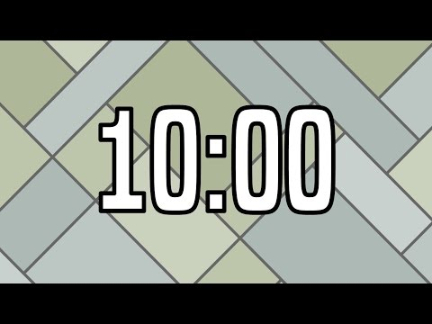
What does student engagement look like?
Consensus Board:
Set Up:
Fold paper into Quadrants, fold middle into triangle, outline folds
Title middle diamond: Group Consensus Statement
Decide on A, B, C, D partners
Consensus Roles::
Partner A: Coordinator
Partner B: Encourager
Partner C: Recorder
Partner D: Reporter
Consensus Process:
Everyone shares out
Using a sentence frame, the team decides on one sentence together
Continue with new question and new roles
We have come to the consensus that student engagement looks like _____ .
Notes:
Anne
till 9:10

Slide 10
Student engagement looks like...
Active listening, participation in various forms (pictorial, physical and written) and interacting with others relative to the topic
All students actively learning by listening questioning and sharing with each other. Students are using different learning styles: visual, kinesthetic and auditory and they’re encouraging and helping each other.
students are happily participating with effortless focus and are shocked and disappointed when the bell rings.
contains speaking, listening, fun and intrinsic motivation, accepting different ideas in a safe space.
using all of your senses for cognitive and purposeful learning. Students taking ownership of their learning and problem solving.
Active learning, targeted participation and differentiation.
On-task collaboration and/or reflection.
STudents collaborating by talking, sharing, doing, questioning, etc. It’s messy and sometimes noisy.
When students are participating in their own wonderings.
Notes:
Anne

Slide 11
How can we know that Juan and Mai are actively engaged in learning?
Depends on the learning target- need to decide ahead of time what the evidence of learning will be
Mai- actively listening, maybe talking with peers in her own language
Juan- actively participating
Mai- body language, cueing in to see if she’s nodding her head, eyes on the speaker and attentive
Juan- ask him for help.
Mai- drawing pictures and talking to their peers.
Notes:
Sarah

Slide 12
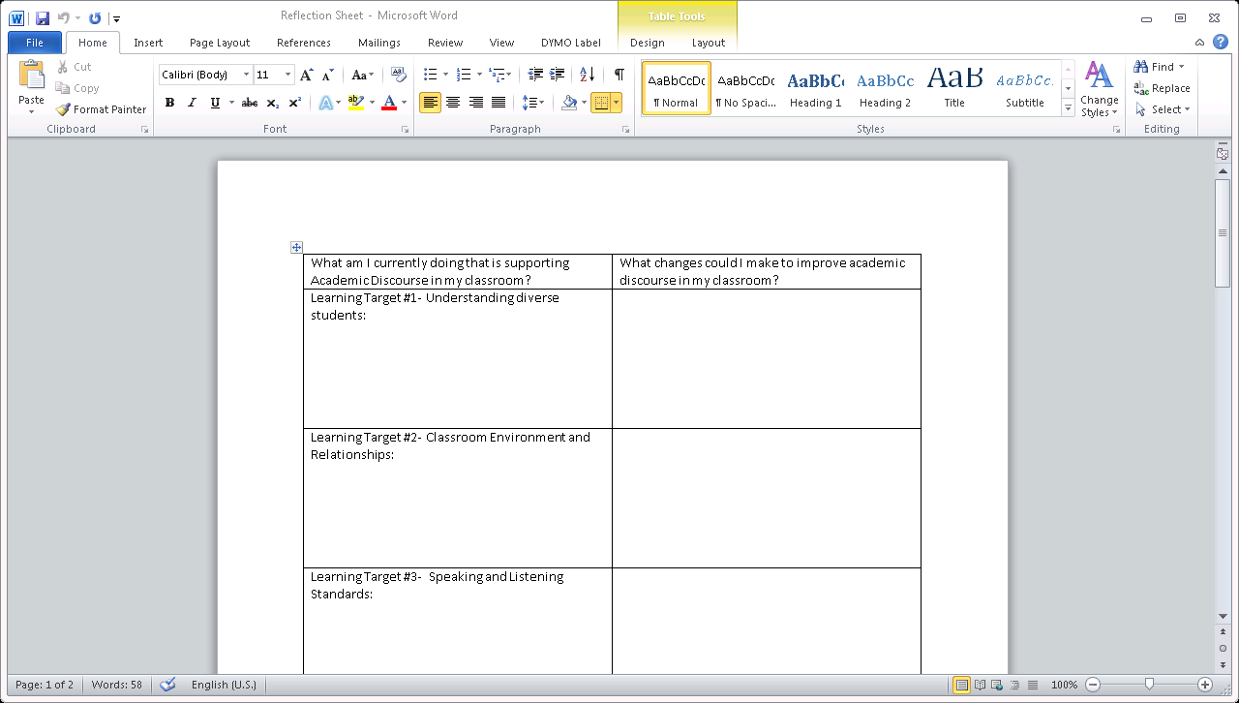

Reflect on your current practice (left side only) individually and share one thing with your group.
Notes:
Sarah

Slide 13
Learning Targets
Success Criteria
Deepen understanding of social/emotional classroom environments necessary to actively engage EL students in classroom learning.
Deepen understanding of physical classroom environments necessary to actively engage EL students in classroom learning.
Improve awareness of the academic environments (and scaffolds) necessary to actively engage EL students in classroom learning.
I can write a quick plan for making adjustments to the social/emotional environment in my classroom to improve active engagement of EL students..
.
I can explain one way in which I will adjust my physical classroom environment to better engage EL students in classroom learning.
I can engage in discussions with my team about routines and scaffolds that are beneficial to actively engage EL students in classroom learning.
Notes:
Sarah

Slide 14
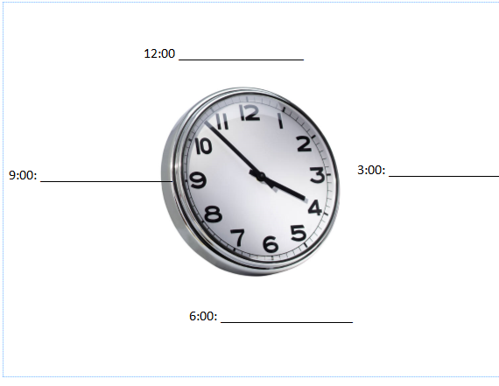

As we’re transitioning, please fill out your appointment sheet. Be sure to share your middle name or nickname with each of your new partners.
Notes:
Anne

Slide 15


Slide 16

Please Thank Your Partner and Take a 10 minute break
Notes:
Anne

Slide 17

Find your 9:00 partner
Notes:
Anne
Primary
Intermediate
Middle
High
Math
ELA
Science
Social Studies
Specialists
Reflect on survey results

Slide 18
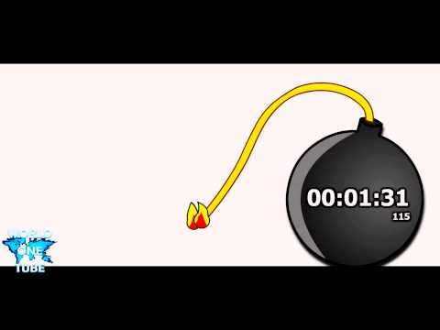
Classroom Environment
_____would help students feel safe because ____________.
The use of ______ creates conditions for students to safely engage because ___ .
Social/Emotional- Affective Filter
Norms
Status and Expectations
Community building/
Relationships
Physical
Arrangement of furniture and anchor charts
Flexible seating (to facilitate flexible grouping)
Academic
Collaboration vs. Cooperation
Routines and Scaffolds
Grouping for conversations
Notes:
Anne

Slide 19
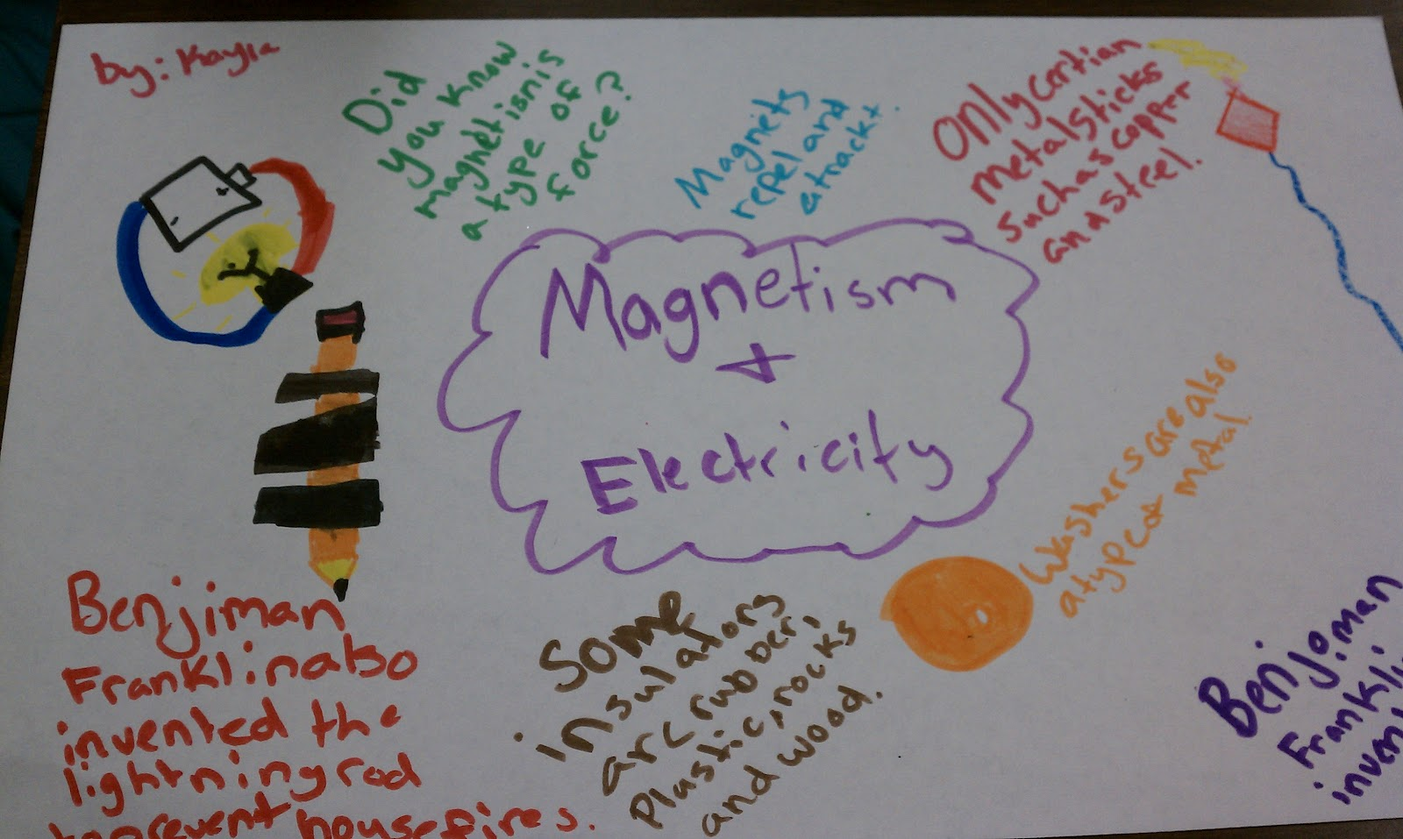

Graffiti Wall
Work in teams of to create a graffiti wall.
Record your work independently-recording your thoughts using graphics, words etc.
When everyone has completed their part, share your thinking.
Which Supports for Developing a Social/Emotional Environment for engagement seems to be essential for your students’ success in the classroom?
Notes:
Anne
norms

Slide 20
Supports for Developing a Social Environment for Talk
-Explicit and well-practiced expectations around mistakes and approximations
-Classroom norms are posted and referred to (with expectations for students)
-Differentiating opportunities to produce language at a level that is appropriate for each student
-Be accepting, as unconditionally as possible. Invite all students to share without fear of judgement.
-Fear of deportation in our communities right now is impacting our students. How can we support that conversation in classrooms to support students in understanding their safety and advocacy.
-Clean slate: no grudges. Today is a new day and I won’t hold what happened yesterday against you.
-Give students a chance- treat them as individuals
-Use humor, be humble, learn about your students from your students
Notes:
Anne talk, Sarah type (norms focus)
Which of these seems to be essential for your students’ success in the classroom?
Set up norms for respect for self and others (diversity of language, culture and individuals)
Take time to build the community of learners
Get to know your students as people and as learners
Celebrate accomplishments- YEAH!!!!
High expectations for ALL students to use academic language
Share your own experiences, important things in your life
Allow students time to share their experiences
Try to connect with family members
Learn what is important to your students to try to connect them with their learning

Slide 21
Hopes and Dreams:
An Asset-Based Approach
Valuing and respecting each other
Valuing diversity
Realizing that cultural context will affect an individual’s communication and participation in education in a variety of ways
Belonging
Self-efficacy
Resilience
Notes:
Anne

Slide 22
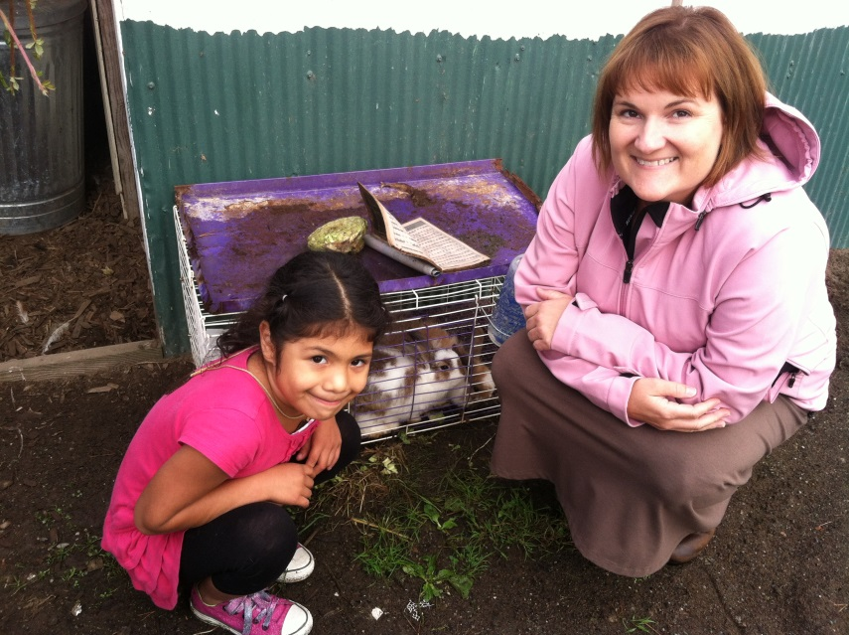
Funds of Knowledge
LUIS MOLL invites educators outside the walls of the classroom to encounter the rich and varied cultural resources within their students’ communities in order to foster educators’ understanding of these resources as strengths rather than as cultural or cognitive deficits.
nd cognitive resources and that these
Luis Moll, Cathy Amanti, Deborah Neff, and Norma Gonzalez (2001)
“Debunks the pervasive idea that linguistically and culturally diverse working-class minority households lack worthwhile knowledge and experiences.”
-Margery Ginsberg
Notes:
Anne
-Community building/RelationshipsClozed choral reading---great for identifying vocabulary, building comprehension and fluency

Slide 23
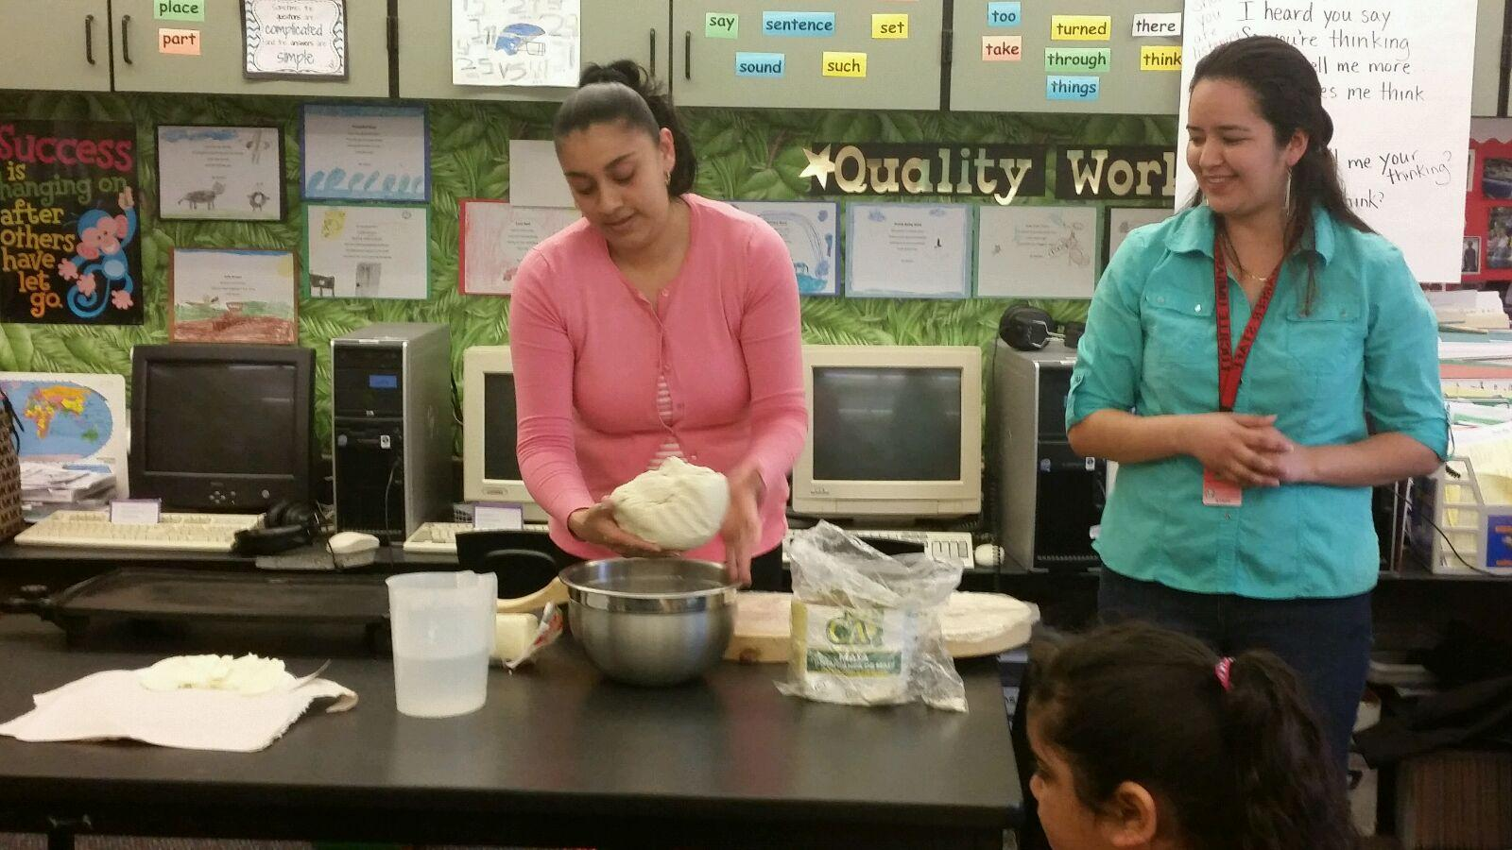

Communal Experiences
Classroom experience at the beginning of a unit to support equal access for all students.
Parent Learner Field Trips Videos
Community Learner Lesson focused on Home School Connection
Think about a lesson or a unit you have taught or will be teaching soon. How could you incorporate a communal experience to provide equitable access to the subject matter?
Think, write, pair, share your response.
Notes:
Anne-Community building/Relationships

Slide 24
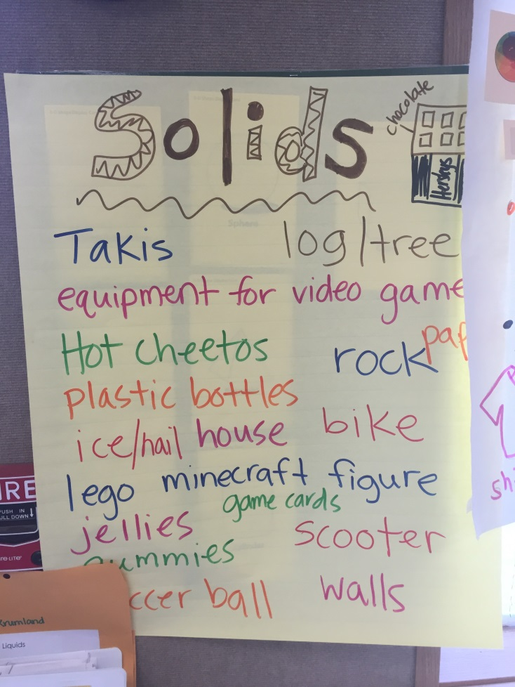

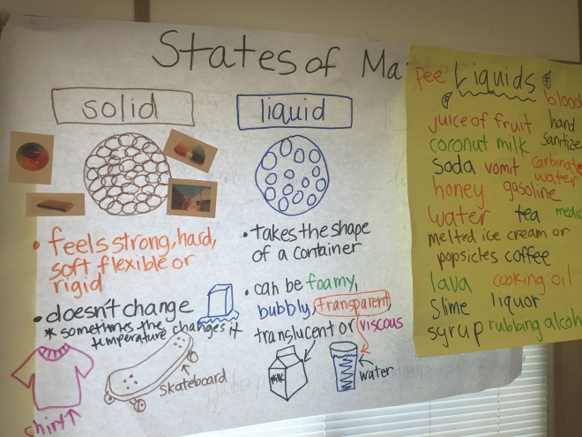
Culturally Sustaining Instruction
Community
Family
Building on students’ background knowledge
Asset based approach
Notes:
Anne-Community building/Relationships

Slide 25
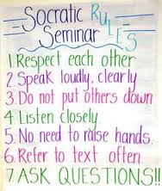
Socratic Seminar
The Socratic seminar is a formal discussion, based on a text, in which the leader asks open-ended questions. Within the context of the discussion, students listen closely to the comments of others, thinking critically for themselves, and articulate their own thoughts and their responses to the thoughts of others.
“to facilitate a deeper understanding of the ideas and values in the text through shared discussion•”
Notes:
Anne

Slide 26

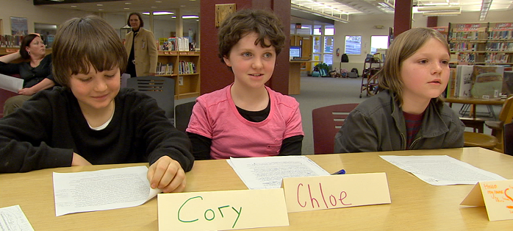
Socratic Seminar
Before the Seminar
Teacher introduces purpose
Students read the text
Review norms
During the Seminar
Teacher is seated at the level of the students
Teacher poses the key/or first question.
Participants relate their statements to particular passages, clarify, and elaborate (sentence frames)
Use Talking Legos or chips for equal voice
Summarize the main points if needed
After the Seminar
Ask debriefing questions
PrPro
Notes:
Anne
Setting Goals for the Seminar Process
GROUP GOALS
Before the seminar, ask the student to choose a group goal, such as:
Focus on ideas and values in the text.
Keep an open mind.
Invite everyone to share their ideas.
Use others’ names.
Remember that one person speaks at a time.
NOVICE GOALS
Then ask the students to each choose an individual goal. You can provide a list of goals for them to choose from. If your students are young or new to seminar, you might suggest goals like:
Look at the speaker.
Speak voluntarily at least twice.
Make clear, accurate statements.
Refer to the text.
ADVANCED GOALS
If your students are more advanced, you can suggest more challenging individual goals like:
Refer to the text and other relevant sources.
Test assumptions and explore inferences.
Acknowledge changes in your perspective.
Offer a more global interpretation of a previous statement.

Slide 27
Socratic Seminar
Break up into 4 groups
Decide roles (timekeeper, teacher)
Create your environment
Read the article, “Ten Books I Wish My White Teacher Had Read.”
Use the questions and sentence frames to support your discussion.
Use Talking Legos if desired
Notes:
Anne-Community building/Relationships
Crystal Paul
@CPLHouseFreelance writer, editor, geek. Oakland, CA

Slide 28
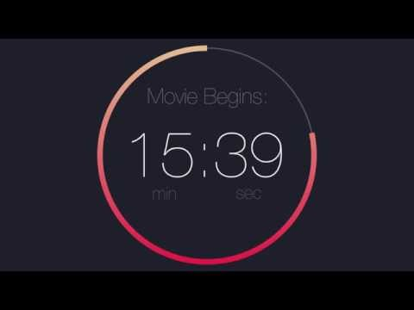
How do the ideas in the text relate to our lives?
What do they mean for us personally?
Why is this material important?
Do you agree with the author? Why or why not.
What is the main idea or underlying value in the text?
What is the author’s purpose or perspective?
What is the most important word, sentence or paragraph?
Notes:
Do you feel like you understand the text at a deeper level? How was the process for us? Did you achieve your goals to participate? What was one thing you noticed about the seminar?
Who has a different perspective? Who has not yet had a chance to speak? Where do you find evidence for that in the text? Can you clarify what you mean by that? How does that relate to what (someone else) said? Is there something in the text that is unclear to you?

Slide 29


Slide 30

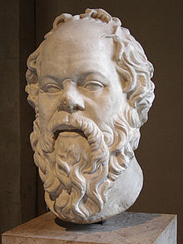

Socratic Seminar vs. Fishbowl
All students face
each other and participate
in the discussion
related to text
Teacher prepares
questions and
then the students
add
students sit in a
fishbowl configuration
One group talks while
another group listens,
then switch
Usually related to a topic
Students prepare questions
Provides
opportunity
to watch the
process before
participating
use of open-
ended questions
supports deeper
understanding of an idea
oral discussions

Slide 31
Reflect on your learning individually and share one thing with your group.
Notes:
Sarah

Slide 32

Strategy Check
Notes:
Sarah

Slide 33
Learning Targets
Success Criteria
Deepen understanding of social/emotional classroom environments necessary to actively engage EL students in classroom learning.
Deepen understanding of physical classroom environments necessary to actively engage EL students in classroom learning.
Improve awareness of the academic environments (and scaffolds) necessary to actively engage EL students in classroom learning.
I can write a quick plan for making adjustments to the social/emotional environment in my classroom to improve active engagement of EL students..
.
I can explain one way in which I will adjust my physical classroom environment to better engage EL students in classroom learning.
I can engage in discussions with my team about routines and scaffolds that are beneficial to actively engage EL students in classroom learning.
Notes:
Sarah

Slide 34
Classroom Environment
Social/Emotional- Affective Filter
Norms
Status and Expectations
Community building/Relationships
Physical
Arrangement of furniture and anchor charts
Flexible seating (to facilitate flexible grouping)
Academic
Collaboration vs. Cooperation
Routines and Scaffolds
Grouping for conversations
Notes:
Sarah

Slide 35
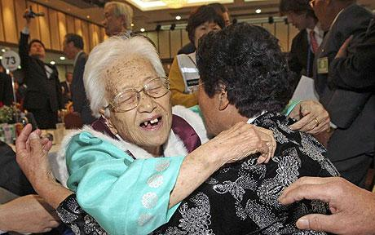
Find your 3:00 partner
Notes:
Sarah
Primary
Intermediate
Middle
High
Math
ELA
Science
Social Studies
Specialists
Reflect on survey results

Slide 36

How might clear expectations help students feel safe to engage in classroom activities and discussions?
How might this be an equity and status issue in classrooms?
Conversation: Can students converse during this activity? About what? With whom? For how long?
Help: How do students get your attention for help? How do students get questions answered? What should they do while they wait for you?
Activity: What is the expected end product of this activity? What is the task or objective?
Movement: For what reasons can students get out of their seats during this activity? Do they need permission to do so?
Participation: What behavior shows that students are participating or not participating?
Success: There are no questions for this one. When CHAMPs expectations are met, students will be successful.
Notes:
Sarah- focus on status and Expectations

Slide 37



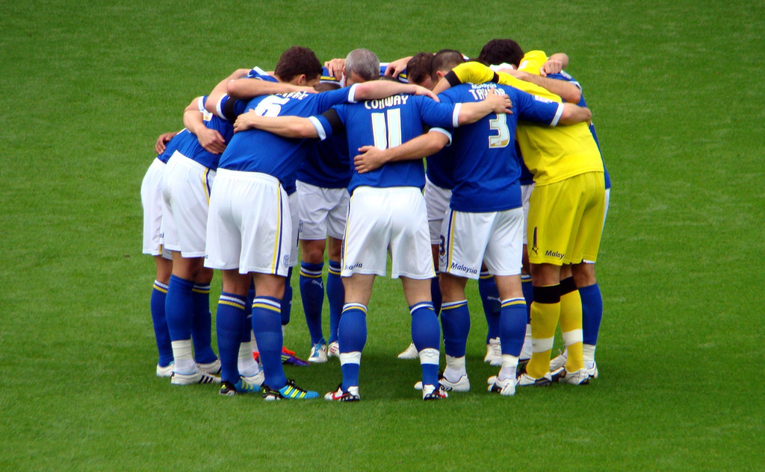


Let’s try it out!
CHAMP for 3-Chart Activity
C
H
A
M
P
S
Conversation: Talk quickly with your partner to generate ideas. Use a level 2 voice.
Help: Ask your partner first, then raise your hand, if teacher help is needed. While you’re waiting, continue to engage in the discussion.
Activity: Generate ideas with your partner, individuals will report out when asked.
Movement: Huddle with your partner. You may leave the pair if you need to take care of personal needs. You do not need to ask for permission.
Participation: Engage in the discussion and share your ideas. They’re worth sharing! Everyone’s voice should be heard.
SUCCESS: You have a better understanding of what engaging classrooms are!
Notes:
Sarah-focus on status and expectations

Slide 38
T-Chart for Social Skills- Engaging Classrooms for ELLs
Look Like:
heads together and mouths moving
laughing
order or process
teacher meeting with partnerships/checking in
aesthetically challenging
smiling
Sound Like:
usage of sentence starters and frames…
I agree with… etc.
native languages
chromebooks talking back
repetition and social language
one word answers
children engaged in conversation with each other rather than teacher talk
Feel Like:
feeling safe
respected
feeling empowered and confident
tired
included
giddy
Notes:
Sarah-status and expectations

Slide 39

Please Thank Your Partner and Go Back to your Seat
Notes:
Sarah

Slide 40

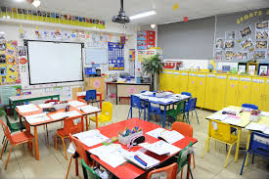
Classroom Environments-
Physical Arrangement
Find a question map that you want to explore and, with that group:
Use videos, the handout, and your own research/understandings to develop a map.
Share your ideas with your group.
https://www.teachingchannel.org/videos/desk-arrangement-for-collaboration-nea
Notes:
Sarah

Slide 41
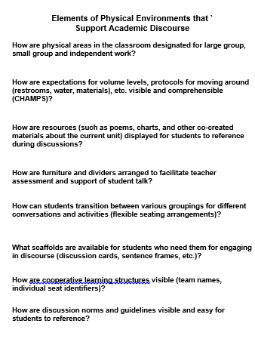
Gallery Walk/Treasure Hunt
With your “Elements of Physical Environment Reflection Sheet”, walk around the room and use the question maps from other groups to record ideas for each section.
Find your 6 o’clock partner and discuss: (3 minutes)
Which element is an area of growth for you?
3. Return to your group.
Notes:
Sarah

Slide 43
Reflect on your learning…
Notes:
Anne

Slide 44
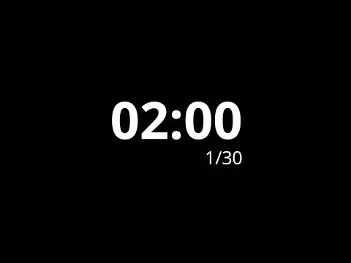
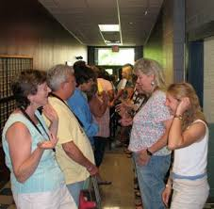
Ice Breaker
Use the number for the month that you were born.
Without talking, line up around the room beginning with January and ending with December.
SLIDE the LINE and find your partner
Share your response to the question below.
Continue down the line when indicated
Describe an environment in which you felt particularly safe or unsafe to participate in an activity.
Notes:
Sarah

Slide 45
Learning Targets
Success Criteria
Deepen understanding of social/emotional classroom environments necessary to actively engage EL students in classroom learning.
Deepen understanding of physical classroom environments necessary to actively engage EL students in classroom learning.
Improve awareness of the academic environments (and scaffolds) necessary to actively engage EL students in classroom learning.
I can write a quick plan for making adjustments to the social/emotional environment in my classroom to improve active engagement of EL students..
I can explain one way in which I will adjust my physical classroom environment to better engage EL students in classroom learning.
I can engage in discussions with my team about routines and scaffolds that are beneficial to actively engage EL students in classroom learning.
Notes:
Sarah

Slide 46
Classroom Environment
Social/Emotional- Affective Filter
Norms
Status and Expectations
Community building/Relationships
Physical
Arrangement of furniture and anchor charts
Flexible seating (to facilitate flexible grouping)
Academic
Collaboration vs. Cooperation
Routines and Scaffolds
Grouping for conversations
Notes:
Sarah

Slide 47

Surfacing Background Knowledge
On a sticky (of your table’s color) write down your favorite routine or scaffold that gets students talking in your classroom.
Put your sticky on another team’s table ONLY if they don’t have a sticky of your color, or the same strategy, already.
Return to your seat and talk with your teammates about which routine or scaffold you liked best and why.
We’ll collect these to add to resources for teachers.
Notes:
Anne- Remember to collect at the end

Slide 48

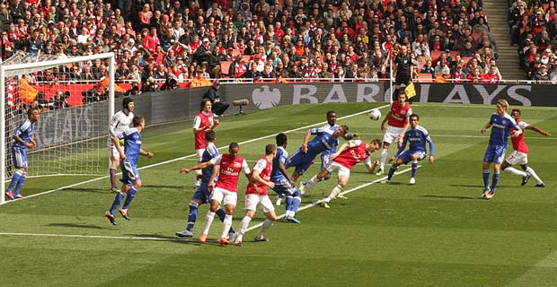
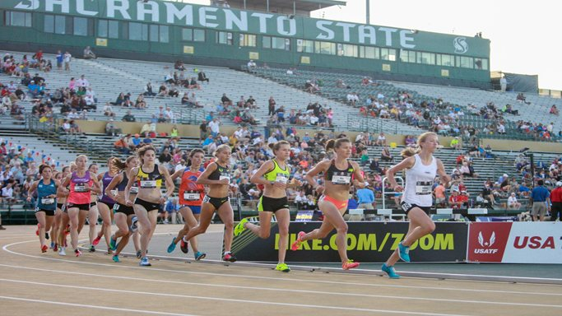
Groupings for Academic Conversations
When are classroom conversations like a soccer game and when are they like a track meet?
Discuss the first synectics and then generate a list with your team of the groupings you use in your classroom.
Notes:
Anne- Synectic:
Teams generate the list:
- -Pairs
Triads
Small Groups, Teams (4-6)
Whole group
1 on 1 with the teacher
Multiple partners in succession (stand up, hand up, pair up)
Individual to pair to quad.

Slide 49
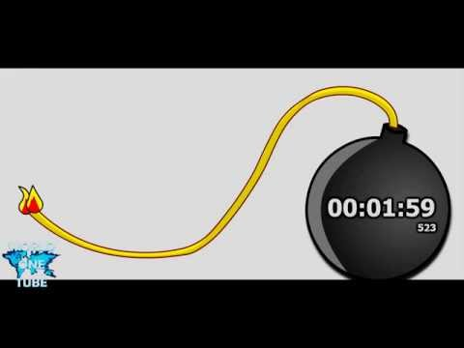
Random Participation Strategies
When does TPS go wrong?
What supports do students need?
Think
Pair
Share
Scaffolding for body
Language scaffolds for output
(sentence frames)
Scaffold listening
paraphrasing
accountability
Notes:
Anne
specific modeling all steps ( at all age levels)- what does your body look like, what to your eyes do, what do your ears do
Language scaffolds or sentence frames
Focus on listening and paraphrasing
accountability

Slide 50
Student Talk
Activities
Structure
Scaffolding
Student Task
The opportunity for student talk
Time
Turns
Assess
Must be clear:
What to talk about
&
How to talk about it
&
Who to talk to
Notes:
Anne

Slide 51

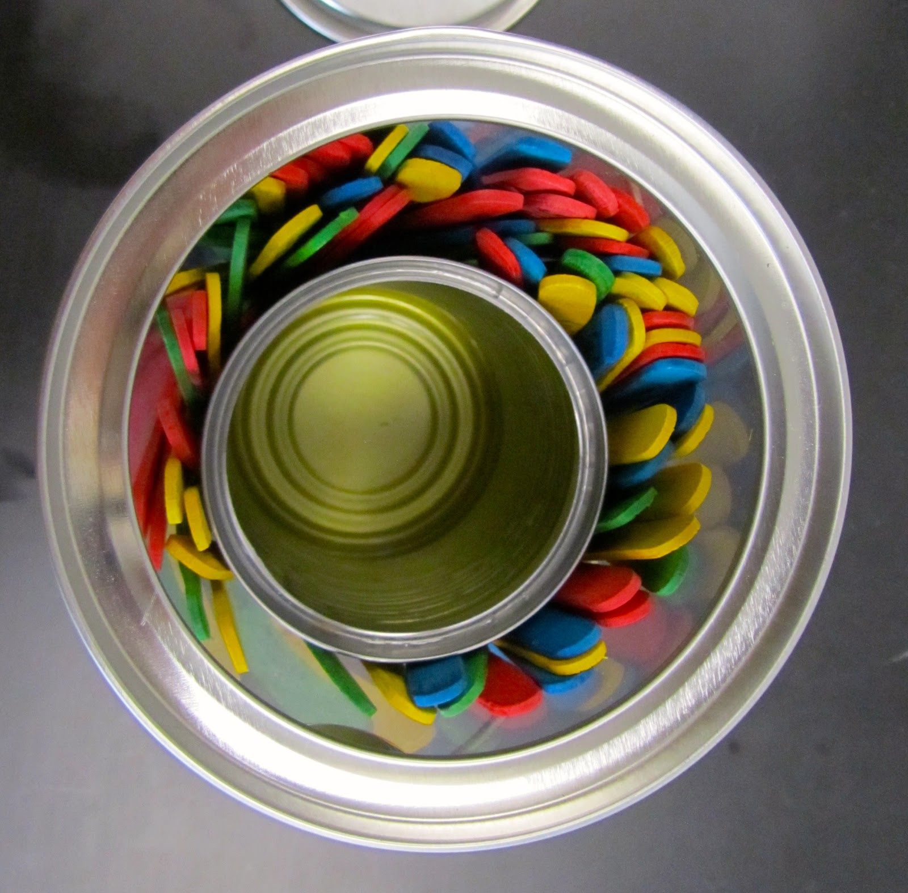
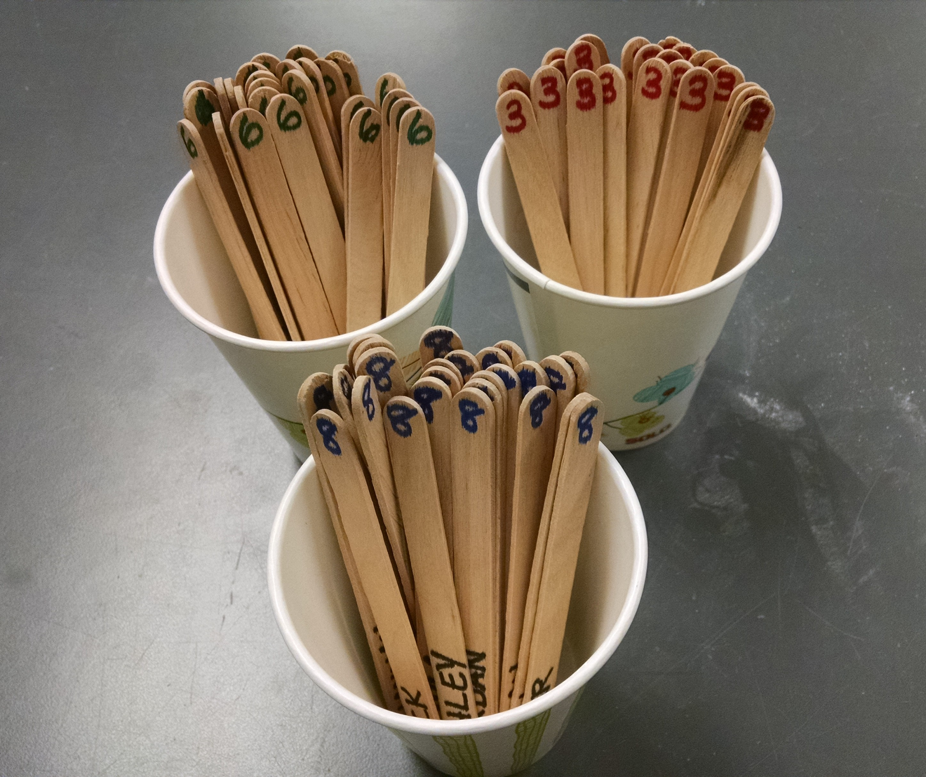
Individual Accountability:
Purpose and Options for Support
Numbered Heads Together
Popsicle sticks
Random Name Picker (app)
Cards
Dice
Notes:
Sarah

Slide 52
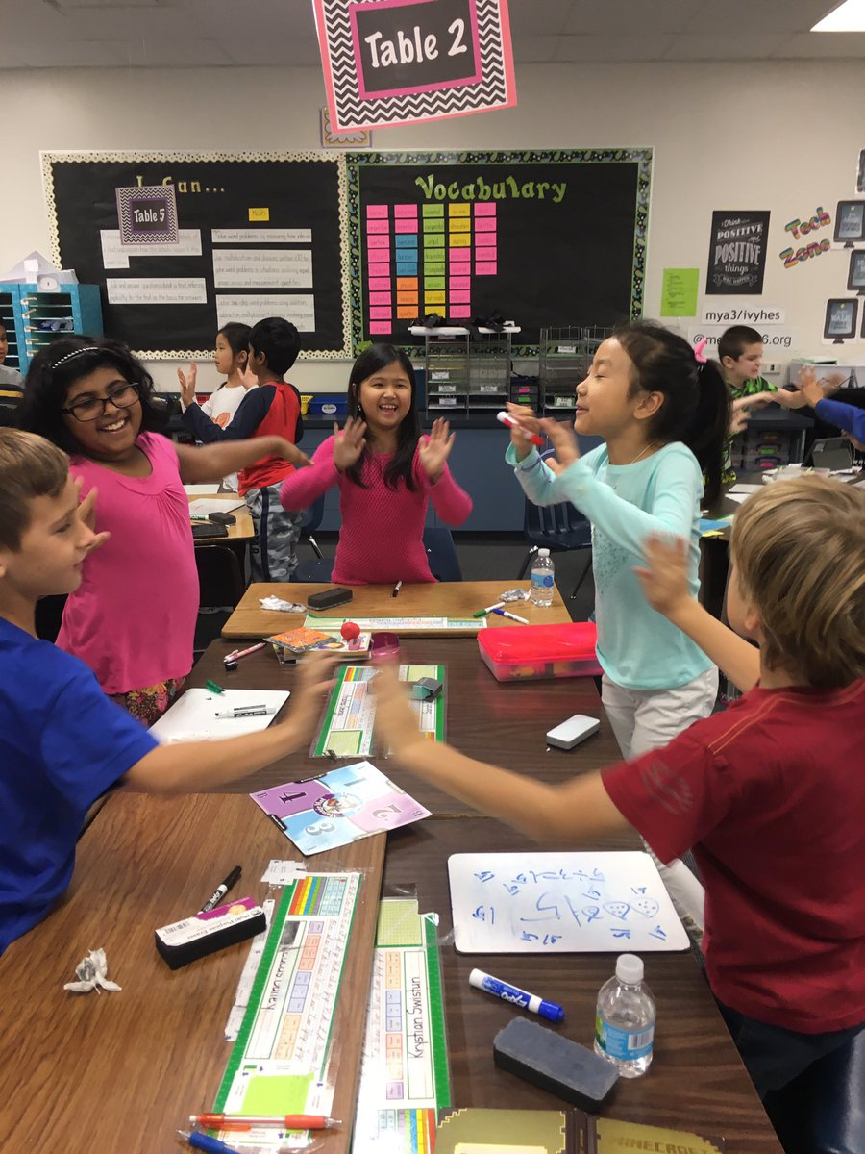
Numbered Heads Together
Number off in your teams 1-4.
Write your number down to remember it.
When it’s your team’s turn to share out, I will call a number and that person will share the team’s contribution.
Notes:
Sarah
Use numbered heads together to have a participants from most groups share out.
Write the strategy on the inventory
AWARD TEAM POINTS
FIND SCOUTS for next whole group activity

Slide 53
How can we know that Juan and Mai are actively engaged in learning?
In your group, discuss the following question:
How can it be acceptable to use random participation and individual accountability with all students?
Notes:
Sarah

Slide 54
Routines for Student Engagement-
Stand Up
For each routine,
Quickly identify potential scaffolds for English learners.
When your group has an idea, everyone stand up.
Anyone in your group might have to share the answer, so pay attention.
Turn and Talk (pairs)
A/B Partners (pairs)
Inside/Outside Circle (multiple partners in succession)
Fishbowl (Whole group)
Socratic Seminar (Whole group)
Talking Legos (Small Groups)
Numbered Heads Together (Small Groups)
Some Enchanted Evening
Line up Fold up (Pairing)
Stand up, hand up, pair up (Multiple partners in succession)
Take a side (Whole group, small group, pairs)
Four Corners (
group, small group, pairs)
Structured Academic Controversy
Notes:
Sarah

Slide 55


Talking Legos Debate
Make triads and discuss:
Which of the routines in the packet do you think is the most beneficial for English learners and why?
Protocol:
Choose one color of Legos
Put a Lego in the center every time you speak..
When you’re out of Legos, just listen to the discussion.
Use the sentence frames posted or table tents to support your conversations. (connected to 4-5 ELP standards)
Notes:
Anne TIMER responsibility- each lego should be worth a minute or less. Each group needs a time keeper
Sentence frames connected to ELA and ELP’s-- claim, evidence, counter example
An ELL can . . . participate in grade appropriate oral and written exchanges of information, ideas, and analyses, responding to peer, audience, or reader comments and questions.
An ELL can...analyze and critique the arguments of others orally and in writing.

Slide 56
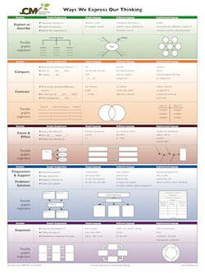
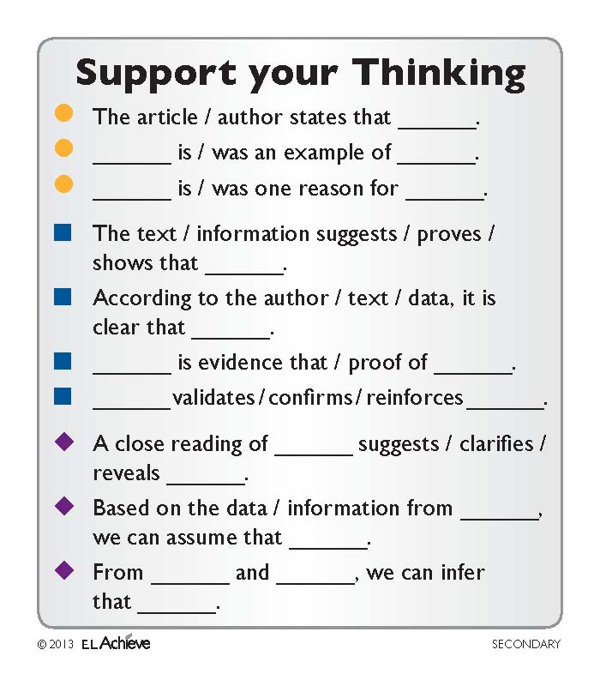
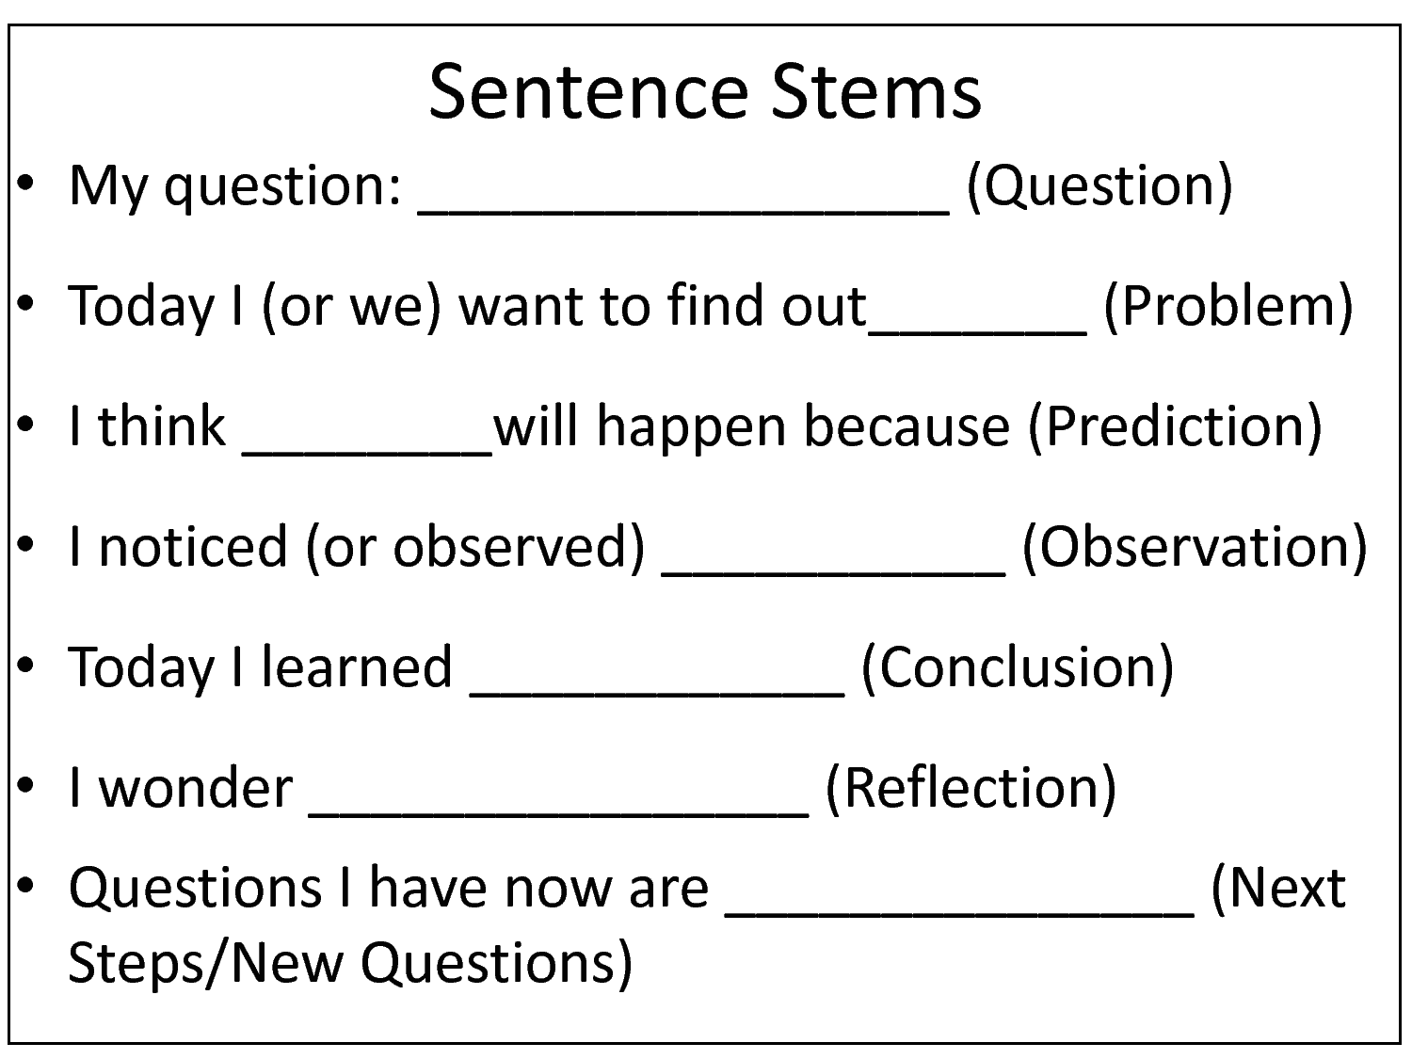
Scaffolds for Student Discourse
Frayer Model
Ways We Express Our Thinking
Discussion Cards- El Achieve
Sentence Frames
Sentence Stems
Prompts
Notes:
Anne

Slide 57
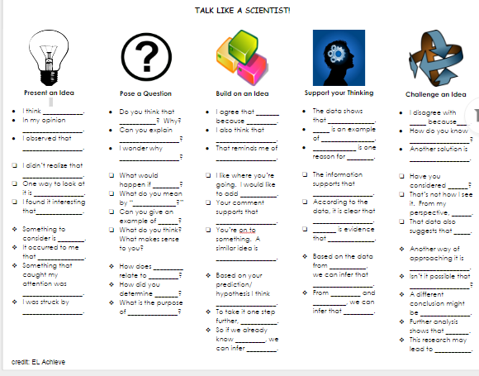
Modifying Scaffolds
Notes:
Anne- Print this off for each participant

Slide 58
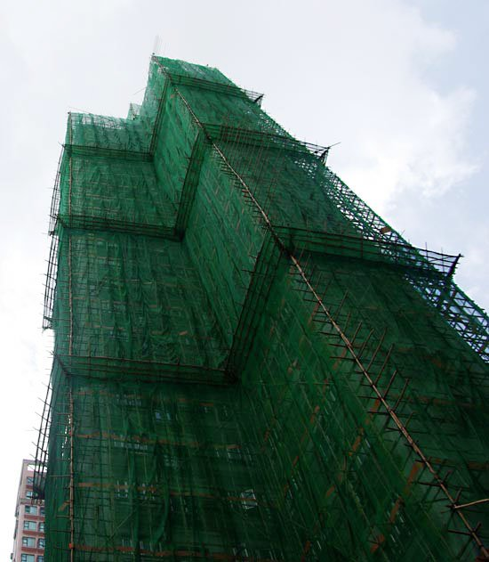

Individually or with a partner
Create some scaffolds that your students could use for academic conversations in your current unit:
Sentence frames/sentence starters
Graphic organizers
Co-created posters
Prompts for discussions
Notes:
Anne- 15 minutes
Group by grade level and content area, if desired or individually
We need resources for this--blank paper?

Slide 59
Reflect on your learning…
Notes:
Anne

Slide 60
Culminating Activity-
Reflecting on our learning collaboratively
Think about which is the most important aspect of academic language development for your students:
Physical Environment
Social/Emotional Environment
Academic Environment- Groupings/Strategies
Academic Environment- Scaffolds for productive language
Notes:
Anne

Slide 61
4 Corners Debate
Go to the corner that represents your most important aspect (physical, social/emotional, academic environment or scaffolds)
With your colleagues, capture the reasons for your belief that yours is the most important on your poster.
Provide evidence for the reasons that you come up with.
Be ready to debate with the other corners.
Notes:
Anne

Slide 62
Learning Targets
Success Criteria
Deepen understanding of social/emotional classroom environments necessary to actively engage EL students in classroom learning.
Deepen understanding of physical classroom environments necessary to actively engage EL students in classroom learning.
Improve awareness of the academic environments (and scaffolds) necessary to actively engage EL students in classroom learning.
I can write a quick plan for making adjustments to the social/emotional environment in my classroom to improve active engagement of EL students..
.
I can explain one way in which I will adjust my physical classroom environment to better engage EL students in classroom learning.
I can engage in discussions with my team about routines and scaffolds that are beneficial to actively engage EL students in classroom learning.
Notes:
Sarah

Slide 63
Thank you!
Anne Jones
Sarah Southard
ajones@be.wednet.edu
ssouthard@be.wednet.ed

