Slide 1
Migrant Convening
Service Delivery Plan
MPOs

Slide 2
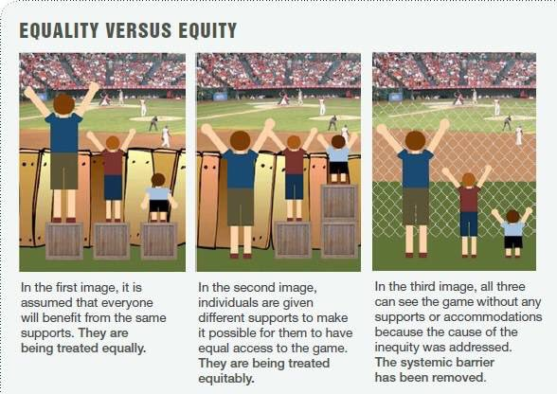

Slide 3
Guiding Question
What leadership moves do I implement to disrupt and dismantle inequitable practices and systems so that all students have equitable access to resources and achieve at high levels
How does our District/School/Program address the unique needs of our Migrant Students and Families

Slide 4
Take a minute to reflect
On one post-it note per initiative write down the “BIG ROCKS” for district, school, or program

Slide 5
Service Delivery Plan
Compacted Information, expectations, measurements …

Slide 6
Measureable Program
Outcomes (MPO)
ELA School Readiness
Math Graduation

Slide 7
Examples of NWESD Planning
ELA and Math
Let’s look at template design
NWESD Math Plan

Slide 8
MPO Brainstorming
ELA best ideas
Math best ideas
School Readiness best ideas
Graduation best ideas

Slide 9
Consensus Board
MPOs
On a piece of Poster Paper draw a circle in the middle
Then draw lines so each participating team member has a section to write
First silent, individual brainstorming
Then building consensus around the best 3 ideas

Slide 10
Sharing Ideas with each other
Please add your team’s best thinking to the wall posters

Slide 11
Revisit your Big Rocks
Which of your “Big Rocks” includes an MPO?
What matches other work you are doing that you could address Migrant student and families needs?

