Slide 1

Migrant Out-Of-School Youth/ Health Coordinator
Northwest Educational Service District 189
Notes:
Tanya Rojas
Started Two Months ago

Slide 2




Outcomes:
Understand Migrant OSY/Health Coordinator plan for Entry
Gain a deeper understanding of current barriers to accessing health services for Migrant communities in ESD 113.
Notes:
By the end of this session I’d like for all of us to share a common understanding …..
*Focus on Health

Slide 3

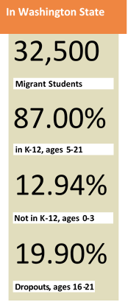
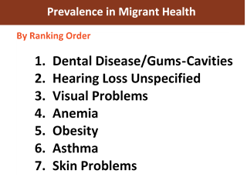
Why?
Out-of-School Youth
Family access
to healthcare

Slide 4
Step 1: Identify baseline resources and barriers by region
Steps 2: Analyze Data
Step 3: Identify initiatives and share plan for roll out
Notes:
Building Relationships
Establishing trust within community
Strategic
Trial and error

Slide 5
Western Washington Region
2
3
ESD 189
ESD 121
ESD 112
ESD 113
ESD 114
4
1
Migrant Student List Report
4,291 Migrant Students
Between ages 0-21
Notes:
Ages 0-2: 189 youth
Ages 3-21: 4,102 youth
Process of Re-designing the program
Supporting West side of Washington state
Piloting initiatives to meet needs with Trial and Error
Not experts, need strong collaboration with strong support from OSPI/ESD

Slide 6
Migrant Project-Districts
189 | Lynden Nooksack Ferndale Burlington-Edison Sedro-Woolley La Connor Mount Vernon Conway Stanwood
121 | Seattle
113 | Aberdeen Ocosta Centralia Chehalis Winlock Mossyrock Naselle-Grays
112 | Ocean Beach Ridgefield White Salmon
114 | Quillayute Valley

Slide 7
Migrant Non-Project Districts
Grays Harbor Mason Thurston Lewis Pacific | Quinault Lake Hood Canal North Mason Shelton Peninsula Olympia North Thurston Rochester Tenino North Beach Hoquiam Satsop Elma Montesano Raymond South Bend Willapa Valley Onalaska Toledo
ESD 113
Notes:
2016-17 Project and Non-Project district map

Slide 8
3 Year COE/Enroll Comparison Summary Report

Slide 9

Individual Reflection
What is going well in your School District and community in meeting the health/wellness needs of Migrant Families?
What are the barriers you see families face in accessing these health services and resources?

Slide 10
Pack up, find Notebook Partner
& join one of four table groups

Slide 11
Group Activity
Read “Edutopia” article independently
Read compiled List of Resources & Barriers in ESD 113
Share with “Notebook” partner what stood out to you
Create Initiative with
Table Group
Gather the why, how and what of “Ready Freddy Initiative” as a group
Share initiative with whole group
Notes:
Read and highlight what stands out to you about their “why” “how” “what” (3 min)
Share with Notebook Partner ( 2 min)
Gather as a group Why, How and What (5 min)
Read Compiled list of Barriers in 113 from Enrique (2 min)
Highlights Top 4. Assign one to each table
Create Initiative with table group with aid of Unconventional community partners (13 min)
Transfer on Chart Paper to Present to whole group
Share your initiative (10)

Slide 12
Questions?

