Slide 1

Implementer Series
Module 1: RTI Screening
National Center on Response to Intervention
Notes:
Welcome participants to the training on Screening
This is the first of three modules developed by the National Center on Response to Intervention (NCRTI) aimed at district or school teams involved in initial planning for Response to Intervention (RTI) implementation.
Introduce yourself (or selves) as the facilitator(s) and briefly cite your professional experience in regards to RTI implementation.

Slide 2
Welcome
Jeanette Grisham-Regional Math Coordinator
Beth Niemi-Literacy Coordinator
Janet Zombro-Math TACSE (DSIA)

Slide 3
Introductions
Who you are…
Why you are here…

Slide 4
Session Agenda
Welcome and Introductions
What is RTI?
Understanding Types of Assessment Within an RTI Framework
What is Screening?
Using Screening Data for Decision Making
Establishing a Screening Process
Wrap-up Review, Questions, Resources
Notes:
Read slide to participants.
The agenda may be changed to fit the timeframe and focus of the training. See the Facilitator’s Guide for suggested agendas and considerations for adapting the presentation.

Slide 5
Upon Completion of This Training, Participants Will Be Able To:
Articulate the four essential components of RTI
Identify the importance of screening
Apply screening data to decision making and action planning
Select appropriate screening tools
Develop a screening implementation plan
Notes:
The objectives for this training are:
Read slide to participants.

Slide 6
What is RTI?
Think-Pair-Share
Notes:
Before we delve deeper into screening, it important to spend some time ensuring that everyone here today has a shared understanding of what RTI is, as well as a shared vocabulary for discussing RTI. The first part of our time together today will be spent on the National Center’s definition of RTI and a broad overview of the essential components of RTI.
The amount of time spent on RTI’s definition and essential components may vary according to audience need and time available.
The Think/Pair/Share activity is optional. The purpose of the activity is to engage the audience and conduct an informal assessment of the audience’s knowledge of RTI.
Think about what words come to mind when you hear RTI.
Give participants approximately 20 seconds.
Pair and share with your neighbor/table and list as many words as you can.
Give participants approximately 2-3 minute.
Allow 2 or 3 pairs/tables to orally share their lists.
Thank you to the pairs/tables that shared their lists. We heard a lot of the same terms repeated. We heard terms related to RTI as an innovation (possible terms include screening, progress monitoring, and interventions) and the implementation of RTI (possible terms include parent involvement, leadership, teams). Today we will be focusing on RTI as an innovation. In other words, what needs to be in place in order for RTI to happen. We refer to the innovation as the essential components of RTI. We will briefly talk about the implementation of RTI and its components, but it is first important to understand what RTI is and why we should implement RTI.
The following are key terms and main points that should be focused on during this segment of the presentation.
Key Terms:
Essential Components
Screening
Progress monitoring
Multi-level prevention system
Data-based decision making
Culturally responsive
Evidence-based
Main Points:
RTI is a school-wide, multi-level prevention system that integrates assessment and intervention.
RTI is preventative, not pre-referral. The primary purpose of RTI to prevent poor learning outcomes, not to refer students to special education or comply with requirements.
The 4 Essential Components of RTI are: screening, progress monitoring, multi-level prevention system, and data-based decision making.

Slide 7
Why RTI?
Sustained improvements in academic performance
Decreased expulsion, behavioral referral and suspension rates
Decreased inappropriate special education referral and placement rates
Notes:
Read slide to participants.
The information below can be shared with the group or used as a reference if participants have questions about this slide.
In a review of four RTI studies (research based and large scale implementation), Burns, Appleton, and Stehouwer (2005) found strong effects on student academic outcomes and system outcomes (referrals to and/or placements in special education, student time in special education services, and number of students retained in a grade) when RTI was implemented.
Dexter, Hughes and Farmer (2008) found improved academic performance and a slight decrease in special education referral and placement rates due to the implementation of RTI.
Simmons, Coyne, Kwok, McDonagh, Harn, and Kame’enui (2008) found that students who were identified early as at-risk and were provided additional reading supports had improved performance that was sustained over time.
References
Burns, M.K., Appleton, J.J., Stehouwer, J.D. (2005). Meta-analytic review of Responsiveness-To- Intervention research: Examining field-based and research-implemented models. Journal of Psychoeducational Assessment, 23, 381-394.
Dexter, D. D., Hughes, C. A., & Farmer, T. W. (2008). Responsiveness to intervention: A review of field studies and implications for rural special education. Rural Special Education Quarterly, 27(4), 3-9.
Simmons, D. S., Coyne, M., Kwok, O., McDonagh, S., Harn, B.A., & Kame’enui, E. (2008). Indexing response to intervention: A longitudinal study of reading risk from kindergarten through third grade. Journal of Learning Disabilities, 41(2), 158-173.

Slide 8
Defining RTI
Response to intervention (RTI) integrates assessment and intervention within a school-wide, multi‑level prevention system to maximize student achievement and reduce behavior problems.
(National Center on Response to Intervention)
Notes:
Although not required, it is recommended that participants have access to the one page What is RTI? Placemat (www.rti4success.org), a supplement to the RTI Essential Components Document, for easy reference. If not, refer participants to pages 2-7 of the Screening Training Manual.
The National Center on RTI has a definition for RTI that includes what we consider to be the essential components. Response to intervention integrates assessment and intervention within a school-wide, multi-level prevention system to maximize student achievement and reduce behavior problems. It is important to point out that RTI is a school-wide prevention system, as opposed to a pre-referral process for special education and it is multi-level as opposed to multi-tier. It is important to understand that there are three levels of prevention in a RTI framework and states, districts, and schools can have multiple tiers within those three levels of instruction in order to prevent poor learning outcomes. This will be discussed more in Module 3: Multi-Level Prevention System.

Slide 9
Defining RTI
With RTI, schools identify students at-risk for poor learning outcomes, monitor student progress, provide evidence-based interventions and adjust the intensity and nature of those interventions based on a student’s responsiveness, and RTI may be used as part of the determination process for identifying students with specific learning disabilities or other disabilities.
(National Center on Response to Intervention)
Notes:
The second part of the definition highlights the essential components of an RTI framework.
The first component involves schools identifying students at-risk for poor learning outcomes. We commonly refer to this process as universal screening.
The next component involves monitoring student progress, through progress monitoring.
The third component relates to providing evidence-based interventions based on a student’s responsiveness. It is not merely the delivery of interventions that is important, but that there is a multi-level prevention system in which students have access to increasingly intense levels of instruction and interventions.
The last component involves the use of data (e.g., screening, progress monitoring) to adjust the intensity and nature of those interventions based on student responsiveness. In other words, there is an explicit, systematic process for data-based decision making.
Some people mistakenly believe that RTI involves only special education. It is important to remember that RTI is a school-wide, multi-level prevention system that results in data that may be used as part of the determination process for identifying students with specific learning disabilities or other disabilities in accordance with your state law.

Slide 10
RTI as a Preventive Framework
RTI is a multi-level instructional framework aimed at improving outcomes for ALL students.
RTI is preventive and provides immediate support to students who are at-risk for poor learning outcomes.
RTI may be a component of a comprehensive evaluation for students with learning disabilities.
Notes:
In summary, RTI is a preventive framework. RTI is not the new name for a pre-referral process. The intent of RTI is to improve outcomes for all students while providing immediate supplemental supports to students at-risk for poor learning outcomes. And remember, RTI may be a component of a comprehensive evaluation for specific learning disability determination, but that is not the overarching purpose of RTI.

Slide 11
Essential RTI Components
Screening
Progress Monitoring
School-wide, Multi-level Prevention System
  Primary Level (a.k.a. Level 1, Core instruction for all)
  Secondary Level (a.k.a. Level 2, Strategic instruction)
  Tertiary Level (a.k.a. Level 3, Intensive instruction)
Data-Based Decision Making for:
  Instruction
  Movement within the multi-level system
  Disability identification (in accordance with state law)
Notes:
So as you saw in the definition, the Center has identified four essential components for RTI.
Screening – a system for identifying students at-risk for poor learning outcomes.
Progress Monitoring – a system for monitoring the effectiveness of the supports provided to students.
School-wide, Multi-level Prevention System – at least three increasingly intense levels of instructional support.
Primary – which is the core instruction and curriculum.
Secondary - which is in addition to the primary level and provides supports targeted to students’ needs
Tertiary – also supplemental to primary, but more intense than secondary.
Data-Based Decision Making for
Instruction – determining who needs assistance, what type of instruction or assistance is needed, is the duration and intensity sufficient, etc.
Movement within the multi-level system – when to move students to something more or less intense, who is responding and/or not responding, etc.
Disability identification – when to refer for special education evaluation, how does the student compare to his/her peers, did he/she receive appropriate instruction, etc. This is, of course, in accordance with the state law.

Slide 12
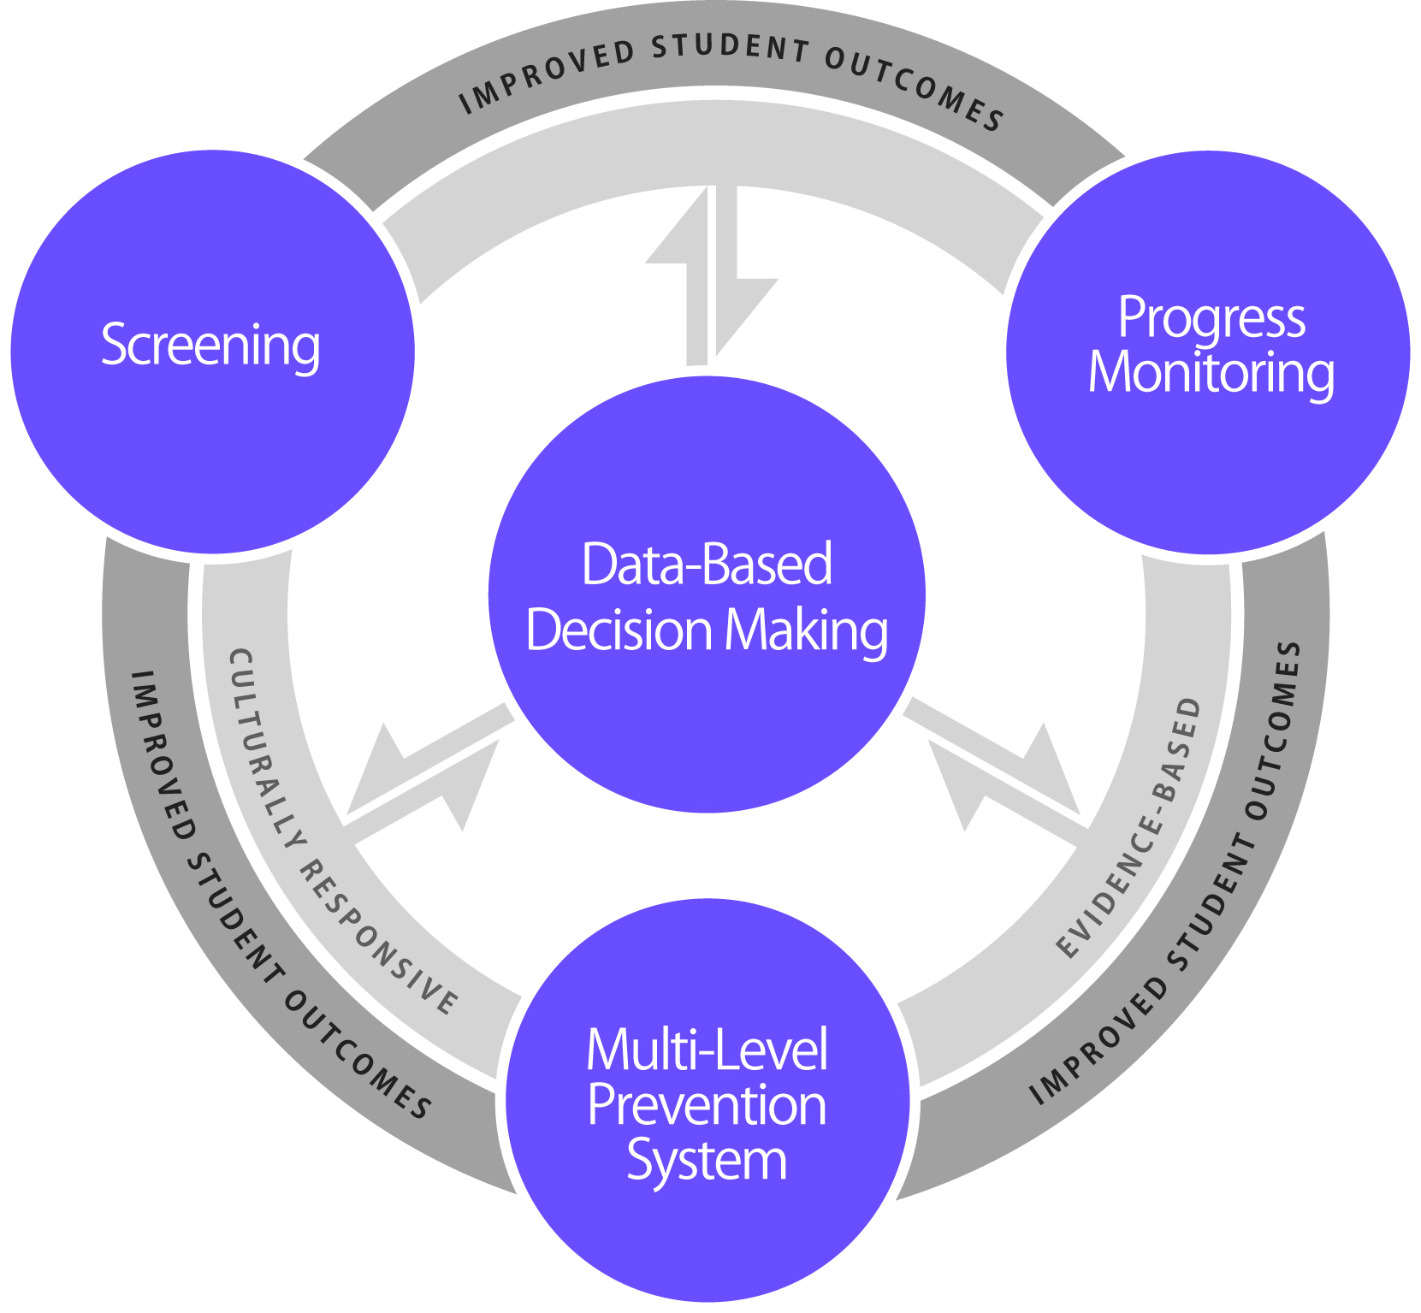
Essential Components of RTI
Notes:
The Center has developed this graphic to highlight the RTI framework. Many of you probably associate the red, green and yellow triangle with RTI. In reality, the triangle does not represent the RTI framework; it only represents one component, the multi-level prevention system. The Center graphic takes into account all of the essential components and most importantly the use of data to make decisions, which is often absent from the traditional RTI triangle.
If you look to the far left you see screening, to the far right, progress monitoring, and at the bottom, the multi-level prevention system. The three outer components require and are necessary parts of data-based decision making, which is why the arrows travel in both directions. If the 3 other components are in place, but data decision making is absent, then RTI is technically not being implemented.
In the center ring, you will see the phrase “culturally responsive”, meaning the screening tools, progress monitoring tools, core instruction, interventions, and data-based decision making procedures should all be culturally responsive. In the same ring, you will notice the phrase “evidence-based”, implying that all components are evidence-based. If these components are implemented through a cohesive model, we would expect to see improved student outcomes. I’m now going to talk about each essential component in a little more detail.

Slide 13
Screening
Essential Component
Notes:
The first component we will discuss is Screening.

Slide 14
Screening
PURPOSE: identify students who are at-risk for poor learning outcomes
FOCUS: all students
TOOLS: brief assessments that are valid, reliable, and demonstrate Classification Accuracy for predicting learning or behavioral problems
TIMEFRAME: administered more than one time per year (e.g., Fall, Winter, Spring )
Notes:
The purpose of screening is to identify those students who are at-risk for poor learning outcomes. Since RTI is a framework for providing services, the outcomes you are concerned about could be anything: academic achievement, behavior, graduation, post-school outcomes. Sites typically identify what outcomes students are expected to achieve and then screen to see which students are not likely to achieve those outcomes.
For example, if the desired outcome is graduation, a quick screen of attendance and credits - predictors of graduation - can reveal which students are not likely to meet the requirements of graduation and need additional support.
Or if the desired outcome is mastery on end of year tests, student performance measures like curriculum based measurements (CBMs) can reveal which students are not likely to pass the test and need additional support.
The focus is on all students, not just those students we may believe are at-risk. Students may slip through the cracks unless there is a systematic process for screening in place. This is not diagnostic test; rather it is a brief, reliable, and valid assessment used to identify which students may need additional assessments, such as progress monitoring or diagnostic assessments, or additional instructional support. The tools should demonstrate Classification Accuracy for predicting learning or behavioral outcomes. In other words, they should be able to accurately identify who could be at-risk.
At a minimum, screening should be administered more than one time per year, such as once in the beginning of the school year and once in the middle. However, we highly recommend conducting screening at least three times a year (fall, winter and spring) in order to evaluate program effectiveness, establish local norms and cut scores, and provide data for next year’s teachers.

Slide 15
Screening
Answers the questions:
Is our core curriculum and instruction effective?
Which students need additional assessment and instruction?
Notes:
In summary, screening data can help answer questions about the overall program effectiveness - including the core instruction and the core curriculum – and which students need additional support or assessment.

Slide 16
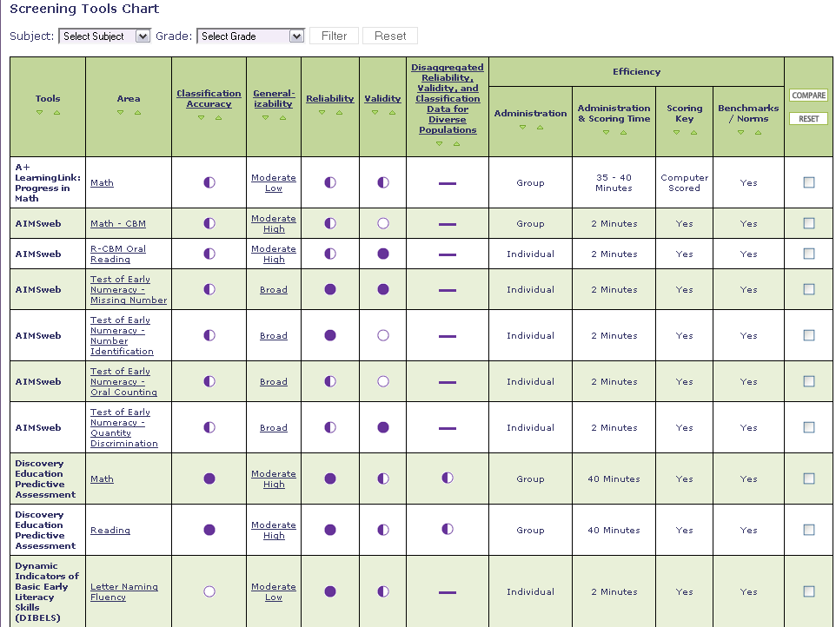
NCRTI Screening Tools Chart
http://www.rti4success.org/screeningTools
Notes:
The Center has developed a screening tools chart (http://www.rti4success.org/screeningTools) that can be accessed through their website at www.rti4success.org. Later in this training we will look in depth at the columns, which include both indictors of valid tools and efficiency factors to consider, as well as the user’s guide and glossary of terms. The tools chart does not recommend tools, but provides users with a “consumer report” on available tools, similar to what you may find when searching for consumer goods, such as a car.

Slide 17
Essential Components of RTI
Notes:
What questions do you have specific to screening?
Remind participants that you will discuss the topic in detail later in the training. Spend no more than 5 minutes answering these questions.

Slide 18
PROGRESS MONITORING
Essential Component
Notes:
Let’s move on to the next essential component: progress monitoring.

Slide 19
Progress Monitoring
PURPOSE: monitor students’ response to primary, secondary, or tertiary instruction in order to estimate rates of improvement, identify students who are not demonstrating adequate progress, and compare the efficacy of different forms of instruction
FOCUS: students identified through screening as at-risk for poor learning outcomes
TOOLS: brief assessments that are valid, reliable, and evidence-based
TIMEFRAME: students are assessed at regular intervals (e.g., weekly, biweekly, or monthly)
Notes:
The purpose of progress monitoring is to monitor students’ response to primary, secondary and tertiary instruction. Progress monitoring data can be used to 1) estimate the rates of improvement which allows for comparison to peers; 2) identify students who are not demonstrating or making adequate progress so that instructional changes can be made, and 3) compare the efficiency of different forms of instruction – in other words, which instructional approach or intervention led to the greatest growth among students.
It is not just for those students identified for supplemental instruction. The focus is on students who have been identified through screening as at-risk for poor learning outcomes. This could include students just above the cut off score as well as those scoring below the cut off score.
Progress monitoring tools, just like screening tools, should be brief, valid, reliable, and evidence-based. Common progress monitoring tools include general outcome measurements, including curriculum based measurements, as well as mastery measurements.
The timeframe for progress monitoring assessment is really dependent on the tools being used and the typical rate of growth for the student.
Progress monitoring can be used anytime throughout the school year. With progress monitoring, students are assessed at regular intervals (weekly, bi-weekly, monthly) to produce accurate and meaningful results that teachers can use to quantify short- and long-term student gains toward end-of-year goals. At a minimum, progress monitoring tools should be administered at least monthly. However, more frequent data collection is recommended given the amount of data needed for making decisions with confidence (6-9 data points for many tools). With progress monitoring, teachers establish long-term (i.e., end-of-year) goals indicating the level of proficiency students should demonstrate by the end of the school year.

Slide 20
Progress Monitoring
Answers the questions:
Are students meeting short- and long-term performance goals?
Are students making progress at an acceptable rate?
Does the instruction need to be adjusted or changed?
Notes:
In summary, progress monitoring data can help answer these questions:
Are students meeting short term goals which will help them reach their long term goals?
Are students making progress at an acceptable rate? It isn’t enough to just make progress. The progress must be meaningful and closing the gap between the student’s progress and his/her peers.
Does the instruction need to be adjusted or changed? Using pre-established data decision rules, progress monitoring allows you to determine if the instruction is working for the student and evaluate the effectiveness of changes.

Slide 21
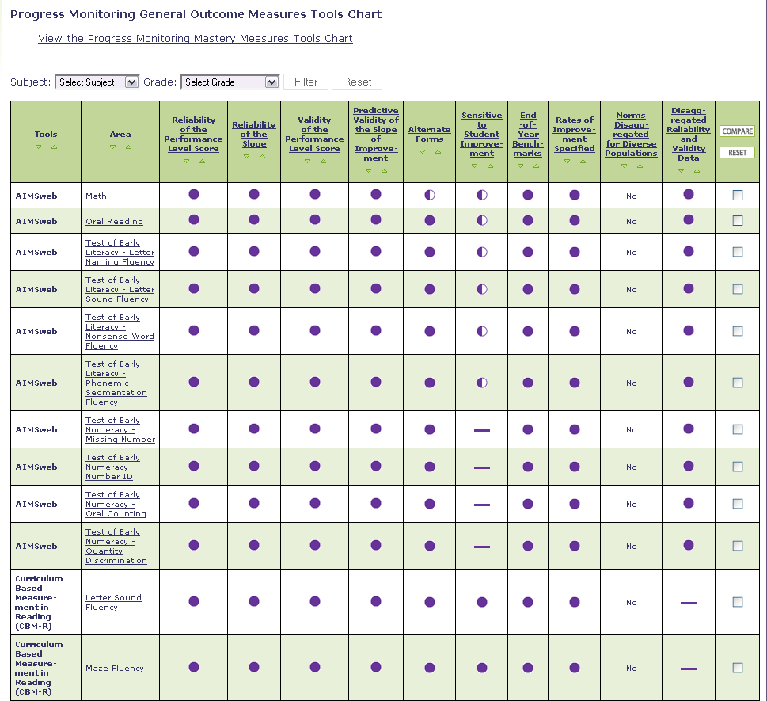
NCRTI Progress Monitoring Tools Chart
www.rti4success.org
Notes:
As with screening, the National Center has developed a progress monitoring tools chart that can be accessed through the National Center on RTI’s website at www.rti4success.org.
You will likely not want to share all of the information below, but rather use it as a reference if participants have questions about this slide.
The PM tools chart began through the National Center on Student Progress Monitoring and has continued through the National Center on RTI. Given the extensive research being conducted in the area of PM, the PM tools chart has significantly more indicators (columns) and tools than the screening tools chart. This is discussed further in the Progress Monitoring Training Module.

Slide 22
Essential Components of RTI
Notes:
What questions do you have specific to progress monitoring?
Remind participants that this topic will be discussed in more detail in the progress monitoring module. Spend no more than 5 minutes answering these questions.

Slide 23
SCHOOL-WIDE, MULTI-LEVEL PREVENTION SYSTEM
Essential Component
Notes:
The next essential component of an RTI framework is a school-wide, multi-level prevention system. School-wide implies that we are referring to preventive instruction for all students not just providing a series of interventions for some students. This instructional system is also designed to be preventive, meaning instructional supports are put in place BEFORE a child fails. It is important to remember that special education is not what we are trying to prevent. Instead, special education is another level of support designed to prevent general school failure.

Slide 24
Multi-level Prevention System
Tertiary Level:
Specialized Individualized
Systems for Students with Intensive Needs
~5%
Secondary Level:
Supplemental Group
Systems for Students with At-Risk Response to
Primary Level
~15%
Primary Level:
School-/Classroom-
Wide Instruction for
All Students, Including Differentiated Instruction
~80% of Students
Notes:
When many folks think of RTI, they imagine this triangle. This triangle represents the three levels of prevention and the percentage of students we would expect to benefit from those levels of prevention in an effective system. The first, or primary level, is indicated in green. We expect most students, at least 80%, to benefit from differentiated instruction within the core curriculum.
The next level, or secondary level, is supplemental to the primary level. We expect about 10-15% of students to need supplemental, small group instruction to benefit from core instruction and curriculum.
The top level, or tertiary level, is also supplemental instruction to primary instruction. It includes specialized, individualized systems for students with intensive needs. It typically involves small group instruction of 1-3 students who are significantly behind their peers.
If less than 80% of students are benefiting from the primary prevention system, consider focusing school improvement efforts on improving core instruction and curriculum. If there is a large percentage of students in the secondary or tertiary level, consider implementing large group instructional activities and system changes with the primary level in order to reduce the number of students requiring additional support.

Slide 25
Primary Level
FOCUS: all students
INSTRUCTION: District curriculum and instructional practices that are research based; aligned with state or district standards; incorporate differentiated instruction
SETTING: general education classroom
ASSESSMENTS: screening, continuous progress monitoring, and outcome measures
Notes:
The focus of the primary level of prevention is on all students. The instruction is the district’s core curriculum and instructional practices that are evidence-based, aligned with state or district standards, and incorporate differentiated instruction. Instruction is delivered within the general education classroom. The assessments administered within the primary level of prevention are screening, continuous progress monitoring and outcome measures. School-based professional development is institutionalized and structured so that all teachers continuously examine, reflect upon, and improve instructional practice.

Slide 26
Secondary Level
FOCUS: students identified through screening as at-risk for poor learning outcomes
INSTRUCTION: targeted, supplemental evidence-based instruction delivered to small groups
SETTING: general education classroom or other general education location within the school
ASSESSMENTS: progress monitoring, diagnostic
Notes:
The focus of the secondary level of prevention is on students identified through screening as at-risk for poor learning outcomes. The instruction is targeted evidence-based interventions that are a supplement to primary instruction and closely aligned and complementary to the core curriculum. Instruction is typically delivered within the general education classroom or other general education locations within the school to small groups of students where the group size is optimal for the age and needs of the student. Procedures are in place to monitor the fidelity of implementation of the secondary level interventions. The assessments administered within the secondary level of prevention are progress monitoring and diagnostic measures.

Slide 27
Tertiary Level
FOCUS: students who have not responded to primary or secondary level prevention
INSTRUCTION: intensive, supplemental evidence-based instruction delivered to small groups or individually
SETTING: general education classroom or other general education location within the school
ASSESSMENTS: progress monitoring, diagnostic
Notes:
The focus of the tertiary level of prevention is on students who have not responded to primary or secondary level prevention. The instruction is evidence-based intensive supplemental instruction and continuously adjusted and individualized to address the needs of each student. The instruction is supplement to primary instruction and closely aligned and complementary to the core curriculum. It is typically delivered within the general education classroom or other general education locations within the school to small groups of students or individually. Procedures are in place to monitor the fidelity of implementation of the tertiary level interventions. The assessments administered within the tertiary level of prevention are progress monitoring and diagnostic measures.

Slide 28
Changing the Intensity and Nature of Instruction
Intervention
Duration
Frequency
Interventionist
Group size
Notes:
Data should guide decisions about changing the level of support needed for students to be successful. Changing the intensity is a two-way street. In cases where students are responding, teams may consider decreasing the intensity. In cases where students are not responding or making adequate progress, the team may consider increasing the intensity.
There are 5 main approaches to changing the intensity of an intervention.
The first is to change the intervention itself; in cases where the current intervention is believed to be ineffective for the student, the team may consider selecting a different intervention. However, this may not always be necessary. If student data indicate a student is making some progress but not necessarily adequate progress, the data-based decision making team may decide to change the intensity of support by manipulating one or more factors of the intervention.
Another way to address the intensity is to increased or decrease the duration of the intervention, or how long the student is receiving the intervention each time.
The intensity may also be changed by increasing or decreasing the number of times a student participates in the intervention (or the frequency of the intervention). For example, the delivery of the intervention may increase from 3 to 5 times a week or increase the number of times per day.
In some cases, the intensity may be modified by changing the interventionist. For example, some schools use paraeducators to delivery supplemental interventions. The intensity of the intervention may be changed by using a content specialist, such as a reading coach, to deliver the intervention.
Another way to modify the intensity is to increase or decrease the number of students participating in the intervention. For example, the team may consider reducing the group size from 5 to 2 in order to provide the students more direct instruction and opportunities to respond.

Slide 29
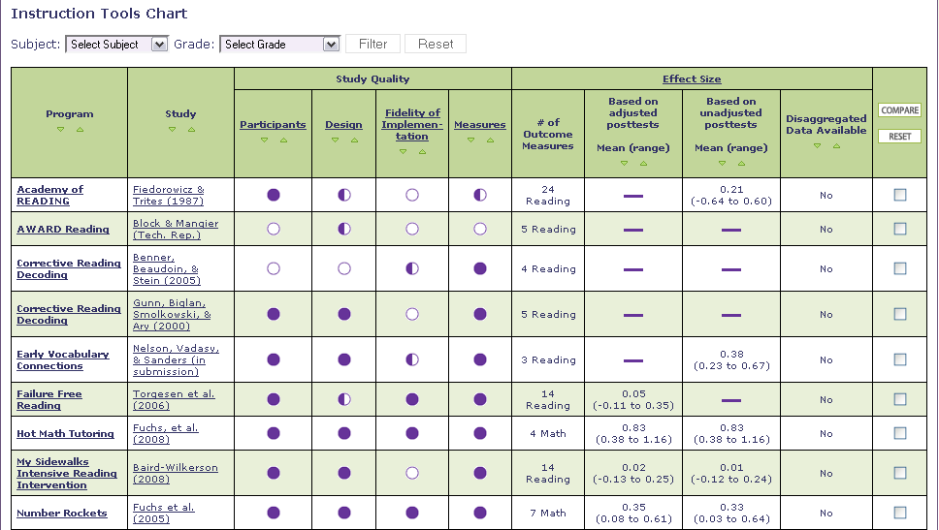
NCRTI Instruction Tools Chart
www.rti4success.org
Notes:
In 2010, the Center released its Instructional Tools Chart to help users determine the effectiveness of interventions used in secondary and tertiary prevention systems. We will discuss this tools chart in detail later today.

Slide 30
Essential Components of RTI
Notes:
What questions do you have specific to a multi-level prevention system?
Remind participants we will discuss the topic in depth during the Multi-Level Prevention Training Module. Allow no more than 5 minutes for questions and answers.
Let’s move on to the next essential component, data-based decision making.

Slide 31
Data-based decision making
Essential Component
Notes:
Implementation of screening, progress monitoring, and a multi-level prevention system alone is not sufficient for RTI. A systematic, comprehensive, data-based decision making process is necessary to connect the pieces.

Slide 32
Data-Based Decision Making:
The Basics
Analyze data at all levels of RTI implementation (e.g., state, district, school, grade level) as well as all levels of prevention (e.g., primary, secondary, tertiary)
Establish routines and procedures for making decisions
Set explicit decision rules for assessing student progress (e.g., state and district benchmarks, level and/or rate)
Use data to compare and contrast the adequacy of the core curriculum and the effectiveness of different instructional and behavioral strategies
Notes:
In a comprehensive RTI framework, data analysis occurs at all levels of RTI implementation, not just at the student level. For example,
States may use RTI data to establish policy and guidance and allocate resources
Districts may use data to evaluate the effectiveness of RTI, establish policies and procedures, and allocate resources
Schools may use data to evaluate the effectiveness of their overall framework and the essential components, assess alignment among grade levels, and allocate resources
Grade level teams may use data to evaluate core curriculum and instruction, identify students for secondary and tertiary instruction, and allocate resources
Data analysis and decision making occurs in all levels of prevention. For example, in primary, we are interested in the effectiveness of the core curriculum and instruction. With secondary and tertiary, we are looking at student level decisions, but we are also looking at how well particular interventions work for the majority of students in the secondary and tertiary levels.
Districts and schools should have established routines and procedures, ideally in writing, for making decisions. Written procedures increase fidelity of the data-based decision making process; ensure equity of resources among students, classes and schools; and help train new teachers more efficiently. Teams should follow pre-established routines and procedures for making decisions. For example, data teams should meet at regularly scheduled intervals, such as monthly or bi-monthly, to systematically review data.
Districts/schools should also establish explicit decision rules for assessing student progress. This includes goals setting procedures, changing instruction/interventions, referring students to special programs, and moving students to more or less intensive tiers.
Schools can also use data to compare and contrast the adequacy of the core curriculum and the effectiveness of different instructional and behavioral strategies at all levels of prevention.

Slide 33
Data-Based Decision Making:
Types of Decisions
Instruction
Movement within the multi-level prevention system
Disability identification (in accordance with state law)
Notes:
These are the more common types of decisions that schools make.
Instruction – how effective is the instruction? What instructional changes need to be made?
Movement within the multi-level prevention system- How do we know when a student no longer needs secondary prevention or should move from secondary prevention to tertiary?
Disability Identification - how do we know if the student should be referred and is eligible for disability identification? Decisions about disability identification should be made in accordance with your state law.
These decision rules should be outlined prior to the implementation of your RTI framework.
Ask if there are any questions about data-based decision making.

Slide 34
Data-Based Decision Making:
IDEA 2004 Learning Disability Eligibility
To ensure that underachievement in a child suspected of having a specific learning disability is not due to lack of appropriate instruction in reading or math, the group must consider, as part of the evaluation described in 34 CFR 300.304 through 300.306:
Data that demonstrate that prior to, or as a part of, the referral process, the child was provided appropriate instruction in regular education settings, delivered by qualified personnel; and
Data-based documentation of repeated assessments of achievement at reasonable intervals, reflecting formal assessment of student progress during instruction, which was provided to the child’s parents.
(www.idea.ed.gov)
Notes:
The National Center on RTI does not provide guidance on eligibility for special education. We recommend you contact your state department of special education and determine what the procedures are for your state.
IDEA states that, “To ensure that underachievement in a child suspected of having a specific learning disability is not due to lack of appropriate instruction in reading or math, the group must consider” two things. The first one is that “Data that demonstrate that prior to, or as a part of, the referral process, the child was provided appropriate instruction in regular education settings.” Screening data that looks at the growth rate of all students can help you answer this question. Progress monitoring data that can be shared with parents can support the next piece, “data-based documentation of repeated assessments of achievement at reasonable intervals.”
You will likely not want to share all of the information below, but rather use it as a reference if participants have questions about this slide.
A State must adopt, consistent with 34 CFR 300.309, criteria for determining whether a child has a specific learning disability as defined in 34 CFR 300.8(c)(10). In addition, the criteria adopted by the State:
Must not require the use of a severe discrepancy between intellectual ability and achievement for determining whether a child has a specific learning disability, as defined in 34 CFR 300.8(c)(10);
Must permit the use of a process based on the child’s response to scientific, research-based intervention; and
May permit the use of other alternative research-based procedures for determining whether a child has a specific learning disability, as defined in 34 CFR 300.8(c)(10).
A public agency must use the State criteria adopted pursuant to 34 CFR 300.307(a) in determining whether a child has a specific learning disability.
[34 CFR 300.307] [20 U.S.C. 1221e-3; 1401(30); 1414(b)(6)]
Include IDEA regulations
The child does not make sufficient progress to meet age or State-approved grade-level standards in one or more of the areas identified in 34 CFR 300.309(a)(1) when using a process based on the child’s response to scientific, research-based intervention; or the child exhibits a pattern of strengths and weaknesses in performance, achievement, or both, relative to age, State-approved grade-level standards, or intellectual development, that is determined by the group to be relevant to the identification of a specific learning disability, using appropriate assessments, consistent with 34 CFR 300.304 and 300.305; and the group determines that its findings under 34 CFR 300.309(a)(1) and (2) are not primarily the result of:
A visual, hearing, or motor disability;
Mental retardation;
Emotional disturbance;
Cultural factors;
Environmental or economic disadvantage; or
Limited English proficiency.
RTI provides a mechanism for states that wish to use movement between the levels to identify students who may have a disability.
The final regulations incorporate new requirements regarding identifying children with specific learning disabilities (SLD) and early intervening services (EIS). With regard to identifying children with SLD, the regulations: (1) allow a local educational agency (LEA) to consider a child’s response to scientific, research-based intervention as part of the SLD determination process; (2) allow States to use other alternative research-based procedures for determining whether a child has a SLD; (3) provide that States may not require the use of a severe discrepancy between intellectual ability and achievement to determine whether a child has a SLD; and (4) require a public agency to use the State criteria in determining whether a child has a SLD and discuss the role that response to scientific research-based interventions plays in a comprehensive evaluation process.
The regulations regarding EIS permit an LEA to use not more than 15% of its IDEA Part B funds to develop and implement EIS. The regulations also indicate how EIS funds can be expended; on whom the EIS funds can be spent; the reporting requirements for EIS; special provisions regarding disproportionality based on race and ethnicity and how that affects an LEA’s use of EIS funds; and the relationship of EIS to maintenance of effort. The purpose of the questions and answers that follow is to provide additional guidance to States and LEAs in complying with the requirements regarding EIS and response to scientific research-based interventions to identify students with a SLD.

Slide 35
Using RTI for SLD Eligibility in Washington
Rules for the Provision of Special Education: Chapter 392-172A WAC http://apps.leg.wa.gov/WAC/default.aspx?cite=392-172A WAC 392-172A-03045: http://apps.leg.wa.gov/WAC/default.aspx?cite=392-172A-03045 WAC 392-172A-03060: http://apps.leg.wa.gov/WAC/default.aspx?cite=392-172A-03060 Washington State SLD Guide: http://www.k12.wa.us/SpecialEd/pubdocs/SLD_Guide.pdf
Notes:
Although use of RTI for special education eligibility under the category of SLD is an option in Washington state, it goes beyond the intended scope of today’s presentation. These links will provide you with additional information regarding current state requirements.

Slide 36
Essential Components of RTI
Notes:
In review, the essential components of RTI are:
Screening or how we identify which students are at-risk and need additional assessment and instruction;
Progress Monitoring or how we monitor whether students are responding to the instruction and supports we provide;
Multi-Level Prevention System or how we provide increasingly intense levels of supports to meet student needs;
Data-based Decision Making or how we use data from those particular components to make decisions about student supports and program effectiveness.

Slide 37
Implementing the RTI Framework
Select and implement evidence-based practices and procedures
Implement essential components and identified framework with integrity
Ensure that cultural, linguistic, and socioeconomic factors are reflected in the RTI framework and its components
Notes:
Implementation of RTI can be quite difficult and will most likely take at least two to four years to achieve full implementation. We recommend that you select and implement evidence-based practices and procedures. The tools charts available through the Center on RTI can help you do that.
You should also implement the essential components and identified framework with integrity. It’s not enough to deliver the core curriculum and interventions with integrity, you also must ensure that the screening and progress monitoring assessments are administered consistently and that data-based decision making procedures are implemented with integrity.
It is important to ensure that cultural and linguistic and socio-economic factors are reflected in the RTI framework and its components. District and schools teams should continually evaluate the efficacy of the model and model components for diverse populations. On the tools charts, there is a column that provides information about how these particular tools have been used with different groups.

Slide 38
THINK – PAIR - SHARE
What did you hear that confirmed your understanding of RTI?
What did you hear that challenged your understanding about RTI?
Notes:
The Think/Pair/Share activity is optional. The purpose of the activity is to engage the audience and conduct an informal assessment of the audience’s conclusions from the session. Encourage participants to talk about misperceptions they may have had in the beginning.
Think about your answers to the following two questions.
What did you hear that confirmed your understanding of RTI?
What did you hear that challenged your understanding of RTI?
Give participants approximately 20 seconds.
Pair and share with your neighbor/table discuss.
Give participants approximately 2-3 minute.
Allow 2 or 3 pairs/tables to orally share their thoughts.

Slide 39
Understanding TYPES of Assessments within An RTI Framework
Notes:
Refer participants to the Screening Training Manual (pg 6-10) for more information and to view graphics more closely.
At this point, we are going to drill deeper into screening. First, we are going to discuss how to select appropriate assessments to use when screening.
This section is important because many participants may be trying to use summative or diagnostic assessments as screening assessments or they might be using several assessments, some of which are repetitive. Screening assessments are typically formative assessments.
The following are key terms and main points that should be focused on during this segment of the presentation.
Key Terms:
Summative
Diagnostic
Formative
Mastery Measures
General Outcome Measures
Main Points:
There is no perfect test, but it is important to find the right type of test to fit your purpose, and to be sure that you are using the test the way it was intended.
Summative assessments are given after learning, diagnostics are given before learning, and formative assessments are given during learning.
Screening assessments should always be formative because they are more efficient than diagnostic at quickly identifying students, and they do not require waiting for a student to fail, like summative.
General outcome measures and mastery measures are two types of formative assessments.

Slide 40
Types of Assessments
Type | When? | Why?
Summative | After | Assessment of Learning
Diagnostic | Before | Identify skill strengths and weakness
Formative | During | Assessment for Learning
Notes:
Refer participants to the Screening Training Manual (pg 6) for more information and to view this graphic more closely.
There are three types of assessments commonly used within an RTI framework: summative, diagnostic, and formative. Summative assessments occur after instruction and are assessments of learning. Diagnostic assessments occur before instruction and help to identify skill strengths and weakness. Formative assessments occur during instruction and are assessments for learning.
We will now spend some more time on each type of assessment.

Slide 41
Summative Assessments
PURPOSE: Tells us what students learned over a period of time (past tense)
  May tell us what to teach but not how to teach
Administered after instruction
Typically administered to all students
Educational Decisions:
  Accountability
  Skill Mastery Assessment
  Resource Allocation (reactive)
Notes:
The first type of assessment is summative. Summative assessments measure what students learned over a period of time. They are typically administered after instruction and can help to determine what to teach but not how to teach. Summative assessments are typically administered to all students and are often used for accountability decisions and to determine the mastery of certain skills. While summative assessments can also be used to allocate resources, because they occur after instruction, the decision is reactive.
If you only use summative assessments, you need to wait until the end of the year to make instructional decisions. That may not always be efficient. Our goal is to prevent poor learning outcomes, not just identify them at the end of the year.

Slide 42
Summative Assessments
Examples:
High-stakes tests (MSP, HSPE, WASL)
GRE, ACT, SAT, and GMAT
Praxis Tests
Final Exams
Notes:
Examples of Summative assessments include High-stakes tests; GRE, ACT, SAT, and GMAT; Praxis Tests; and Final Exams
Although summative assessments provide useful information, they:
1. Usually require time away from instruction;
2. Are not valid for individual decision making; and
3. Don’t tell us how or why students achieved certain scores.

Slide 43
Diagnostic Assessments
PURPOSE: Measures a student's current knowledge and skills for the purpose of identifying a suitable program of learning.
Administered before instruction
Typically administered to some students
Educational Decisions:
  What to Teach
  Intervention Selection
Notes:
Diagnostic assessments are measures of students’ current knowledge and skills and can be used to identify a suitable program of learning. They are administered before instruction occurs to assist in identifying appropriate instruction and interventions. Since diagnostic assessments provide detailed information about individual student learning, they are most effective in understanding the needs of specific students rather than all students and are therefore typically administered to only some students. Diagnostic assessments can help determine what to teach and in the selection of appropriate interventions. Diagnostic assessments provide useful information but should be used sparingly, as they can be very expensive and time consuming.
If you are familiar with the district, you may list types of diagnostics and ask participants to think about whether they are using these diagnostic tools the way they were intended.

Slide 44
Diagnostic Assessments
Examples:
Qualitative Reading Inventory (QRI/IRI)
Diagnostic Reading Assessment
Diagnostic Decoding Survey
Key Math
Running Records with Error Analysis
Notes:
Examples of diagnostic assessments include Qualitative Reading Inventory, Diagnostic Reading Assessment, Key Math, and Running Records with Error Analysis.

Slide 45
Formative Assessments
PURPOSE: Tells us how well students are responding to instruction
Administered during instruction
Typically administered to all students during benchmarking and some students for progress monitoring
Informal and formal
Notes:
Formative assessment is a form of evaluation used to plan instruction in a recursive way. Formative assessments tell us how well students are responding to instruction. With formative assessment, student progress is systematically assessed during instruction to provide continuous feedback to both the student and the teacher concerning learning successes and failures. Formative assessments are typically administered to all students during benchmarking and some students for progress monitoring.
Formative assessments may be informal or formal. Informal assessments are not data driven but rather content and performance driven. Examples include observations and teacher made assessments. Formal assessments have data which support the conclusions made from the test. We usually refer to these types of tests as standardized measures. These tests have been tried before on students and have statistics which support the conclusion such as the student is reading below average for his age. The data are often mathematically computed and summarized. Scores such as percentiles, stanines, or standard scores are commonly received from this type of assessment. Examples include (but are not limited to): CBM, CBA, pre/post tests, benchmark assessments, and quizzes.

Slide 46
Formative Assessments
Educational Decisions:
Identification of students who are nonresponsive to instruction or interventions
Curriculum and instructional decisions
Program evaluation
Resource allocation (proactive)
Comparison of instruction and intervention efficacy
Notes:
With formative assessment, teachers diagnose skill, ability, and knowledge gaps; measure progress; and evaluate instruction. Educational decisions that can be made using formative assessments include:
Identification of students who are nonresponsive to instruction or interventions (screening and progress monitoring);
Curriculum and instructional decisions;
Program evaluation;
Resource allocation (this is proactive as this information is provided as the instruction is occurring); and
Comparison of instruction and intervention efficacy.
Formative assessments are not necessarily used for grading purposes.

Slide 47
Formative Assessments
Mastery measures (e.g., intervention or curriculum dependent)
General Outcome Measures (e.g., CBM)
  AIMSweb –R-CBM, Early Literacy, Early Numeracy
  Dynamic Indicators of Basic Early Literacy Skills (DIBELS) – Early Literacy, Retell, and D-ORF
  iSTEEP – Oral Reading Fluency
  Word Identification Fluency
Notes:
The main types of formative assessments are:
Mastery Measures are measures which index a student’s successive mastery of a hierarchy of objectives and are intervention or curriculum dependent.
General Outcome Measures (GOM) are measures that reflect overall competence in the annual curriculum. Examples of general outcome measures include AIMSweb’s R-CBM, Early Literacy and Early Numeracy, Dynamic Indicators of Basic Early Literacy Skills (DIBELS)’ Retell, and iSTEEP’s Oral Reading Fluency.

Slide 48
Summative or Formative?
Educational researcher Robert Stake used the following analogy to explain the difference between formative and summative assessment:
“ When the cook tastes the soup, that's formative. When the guests taste the soup, that's summative.”
(Scriven, 1991, p. 169)
Notes:
The following quote is helpful in thinking about the differences between summative and formative.
“ When the cook tastes the soup, that's formative. When the guests taste the soup, that's summative.” (Scriven, 1991, p169)
Scriven, M. (1991) Evaluation thesaurus, (4th edition). Newbury Park, CA: Sage.

Slide 49
Norm-referenced vs. Criterion-referenced tests
Norm-referenced
  Students are compared to each other
  Score is interpreted as the student’s abilities relative to other students
  Percentile scores are used
Criterion-referenced
  Students’ performance compared to a criterion for mastery
  Score indicates whether the student met mastery criteria
  Pass/fail score
Notes:
One final concept to think about in relation to assessments is whether tests are norm-referenced, criterion referenced, or possibly both.
Norm referenced test include tests like the ACT, SAT, and GRE. Students’ scores are compared to each other using percentile scores. For example, a student who scored in the 64th percentile scored better than 64% of students who took the test. S/he scored lower than 36% of students who took the test.
Criterion-referenced tests are often standards-based tests that compare a student’s performance to a criterion for mastery of a skill or objective. The score indicates whether the student met the mastery criteria, and so it often looks like a pass/fail or proficiency score.
Assessments, including screening assessments, can be both norm-referenced and criterion-referenced depending on what information you are trying to gather. If you are interested in knowing how a student compares to other students in the screening process, you would be interested in norm-referenced assessment. If you want to screen for which students met or did not meet the set criteria, typically a score, then you would be interested in criterion-referenced. We will discuss this more later.

Slide 50
Team Activity
List the assessments and data collected that are used at your school (quizzes, state-developed, CBM, etc).
What questions are being answered with those assessment data? How is the data used?
Notes:
With your team list the assessments and data collected that are used at your school (quizzes, state-developed, CBM, etc).
Then answer the following questions: What questions are being answered with that assessment data? How is the data used? Do the purposes of the assessments match the type of assessments? For example, are you using diagnostic tests when you should be using summative or vise versa?
Depending on time, this is an activity that can be used as a quick activity where participants are encouraged to continue the conversation at their site or as an expanded activity that is completed during extended team discussion time. Facilitators may want to assign the first part of this activity as prework to be completed before they attend the training.
Possible follow-up questions:
Are you over assessing students?
Do you see any redundancy in your data collection?
Is all of the data being collected necessary or being used for education decision making? Why or why not?
This activity helps schools see that they may be using too many screeners, or using assessments in the wrong way. When you add assessments for RTI, you may need to reduce other assessments. Teams should think, “Why are we doing these assessments?” “Can we be more efficient?”

Slide 51
Common Formative Assessments
Mastery Measurement
General Outcome Measures
vs.
Notes:
We are now going to discuss in more detail the two common formats for formative assessments. Each type of measure has value although they are typically used for different reasons.
Mastery Measurement indexes a student’s successive mastery of a hierarchy of objectives.
General Outcome Measure reflects overall competence in the annual curriculum.

Slide 52
Mastery Measurement
Describes mastery of a series of short-term instructional objectives
To implement Mastery Measurement, the teacher:
  Determines a sensible instructional sequence for the school year
  Designs criterion-referenced testing procedures to match each step in that instructional sequence
Notes:
A Mastery Measure
Read slide

Slide 53
Fourth Grade Math Computation Curriculum
Multidigit addition with regrouping
Multidigit subtraction with regrouping
Multiplication facts, factors to 9
Multiply 2-digit numbers by a 1-digit number
Multiply 2-digit numbers by a 2-digit number
Division facts, divisors to 9
Divide 2-digit numbers by a 1-digit number
Divide 3-digit numbers by a 1-digit number
Add/subtract simple fractions, like denominators
Add/subtract whole number and mixed number
Notes:
Here is an example of a typical fourth grade math computation curriculum, with 10 objectives the teacher plans to accomplish for the year. The first objective is multidigit addition with regrouping.

Slide 54
Mastery Measure: Multidigit Addition Assessment
Notes:
While teaching multidigit addition with regrouping, the teacher may give assessments that look something like this. There are 10 problems all dealing with multidigit addition with regrouping.

Slide 55
Mastery Measure: Multidigit Addition Results
Multidigit Addition
Multidigit Subtraction
10
8
6
Number of problems correct in 5 minutes
4
2
0
2
4
6
8
10
12
14
WEEKS
Notes:
As the teacher gives this assessment, he or she could graph the student’s results. In the first week of teaching the objective, the student did not get many answers correct. But as the weeks go by, the student gets better until he or she has had three consecutive weeks of getting 80% or more of the problems correct.
Once this happens, then the teacher moves on to the next objective.

Slide 56
Fourth Grade Math Computation Curriculum
Multidigit addition with regrouping
Multidigit subtraction with regrouping
Multiplication facts, factors to 9
Multiply 2-digit numbers by a 1-digit number
Multiply 2-digit numbers by a 2-digit number
Division facts, divisors to 9
Divide 2-digit numbers by a 1-digit number
Divide 3-digit numbers by a 1-digit number
Add/subtract simple fractions, like denominators
Add/subtract whole number and mixed number
Notes:
The next objective in the curriculum is multidigit subtraction with regrouping.

Slide 57
Mastery Measure: Multidigit Subtraction Assessment
Notes:
Again, as the teacher is teaching this objective, he or she may give assessments that look like this - 10 problems all dealing with multidigit subtraction with regrouping.

Slide 58
Mastery Measure: Multidigit Subtraction Assessment
Multidigit Addition
Multidigit
Subtraction
Multiplication
Facts
10
8
6
Number of problems correct in 5 minutes
4
2
0
2
4
6
8
10
12
14
WEEKS
Notes:
Again, the student’s progress is charted.
A problem with this chart is that we cannot tell if the student is learning the objectives at a pace fast enough that will allow him or her to learn all the curriculum’s objectives in the span of the school year.

Slide 59
Advantages of Mastery Measures
Skill and program specific
Progress monitoring data can assist in making changes to target skill instruction
Increasing research demonstrating validity and reliability of some tools
Notes:
There are some advantages of using mastery measures. By focusing on a single skill, practitioners can assess whether a student can learn target skills in isolation. Teachers can use the information from the ongoing progress monitoring data to make decisions about changing target skill instruction. Until recently, the psychometric properties of most mastery measures were not valid and reliable. However, as you can see by the addition to Mastery Measures to the NCRTI Progress Monitoring Tool Chart, there is increasing research demonstrating the validity and reliability of some tools. Mastery measure are typically not valid screening measures. They are often used for progress monitoring students identified through screening measures.

Slide 60
Problems Associated With Mastery Measurement
Hierarchy of skills is logical, not empirical
Assessment does not reflect maintenance or generalization
Number of objectives mastered does not relate well to performance on criterion measures
Measurement methods are often designed by teachers, with unknown reliability and validity
Cannot compare scores longitudinally
Notes:
Despite the advantage, there are some problems associated with mastery measurement:
Hierarchy of skills is logical, not empirical – meaning that while it may seem logical to teach addition first and then subtraction, there is no evidence-based research that says you have to do it that way.
Assessment does not reflect maintenance or generalization. After teaching subtraction with regrouping, you don’t know if the student remembers how to do addition with regrouping.
Number of objectives mastered does not relate well to performance on criterion measures – meaning how a student does on these assessments does not indicate how he or she will do on standardized tests.
Measurement methods are often designed by teachers, with unknown reliability and validity.
Cannot compare scores longitudinally. You will not be able to compare a student’s score on a mastery measure in September with their score in May.

Slide 61
General Outcome Measure (GOM)
Reflects overall competence in the year-long curriculum
Describes individual children’s growth and development over time (both “current status” and “rate of development”)
Provides a decision-making model for designing and evaluating interventions
Is used for individual children and for groups of children
Notes:
General outcome measures often address the problems associated with mastery measures.
A General Outcome Measure:
Is Program Independent –they reflect overall competence in the year-long curriculum as opposed to being dependent on a particular program;
Describes individual children’s growth and development over time (both “current status” and “rate of development”);
Provides a decision-making model for designing and evaluating interventions;
Is used for individual children and for groups of children.
As a result, GOM can serve as both screening and progress monitoring measures.

Slide 62
Common Characteristics of GOMs
  Simple and efficient
  Classification accuracy can be established
  Sensitive to improvement
  Provide performance data to guide and inform a variety of educational decisions
  National/local norms allow for cross comparisons of data
Notes:
General Outcome Measures are
Simple and efficient – these are brief assessments that typically take 1 – 10 minutes to administer. They provide you with enough information to be able to make quick decisions.
Classification accuracy can be established. The classification accuracy indicates the extent to which a screening tool is able to accurately classify students into “at-risk” and “not at-risk” categories.
Sensitive to improvement Sensitivity is the extent to which a screening measure accurately identifies students at-risk for the outcome of interest.
Provide performance data to guide and inform a variety of educational decisions
National/local norms allow for cross comparisons of data

Slide 63
Advantages of GOMs
Focus is on repeated measures of performance
Makes no assumptions about instructional hierarchy for determining measurement
Curriculum independent
Incorporates automatic tests of retention and generalization
Notes:
The focus of general outcome measures is on repeated measures of performance. GOMs make no assumptions about instructional hierarchy for determining measurement. In other words, GOMs fit with any instructional approach. Also, GOMs incorporate automatic tests of retention and generalization. Therefore the teacher is constantly able to assess whether the student is retaining what was taught earlier in the year.
The point here is not to say that practitioners should always use GOM or Mastery measures, but that it is important to think about which measure is better for each objective.
For screening purposes, General Outcome Measures should always be used as GOMs work better to fulfill the objective of a screener.

Slide 64
GOM Example: CBM
Curriculum Based Measure (CBM)
  a general outcome measure (GOMs) of a student’s performance in either basic academic skills or content knowledge
  CBM tools available in basic skills and core subject areas grades K-8 (e.g., DIBELS, AIMSweb)
Notes:
One type of a general outcome measure is curriculum based measure or CBM.
CBM is a general outcome measure of a student’s performance in either basic academic skills or content knowledge.
CBM was initially developed more than 30 years ago by Stanley Deno and others at the University of Minnesota Institute for Research on Learning Disabilities as a reliable and valid measurement system for evaluating basic skills growth.
Research began in the area of reading and has expanded to additional tools in literacy, math, and writing as well as tools in Spanish.

Slide 65
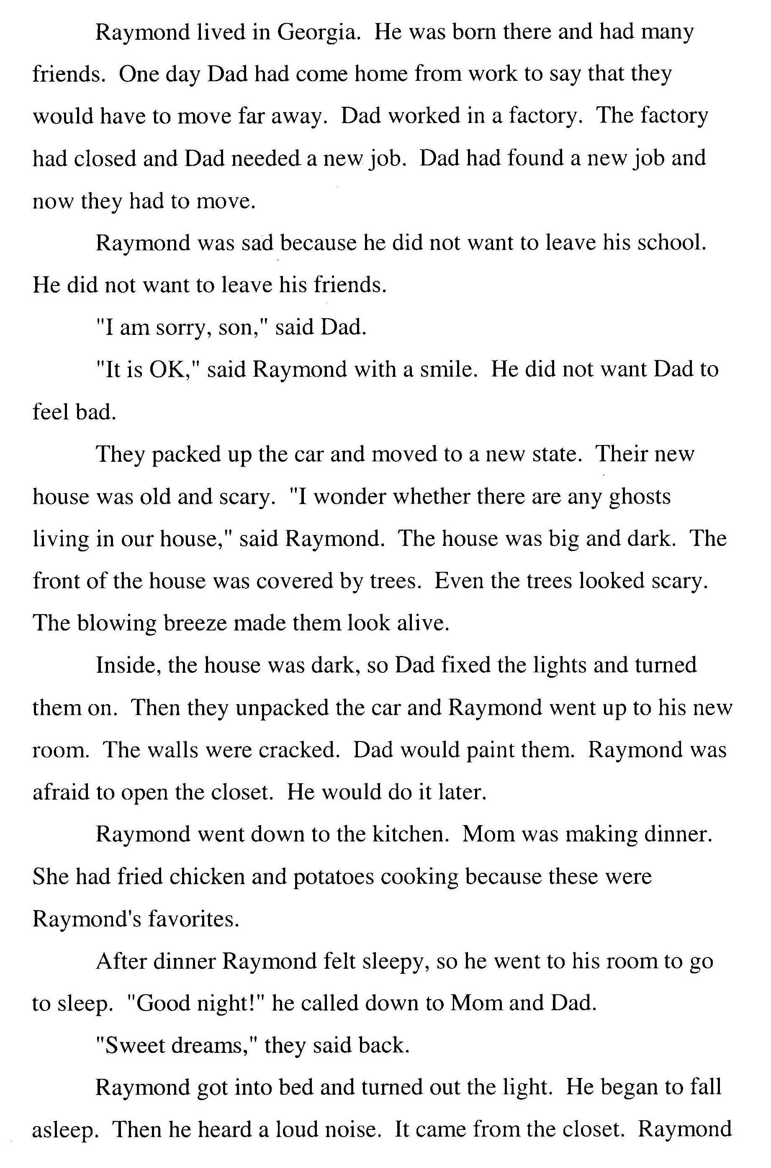
CBM Passage Reading Fluency
Student copy
Notes:
Here is an example of a CBM for reading fluency. Students would be asked to read this passage aloud while being timed for one minute. The score would be based on the words correct per minute the student read aloud.

Slide 66
Common Formative Assessments
Mastery Measurement
General Outcome Measures
vs.
Multidigit Addition
Multidigit
Subtraction
Multiplication
Facts
10
8
6
Number of problems correct in 5 minutes
4
2
0
2
4
6
8
10
12
14
WEEKS
Notes:
In summary, both types of formative assessment provide useful, but different information. Mastery measurement data indicates progress towards mastery of specific subskills (e.g., decoding short vowel sounds, calculating 9 math facts) while GOMs indicate progress toward a broader outcome. The latter involves the application of all of the subskills learned over time.
One key difference between Mastery Measures and General Outcome Measures is comparability of data longitudinally. With GOM you can compare the score a student received in May to a score they had in September. This cannot be done with Mastery Measures.

Slide 67
Think-Pair-Share
What mastery measures and GOMs are used in my district or school?
How are mastery measures and GOMs used to inform instruction?
Notes:
The Think/Pair/Share activity is optional. The purpose of the activity is to engage the audience and conduct an informal assessment of the audience’s conclusions from the session.
Think to yourself about the answers to the following questions:
What mastery measures and GOMs are used in my district or school?
How are mastery measures and GOMs used to inform instruction?
Give participants approximately 20 seconds.
Pair and share with your neighbor/table and discuss.
Give participants approximately 2-3 minute.
Allow 2 or 3 pairs/tables to orally share their thoughts.
This is more about making participants aware of what they are using, rather than showing that one is right and one is wrong.

Slide 68
What is Screening?
Notes:
The following are key terms and main points that should be focused on during this segment of the presentation.
Key Terms:
Universal screening
Classification accuracy
Main Points:
Screening is helpful in identifying students at-risk for poor learning outcomes and who need additional assessment and intervention.
Screening data is important and useful at the state, district, and school level.

Slide 69
Essential Components of RTI
Notes:
This training focuses on the essential component of screening. Without screening, it is difficult to determine who should be progress monitored or who should receive supplemental instruction. Universal screening (the first part of the screening process) is necessary to make these initial data-based decisions.

Slide 70
Screening
PURPOSE: identify students who are at-risk of poor learning outcomes
FOCUS: conducted for all students
TOOLS: involves brief assessments that are valid, reliable, and evidence-based
TIMEFRAME: administered more than 1x per year (e.g., Fall, Winter, Spring )
Notes:
A basic understanding of the purpose, focus, tools and timeframe for screening was introduced earlier. Now we will talk about each of these in more detail.

Slide 71


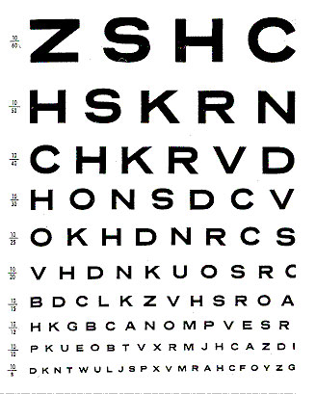
Examples of Common Screening Processes
Notes:
The screening process is not unique to education. In fact, standardized screening processes are common in many other fields, such as cancer screenings, courtesy checks during oil changes, and vision screenings in the primary grades. In all cases, the purpose is to identify indicators that predict if more testing or further intervention is needed.
The major thing all of the screening processes do is to identify and address potential problems early in order to prevent bigger problems in the future.
Depending on time available, you may or may not want to provide the following more in-depth explanations of other types of screening.
For example, how many of you have participated in cancer screenings? These measures do not actually indicate if you have cancer. Instead, the results of these cost efficient and brief assessments indicate that more information is needed. Additional assessments (that are most likely more expensive and invasive) are needed to confirm the presence of the disease.
How many of you get regular oil changes? During the oil change, there is typically 17-21 point courtesy check. Aside from regular maintenance, the screening checks are designed to identify issues that may make the car at-risk for more expensive problems later on (e.g., leaks, worn brake pads). Although the car functions okay now, it is likely to experience issues in the future. We perform these check-ups for preventive purposes.
All of us have had eye exams, probably beginning in school. This very cheap screening process provided school nurses with sufficient data to refer a child for further assessment. Without this type of standardized eye screening in schools, many children may not have received appropriate vision supports until much later in their schooling. Many schools have or did have similar screening processes for hearing and scoliosis checks.

Slide 72
Purpose of Screening
Identify students at-risk for poor learning outcomes
Identity students who need additional assessment (i.e., progress monitoring) and instruction (i.e., secondary or tertiary)
Provide data on the effectiveness of the core instruction and curriculum.
Notes:
The same process applies in learning environments. In addition to identifying students at-risk for poor learning outcomes and who need additional assessment and intervention, screening data can help to answer key questions about the effectiveness of your curriculum and instruction.
Read slides.

Slide 73
Universal Screening
Video 1: Principal Perspectives
Notes:
Now you will hear from several principals about why they believe screening is important.
Play the video (3:26).
Universal Screening: http://www.youtube.com/watch?v=HaHWoN-LVFc
Skipping the video entirely is not recommended as it is valuable for the participants to hear a practitioner’s point of view on screening.
Note: This is a good opportunity to remind participants about the importance of coming to consensus as a team about why screening is important . This might be a good time to mention that teams will be given some time in the second half of the training to talk about the purpose of screening at their sites.

Slide 74
Focus of Screening
Screening typically includes all students
Two-stage screening process
  Stage 1: Universal screening
  Stage 2: More in-depth testing or progress monitoring for students who scored at or below the cut score
Should be an educationally valid outcome
Notes:
Who gets screened and what are they screened for?
Screening typically includes all students.
As mentioned in the video, regular screening is necessary throughout the year for ALL students. Through screening at the middle or end of the year, you may “catch” students who were doing well at the beginning of the year but are struggling as the demands increase.
Two-stage screening process
Struggling students are identified by implementing a 2-stage screening process. The first stage, universal screening, is a brief assessment for all students conducted at the beginning of the school year; however, many schools and districts use it 2-3 times throughout the school year. For students who score at or below the cut score on the universal screener, a second stage of screening is then conducted to more accurately predict which students are truly at-risk for poor learning outcomes. This second stage involves additional, more in-depth testing or short-term progress monitoring to confirm a student’s at-risk status.
Should be an educationally valid outcome.
What is screened should be based on the needs and goals of the school. Schools typically screen in reading, math, and behavior but may also consider screening in other areas because of need. This may include language or writing.

Slide 75
Screening Tools
Must choose reliable, valid tools that demonstrate diagnostic accuracy
Must choose age-appropriate outcome measures that capture student ability, and
May have different screeners to assess different outcome measures
Notes:
How do we screen?
When selecting screening tools you:
Must choose reliable, valid tools that demonstrate Classification Accuracy for predicting which students will develop learning or behavioral difficulties. Since we are interested in predicting to an outcome, GOMs are commonly used as screeners.
Must choose age-appropriate outcome measures that capture student ability.
It is important that the screener you choose has strong classification accuracy, meaning the screening tool is able to accurately classify students into “at-risk” and “not at-risk” categories. For example, in reading, in order to have good classification accuracy, screeners must target reading or reading-related skills that are pertinent to the grade and time the screen is administered (Jenkins, Hudson, & Johnson, 2007, pp. 585).
In kindergarten, relevant skills could include phonemic awareness, letter and sound knowledge, and vocabulary.
In 1st grade, phonemic spelling, decoding, word identification, and text reading are important skills to assess.
In 2nd & 3rd grades, measures should assess number and type of words students can read and comprehend, and the fluency of those skills.
In higher grades, comprehension of more difficult texts is an important relevant reading skill.
May have different screeners to assess different outcome measures.
No one screener can screen for all areas. Different screeners may be necessary for different outcome areas.

Slide 76
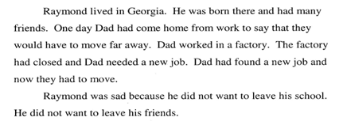
CBM Passage Reading Fluency
Student copy
Notes:
Here is an example screener. This copy is placed in front of the student.
Students are provided standardized directions and asked to read aloud for one minute. To get an accurate score for CBM for reading at each screening period, students read three 1 minute passages and the median (middle) score is recorded.

Slide 77
NCRTI Screening Tools Chart
www.rti4success.org
Notes:
The Center has developed a screening tools chart that can be accessed through the National Center on RTI’s website at www.rti4success.org. We will look at the process for using the tools chart, recommended in the Users Guide. We will also look in depth at the columns, which include both indictors of valid tools and efficiency factors to consider.

Slide 78
Tips for Using the Tools Chart
Gather a team
Determine your needs
Determine your priorities
Familiarize yourself with the content and language of the chart
Review the data
Ask for more information
Notes:
The tools chart includes a large amount of information designed to assist you in selecting a tool that is most appropriate for use in your classroom, school, or district. The “best” tool is not going to be the same for every user and is not determined by any single element on the chart. Users of the chart should review all of the different elements of the chart when making a decision. We recommend the following six steps for using the tools charts to select a screening tool:
Read the slide.
For more information about the six recommended steps for using the screening tools chart and selecting a tool, check out the NCRTI Users Guide available for download on the NCRTI website, www.rti4success.org.

Slide 79
1. Gather a Team
Who should be involved in selecting a screening tool?
What types of expertise and what perspectives should be involved in selecting a tool?
Notes:
Often, decisions about appropriate screening tools will involve the input of
multiple teachers and staff. When using the tools chart, a team of key constituents
in your school and district should review the information together. In gathering this team, you should think about the following questions:
Read the slide.

Slide 80
2. Determine Your Needs
For what skills do I need a screening tool?
For which specific academic outcome or measure am I interested in screening?
For what grades do I need a screening tool?
Will this screening tool be used with all students or only a specific subgroup(s) of students? Which subgroup(s)?
Notes:
The most appropriate screening tool for you will depend on your specific needs. In determining your needs, you should think about the following questions:
Read the slide. Refer participants to the Screening Tools Chart User’s Guide for the list of questions.

Slide 81
3. Determine Your Priorities
Is it a tool that can be purchased for a reasonable cost?
Is it a tool that does not take long to administer and score?
Is it a tool that offers ready access to training and technical support for staff?
Is it a tool that meets the highest standards for technical rigor?
Is it a tool whose effectiveness has been studied and demonstrated in my district or state?
Notes:
In addition to determining your needs for a screening tool, your team should also consider its priorities. Although you may want a tool that meets all of these criteria, such a tool may not exist. You will need to weigh your priorities carefully when making your selection. In determining your priorities, you should think about the following questions. For example, if cost is a priority ask, “Is it a tool that can be purchased for a reasonable cost?”
Other priorities may be administration time (read bullet 2), training required (read bullet 3), standard of technical rigor (read bullet 4), or demonstrated effectiveness (read bullet 4).
Refer participants to the Screening Tools Chart User’s Guide for the list of questions.

Slide 82
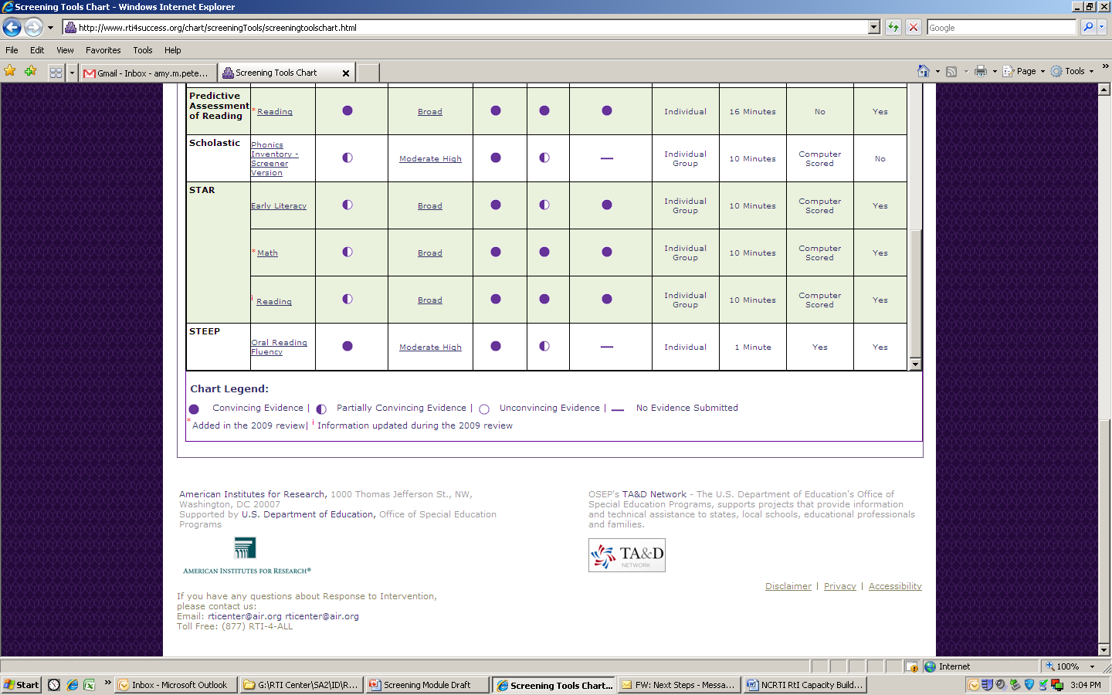
4. Familiarize Yourself With the Content and Language of the Chart
Ratings of technical rigor:
The efficiency of the tool
Implementation requirements for the tool
Detailed data submitted by the vendor
Notes:
There are four main areas on which tools are evaluated: ratings of technical rigor, efficiency, implementation requirements (e.g., cost, training needs) and the data submitted by the vendor (e.g., reliability data, validity data). The ratings of technical rigor are represented with rating bubbles, similar to the symbols used in Consumer Reports. A full bubble indicates convincing evidence, while an empty bubble indicates unconvincing evidence.

Slide 83
Content and Language of Chart
Technical rigor:
  Classification Accuracy
  Generalizability
  Reliability
  Validity
  Disaggregated data
Notes:
Ideally, demonstrate the most updated version of tools chart on the website instead of the following screenshots.
The first area that is presented is the ratings of technical rigor. For each of these standards, the Technical Review Committee (TRC) reviewed data submitted by developers of the tools and gave a rating of “convincing,” “partially convincing,” “unconvincing,” or “no evidence.” If using the tools chart online, you can click on the name of the standard in the column heads of the chart to view a definition of the standard and a rubric describing the specific criteria used by the Technical Review Committee (TRC) to rate tools on that standard.
Refer participants to the tools chart and glossary of terms in the back of the training manual.
Classification Accuracy The classification accuracy indicates the extent to which a screening tool is able to accurately classify students into “at-risk for poor learning outcomes” and “not at-risk for poor learning outcomes” categories.
Generalizability. Generalizability is the extent to which results generated from one population can be applied to another population. A tool is considered more generalizable if studies have been conducted on larger, more representative samples.
Reliability. Reliability is the consistency with which a tool classifies students from one administration to the next. A tool is considered reliable if it produces the same results when administering the test under different conditions, at different times, or using different forms of the test.
Validity. Validity is the extent to which a tool accurately measures the underlying construct that it is intended to measure.
Disaggregated Data. Data are disaggregated when they are calculated and reported separately for specific sub-populations (e.g., race, economic status, academic performance, etc.).
If you don’t find the information you’re looking for it, ask the vendor.

Slide 84
Content and Language of Chart
Efficiency:
  Administration format
  Administration and scoring time
  Scoring key
  Norms/benchmarks
Notes:
Ideally, demonstrate the most updated version of tools chart on the website instead of the following screenshots.
The last four columns of the chart offer information about the efficiency of each screening tool:
Administration format: Is the tool designed to be administered to an individual or to a group or both?
Administration and scoring time: How long does it take to administer and score the tool?
Scoring key: Is a scoring key provided? If not, is it scored by a computer?
Norms/Benchmarks: Are benchmarks and/or norms available for reference?

Slide 85
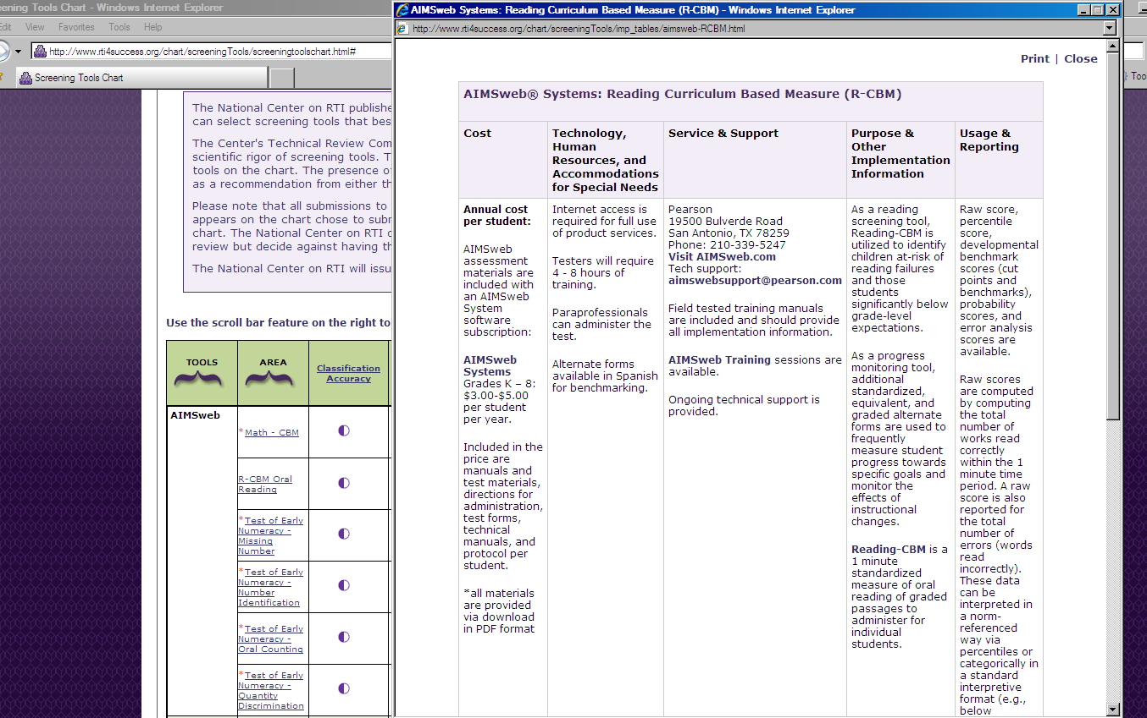
Content and Language of Chart
Implementation Requirements:
Click name of tool to view “implementation table”
  Cost of tool?
  Training required to implement tool?
  Level of expertise required to administer tool?
  Training and technical support offered?
  How are scores reported?
Notes:
Ideally, demonstrate the most updated version of tools chart on the website instead of the following screenshots.
The tools chart offers an “implementation table” for each tool, which can be accessed by clicking on the name of the tool. The implementation table includes the following information:
Cost of the tool
Training required to implement the tool
Level of staff expertise required to administer the tool
Where to go for training and technical support
How scores are reported
This information is provided by the vendor.

Slide 86
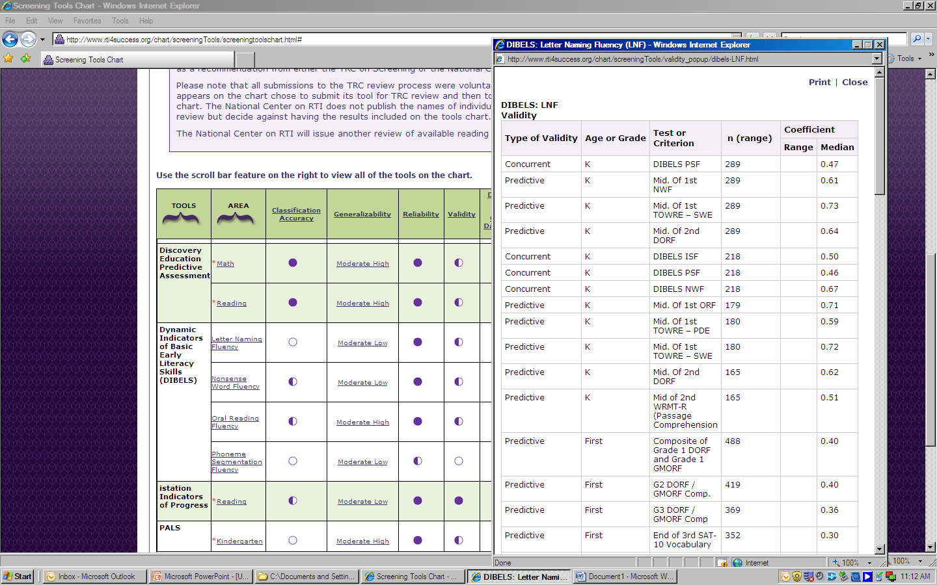
Content and Language of Chart
Data:
  Detail about data submitted to TRC.
  Look for tools that conducted classification studies with outcome measures and samples similar to your population and outcome of interest.
  More information to help you determine which tool(s) is most appropriate for which populations of students.
Click on any rating bubble to view data
Notes:
Ideally, demonstrate the most updated version of tools chart on the website instead of the following screenshots.
The tools chart also includes detail about the actual data that were submitted to the TRC for review. These data can be viewed by clicking on any of the rating bubbles in the cells in the chart.
We recommend that you look for tools that conducted classification studies with outcome measures and samples similar to your population and outcome of interest.
By clicking on the rating bubble, you will obtain more information about which tool(s) is most appropriate for which populations of students.
We recommend that someone on the team is familiar with data and can explain the ratings.

Slide 87

5. Review for Data
Notes:
Ideally, demonstrate the most updated version of tools chart on the website instead of the following screenshots.
Examining these data can be useful for a number of reasons. You may see two or more tools that received the same rating for a particular standard. But in these cases, how do you know which one really best meets your needs? By clicking on the rating and viewing the actual data, you have more information to help you determine which tool is most appropriate. For example, for classification accuracy, the chart includes statistics about how well a tool classifies students, as well as the outcome measure and details about the sample that was used to generate such statistics.
The detailed data can also help you determine the tools that are most appropriate for certain subgroups of students. For example, your district or subgroup of interest may be comprised mostly of English language learners (ELLs). Therefore, you may be interested in how accurately the tool classifies students into risk categories, how reliable it is, and how valid it is, for only the ELL subgroup. By clicking on the bubble in the disaggregated data column, you will be able to see detailed data about how well the tool works among various subgroups.

Slide 88
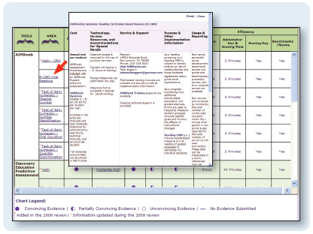
6. Ask for More Information
Notes:
Ideally, demonstrate the most updated version of tools chart on the website instead of the following screenshots.
You may find that the tools chart does not provide you with all the information you need. For example, what if a tool in which you are interested does not have disaggregated data for a particular subgroup that is important to you? We recommend you ask the vendor or developer. Developers who have chosen to submit their tools for review and publish them on the chart are interested in meeting the needs of their customers. As such, they are interested in doing more research to provide the data that you need. Similarly, if a tool that you currently use or are interested in learning about is not on the chart, call the developer of that tool. Let them know about the TRC review process and the tools chart, and ask them to consider submitting the tool for review.
The tools chart provides publisher contact information in the pop-ups found in the second column.

Slide 89
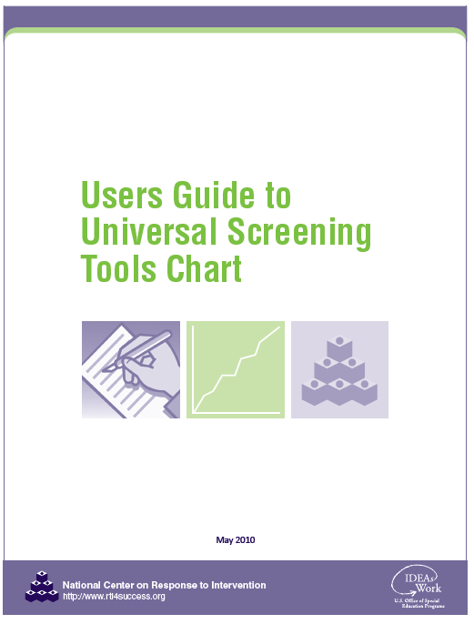
The NCRTI Screening Tool Chart User Guide
Notes:
Ideally, demonstrate where to find this on the website instead of the following screenshots.
For more information about the six recommended steps for using the screening tool chart and selecting a tool, check out the NCRTI User Guide available for download on the NCRTI website, www.rti4success.org

Slide 90
Timeframe
Screening typically occurs at least 3 times year
  Fall, winter, spring
  Should remain consistent across school years and sites
  Screeners must target skills pertinent to the grade and time the screen is administered.
Delivery option:
  Individually administered test: approximately 1-5 minutes
  Class-wide tests: range from 2-60 minutes
Notes:
When do we screen and how long does it take to screen?
Screening typically occurs at least 3 times year in the fall, winter, and spring. Screening should remain consistent across school years and sites and must target skills pertinent to the grade and time the screen is administered.
Screeners can be delivered in two ways. Screeners can be individually administered tests, which take approximately 1 to 5 minutes. They can also be class-wide tests, which range from 2 minutes to 60 minutes.

Slide 91
Team Time: Screening
Review Screening Tools Chart
  What screening tools in math and reading have high classification accuracy, reliability, and validity?
  Are your tools there? What evidence exists for their reliability and validity?
Notes:
Read slides.
Allow 10-15 minutes for teams to look more closely at the screening tools chart, either online if computers are available, or printed copies. The time for this team time activity will depend of the needs of the group. If time allows, consider having two or three teams to share their tools and the evidence they found that supports its validity and reliability.

Slide 92
THINK-PAIR-SHARE
How has what you heard challenged your thinking about screening?
How has it confirmed your thinking?
Notes:
This is a good activity to complete right before breaking. The purpose of the activity is to engage the audience and allow them to think about what challenged or confirmed their thinking about screening
Think about….
How has what you heard challenged your thinking about screening?
How has it confirmed your thinking?
Give participants approximately 20 seconds.
Pair and share with your neighbor/table.
Give participants approximately 2-3 minutes.
If time allows, consider having several partners share with the larger group.

Slide 93
Using Screening Data for Decision Making
Notes:
Decision making is an essential part of any RTI model. As we saw earlier in the diagram of the RTI framework, data-based decision making is part of the screening process, and data from the screening process are used for a variety of educational decisions. Data-based decision making is not just for student-level decisions. RTI asks entire systems (schools, districts, states) to use data-based procedures at all levels of implementation.
The following are key terms and main points that should be focused on during this segment of the presentation.
Key Terms:
Cut scores, benchmarks, and targets
Norm referenced
Criterion referenced
Box and whisker plots
Target identification rate
Main Points:
Screening data can help answer key questions about the effectiveness of curriculum and instruction, and inform allocation of resources.
Screening measures are not perfect, so you need to be aware of screeners’ strengths and weaknesses as you select and use them.
If possible, districts should establish cut scores, so there is consistency and comparability within the district.
Teams should establish routines and procedures for conducting data reviews, establish decision-making processes, and establish explicit decision rules for assessing student progress.
Data analysis is important for identifying students who need additional assessment and instruction, evaluating effectiveness of core curriculum and instruction, allocating resources, and evaluating effectiveness of instruction programs for target groups (e.g., ELL, Title 1).
Be purposeful in data analysis – determine what you are looking for at all levels (school, district, state).
Your purpose should determine what data you use and how you choose to interpret your data.

Slide 94
District Educational Decisions: Screening
Program Improvement and Curriculum Decisions
Innovation and Sustainability Decisions
  General Effectiveness of Implementation
  General Effectiveness of RTI Model
Ensure Equitable Services and Supports Across Schools
  Access to supplemental supports
  Access to effective instruction
  SLD identification
Allocation of Resources and Professional Development
Notes:
This slide should help explain why screening is important for districts. Screening is more than just determining who needs interventions; the data informs district level decisions about support and allocation.
District level decisions related to screening include:
Read slide.

Slide 95
School Educational Decisions: Screening
General school and grade level trends or issues
Effectiveness of school wide curriculum and instructional delivery
Areas of need and guidance on how to set measurable school wide goals
Notes:
This helps answer the question why screening is important for schools.
School level decisions related to screening include identifying:
General school trends or issues, and then grade level trends
Are there holes in grade level performance?
Do we lose subgroups of students at certain times?
Effectiveness of school wide curriculum and instruction delivery
Is there consistent performance across grade levels? For example, data may indicate consistent growth from grades 1-4 and then a significant drop in performance when students reach 5th grade. This may be an indication that 4th grade instruction/curriculum is not adequately preparing students for 5th grade expectations.
Areas of need and guidance on how to set measurable school wide goals

Slide 96
Grade Level Educational Decisions: Screening
Grade level trends or issues
Effectiveness of grade level curriculum and instruction
Areas of need and guidance on how to set measurable grade level goals
Students who may need additional instruction or assessment
Notes:
This helps answer the question why screening is important at the grade level.
Grade level decisions related to screening include identifying:
Read slide.

Slide 97
Requirements for Educational Decisions: Screening
How do you know who is at-risk?
Cut score
A cut score is a score on a screening test that divides students who are considered potentially at-risk from those who are considered not at-risk.
Notes:
Depending on time available, you may chose to have the audience participate in the following activity. If time is not available, you may omit the audience participation aspect of this slide.
Think how you know who is at-risk.
Give participants approximately 20 seconds.
Pair and Share with your neighbor/table discuss.
Give participants approximately 2-3 minute.
If time allows consider having several partners share with the larger group
A cut score is a score on a screening test that divides students who are considered potentially at-risk from those who are considered not at-risk. Cut scores might also be referred to as cut-points or targets depending on the tool. It is important to remember that cut scores used to identify students as at-risk may not be the same way you identify students for supplemental support. We refer to this as target identification rate and will talk in more detail about this later.

Slide 98
Identifying Students as At-risk
RTI success depends on accurate identification of the students identified as at-risk.
Perfect screening would result in 100% accurate identification of “True Positives” (those who need additional support) and “True Negatives” (those who do not need additional support).
Cut scores for screening tools are often set to over-identify students as at-risk.
Notes:
RTI success depends on accurate identification of the students identified as at-risk. This is essential for preventing costly identification errors.
Perfect screening would result in 100% accurate identification of “True Positives” (those who need additional support) and “True Negatives” (those who do not need additional support).
Cut scores are often set to over-identify students as at-risk. Your choice of cut score will affect classification accuracy (sensitivity and specificity). In order to avoid inappropriately identifying students who do not need interventions, progress monitoring may need to be conducted on identified students before moving them into an intervention. This will be explained in more detail in the Progress Monitoring Module.

Slide 99
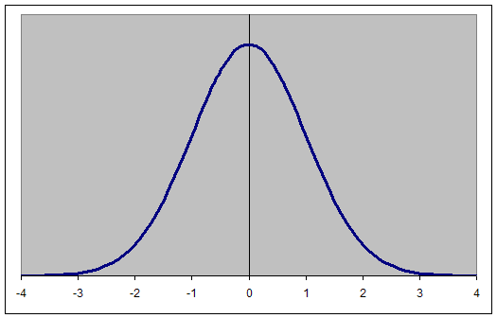
Categorical vs. Continuous
Arbitrary cut score
True Negatives & False Negatives
Number of students
True Positives & False Positives
Scores on a measure of reading/math
Notes:
Risk can be identified in two ways
The first way is categorical – meaning the screener clearly indicates risk. For example, given the results of a particular test, you are either diabetic or you are not.
The other way is continuous – meaning that a student’s performance falls along a bell curve (some kids will do well, and others will not). However, his/her performance on the screener does not 100% accurately predict risk status. The cut score is the best guess (based on existing data) of who may or may not be at-risk. However, other factors may lead to the over identification or under identification of students (e.g., student was sick on test day, student is a word caller but lacks comprehension).
The establishment of a logical cut score is essential for accurately identifying students for additional assessment and supports and evaluating the effectiveness of the support system.

Slide 100
Clinical Decision Making Model
True Positive – students correctly identified at-risk
False Positive – students incorrectly identified at-risk
False Negative – students incorrectly identified not at-risk
True Negative – students correctly identified not at-risk
Outcome
at-risk
Not at-risk
True Positive
False Positive
at-risk
Screen
False Negative
True Negative
Not at-risk
Notes:
Screening tools in education are rarely 100% accurate since there are so many variables that can affect performance.
Ideally, the screener would only indicate that a student is at-risk if she is at-risk. When students are correctly identified at-risk, it is called a true positive.
Point to the chart to show the boxes where students are screened as “at-risk” and the outcome is “at-risk.”
We also would like the screener to indicate that a student is not at-risk if she is not at-risk. When students are correctly identified as not at-risk, it is called a true negative.
Point to the chart to show the boxes where students are screened as “not at-risk” and the outcome is “not at-risk.”
Unfortunately screeners are not perfect. The screening tool might indicate that a student will be at-risk when in fact he was not at-risk. A case where the screener indicates that a student is at-risk and the actual outcome shows that the student was not at-risk, is called a false positive (or a false alarm); students are incorrectly identified at-risk.
Point to the chart to show the boxes where students are screened as “at-risk” and the outcome is “not at-risk.”
Alternatively, the screening tool might show that the student was not at-risk when in fact he was. This is called a false negative because the screener indicated that he was not at-risk when the outcome shows that he was at-risk. In this case, students are incorrectly identified as not at-risk.
Point to the chart to show the boxes where students are screened as “not at-risk” and the outcome is “at-risk.”
We use additional screenings (e.g., winter) and follow up assessment (e.g., progress monitoring) to verify the accuracy of these results.
Screening tools vary in their sensitivity and specificity. Sensitivity is the extent to which a screening measure accurately identifies students at-risk for the outcome of interest. Specificity is the extent to which a screening measure accurately identifies students not at-risk for the outcome of interest.

Slide 101
Comparison Based on Changing the Cut Score
Example 1: Overlapping distributions
Example 2: Overlapping distributions with lowered cut score
TP
FP
TP
FP
80
20
95
5
cut score
(i.e. 65 wpm)
cut score
(i.e. 55 wpm)
FN
TN
FN
TN
35
65
20
80
Poor Readers
Poor Readers
Good Readers
Good Readers
80%
80%
65%
95%
20%
20%
5%
35%
Number of items correct on screening instrument
Number of items correct on screening instrument
Notes:
Regardless of the type of cut score (e.g., local norm, national norm), if you change the cut score you influence the number of students accurately identified or inaccurately identified.
Example 1: In the example on the left, we accurately predicted 80% of the true positives (screened at-risk and were at-risk) and 80% of the true negatives (screened as not at-risk and were not at-risk) while over identifying about 20% and under identifying 20% of students. In other words, our data indicated 20% of students needed support when they really did not while not identifying 20% who actually needed it.
Example 2: In this example, the cut score was lowered. With the new cut score, we accurately predicted 95% of the students at-risk and incorrectly identified about 5% as at-risk when they were not (false positive). In changing our accuracy we misidentified 35% of students who actually needed services as not at-risk.
With most screening assessments, the typical goal is to minimize the number of false negative classifications (consistent with Example 1). This means that screening measures will often OVER-IDENTIFY students who may be at-risk so that teachers do not miss those who require extra support. At the same time, over-identification can be expensive so it is important to monitor students who are initially identified as at-risk with diagnostic and/or progress monitoring assessments to verify their low achievement. This issue will be addressed in greater detail during Module 2.

Slide 102
Setting Realistic Cut Scores
Poor Readers
Good Readers
Number of items correct on screening instrument
Notes:
So where do we set the cut score?
The lines represent options for the cut scores.
Typically the best cut score is the one that produces the most accurate representation of who is at-risk and who is not at risk, as shown with the center line. In this example, we are likely to identify students as at risk as accurately as we identify students not at risk. We know that follow up progress monitoring and screening will help increase the accuracy of the identification rate.
The cut score can be adjusted to meet the needs and priorities of schools or districts. They may ask themselves…
(click for animation) Do we increase our accuracy by correctly identifying all students who are not at-risk but accept the possibility of missing a larger group of students who are at-risk?
Point to the line farthest to the “poor readers” side of the graph.
(click for animation) Or do we increase our accuracy in correctly identifying students at-risk while increasing the number of students we overidentify?
Point to the line farthest to the “good readers” side of the graph.
Regardless of what cut score is used, it is critical that those interpreting the data understand the reason for the selected cut score.
The Think/Pair/Share activity is optional. The purpose of the activity is to engage the audience and conduct an informal assessment of the audience’s conclusions from the session.
Think to yourself about the current cut score your school currently uses. Do you believe it over or under-identifies students?
Give participants approximately 20 seconds.
Pair and share with your neighbor/table and discuss.
Give participants approximately 1 minute.
Allow 2 or 3 pairs/tables to orally share their lists if time allows.

Slide 103
Over vs. Under Identification
Public Health
Overidentification
  Expense of additional testing
  Unnecessary worry
Underidentification
  Miss serious health problem
Education
Overidentification
  Expense of additional testing
  Expense of early intervention services
  Missed instructional time in other content areas
Underidentification
  Miss opportunity for prevention/early intervention
Notes:
The risks associated with the over and underidentification of students are similar to the risks found in Public Health.
Review the slide with participants.
To combat the costs associated with over identification, we use additional assessments, such as progress monitoring, to confirm or disconfirm the initial screening results.

Slide 104
Screening: Establishing Cut Scores
Logical practices to establish cut scores indicating skill proficiency
  National cut scores (e.g., AIMSweb, DIBELS, also see Hasbrouck & Tindal, 2006)
  Local norms
  Cut scores based on likelihood of demonstrating mastery on core testing
Typically based on statistical analysis
Notes:
Establishing a cut score should be based on logical practices and be educationally relevant.
Some screening tools include national norms to establish cut scores. See Hasbrouck and Tindal (2006) for additional information.
You could also use local norms as cut scores. Some data systems provide users the tools to develop local cut scores based on outcomes on high stakes tests. Similar district assessment tools and cut scores allow for comparisons across schools.
You could also use cut scores based on the likelihood of demonstrated mastery on core testing. This is also known as benchmark testing. A benchmark is a pre-determined level of performance on a screening test that is considered representative of proficiency or mastery of a certain set of skills.
Cut scores, although consider arbitrary, are typically based on statistical analysis (e.g., ROC curves, correlations)
References
Hasbrouck, J & Tindal, G.A. (2006). Oral reading fluency norms: A valuable assessment tool for reading teachers. The Reading Teacher, 59, 636-644.

Slide 105
Screening
Video 2: Establishing cut scores
Notes:
Here’s a short clip of two principals discussing how they established their cut scores.
Play the video (1:13 minutes).
Establishing Cut Scores: http://www.youtube.com/watch?v=l0lLkDicXZA

Slide 106
Benefits of District Over School Established Cut Scores
More effective and efficient allocation of resources
Increased buy-in and use of data by schools/teachers
Common message and focused activities
Increase equity in access to supplemental supports
Notes:
There are some benefits for using district established cut scores as opposed to using school established cut scores. District established cut scores may lead to:
More effective and efficient allocation of resources
Target schools with greatest need
Identify effective approaches for scale up in other sites
Decisions about resources are based on data
Decisions about resource allocation are more relevant and timely
Increased buy-in and use of data by schools/teachers
Districts can clearly justify why changes are being made (e.g., data demonstrate that new curriculum is not working at most sites, data demonstrate school X has greater need thus requires more resources)
Common message and focused activities
Expectations across sites are clear and consistent
Changes from performance on outcomes alone to progress (even in highest performing sites)
TA and PD activities are based on data showing needs of sites
Increase equity in access to supplemental supports This last bullet point will be illustrated by an example on the next slide.

Slide 107
Problems with Schools Independently Establishing Cut Scores
School | Percent At or Above School Cut Score
School 1 | 50%
School 2 | 63%
School 3 | 48%
Notes:
Let’s look at three schools in the same district. These schools all established their own cut scores. From this table, which school appears to be doing the best? School 2.
Which school or schools appear to have the greatest needs? Schools 1 and 3.
Numbers alone can be deceiving. If districts allocate resources based on school based cut scores, students in school 1 and school 3 would receive equal amounts of resources. The question is are we comparing apples to apples?

Slide 108
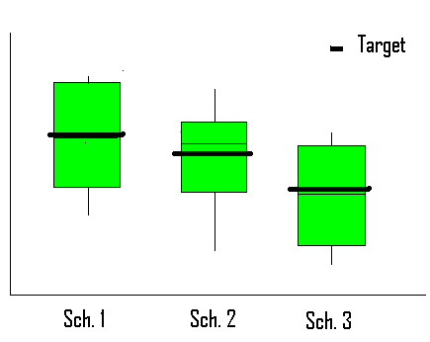
Problems with Schools Independently Establishing Cut Scores
63%
48%
50%
Notes:
If we look at the actual performance comparisons graphically we notice that school 1 significantly out-performs school 3. While School 1 only has 50% of students at or above the cut score, their cut score is higher than the cut scores for school 2 or school 3. Since each school established its own cut score, it is difficult for districts to determine the actual number of students at-risk and make comparisons across schools.

Slide 109
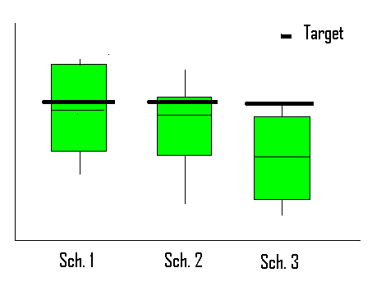
Importance of District Cut Scores
20%
4%
44%
Notes:
Using a district established cut score, it becomes clear that School 3 has a much lower percentage of students at or above the cut score (4%) than either School 1 (44%) or School 2 (20%). School 3 would likely receive more intensive supports from the district since it demonstrates the greatest educational need. Even School 2, which had the highest percentage of students at or above the cut score in the school based example (63%), only has 20% at or above the district established cut score. A standard cut score or target (as seen in this graph) across the district provides a more accurate picture of performance across the district and provides more accurate data for allocating district resources and targeting district supports.

Slide 110
Team Activity: Establishing Cut Scores
How does your district determine which students are at-risk?
  If a clear definition is available, how can you ensure it is known by all sites? How is it used?
  If one does not exist, what are your next steps?
Notes:
As a team, take 5 minutes to discuss the following questions.
Read the slide aloud.
Give teams 5 minutes to discuss (you may adjust this time period based on time available, audience participation, etc.) You may want to ask 2 or 3 teams to share how their districts determine which students are at-risk.

Slide 111
Establishing Routines & Procedures for Data Decision Making
Teams should establish:
Routines and procedures for conducting data reviews
Decision- making processes
Explicit decision rules for assessing student progress
Notes:
We recommend teams establish routines and procedures for conducting data reviews, establish decision-making processes, and establish explicit decision rules for assessing student progress. This is an important task for district teams to accomplish so that there is some consistency across schools.

Slide 112
Conducting Data Reviews
Conduct data reviews at logical, predetermined intervals
Schedule data reviews prior to the beginning of instruction
Use established meeting structures
Involve relevant team members
Notes:
It is important to develop routines and procedures for how your team will review data. We recommend that you:
Read slide.

Slide 113
Screening
Video 3: Data Review Process
Notes:
Learn from several principals about the importance of general education teacher involvement in the data review process.
This video helps stress that the screening process is not pre-referral for special education, but is rather a preventative process for all students within general education.
Play video (4:51 minutes). General Education Teachers Video: http://www.youtube.com/watch?v=IWMapp3AIkA
If time is available, consider having teams discuss how general education teams are involved in data review in their schools/districts.

Slide 114
Data-decision Making Routines and Procedures
Articulate routines and procedures in writing
Implement established routines and procedures with integrity
Ensure routines and procedures are culturally and linguistically responsive
Notes:
We recommend having established routines and procedures for data-based decision making. In other words, what steps are you going to follow in order to use the screening data to make decisions?
Articulating routines and procedures in writing helps ensure and assess if established routines and procedures are being implemented with integrity. Ongoing evaluation of the selected routines and procedures is necessary to ensure they are culturally and linguistically responsive and lead to the desired outcome.

Slide 115
Establishing Routines and Procedures
Consider clarifying the following in writing:
What you are looking for?
How will you look for it?
How will you know if you found it?
Notes:
Consider clarifying the following points in writing prior to implementation.
What are you looking for?
Data fishing can be fun, but may lead to problems. It can cause sites to delay the use of data (especially if there are a lot of data), change the focus of the analysis, and miss important trends or issues. Identify what you are interested in knowing prior to your data analysis. If you are unclear what you are looking for, conduct an analysis of the more critical outcomes first (graduation, reading performance) and then focus on outcomes in other areas. It is important to prioritize.
Identify what you are looking for at all levels of analysis (district, school, grade, class, students) and levels of prevention (efficacy, struggling students)
How will you look for it?
Develop a plan for how you will systematically analyze your data. This can increase the efficiency of your data analysis activities. It also helps manage the output many data systems offer. Only the most critical data are needed at first. It allows you to know where to delve deeper.
How will you know if you found it?
Determine how much evidence is needed for the team to identify success or lack of success. Once identified the team can continue moving through the problem solving process in order to develop a plan of action.

Slide 116
Examples of Explicit Decision Rules
Consider articulating in writing, what happens when:
More than 80% of students are above the cut score
Less than 80% have reached the cut score
Lack of progress is evident
Student progress varies by target group (e.g., Title 1, special education, low SES)
Notes:
We also recommend that you have established decision rules.
Consider articulating in writing, what happens when certain things occur:
More than 80% of students are above cut score
Less than 80% have reached the cut score: Do we strengthen the core instruction and curriculum? Do we add an intervention?
Lack of progress is evident: What do you do? Do you make a plan?
Student progress varies by target group (e.g., title 1, special education, low SES)
Decision rules should be established at all levels including class, grade, and school.

Slide 117
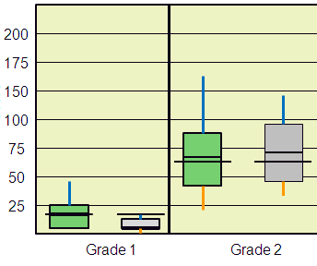
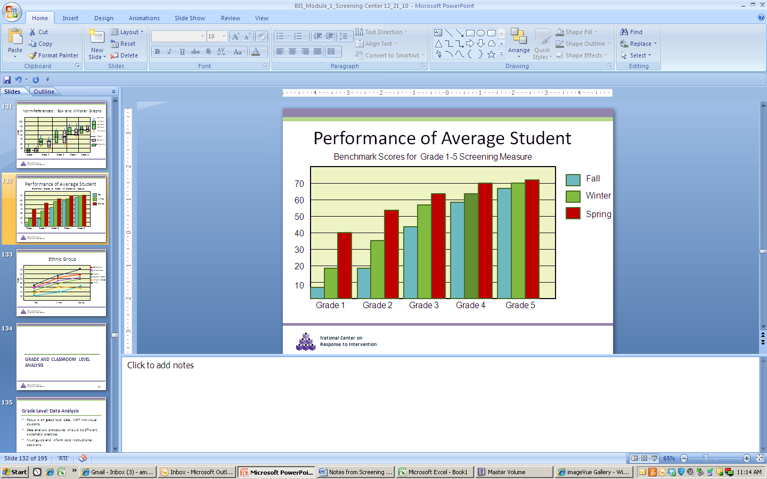
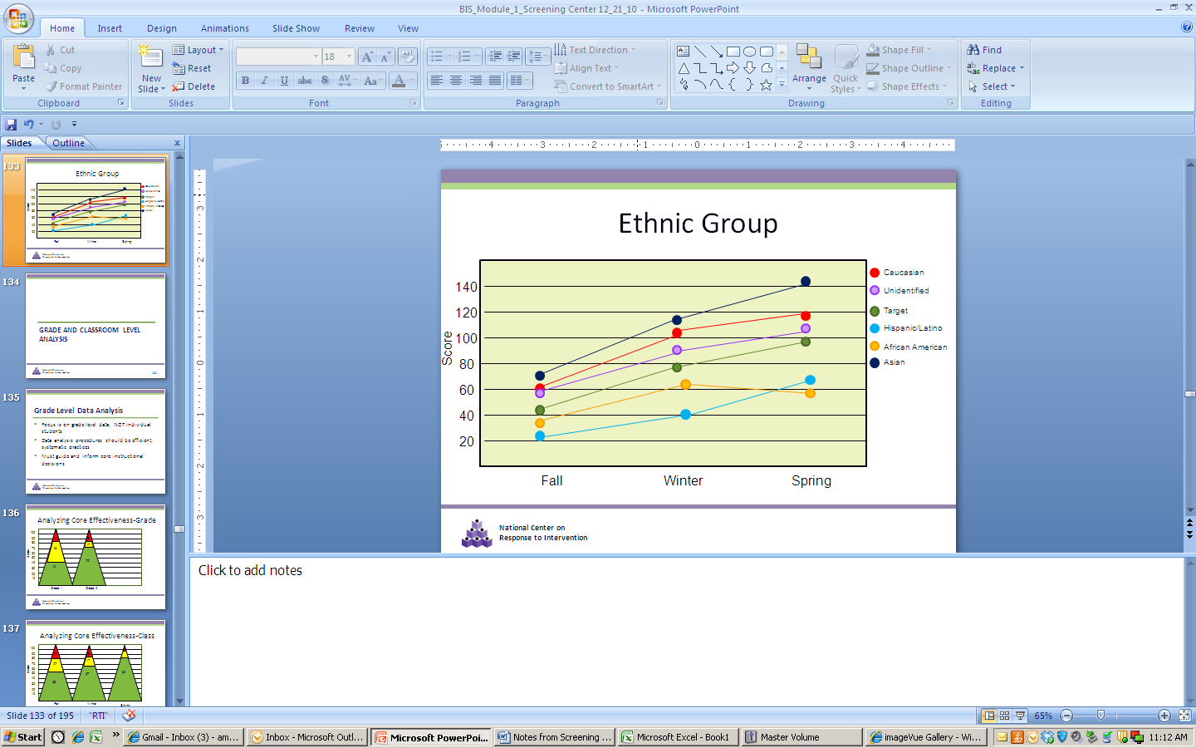
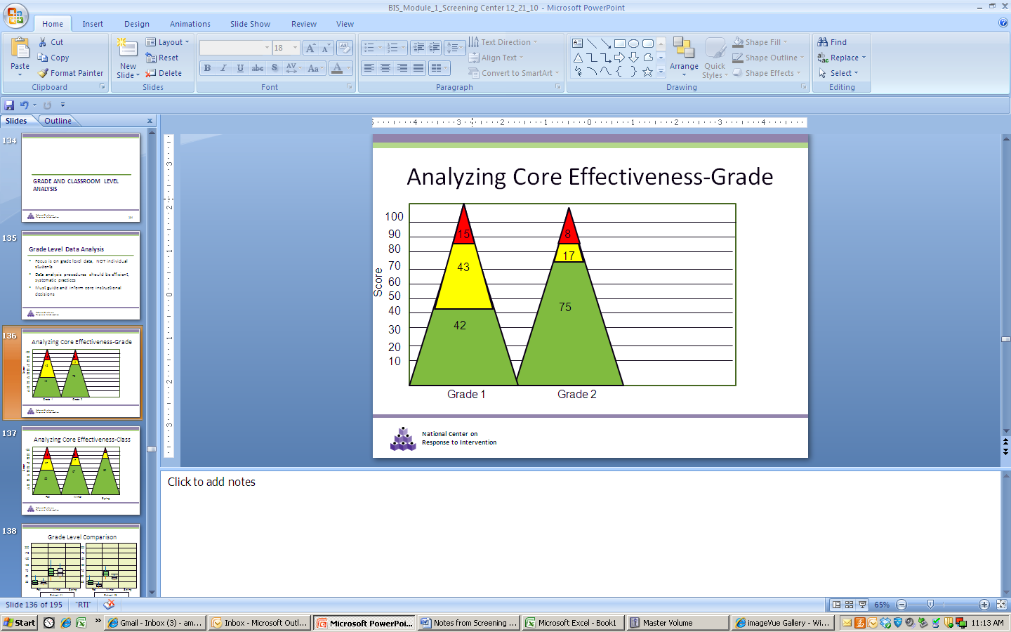
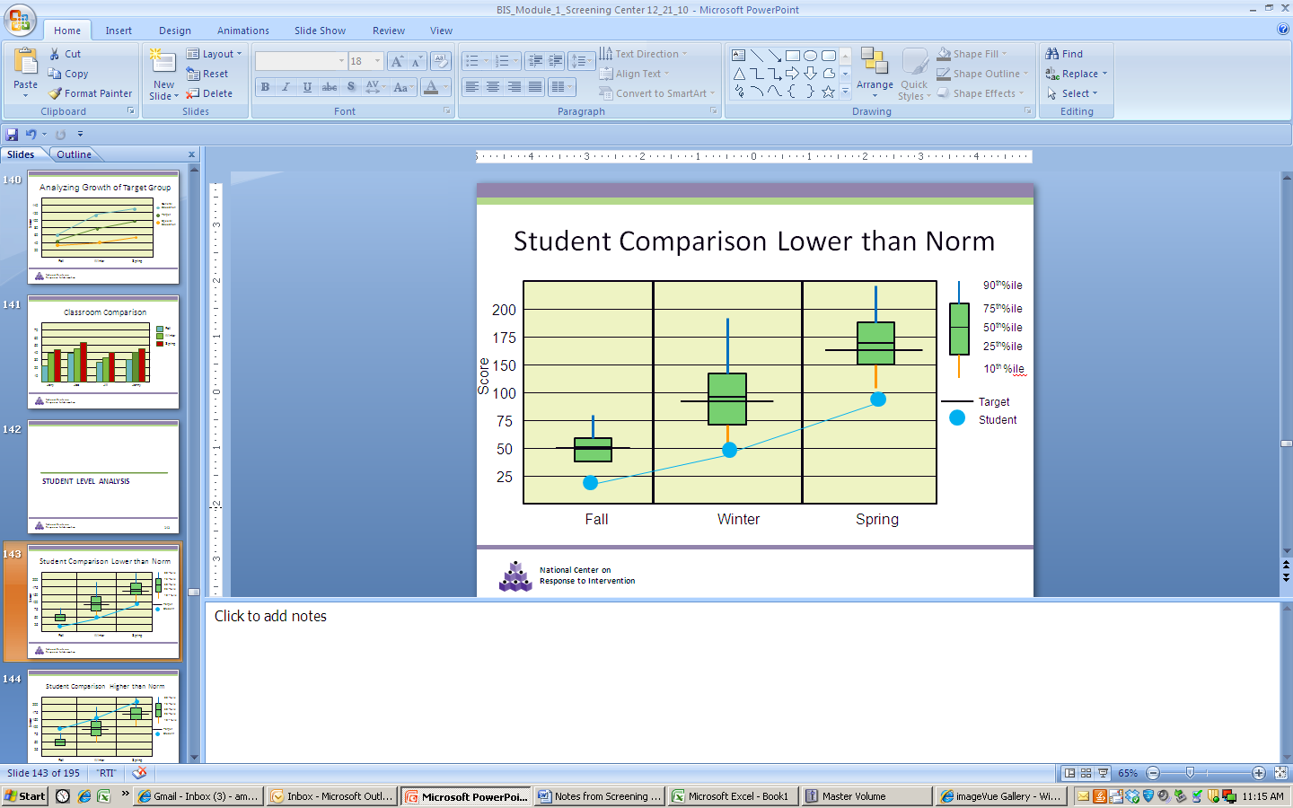
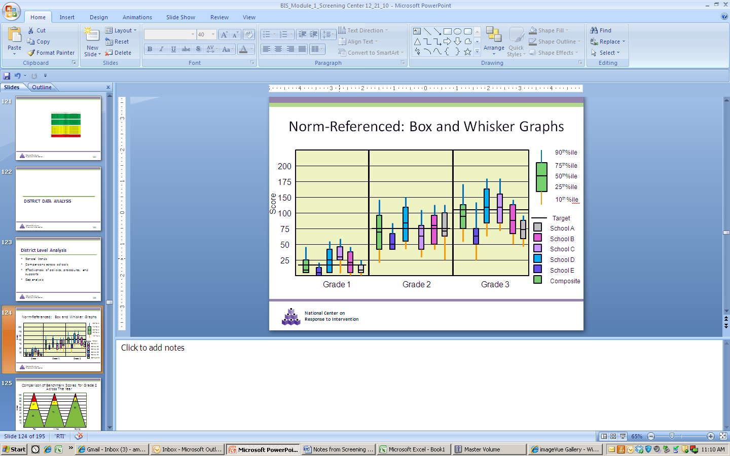
Data Analysis
Notes:
Data collection is not nearly as difficult for teams as data analysis. Screening data can assist teams in answering many of the questions they are asking. However, data analysis can become overwhelming.
Click on slide for animation.
This graphic demonstrates how overwhelming data analysis can be. Many data systems provide users more outputs than they know what to do with. Teams struggle with where to start, what data are most important, and what data provide the information we are looking for. Data systems can help manage data; however, if we are unfamiliar with the data system and what it has to offer, we may be paralyzed by its outputs. We will discuss the different types of data analysis that can be done with screening data further in this section.

Slide 118
Data Analysis
Data analysis should occur at the:
  District Level
  School Level
  Grade/Class Level
  Student Level
Notes:
Read the slide.
Identify what you are looking for at all levels of analysis (district, school, grade, class, students) and levels of prevention (efficacy, struggling students).

Slide 119
Purpose of Data Analysis
Identify students who need additional assessment and instruction
Evaluate effectiveness of core curriculum and instruction
Allocate resources
Evaluate effectiveness of instruction programs for target groups (e.g., ELL, Title 1)
Notes:
Read the slide.

Slide 120
Team Activity: Purpose
What is our purpose for screening?
Notes:
In teams, you will now use Handout 1: Purpose for Screening to identify a shared purpose for screening. We will now pause so you can complete it. As a team, discuss your purpose for screening and record your answers.
Directions for this activity are written on the top of the handout. It may be helpful to review the directions with participants.
Allow 5 to 15 minutes for this activity. When approaching this activity, prompt teams to focus on the district level first and then school level second and so on.
Prompts you can use to encourage discussion among teams: What you are looking for (i.e., what do you want to know)? Why are you screening?

Slide 121
Commonly Confused Terms
Cut Score - score on a screening test that divides students who are considered potentially at-risk from those who are considered not at-risk.
Target or Benchmark - pre-determined level of performance on a screening test that is considered representative of proficiency or mastery of a certain set of skills.
Criterion scores – scores on a screening test that separate students into performance levels (e.g., established, emerging, deficient)
Notes:
These are some of the more common, and sometimes confused, terms you may see while analyzing and interpreting data. You may have seen the terms used the interchangeably, especially by publishers of screening tools. For purposes of this presentation, we refer to these terms as follows.
Read the slide.
The target or benchmark is more often than not the same score as the cut score, especially when the cut score is predictive of the state test. However, it does not have to be. For example, schools or districts may choose to set higher benchmarks or targets that are predictive of higher standards while setting cut scores to be more predictive who is at-risk and not at-risk. This is why it is essential for teams to understand how the cut scores, targets and benchmarks were established. The term “cut score” is sometimes used to refer to criterion scores that separate students by performance levels – commonly viewed by green (e.g., primary), yellow (e.g., secondary), and red (e.g., tertiary) highlighted students. It is important to remember that the purposes of these two terms, cut score and criterion score, are very different. We will talk more about this in a bit.

Slide 122
Interpreting Screening Data
Norm Referenced
Criterion Referenced
Target Score
Notes:
Before we begin analyzing some sample data, it is important to make sure everyone understands how screening data may be presented. Although we will be looking at fictitious data, the procedures we will be using can be applied to almost any type of data. (It is important to stress this point with the audience.)
Screening data can be interpreted in several different ways. What you are interested in (comparing students, determining the number of students at-risk) will determine what data you use (norm referenced, criterion referenced, or target scores) and how you choose to interpret your data. We will discuss each of these further.

Slide 123
Norm-Referenced
Students are measured against others, NOT a defined criteria.
Permits a fixed proportion of students to pass and fail.
  This means that standards may vary from year to year, depending on the quality of the cohort;
Effective way of comparing students.
Notes:
If you are using norm-referenced data,
Read the slide

Slide 124
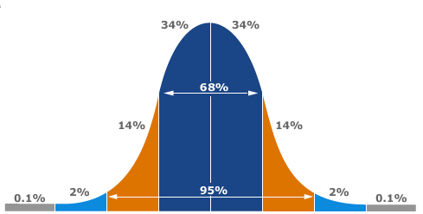

Norm-Referenced: Bell Curve
Above 90th percentile
Above Average Range
90th percentile
Average Range (middle 50%)
  75th percentile
  Median (50th percentile)
  25th percentile
Below Average Range
10th percentile
Notes:
In norm referenced data, we are comparing an individual against his or her peers. A common way these data are represented is through a bell curve.
In the middle, we find a mid-point (median) or the 50% percentile. Half of the population is to one side of the line and the other half is on the other. In a normal distribution, the majority of people fall near the middle (creating the perception of an average). The farther away from the middle the less people you will find. In the education field, we typically imagine students who are very high achievers on the right end and very low achievers on the left end. In a typical classroom, we would expect a similar distribution of skills among students, with very few high and low achievers, and the majority of students possessing similar skills.

Slide 125
Norm-Referenced: Box and Whisker Graphs
90th %tile
75th %tile
50th %tile
25th %tile
10th %tile
Notes:
Box-plots are common ways to graphically present norm-referenced data. Think about the bell-curve turned on its side; what you end up getting is a box plot. Box plots are somewhat similar in shape and representation. In a bell curve, the middle line is the median score, or 50%tile; in the box plot, it is the middle line. The box represents the majority of the population, 25%-75%tiles, while the lines above and below represent the 75-90%tiles and 10-25%tiles, respectively. Students who fall above or below the box are considered to be outliers.
Box plots are helpful in comparing different groups or cohorts of students. They focus on where the average students fall, instead of the outliers.

Slide 126
Norm-Referenced: Box and Whisker Graphs
Benchmark Scores for Grade 2 Screening Measure
70
60
Score
Above Average
50
40
Average
30
Below Average
20
Student
10
Fall
Winter
Spring
Notes:
All data presented in this presentation are fictitious but representative of data that a school or district may use.
This is an example of individual student data for a grade 2 screening measure. This box plot compares an individual student to his peer group. The class or grade is represented in the box plot. This level of analysis would be appropriate for identifying students in need of supplemental support.
Ask the audience to identify the average score (~45), what students in the 90th percentile scored (70), what students in the 10th percentile score (~15), and what the student in this case scored (~8).
In this example you can see that the student is performing well below his peer group.

Slide 127
Norm-Referenced: Box and Whisker Graphs
90th%ile
200
75th%ile
50th%ile
175
25th%ile
Score
150
10th %ile
100
Cut score
75
School A
50
Composite
25
Grade 1
Grade 2
Grade 3
Notes:
Norm referenced data allows us to make comparisons of groups, in this case a school, to other schools. This type of analysis would be helpful in identifying which grades need additional support.
Note: For more advanced participants, consider a discussion about the data. The green box plot (or comparison group) provides a composite of all students in a state who have completed the same screening measure for that grade level in the Fall. The grey box is School A’s scores and the black line is the target score. How does this school’s 1st grade compare to the state’s composite norm for 1st grade?
Although the median score for the state is below the target score, the majority of 1st grade students in this school are below the target, this school performs much lower than the norm. However, in grade 2, the school is performing slightly better that the norm (the 25th, 50th and 75th percentile are higher).
What about third grade performance in comparison to their peers?
For grade 3, the state norm is well below the target score. But even worse, is that all students in this school are performing below the target. It may be worth noting here that since most students, including those in the comparison group, are performing below the target, teams may need to determine if larger systemic issues are affecting student performance (e.g., ineffective policies, district curriculum, or teacher training).

Slide 128
Criterion Referenced
Students are measured against defined (and objective) criteria.
Criterion-referenced assessment is often, but not always, used to establish a person’s competence (whether s/he can do something).
Criteria typically do not vary from year to year (unless the criteria change).
Notes:
If you are using criterion-referenced data,
Read the slide
With norm-referenced data, we were comparing between students, but with criterion-referenced data we are comparing to a pre-set criterion.

Slide 129
Criterion Referenced
There are multiple ways to determine the criterion. One example is percentile ranks:
  Below 10%tile = deficient
  10%tile - 25%tile = emerging
  Above 25%tile = established
Notes:
Read the slide

Slide 130
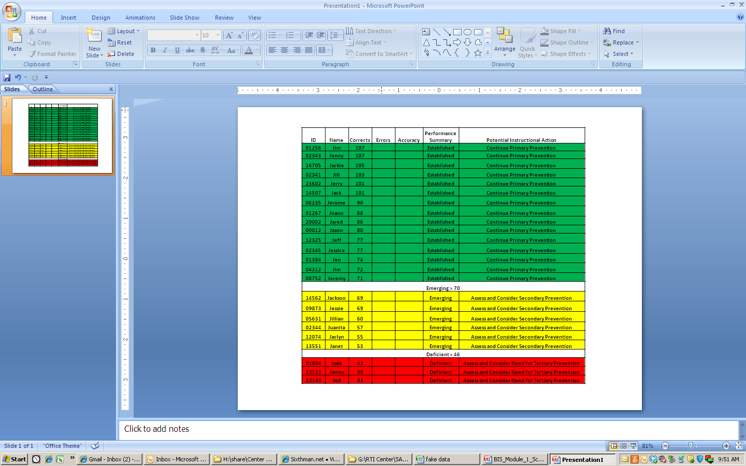
Notes:
This type of data representation is what we often associate with the triangle. In fact if you turn this upside down (click for animation), you will see where the triangle graphic originates.

Slide 131
Norm Referenced
vs. Criterion Referenced
ID | Name | Corrects | Errors | Accuracy | Performance Summary | Potential Instructional Action
Cut score=77
1256 | Jim | 73 |  |  | Well Above Average | Continue Primary Prevention
2343 | Jenny | 70 |  |  | Well Above Average | Continue Primary Prevention
16705 | Jackie | 69 |  |  | Well Above Average | Continue Primary Prevention
Well Above Average =68 (90th percentile)
2341 | Jill | 67 |  |  | Above Average | Continue Primary Prevention
23602 | Jerry | 67 |  |  | Above Average | Continue Primary Prevention
14507 | Jack | 67 |  |  | Above Average | Continue Primary Prevention
6235 | Jerome | 67 |  |  | Above Average | Continue Primary Prevention
1267 | Joann | 67 |  |  | Above Average | Continue Primary Prevention
Above Average =66 (75th Percentile)
20002 | Jared | 60 |  |  | Average | Continue Primary Prevention
2345 | Jessica | 58 |  |  | Average | Continue Primary Prevention
1384 | Jen | 58 |  |  | Average | Continue Primary Prevention
4312 | Jim | 56 |  |  | Average | Continue Primary Prevention
8752 | Jeremy | 50 |  |  | Average | Continue Primary Prevention
14562 | Jackson | 47 |  |  | Average | Continue Primary Prevention
Average = 43 (25th percentile)
9873 | Jessie | 41 |  |  | Below Average | Assess and Consider Secondary Prevention
5631 | Jillian | 41 |  |  | Below Average | Assess and Consider Secondary Prevention
2344 | Juanita | 40 |  |  | Below Average | Assess and Consider Secondary Prevention
12074 | Jaclyn | 38 |  |  | Below Average | Assess and Consider Secondary Prevention
13551 | Janet | 37 |  |  | Below Average | Assess and Consider Secondary Prevention
Below Average = 36 (10th percentile)
1834 | Jade | 35 |  |  | Well Below Average | Assess and Consider Tertiary Prevention
23515 | James | 18 |  |  | Well Below Average | Assess and Consider Tertiary Prevention
22145 | Jed | 9 |  |  | Well Below Average | Assess and Consider Tertiary Prevention
ID | Name | Corrects | Errors | Accuracy | Performance Summary | Potential Instructional Action
Cut score=77
Emerging> 75
1256 | Jim | 73 |  |  | Emerging | Assess and Consider Secondary Prevention
2343 | Jenny | 70 |  |  | Emerging | Assess and Consider Secondary Prevention
16705 | Jackie | 69 |  |  | Emerging | Assess and Consider Secondary Prevention
2341 | Jill | 67 |  |  | Emerging | Assess and Consider Secondary Prevention
23602 | Jerry | 67 |  |  | Emerging | Assess and Consider Secondary Prevention
14507 | Jack | 67 |  |  | Emerging | Assess and Consider Secondary Prevention
6235 | Jerome | 67 |  |  | Emerging | Assess and Consider Secondary Prevention
1267 | Joann | 67 |  |  | Emerging | Assess and Consider Secondary Prevention
20002 | Jared | 60 |  |  | Emerging | Assess and Consider Secondary Prevention
12 | Jason | 60 |  |  | Emerging | Assess and Consider Secondary Prevention
12325 | Jeff | 60 |  |  | Emerging | Assess and Consider Secondary Prevention
2345 | Jessica | 58 |  |  | Emerging | Assess and Consider Secondary Prevention
1384 | Jen | 58 |  |  | Emerging | Assess and Consider Secondary Prevention
4312 | Jim | 56 |  |  | Emerging | Assess and Consider Secondary Prevention
8752 | Jeremy | 50 |  |  | Emerging | Assess and Consider Secondary Prevention
14562 | Jackson | 47 |  |  | Emerging | Assess and Consider Secondary Prevention
Deficient > 46
9873 | Jessie | 41 |  |  | Deficient | Assess and Consider Need for Tertiary Prevention
5631 | Jillian | 41 |  |  | Deficient | Assess and Consider Need for Tertiary Prevention
2344 | Juanita | 40 |  |  | Deficient | Assess and Consider Need for Tertiary Prevention
12074 | Jaclyn | 38 |  |  | Deficient | Assess and Consider Need for Tertiary Prevention
13551 | Janet | 37 |  |  | Deficient | Assess and Consider Need for Tertiary Prevention
1834 | Jade | 35 |  |  | Deficient | Assess and Consider Need for Tertiary Prevention
23515 | James | 18 |  |  | Deficient | Assess and Consider Need for Tertiary Prevention
22145 | Jed | 9 |  |  | Deficient | Assess and Consider Need for Tertiary Prevention
Notes:
The first table shows how students could be grouped if we were using norm referenced data. In this output, students are compared to their grade-level peers. Some students fall in the upper performance level, others in the lower performance level. This type of data output allows the grade level teachers to see which students have the lowest and highest scores in the class and what is the “average” performance group in the class. This can assist with differentiation and grouping.
Click to add the criterion referenced table.
The second table presents the same data using criterion scores to identify students (or criterion referenced data). In this data output, you can see that all students are performing below the criteria (usually a national or locally normed scores). These data can assist in evaluating the efficacy of the core program.
Analyzing the same data in multiple ways allows for different questions to be answered.

Slide 132
Target Score
Typically based on statistical analysis
Can be correlated with high stakes testing
  e.g., students who reach the target score have an 80% likelihood of scoring proficient on the state test
Notes:
Data-based decisions can also be made using established benchmarks or target scores, not just the criterion referenced scores. These scores are typically based on statistical analysis and can be correlated with high stakes testing (e.g., students who reach the benchmark or target score have an 80% likelihood of scoring proficient on the state test). Using target scores can assist with determining overall efficacy of core curriculum and instruction while criterion referenced scores can help with grouping of students for instructional programming.

Slide 133
ID | Name | Corrects | Errors | Accuracy | Performance Summary | Potential Instructional Action
01256 | Jim | 107 |  |  | Established | Continue Primary Prevention
02343 | Jenny | 107 |  |  | Established | Continue Primary Prevention
16705 | Jackie | 105 |  |  | Established | Continue Primary Prevention
02341 | Jill | 103 |  |  | Established | Continue Primary Prevention
23602 | Jerry | 101 |  |  | Established | Continue Primary Prevention
14507 | Jack | 101 |  |  | Established | Continue Primary Prevention
06235 | Jerome | 90 |  |  | Established | Continue Primary Prevention
01267 | Joann | 88 |  |  | Established | Continue Primary Prevention
20002 | Jared | 86 |  |  | Established | Continue Primary Prevention
------------Cut score = 82-----------
00012 | Jason | 80 |  |  | Established | Continue Primary Prevention
12325 | Jeff | 77 |  |  | Established | Continue Primary Prevention
02345 | Jessica | 77 |  |  | Established | Continue Primary Prevention
01384 | Jen | 74 |  |  | Established | Continue Primary Prevention
04312 | Jim | 72 |  |  | Established | Continue Primary Prevention
08752 | Jeremy | 71 |  |  | Established | Continue Primary Prevention
Emerging > 70
14562 | Jackson | 69 |  |  | Emerging | Assess and Consider Secondary Prevention
09873 | Jessie | 69 |  |  | Emerging | Assess and Consider Secondary Prevention
05631 | Jillian | 60 |  |  | Emerging | Assess and Consider Secondary Prevention
02344 | Juanita | 57 |  |  | Emerging | Assess and Consider Secondary Prevention
12074 | Jaclyn | 55 |  |  | Emerging | Assess and Consider Secondary Prevention
13551 | Janet | 53 |  |  | Emerging | Assess and Consider Secondary Prevention
Deficient > 46
01834 | Jade | 43 |  |  | Deficient | Assess and Consider Need for Tertiary Prevention
23515 | James | 39 |  |  | Deficient | Assess and Consider Need for Tertiary Prevention
22145 | Jed | 31 |  |  | Deficient | Assess and Consider Need for Tertiary Prevention
Target
Notes:
The target score is typically a score where we feel confident that students have mastered or are proficient on the assessed skills. In other words, these are students we are confident will not need additional assistance. In this example, several students that met the established criteria fall below the target score. Although they are demonstrating established skills, we are not as confident that they have mastered these skills and, thus, will remain in the established range. Sites may consider progress monitoring these students to ensure they continue to make progress in the general education classroom.

Slide 134
District Data Analysis
Notes:
Based on time available, ask the following questions of the audience: What type of questions are you interested in answering at the district level? What data will you use? You may consider allowing them to discuss the answers in teams.
Sample Uses of District Data:
Program Improvement and Curriculum Decisions
Innovation and Sustainability Decisions
Ensure equitable services and supports across schools
Access to supplemental supports
Access to effective instruction
SLD identification
Allocation of Resources and Professional Development

Slide 135
District Educational Decisions: Screening
Program Improvement and Curriculum Decisions
Innovation and Sustainability Decisions
  General Effectiveness of Implementation
  General Effectiveness of RTI Model
Ensure Equitable Services and Supports Across Schools
  Access to supplemental supports
  Access to effective instruction
  SLD identification
Allocation of Resources and Professional Development
Notes:
Here is another look at the district level decisions that can made using screening data. Let’s look at some district level data to see how we can use screening to assist in instruction decision making.

Slide 136
Norm-Referenced: Box and Whisker Graphs
90th%ile
200
75th%ile
50th%ile
175
25th%ile
Score
150
10th %ile
100
Target
75
School A
School B
50
School C
25
School D
School E
Grade 1
Grade 2
Grade 3
Composite
Notes:
Districts could use data presented in this manner to compare schools at different grade levels and answer questions about the effectiveness. For example, is primary prevention (e.g., core curriculum and instruction) working for most students in the schools? Districts can also use this data to make decisions about resource allocation (e.g., which schools appear to need additional support or further analysis?)
In looking closer at the schools in the district, the district might find School E seems to perform lower than the other schools. The district may consider analyzing the causes of the differences. They may ask themselves, what is School D doing that causes them to perform better than expected and what is happening at school E that causes them to perform lower across all three grades? Other things to consider is that school C scores above the cut score for both Grade 1 and Grade 3 but below the cut score for Grade 2.
There is also a lot of variation in performance. The district may also be interested in why there appears to be such variation in performance across schools despite a standardized district curriculum.

Slide 137
Comparison of Benchmark Scores for Grade 2 Across The Year
100
90
18
13
80
16
17
Percent
70
27
60
80
50
40
70
55
30
55
20
10
Fall
Winter
Spring
Notes:
Districts can also look at district-wide performance by grade level over the year. This chart shows changes in the percentage of students meeting the established criterion scores for each benchmark. This chart indicates that although only 55% of students met the criterion for “established” (or green section) at the beginning of the year, 80% met it by the end of year. In general, it appears that instruction in grade 2 is effective. The district may be concerned, though, that the majority of students did not enter 2 grade meeting the criteria for “established.”
Teams may ask themselves, “What happened in 1st grade?” “Why is second grade having to catch up?”

Slide 138
Analyzing Growth of Subgroups Across the District
140
Other
120
Target Score
Score
Title I Status
100
Special Education
80
60
40
20
Fall
Winter
Spring
Notes:
Districts can also analyze performance by subgroup. Are students in Title I performing similarly to other students? Are students with disabilities performing at similar rates as students without? It appears, based on these data, that students in the “other” category, who are not identified with a specific status, are outperforming the target group (based on national or locally developed targets or benchmarks) in this district yet both the Title I and Special Education populations fall below the target or benchmark scores score. It is also important to note that compared to other groups, students in special education are not making the same level of growth.
The district would need to obtain more information about special education students to determine why they are not closing the gap.
It’s important to look at the district level data first to identify district-wide trends, before looking at school and student level data.
Note: “Special education” here refers to students identified as having a learning disability. Students in special education may still be receiving instruction within a general education setting.
Note: For more advanced groups, consider emphasizing the differences in slope between groups and any gaps.

Slide 139
Analyzing Growth of Ethnic Groups Across the District
Caucasian
140
Unidentified
120
Target Scores
Score
Hispanic/Latino
100
African American
80
Asian
60
40
20
Fall
Winter
Spring
Notes:
Districts may also compare performance across ethnic groups. This graph shows that some ethnic groups are not performing at appropriate growth rates while others are.
Note: For more advanced groups, consider emphasizing the differences in slope between groups and any gaps.

Slide 140
Analyzing Growth of English Language Learners Across the District
140
No
120
Target Scores
Score
100
Yes
80
60
40
20
Fall
Winter
Spring
Notes:
At the beginning of the school year, this district was able to see that there was a gap in performance between English Language Learners (ELL) and non-English Language Learners. After analyzing for root causes and developing and implementing an action plan, the ELLs’ performance improved significantly. Although their performance does not match the performance of same age peers in the school, their performance is closer to the national performance.
As you can see, depending on how your screening data are coded, districts can use this data to analyze performance differences across a variety of factors – socio-economic status, teacher characteristics, curriculum, and school schedule.
Note: For more advanced groups, consider emphasizing the differences in slope between groups and any gaps.

Slide 141
School level data Analysis
Notes:
Depending on time available, you may want to ask the audience the following questions: What types of questions are you interested in answering at the school level? What data will you use?
You may structure this as a think, pair, share activity.
Possible answers:
General school trends or issues
Are there holes in grade level performance?
Do we lose groups of students at certain periods of time?
Effectiveness of school wide curriculum and instruction delivery
Is there consistent performance across grade levels? For example, data may indicate consistent growth from grades 1-4 and then a significant drop in performance when students reach 5th grade. This may be an indication that 4th grade instruction/curriculum is not adequately preparing students for 5th grade expectations.
Areas of need and guidance on how to set measurable school wide goals.

Slide 142
School Educational Decisions: Screening
General school and grade level trends or issues
Effectiveness of school wide curriculum and instructional delivery
Areas of need and guidance on how to set measurable school wide goals
Notes:
Here is another look at the district level decisions that can made using screening data. Let’s look at some district level data to see how we can use screening to assist in instruction decision making.
School level decisions related to screening include identifying:
General school trends or issues, and then grade level trends
Are there holes in grade level performance?
Do we lose subgroups of students at certain times?
Effectiveness of school wide curriculum and instruction delivery
Is there consistent performance across grade levels? For example, data may indicate consistent growth from grades 1-4 and then a significant drop in performance when students reach 5th grade. This may be an indication that 4th grade instruction/curriculum is not adequately preparing students for 5th grade expectations.
Areas of need and guidance on how to set measurable school wide goals

Slide 143
Norm-Referenced: Box and Whisker Graphs
90th%ile
200
75th%ile
50th%ile
175
25th%ile
Score
150
10th %ile
100
Target Score
75
School A
50
Composite
25
Grade 1
Grade 2
Grade 3
Grade 4
Grade 5
Notes:
Schools can analyze performance across grade levels. This graph indicates that Grade 2 (below cut score) and grade 3 (broad variation in performance displayed by the long box plot) may need additional support.
A school with this data would 1) Identify general trends and issues, 2) Analyze for causes, 3) Develop a plan, 4) Implement and monitor the plan, and 5) Evaluate and adjust the plan. This data could help to guide basic resource allocation.

Slide 144
Performance of Average Student
Benchmark Scores for Grade 1-5 Screening Measure
Fall
70
Winter
60
50
Spring
Score
40
30
20
10
Grade 1
Grade 2
Grade 3
Grade 4
Grade 5
Notes:
Schools can look at growth by benchmark period by grade level by looking at the performance of an average student across grade levels. The average student appears to be making growth at all grade levels, with more growth in the earlier grades.

Slide 145
Analyzing Growth of Ethnic Groups at the School Level
Caucasian
140
Unidentified
120
Target Scores
Score
Hispanic/Latino
100
African American
80
Asian
60
40
20
Fall
Winter
Spring
Notes:
Schools, like districts, can also look at growth by target group (ethnicity, ELL status, SES, special education status). This will depend on what variables schools collect student data. In this school, African American and Latino students appear to be performing below the target scores. The decline in scores from winter to spring for African American students is also cause for concern and will likely need to be addressed.
Note: For more advanced groups, consider emphasizing the differences in slope between groups and any gaps.

Slide 146
Grade and Classroom Level Analysis
Notes:
Depending on time available, you may want to ask the audience the following questions: What type of questions are you interested in answering at the grade or class level? What data will you use?
You may structure this as a think, pair, share activity.

Slide 147
Grade Level Educational Decisions: Screening
Grade level trends or issues
Effectiveness of grade level curriculum and instruction
Areas of need and guidance on how to set measurable grade level goals
Students who may need additional instruction or assessment
Notes:
Here is another look at the grade level decisions that can be addressed with screening data. Grade level decisions related to screening include identifying:
Read slide.
When analyzing data at the grade level, it is important to remember that the
Focus is on grade level data, NOT individual students. Look at big picture first. It should be an efficient and systematic process. Remember – your model may look different to make it more efficient in you context.
Data analysis procedures should be efficient, systematic practices
Analysis must guide and inform core instructional decisions
Grade level data analysis should not be about compliance, but rather about improving efficiency and instruction.

Slide 148
Analyzing Core Effectiveness-Grade
100
90
18
8
80
17
70
37
Percent
60
50
40
45
75
30
55
20
10
Fall
Winter
Spring
Notes:
Grade level teams can also analyze the effectiveness of the core instruction and curriculum across grade levels. As you can see from this example, the percentage of students meeting the established criteria (shown in green) in this grade level increased from 45% to 75% between the fall and the winter. It appears that during this time, the core curriculum and instruction is effective for most students. There may be some concern about why only 45% of the students met the established criteria in the fall. This may indicate the need to look at the core curriculum and instruction in the previous year more closely.

Slide 149
Analyzing Core Effectiveness-Grade
100
90
18
8
15
80
17
70
37
Percent
60
50
40
45
75
80
30
20
10
Fall
Winter
Spring
Notes:
By the spring you can see that 80% of students in this grade level met the criteria for “established.” Again this appears to indicate that the core curriculum and instruction is effective for most students.

Slide 150
Analyzing Core Effectiveness-Class
100
90
12
80
15
70
Percent
60
50
40
55
30
73
20
10
Fall
Winter
Spring
Notes:
Analysis of the core curriculum and instruction can also occur at the class level across the year. For this class, 73% of students met the criteria for “established” in the fall.

Slide 151
Analyzing Core Effectiveness-Class
100
90
12
15
80
15
70
Percent
32
60
50
40
55
53
30
73
20
10
Fall
Winter
Spring
Notes:
From fall to winter benchmark, the percentage of students meeting the “established” criteria decreased from 73% to 53%. It appears that during that time period the primary prevention system, including the core curriculum and instruction, was not effective for many students in the class. Therefore, it is necessary to look more closely at the core curriculum and instruction and adjust as needed.

Slide 152
Analyzing Core Effectiveness-Class
100
10
90
12
15
80
14
15
70
Percent
32
60
50
40
55
53
76
30
73
20
10
Fall
Winter
Spring
Notes:
The data indicate that the change implemented by the teacher or school at the class level lead to improvements in the number of students meeting the established criteria. Between the winter and the spring, the percentage of students meeting the established criteria increased from 53% to 76%.

Slide 153
Analyzing Growth of Subgroups by Grade or Class
140
120
Caucasian
Score
Target Scores
100
African American
80
60
40
20
Fall
Winter
Spring
Notes:
Growth, just like at the school and district, can be analyzed at the grade and class level. Given the large number of data (i.e., number of students in the analysis) at the district and school level, some gaps at the grade or class level may be missed. Class and grade levels should follow the same data analysis routine to identify potential gaps in performance.
Note: For more advanced groups, consider emphasizing the differences in slope between groups and any gaps.

Slide 154
Analyzing Growth of Special Education Students by Grade or Class
140
Other
120
Target Scores
Score
100
Special Education
80
60
40
20
Fall
Winter
Spring
Notes:
Grades and classes can also look at growth by target group (e.g., general education and special education). In this class, the general education students are making progress above the target groups’ benchmark performance but the special education students remain below the target group and show little progress.
Note: For more advanced groups, consider emphasizing the differences in slope between groups and any gaps.

Slide 155
Classroom Comparison
Fall
70
Winter
60
50
Spring
Score
40
30
20
10
Class 1
Class 2
Class 3
Class 4
Notes:
This chart shows average student performance for four fictitious classes. We can compare student performance across classrooms at different points in the year.
We look at the data to make decisions about resource allocation, instruction, and evaluation of the core curriculum; not to evaluate teachers. There should not be fear about the data. The discussion should be open.
We see that in the fall, the classes were performing at different levels. The school may need to allocate resources appropriately to ensure that class 1, 3, and 4 can close the gap.
Click for animation.
It looks like class 1 made a lot of gains. This may be a result of additional resources, fidelity of implementation, teacher training, or other variables. Further analysis is needed to determine and address performance differences.
Click for animation.
Spring data indicate that, on average, students in classes 1, 3 and 4 are not performing similarly to class 2. Adjustments may need to be made in the following grade to account for differences.

Slide 156
ID | Name | Corrects | Errors | Accuracy | Performance Summary | Potential Instructional Action
01256 | Jim | 107 |  |  | Established | Continue Primary Prevention
02343 | Jenny | 107 |  |  | Established | Continue Primary Prevention
16705 | Jackie | 105 |  |  | Established | Continue Primary Prevention
02341 | Jill | 103 |  |  | Established | Continue Primary Prevention
-------------Cut score = 102-----------
23602 | Jerry | 101 |  |  | Established | Continue Primary Prevention
14507 | Jack | 101 |  |  | Established | Continue Primary Prevention
06235 | Jerome | 90 |  |  | Established | Continue Primary Prevention
01267 | Joann | 88 |  |  | Established | Continue Primary Prevention
20002 | Jared | 86 |  |  | Established | Continue Primary Prevention
00012 | Jason | 80 |  |  | Established | Continue Primary Prevention
12325 | Jeff | 77 |  |  | Established | Continue Primary Prevention
02345 | Jessica | 77 |  |  | Established | Continue Primary Prevention
01384 | Jen | 74 |  |  | Established | Continue Primary Prevention
04312 | Jim | 72 |  |  | Established | Continue Primary Prevention
08752 | Jeremy | 71 |  |  | Established | Continue Primary Prevention
Emerging > 70
14562 | Jackson | 69 |  |  | Emerging | Assess and Consider Secondary Prevention
09873 | Jessie | 69 |  |  | Emerging | Assess and Consider Secondary Prevention
05631 | Jillian | 60 |  |  | Emerging | Assess and Consider Secondary Prevention
02344 | Juanita | 57 |  |  | Emerging | Assess and Consider Secondary Prevention
12074 | Jaclyn | 55 |  |  | Emerging | Assess and Consider Secondary Prevention
13551 | Janet | 53 |  |  | Emerging | Assess and Consider Secondary Prevention
Deficient > 46
01834 | Jade | 43 |  |  | Deficient | Assess and Consider Need for Tertiary Prevention
23515 | James | 39 |  |  | Deficient | Assess and Consider Need for Tertiary Prevention
22145 | Jed | 31 |  |  | Deficient | Assess and Consider Need for Tertiary Prevention
Notes:
We can also use ranking graphs to conduct student level analysis at the grade or class level. This type of analysis can allow us to see how individual students rank against other students in the class or grade. Teachers can use this information for differentiating instruction or to create small instructional groups (for example the students grouped in the black boxes).

Slide 157
Identifying Students in Need of Additional Support
Notes:
Once class and grade level analysis is complete, data teams may be interested in looking at the performance of individual students to identify which students need additional support in comparison to his peers, the target score, or other performance criteria.

Slide 158
Student Comparison Lower than Norm
90th%ile
200
75th%ile
50th%ile
175
25th%ile
Score
150
10th %ile
100
Target
75
Student
50
25
Fall
Winter
Spring
Notes:
With screening data, we can compare individual student’s performance to the norm group (box plots) and the target score (black line).
If you look at the green boxes, you can see that the group appears to be making progress overtime. While this student (shown in blue) is making some progress across the year, his progress appears to be insufficient to close the gap with his peers. In fact, if you look closely, it appears the gap may actually be increasing as shown by the increasing difference between the 50th%tile of the peer group and the student’s benchmark score. This may be a student who needs additional support.

Slide 159
Student Comparison Higher than Norm
90th%ile
200
75th%ile
50th%ile
175
25th%ile
Score
150
10th %ile
100
Cut score
75
Student
50
25
Fall
Winter
Spring
Notes:
Analyzing student data are important not just for students who are struggling. We also want to ensure high performers continue to make the appropriate level of progress throughout the school year. This may also be a student who is in need of additional support.

Slide 160
Identifying Students in Need of Additional Support
May vary based on needs and resources of school
  Target or criterion scores
  Lowest percentage of students whose needs can be met by existing resources (e.g., 20%)
If more than 20%, focus should be on improving core instruction/curriculum
Notes:
How do we use screening data to determine who will need supplemental support? After determining the effectiveness of primary prevention and establishing instructional plans for improving core instruction, teams can begin to analyze data to determine which students need additional support.
Identifying students in need of additional support is not always as simple as providing interventions for all students well above or well below the cut score or target score. It may vary based on needs and resources of school, and the target or criterion scores chosen.
There may be more students below the target score than can be served by the existing resources. We need to look at which students to allocate resources to, based on how much resources are available. We may need to identify the lowest percentage of students whose needs can be met by existing resources (e.g., 20%).
If there are many students below (more than 20%), there has to be some primary level of support and the focus should be on improving core instruction/curriculum.

Slide 161
Secondary Level or Tertiary Level Support
Access to supplemental supports may be based on school resources
ID | Name | Corrects | Errors | Accuracy | Performance Summary | Potential Instructional Action
1256 | Jim | 107 |  |  | Established | Continue Primary Prevention
2341 | Jill | 103 |  |  | Established | Continue Primary Prevention
Cut Score=100
6235 | Jerome | 90 |  |  | Established | Continue Primary Prevention
2345 | Jessica | 77 |  |  | Established | Continue Primary Prevention
Emerging > 75
1384 | Jen | 74 |  |  | Emerging | Assess and Consider Secondary Prevention
4312 | Jim | 72 |  |  | Emerging | Assess and Consider Secondary Prevention
13551 | Janet | 53 |  |  | Emerging | Assess and Consider Secondary Prevention
Deficient> 46
1834 | Jade | 43 |  |  | Deficient | Assess and Consider Need for Tertiary Prevention
22145 | Jed | 31 |  |  | Deficient | Assess and Consider Need for Tertiary Prevention
Notes:
Practitioners can use “criterion scores” from criterion referenced scores to determine what level of instruction supports students may need. In this example, students in the yellow may need secondary support while students in the red may need tertiary. Although this method does provide established scores for grouping, it can lead to problems in schools where the majority of students fall into these two categories.

Slide 162
Problems with Cut Scores to Determine Supplemental Support
80%
96% in need
56%
Notes:
This graph provides an example of a situation where most students fall below the cut score or target score. If cut scores or target scores were used to determine supplemental intervention in this district, then School 3 would have significantly more students to support. This would be an issue of inequity in terms of resources. The focus for all of these schools, given the high numbers of students in need, should be on improving core instruction and curriculum.

Slide 163
Target Identification Rate
Target identification rate is the proportion of students to be identified as at-risk.
  May depend on program objectives and resources.
Unique target identification rates may be specified for different skill areas (e.g., larger target identification rate for word reading than for comprehension due to resource availability).
Notes:
Another way to identify students in need of support is to use the target identification rate. This is different than the cut score or target score.
Read the slide.

Slide 164
Determining Target Identification Rate
Tertiary
5%
3%
Secondary
15%
12%
Primary
80%
85%
School 1:
Resources available for 20%
School 2:
Resources available for 15%
Notes:
This is an example of how the target identification rate may differ from school to school. School 1 has resources available to serve 20 percent of the students in secondary or tertiary; therefore, it sets it target identification rate as identifying the lowest 20 percent. In contrast, School 2 only has enough resources available to serve 15 percent of students in secondary and tertiary, so it’s target identification rate is set to identify the lowest 15 percent.
Regardless of a school’s target identification rate, if more than 20 percent of the student population is identified as at-risk, the focus should be on improving core curriculum and instruction.
The district should help identify resources available and help guide schools in allocating resources.

Slide 165
Things to Remember
Good data IN… Good data OUT
  Know where your data came from and the validity of that data
Focus on the big picture or ALL Students
  Are most students making progress?
ALL instructional and curriculum decisions should be based on DATA.
Keep it Simple and Efficient!
Notes:
Read the slide.
Teachers and leaders need to be able to trust the data.
When working with data, we should also think, “Is there a simpler way to do this?” “Do we need these forms?” “Are we getting to the point?”

Slide 166
Team Activity
Establishing recommendations for target identification rate.
  What current practices exist for identifying students for secondary and tertiary instruction?
  Are these practices effective? Why or why not?
Notes:
In teams, please answer the following questions.
What current practices exist for identifying students for secondary and tertiary instruction?
Are these practices effective? Why or why not?
Give teams 5 minutes to discuss (you may adjust this time period based on time available, audience participation, etc.) You may want to ask 2 or 3 teams to share how their districts determine which students need supplemental support.

Slide 167
Establishing a Screening Process
Notes:
Now we are going to discuss how to establish a screening process in your school or district.
The Handouts 2 and 3, located in Appendix A of the Training Manual, are meant to be used during this part of the presentation. Depending on time, presenters may stop after each section to have participants complete that particular section, or presenters may chose to review all sections and then have participants complete the handout all at once. Presenters may want to have teams assign roles such as timekeeper, note taker, and facilitator in order to facilitate the completion of this activity. See the Facilitator’s Guide for additional information about how to use the handouts. If you plan to use the Handouts during the Presentation:
During this section of the presentation, we will be using the Handouts 2 and 3. Please take them out now, but do not complete them yet. I will give you time to complete each section.
The following are key terms and main points that should be emphasized during this segment of the presentation.
Key Terms:
Classification Accuracy
Generalizability
Reliability
Validity
Disaggregated Data
Main Points:
To establish a screening process, (1) determine needs, priorities, and logistics, (2) select a screening tool, and (3) establish procedures.
Establishing a screening process is an activity that should be completed by a team of people with different viewpoints and expertise.
Selecting a screening tool is a process that requires thought and discussion.

Slide 168
Getting Started
STEP 1: Determining Needs, Priorities, and Logistics
STEP 2: Selecting a Screening Tool
STEP 3: Establishing Procedures
Notes:
We recommend these steps for establishing a screening process.
Read the slide.

Slide 169
STEP 1: Determining Needs, Priorities, and Logistics
Outcome Measures
Scope
Population
Timing
Materials
Funds
Training
Notes:
The first step is to determine your needs, priorities, and logistics. As a team, you already identified your purpose or purposes for screening in Handout 1. Keeping that in mind, in a moment, your team will have an opportunity to discuss your school or districts’ needs, priorities, and logistics using Handout 2. This tool is designed to be completed by the team.

Slide 170
Outcomes
Choice of outcome measure:
  What is the criterion?
  What are we predicting to?
Should be educationally valid outcome.
Schools must choose age-appropriate outcome measures that capture student ability.
May have different screeners to assess different outcomes
Notes:
One of the first decisions you need to make is what your outcome measure is. What is the criterion? What are we predicting to? For example, are you predicting to performance on the state grade level assessment or are you predicting to performance on the SAT?
Should be an educationally valid outcome.
Schools must choose age-appropriate outcome measures that capture student ability. For example, although oral reading fluency (ORF) is somewhat accurate, it may not provide the best information concerning which instructional supports a student may need.
Alternatively, measures of word reading fluency and listening comprehension may give a more comprehensive picture of reading ability.
You may have different screeners to assess different outcomes.

Slide 171
Team Questions: Outcomes
What is your focus?
  Outcome (e.g., skill, academic, behavioral, both)
  Outcome measures (e.g., reading fluency)
How are they aligned with the current curriculum and state standards?
Notes:
As a team, discuss the following and record your discussion in Section 1: What are the outcomes we are focused on? On Handout 2.
Read the slide.
You may allow teams to answer the questions at this point (if so, set a specific time limit and remind them only to answer the questions for this section) or you may remind them that you are reviewing all the sections and questions and then the teams will have time to go back to complete all of the sections.

Slide 172
Scope
District or school focus
  Pros
  Cons
Alignment of other initiatives, activities, and policies
Notes:
Next you need to determine if you will have a focus on the district level or the school level.
Pros – An advantage of a district focus is that it provides the ability to evaluate district efforts.
Cons – A disadvantage of a school focus it that it makes it difficult to make comparisons across district (which is needed for allocation of resources)
Alignment of other initiatives, activities, and policies. When ‘adding something new,’ something must be removed. Screening should not be seen as an additional component but a component that can help align other activities. Remember, screening can assist with school improvement efforts, special education eligibility, allocating resources, etc.

Slide 173
Team Questions: Scope
Is it a district or school level focus?
  Are efforts aligned?
Are there other efforts in place that can be aligned with screening?
Notes:
As a team, discuss the following questions and record your discussion on Section 2: What is our scope? On Handout 2.
Read the slide.
You may allow teams to answer the questions at this point (if so, set a specific time limit and remind them only to answer the questions for this section) or you may remind them that you are reviewing all the sections and questions and then the teams will have time to go back to complete all of the sections.
Inform the teams that they may not have answers to all the questions at this point in time. In those situations, instruct them to use this time to determine action steps for finding the answers.

Slide 174
Target Population
Screening tools may differ in their validity, reliability and accuracy depending on the population
  Specific subgroups (ELL, special education)
    Test may need language or other accommodations
  Grade levels
Notes:
Screening tools may differ in their validity, reliability, and accuracy depending on the population. This is especially true for specific subgroups, like students in special education and English Language Learners. In addition, not all tools are equally valid or accurate across different grade levels.

Slide 175
Team Questions: Target Population
Who is the target population?
  What schools (ES, MS, JH, HS)?
  What grade level(s)?
  Are there specific subgroup(s)?
What are the demographics/characteristics of the population?
Notes:
As a team, discuss the following and record your responses on Section 3: Who is the target population? On Handout 2.
Read the slide.
You may allow teams to answer the questions at this point (if so, set a specific time limit and remind them only to answer the questions for this section) or you may remind them that you are reviewing all the sections and questions and then the teams will have time to go back to complete all of the sections.
If they have time, they may go back and answer questions from previous sections. Remind the teams that they may not have answers to all the questions at this point in time. In those situations, instruct them to use this time to determine action steps for finding the answers.

Slide 176
Timing
Screening should occur more than one time per year, but it is recommended that it occurs at least 3 times per year
  Fall, winter, spring
  Create a clear schedule before the year begins
  Screeners must target skills pertinent to the grade and time the screen is administered.
Delivery option:
  Individually administered test approximately 1 -5 minutes
  Class-wide tests range from 3-60 minutes
Notes:
In thinking about when screening will occur, it is important to remember that:
Screening should occur more than one time per year, but it is recommended that it occurs at least 3 times per year (fall, winter, spring).
Teams should create a clear schedule before the year begins of when screening will occur.
Screeners must target skills pertinent to the grade and times the screen is administered (in other words, don’t screen students solely on skills that have not been taught yet or that are no longer that pertinent – such as a measure of phonemic awareness in 3rd grade.) Children are developing the very skills we are interested in measuring—”moving target.”(Speece, 2005) How we time the screen with this development can make a big difference in its accuracy.
You also should consider how the screener will be administered. There are two main delivery options: individual and class-wide.

Slide 177
Team Questions: Timing
When will screening occur?
How frequently?
Individually or as a group?
Time available?
  for students to participate
  for administration and scoring of the assessments
  for reviewing results and incorporating them into instruction
Notes:
As a team, discuss the following and record your responses on Section 4: What do we need to know about timing? On Handout 2.
Read the slide.
You may allow teams to answer the questions at this point (if so, set a specific time limit and remind them only to answer the questions for this section) or you may remind them that you are reviewing all the sections and questions and then the teams will have time to go back to complete all of the sections.
If they have time, they may go back and answer questions from previous sections. Remind the teams that they may not have answers to all the questions at this point in time. In those situations, instruct them to use this time to determine action steps for finding the answers.

Slide 178
Staff Roles
Conducting the assessment
    Assessment team
    General education teacher
    Paraeducator
  Data team for analyzing and sharing data
Notes:
Schools and districts need to consider who will be conducting the assessment and who will be serving on the data analysis team. These decisions need to be driven by identifying who has the prerequisite skills, who logistically has the time, etc.

Slide 179
Team Question: Staff Roles
What are staff roles related to screening?
  Conducting assessments
  Scoring assessments
  Interpreting results
Does staff have adequate skills and knowledge?
Notes:
As a team, discuss the following questions and record your responses on Section 5: What are staff roles related to screening? On Handout 2.
Read the slide.
You may allow teams to answer the questions at this point (if so, set a specific time limit and remind them only to answer the questions for this section) or you may remind them that you are reviewing all the sections and questions and then the teams will have time to go back to complete all of the sections.
If they have time, they may go back and answer questions from previous sections. Remind the teams that they may not have answers to all the questions at this point in time. In those situations, instruct them to use this time to determine action steps for finding the answers.

Slide 180
Administration
Delivery option:
  Paper and pencil
  Computer/Internet
Analysis
  Internet based analysis and reporting software
  Statistical software
Location
  Classroom
  Other space (i.e. Computer lab)
Notes:
There are three main areas of focus regarding the logistics of administering the screener. You will need to consider the delivery options, the tools required for analysis, and the location where the screener can be administered.

Slide 181
Team Questions: Administration
What materials are required to administer the screening tools?
Are there accommodations for students with special needs, languages?
What statistical software will be used for analysis, reporting, and monitoring?
Notes:
As a team, you will answer the following questions on Section 6: What do we need for administration of screening? On Handout 2.
Read the slide.
You may allow teams to answer the questions at this point (if so, set a specific time limit and remind them only to answer the questions for this section) or you may remind them that you are reviewing all the sections and questions and then the teams will have time to go back to complete all of the sections.
If they have time, they may go back and answer questions from previous sections. Remind the teams that they may not have answers to all the questions at this point in time. In those situations, instruct them to use this time to determine action steps for finding the answers.

Slide 182
Funds
Cost of screening tool
  Many tools have a per student cost ($1-5)
  Some have additional systems costs
Cost of necessary materials
Cost of training
  Many tools provide technical assistance and training (in person or web based) for a price
Cost of instruction for identified students
  When making data decisions need to consider the whether you can afford to serve the students that you have identified in each level
Notes:
Schools and districts must, of course, also consider the related costs for screening. These costs include the cost of the tool, any necessary materials such as computers or number 2 pencils, the cost of training (for example, one screening tool in reading - Discovery Education Predictive Assessment-Reading - has on-site professional development for $2500/day or a Professional Development Webinar for $250), and the cost of instruction for the identified students. The cut score or targeted instruction rate you select for screening should be related to the amount of funds you have for instruction.

Slide 183
Team Question: Funds
What funds are available to purchase screening tools and materials?
What costs are associated with training?
Are there additional cost demands for hiring staff?
Notes:
As a team, discuss the following questions and record your response on Section 7: What funds are available? On Handout 2.
Read the slide.
You may allow teams to answer the questions at this point (if so, set a specific time limit and remind them only to answer the questions for this section) or you may remind them that you are reviewing all the sections and questions and then the teams will have time to go back to complete all of the sections.
If they have time, they may go back and answer questions from previous sections. Remind the teams that they may not have answers to all the questions at this point in time. In those situations, instruct them to use this time to determine action steps for finding the answers.

Slide 184
Training
Training helps to ensure the fidelity of implementation
Training may include:
  Field tested training manuals
  Professional development activities
    In person
    Web-based
Ongoing technical assistance support
Notes:
In order to help ensure that the measures are administered with integrity, anyone administering the screener must be trained.
Read the slide.

Slide 185
Team Question: Training
How much time is available for training on screening tool administration and data analysis?
Who will provide the training and technical assistance?
    Does the publisher provide training and technical assistance?
    Will you bring in outside trainers?
How much training is needed to implement with fidelity? Use assessment results?
Notes:
As a team, discuss the following questions and record your responses on Section 8: What do we need for training? On Handout 2.
Read the slide.
Allow teams to answer the questions on Activity Handout-Step 1 at this point. Set a specific time limit (will vary depending on if they are only answering the training questions or if they are answering the questions in all the sections.) If they have time, they may go back and answer questions from previous sections. Remind the teams that they may not have answers to all the questions at this point in time. In those situations, instruct them to use this time to determine action steps for finding the answers.

Slide 186
STEP 2: Selecting a Screening Tool
Notes:
After you have determined your priorities, needs, and logistics, you are ready to select a tool. Use Handout 3: Selecting a Screening Tool to guide discussions about the match between identified tools and your needs and priorities.
Note: Handout 3 is optional. For teams who are able to clearly define their needs and priorities or for teams that already have a tool, this activity may be appropriate. For many teams new to RTI, they may need to go back to their district or school to clarify the their needs, priorities, and logistics. Recommend that teams reconvene after the training to complete Handout 2 and move to Handout 3 when they are ready.

Slide 187
STEP 3: Establishing Procedures
Conducting data reviews
Identifying the at-risk population
Assessing efficacy of core and interventions
Assessing progress of groups of students
Making decisions
Reporting and sharing data
Notes:
The three step process for establishing a screening process is to first determine needs, priorities, and logistics; next, you will select a screening tool; and last, you need to establish basic procedures. Some procedures that need to be established are:
Read the slide.
We’ve already spent time today on the first five. Let’s talk now about number 6: Reporting and sharing data.

Slide 188
Establish Procedures for Sharing Data
Communicating purpose of data collection AND results
Occurs throughout the year
  E.g., following benchmark testing
Dissemination with discussion is preferred
  Encourage all school teams to talk about results, patterns, possible interpretations, and likely next steps.
Notes:
Some things to think about when determining how you are going to share the screening data:
Read the slide.
This is a great way for the district to demonstrate and model for the schools how sharing data can be done.

Slide 189
Closing
Notes:
Before we wrap up, lets see what you learned today and discuss next steps.

Slide 190
Review Activity
List the four essential components of RTI.
How often are screening assessments administered?
Do screening tools tend to overidentify or underidentify? Why?
Provide three examples of questions you can answer based on screening data.
What is the difference between a summative and formative assessment? Provide an example of each.
Who should receive a screening assessment?
What is classification accuracy?
What is a cut score?
Notes:
Quickly turn to a partner and quiz each other on the following questions.
Note: Below is a simple way to conduct a review of today’s content. Feel free to change the format to meet the needs of the audience.
Depending on time available, give pairs 5 – 10 minutes to answer questions. Review the questions and answers with the group.
List the four essential components of RTI: screening, progress monitoring, multi-level system of prevention, and data-based decision making
How often are screening assessments administered? At least once a year; we recommend at least 3 times per year.
Do screening tools tend to overidentify or underidentify? Why? Overidentify – we’d rather “catch” students who do not need extra help rather than “miss” students who do.
Provide three examples of questions you can answer based on screening data: Is your core curriculum effective? What students need additional support? What grades/schools need additional support? Are certain policies effective?
What is the difference between a summative and formative assessment? Provide an example of each. Summative assessments are typically administered after instruction and tell us what a student learned (ex. end of chapter tests, high stakes tests, final exams.) Formative assessments are administered during instruction and tell us how well students are responding to instruction (ex. mastery measures, general outcome measures.)
Who should receive a screening assessment? All students
What is classification accuracy? The classification accuracy indicates the extent to which a screening tool is able to accurately classify students into “at-risk “ and “not at-risk” categories.
What is a cut score? A cut score is a score on a screening test that divides students who are considered potentially at-risk from those who considered not at-risk.

Slide 191
Review Objectives
Articulate the four essential components of RTI
Identify the importance of screening
Apply screening data to decision making and action planning
Select appropriate screening tools
Develop a screening implementation plan
Notes:
Today, you learned how to…
Read the slide.

Slide 192
Team Activity: Next Steps
Gather additional information?
Participate or deliver additional training?
Clarify the purpose of screening?
Review existing practices?
Identify needs, priorities, logistics?
Develop additional guidance?
Notes:
Given what you learned today, what are your next steps? Consider your earlier team discussions.
The following are questions you may consider. Do we need to...
Read the slide. Allow teams 5-10 minutes.

Slide 193
Need More Information?
National Center on Response to Intervention
www.rti4success.org
RTI Action Network
www.rtinetwork.org
IDEA Partnership
www.ideapartnership.org
Notes:
Here are three websites for additional information on screening and other RTI-related topics.

Slide 194
Questions?
National Center on Response to Intervention
www.rti4success.org
OSPI
rebecca.zumeta@k12.wa.us

Slide 195
National Center on
Response to Intervention
This document was produced under U.S. Department of Education, Office of Special Education Programs Grant No. H326E07000.4 Grace Zamora Durán and Tina Diamond served as the OSEP project officers. The views expressed herein do not necessarily represent the positions or policies of the Department of Education. No official endorsement by the U.S. Department of Education of any product, commodity, service or enterprise mentioned in this publication is intended or should be inferred. This product is public domain. Authorization to reproduce it in whole or in part is granted. While permission to reprint this publication is not necessary, the citation should be: www.rti4success.org.

Slide 196
WA OSPI
DISCLAIMER
The opinions and positions expressed herein are not intended to ensure compliance with any particular law or regulation pertaining to the provision of educational services for eligible students. This presentation and/or materials should be viewed and applied by users according to their specific needs. This presentation and/or materials represent the views of the presenter(s) regarding what constitutes preferred practice based on research available at the time of this publication. The presentation and/or materials should be used as guidance. Any references specific to any particular education product are illustrative, and do not imply endorsement of these products by OSPI, or to the exclusion of other products that are not referenced in the presentation materials. OSPI, Special Education, is not responsible for the content of those educational product(s) referenced in this presentation.
Douglas H. Gill, Ed.D.,
Director, Special Education

